Slide 1
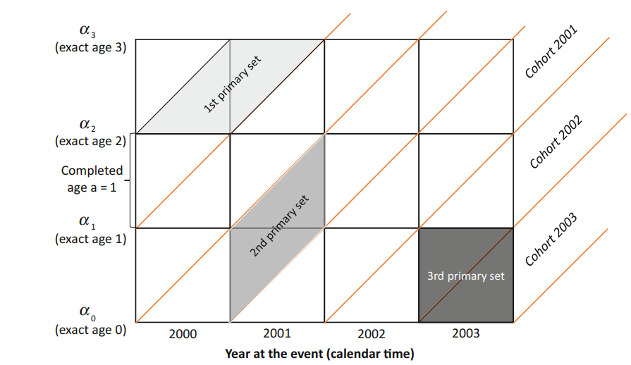
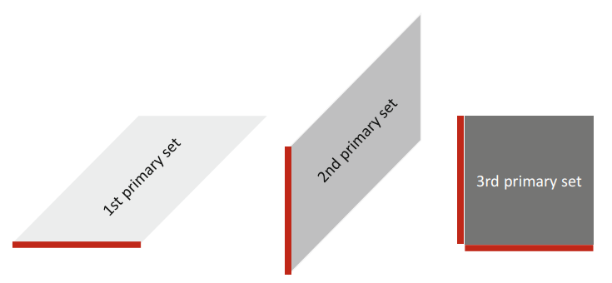




Lexis diagram
p calender time (period)
c cohort
y age (years) reached
a age completed
α exact age
π particular moment in time
σ moment of birth
Area = calender time, completed age, reached age, cohort
Line ~ calender date, exact age
$${{}_{2001}^{2000}D}_{0–1}^{}$$
Reached age is the difference between calender time and cohort:
y = p – c
For a single completed age there are two different cohorts. The cohort for upper elementary set equals to:
c = t – a – 1 („the older ones“)
Cohort for lower elementary set equals to:
c = t – a („the younger ones“)
$${{}_{2003}^{2002–2003}D}_{0}^{}$$
$${{}_{200–2001}^{1998}D}_{2}^{}$$
Standard notation:
$${{}_{period}^{cohort}D}_{age}^{\begin{aligned}another \\ attribute\end{aligned}}$$

Slide 2
Exercise 1
Data in 9_11_DA1_Exercise_1.

Slide 3
a. Draw to the Lexis diagram population of males at ages 20, 21, 22 and 23 years to the date 1. 1. 2014.
23
68 105
22
67 499
21
63 532
20
62 764
2013
2014

Slide 4
b. Draw to the Lexis diagram population of females at ages 20, 21, 22 and 23 years to the date 1. 7. 2014.
23
65 060
22
62 382
21
60 335
20
56 784
2013
2014

Slide 5
c. Draw to the Lexis diagram population living at exact age 61 in years 2005, 2006 and 2007.
62
62’
61
62 263
58 923
73 181
61’
60
2005
2006
2007

Slide 6
d. Draw to the Lexis diagram total number of births by the age of mother (ages 15, 16 and 17) in 2008.
3rd primary sets group the events by the age completed
17
612
244
16
15
66
2007
2008

Slide 7
e. Draw to the Lexis diagram number of marriages of divorced men by the time elapsed since the divorce (1, 2 and 3 years) in 1997.
1 364
3
2
1 695
2 104
1
0
3 007
1996
1997

Slide 8
f. Draw to the Lexis diagram number of marriages of males with university level of education by age (ages 26, 27, 28 and 29) in 2002.
29
597
28
790
711
27
26
724
2001
2002

Slide 9
g. Draw to the Lexis diagram deaths of females by age (70, 71 and 72) and cohort in 2014.
cohort 1942
cohort 1942
454
72
cohort 1943
451
456
71
cohort 1944
533
476
70
499
69
2013
2014

Slide 10
h. Draw to the Lexis diagram number of divorces in 2005 by the length of duration of marriage (0, 1 and 2 years) and by the year of marriage.
cohort 2002
cohort 2003
696
2
641
cohort 2004
509
cohort 2005
1
461
187
0
–
2003
2004
2005

Slide 11
i. Draw to the Lexis diagram deaths by 5-year age groups (30–34, 35–39, 40–44) in 2006.
45
44
43
42
1 308
41
40
39
38
37
784
36
35
34
33
32
613
31
30
2006

Slide 12
j. Draw to the Lexis diagram number of marriages of males born in 1988, 1989, 1990 and 1991 in 2012.
cohort 1988
24
cohort 1989
Hint:
Age reached = difference between the actual year and cohort (f. e: 2012-1990=22’)
2nd primary sets group events by the age reached
24’
983
23
cohort 1990
23’
541
22
cohort 1991
22’
383
21
21’
214
20
2011
2012

Slide 13
k. Draw to the Lexis diagram number of marriages of unmarried females born in 1980 by age (reached ages 29, 30, 31 and 32).
Hint:
Age reached = difference between the actual year and cohort (f. e: 2009-1980=29’)
cohort 1980
32
32’
1 663
31
31’
2 123
30
30’
2 721
29
29’
3 144
28
Retrospective analysis
2009
2010
2011
2012

Slide 14
l. Draw to the Lexis diagram number of marriages of males in Prague in 2014 by quarters of 2014.
x_{max}
…
…
…
…
2 689
607
606
1 960
15
Q1
Q2
Q3
Q4
2014
2015

Slide 15
m. Draw to the Lexis diagram number of male infant deaths by age (0, 1, 2 and 3 months) in 2010.
1’
11 month
10 month
9 month
8 month
7 month
0
6 month
5 month
4 month
3 month
15
2 month
10
1 month
17
0 month
106
2010

Slide 16
n. Draw to the Lexis diagram male population by age (0, 1–4) to 1.7.2000 and 1.7.2001.
4
3
182 996
186 307
2
1
0
46 292
46 333
2000
2001

Slide 17
o. Draw to the Lexis diagram number of divorces by the length of marriage (0–1, 2 years) in 1960–1962.
2
915
1 028
1 132
1
978
1 149
1 226
0
1960
1961
1962

Slide 18
p. Draw to the Lexis diagram number of abortions by the age of female (15–19, 20–24) in 1986 and 1987.
25
24
23
22
23 862
32 265
21
20
19
18
17
8 710
11 251
16
15
1986
1987

Slide 19
q. Draw to the Lexis diagram number of births in the current marriage by the time elapsed since the marriage of parents (3, 4 and 5 years) in 2014.
5
4 218
4
5 533
3
7 089
2
1
0
2013
2014
2015
2016

Slide 20
r. Draw to the Lexis diagram number of marriages in 1997 by the birth cohort of a bride (1978, 1979, 1980).
cohort 1978
Deduce reached age of bride for a given cohort and period (calender time):
1997-1978=19’
cohort 1979
19
cohort 1980
19’
3 153
18
18’
1 325
17
17’
124
16
1997

Slide 21
s. Draw to the Lexis diagram number of marriages in 2008 by the birth cohort of the groom (1973–1977, 1978–1982 and 1983–1987).
cohort 1973
cohort 1974
cohort 1975
cohort 1976
cohort 1977
cohort 1978
cohort 1979
cohort 1980
cohort 1981
cohort 1982
13 841
cohort 1983
cohort 1984
cohort 1985
cohort 1986
cohort 1987
17 628
5 230
2008

Slide 22
t. Draw to the Lexis diagram first births by the age of mother (20–24, 25–29) in 1995.
29
28
27
7 933
26
25
24
23
22
24 533
21
20
1995

