Slide 1


PLEDGE TO PROGRESS Sustainability Hackathon
Sponsored By
Your Team Name : Team Uttam-Bhumi (The Best Land)
Your team bio : Technology enthusiast with special interest in IoT application for Smart metering, Smart home and energy efficiency
Date :

Slide 2
Saving energy consumed by HVAC systems
Why did you decide to solve this Problem statement?
Energy consumed by heating, ventilation and air conditioning system in offices, building and household is major concern for sustainability. IoT gives opportunities to intelligently monitor and control the performance and condition of HVAC systems. Here are the five primary ways to use IoT to improve these operations:
Energy Efficiency and benchmarking
Regulatory compliance
Better comfort and reduced cost
Recurring service plans
Preventive Maintenance

Slide 3
User Segment & Pain Points
Which user /advertiser segment would be early adopter of your product & why?
Hotels, offices and housing societies will be early adopter of the system as this will help them
Reduce energy cost without compromising comfort
Meeting regulatory compliances
Net-Zero buildings
HVAC system providers will also adopt the system as this will help them
Creating recurring service plans
Preventive maintenance
Individual households
Reduce energy cost
Satisfaction of reducing carbon emission.

Slide 4
Pre-Requisite
What are the alternatives/competitive products for the problem you are solving?
Many established and start up are providing custom developed solution for HVAC system for energy saving.
Majority of solutions are focused toward remote monitoring and control with rule based energy saving.
Only few solutions are there which use machine learning and data analytics to address energy saving and sustainability

Slide 5
Tools or resources
Azure tools or resources which are likely to be used by you for the prototype, if your idea gets selected 1. Azure IoT Hub and Azure IoT device SDK 2. Azure Cosmos DB 3. Azure Machine Learning 4. Microsoft cloud for sustainability 5. Azure AD B2C 4. Power Apps

Slide 6
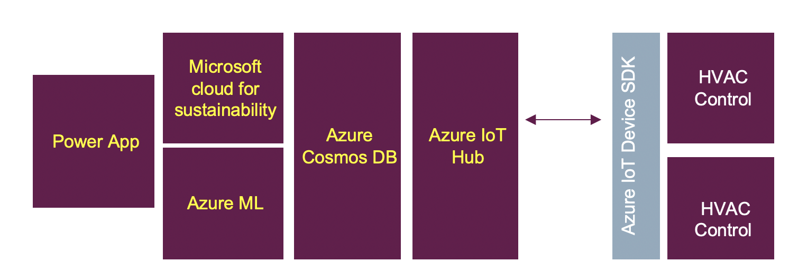
Any Supporting Functional Documents
Present your solution, talk about methodology, architecture & scalability

Slide 7
Key Differentiators & Adoption Plan
How is your solution better than alternatives and how do you plan to build adoption?
The solution uses the device data , apply machine learning to it to provide better comfort at lower cost.
This solution have comprehensive sustainability platform which most of comptetion products does not focus upon.
Instead of custom build application solution is based Azure technology which are proven for scalability

Slide 8
GitHub Repository Link & supporting diagrams, screenshots, if any
Github link - https://github.com/ukotdiya02/SustainabilityHackathon
How far it can go?

Slide 9
Thank You
Team member names
Uttam Kotdiya
Bhumika Kotdiya

