Slide 1

檔案處理(File)

Slide 2
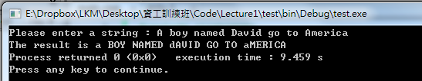
不想要再輸入了， 可不可以直接把資料存起來用？

Slide 3
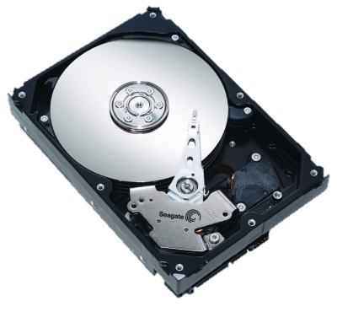
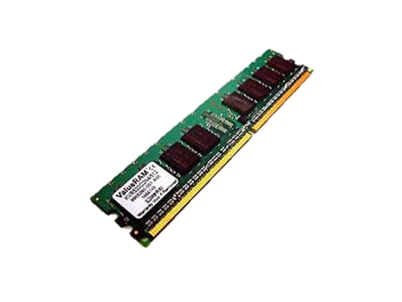

txt
csv

Slide 4
學習大綱
File I/O
基本輸入/輸出
檢查狀態
csv
stream position
binary

Slide 5
學習大綱
File I/O
基本輸入/輸出
檢查狀態
csv
stream position
binary

Slide 6
檔案處理
從檔案讀進資料或將結果存入檔案之中。
#include <fstream>
包含了<ifstream> <ofstream>
基本語法
open (“filename")
close()
is_open()
getline (myfile,line)
eof()

Slide 7
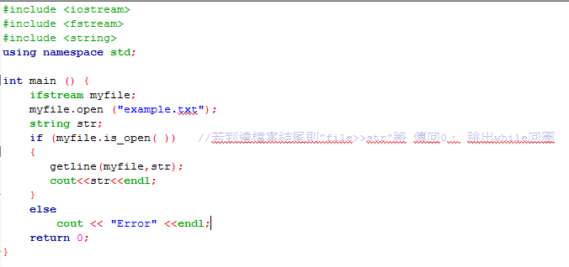
檔案處理-讀取檔案
先建出一個物件才能使用
fstream
ifstream
ofstream
open (“filename")
<< 與 >>
.close()
Notes:
#include <iostream>
#include <fstream>
#include <string>
using namespace std;
int main () {
ifstream myfile;
myfile.open ("example.txt");
string str;
while(!myfile.eof( )) //若到達檔案結尾則”file>>str”將 傳回0， 跳出while回圈
{
myfile>>str;
cout<<str<<endl;
}
return 0;
}

Slide 8
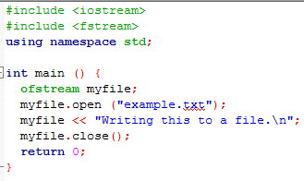
檔案處理-寫入檔案
先建出一個物件才能使用
fstream
ifstream
ofstream
open (“filename")
<< 與 >>
.close()
Notes:
#include <iostream>
#include <fstream>
using namespace std;
int main () {
ofstream myfile;
myfile.open ("example.txt");
myfile << "Writing this to a file.\n";
myfile.close();
return 0;
}

Slide 9
學習大綱
File I/O
基本輸入/輸出
檢查狀態
csv
stream position
binary

Slide 10
close(): 關檔
用於關閉檔案，如果close( )執行失敗，它的傳回值是非零值。
關閉檔案主要的目的：
檔案在關閉前會確認將檔案緩衝區資料寫入磁碟檔案內，否則檔案緩衝區資料有可能會遺失
想要從讀/寫的模式中轉換

Slide 11
檢查是否成功
進行檔案IO時，需要偵測的狀態有三 類
資料流錯誤
檔案開啟的錯誤
是否到達檔案結尾

Slide 12
資料流與檔案開啟的錯誤
file.is_open()開檔成功/失敗，會回傳True/False
常用來判斷檔案是否存在！
Notes:
#include <iostream>
#include <fstream>
#include <string>
using namespace std;
int main () {
ifstream myfile;
myfile.open ("example.txt");
string str;
if (myfile.is_open( ))
{
getline(myfile,str);
cout<<str<<endl;
}
else
cout << "Error" <<endl;
return 0;
}

Slide 13
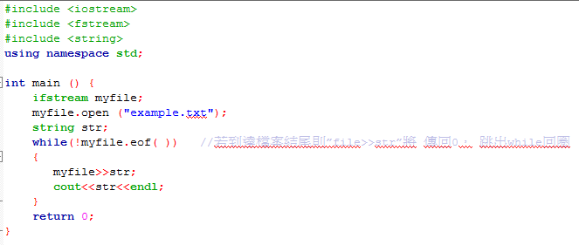
是否到達檔案結尾
如果檔案已經讀到末端,則eof(回傳) True;若還沒有,則回傳False
Notes:
#include <iostream>
#include <fstream>
#include <string>
using namespace std;
int main () {
ifstream myfile;
myfile.open ("example.txt");
string str;
while(!myfile.eof( )) //若到達檔案結尾則”file>>str”將 傳回0， 跳出while回圈
{
myfile>>str;
cout<<str<<endl;
}
return 0;
}

Slide 14
其他狀態 (補充)
bad()
Returns true if a reading or writing operation fails. For example, in the case that we try to write to a file that is not open for writing or if the device where we try to write has no space left.
fail()
Returns true in the same cases as bad(), but also in the case that a format error happens, like when an alphabetical character is extracted when we are trying to read an integer number.
good()
It is the most generic state flag: it returns false in the same cases in which calling any of the previous functions would return true. Note that good and bad are not exact opposites (good checks more state flags at once).
clear()
can be used to reset the state flags.

Slide 15

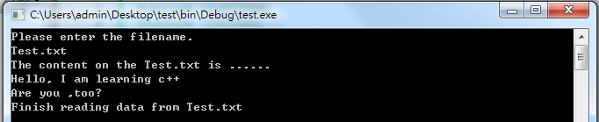
Mission
Input : The filename
Output : The content of the file
Notes:
#include <iostream>
#include <fstream>
using namespace std;
int main () {
string str;
ifstream ifile;
cout << "Please enter the filename." << endl;
cin >> str;
ifile.open(str);
if (ifile)
{
cout <<"The content on the "<<str<<" is ......" << endl;
while (getline (ifile,str) ){
cout << str << endl;
}
cout << "Finish reading data from Test.txt" << endl;
}
else
{
cout << "Error, no file named "<< str <<endl;
}
ifile.close();
return 0;
}

Slide 16
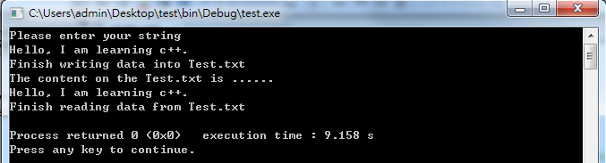
Practice 1
Mission ：
Write a sentence to a txt and read it out.
Notes:
#include <iostream>
#include <fstream>
using namespace std;
int main () {
ofstream file;
string str;
file.open("Test.txt");
if (file)
{
cout <<"Please enter your string" << endl;
getline (cin,str);
file << str << "\n";
cout << "Finish writing data into Test.txt" << endl;
}
else
{
cout << "Error" <<endl;
}
file.close();
ifstream ifile;
ifile.open("Test.txt");
if (ifile)
{
cout <<"The content on the Test.txt is ......" << endl;
while (getline (ifile,str) ){
cout << str << endl;
}
cout << "Finish reading data from Test.txt" << endl;
}
else
{
cout << "Error" <<endl;
}
ifile.close();
return 0;
}

Slide 17
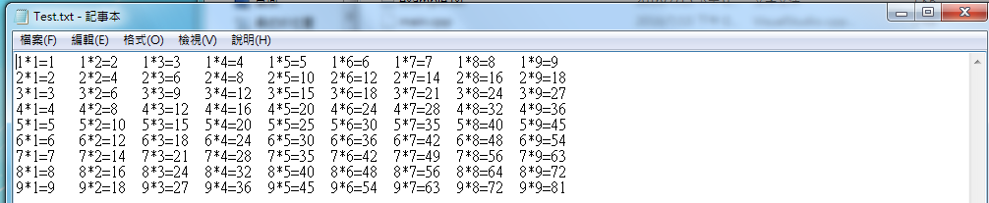
Practice 2
Mission ：
Write a 9x9 table to txt, separating each element by tab.
Read it out.
Notes:
#include <iostream>
#include <fstream>
using namespace std;
int main () {
ofstream file;
string str;
file.open("Test.txt");
if (file)
{
for (int i=1;i<=9;i++)
{
str="";
for (int j=1; j<=9; j++){
file << i << "*" << j << "=" << i*j << "\t";
}
file << "\n";
}
cout << "Finish writing data into Test.txt" << endl;
}
else
{
cout << "Error" <<endl;
}
file.close();
ifstream ifile;
ifile.open("Test.txt");
if (ifile)
{
cout <<"The content on the Test.txt is ......" << endl;
while (getline (ifile,str) ){
cout << str << endl;
}
cout << "Finish reading data from Test.txt" << endl;
}
else
{
cout << "Error" <<endl;
}
ifile.close();
return 0;
}

Slide 18
學習大綱
File I/O
基本輸入/輸出
檢查狀態
csv
stream position
binary

Slide 19
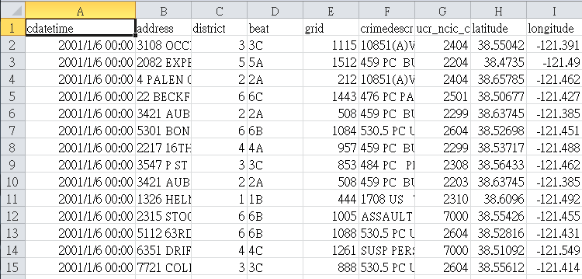
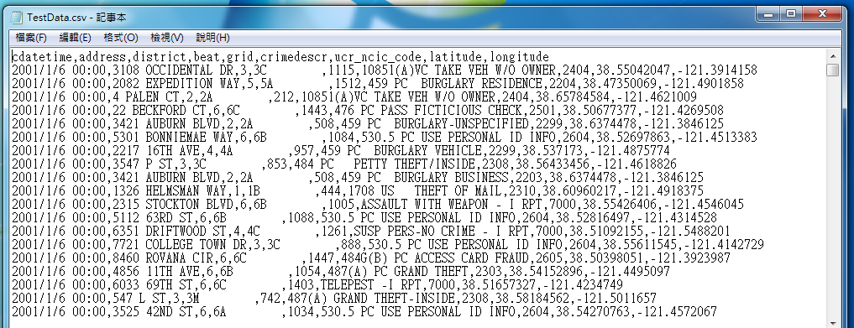
csv File
以,為分隔的活頁簿格式,可用excel展開
getline ( file, value, ',' );
Notes:
#include <iostream>
#include <fstream>
#include <stdlib.h>
using namespace std;
int main () {
fstream file;
file.open("Reader.txt", ios::in);
if(!file) //檢查檔案是否成功開啟，如果!file為真，表示無法開啟檔案
{
cerr << "Can't open file!\n";
exit(1); //在不正常情形下，中斷程式的執行
}
else
cout<<"File open successfully!\n";
return 0;
}

Slide 20
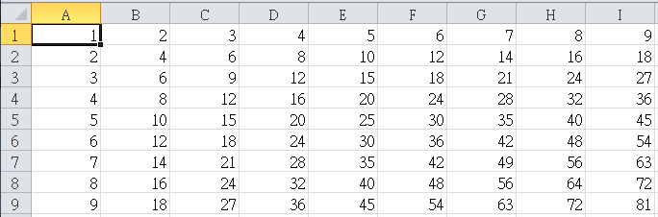
Mission
Write the value of 9x9 into csv
Read it out
Notes:
#include <iostream>
#include <fstream>
#include <sstream>
using namespace std;
int main () {
ofstream file;
string str;
file.open("Test.csv");
if (file)
{
for (int i=1;i<=9;i++)
{
str="";
for (int j=1; j<=9; j++){
stringstream temp;
temp << i*j;
str+=temp.str()+",";
}
cout << str <<endl;
file << str << "\n";
}
cout << "Finish writing data into Test.txt" << endl;
}
else
{
cout << "Error" <<endl;
}
file.close();
ifstream ifile;
ifile.open("Test.csv");
if (ifile)
{
cout <<"The content on the Test.txt is ......" << endl;
while (getline (ifile,str,',') ){
cout << str << endl;
}
cout << "Finish reading data from Test.txt" << endl;
}
else
{
cout << "Error" <<endl;
}
ifile.close();
return 0;
}

Slide 21
Practice 3
Mission ：
Download the test data, print the address out only
https://goo.gl/YbDcZF
Ref:
https://support.spatialkey.com/spatialkey-sample-csv-data/
Hint :
\n and ,
Notes:
#include <iostream>
#include <fstream>
using namespace std;
int main () {
ifstream file;
string str;
file.open("TestData.csv");
if(file){
int c = 1;
while(getline(file,str,',')){
if(c%8==2)
cout << str << endl;
c++;
}
}
else
cout << "File not exist" << endl;
file.close();
return 0;
}

Slide 22
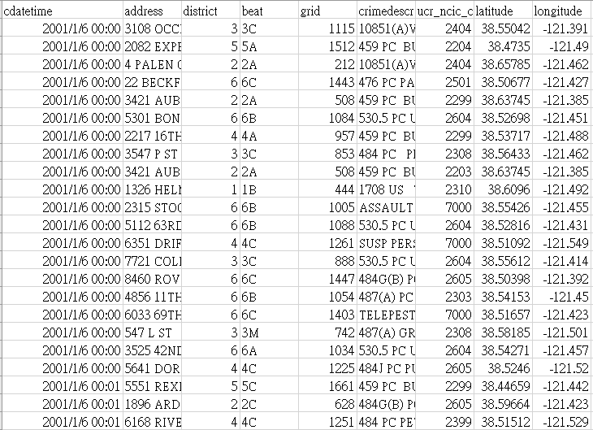

Slide 23
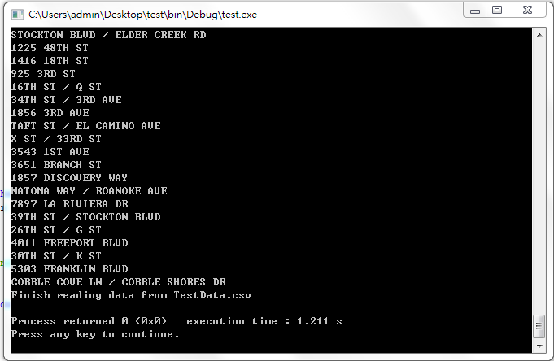

Slide 24
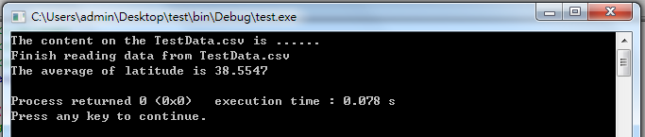
Practice 4
Mission ：
Download the test data, calculate the average latitude
https://goo.gl/YbDcZF
Ref:
https://support.spatialkey.com/spatialkey-sample-csv-data/
Hint :
stringstream ss(s);
ss >> value;
Notes:
#include <iostream>
#include <fstream>
#include <sstream>
using namespace std;
int main () {
string str;
ifstream ifile;
double sum = 0.0;
int cou = 0;
ifile.open("TestData.csv");
if (ifile)
{
int c=0;
int ss=0;
cout <<"The content on the TestData.csv is ......" << endl;
while (getline (ifile,str,',')){
if (c>7)
c=0;
else if (c==7){
stringstream ss(str);
double value = 0.0;
ss >> value;
sum += value;
cou++;
}
c++;
}
cout << "Finish reading data from TestData.csv" << endl;
}
else
{
cout << "Error" <<endl;
}
ifile.close();
cout << "The average of latitude is "<< sum/cou << endl;
return 0;
}

Slide 25
學習大綱
File I/O
基本輸入/輸出
檢查狀態
csv
stream position
binary

Slide 26
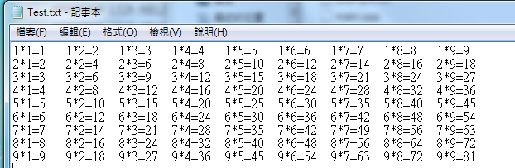
stream position control (補充)
getline()
1*1=1\t1*2=2\t1*3=3\t1*4=4\t1*5=5\t1*6=6\t1*7=7\t1*8=8\t1*9=9\t\n2*1=2\t2*2=4\t2*3=62*4=8\t2*5=10\t2*6=12\t2*7=14\t2*8=16\t2*9=18\t\n…
getline()

Slide 27
stream position control (補充)
指標可以控制目前輸出的位置，通常搭配bin使用
tellg()
get 指標，會指向檔案中下一個輸入讀取的位置
tellp()
put 指標，會指向檔案中下一個輸出寫入的位置
seekg()
操作 get指標
seekp()
操作 put 指標

Slide 28
學習大綱
File I/O
基本輸入/輸出
檢查狀態
csv
stream position
binary

Slide 29
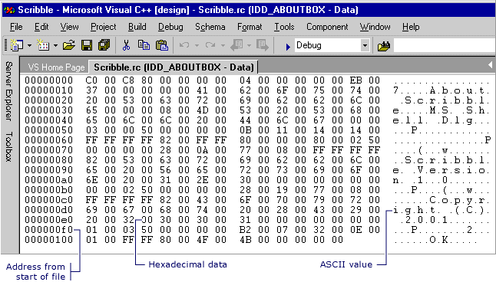
Binary files (補充)
檔案的儲存方式通常分成兩種：“文字檔”和“二進位檔”。
文字檔中存放的東西都是肉眼可視的英文字母或數字符號等。
二進位檔是把數值的內容原封不動使用它的二進位方式直接儲存下來。
舉例：
int a=100000 若用文字檔來存, 存下來的會是"100000"這個字串，佔6個byte。
若用二進位檔來存，存下來的是0x186A0的的二進位值， 固定佔4個byte，因為int型態就是占4個byte。

Slide 30
read/write: 二進位讀寫檔 (補充)
file.open(“Reader.txt”,ios::in | :ios::binary) ;
read (memblock, size);
讀取檔案某size大小的變數之某個
write ( memory_block, size );
寫入檔案某size大小的變數之某個
動動腦：為什麼txt不適合用指標？

Slide 31
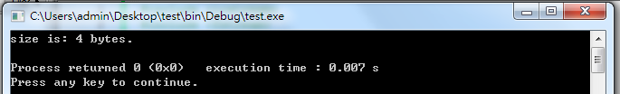
Mission
Get the length of data.
Notes:
#include <iostream>
#include <fstream>
using namespace std;
int main () {
streampos begin,end;
ifstream myfile ("Test.txt", ios::binary);
begin = myfile.tellg();
myfile.seekg (0, ios::end);
end = myfile.tellg();
myfile.close();
cout << "size is: " << (end-begin) << " bytes.\n";
return 0;
}

Slide 32
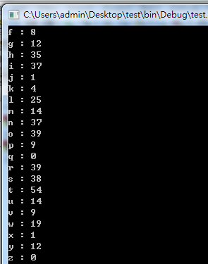
Practice 5
Mission ：
Design a program which can calculate the amount of each alphabet from a whole txt file.
Hint :
Use Ascii Code
#include <ctype.h> to judge it is capital or small
(isupper, islower)
for (char c : str)
Copy the code from the comment of slide 15
Notes:
#include <iostream>
#include <fstream>
#include <string>
#include <ctype.h>
using namespace std;
int main () {
ifstream myfile;
int alphabet[52] = {0};
myfile.open ("Test.txt");
string str;
if (myfile.is_open( )) //若到達檔案結尾則”file>>str”將 傳回0， 跳出while回圈
{
while(!myfile.eof()){
getline(myfile,str);
for (char c : str)
{
if (isupper(c))
alphabet[c-65]++;
else if (islower(c))
alphabet[c-71]++;
}
}
for (int i=0;i<52;i++){
if (i<26)
cout << char (i+65) <<" : " <<alphabet[i] <<endl;
else
cout << char (i+71) <<" : " <<alphabet[i] <<endl;
}
}
else
cout << "Error" <<endl;
return 0;
}

