Slide 1

結構(Structure)

Slide 2
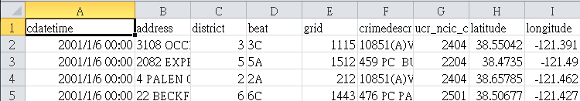
我想要把資料分類存好呢？
Data
cdatetime
address
district

Slide 3
學習大綱
Struct
Enum
Struct
Pointer & struct

Slide 4
Enumeration
有名稱的列舉數，實際上是整數常數
若沒有初值，則第一項預設為０，後逐項遞增１
enum identifier { element1, element2, … };
enum Action { stop, walk, sit };
{ 0 , 1 , 2 }
enum Action { stop=1, walk, sit=2 };
{ 1 , 2 , 2 }
Action action = stop;
printf("%d, then %d", action, action+2);
輸出為何？
Notes:
Ans: 0, then 2 1, then 3

Slide 5
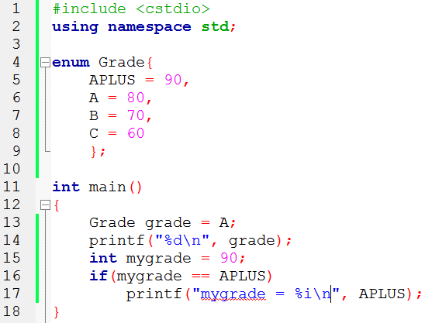
Enumeration example
enum結束要記得加分號

Slide 6
Enumeration (列舉)
有名稱的列舉數，實際上是整數常數
若沒有初值，則第一項預設為０，後逐項遞增１
enum identifier { element1, element2, … };
enum Action { stop, walk, sit };
{ 0 , 1 , 2 }
enum Action { stop=1, walk, sit=2 };
{ 1 , 2 , 2 }
Action action = stop;
printf("%d, then %d", action, action+2);
輸出為何？
Notes:
Ans: 0, then 2 1, then 3

Slide 7
Enumeration example
enum結束要記得加分號

Slide 8
學習大綱
Struct
Enum
Struct
Pointer & struct

Slide 9
Struct (結構)
將可能有相關性的異質資料包裝在一起
struct identifier { element, element2, … };
struct Student {
int id;
string name;
};
struct Student s = {3,"Ben"};
s.id = 10;
printf("No.%d: %s", s.id, s.name);
No.10: Ben
記得加分號

Slide 10
結構 (structure)
結構是一種由程式設計師自訂之資料型態。
用途：自訂一個新的資料型態，將相同或不同型態的資料儲存一起。
使用時機：資料的群組化管理。
常用：搭配指標做資料的管理 (進階班 - 資料結構)
struct
int
double
70
2.12
int
70
a
a
char
b
double
2.12
b
‘A’
char
‘A’
c
c

Slide 11
結構的定義
定義一個結構之語法：
struct 結構名稱標籤 { 資料型態 資料變數成員1; 資料型態 資料變數成員2; ‧‧‧‧‧‧‧‧ };
結構的標籤名稱(tag)
可看成是一個程式設計師自訂的新型態。
結構的成員(member)
其資料型態可以使用 int、float 及 char。也可用陣列與指標或是另外一個結構，但不能給定初始值。

Slide 12
結構的宣告與使用
宣告一個結構實體之語法：
struct 結構名稱標籤 結構實體名稱;
struct 結構名稱標籤 結構實體名稱 = {初始值1,初始值2, …};
結構中成員的使用之語法：
結構實體之成員的直接存取
結構實體.成員名稱
結構指標之成員的間接存取
結構指標->成員名稱

Slide 13
結構
Example
struct Person { char name[80]; int height; int weight; };
struct Person p;
Person: 88 bytes
P
name[0]
name[1]
…
name[79]
height
weight
80 bytes
int : 4 bytes
int : 4 bytes

Slide 14
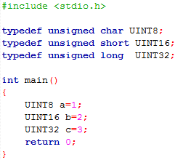
typedef
typedef可以把所有C語言中的型態改用程式設計師自己取的名字來取代。
Notes:
#include <stdio.h>
typedef unsigned char UINT8;
typedef unsigned short UINT16;
typedef unsigned long UINT32;
int main()
{
UINT8 a=1;
UINT16 b=2;
UINT32 c=3;
return 0;
}

Slide 15
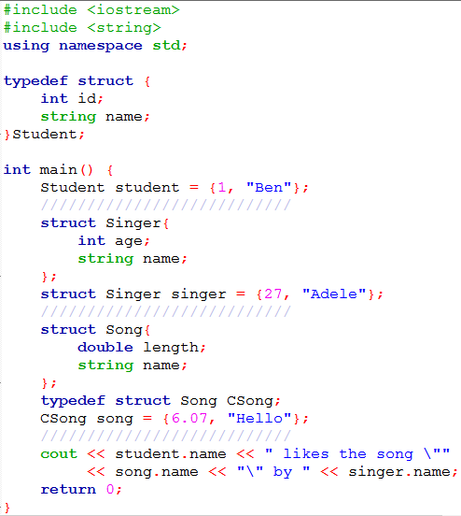
使用typedef宣告struct
直接宣告struct
使用typedef宣告struct
Notes:
http://groangao.pixnet.net/blog/post/24474489-%5Bc,c%2B%2B%5D-typedef-struct-%E7%94%A8%E6%B3%95%E8%AA%AA%E6%98%8E
http://vincecc.blogspot.tw/2013/10/cc-typedef-struct-typedef-struct.html

Slide 16
enum vs. struct
enum (列舉)：一組有名稱的整數常數
struct (結構)：一群有相關性的異質資料
皆可以使用 typedef 定義名稱
typedef enum{
January = 1,
February,
May = 5
} Month;
Month m = May;
typedef struct{
int year;
string monthName; int day;
} Date;
Date d = {2016, "May", 31};
Notes:
Enumerated types with enum class:
Enum class EyeColor : char {blue, green, brown};
it is possible to create real enum types that are neither implicitly convertible to int and that neither have enumerator values of type int, but of the enum type itself

Slide 17
小結
將可能有相關性的異質資料包裝在一起
可以使用 typedef 定義 struct 的名稱 後面產生實例時就不用再寫 struct
typedef struct {
int id;
string name;
} Student;
Student s = {2, "Li"};
struct St {
int id;
string name;
};
typedef struct St Student
Student s = {2, "Li"};
Notes:
TODO: 找個地方講一講 Type aliases (ref = aliases of identifier/name, typedef = aliases of data type, is there any alias of variable??)
i.e.
typedef char C;
typedef unsigned int WORD;
typedef char * pChar;
typedef char field [50];
Perhaps using along the way:
using C = char;
using WORD = unsigned int;
using pChar = char *;
using field = char [50];

Slide 18
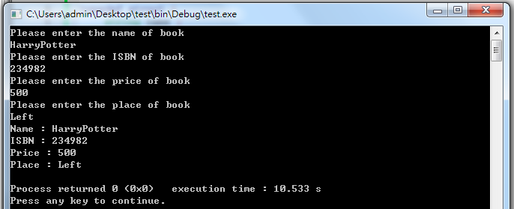
Mission
Build a structure composed of the name of book, its ISBN, price, place
Notes:
#include <iostream>
using namespace std;
typedef struct {
string name ;
long int ISBN ;
int price ;
string place ;
} book;
int main () {
book HarryPotter;
cout << "Please enter the name of book" <<endl;
cin >> HarryPotter.name;
cout << "Please enter the ISBN of book" <<endl;
cin >> HarryPotter.ISBN;
cout << "Please enter the price of book" <<endl;
cin >> HarryPotter.price;
cout << "Please enter the place of book" <<endl;
cin >> HarryPotter.place;
cout << "Name : " << HarryPotter.name << endl;
cout << "ISBN : " << HarryPotter.ISBN << endl;
cout << "Price : " << HarryPotter.price << endl;
cout << "Place : " << HarryPotter.place <<endl;
return 0;
}

Slide 19
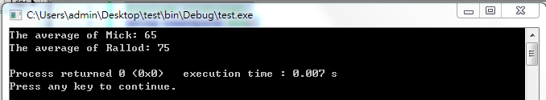
Practice 1
Mission ：
Build a structure composed of the name of students, his id , English score, Math Score
Have a function to output the average score of his two scores
Hint : You can create your own data
Notes:
#include <iostream>
using namespace std;
typedef struct {
string name;
int id;
int scoresEnglish;
int scoresMath;
} student;
double avg(student student1);
int main () {
student Mick = {"Mick",268,80,50};
student Rallod = {"Rallod",269,60,90};
cout << "The average of Mick: " << avg(Mick) << endl;
cout << "The average of Rallod: " << avg(Rallod) << endl;
return 0;
}
double avg(student student1){
double average = 0.0;
average = (double) (student1.scoresEnglish+student1.scoresMath)/2.0;
return average;
}

Slide 20
Practice 2
Mission：
Build a structure, including following variables :
cdatetime (string)
address (string)
district (int)
beat (string)
grid (int)
crimedescr (string)
ucr_ncic_code (int)
latitude (float)
longitude (float)
Notes:
typedef struct {
string cdatetime;
string address;
int district;
string beat;
int grid;
string crimedescr;
int ucr_ncic_code;
float latitude;
float longitude;
} Data;

Slide 21
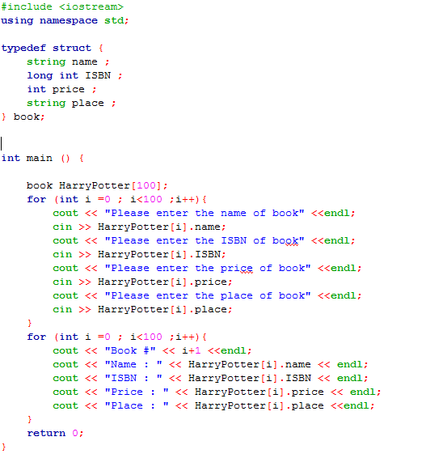
結構陣列
結構也可宣告成陣列，方便做重覆控制。
Notes:
#include <stdio.h>
#define PEOPLE 2
struct Person
{
char name[80];
int height;
int weight;
};
int main()
{
struct Person p[PEOPLE];
int i;
for (i=0; i < PEOPLE; i++ )
{
scanf("%s", &p[i].name );
scanf("%d", &p[i].height );
scanf("%d", &p[i].weight );
printf("Name:%s\nHeight:%d\nWeight:%d\n", p[i].name, p[i].height, p[i].weight);
}
return 0;
}

Slide 22
Practice 3
Mission：
Download the test data, print the address out only
https://goo.gl/YbDcZF
Import all the data from TestData.csv to the struct array.
Hint :
Modify the codes from Mission 2 and Mission 3 in Chapter 10
Change all the data type to string will be easier
#include <sstream>;
while (getline (ifile,str))
stringstream ss(str);
getline (ss,data[c].cdatetime,',');
Notes:
#include <iostream>
#include <fstream>
#include <sstream>
using namespace std;
typedef struct {
string cdatetime;
string address;
string district;
string beat;
string grid;
string crimedescr;
string ucr_ncic_code;
string latitude;
string longitude;
} Data;
int main () {
string str;
ifstream ifile;
Data data[7585];
ifile.open("TestData.csv");
if (ifile)
{ int c = 0;
cout <<"The content on the TestData.csv is ......" << endl;
while (getline (ifile,str)){
stringstream ss(str);
// ss → 每一行資料轉成串流
getline (ss,data[c].cdatetime,',');
getline (ss,data[c].address,',');
getline (ss,data[c].district,',');
getline (ss,data[c].beat,',');
getline (ss,data[c].grid,',');
getline (ss,data[c].crimedescr,',');
getline (ss,data[c].ucr_ncic_code,',');
getline (ss,data[c].latitude,',');
getline (ss,data[c].longitude);
c++;
}
cout << "Finish reading data from TestData.csv" << endl;
for (int i=0; i<7585 ;i++){
cout << "-------" << i+1 <<"-------" <<endl;
cout << "cdatetime : " <<data[i].cdatetime << endl;
cout << "address : " <<data[i].address << endl;
cout << "district : " <<data[i].district << endl;
cout << "beat : " <<data[i].beat << endl;
cout << "grid : " <<data[i].grid << endl;
cout << "crimedescr : " <<data[i].crimedescr << endl;
cout << "ucr_ncic_code : " <<data[i].ucr_ncic_code << endl;
cout << "latitude : " <<data[i].latitude << endl;
cout << "longitude : " <<data[i].longitude << endl;
}
}
else
{
cout << "Error" <<endl;
}
ifile.close();
return 0;
}

Slide 23
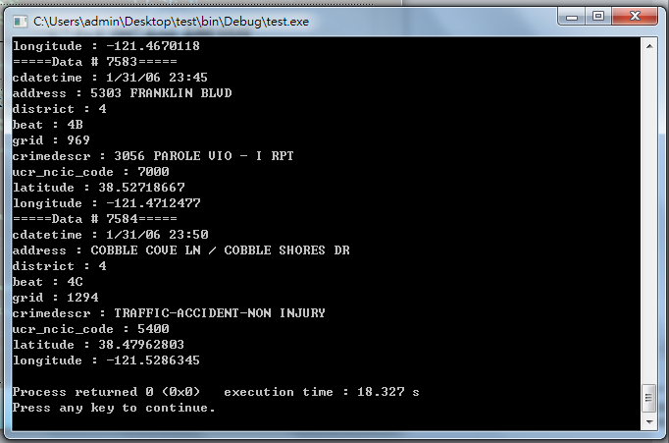

Slide 24
學習大綱
Struct
Enum
Struct
Pointer & struct

Slide 25
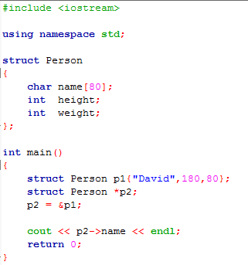
結構的指標
使用結構指標存取另一個結構的資料
struct Person*
p2
struct Person
char[80]
name
int
height
int
weight
p1
Notes:
#include <iostream>
using namespace std;
struct Person
{
char name[80];
int height;
int weight;
};
int main()
{
struct Person p1{"David",180,80};
struct Person *p2;
p2 = &p1;
cout << p2->name << endl;
return 0;
}

