Slide 1
Key Concept – Pipeline (Common)
Multiplication
Addition
Answer
Multiplication
Addition
Answer

Slide 2
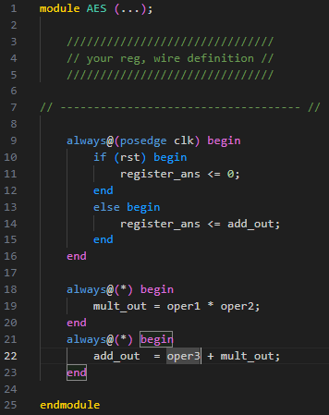
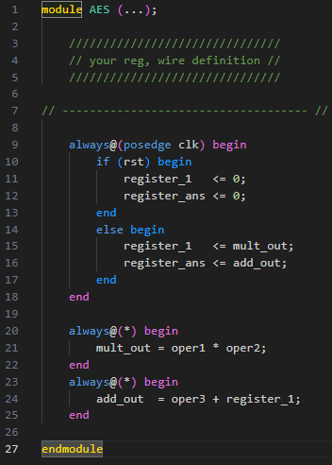
Verilog

