Slide 1
RISC-V Microcontroller On Cmod-A7-35T
Developed by Wei-Feng Huang, DICLAB, NCKU

Slide 2
Outline
FPGA Selection and Spec
Microcontroller Overview
Data Path / Instruction Path
MDM / GPIO / Interrupt System / Timer & PWM / XADC / UART
Memory Hierarchy
Hardware Report
Software Design Flow
JTAG Debug Flow
Standalone Boot Sequence

Slide 3
FPGA Selection and Spec
Microcontroller Overview
Data Path / Instruction Path
MDM / GPIO / Interrupt System / Timer & PWM / XADC / UART
Memory Hierarchy
Hardware Report
Software Design Flow
JTAG Debug Flow
Standalone Boot Sequence

Slide 4
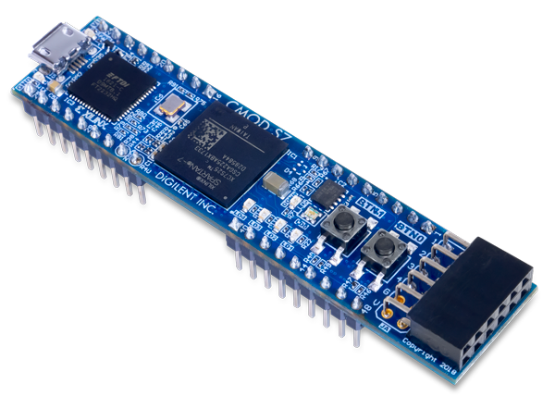




FPGA Selection and Spec
Board: Cmod-A7-35T
Chip: xc7a35tcpg236-1
Breadboard-friendly 48-pin DIP connector
All 48 DIP pins at LVCMOS33 (3.3 V logic level)
No series resistors — direct connection to FPGA I/O
Analog pins: 0–3.3 V input, scaled to 0–1 V via on-board voltage divider
TWD: 3,092

Slide 5
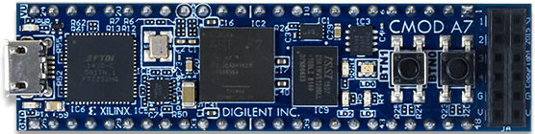
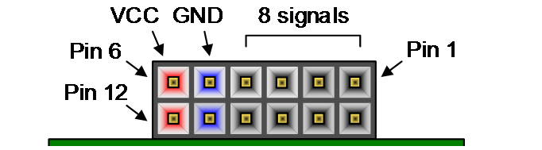
FPGA Selection and Spec
NOR Flash 4MB:
Micron-N25Q032A (32Mbit / 4MB) or
Macronix-MX25L3233FZBI-08G/Q (32Mbit / 4MB)
UART / JTAG
FTDI FT2232HQ
Micro-USB
PMOD
FPGA:
XC7A35T-1CPG236C
SRAM 512KB:
IS61WV5128BLL-10BLI (512KB)

Slide 6
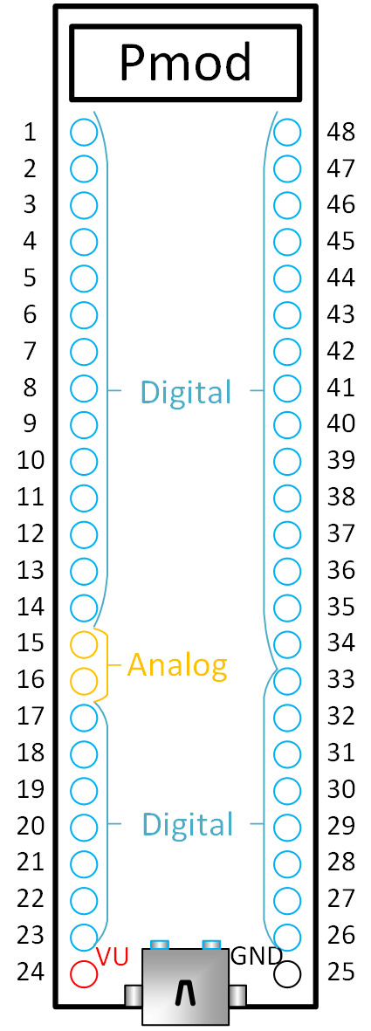
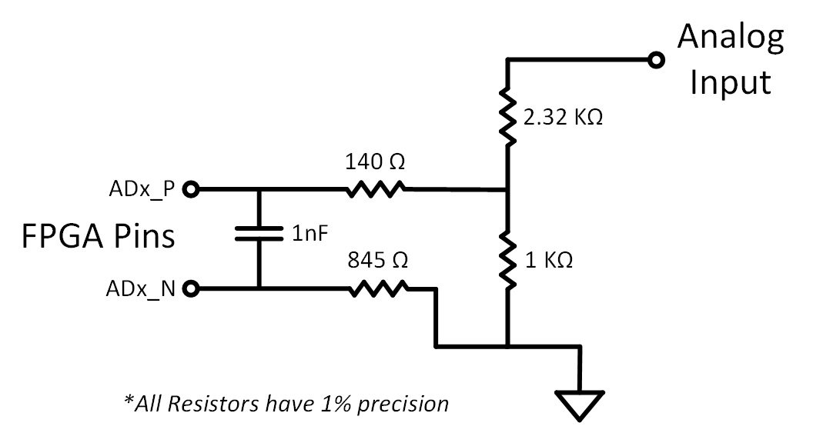



FPGA Selection and Spec
$$V_{DIV}=V_{AIN}×\frac{R_{2}}{R_{1}+R_{2}}=V_{AIN}×\frac{1 kΩ}{2.32 kΩ+1 kΩ}=V_{AIN}×0.301$$
$$V_{DIV}=3.3×0.301=0.994 V$$
DIP pin:
$$V_{measured}=V_{ADx_P}−V_{ADx_N}≈V_{DIV}−0=0.994 V$$
$$V_{AIN}$$
Filter Capacitor
$$V_{DIV}$$

Slide 7
FPGA Selection and Spec
Microcontroller Overview
Data Path / Instruction Path
MDM / GPIO / Interrupt System / Timer & PWM / XADC / UART
Memory Hierarchy
Hardware Report
Software Design Flow
JTAG Debug Flow
Standalone Boot Sequence

Slide 8
Microcontroller Overview
SRAM
512KB
Data Mem /
Inst Mem /
Shared 128KB
Local Memory
Bus
On-Board
LED /
RGB LED /
Button
GPIO pin*28
GPIO_A0 ~ GPIO_A6
……
GPIO_D0 ~ GPIO_D6
Interrupt pin*4
INTR_0
……
INTR_3
AXI
EMC
AXI GPIO * 7
Debug
Module
MicroBlaze V
JTAG
AXI Interconnect (BUS)
AXI UART
16550
AXI Timer
AXI
Quad-SPI
NOR
Flash
4MB
XADC
AXI UART
16550 * 2
AXI Timer
AXI Timer
* 6
USB-UART / UART_RX / UART_TX
PWM_0 ~ PWM_2
ADC_0 / ADC_1

Slide 9
MicroBlaze Config
Processor: MicroBlaze RISC-V, 32-bit, Single Core, 5-Stage Pipeline
Clock: 100 MHz (12 MHz OSC → Clocking Wizard PLL)
ISA Extensions: RV32IM_Zba_Zbb_Zbc_Zbs
Local Memory: 128 KB BRAM (ILMB + DLMB)
Cache: Disabled (I-Cache & D-Cache both off)
Debug: MDM JTAG — breakpoints, register, memory R/W
Interrupt: AXI INTC, 6 sources (3 Timer + 2 UART + 1 GPIO)

Slide 10
FPGA Selection and Spec
Microcontroller Overview
Data Path / Instruction Path
MDM / GPIO / Interrupt System / Timer & PWM / XADC / UART
Memory Hierarchy
Hardware Report
Software Design Flow
JTAG Debug Flow
Standalone Boot Sequence

Slide 12
Memory Subsystem Architecture
Data Mem /
Inst Mem /
Shared 128KB
SRAM
512KB
NOR
Flash
4MB
XIP (Execute in Place) is supported, Read Only
Local Memory
Bus
AXI
EMC
AXI
Quad-SPI
MicroBlaze V
DP
IP
DP
IP
DP
IP
AXI Interconnect (BUS)

Slide 13
FPGA Selection and Spec
Microcontroller Overview
Data Path / Instruction Path
MDM / GPIO / Interrupt System / Timer & PWM / XADC / UART
Memory Hierarchy
Hardware Report
Software Design Flow
JTAG Debug Flow
Standalone Boot Sequence

Slide 14
MDM (MicroBlaze Debug Module)
MDM (MicroBlaze Debug Module)
Hardware debug bridge: JTAG ↔ MicroBlaze RISC-V core
Connected to MicroBlaze via DEBUG port
Debug Memory Access (RISC-V Debug Spec 0.13.2):
Abstract Access — debugger issues memory read/write commands directly through the Debug Module, without CPU involvement
Program Buffer — Debug Module halts the CPU, then injects load/store instructions for the CPU to execute on its own bus interface
Data Path:
PC → USB → JTAG → MDM → CPU DEBUG port → LMB Bus / AXI Bus

Slide 15
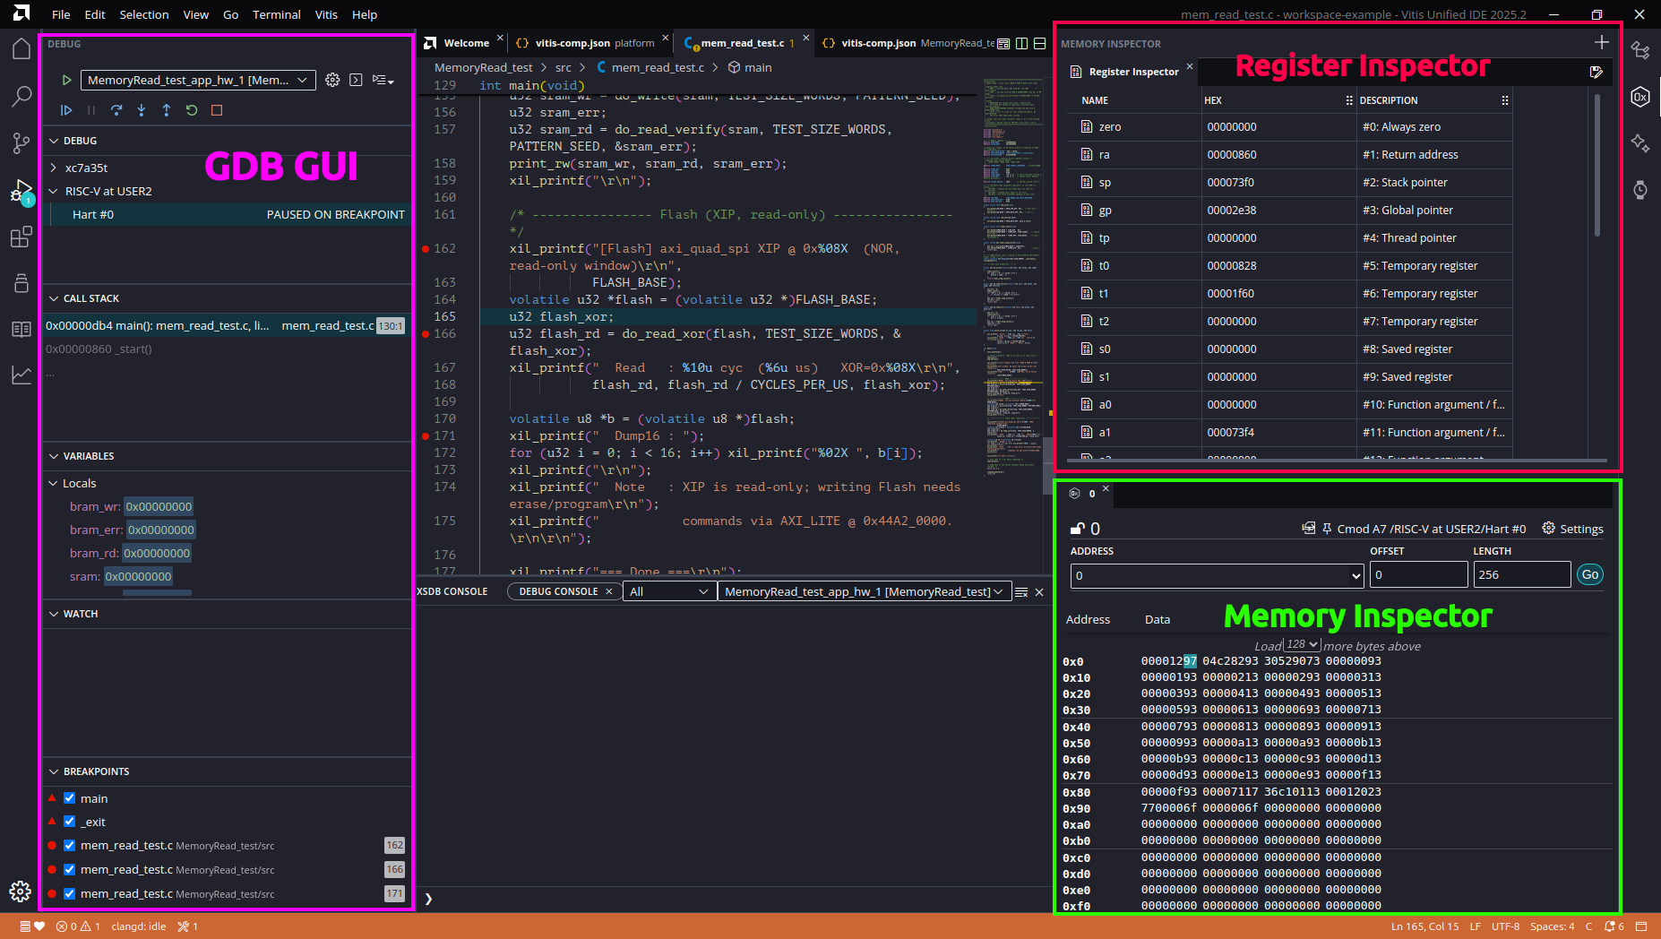
MDM (MicroBlaze Debug Module)

Slide 16
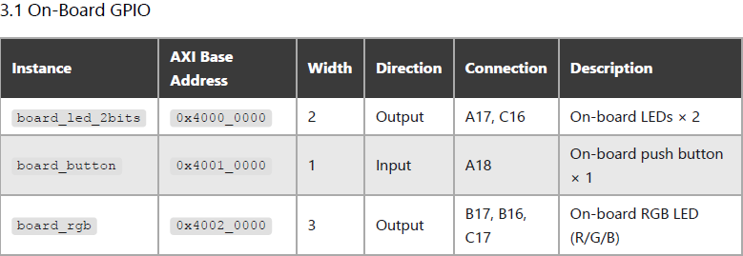
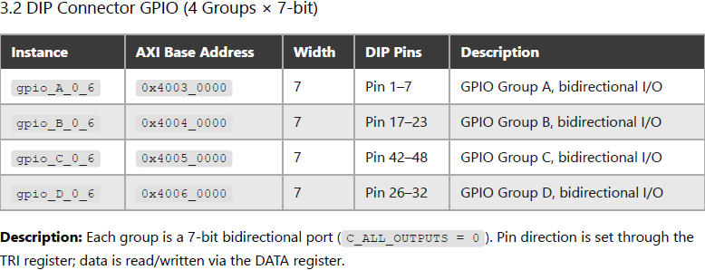
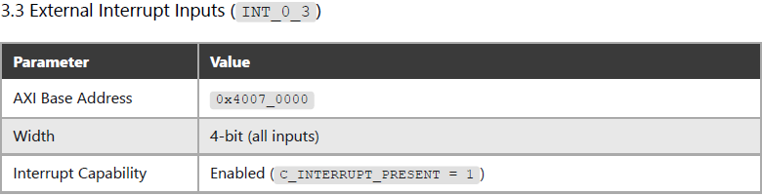
GPIO
gpio_A_0_6
gpio_B_0_6
gpio_C_0_6
gpio_D_0_6
AXI Interconnect (BUS)
board_led_2bits
board_rgb
board_button
INT_0_3

Slide 17
Timer & PWM
6 AXI Timer Instances — Two Roles:
3 × System Timers (timer_0 / timer_1 / timer_2)
Connected to AXI Interrupt Controller
3 × PWM Timers (PWM_0 / PWM1 / PWM_2)
Generate periodic interrupts for scheduling, timeout, or time measurement
Used for servo control (SG90)
All 6 timers are the same IP, the difference is purely in how they are used — interrupt source vs. PWM output.
AXI
Interrupt
Controller
Concat
AXI Timer
* 3
AXI Timer
* 3
AXI Timer
* 3
irq
RISC-V
Core
AXI Interconnect (BUS)
AXI Timer
* 3
AXI Timer
* 3
AXI Timer
* 3
PWM_0 ~ PWM_2

Slide 18
UART
2 × AXI UART 16550 Instances:
uart_USB — Console / Debug
Connected to on-board USB-UART via Micro-USB (J3)
No DIP pin exposed — accessed through USB cable
uart_1 — External Communication
TX/RX routed to DIP Pin 11 / Pin 12
Available for connecting external devices (sensors, modules, another MCU)
AXI UART
16550
UART_RX / UART_TX
AXI Interconnect (BUS)
AXI UART
16550 * 2
USB-UART

Slide 19
XADC
XADC — On-chip Analog-to-Digital Converter
Built-in 12-bit ADC inside Artix-7 FPGA
Enabled Channels (Continuous Sequencer):
VAUX4 (DIP Pin 15) — external analog input
VAUX12 (DIP Pin 16) — external analog input
Temperature — on-chip die temperature
VCCINT — core voltage monitor (1.0 V)
VCCAUX — auxiliary voltage monitor (1.8 V)
Key Specs:
Total conversion rate: 500 Kilo Samples Per Second (KSPS)
Per-channel effective rate: ~100 KSPS (500K ÷ 5 channels)
Input range: 0–1 V at FPGA pins (3.3 V on DIP pin scaled by on-board voltage divider)
Resolution: 12-bit (4096 levels)

Slide 20
Interrupt System
Interrupt handling flow (Normal Mode) :
Peripheral asserts interrupt line
Concat interrupt lines → AXI Interrupt Controller
AXI Interrupt Controller asserts IRQ → CPU
CPU jumps to fixed ISR entry point
Reads axi_intc register to identify source
Branches to corresponding handler
Handler processes the event
Clear peripheral interrupt first
Then clear axi_intc
Return from ISR, CPU resumes normal execution
AXI Timer
* 3
AXI Timer
* 3
AXI Timer
* 3
AXI
Interrupt
Controller
Concat
AXI GPIO
w intr * 3
AXI Interconnect (BUS)
irq
RISC-V
Core
AXI UART
16550
AXI UART
16550 * 2

Slide 21
FPGA Selection and Spec
Microcontroller Overview
Data Path / Instruction Path
MDM / GPIO / Interrupt System / Timer & PWM / XADC / UART
Memory Hierarchy
Hardware Report
Software Design Flow
JTAG Debug Flow
Standalone Boot Sequence

Slide 22
Memory Hierarchy

Slide 23
FPGA Selection and Spec
Microcontroller Overview
Data Path / Instruction Path
MDM / GPIO / Interrupt System / Timer & PWM / XADC / UART
Memory Hierarchy
Hardware Report
Software Design Flow
JTAG Debug Flow
Standalone Boot Sequence

Slide 24
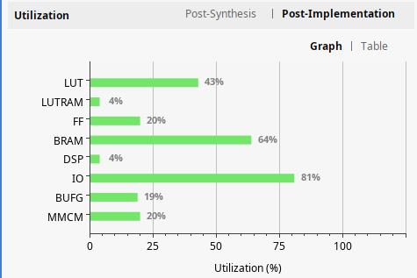
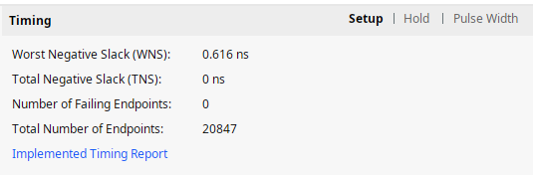
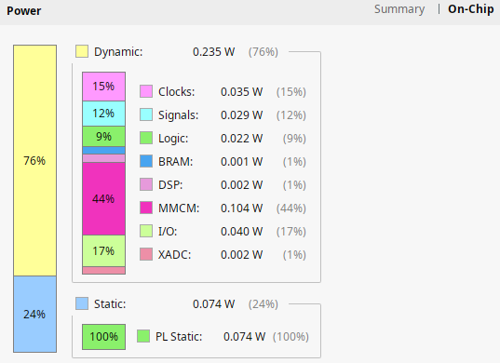
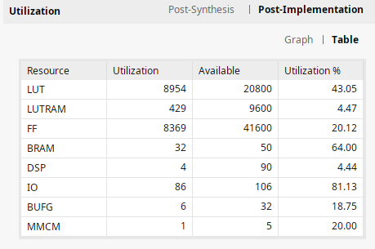
Hardware Report

Slide 25
FPGA Selection and Spec
Microcontroller Overview
Data Path / Instruction Path
MDM / GPIO / Interrupt System / Timer & PWM / XADC / UART
Memory Hierarchy
Hardware Report
Software Design Flow
JTAG Debug Flow
Standalone Boot Sequence

Slide 26
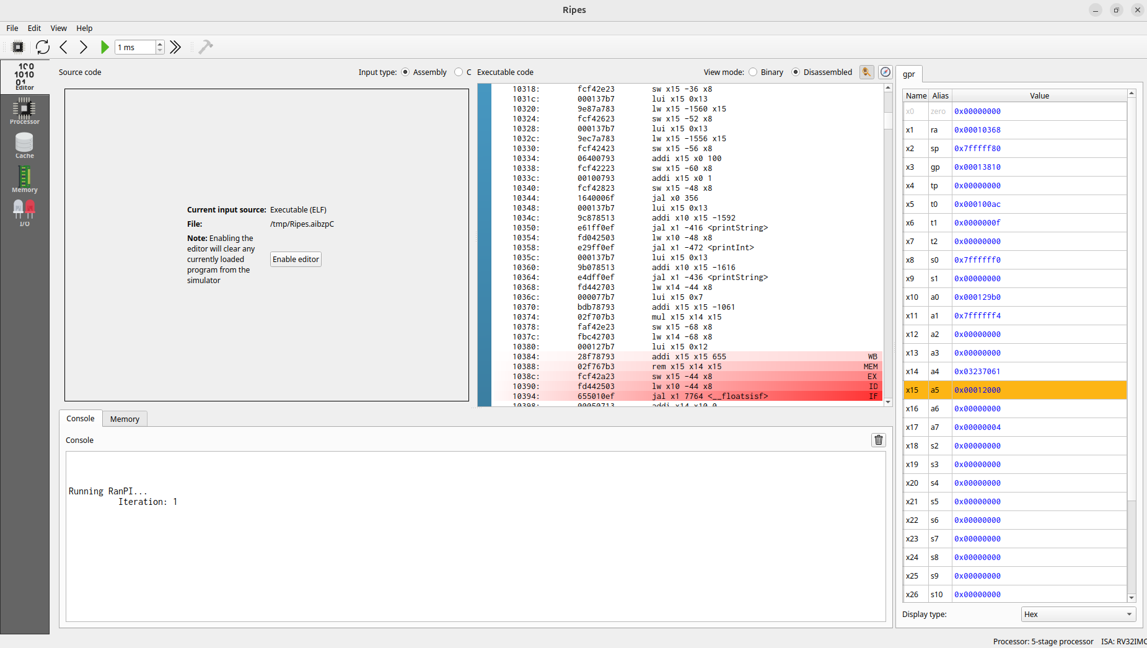
Ripes

Slide 27
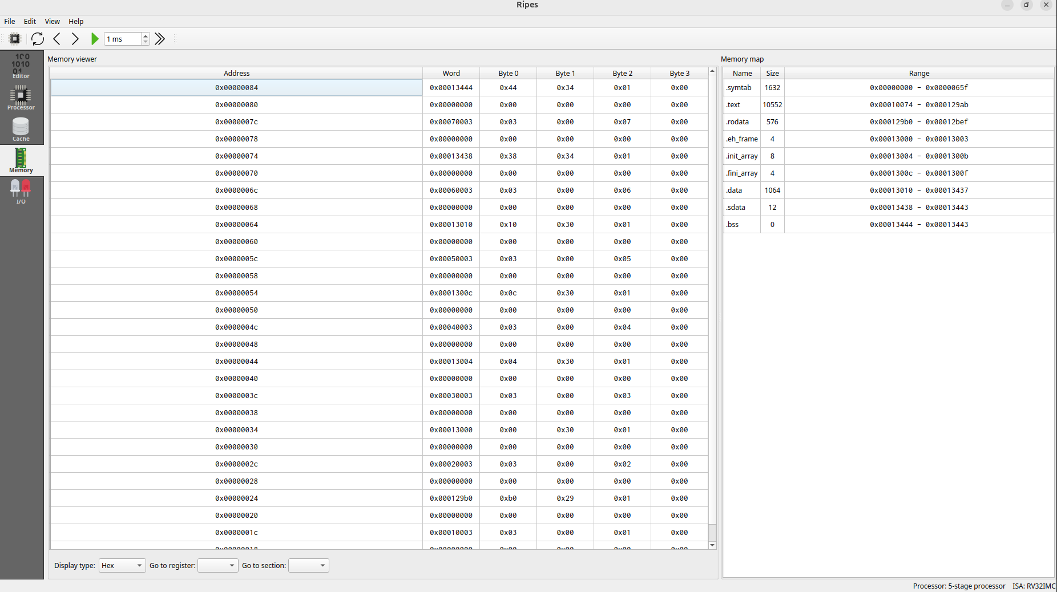
Ripes

Slide 28


Software Design Flow
Two development approaches:
Xilinx Vitis + Embedded SW Libraries
Official IDE with BSP auto-generation
Includes drivers for all AXI peripherals (GPIO, UART, Timer, SPI, EMC)
RISC-V GNU Toolchain
Standalone GCC cross-compiler (riscv32-unknown-elf / riscv64-unknown-elf)
Full control over linker scripts, startup code, and register-level access
No dependency on Xilinx toolchain

Slide 29
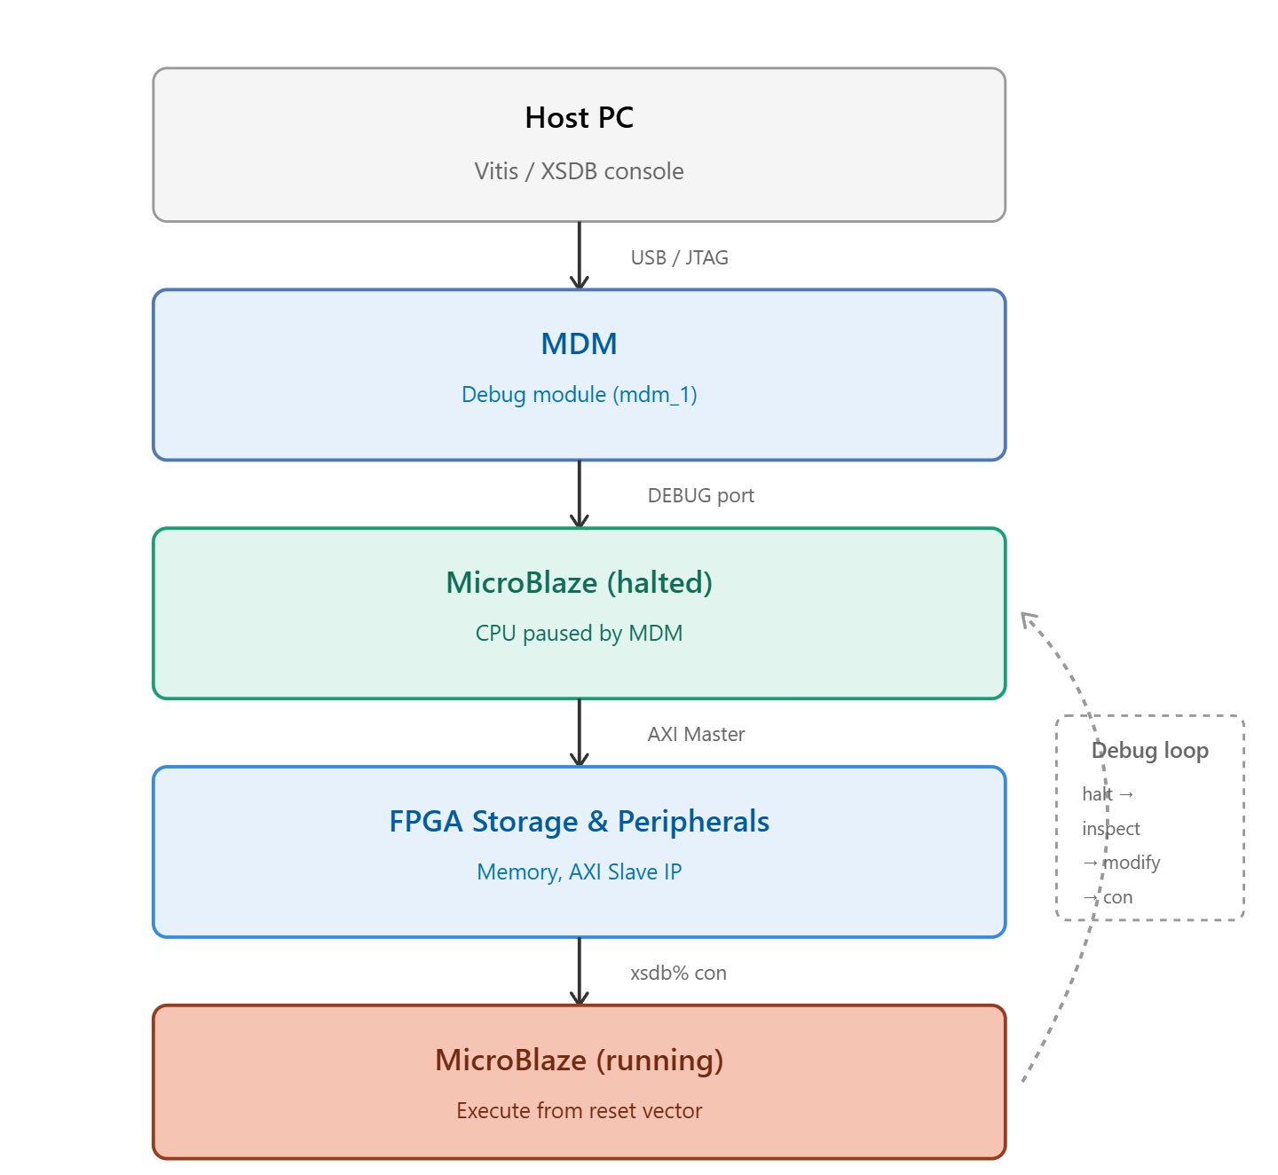
XSDB (Xilinx System Debugger)
XSDB (Xilinx System Debugger)
Command-line debug interface over JTAG
Connects to MicroBlaze via MDM (MicroBlaze Debug Module)
Capabilities:
Download ELF directly to BRAM/SRAM/Flash — no Flash needed
Halt, step, and resume CPU execution
Read/write memory and registers in real time
Enables rapid code-test-fix cycles during development
No bootloader required

Slide 30
FPGA Selection and Spec
Microcontroller Overview
Data Path / Instruction Path
MDM / GPIO / Interrupt System / Timer & PWM / XADC / UART
Memory Hierarchy
Hardware Report
Software Design Flow
JTAG Debug Flow
Standalone Boot Sequence

Slide 31
JTAG Debug Flow
RISC-V-MCU-on-Cmod-A7/Vitis-Software-Dev-Guide/JTAG-Debug-Mode/JTAG-Debug-Mode.md at main · ukp66482/RISC-V-MCU-on-Cmod-A7

Slide 32
FPGA Selection and Spec
Microcontroller Overview
Data Path / Instruction Path
MDM / GPIO / Interrupt System / Timer & PWM / XADC / UART
Memory Hierarchy
Hardware Report
Software Design Flow
JTAG Debug Flow
Standalone Boot Sequence

Slide 33
Standalone Boot Sequence

Slide 34
Reference
The RISC-V Instruction Set Manual, Volume I :: RISC-V Ratified Specifications Library
The RISC-V Instruction Set Manual, Volume II :: RISC-V Ratified Specifications Library
riscv-debug-release.pdf
Introduction • MicroBlaze V Processor Reference Guide (UG1629) • Reader • AMD Technical Information Portal
Introduction • MicroBlaze Debug Module V (MDM V) LogiCORE IP Product Guide (PG428) • Reader • AMD Technical Information Portal
Getting Started with Vitis • Vitis Unified Software Platform Documentation: Embedded Software Development (UG1400) • Reader • AMD Technical Information Portal
BSP and Libraries Overview • Standalone Library Documentation: BSP and Libraries Document Collection (UG643) • Reader • AMD Technical Information Portal

Slide 35
Issue to Address
Interrupt (GPIO / Timer)
GPIO input
uart 16550 Baud Rate 更改
XADC 五個channel讀值
NOR FLASH 內建 Bitstream
EMC SRAM 使用
Memory Hier 設計
Standalone Boot Sequence流程

