Slide 1
RISC-V Microcontroller
On Cmod-A7-35T
Developed by Wei-Feng Huang, DICLAB, NCKU

Slide 2
Outline
FPGA Selection and Spec
Overview Microcontroller / AXI Mapping
GPIO / Interrupt System / Timer & PWM / XADC / UART
Memory Hierarchy
Hardware Report
Software Design Flow
Standalone Boot Sequence

Slide 3
Outline
FPGA Selection and Spec
Overview Microcontroller / AXI Mapping
GPIO / Interrupt System / Timer & PWM / XADC / UART
Memory Hierarchy
Hardware Report
Software Design Flow
Standalone Boot Sequence

Slide 4
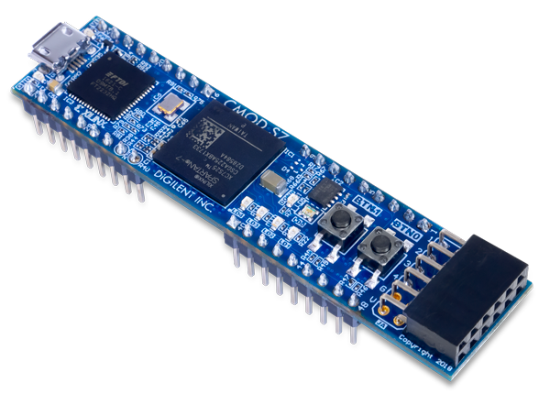
FPGA Selection and Spec
Board: Cmod-A7-35T
Chip: xc7a35tcpg236-1
Breadboard-friendly 48-pin DIP connector
All 48 DIP pins at LVCMOS33 (3.3 V logic level)
No series resistors — direct connection to FPGA I/O
Analog pins: 0–3.3 V input, scaled to 0–1 V via on-board voltage divider
TWD: 3,092

Slide 5
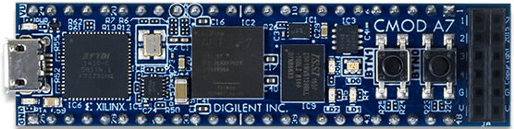
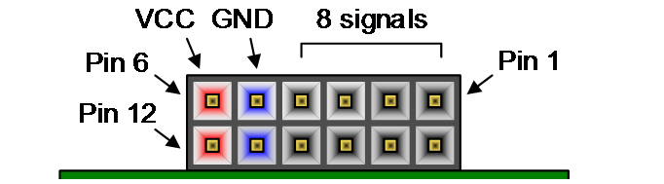
FPGA Selection and Spec
NOR Flash 4MB:
Micron-N25Q032A (32Mbit / 4MB) or
Macronix-MX25L3233FZBI-08G/Q (32Mbit / 4MB)
UART / JTAG
FTDI FT2232HQ
UART / JTAG
Micro-USB
PMOD
FPGA:
XC7A35T-1CPG236C
SRAM 512KB:
IS61WV5128BLL-10BLI (512KB)

Slide 6
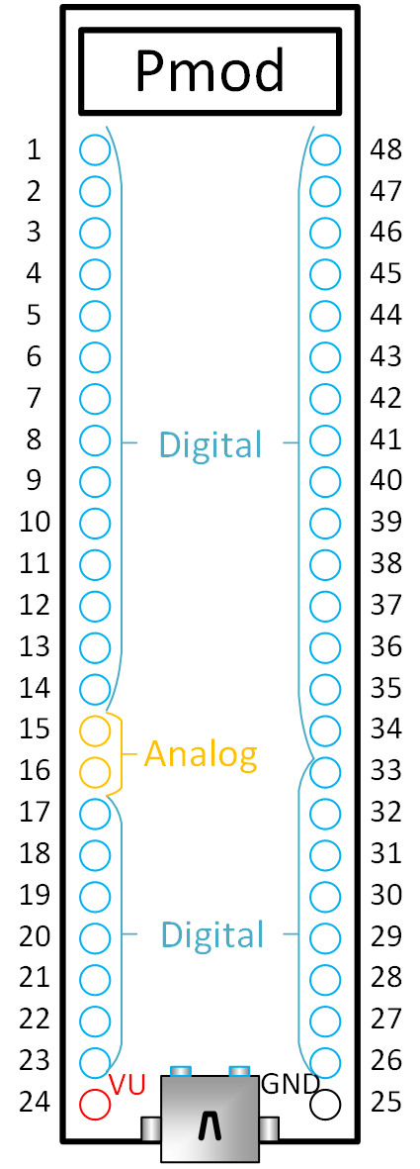
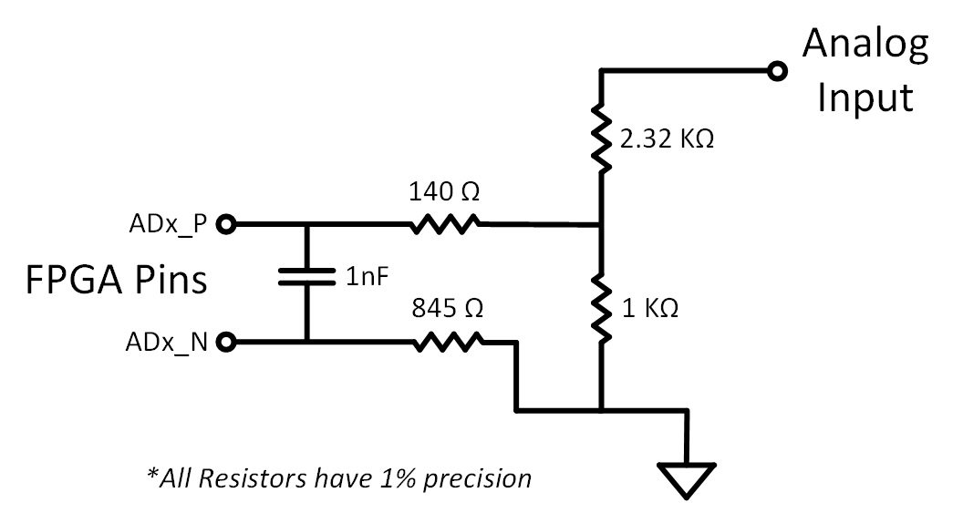



FPGA Selection and Spec
$$V_{DIV}=V_{AIN}×\frac{R_{2}}{R_{1}+R_{2}}=V_{AIN}×\frac{1 kΩ}{2.32 kΩ+1 kΩ}=V_{AIN}×0.301$$
$$V_{DIV}=3.3×0.301=0.994 V$$
DIP pin:
$$V_{measured}=V_{ADx_P}−V_{ADx_N}≈V_{DIV}−0=0.994 V$$
$$V_{AIN}$$
Filter Capacitor
$$V_{DIV}$$
Notes:
1. 降壓分壓：2.32kΩ 與 1kΩ 電阻負責將外部訊號（如 3.3V）按比例縮小至 XADC 安全可測的 0~1V 範圍。
2. 戴維寧等效電阻 (ADx_P)：將電源短路接地後，分壓電阻視為並聯。ADx_P 端看出去的等效阻抗為 (2.32kΩ // 1kΩ) + 140Ω ≈ 838Ω。
Adx_N 則為845直接接地
3. 阻抗匹配 (ADx_N)：ADx_N 端直接串聯 845Ω 電阻接地，目的是與 ADx_P 端的 838Ω 達成極度接近的阻抗匹配。
4. 核心目的：兩端阻抗平衡可以完美抵銷 ADC 內部直流偏置電流（DC Bias Current）所造成的壓降誤差，大幅提升差分測量的精準度。
5. 高輸入阻抗：XADC 測量端阻抗極高，實際流入的電流微乎其微（nA等級），在外部電阻上產生的電壓降極小，幾乎不影響量測。
6. 差分相減抵銷誤差：即便有微小的偏置電流，因為 P 端 (838Ω) 與 N 端 (845Ω) 阻抗極度匹配，兩端產生的誤差電壓相等。XADC 測量差分電壓（P減N）時，此誤差會被完美抵銷。

Slide 7
FPGA Selection and Spec
Overview Microcontroller / AXI Mapping
GPIO / Interrupt System / Timer & PWM / XADC / UART
Memory Hierarchy
Hardware Report
Software Design Flow
Standalone Boot Sequence

Slide 8
Overview Microcontroller
Data Mem /
Inst Mem /
Shared 128KB
Local Memory
Bus
On-Board
LED /
RGB LED /
Button
GPIO pin*28
GPIO_A0 ~ GPIO_A6
……
GPIO_D0 ~ GPIO_D6
Interrupt pin*4
INTR_0
……
INTR_3
Debug
Module
MicroBlaze V
AXI GPIO * 7
JTAG
AXI Interconnect (BUS)
AXI UART
16550
AXI
EMC
SRAM
512KB
AXI Timer
AXI
Quad-SPI
Flash
4MB
XADC
AXI UART
16550 * 2
AXI Timer
AXI Timer
* 6
USB-UART / UART_RX / UART_TX
PWM_0 ~ PWM_2
ADC_0 / ADC_1

Slide 9
Memory-Mapped I/O vs SFR
Memory-Mapped I/O (MMIO):
Peripherals are mapped into the memory address space
Accessed using normal load/store instructions
Easy to integrate and extend (add new devices by assigning new addresses)
SFR (Special Function Registers) in traditional MCUs (e.g., PIC):
Peripheral control uses dedicated special registers
Often requires bank selection / bit-level control
Less flexible when scaling to more peripherals

Slide 10
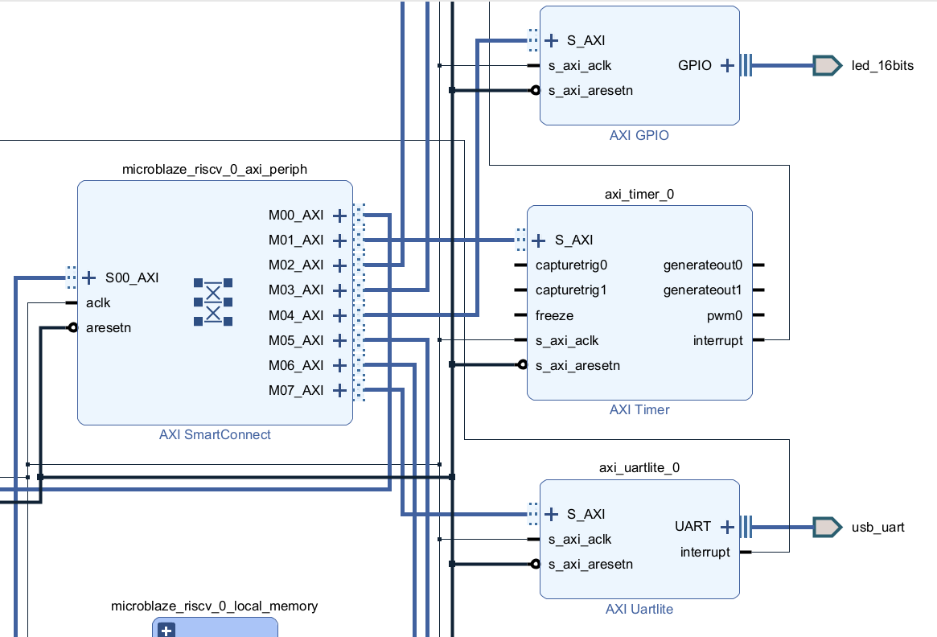
AXI Mapping
Although each peripheral is mapped to a memory address range, this address region does not correspond to physical RAM.
Instead, AXI address decoding and routing logic forwards these transactions to the target peripheral’s register interface (MMIO).

Slide 11
Overview Microcontroller
Processor: MicroBlaze RISC-V, 32-bit, Single Core
Clock: 100 MHz (12 MHz OSC → Clocking Wizard PLL)
ISA Extensions: RV32IM_Zba_Zbb_Zbc_Zbs
Local Memory: 128 KB BRAM (ILMB + DLMB)
Cache: Disabled (I-Cache & D-Cache both off)
Debug: MDM JTAG — breakpoints, register, memory R/W
Interrupt: AXI INTC, 6 sources (3 Timer + 2 UART + 1 GPIO)

Slide 12
FPGA Selection and Spec
Overview Microcontroller / AXI Mapping
GPIO / Interrupt System / Timer & PWM / XADC / UART
Memory Hierarchy
Hardware Report
Software Design Flow
Standalone Boot Sequence

Slide 13
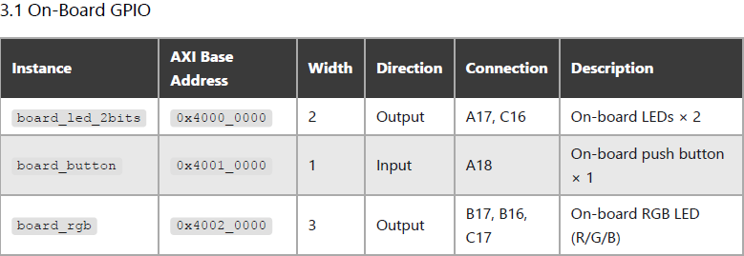
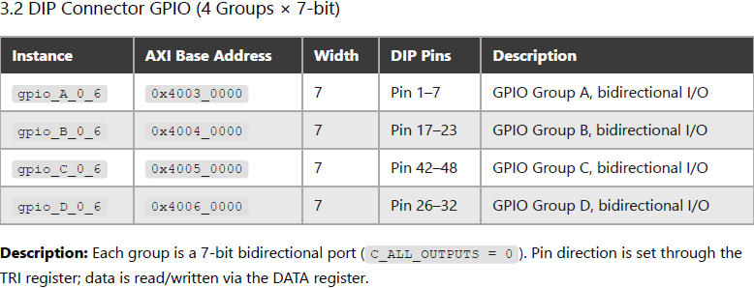
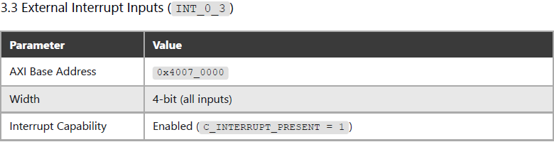
GPIO
gpio_A_0_6
gpio_B_0_6
gpio_C_0_6
gpio_D_0_6
AXI Interconnect (BUS)
board_led_2bits
board_rgb
board_button
INT_0_3

Slide 14
Timer & PWM
6 AXI Timer Instances — Two Roles:
3 × System Timers (timer_0 / timer_1 / timer_2)
Connected to AXI Interrupt Controller
Generate periodic interrupts for scheduling, timeout, or time measurement
3 × PWM Timers (PWM_0 / PWM1 / PWM_2)
Configured in PWM mode
Used for servo control (SG90)
All 6 timers are the same IP, the difference is purely in how they are used — interrupt source vs. PWM output.
AXI
Interrupt
Controller
Concat
AXI Timer
* 3
AXI Timer
* 3
AXI Timer
* 3
irq
RISC-V
Core
AXI Interconnect (BUS)
AXI Timer
* 3
AXI Timer
* 3
AXI Timer
* 3
PWM_0 ~ PWM_2

Slide 15
UART
AXI UART
16550
2 × AXI UART 16550 Instances:
uart_USB — Console / Debug
Connected to on-board USB-UART via Micro-USB (J3)
No DIP pin exposed — accessed through USB cable
uart_1 — External Communication
TX/RX routed to DIP Pin 11 / Pin 12
Available for connecting external devices (sensors, modules, another MCU)
UART_RX / UART_TX
AXI Interconnect (BUS)
AXI UART
16550 * 2
USB-UART

Slide 16

XADC
XADC — On-chip Analog-to-Digital Converter
Built-in 12-bit ADC inside Artix-7 FPGA
Enabled Channels (Continuous Sequencer):
VAUX4 (DIP Pin 15) — external analog input
VAUX12 (DIP Pin 16) — external analog input
Temperature — on-chip die temperature
VCCINT — core voltage monitor (1.0 V)
VCCAUX — auxiliary voltage monitor (1.8 V)
Key Specs:
Total conversion rate: 500 Kilo Samples Per Second (KSPS)
Per-channel effective rate: ~100 KSPS (500K ÷ 5 channels)
Input range: 0–1 V at FPGA pins (3.3 V on DIP pin scaled by on-board voltage divider)
Resolution: 12-bit (4096 levels)
$$V_{DIV}$$

Slide 17
Interrupt System
Interrupt handling flow (Normal Mode) :
Peripheral asserts interrupt line
Concat interrupt lines → AXI Interrupt Controller
AXI Interrupt Controller asserts IRQ → CPU
CPU jumps to fixed ISR entry point
Reads axi_intc register to identify source
Branches to corresponding handler
Handler processes the event
Clear peripheral interrupt first
Then clear axi_intc
Return from ISR, CPU resumes normal execution
AXI Timer
* 3
AXI Timer
* 3
AXI Timer
* 3
AXI
Interrupt
Controller
Concat
AXI GPIO
w intr * 3
AXI Interconnect (BUS)
irq
RISC-V
Core
AXI UART
16550
AXI UART
16550 * 2

Slide 18
FPGA Selection and Spec
Overview Microcontroller / AXI Mapping
GPIO / Interrupt System / Timer & PWM / XADC / UART
Memory Hierarchy
Hardware Report
Software Design Flow
Standalone Boot Sequence

Slide 19
Memory Hierarchy

Slide 20
FPGA Selection and Spec
Overview Microcontroller / AXI Mapping
GPIO / Interrupt System / Timer & PWM / XADC / UART
Memory Hierarchy
Hardware Report
Software Design Flow
Standalone Boot Sequence

Slide 21
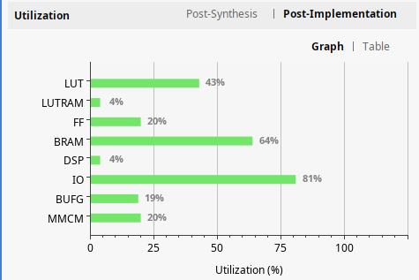
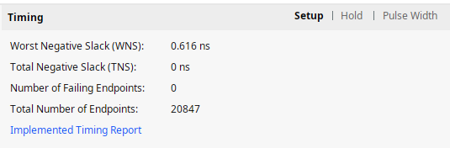
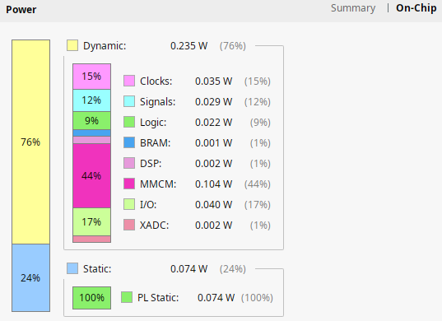
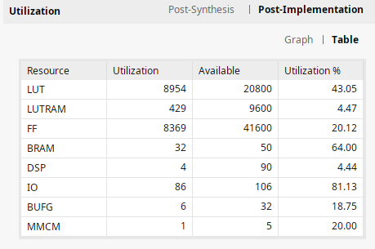
Hardware Report

Slide 22
FPGA Selection and Spec
Overview Microcontroller / AXI Mapping
GPIO / Interrupt System / Timer & PWM / XADC / UART
Memory Hierarchy
Hardware Report
Software Design Flow
Standalone Boot Sequence

Slide 23
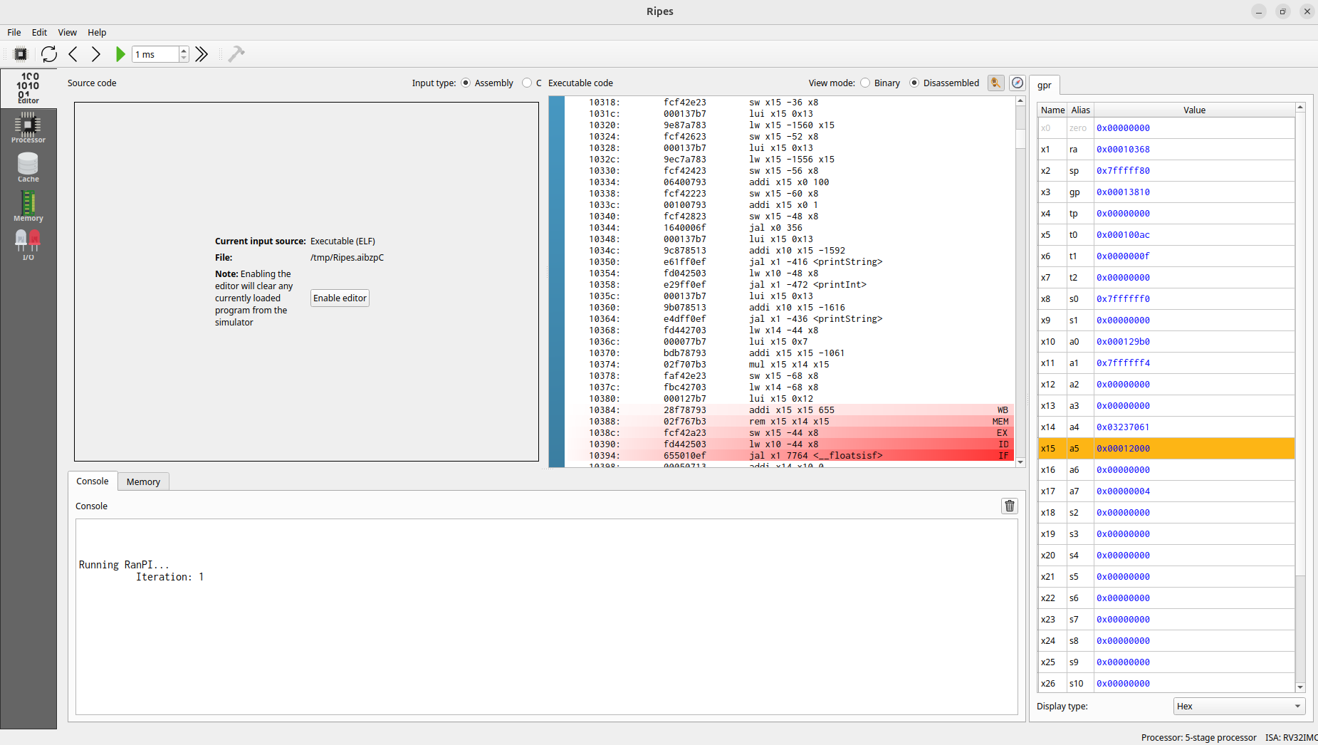
Software Design Flow

Slide 24
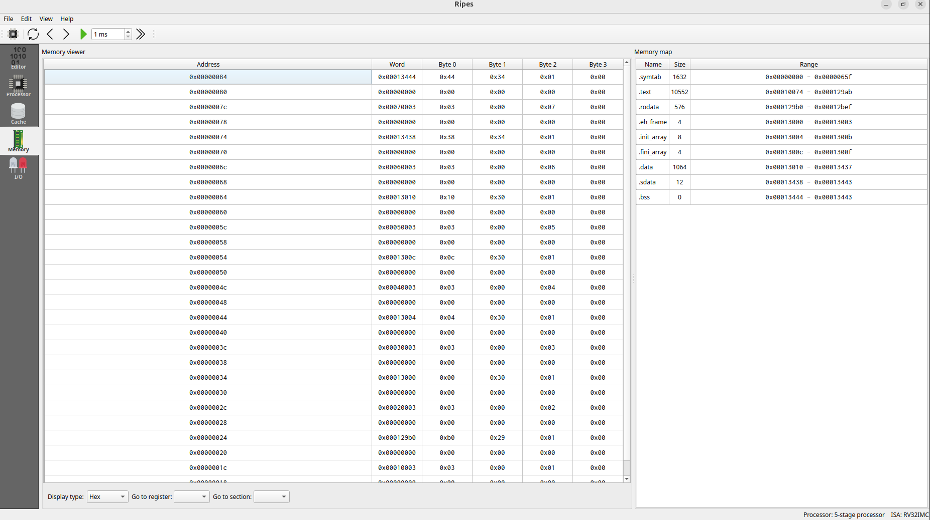
Software Design Flow

Slide 25


Software Design Flow for Debug
Two development approaches:
Xilinx Vitis + Embedded SW Libraries
Official IDE with BSP auto-generation
Includes drivers for all AXI peripherals (GPIO, UART, Timer, SPI, EMC)
RISC-V GNU Toolchain
Standalone GCC cross-compiler (riscv32-unknown-elf / riscv64-unknown-elf)
Full control over linker scripts, startup code, and register-level access
No dependency on Xilinx toolchain
Both target the MicroBlaze RISC-V soft processor running on the Cmod A7-35T.

Slide 26
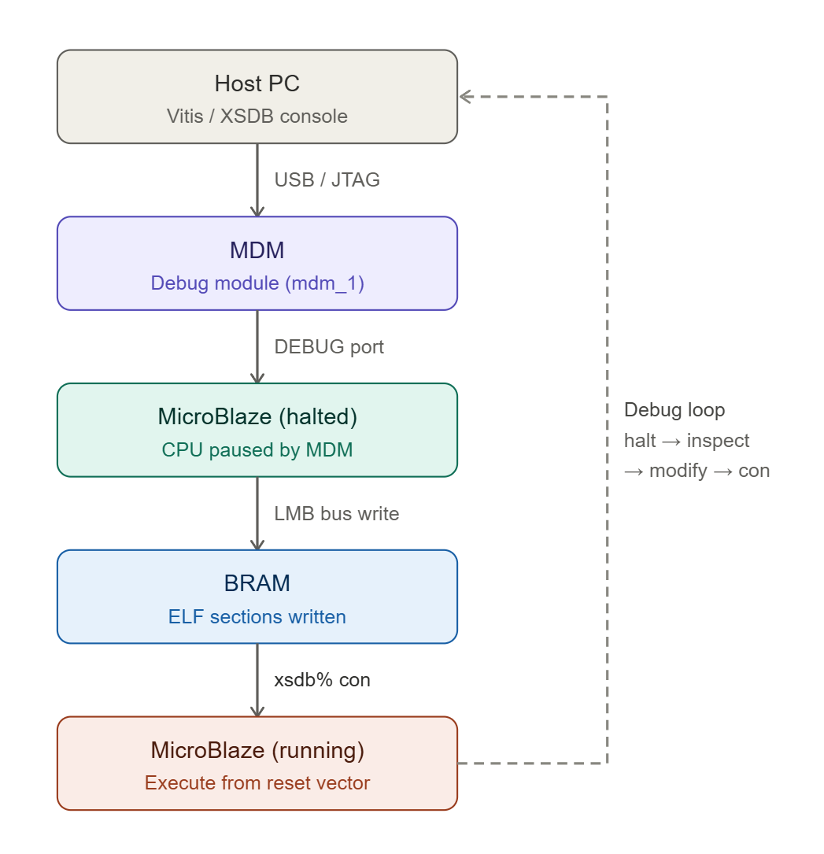
Software Design Flow for Debug
XSDB (Xilinx System Debugger)
Command-line debug interface over JTAG
Connects to MicroBlaze via MDM (MicroBlaze Debug Module)
Capabilities:
Download ELF directly to BRAM/SRAM — no Flash needed
Halt, step, and resume CPU execution
Read/write memory and registers in real time
Enables rapid code-test-fix cycles during development
No bootloader required

Slide 27
FPGA Selection and Spec
Overview Microcontroller / AXI Mapping
GPIO / Interrupt System / Timer & PWM / XADC / UART
Memory Hierarchy
Hardware Report
Software Design Flow
Standalone Boot Sequence

Slide 28
Standalone Boot Sequence

Slide 29
Issue to Address
Interrupt (GPIO / Timer)
GPIO input
uart 16550 Baud Rate 更改
XADC 五個channel讀值
QSPI 內建 Bitstream
EMC SRAM 使用
Memory Hier 設計
Standalone Boot Sequence流程

