Slide 1
RISC-V Microcontroller
Developed by Wei-Feng Huang, DICLAB, NCKU
Notes:
老師，各位同學好

Slide 2
Microcontroller Selection
E203
RV32IM ISA with interrupt and exception support
Developed by Nuclei System Technology (China)
FreeRTOS support available
MicroBlaze V
Xilinx
Configurable ISA with interrupt and exception support
JTAG support available
FreeRTOS support planned for 2026
Strong toolchain support (Vivado/Vitis integration, beginner-friendly)
DICLAB’s CPU (developing)
RV32IMB ISA with interrupt and exception support
FreeRTOS support targeted

Slide 3
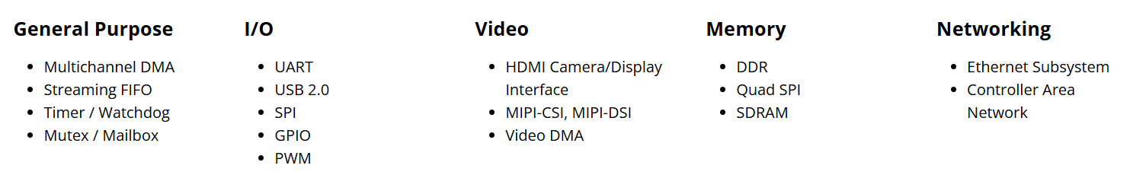
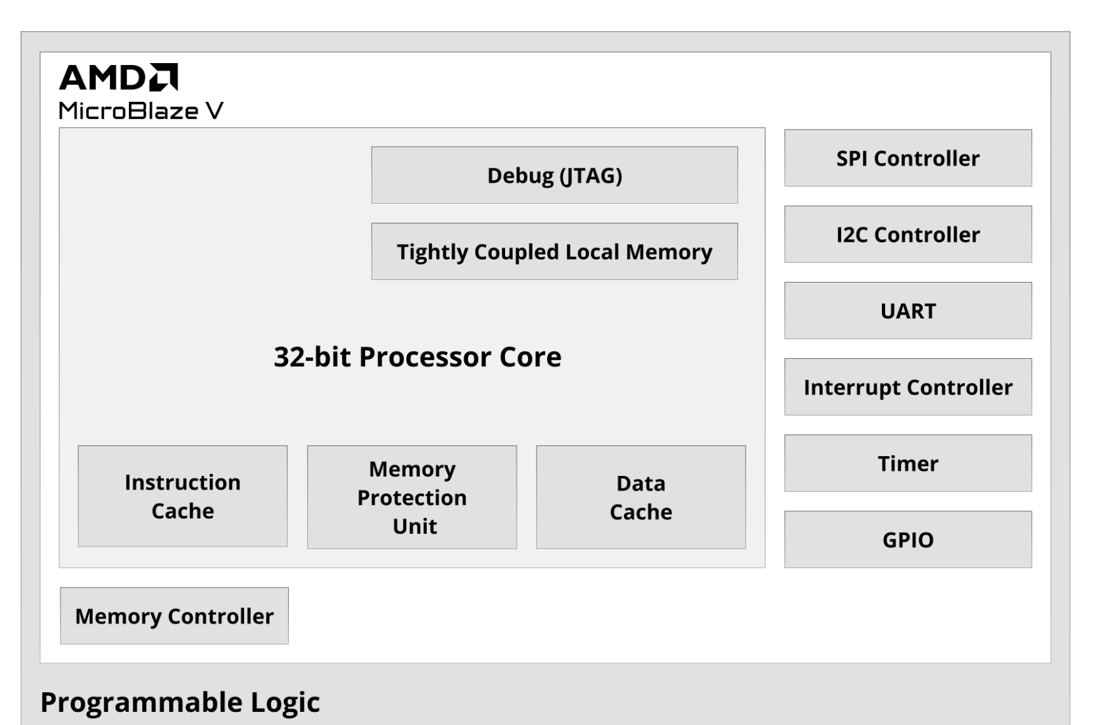
MicroBlaze V high-end Peripheral
External I/O is FPGA-configurable via GPIO ports.
Onboard switches/LEDs/buttons are also supported.
The right figure shows a Xilinx MicroBlaze V microcontroller reference design example.

Slide 4
Our Microcontroller (temporary)
Data Mem
Local Memory
Bus
Inst MEM
Switch / PWM / LED / RGB LED / Button
Debug
Module
MicroBlaze V
AXI GPIO
JTAG
AXI Interconnect (BUS)
AXI Interrupt
Controller
AXI UART
AXI Timer
USB UART

Slide 5
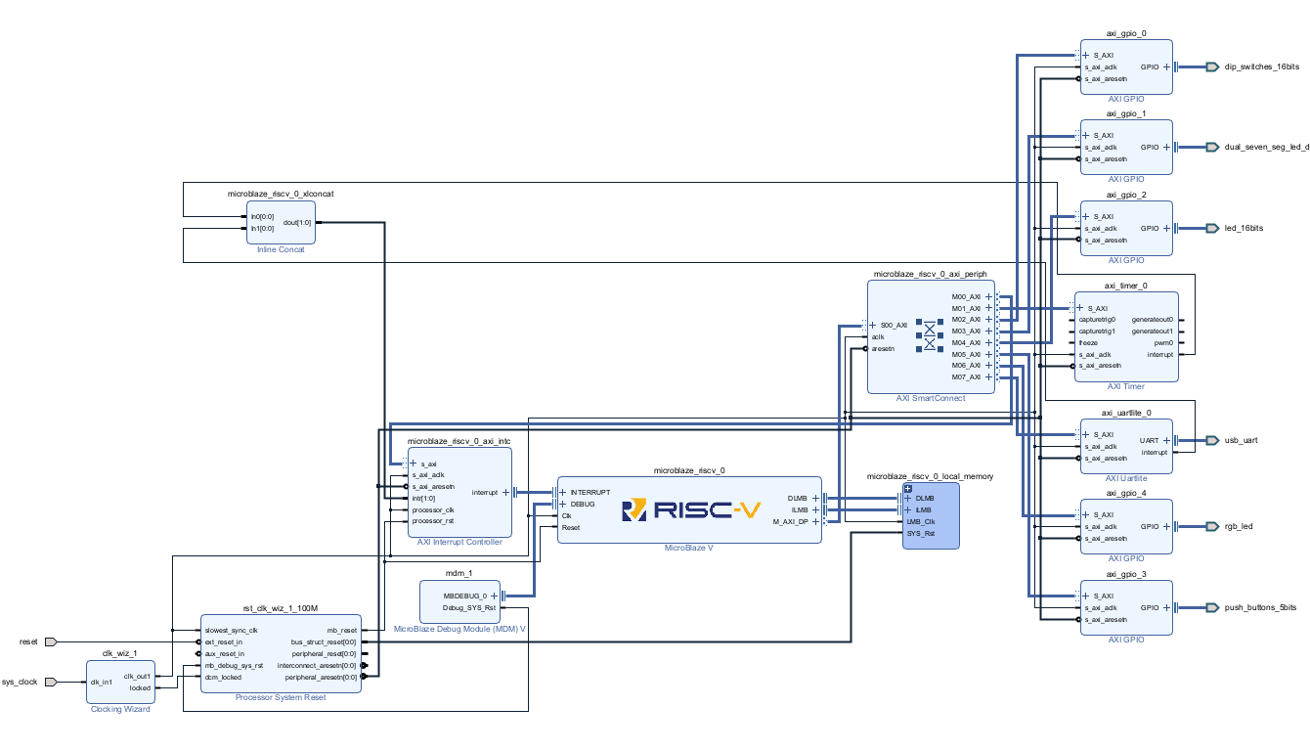
Block Design

Slide 6
Memory-Mapped I/O vs SFR
Memory-Mapped I/O (MMIO):
Peripherals are mapped into the memory address space
Accessed using normal load/store instructions
Easy to integrate and extend (add new devices by assigning new addresses)
SFR (Special Function Registers) in traditional MCUs (e.g., PIC):
Peripheral control uses dedicated special registers
Often requires bank selection / bit-level control
Less flexible when scaling to more peripherals

Slide 7
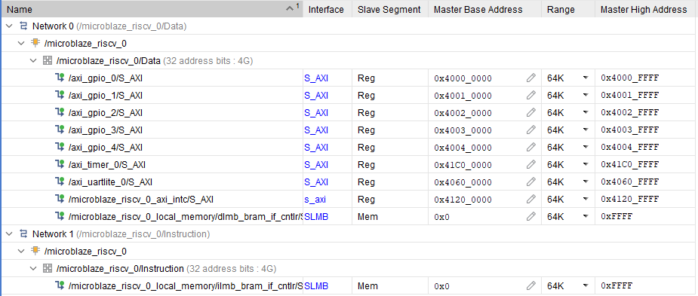
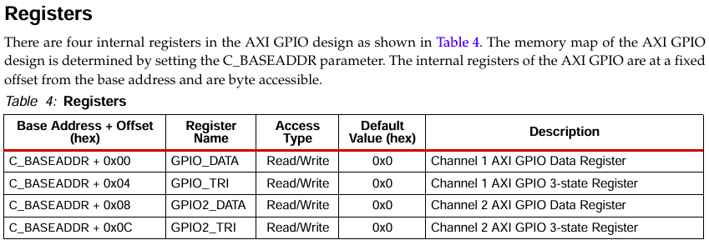
Memory Map in our microcontroller
Each mapped IP provides its own datasheet / product guide.
The document specifies the internal register map (offsets from the base address) and explains how to use each register for configuration and I/O control.

Slide 8
Memory Architecture
CPU internal (MicroBlaze core):
MicroBlaze uses a Harvard-style internal structure, with separate instruction and data paths.
Data Mem
Local Memory
Bus
Inst MEM
Modified Harvard Architecture
MicroBlaze V
SOC Level:
The overall system looks more like a von Neumann model, because both instructions and data are placed in a single unified memory address space when accessing external memory and memory-mapped peripherals.

Slide 9
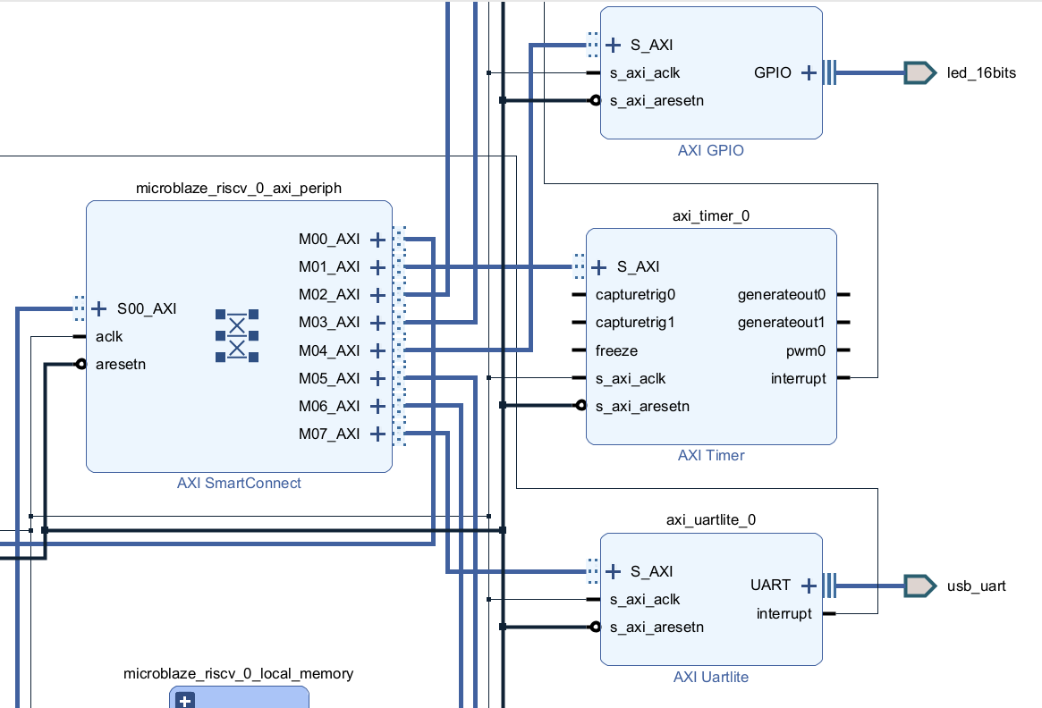
AXI Mapping
Although each peripheral is mapped to a memory address range, this address region does not correspond to physical RAM.
Instead, AXI address decoding and routing logic forwards these transactions to the target peripheral’s register interface (MMIO).

Slide 10
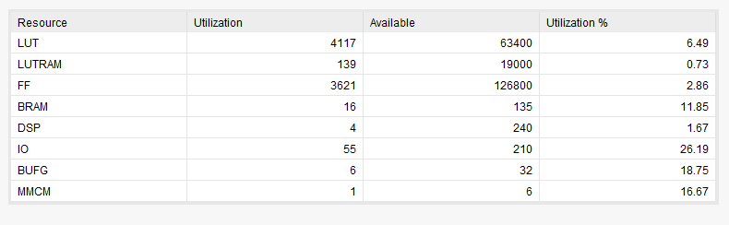
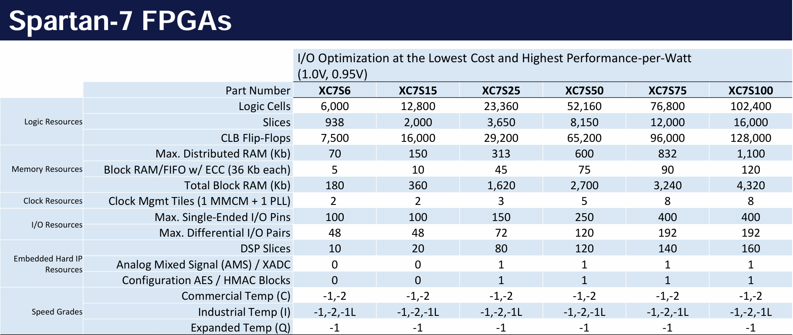
Resource Utilization
=1.6 * LUT

Slide 11


Tool Chain
Vivado for FPGA Design (RTL → Bitstream)
Vitis for Software Development (C/C++ → ELF)

Slide 12
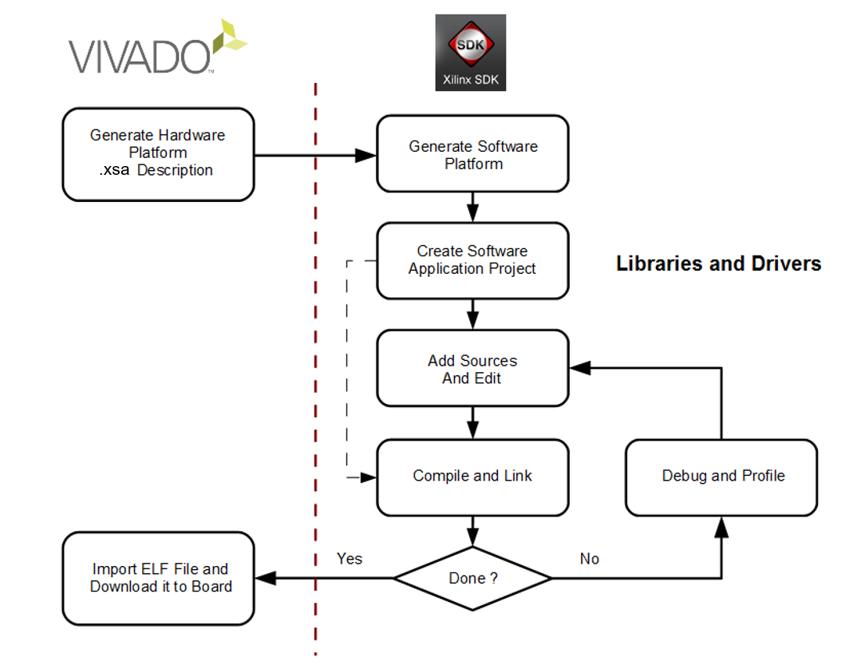
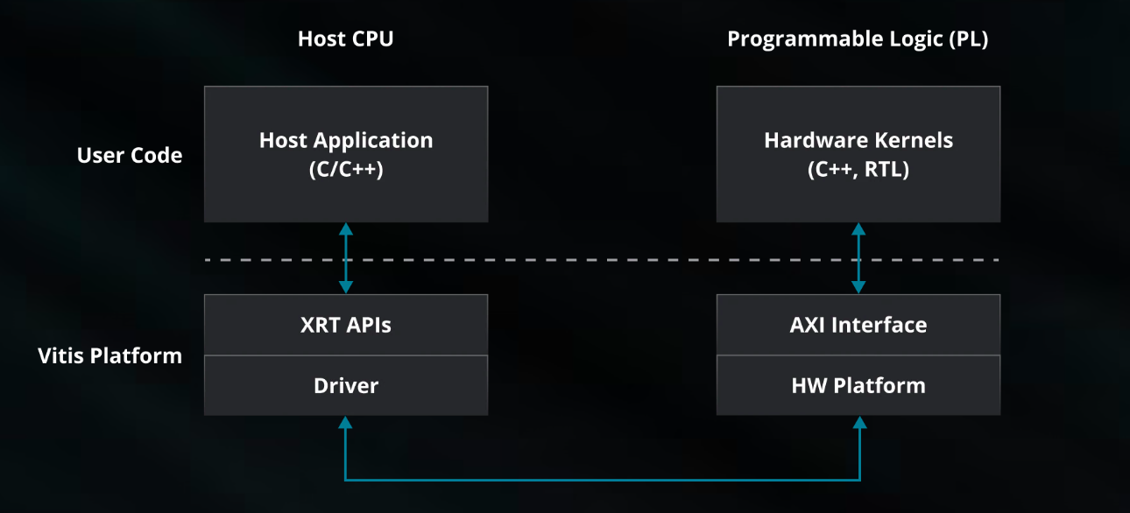

Design Flow

Slide 13
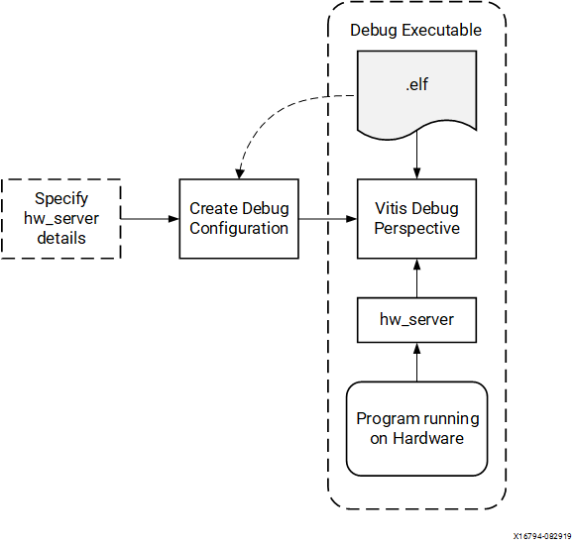
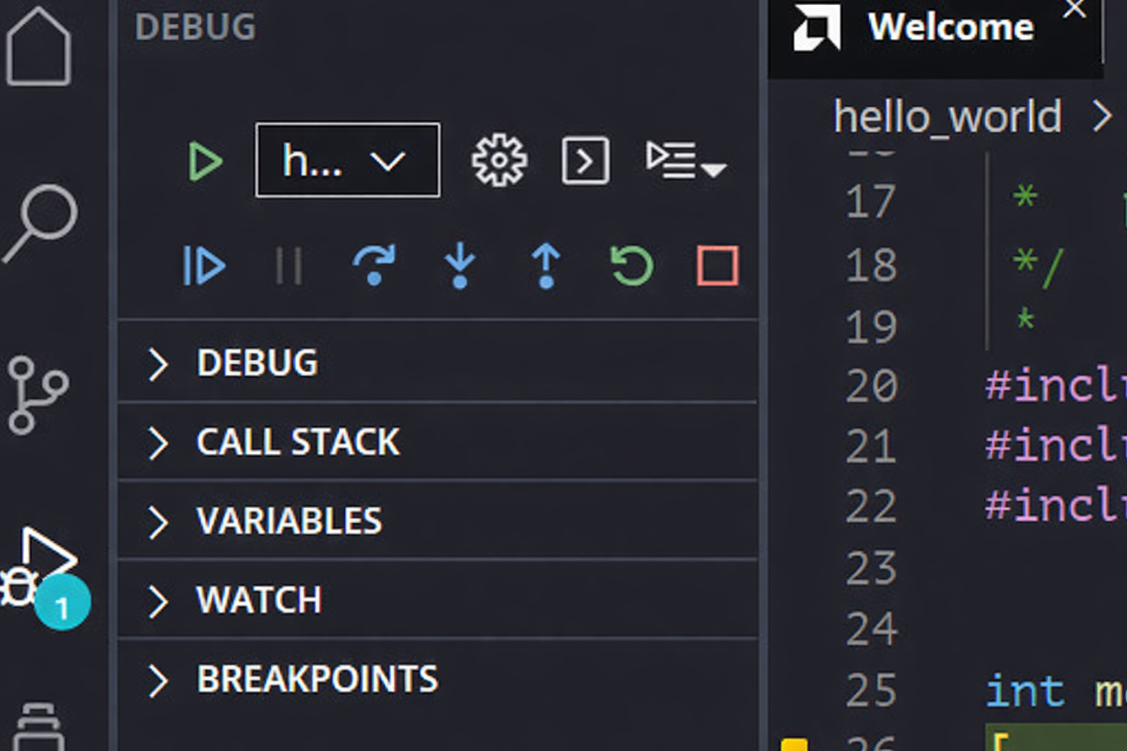
Program to FPGA and Debug - XSDB (via JTAG)
XSDB (Xilinx System Debugger) communicates with the target board through JTAG (IEEE 1149.1), a standard interface for device programming and hardware debugging.
It uses the MicroBlaze Debug Module (MDM) to halt/reset the CPU and access system memory.
XSDB then downloads the .elf sections (e.g. .text, .data) into on-chip BRAM according to the ELF memory map.
Finally, XSDB sets the program entry point (PC) and starts CPU execution.

Slide 14
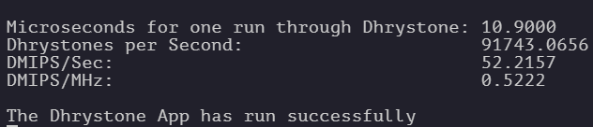
Software Template
Dhystone
Peripheral Test
UART Test
Monte Carlo
Interrupt Service Routine
MicroBlaze V (single-core) measured 0.522 DMIPS/MHz.
Cortex-A9 (dual-core, hard-core) is commonly reported around ~2.5 DMIPS/MHz per core, but in some practical cases it can drop to ~1.0 DMIPS/MHz depending on memory/cache and system configuration.

Slide 15
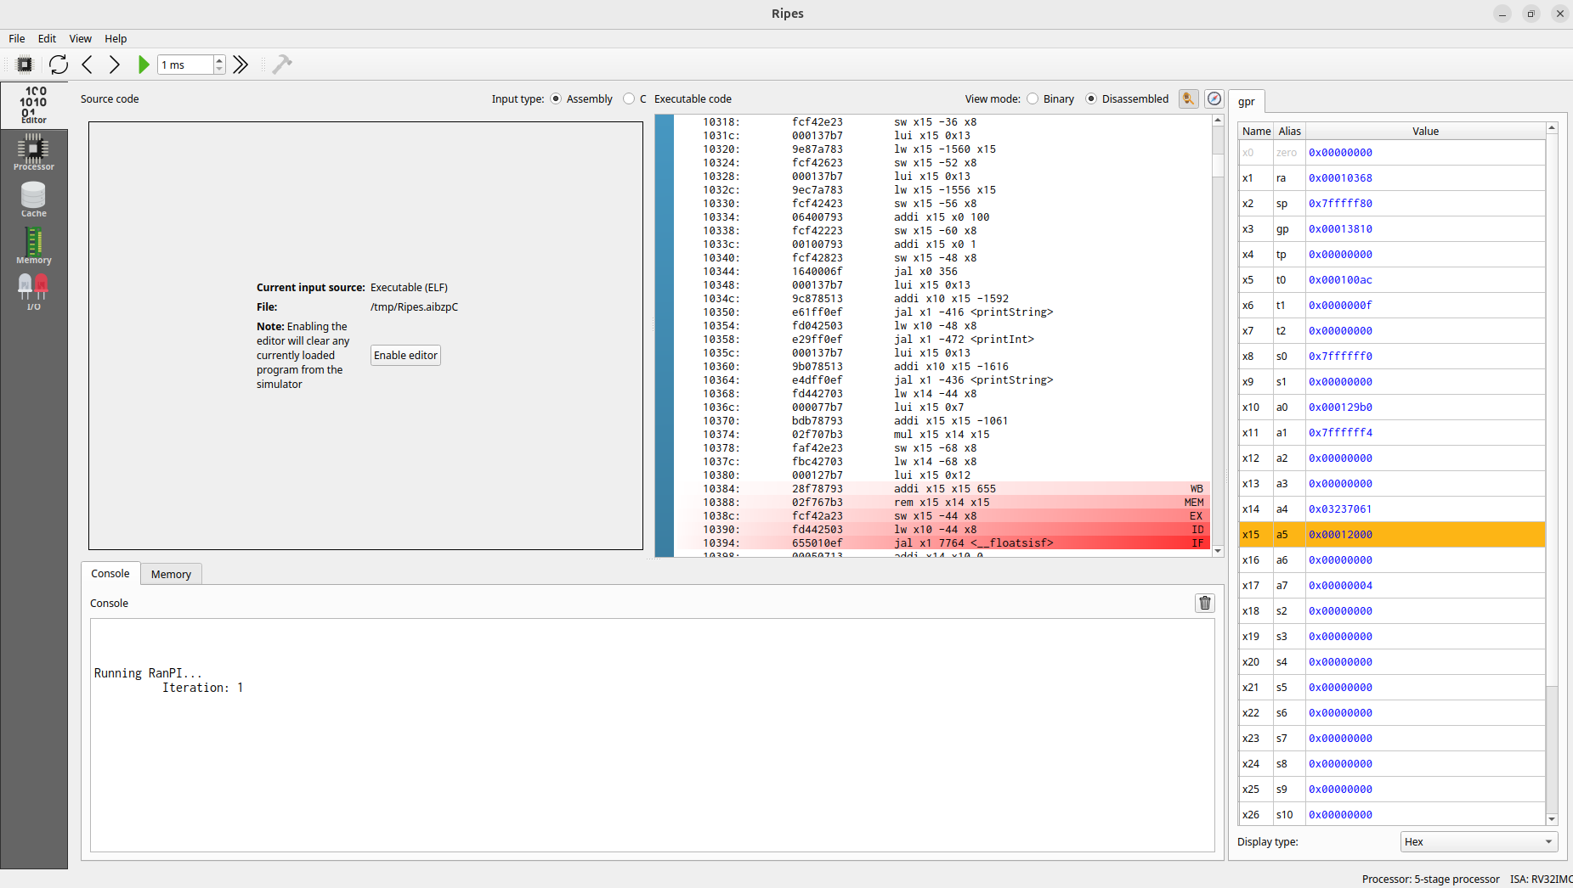
Ripes

Slide 16
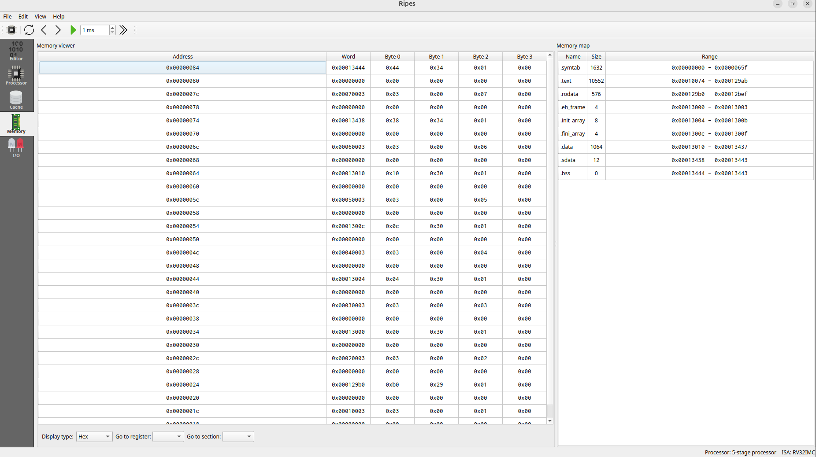
Ripes

Slide 17
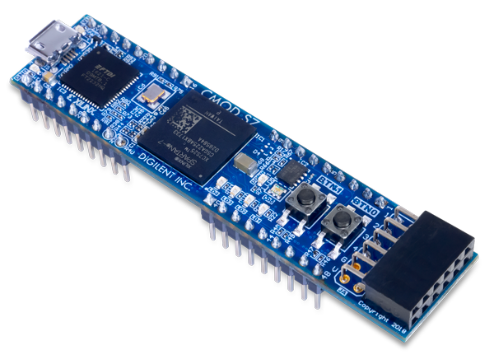
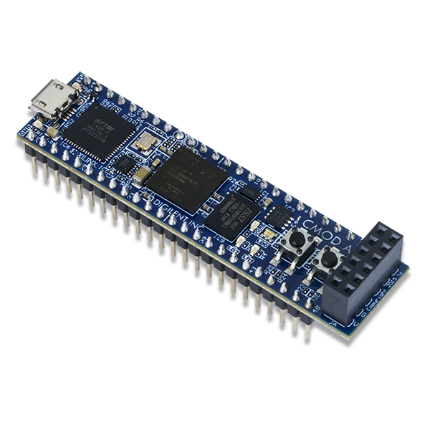
Issues to Address
Full Assembly Boot Chain in Vitis (How to Implement)
start.S : reset entry + stack + jump
main.S : your main logic (or C main if mixed mode)
lscript.ld : defines memory regions & entry address
FPGA Board Selection
Spartan-series without DDR FPGA boards
Xilinx part number ≤ 35
Cmod S7
Cmod A7

