Slide 1
RISC-V Microcontroller On Cmod-A7-35T
Developed by Wei-Feng Huang, DICLAB, NCKU

Slide 2
Outline
FPGA Selection and Spec
Microcontroller Overview
MDM / GPIO / Interrupt System / Timer & PWM / XADC / UART
Memory Hierarchy
Hardware Report
Software Design Flow
JTAG Debug Flow
Standalone Boot Sequence

Slide 3
FPGA Selection and Spec
Microcontroller Overview
MDM / GPIO / Interrupt System / Timer & PWM / XADC / UART
Memory Hierarchy
Hardware Report
Software Design Flow
JTAG Debug Flow
Standalone Boot Sequence

Slide 4
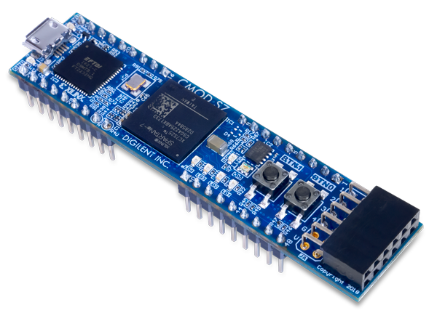




FPGA Selection and Spec
Board: Cmod-A7-35T
Chip: xc7a35tcpg236-1
Breadboard-friendly 48-pin DIP connector
All 48 DIP pins at LVCMOS33 (3.3 V logic level)
No series resistors — direct connection to FPGA I/O
Analog pins: 0–3.3 V input, scaled to 0–1 V via on-board voltage divider
TWD: 3,092

Slide 5
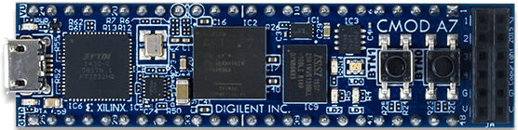
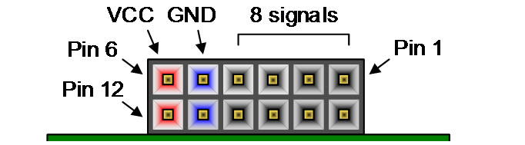
FPGA Selection and Spec
NOR Flash 4MB:
Micron-N25Q032A (32Mbit / 4MB) or
Macronix-MX25L3233FZBI-08G/Q (32Mbit / 4MB)
UART / JTAG
FTDI FT2232HQ
Micro-USB
PMOD
FPGA:
XC7A35T-1CPG236C
SRAM 512KB:
IS61WV5128BLL-10BLI (512KB)

Slide 6
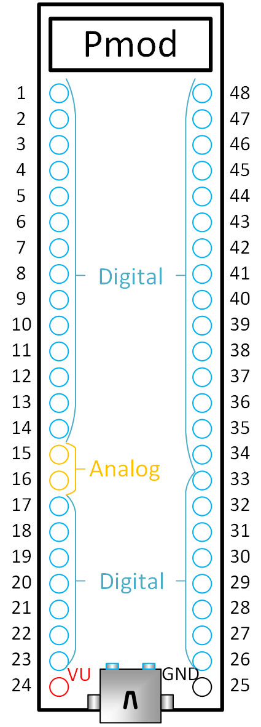
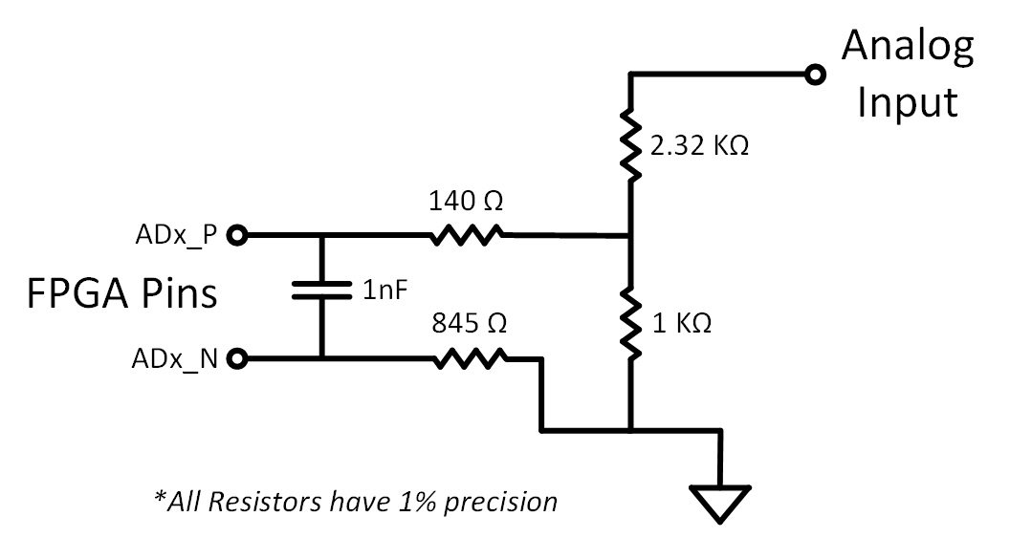



FPGA Selection and Spec
$$V_{DIV}=V_{AIN}×\frac{R_{2}}{R_{1}+R_{2}}=V_{AIN}×\frac{1 kΩ}{2.32 kΩ+1 kΩ}=V_{AIN}×0.301$$
$$V_{DIV}=3.3×0.301=0.994 V$$
DIP pin:
$$V_{measured}=V_{ADx_P}−V_{ADx_N}≈V_{DIV}−0=0.994 V$$
$$V_{AIN}$$
Filter Capacitor
$$V_{DIV}$$

Slide 7
FPGA Selection and Spec
Microcontroller Overview
MDM / GPIO / Interrupt System / Timer & PWM / XADC / UART
Memory Hierarchy
Hardware Report
Software Design Flow
JTAG Debug Flow
Standalone Boot Sequence

Slide 8
Microcontroller Overview
SRAM
512KB
Data Mem /
Inst Mem /
Shared 128KB
Local Memory
Bus
On-Board
LED /
RGB LED /
Button
GPIO pin*28
GPIO_A0 ~ GPIO_A6
……
GPIO_D0 ~ GPIO_D6
Interrupt pin*4
INTR_0
……
INTR_3
AXI
EMC
AXI GPIO * 7
Debug
Module
MicroBlaze V
JTAG
AXI Interconnect (BUS)
AXI UART
16550
AXI Timer
AXI
Quad-SPI
NOR
Flash
4MB
XADC
AXI UART
16550 * 2
AXI Timer
AXI Timer
* 6
USB-UART / UART_RX / UART_TX
PWM_0 ~ PWM_2
ADC_0 / ADC_1

Slide 9
Instruction Path vs Data Path
Data Mem /
Inst Mem /
Shared 128KB
SRAM
512KB
NOR
Flash
4MB
XIP (Execute in Place) is supported
Local Memory
Bus
AXI
EMC
AXI
Quad-SPI
MicroBlaze V
DP
IP
DP
IP
DP
IP
AXI Interconnect (BUS)

Slide 10
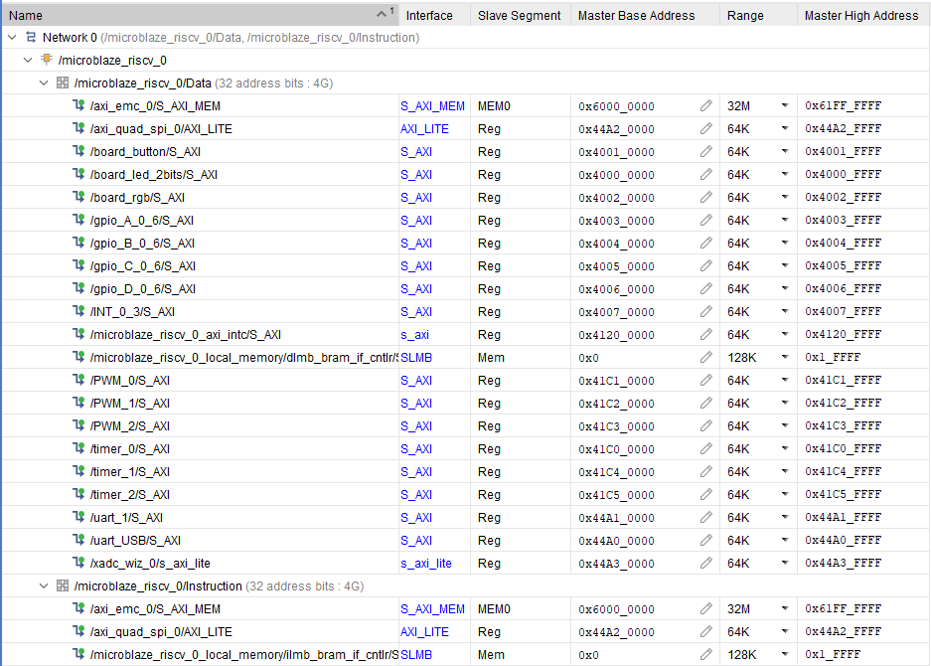
Instruction Network / Data Network

Slide 11
Memory-Mapped I/O vs SFR
Memory-Mapped I/O (MMIO):
Peripherals are mapped into the memory address space
Accessed using normal load/store instructions
Easy to integrate and extend (add new devices by assigning new addresses)
SFR (Special Function Registers) in traditional MCUs (e.g., PIC):
Peripheral control uses dedicated special registers
Often requires bank selection / bit-level control
Less flexible when scaling to more peripherals

Slide 12
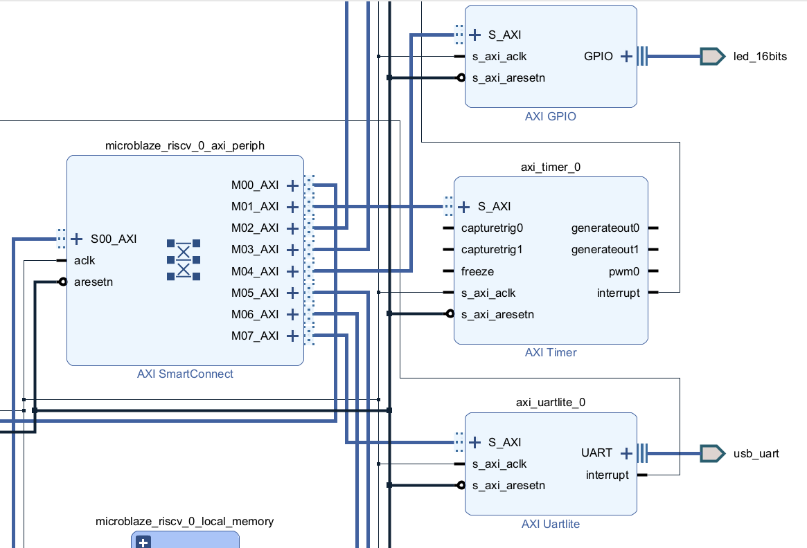
AXI Mapping
Although each peripheral is mapped to a memory address range, this address region does not correspond to physical RAM.
Instead, AXI address decoding and routing logic forwards these transactions to the target peripheral’s register interface (MMIO).

Slide 13
Microcontroller Overview
Processor: MicroBlaze RISC-V, 32-bit, Single Core, 5-Stage Pipeline
Clock: 100 MHz (12 MHz OSC → Clocking Wizard PLL)
ISA Extensions: RV32IM_Zba_Zbb_Zbc_Zbs
Local Memory: 128 KB BRAM (ILMB + DLMB)
Cache: Disabled (I-Cache & D-Cache both off)
Debug: MDM JTAG — breakpoints, register, memory R/W
Interrupt: AXI INTC, 6 sources (3 Timer + 2 UART + 1 GPIO)

Slide 14
FPGA Selection and Spec
Microcontroller Overview
MDM / GPIO / Interrupt System / Timer & PWM / XADC / UART
Memory Hierarchy
Hardware Report
Software Design Flow
JTAG Debug Flow
Standalone Boot Sequence

Slide 15
MDM (MicroBlaze Debug Module)
MDM (MicroBlaze Debug Module)
Hardware debug bridge: JTAG ↔ MicroBlaze RISC-V core
Connected to MicroBlaze via DEBUG port
Debug Memory Access (RISC-V Debug Spec 0.13.2):
Abstract Access — debugger issues memory read/write commands directly through the Debug Module, without CPU involvement
Program Buffer — Debug Module halts the CPU, then injects load/store instructions for the CPU to execute on its own bus interface
Data Path:
PC → USB → JTAG → MDM → CPU DEBUG port → LMB Bus / AXI Bus

Slide 16
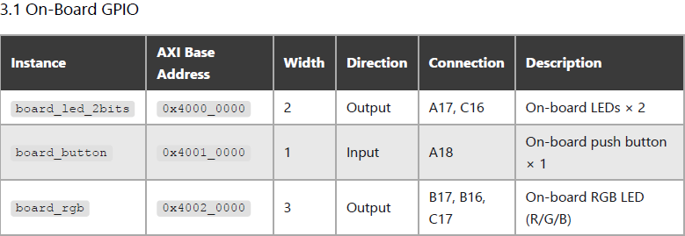
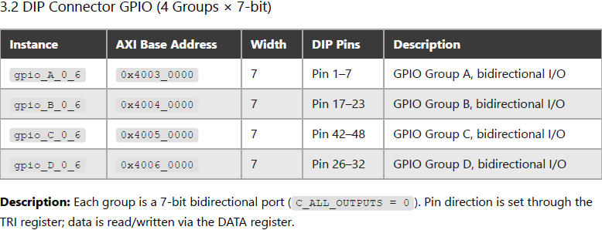
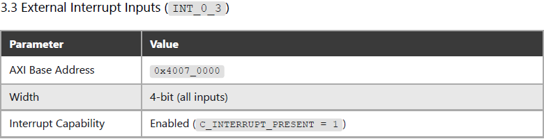
GPIO
gpio_A_0_6
gpio_B_0_6
gpio_C_0_6
gpio_D_0_6
AXI Interconnect (BUS)
board_led_2bits
board_rgb
board_button
INT_0_3

Slide 17
Timer & PWM
6 AXI Timer Instances — Two Roles:
3 × System Timers (timer_0 / timer_1 / timer_2)
Connected to AXI Interrupt Controller
3 × PWM Timers (PWM_0 / PWM1 / PWM_2)
Generate periodic interrupts for scheduling, timeout, or time measurement
Used for servo control (SG90)
All 6 timers are the same IP, the difference is purely in how they are used — interrupt source vs. PWM output.
AXI
Interrupt
Controller
Concat
AXI Timer
* 3
AXI Timer
* 3
AXI Timer
* 3
irq
RISC-V
Core
AXI Interconnect (BUS)
AXI Timer
* 3
AXI Timer
* 3
AXI Timer
* 3
PWM_0 ~ PWM_2

Slide 18
UART
2 × AXI UART 16550 Instances:
uart_USB — Console / Debug
Connected to on-board USB-UART via Micro-USB (J3)
No DIP pin exposed — accessed through USB cable
uart_1 — External Communication
TX/RX routed to DIP Pin 11 / Pin 12
Available for connecting external devices (sensors, modules, another MCU)
AXI UART
16550
UART_RX / UART_TX
AXI Interconnect (BUS)
AXI UART
16550 * 2
USB-UART

Slide 19
XADC
XADC — On-chip Analog-to-Digital Converter
Built-in 12-bit ADC inside Artix-7 FPGA
Enabled Channels (Continuous Sequencer):
VAUX4 (DIP Pin 15) — external analog input
VAUX12 (DIP Pin 16) — external analog input
Temperature — on-chip die temperature
VCCINT — core voltage monitor (1.0 V)
VCCAUX — auxiliary voltage monitor (1.8 V)
Key Specs:
Total conversion rate: 500 Kilo Samples Per Second (KSPS)
Per-channel effective rate: ~100 KSPS (500K ÷ 5 channels)
Input range: 0–1 V at FPGA pins (3.3 V on DIP pin scaled by on-board voltage divider)
Resolution: 12-bit (4096 levels)

Slide 20
Interrupt System
Interrupt handling flow (Normal Mode) :
Peripheral asserts interrupt line
Concat interrupt lines → AXI Interrupt Controller
AXI Interrupt Controller asserts IRQ → CPU
CPU jumps to fixed ISR entry point
Reads axi_intc register to identify source
Branches to corresponding handler
Handler processes the event
Clear peripheral interrupt first
Then clear axi_intc
Return from ISR, CPU resumes normal execution
AXI Timer
* 3
AXI Timer
* 3
AXI Timer
* 3
AXI
Interrupt
Controller
Concat
AXI GPIO
w intr * 3
AXI Interconnect (BUS)
irq
RISC-V
Core
AXI UART
16550
AXI UART
16550 * 2

Slide 21
FPGA Selection and Spec
Microcontroller Overview
MDM / GPIO / Interrupt System / Timer & PWM / XADC / UART
Memory Hierarchy
Hardware Report
Software Design Flow
JTAG Debug Flow
Standalone Boot Sequence

Slide 22
Memory Hierarchy

Slide 23
FPGA Selection and Spec
Microcontroller Overview
MDM / GPIO / Interrupt System / Timer & PWM / XADC / UART
Memory Hierarchy
Hardware Report
Software Design Flow
JTAG Debug Flow
Standalone Boot Sequence

Slide 24
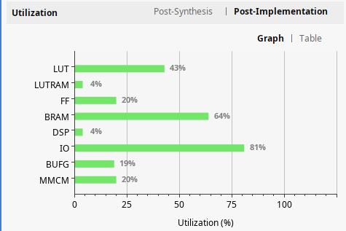
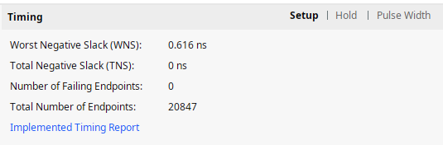
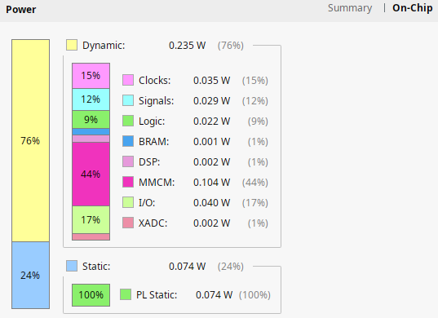
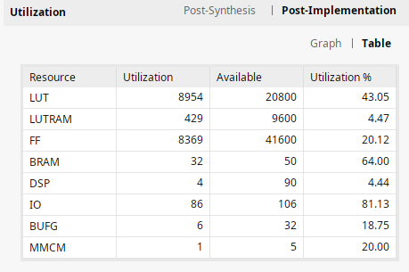
Hardware Report

Slide 25
FPGA Selection and Spec
Microcontroller Overview
MDM / GPIO / Interrupt System / Timer & PWM / XADC / UART
Memory Hierarchy
Hardware Report
Software Design Flow
JTAG Debug Flow
Standalone Boot Sequence

Slide 26
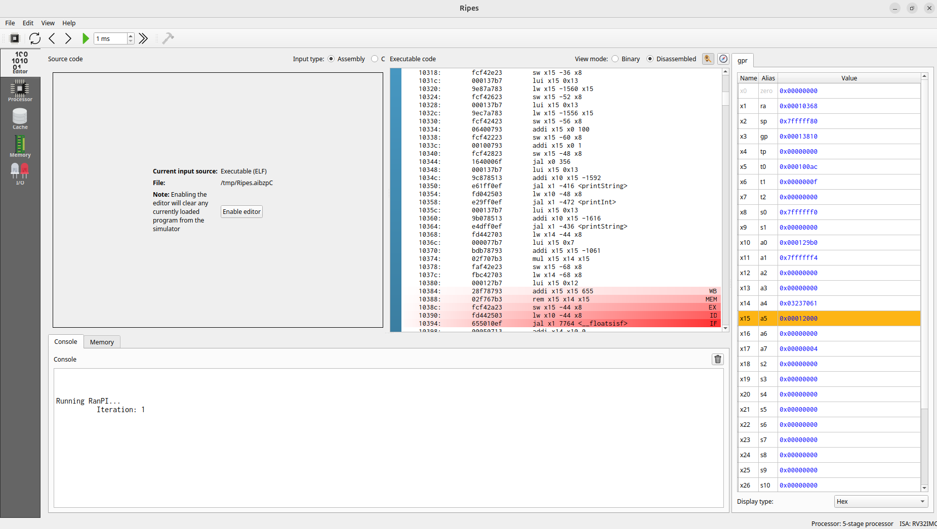
Ripes

Slide 27
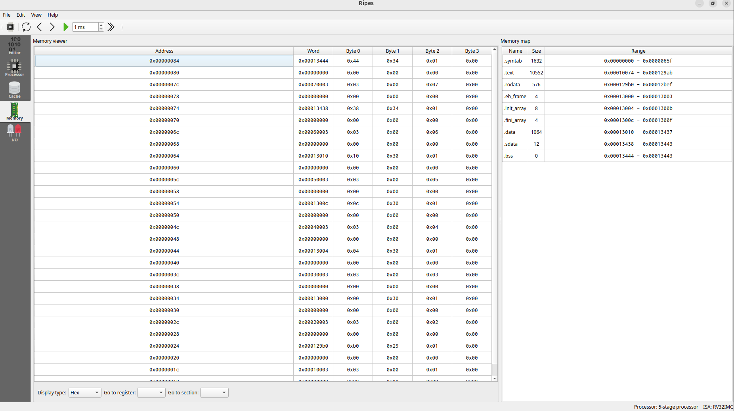
Ripes

Slide 28


Software Design Flow
Two development approaches:
Xilinx Vitis + Embedded SW Libraries
Official IDE with BSP auto-generation
Includes drivers for all AXI peripherals (GPIO, UART, Timer, SPI, EMC)
RISC-V GNU Toolchain
Standalone GCC cross-compiler (riscv32-unknown-elf / riscv64-unknown-elf)
Full control over linker scripts, startup code, and register-level access
No dependency on Xilinx toolchain

Slide 29
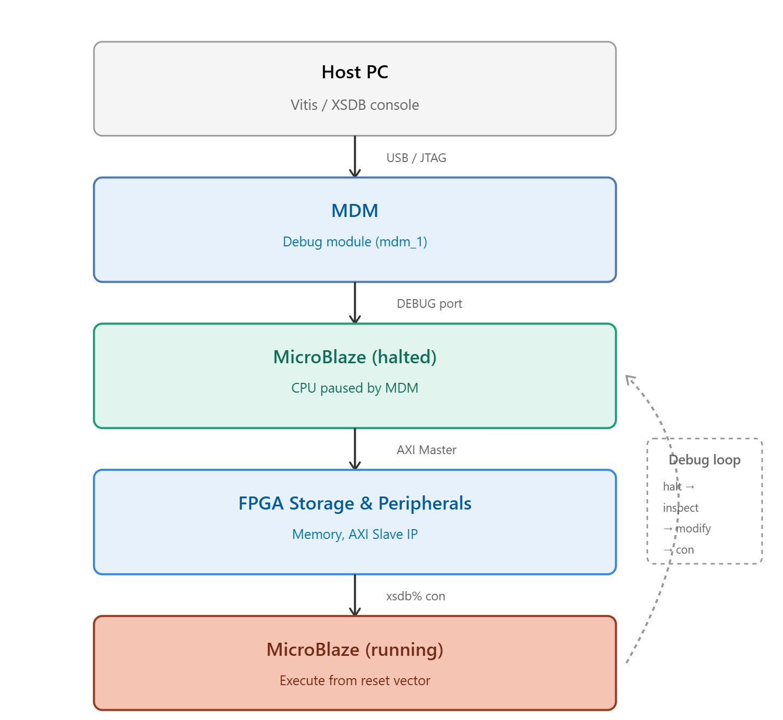
XSDB (Xilinx System Debugger)
XSDB (Xilinx System Debugger)
Command-line debug interface over JTAG
Connects to MicroBlaze via MDM (MicroBlaze Debug Module)
Capabilities:
Download ELF directly to BRAM/SRAM/Flash — no Flash needed
Halt, step, and resume CPU execution
Read/write memory and registers in real time
Enables rapid code-test-fix cycles during development
No bootloader required

Slide 30
FPGA Selection and Spec
Microcontroller Overview
MDM / GPIO / Interrupt System / Timer & PWM / XADC / UART
Memory Hierarchy
Hardware Report
Software Design Flow
JTAG Debug Flow
Standalone Boot Sequence

Slide 31
JTAG Debug Flow
RISC-V-MCU-on-Cmod-A7/Vitis-Software-Dev-Guide/JTAG-Debug-Mode/JTAG-Debug-Mode.md at main · ukp66482/RISC-V-MCU-on-Cmod-A7

Slide 32
FPGA Selection and Spec
Microcontroller Overview
MDM / GPIO / Interrupt System / Timer & PWM / XADC / UART
Memory Hierarchy
Hardware Report
Software Design Flow
JTAG Debug Flow
Standalone Boot Sequence

Slide 33
Standalone Boot Sequence

Slide 34
Reference
The RISC-V Instruction Set Manual, Volume I :: RISC-V Ratified Specifications Library
The RISC-V Instruction Set Manual, Volume II :: RISC-V Ratified Specifications Library
riscv-debug-release.pdf
Introduction • MicroBlaze V Processor Reference Guide (UG1629) • Reader • AMD Technical Information Portal
Introduction • MicroBlaze Debug Module V (MDM V) LogiCORE IP Product Guide (PG428) • Reader • AMD Technical Information Portal
Getting Started with Vitis • Vitis Unified Software Platform Documentation: Embedded Software Development (UG1400) • Reader • AMD Technical Information Portal
BSP and Libraries Overview • Standalone Library Documentation: BSP and Libraries Document Collection (UG643) • Reader • AMD Technical Information Portal

Slide 35
Issue to Address
Interrupt (GPIO / Timer)
GPIO input
uart 16550 Baud Rate 更改
XADC 五個channel讀值
QSPI 內建 Bitstream
EMC SRAM 使用
Memory Hier 設計
Standalone Boot Sequence流程

