Slide 1

Project Name : School Management System
Prepared By :
UTTAM KUMAR SINGH
(22SDSCE01242)
DIPLOMA IN COMPUTER ENGINEERING
Semester : 6th
Year : 2024-25
Under the guidance of
PROF. MILAN SAVALIYA
(Internal Guide)
SCHOOL OF DIPLOMA STUDIES
RK. UNIVERSITY
RAJKOT (GUJRAT-INDIA) 360020.

Slide 2
OVERVIEW OF PRESENTATION
Introduction
Problem Definition
Objectives
Scope of Work
Functional Requirements
Non functional Requirements
Advantages/Benefits
Entity Relationship Diagram
Data Flow Diagram
Activity Diagram
Use Case Diagram

Slide 3
INTRODUCTION
School Management Systems Plays an essential role in the current educational system. School authorities all over the world are engaged in a lot of day-to-day administrative and academic activities to manage and provide a better academic experience to students effectively. However, maintaining and keeping track of school administrative activities is not an easy process in the fast-growing world. It requires hard work and often it is time-consuming.
To better perform the school administrative activities of educational institute and to assure parents the real-time progress and security of their children, educational institutes utilizes School Management software nowadays. Such applications often offer many features that help to enhance the performance of schools with minimum efforts. School Management software does it by avoiding the manual paper works and automation of many academic and administrative activities. Now let us take a look at why institutes need to implement it.

Slide 4
Problem Definition
Student Attendance
Time Wastage
Student Monitoring
Maintains Problem
Forecasting the academic achievement
Teachers/ Staff Management
School Administration
Lake of communication between teachers, students and their parents
Fee Management

Slide 5
Objectives
It is designed for better interaction between students, teachers, parents, and management. This management software very greatly handles all the requirements for easy school management.
Maintaining student details and information, registering students, and teacher’s information.
Giving Access to parents to view their children information regarding their performance.
Enabling admin, teachers, students, and parents to stay in touch with each other.

Slide 6
Scope for Work
The purpose is to make people life easier. This project is used to manage the school system and will organise the work inside the school and will perform the following task
Fees management.
Teacher information management.
Administration management.
Student information management.
Management of parent portal.
Attendance.
Manage Marks of student.
Manage Class and Exam Timetable Schedule.
Notice Board.

Slide 7
Functional Requirements
Hardware Requirements:
  Processor : - Intel Core i3/i5 & above.
  Ram :- 4GB/8GB & above.
  Storage :- 100GB HDD/ 256GB SSD & above.
  Network :- Stable Internet Connection.
Software Requirements:
  Operating System :- Windows 10/11, MacOs, Linux.
  Language :- HTML, CSS, JavaScript, PHP Framework (Laravel).
  Server :- Apache Server (Laragon).
  Database :- MySQL (PhpMyAdmin).
  Development Tools :- Visual Studio Code.
  Browser :- Any Web Browser (Google Chrome, Mozill FireFox).
  Security :- bcrypt for password encryption.

Slide 8
Non Functional Requirements
The system should be easy to use.
The System should be available 24 hours.
The system should response at the time.
System should provide specific information to specific user.
The system should not fail.
Right information is available to right student and teacher at right time.

Slide 9
Advantages/Benefits
Improved communication: Teachers, students, and parents can communicate more easily.
Enhanced efficiency: Schools can save time and money by reducing manual record-keeping and data processing errors.
Improved student experience: Schools can provide a seamless educational experience by tracking student progress, attendance, and course completion.
Improved teacher-parent relationships: Schools can keep parents updated on their children's learning.
Improved human resources management: Schools can manage payrolls, leaves, and the hiring process.

Slide 10
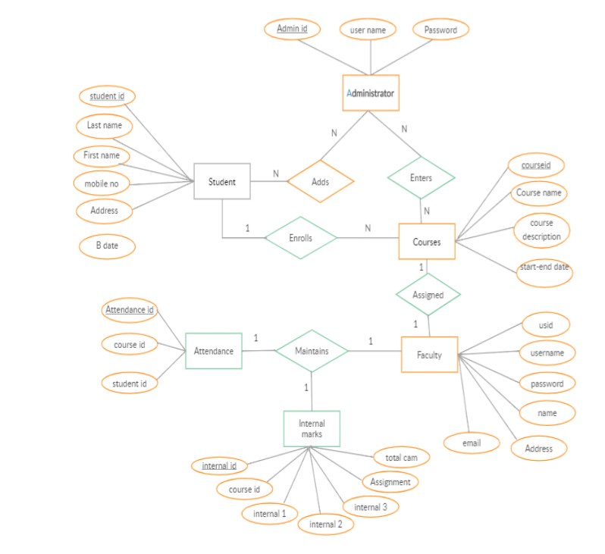
Entity-Relationship (ER) Diagram

Slide 11
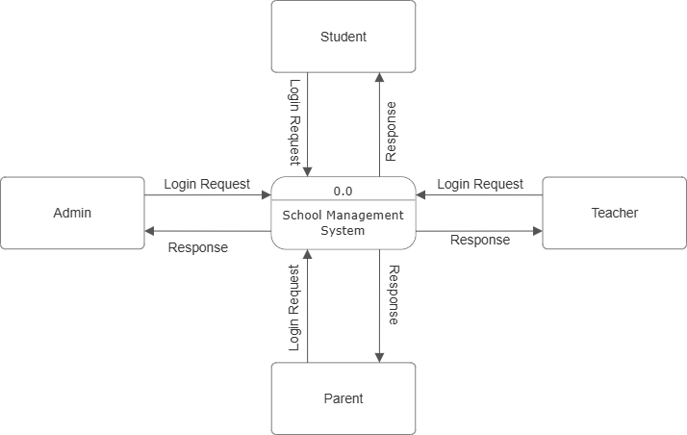
Data Flow Diagram (DFD)
DFD Level 0 : School Management System

Slide 12
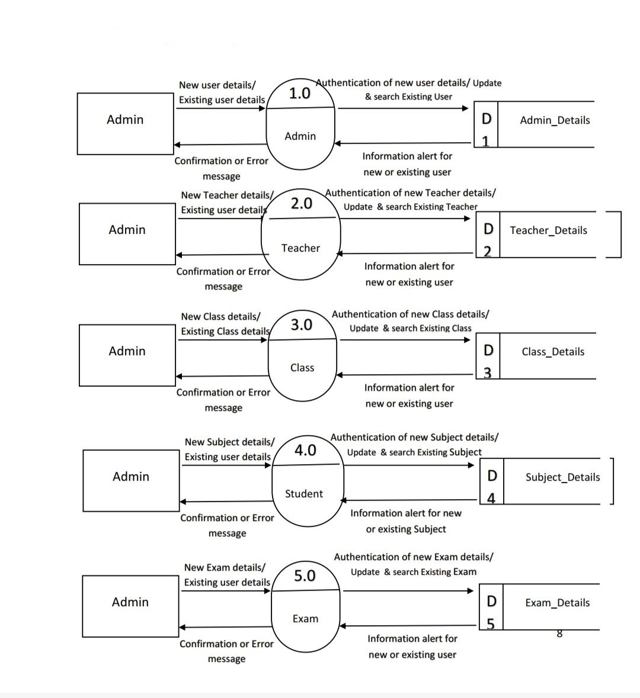
Data Flow Diagram (DFD)
DFD Level 1 : School Management System (Admin)

Slide 13
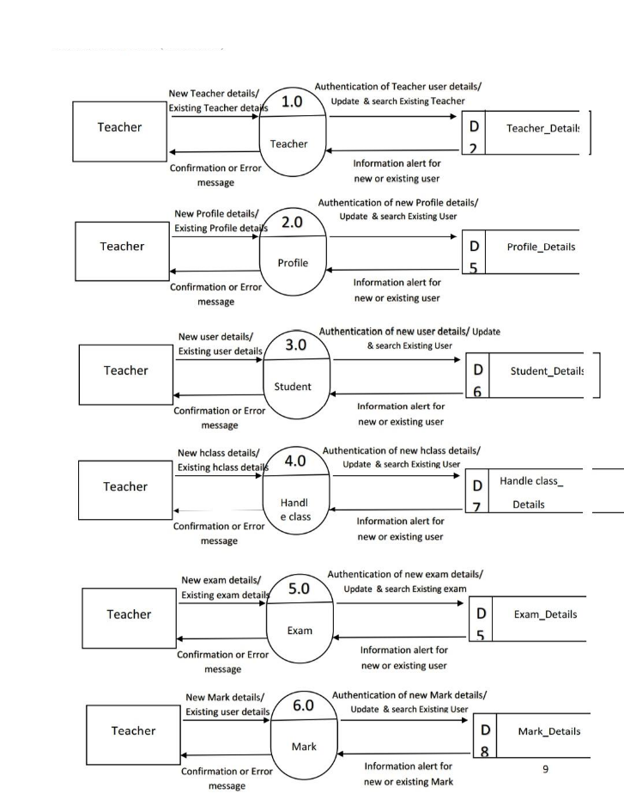
Data Flow Diagram (DFD)
DFD Level 1 : School Management System (Teacher)

Slide 14
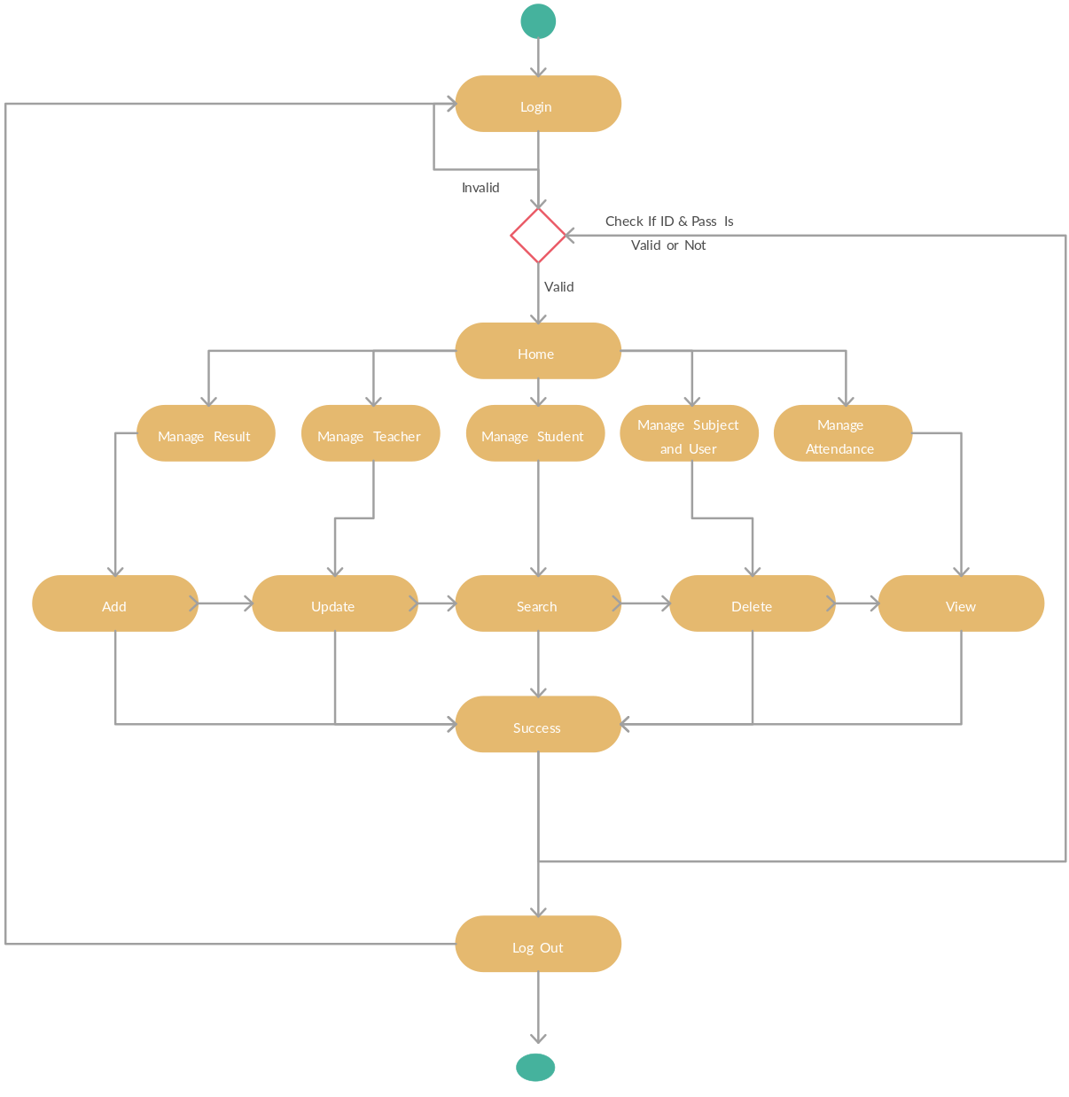
Activity Diagram: School Management System

Slide 15
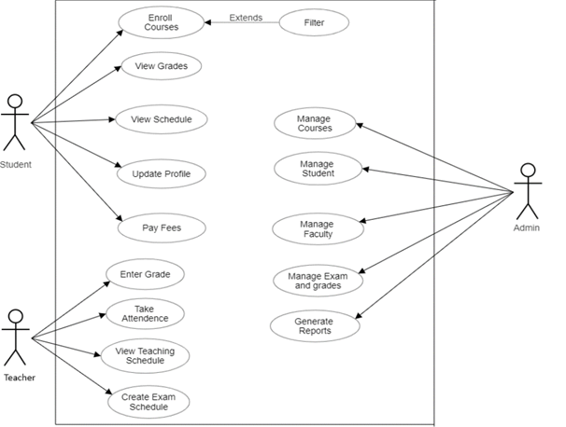
Use Case Diagram: School Management System

Slide 16

Thank You!

