Slide 1
Dash Tutorial
Changuk Lee

Slide 2
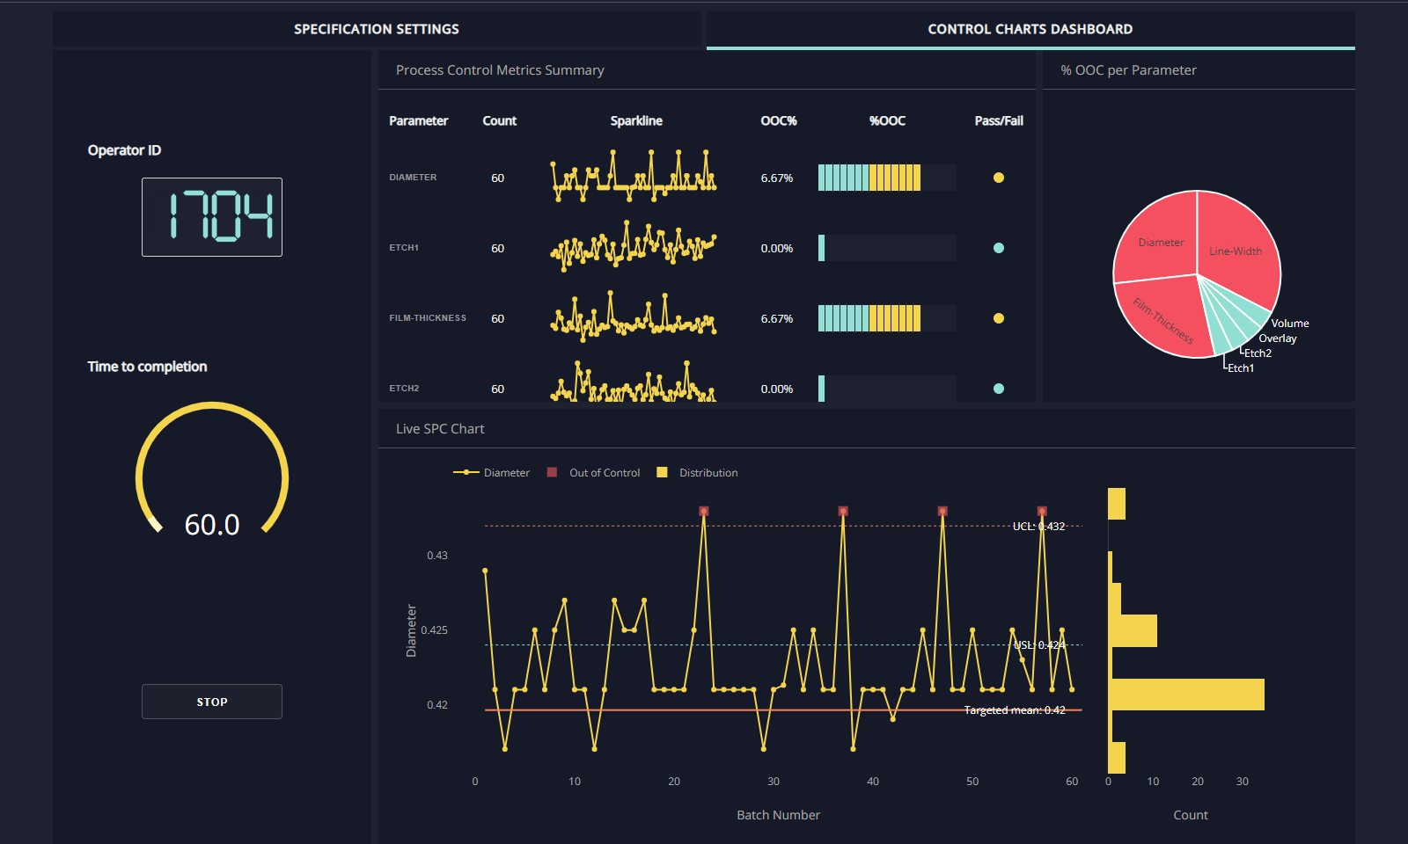
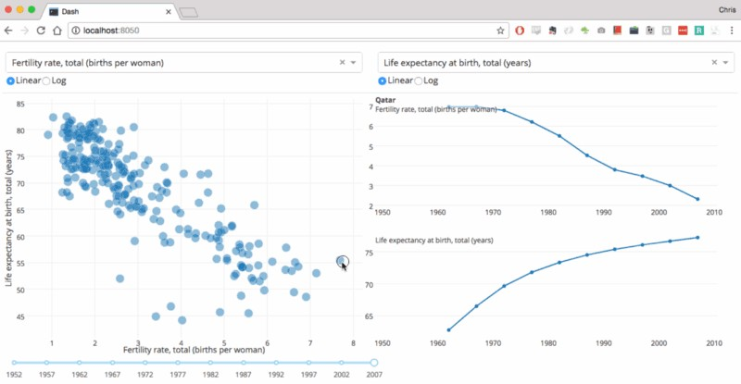
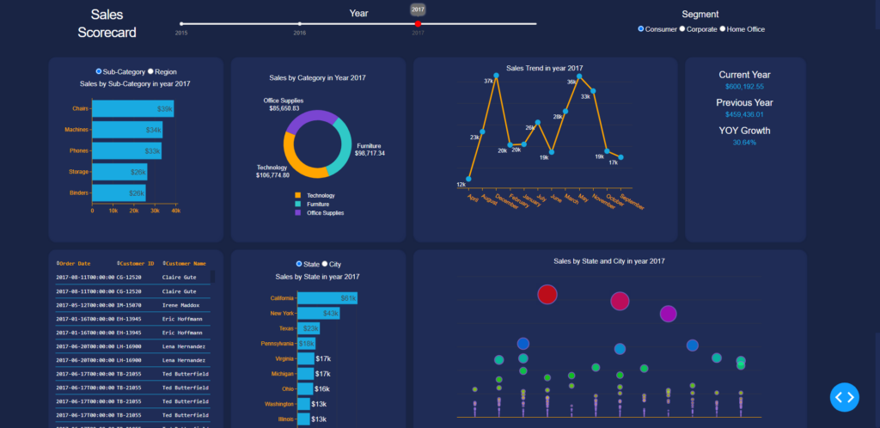
Why Dash?
Can deploy customized user interfaces
Useful for Python data scientists who aren’t familiar with web
Supports modern UI elements like dropdowns, sliders and graphs

Slide 3
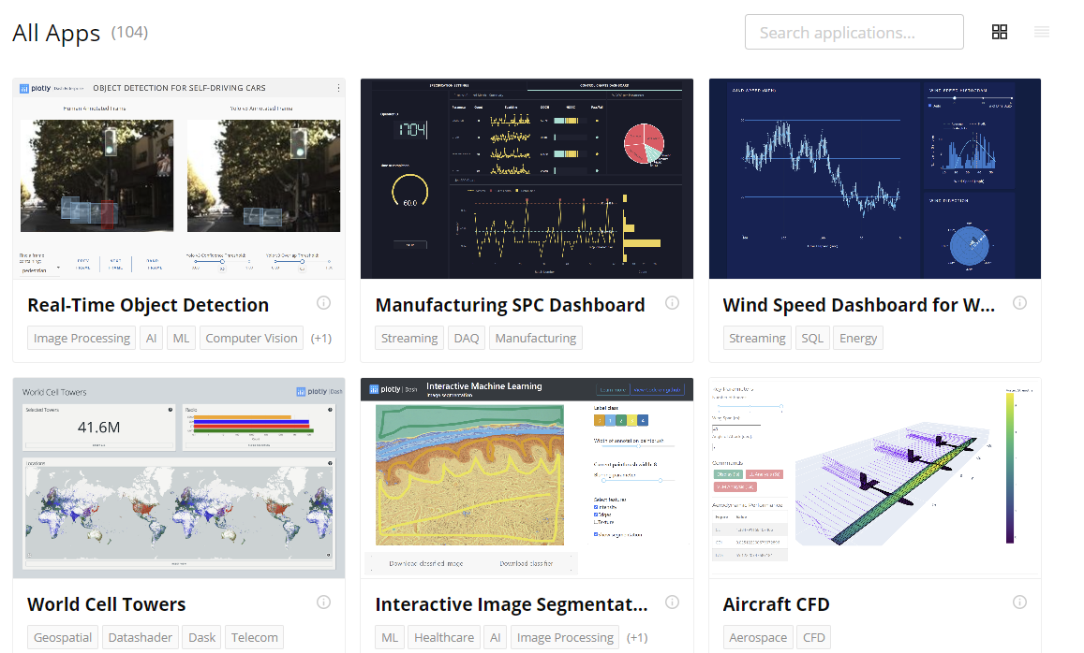
Dash Enterprise Gallery
https://dash.gallery/Portal/

Slide 4
Dash Tutorial
https://drive.google.com/file/d/1x0JwDtv7vMihBBibUh6g5T5y_HxhDpLt/view?usp=share_link

Slide 5
Starting Dash
Installation
!pip install dash
!pip install dash_core_components
!pip install dash_html_components
!pip install dash-renderer

Slide 6
Starting Dash
dash_core_components : gives Interactive User Interactives
dash_html_components : instead using html engine, we can compose layout using Python code

Slide 7
dash_core_components
dcc.Dropdown()
dcc.Slider()
dcc.Rangeslider()
dcc.Input()
dcc.Textarea()
dcc.Checklist()
dcc.RadioItems()
dcc.DatePickerSingle()

Slide 8
dash_html_components
html.H1()
html.P()
html.Div()
html.Label()
html.Br()
html.Button()

Slide 9
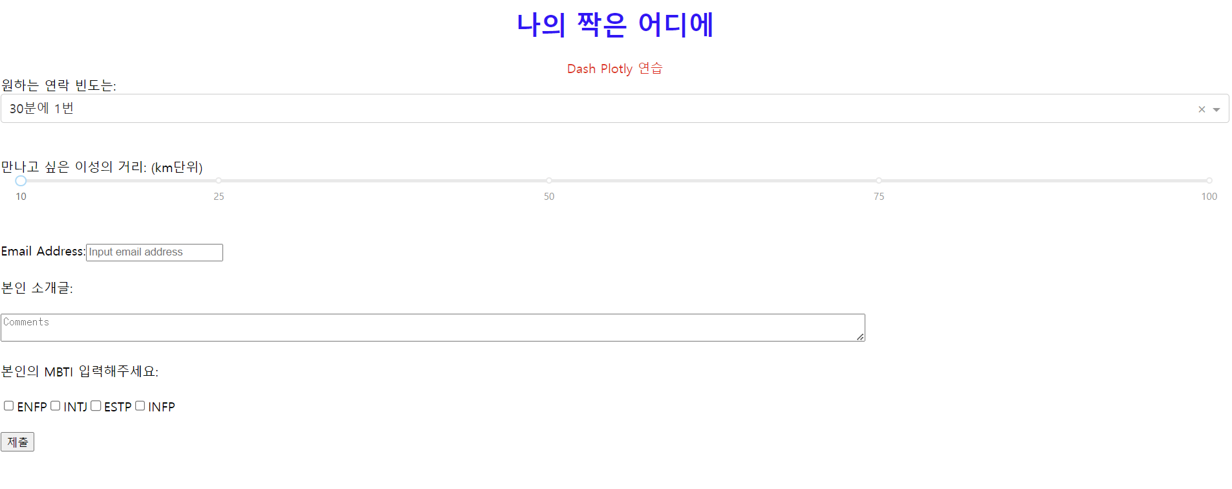
Practice Session

Slide 10
More…
https://dash.plotly.com/dash-core-components
https://dash.plotly.com/dash-html-components

Slide 11
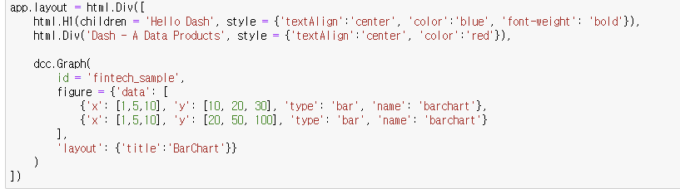
dcc.Graph()

Slide 12
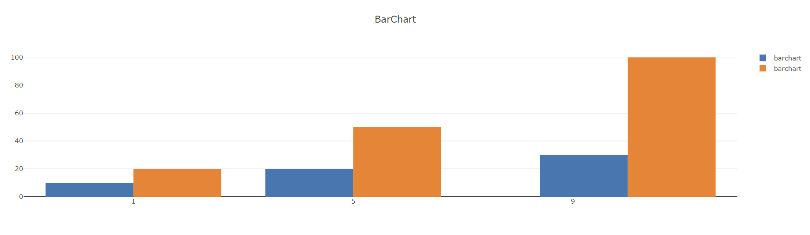
dcc.Graph()

Slide 13
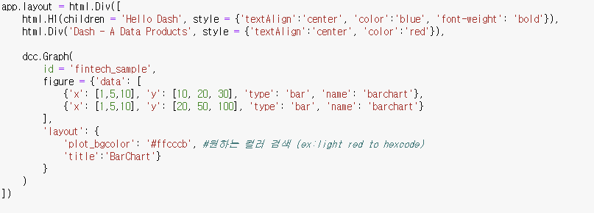
dcc.Graph() -> plot_bgclor 옵션

Slide 14
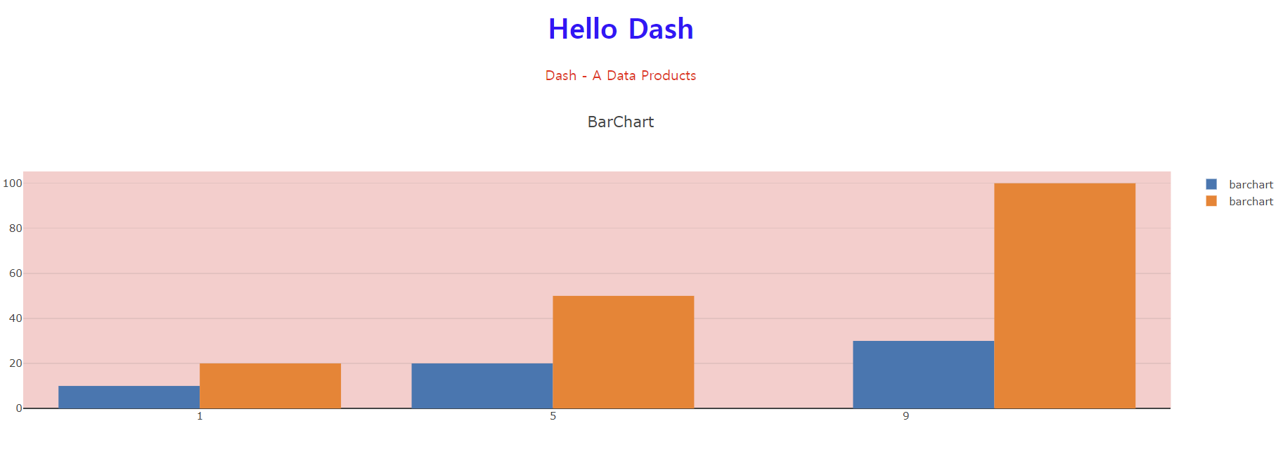
dcc.Graph()

Slide 15
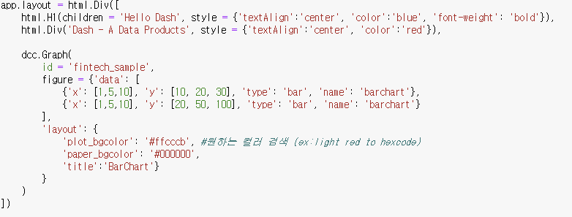
dcc.Graph() -> paper_bgcolor 옵션

Slide 16
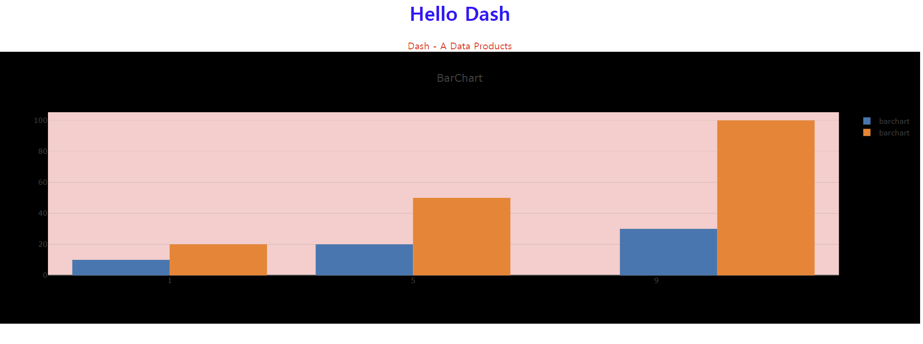
dcc.Graph()

Slide 17
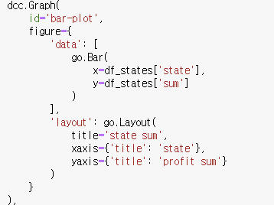
Bar Plot

Slide 18
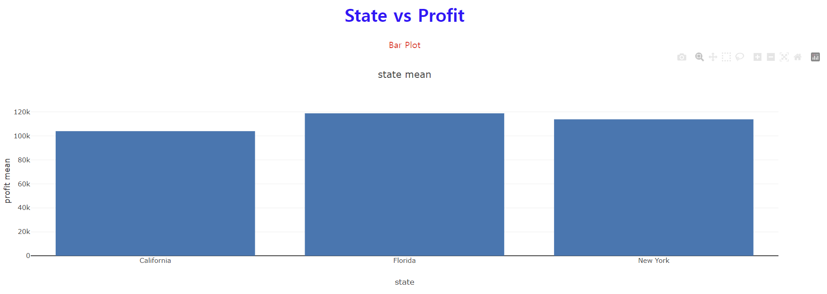
Bar Plot

Slide 19
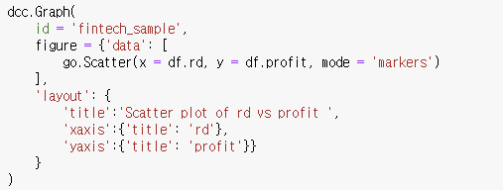
Scatter Plot

Slide 20
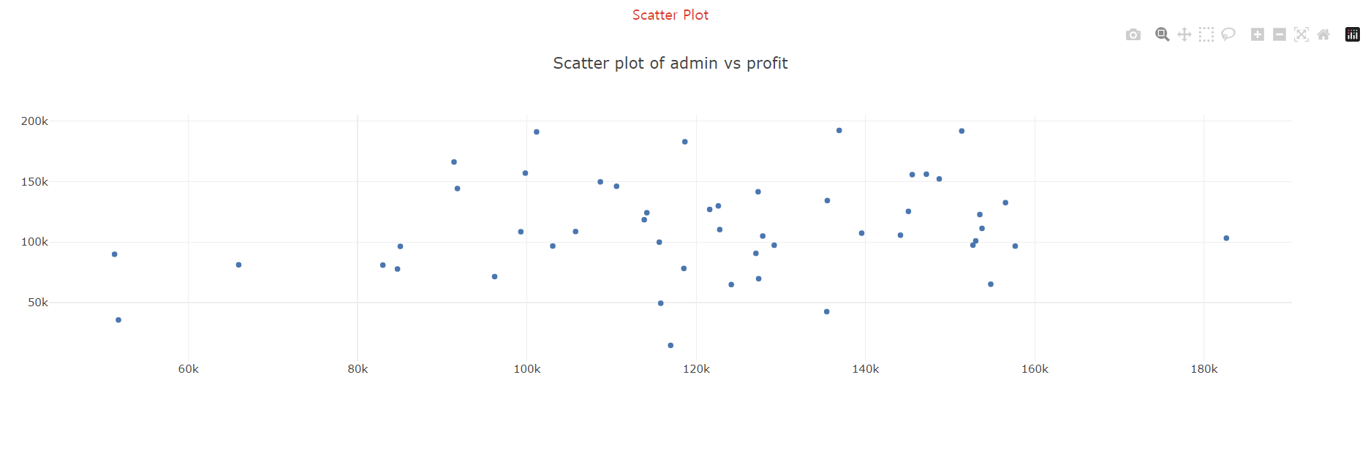
Scatter Plot

Slide 21
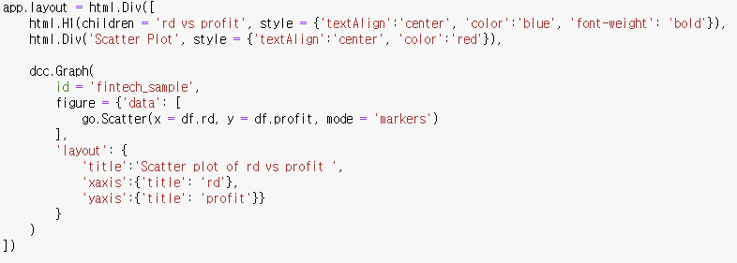
Scatter Plot with options

Slide 22
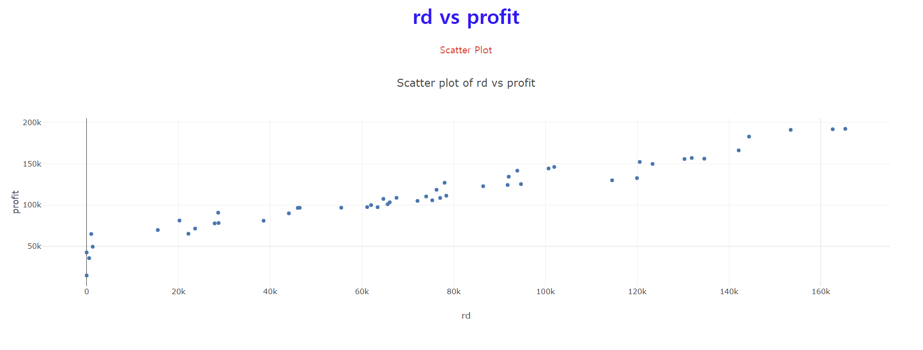
Scatter Plot with options

Slide 23
Practice Session with Kaggle Dataset

Slide 24
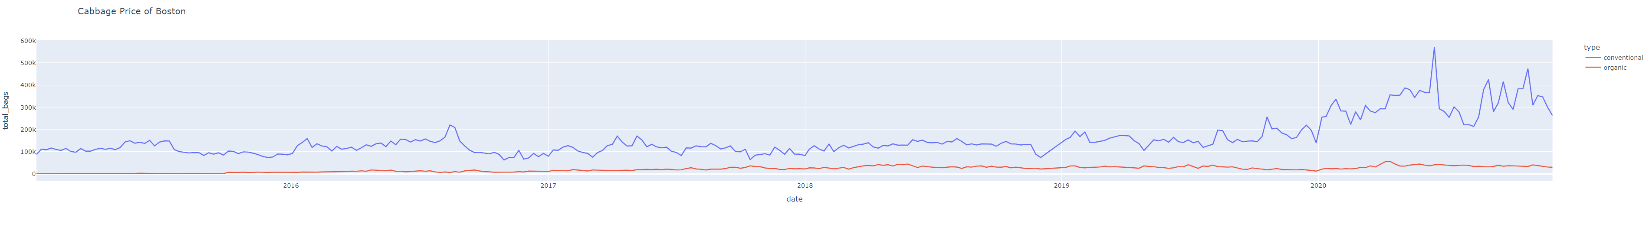
Practice 1
date vs total_bags line graph 출력해보기!

Slide 25
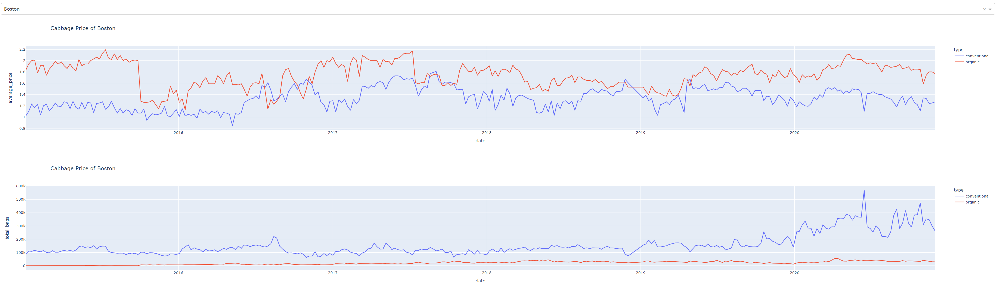
Practice 2
date vs average_price, date vs total_bags line graph 같은 대쉬보드에 출력해보기!

Slide 26
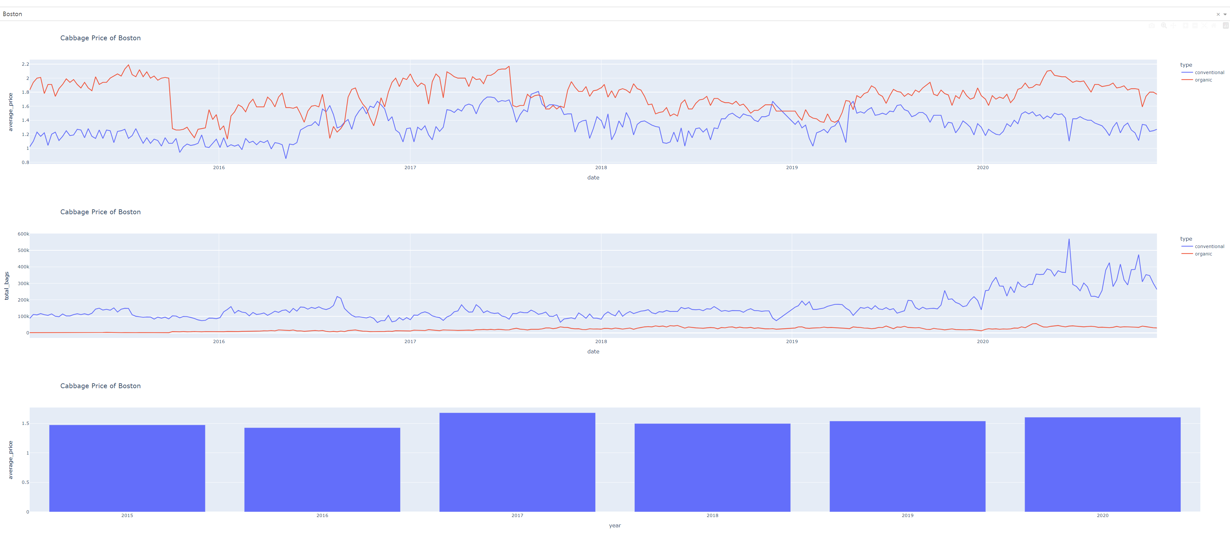
Practice 3
년도 별 막대 그래프도 추가해서 같은 대쉬보드에 출력해보기!

Slide 27
수고하셨습니다!

