Slide 1



Modelling and Optimizing Complex Heterogeneous Architecture
Iain Bate
Real-Time Systems Group, University of York

Slide 2
Outline
Overview of the MOCHA project
Modelling of the system – a digital-twining approach
Key research questions we plan to address

Slide 3
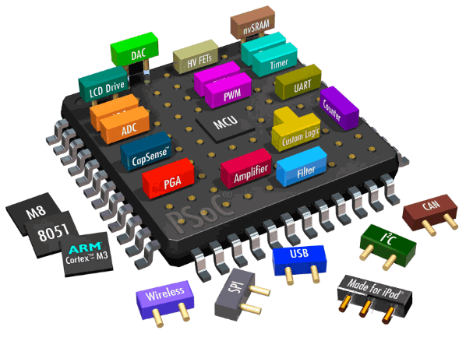
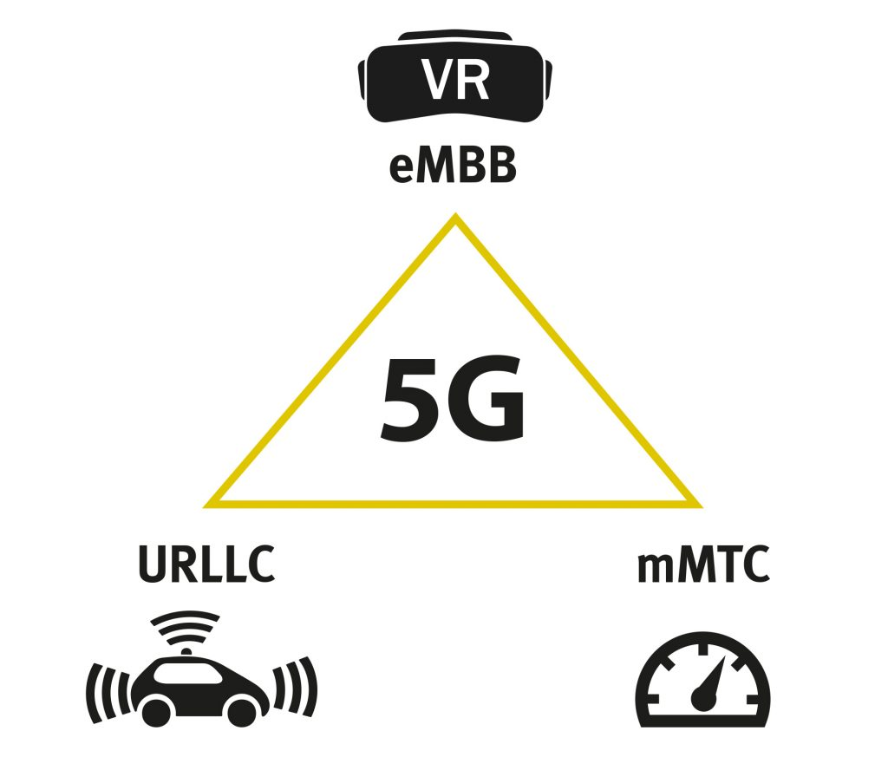
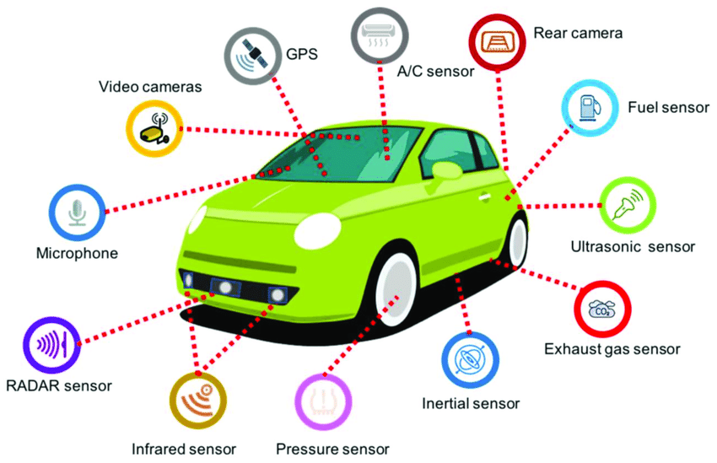
MOCHA – Background
The applications, resources and architectures of real-time embedded systems are becoming ever more complex to understand, control and maintain.
Traditional (static) methods are difficult to apply in heterogeneous MPSoC as:
Increased complexity in software design.
Difficulties in modelling, scheduling and analyzing the system.
Systems are hard to optimise
To understand how the software executes on the platform.
To design the MPSoC and then schedule / allocate the software.
This has led the research into:
building high-level models of systems.
developing dynamic policies based on statistical models.
MPSoC

Slide 4
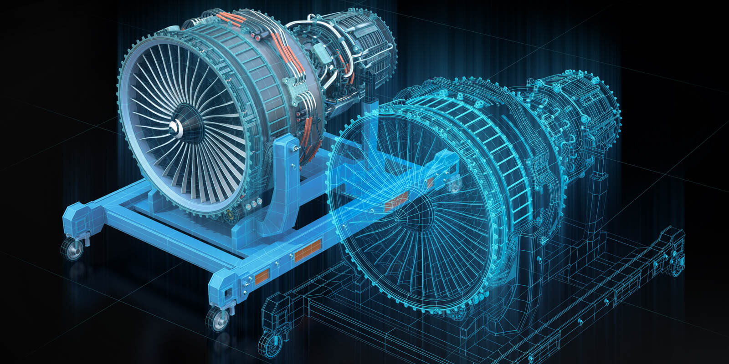
System Modelling - a digital-twinning approach
Realistic and configurable simulation.
Supports varies of hardware/scheduler configurations.
Supports large-scale evaluation and design space exploration.
Profiling and data analysis for real systems.
Allows the digital twin to be validated and refined.
Delivers appropriate understanding of the systems so large-scale evaluations are representative
I. Digital Twin
II. Modelling
MOCHA
III. Scheduling and Allocation Research
Reduced number of cache misses on the platform
Reduced and more predictable latencies
Improved system throughput
(*) Picture from: https://job-wizards.com/en/digital-twins-doubling-the-potential-for-innovation/

Slide 5
MOCHA – Research vision
Our vision is to develop a set of statistical models and adaptive methods that can be applied to all layers (from application to platform) of a MPSoC system.
Application - A high-validity digital twin for the timing aspects of a complex MPSoC systems built upon
Systematically profile the real system based on the significant factors.
Establish valid statistical models of the system.
A high-speed and configurable simulator for generic heterogeneous architectures.
Application
Resource Management
Platform

Slide 6
MOCHA – Research vision
Our vision is to develop a set of statistical models and adaptive methods that can be applied to all layers (from application to platform) of a MPSoC system.
Resource management - Better control of systems execution and improved performance
Feedback-based task scheduling and allocation methods.
Configurable system policies, including the management of hardware resources, e.g., cache locking and scratch bad allocation.
Controlling back pressure of work coming into the main processors.
Platform – Later use the models for design space exploration of the platform itself
Application
Resource Management
Platform

Slide 7
MOCHA – Challenges
Building realistic execution models with partial/limited information.
The scale of the studied system can be very large (millions lines of codes) with numerous execution scenarios.
Some information of the system from industrial partners is strictly confidential due to protection of intellectual properties and thus cannot be fully accessed.
Refining the predicted models and the techniques to reflect all execution scenarios.
The predicted models are constructed based on limited information and cannot reflect the general case without further refinement.
Producing error tolerant systems that can deal with inevitable differences between the models and the real systems
The predicted models may still behave differently from the actual system in corner cases and special situations.

Slide 8
MOCHA – Challenges
Building realistic execution models with limited information.
Choosing an appropriate abstraction level.
Identifying the most influential factors from the observations.
Refining the predicted models and the techniques to reflect all execution scenarios.
Identifying the key differences in the influential factors under different execution scenarios.
Producing error tolerant systems that can deal with inevitable differences between the model and the real system
Understanding the trends in behaviour.
Identifying problematic/anomaly cases that might occur.
Determining the mitigation strategies to avoid faulty cases.

Slide 9
System Modelling - a digital-twinning approach
Simulate and model actual application using profiling tools, and then create the digital twin.
Ensure the digital twin is valid with changing input workloads.
(Worst-Case) Execution Time models.
Cache (and memory) models.
Extend the digital twin to support multi-core scheduling with shared cache and memory.
Upgraded models with inter-thread/core effects.
Validate the digital twin against a real target.
Reproduce the scheduling and timing behavior.
Profiling Tools
Application
& Inputs
(WC)ET Model
Executable models
Simulating
(Worst-case) Execution times
/ Graph models
Simulation Core
Cache Model
Cache effects on ET
Modeling
Refine
Profiling Tools
Validate
Digital Twin

Slide 10
Open Research Questions
Scheduling and allocation of software task to caches / scratchpads and cores again well established.
Design space exploration as part of MPSoC design are also well understood
Robustness – How to assess the effect of inaccuracies and uncertain operational contexts on the models?
Sensitivities – How to understand the sensitivities so the design can be made robust and the impact of errors understood?
Predictability – How to assess the predictability of systems?
Scalability – How to perform design space exploration for large numbers of configurations and scenarios?

Slide 11
Open Research Questions
Digital Twins (DT) is a well-established practice but what are the challenges around timing.
Acceptability – What information can we realistically be expected to extract from a real system?
Accuracy - What does it mean for a simulator to be accurate?
This very much depends on the questions to be answered with DT.
Efficiency – What is the right level of abstraction for the model and the right type of feedback?
Success – Is a successful solution one where the model has similar accuracy with less data (types and quantity) at a higher level of abstraction?
Note
Some colleagues would not define the presented work as a DT as the changes to resource management are offline.
Do we have a shared definition of what a DT is?

Slide 12
Thank you for your attention!
The MOCHA Research Group

Slide 13







MOCHA – from application to platform level
At the application level, we focus on systems in which the activities form a single re-current DAG (direct acyclic graph) task.
We proposed a model to describe the dependency and parallelism of nodes.
Based on the model, new scheduling method and schedulability analysis are developed.
This work has been published in RTSS 2020 [1].
With lower levels considered, we study the effects from memory, cache and bus which are shared by multiple processors.
Construct digital twin and statistical models for cache behaviors and cache-related characteristics of the system (on-going).
Consider OS-related overheads and bus contention.
Based on the digital twin, we aim to develop novel feedback-based cache-aware scheduling and allocation methods.
2
$3$
$1$
$4$
$8$
$5$
$7$
$6$
Example of a DAG task
Application
Resource Management
Platform
[1] Zhao, Shuai, Xiaotian Dai, Iain Bate, Alan Burns, and Wanli Chang. "DAG Scheduling and Analysis on Multiprocessor Systems: Exploitation of Parallelism and Dependency." In IEEE Real-Time Systems Symposium. 2020.

Slide 14
System Modelling - a digital-twining approach
Simulate and model actual application using profiling tools, and then create the digital twin.
Ensure the digital twin is valid with changing input workloads.
(Worst-Case) Execution Time models.
Cache (and memory) models.
Extend the digital twin to support multi-core scheduling with shared cache and memory.
Upgraded models with inter-thread/core effects.
Validate the digital twin against a real target.
Reproduce the scheduling and timing behavior.
Profiling Tools
Application
& Inputs
(WC)ET Model
Executable models
Simulating
(Worst-case) Execution times
/ Graph models
Simulation Core
Cache Model
Cache effects on ET
Modeling
Refine
Profiling Tools
Validate
Digital Twin

Slide 15
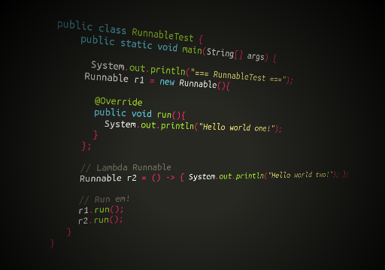
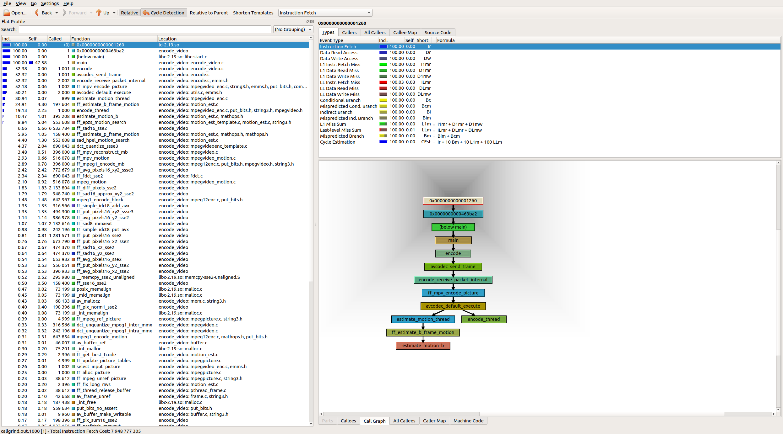
System profiling and cache modelling
System profiling (e.g., Valgrind) is a dynamic analysis that measures the performance of a system
Space (memory) and time complexity.
The frequency and duration of function calls.
Context switches and cache misses.
System profiling allows us to:
Understand the execution flow of complex systems.
Identify key influential factors that are cache-related.
Research question - choose the appropriate abstraction level of the system.
application
Profiling results
assembly; code line; function; thread; whole application.
lower abstraction level ≈ higher (profiling and simulation) time & higher accuracy.

Slide 16
System profiling and cache modelling
Abstract the application into a set of logical execution blocks.
Executable blocks can be constructed at a manageable abstraction level, e.g., by functions.
Each execution block contains a set of code that will be executed in a certain manner.
Execute the application with profiling tools (Valgrind) and obtain cache-related factors.
Each executable block is associated with a set of cache-related and execution-related parameters that are observed from the profiling results.
Block 1
# of invocations
# of instruction access
# of data read
# of data write
Frequency of access
Current cache state
...
Path control
# of executions
Execution path
Block 2
Cache-related parameters
Abstraction
Profiling
(Valgrind)
Block 3
Block 4
Block 4
application
Execution-related parameters
Block 5

Slide 17
System profiling and cache modelling
Data-driven parametrized and automated cache model with observable factors.
Based on measurements and statistical analysis.
Produce results fast without the need for low-level simulation or real execution.
Can be applied on-line for dynamic schedule, e.g., feedback-based scheduler.
Based on profiling results, for each execution block:
Construct an intra-cache model.
Produce cache miss estimations for executing the block sequentially.
Reflects the cache misses without any inter-core interference.
Construct an inter-cache model for this and each of the parallel blocks.
Produce cache misses for inter-core interference (migrations and preemptions).
Considers effects for cache that is shared among processors.

Slide 18
System profiling and cache modelling
Constructing intra-cache models for each execution block
Each execution block has a set of intra-cache models, one for each cache miss event.
With statistical analysis, cache models are constructed with the cache- and execution-related parameters obtained during profiling.
Global inputs
Block parameters
Cache configuration
(e.g., cache size)
Input workload
(workload size, types)
Cache-related parameters
(e.g., # of accesses)
Execution-related parameters
Block 1
Block 2
L1 I-cache
L1 D-cache read
L1 D-cache write
Inputs
Block 3
Cache Model
(Linear regression, graphical models, neural networks)
LL I-cache
LL D-cache read
LL D-cache
write
Block 4
Intra cache models for an execution block
Block 5
Outputs
#(Cache miss)

Slide 19
System profiling and cache modelling
Constructing inter-cache models (future)
Based on previous study^{[1]}, learning-based methods have promising results in estimating inter-task interference.
This technique can be applied for constructing the inter cache models, which accounts for cache effects due to preemptions and migrations.
For any two blocks:
Collect data against the parallel block sequence (i.e., competitor threads).
Identify influential factors that cause variations in the execution of the analyzed block.
Feed the key factors to FLB model to train inter cache models.
(Valgrind)
(PCA)
(Neural Network)
(Observations)
Data collection
Data selection
Modelling
Validation
Workflow
Execution Times
FLB analysis
Run-time
Specification
(Valgrind)
(PCA)
Observations
(e.g., No. inst)
Intra-cache
Models
Inflation Factor
(Valgrind)
(Neural Network)
WCET in isolation
WCET with
cache cost
(Valgrind)
Forecast learning-based (FLB) model
[1] Griffin, David, Benjamin Lesage, Iain Bate, Frank Soboczenski, and Robert I. Davis. "Forecast-based interference: Modelling multicore interference from observable factors." RTNS, pp. 198-207. 2017.

Slide 20
Future Research Plans
Build the analytic cache model to incorporate intra- and inter-interferences.
Modelling cache states that is independent to the cache configuration --- for example by normalization.
Trade-offs between modelling accuracy and modelling efficiency.
Compare the results with these from the actual system and refine the task model.

Slide 21
Future Research Plans
Based on the digital twin and the model:
Support design space exploration: cache configuration, cache size, cache replacement policy, etc.
Task scheduling and allocation that minimize cache misses and bus contention, with hard real-time deadline constraints and in a mixed-criticality context.

