Slide 1

Towards Emergent Scheduling for Distributed Execution Frameworks
Paul Allan Dean
Supervisor: Dr Barry Porter
Lancaster University, UK
p.dean1@lancaster.ac.uk

Slide 2
Introduction
As data collection, storage, and processing capabilities have increased, it is now common to process many gigabytes of data – for analysis, information extraction, or machine learning. ​
Distributed execution frameworks (DEFs) like Spark provide users with a framework for submitting, scheduling, and executing large complex workloads across hundreds of machines.​
Workloads consist of multiple jobs​
A job is a set of one or more computational tasks.​
​
The main cost of DEFs is the scheduling of workloads, with a reduction in this cost offering:​
Lower completion time​
Efficient resource usage ​
Reduced energy consumption

Slide 3
Previous Approaches
General purpose DEFs
Apache Spark
In-memory Data intensive workloads
Flink
Prioritises latency sensitive workloads
Hadoop
Long running batch processes
Single fixed architecture using a single policy
Same scheduling for all workloads

Slide 4
Previous Approaches
General purpose DEFs
Workload specific DEFs
Apache Spark
In-memory Data intensive workloads
Flink
Prioritises latency sensitive workloads
Hadoop
Long running batch processes
Ray
Prioritises reinforcement learning workloads
Storm
Low-latency/real-time task computation
Horovod
Machine learning (Deep Learning) workloads
Single fixed architecture using a single policy
Same scheduling for all workloads
Increased performance for a specific workload
Unintended workloads suffer a larger performance hit

Slide 5
Previous Approaches
General purpose DEFs
Workload specific DEFs
Hybrid DEFs
Apache Spark
In-memory Data intensive workloads
Flink
Prioritises latency sensitive workloads
Hadoop
Long running batch processes
Ray
Prioritises reinforcement learning workloads
Storm
Low-latency/real-time task computation
Horovod
Machine learning (Deep Learning) workloads
Hawk
Provides two approaches to scheduling at the cost of overall performance
Mercury
Expands Apache spark providing hybrid scheduling while maintaining fairness
Single fixed architecture using a single policy
Same scheduling for all workloads
Increased performance for a specific workload
Unintended workloads suffer a larger performance hit
Capable of scheduling a larger workload set
Limited by the overhead of selecting the correct approach

Slide 6
Previous Approaches
General purpose DEFs
Workload specific DEFs
Hybrid DEFs
Adaptive/Learning DEFs
Apache Spark
In-memory Data intensive workloads
Flink
Prioritises latency sensitive workloads
Hadoop
Long running batch processes
Ray
Prioritises reinforcement learning workloads
Storm
Low-latency/real-time task computation
Horovod
Machine learning (Deep Learning) workloads
Hawk
Provides two approaches to scheduling at the cost of overall performance
Mercury
Expands Apache spark providing hybrid scheduling while maintaining fairness
MR Adapt
Policy adaptation using user provided completion times
FlexTree
Model-based adaptation for workloads
Decima
Learns a scheduling policy for a specific workload type
Single fixed architecture using a single policy
Same scheduling for all workloads
Increased performance for a specific workload
Unintended workloads suffer a larger performance hit
Capable of scheduling a larger workload set
Limited by the overhead of selecting the correct approach
Require user intervention for correct adaptation
Learning based approaches are efficient while limited to a specific workload type

Slide 7
Self-Adaptive Approach
Create a DEF which is capable of adapting the scheduling policy at runtime to reduce the scheduling overhead for a current workload of a larger set.
Using the Dana programming language to create components containing DEF logic
Components are assembled into a composition creating a complex system (node within DEF)
Self-adaptation of a scheduling policy for a given workload is challenging:
Adaptation requires an identifiable point to change during workloads
A machine learning agent to learn the near optimal composition for a given workload

Slide 8

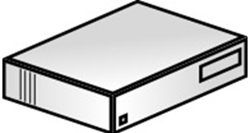
System Architecture
User submitted workload is passed to the Resource Manager starting the deployment of Application Masters
Resource Manager
Application Master Service
Scheduling Components
Node Manager
Node Manager
Node Manager

Slide 9
System Architecture
Application Master begins on a corresponding Node Manager and request Executors
Resource Manager
Application Master Service
Scheduling Components
Node Manager
Node Manager
Node Manager
Application Master

Slide 10
System Architecture
Executors are scheduled, deployed and begin completing computational tasks passed from the Application Master
Resource Manager
Application Master Service
Scheduling Components
Node Manager
Node Manager
Node Manager
Application Master
Executor
Executor

Slide 11
System Architecture
Previous process is repeated for the remaining submitted jobs within the schedulers queue
Resource Manager
Application Master Service
Scheduling Components
Node Manager
Node Manager
Node Manager
Application Master
Executor
Executor
Executor
Application Master
Executor

Slide 12
Emergent scheduler – example
App<Interface>
Main method: opens server sockets, accepts client requests and begins job submission
Resource Manager
Takes executor requests from registered Application Masters
AppMstrService<Interface>
AppSubmission<Interface>
Takes user submitted applications and parses all required information
Application Master Service
Application Submission handler
Scheduling<Interface>
Takes requests from application submission handler and Application Master Service, scheduling and deploying Application masters and Executors
FIFO
Naïve Fair - Thread
Naïve Fair - Memory
Dominant Resource Fairness
Begin setup of deployed component via a Node Manager

Slide 13
Emergent scheduler – example (continued)
Workload A
App<Interface>
Submission of 15 fine grained jobs
Resource Manager
AppMstrService<Interface>
AppSubmission<Interface>
Application Master Service
Application Submission handler
Scheduling<Interface>
FIFO
Naïve Fair - Thread
Naïve Fair - Memory
Dominant Resource Fairness
Begin setup of deployed component via a Node Manager

Slide 14
Emergent scheduler – example (continued)
Workload B
App<Interface>
Submission of 15 coarse grained jobs
Resource Manager
AppMstrService<Interface>
AppSubmission<Interface>
Application Master Service
Application Submission handler
Scheduling<Interface>
FIFO
Naïve Fair - Thread
Naïve Fair - Memory
Dominant Resource Fairness
Begin setup of deployed component via a Node Manager

Slide 15
Methodology
The experiments consisted of 15 synthetic workloads of varying granularity:
Coarse
Fine
Mixed
Using 4 scheduling policies:
FIFO
Dominant resource fairness
Naïve fair (Thread)
Naive fair (Memory)
The workloads were run on a cluster comprised of 5 machines:
3.6GHz 8 cores
16GB memory

Slide 16
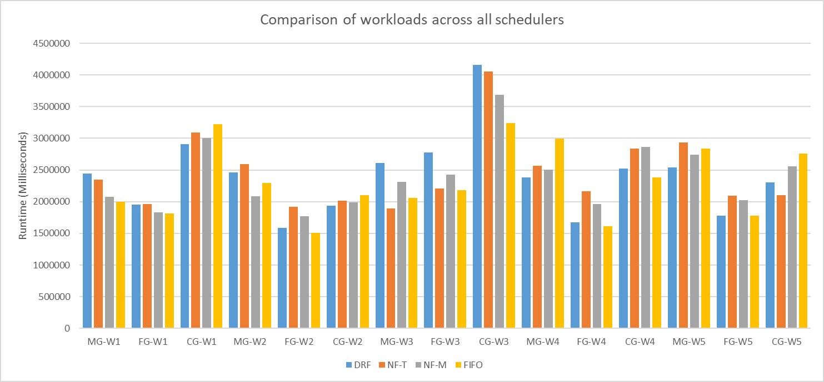
Results: Comparison for all workloads

Slide 17
Results: Comparison for all workloads

Slide 18
Results: Comparison for all workloads

Slide 19
Results: Comparison for all workloads

Slide 20
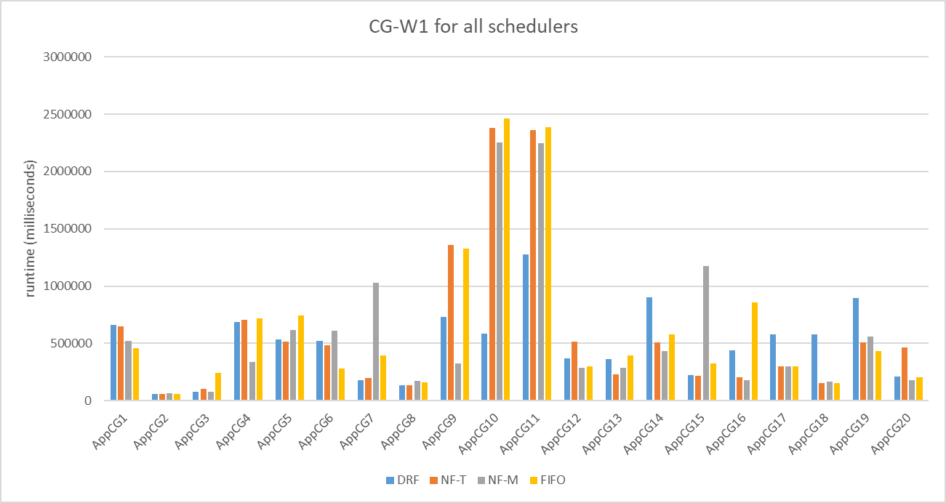
Results for workload CG-W1

Slide 21
Results for workload CG-W1

Slide 22
Results for workload CG-W1

Slide 23
Results for workload CG-W1

Slide 24
Future Work
The previously shown results identify points within the batched and individual workload traces where a performance gain may be obtained through adaptation.
Experiment and compare public benchmarks/workloads of the same type
Explore the efficiency of machine learning agents for adaptation
Compare a self-adaptive scheduling approach
Paul Allan Dean p.dean1@Lancaster.ac.uk

