Slide 1
Debugging Unikernel Operating Systems
Kareem Ahmad, Alan Dearle, Jon Lewis, Ward Jaradat
School of Computer Science
University of St Andrews
Email: kareemahmad@protonmail.com

Slide 2
Abstract
Unikernels are an executable that runs directly on the hyper-visor with the executable containing both the Operating Systems (OS) functions and the applications code.
Unikernels are challenging to debug as there are not many production ready debuggers for unikernels. In this talk we report on a undergraduate led project to develop debugger for unikernels running on Xen. Specifically we focused on debugging support for the Stardust unikernel. However the work is applicable to any unikernel written in C or C++.
Unikernels are difficult to debug for a number of reasons. Firstly, the kernel and the application are both compiled statically into a single image and therefore debugging support needs to be embedded in the kernel. However this is clearly problematic as an independent debugging context is needed in order to provide isolation and the ability to stop and start the Operating System. Secondly, Unikernels may not be designed for compatibility with conventional debugging tools like GDB, and may not provide drivers that make use of the debugging facilities provided by the underlying hypervisor. Furthermore, tools like gdb also rely on unix process structures and system calls such as fork.
The debugger is based on previous work done by Spencer Micheals at the NCC Group. Both debuggers run in Dom0, this is where we handle allocation and destruction of Virtual Machines (VM), and use Xen’s Virtual Machine Introspection (VMI) interface to Stardust. However this interface is not sufficient for a complete debugger and the current project employs additional libraries to extract high level program information such as the mappings of code, and variables to line numbers, and addresses respectively as well as data structure representations etc.
During this project, we have experimented with two approaches to the construction of a debugger; one in C++ and one in Go. We highlight the differences in these approaches.
We hope this work will both support the development of Stardust, and will be of help to the community developing unikernel operating systems.

Slide 3
Overview
In this talk we report on an undergraduate led project to develop debugger for unikernels running on Xen.
Unikernels are challenging to debug as there are not many production ready debuggers for unikernels.
Specifically, we focused on debugging support for the Stardust unikernel.
This work is applicable to any unikernel written in C and hosted on Xen.

Slide 4
What Is A Unikernel?
Specialised Operating System that runs directly above the Hypervisor (such as Xen)
Single image that contains the OS, an application plus any required libraries
Small image size (400KB including application)
Fast to boot
Fast to deploy
Fast to provision

Slide 5
What is Xen?
Dom0
DomU
DomU
Xen
Hardware

Slide 6
The Problem
Unikernels are difficult to debug:
The kernel and the application are compiled into a single image requiring embedded support.
An independent debugging context is needed in order to provide isolation and the ability to stop and start the Operating System.
Unikernels may not be designed for compatibility with conventional debugging tools like gdb
Gdb commonly makes use of Unix process structures, ptrace, and library calls
Notes:
* Standard debugs tools do no work with sort of system as they rely on their being multiple processes and a host of unix/OS provided libraries for manipulating them. None of which are present.
*

Slide 7
Approach
The approach taken was based on xendbg developed at Nccgroup by Michael Spencer
Algorithms and techniques used by Duster and xendbg are very similar.
Duster focused on allowing the developer to use source-level constructs during debugging
Uses Xen's Virtual Machine Introspection API for interacting with the Unikernel
Written in C and Go
Uses standard DWARF file format to get symbolic information (e.g. variables)

Slide 8
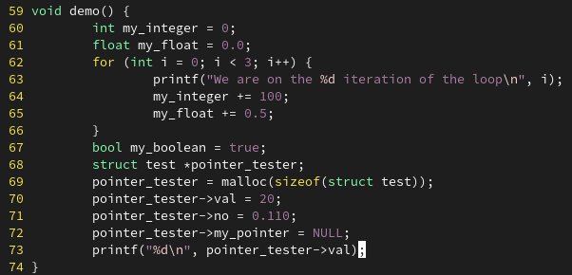
Demo Code (kernel.c)

Slide 9
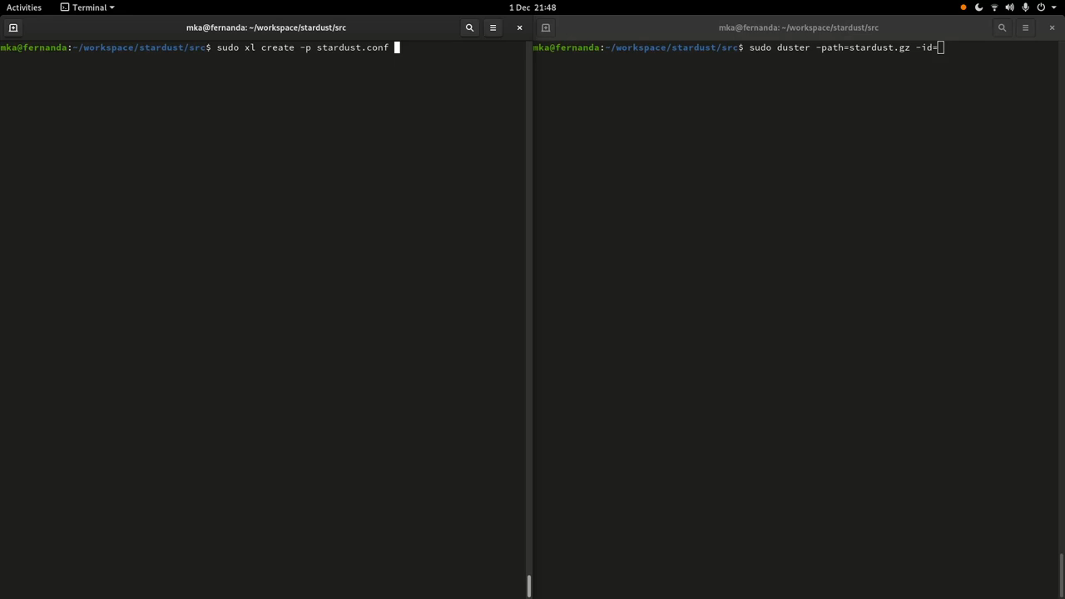

Slide 10
Explanation
Control
Duster
(Dom0)
We assume for the explanation
that kernel.c:60 is 0x80 and
Stardust starts running at
0x0 (which of course it doesn’t)
Stardust
State: Paused
Xen
Hardware

Slide 11
Explanation
Control
Duster
(Dom0)
Stardust
State: Paused
Put domain into debug mode
Xen
Hardware

Slide 12
Explanation
Control
Duster
(Dom0)
Stardust
State: Paused
Set breakpoint:
Write int3
to 0x80
Using VMI API
Program Counter: 0x0
Xen
Hardware

Slide 13
Explanation
Control
Duster
(Dom0)
Stardust
State: Paused
Unpause domain
Program Counter: 0x0
Xen
Hardware

Slide 14
Explanation
Control
Duster
(Dom0)
Duster is busy waiting for
Stardust to go into paused
mode
Stardust
State: Running
Program Counter: 0x0
Xen
Hardware

Slide 15
Explanation
Control
Duster
(Dom0)
Stardust in debug mode.
In debug mode interrupts
cause domain to be paused
Hit int3 instruction
Pause domain
Stardust
State: Running
Program Counter: 0x80
Xen
Hardware

Slide 16
Explanation
Control
Duster
(Dom0)
Stardust
State: Paused
Program Counter: 0x80
Xen
Hardware

Slide 17
How Does Duster Step Through Code?
Translates the line and source file to address via DWARF
Put the domain into debug mode
Write INT3 to where we want to break
Rolls back and restores memory on reach breakpoint
To step single puts breaks on each instructions and checks whether new line

Slide 18
Demo Code

Slide 19
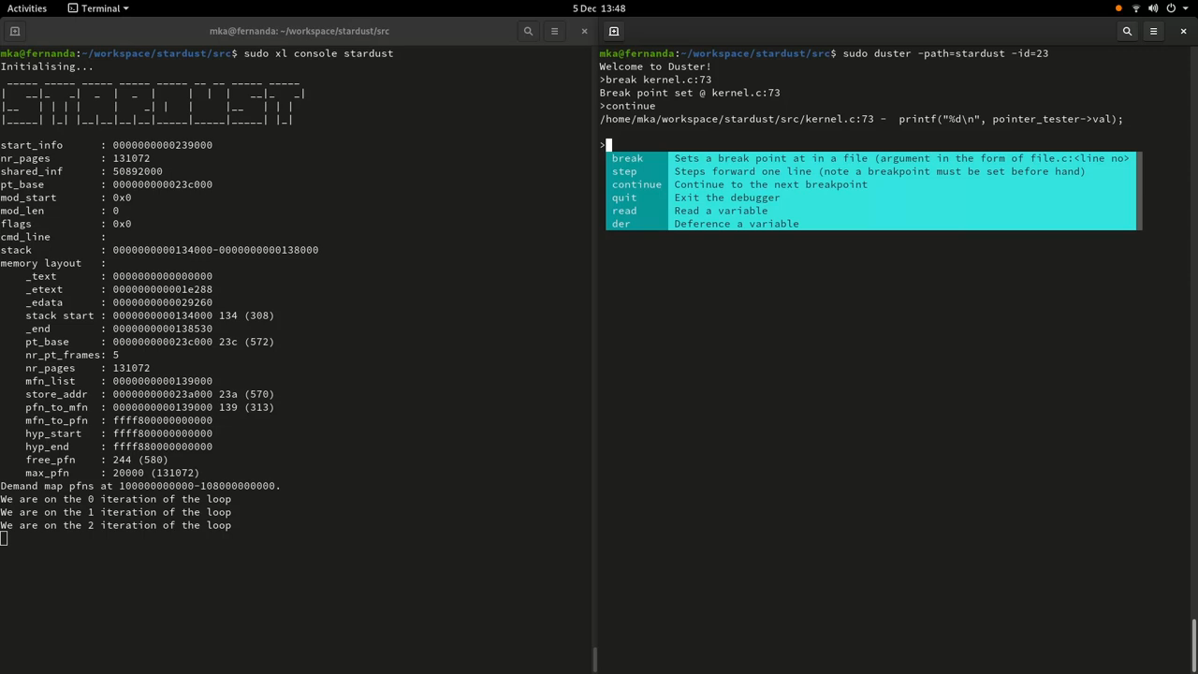
Reading Variables From Memory

Slide 20
How Does Duster Read Variables?
Builds a symbol table from the symbol data stored in the DWARF
Maps over page of memory containing the address found in table via VMI
Calculates the location of the data in the page with the formula address % page_size
Uses DWARF information to convert raw bytes into human readable format

Slide 21
Conclusions
We have extended the Xendbg code to support the debugging of high level (C) programming language code x86-64 Para-virtualised unikernels
Without this (we at least) had no debug support
Does not support some GDB operations including writing to memory, stack frame analysis
But can:
Set and remove breakpoints on the source level
Step through code line at a time
Read memory using symbolic names
Pretty print memory based on C types

Slide 22
Links
Xendbg: https://github.com/SpencerMichaels/xendbg
Duster: https://github.com/StardustOS/duster
Stardust: https://github.com/StardustOS
Stardust (docs): https://stardustos.gitbook.io/docs/
Slides: https://tinyurl.com/yxq9w6tz

