Slide 1


DA120B_Student_Performance_Prediction
Data Analytics Course Project

Slide 2



Problem Analysis
Universities struggle to identify students at risk of poor academic performance early.
Key factors: attendance, study time, previous grades, internet access, family support, and extracurricular activities.
Early prediction enables timely intervention and improves student success rates.

Slide 3

Why Early Prediction Matters
"Identifying at-risk students early supports timely intervention and better academic outcomes."
Up to 30% of students face academic difficulties without early identification.

Slide 4

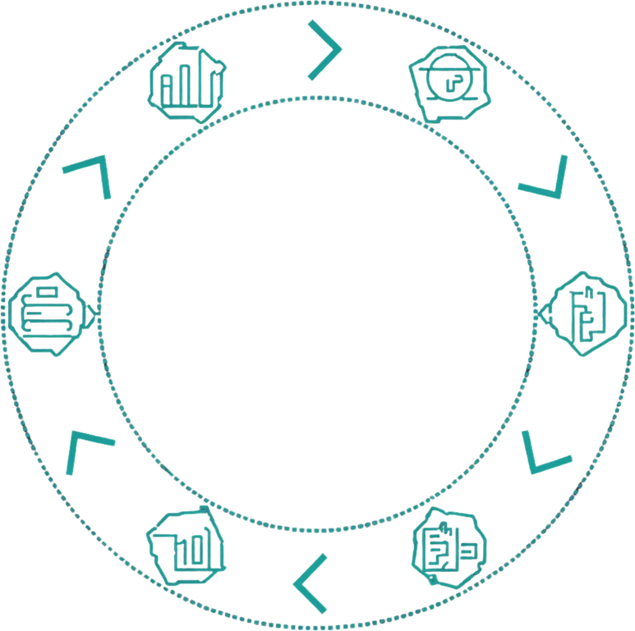
System Design & Workflow
Data Collection
Data Cleaning
Exploratory Data Analysis
Feature Selection
Model Development → Evaluation → Dashboard Generation

Slide 5

Project Plan (8-Week Timeline)
01
Week 1–2: Foundation
03
Week 5–6: Model Development
Week 1: Problem Definition & Literature Review — Define objectives and review related academic work. Week 2: Dataset Collection — Obtain and verify the Kaggle Student Performance dataset.
Week 5: Model Development — Build predictive machine learning models using Scikit-learn. Week 6: Model Testing & Evaluation — Assess accuracy, tune hyperparameters, and optimize models.
02
Week 3–4: Data Processing
04
Week 7–8: Reporting & Submission
Week 3: Data Cleaning & Preparation — Preprocess data and handle missing values. Week 4: Exploratory Data Analysis — Generate statistical and visual insights from the dataset.
Week 7: Report Writing & Dashboard Prep — Document findings and create visualization dashboards. Week 8: Final Presentation & Submission — Deliver the final presentation and submit all project deliverables.

Slide 6
Tools & Technologies Used
Python
Pandas & NumPy
Main programming language for the entire project. Used for data preprocessing, exploratory analysis, model development, and generating visualizations throughout the pipeline.
Pandas handles data manipulation, cleaning, and preprocessing of the student dataset. NumPy supports numerical operations and array computations required for feature engineering.
Jupyter Notebook
Scikit-learn
Interactive coding environment for step-by-step analysis and visualization. Enables clear documentation of code, outputs, and insights in a single shareable notebook format.
Core machine learning library used to build, train, and evaluate predictive models. Provides algorithms such as Decision Tree, Random Forest, and Logistic Regression for performance prediction.

Slide 7


Dataset Description
Source: Student Performance Dataset (Kaggle)
Format: CSV — demographic, academic & behavioral data
Features: age, gender, attendance, study time, parental education, internet access, final grades
Purpose: Train and test ML models to predict student academic outcomes

Slide 8

Team Responsibilities
Team Lead & Data Analyst
ML Developer
Documentation Specialist
Team Lead: Project coordination, GitHub repository management, team meeting updates, and task delegation.
Data Analyst: Data cleaning, preprocessing, handling missing values, and exploratory data analysis (EDA).
Responsible for building and training predictive machine learning models using Scikit-learn.
Tasks include model selection, hyperparameter tuning, performance evaluation, and accuracy optimization.
Handles all project documentation including report writing, creating visualization dashboards, and preparing the final presentation.
Ensures deliverables meet academic standards and submission requirements.

Slide 9
GitHub Repository Structure
/Documentation & /Reports
/Data
/Source & /Logs
Raw and cleaned datasets sourced from Kaggle.
• student_raw.csv
• student_cleaned.csv
• data_dictionary.txt
Stores all original and preprocessed data files used for analysis and model training.
Code notebooks, scripts, and progress logs.
• data_cleaning.ipynb
• eda_analysis.ipynb
• model_training.ipynb
• week1_log.md
• week2_log.md
All Python notebooks, scripts, and weekly progress logs are maintained here.
Project docs, references, analysis reports, and visuals.
• project_proposal.pdf
• references.bib
• eda_report.pdf
• model_evaluation.pdf
• dashboard_visuals/
All written documentation and generated visual reports are stored here.

Slide 10

Project Log & Progress
Topic selected and team discussion completed
GitHub repo created with folder structure
Initial planning finished
Next: dataset collection, data cleaning & task assignment

Slide 11
Thank You
Questions & Discussion Welcome

