Slide 1

Rohit Agrawal, Yashvardhan Nanavati, Wenjun Shen, Tianqi Xu, Anirvan Maiti, Aswin Vasudewan
‹#›

Slide 2
Team Formation
Environment Setup
Design Proposal
Initial Skeleton
ETL Workflows
Presentation Week
Project Idea Brainstorming
Project Proposal
Pivotal Tracker Setup
Development Environment Setup [JDK 8, Eclipse, GIT etc.]
GitHub Setup
Initial Architecture Design Proposal
Deep Dive in Design Patterns to use
Initial JAVA + Spring + Maven Application Skeleton Setup
Initial GitHub Commit
Ukubuka Schema Design
Extract, Transform, Load Workflows
SpEL Workflows
Project Progress Review
Test Harness
Final Presentation
10%
30%
50%
75%
95%
100%
Week 1
Week 2
Week 3
Week 4
Week 5
Week 6
01
02
03
04
05
06

Slide 3
OVERVIEW
Ukubuka Schema
What is ETL?
ETL is a process in data warehousing responsible for pulling data out of the source systems and placing it into a data warehouse. ETL involves the following tasks:
#1
Extract
Extracting the data from multiple source systems. Data from different source systems is converted into one consolidated data warehouse format which is ready for transformation processing.
#2
Transform
Transforming the datasets by a series of operations involving Cleaning, Filtering, Splitting, Joining, Applying Business Rules etc.
#3
Load
Loading the data into a data warehouse or data repository after performing the final set of post-transform operations.
‹#›
Notes:
The next big question is why do we need creative heatmaps.
Visualizing heatmaps can benefit us in following three ways.
We can do clicks analysis to determine the hot areas which are visually appealing to users.
We can priortize future experiments based on the information revealed by them.
We can also launch an advertiser facing version for the advertisers to visualize customers engagement.

Slide 4
OVERVIEW
Ukubuka Schema
#1
Extract Tag(s)
Ordered List of EXTRACT Tag which consists of Unique Identification Tag (UID), Source File Type, Source File Location & Flags
#2
Transform Tag(s)
Ordered List of TRANSFORM Tag which consists of Unique Identification Tag (UID) & Ordered List of Operations
#3
Load Tag(s)
Ordered List of LOAD Tag which consists of Unique Identification Tag (UID), Source File Type, Source File Location & Ordered List of Operations
#4
Visualize Tag(s)
Ordered List of VISUALIZE Tag structure of which is TBD
‹#›

Slide 5
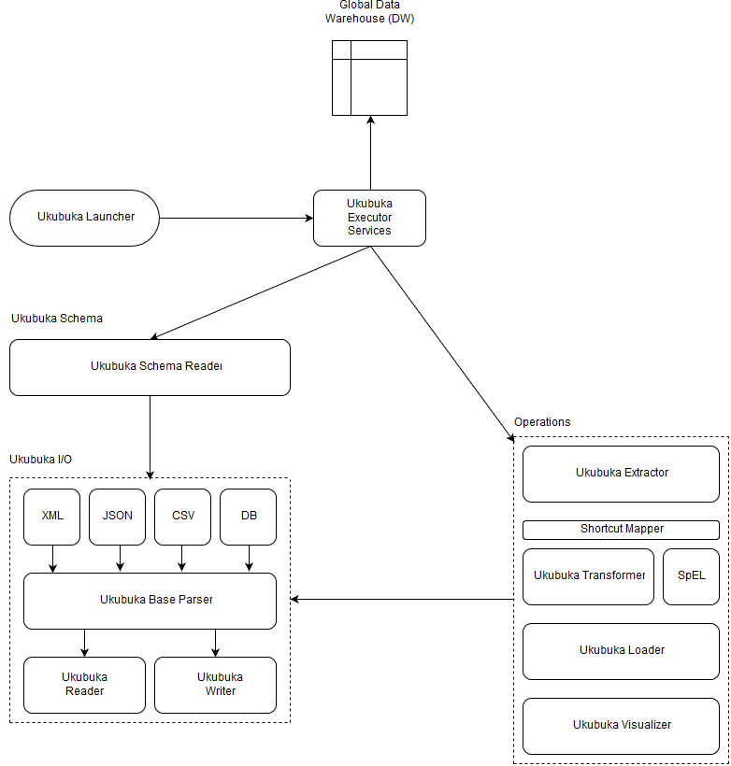
DESIGN
Ukubuka Design Architecture
‹#›

Slide 6
DESIGN
JSON Parsing Design
[{ “firstname”: “Matt”,
“lastname”: “Damon”,
“gender”: “Male”
“City”: “Boston”,
“Age”: 47},
…]
Java array list:
[“Matt”, “Damon”, “Male”, “Boston”, 47]
Extract only the info we need:
[“Male”, “Boston”, 47 ]
Then visualization…
The flow chart above represents the conversion form JSON to Java internal representation by using the jackson.databind.ObjectMapper library.
Jackson parses the JSON file to an Object class according to the item number in JSON file and then calls the getString() method in that object class to extract the information to an ArrayList which can be manipulated by the user later for the visualization.
‹#›

Slide 7
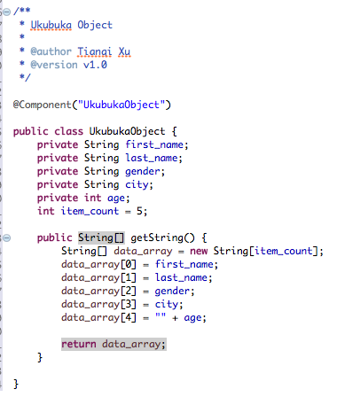
DESIGN
JSON Parsing Design
Object class that is used to temporarily store the JSON value; by calling getString() in that object class. We later put the extracted data into JAVA internal representation.
ObjectMapper mapper = new ObjectMapper();
UkubukaObject object = new UkubukaObject();
UkubukaObject object = mapper.readValue(new File("c:\\file.json"), UkubukaObject.class);
new String[5] jsonvalue = object.getString();
‹#›

Slide 8
Pipelines
Extract, Transform & Load
‹#›

Slide 9
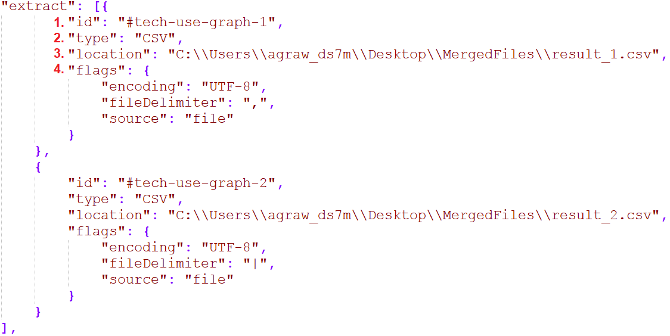
SECTION ONE
Extract
‹#›

Slide 10
SECTION ONE
Extract
Reading EXTRACT Operation(s) Schema
30%
UkubukaSchemaReader reads the injected schema file and calls the UkubukaExtractor to perform the extract operations by honoring the list order.
99%
Saving Dataset
The extracted tagged dataset is then saved to the Global DW for further processing.
70%
Transform
Trigger
Parsing Data-Source
90%
UkubukaParser parses the given source file from URL or Disk to the Ukubuka’s internal representation.
Data-Source Tagging
UkubukaExecutorServices attaches a UID (Unique Identification) Tag to each extracted file which later helps in uniquely identifying the source for transform and load operations.
* Flags contains the valuable information regarding the file encoding, format etc.
‹#›

Slide 11
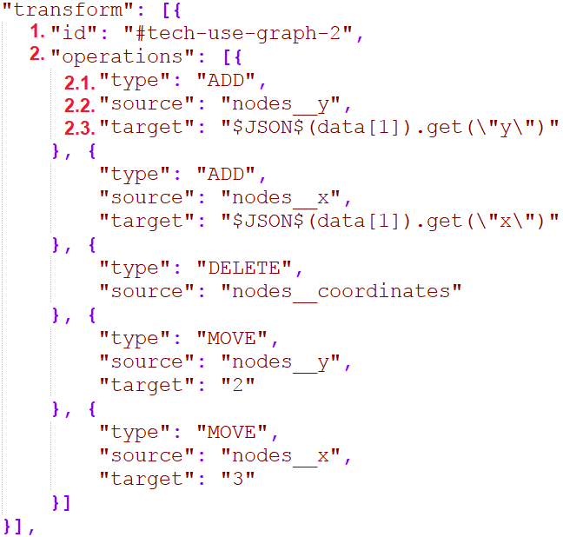
SECTION TWO
Transform
‹#›

Slide 12
SECTION TWO
Transform
Reading TRANSFORM Operation(s) Schema
Leveraging Spring Expression Language
UkubukaSchemaReader reads the injected schema file and calls the UkubukaExtractor to perform the transform operations by honoring the list order.
UkubukaExpressionEvaluator invokes the SpEL with the raw expression to evaluate the expression. It can virtually perform any operation which is available in JAVA.
15%
85%
Retrieving Dataset
20%
UkubukaTransformer retrieves the dataset from the Global DW by matching the UID provided in the transform tag.
99%
Dataset Update
60%
Operated dataset is saved back in the Global DW and is identified by the same UID for further processing.
Trigger
Shortcut Mapping
UkubukaExperssionEvaluator provides the functionality of hiding the raw method declarations behind the keywords which acts as the shortcuts
30%
Load
Performing Operations
* Shortcut Mappings are available from the shipped SMap file and can also be extended by passing a SMap file.
UkubukaTransformer loops in the list of operations to be performed and pipes to the operation executor for performing these operations
45%
Evaluating Expression(s)
Operations requiring the expression evaluations use UkubukaExpressionEvaluator to evaluate these expressions.
‹#›

Slide 13
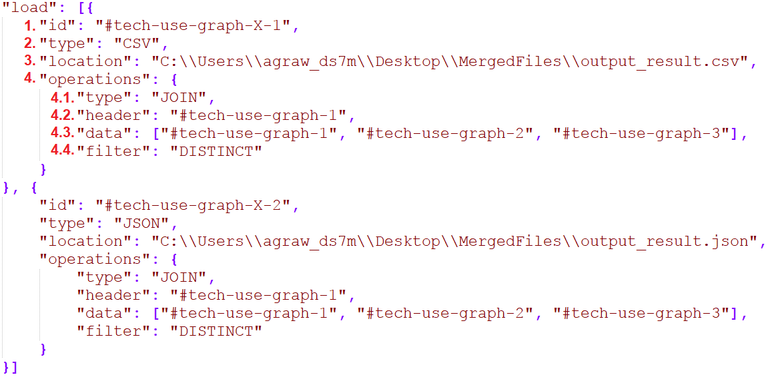
SECTION THREE
Load
‹#›

Slide 14
SECTION THREE
Load
Reading LOAD Operation(s) Schema
UkubukaSchemaReader reads the injected schema file and calls the UkubukaLoader to perform the load operations by honoring the list order.
15%
50%
Retrieving Dataset
99%
Tagging & Exporting
UkubukaLoader retrieves the dataset from the Global DW by matching the UID provided in the load tag.
The processed concatenated dataset can be exported in the given format by the UkubukaWriter and also saved in Global DW for further processing.
Trigger
70%
Visualize
Merging Datasets
90%
Uniquely identifiable datasets are knitted together by the UkubukaLoader on the selected header.
Performing Post-Load Operation(s)
UkubukaLoader performs any post-load operations like DISTINCT, ALL, etc. on the concatenated datasets.
‹#›

Slide 15
Testing
Test Harness Framework
‹#›

Slide 16
SECTION FOUR
Test Harness
A collection of test cases to test Ukubuka engine under various conditions automatically.
Implement a python script to generate testing data set.
Partition
Add or remove column
Column separated to semi column separated
Combine columns
Perform same transformations to file on Ukubuka engine, test case passes if the output file equals to the original file.
‹#›

Slide 17
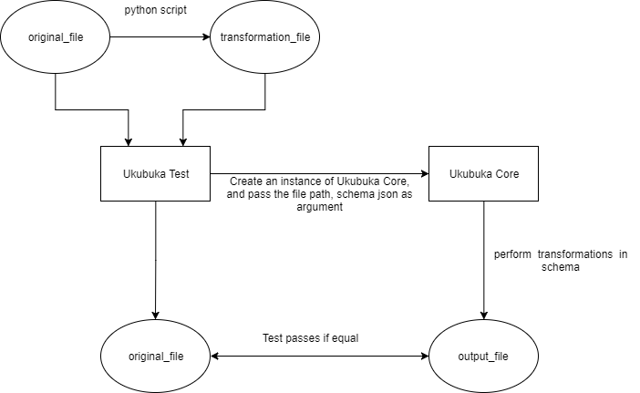
SECTION FOUR
Test Harness Design
‹#›

Slide 18

Demo Time
‹#›

Slide 19

Dataset
Software Technologies Penetration
It’s a graph dataset which shows the penetration of software technologies for a number of different projects.
Here, the data is organized in terms of different nodes where each node determines a particular technology like Java or Javascript etc. and has following attributes associated with it:
Node Color
Node Size
Node Position [(x,y) Coordinates]
Node Edges Information
‹#›

Slide 20
Dataset #1
Software Technologies Penetration
Delimiter: Comma (,)
Column Details:
nodes__label
nodes__y
nodes__x
nodes__id
nodes__color__red [RED Color Decimal Value]
nodes__color__green [GREEN Color Decimal Value]
nodes__color__blue [BLUE Color Decimal Value]
nodes__size
edges__sourceID
edges__targetID
edges__size
‹#›

Slide 21
Dataset #2
Software Technologies Penetration
Delimiter: Bar (|)
Column Details:
nodes__color
nodes__coordinates [JSON with x & y coordinates]
nodes__label
nodes__id
nodes__size
edges__sourceID
edges__targetID
edges__size
‹#›

Slide 22
Dataset #3
Software Technologies Penetration
Delimiter: Backslash (\)
Column Details:
nodes__color
nodes__label
nodes__y
nodes__x
nodes__size [Not Normalized : Need to divide these values by 100]
nodes__id
edges__sourceID
edges__targetID
edges__size
‹#›

Slide 23
Operations Performed
Software Technologies Penetration
Dataset #1 : Add new column with RGB To HEX conversion
Dataset #1 : Delete RGB columns
Dataset #1 : Move newly added column to index 0
Dataset #2 : Add new column with parsed x & y coordinates
Dataset #2 : Delete nodes_coordinates columns
Dataset #2 : Move newly added column to their respective indices
Dataset #3 : Add new column with normalized data
Dataset #3 : Delete the column with un-normalized data
Dataset #3 : Move newly added column to its respective index
‹#›

Slide 24
Metrics
Iteration Evaluation
‹#›

Slide 25
METRICS
SOLID Principles
S
Single Responsibility Principle
A class should have only a single responsibility.
O
Open/Closed Principle
Software entities should be open for extension, but closed for modification.
L
Liskov Substitution Principle
Objects in a program should be replaceable with instances of their subtypes without altering the correctness of that program.
I
Interface Segregation Principle
Many client-specific interfaces are better than one general-purpose interface.
D
Dependency Inversion Principle
One should depend upon abstractions and not concretions.
‹#›

Slide 26
SECTION FOUR
Metrics
Defects & Enhancements Raised/Resolved
1. RegEx is unable to parse the complex flat files data expressions.
[BUG Raised By: Yashvardhan Nanavati]
Resolution: Switched from RegEx based logic to our own logic for parsing flat files data.
[Resolver: Rohit Agrawal]
2. Include Shortcut Mappings for the Expression Evaluator so that user doesn’t have to type JAVA Raw expressions from scratch. It can also make code DRY.
[ENHANCEMENT Raised By: Justin]
Resolution: Added another Shortcut Mapper class which sits on top of the Expression Evaluator providing the ease of writing
expressions to users. [Resolver: Yashvardhan Nanavati]
3. Make the LOAD a list so that various load operations can be performed instead of just one.
[ENHANCEMENT Raised By: Rohit Agrawal]
Resolution: Changed the Ukubuka Schema to accommodate the changes for multiple LOAD operations instead of just one.
[Resolver: Rohit Agrawal]
‹#›

Slide 27
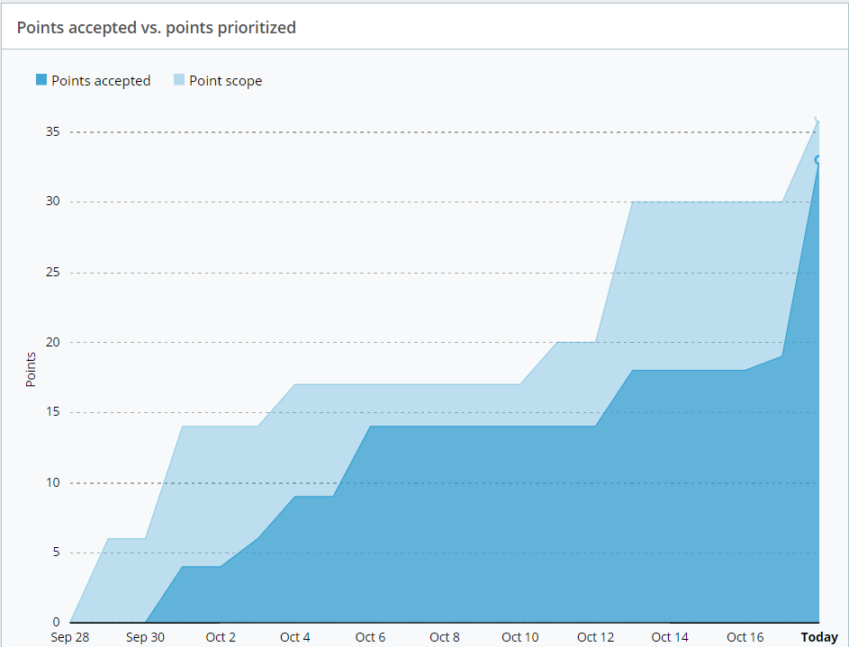
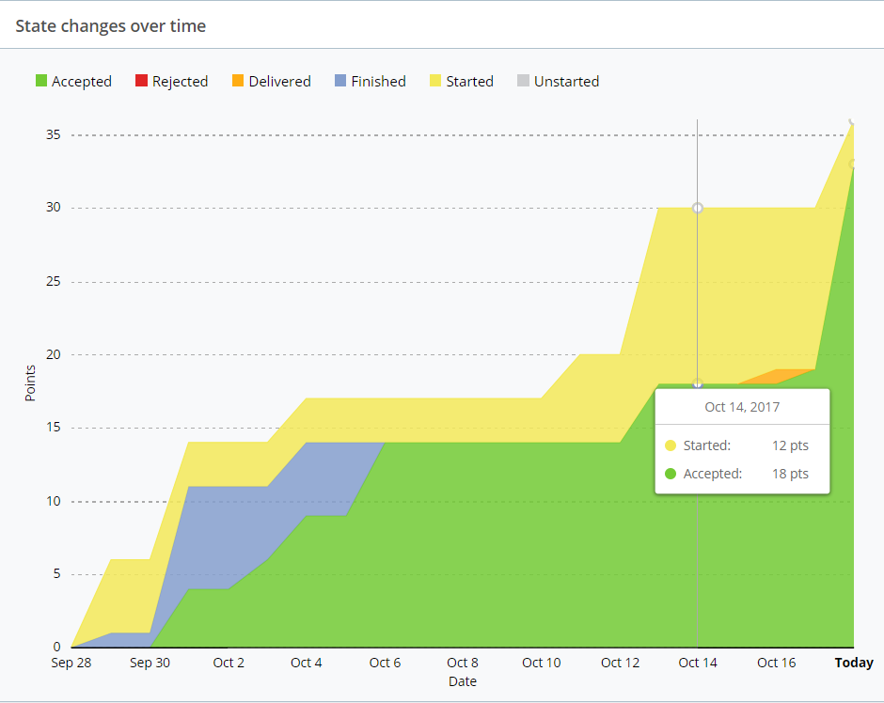
SECTION FOUR
Metrics
Burnup Chart
Cumulative Flow
‹#›

Slide 28

SECTION FIVE
Questions
‹#›

