Slide 1

Rohit Agrawal, Yashvardhan Nanavati, Wenjun Shen, Tianqi Xu, Anirvan Maiti, Aswin Vasudewan
1

Slide 2
Project Analysis
Iteration #0
Iteration #1
Iteration #2
Iteration #3
Presentation Week
Project Idea Brainstorming & Proposal
Pivotal Tracker Setup
Development Environment & GitHub Setup
Architecture Design
Spring + JAVA + Maven Project Setup
Ukubuka Schema Design
Extract, Transform, Load Workflows
SpEL Workflows
Ukubuka-Scripts
ECharts, TauCharts Libraries Integration
Aggregation Workflows
Visualization Workflows
Project Progress Review
Test Harness
Final Presentation
10%
30%
50%
75%
95%
100%
Week 1
Week 2
Week 3
Week 4
Week 5
Week 6
01
02
03
04
05
06

Slide 3
OVERVIEW
Ukubuka Schema
What is ETL?
ETL is a process in data warehousing responsible for pulling data out of the source systems and placing it into a data warehouse. ETL involves the following tasks:
#1
Extract
Extracting the data from multiple source systems. Data from different source systems is converted into one consolidated data warehouse format which is ready for transformation processing.
#2
Transform
Transforming the datasets by a series of operations involving Cleaning, Filtering, Splitting, Joining, Applying Business Rules etc.
#3
Load
Loading the data into a data warehouse or data repository after performing the final set of post-transform operations.
3
Notes:
The next big question is why do we need creative heatmaps.
Visualizing heatmaps can benefit us in following three ways.
We can do clicks analysis to determine the hot areas which are visually appealing to users.
We can priortize future experiments based on the information revealed by them.
We can also launch an advertiser facing version for the advertisers to visualize customers engagement.

Slide 4
OVERVIEW
Ukubuka Schema
#1
Extract Tag(s)
Ordered List of EXTRACT Tag which consists of Unique Identification Tag (UID), Source File Type, Source File Location & Flags
#2
Transform Tag(s)
Ordered List of TRANSFORM Tag which consists of Unique Identification Tag (UID) & Ordered List of Operations
#3
Load Tag(s)
Ordered List of LOAD Tag which consists of Unique Identification Tag (UID), Source File Type, Source File Location & Ordered List of Operations
#4
Visualize Tag(s)
Ordered List of VISUALIZE Tag structure of which is TBD
4

Slide 5
Analysis
Requirement Analysis
5

Slide 6
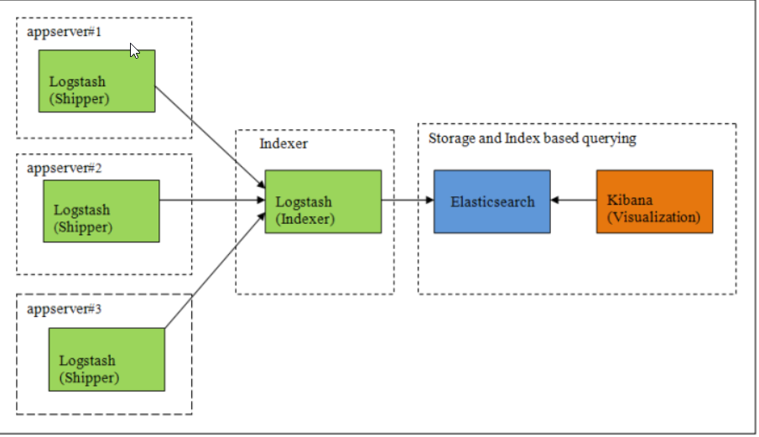
SECTION ONE
Kibana Workflow
6

Slide 7
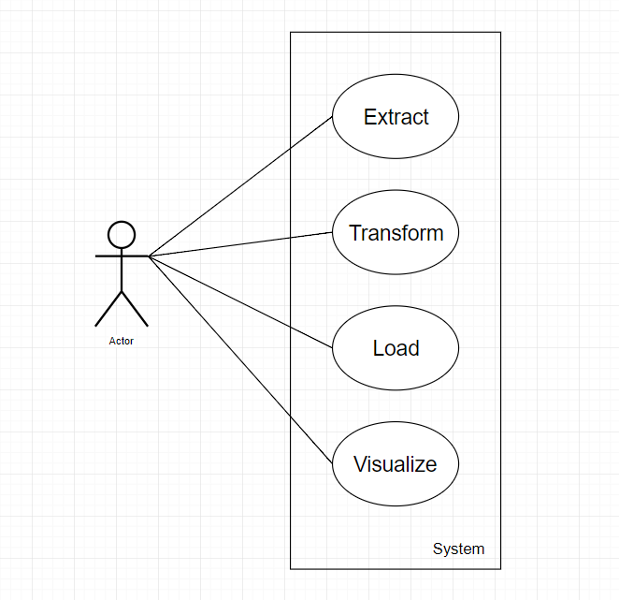
SECTION ONE
Use Case Diagram
7

Slide 8
SECTION ONE
Transform User Story Example
User Story [3 Points --- 9 Man Hours]
As a customer, I would like to perform transformation operations like Adding a column, Deleting a column, and Renaming a column on individual files given as input so that I can standardize the format across all files which can be later used to combine multiple files into one.
Acceptance Criteria:
Given that the customer provides the engine with an expression which contains source column names and mathematical operations to be performed on them, name of the resulting (target) column, and name of the file on which this is to be performed, when the user puts “add” as the type of transformation, then a new column should be appended to that file which will contain data according to the user’s specifications.
Given that the customer provides the engine with the name of the file and the source column name on which deletion is to be performed, when the user puts “delete” as the type of transformation, then the source column should be deleted from the file specified by the user.
Given that the customer provides the engine with the name of the file, the source column name on which renaming is to be performed and the (target) new name of the column, when the user puts “rename” as the type of transformation, then the header of source column should be changed to the (target) ‘new name’ in the file specified by the user.
8
Notes:
The next big question is why do we need creative heatmaps.
Visualizing heatmaps can benefit us in following three ways.
We can do clicks analysis to determine the hot areas which are visually appealing to users.
We can priortize future experiments based on the information revealed by them.
We can also launch an advertiser facing version for the advertisers to visualize customers engagement.

Slide 9
Metrics
Iteration Evaluation
9

Slide 10
METRICS
SOLID Principles
S
Single Responsibility Principle
A class should have only a single responsibility.
O
Open/Closed Principle
Software entities should be open for extension, but closed for modification.
L
Liskov Substitution Principle
Objects in a program should be replaceable with instances of their subtypes without altering the correctness of that program.
I
Interface Segregation Principle
Many client-specific interfaces are better than one general-purpose interface.
D
Dependency Inversion Principle
One should depend upon abstractions and not concretions.
10

Slide 11
SECTION TWO
Metrics
Defects & Enhancements Raised/Resolved
1. RegEx is unable to parse the complex flat files data expressions.
[BUG Raised By: Yashvardhan Nanavati]
Resolution: Switched from RegEx based logic to our own logic for parsing flat files data.
[Resolver: Rohit Agrawal]
2. Include Shortcut Mappings for the Expression Evaluator so that user doesn’t have to type JAVA Raw expressions from scratch. It can also make code DRY.
[ENHANCEMENT Raised By: Justin]
Resolution: Added another Shortcut Mapper class which sits on top of the Expression Evaluator providing the ease of writing
expressions to users. [Resolver: Yashvardhan Nanavati]
3. Make the LOAD a list so that various load operations can be performed instead of just one.
[ENHANCEMENT Raised By: Rohit Agrawal]
Resolution: Changed the Ukubuka Schema to accommodate the changes for multiple LOAD operations instead of just one.
[Resolver: Rohit Agrawal]
11

Slide 12
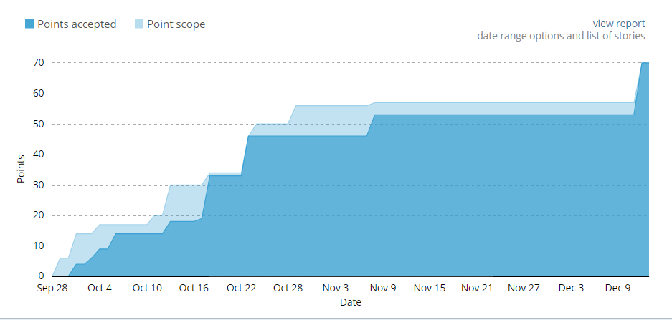
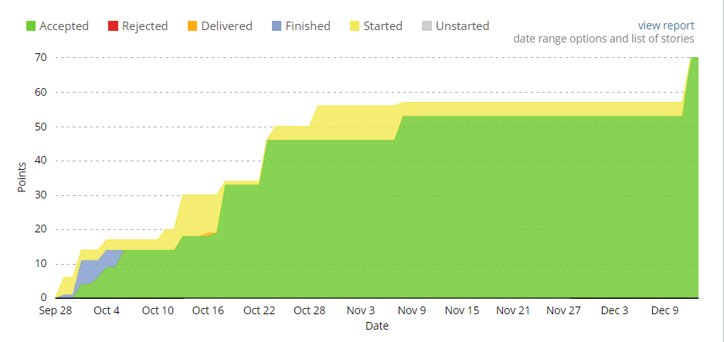
SECTION TWO
Metrics
Burnup Chart
Cumulative Flow
12

Slide 13
Design
Architecture, Design Patterns & Key Algos.
13

Slide 14
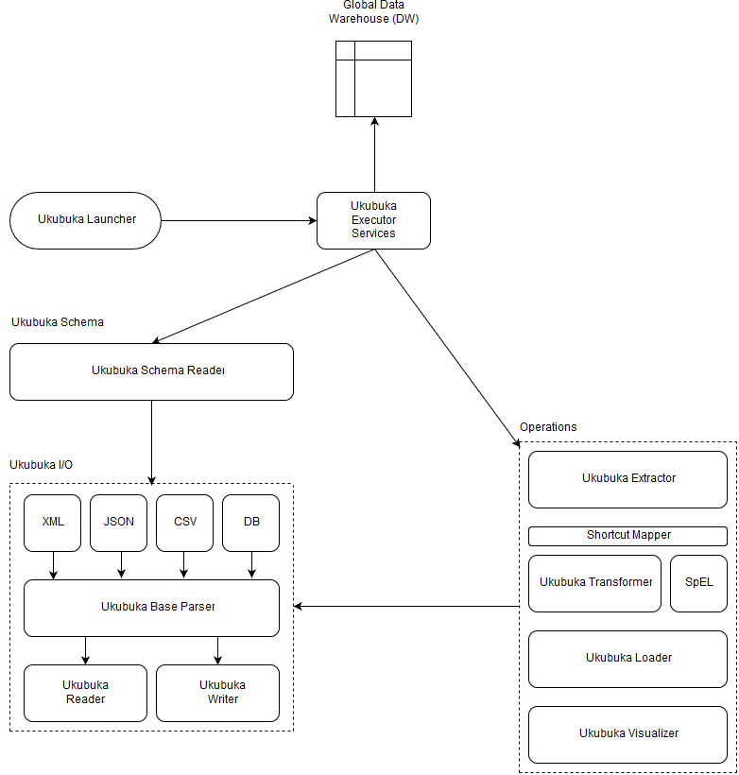
DESIGN
Ukubuka Design Architecture
14

Slide 15
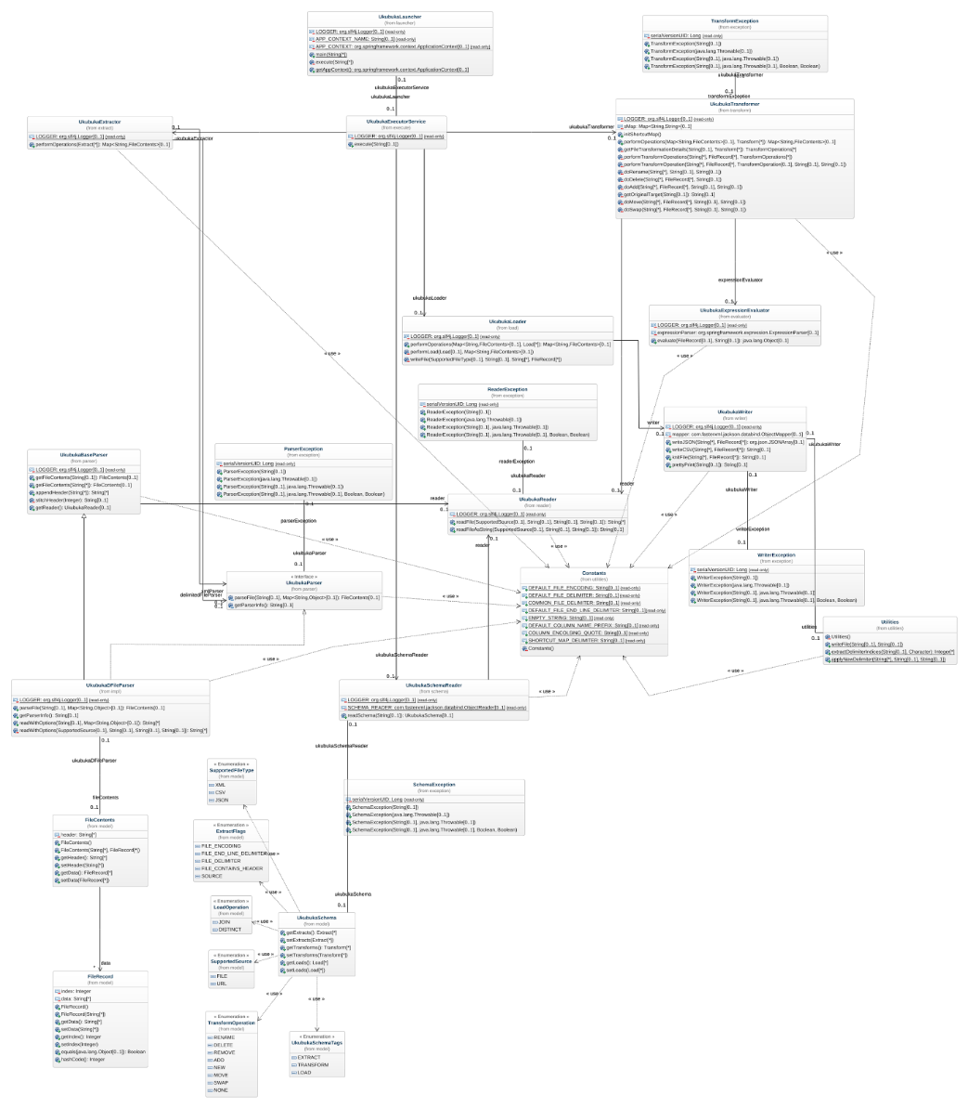
DESIGN
Ukubuka Class Diagram
15

Slide 16
SECTION THREE
Design Patterns
We have used the Java Singleton Design pattern for our project which comes under the Creational Design pattern category. As its definition states, this design pattern restricts the instantiation of a class and ensures that there exists only one instance of the class in the JVM (Java Virtual Machine).
We have also implemented Factory and Builder design patterns in our project. The Factory method can be seen as a simplified version of the Builder method.
In the Factory design pattern, the factory is in charge of creating various subtypes of an object depending on the needs of a project. However, it does not know the exact subtype of the object. Rather it’s a high level view.
An example of Factory method could be if there is a method named “produceCars”, it might return a “BMW” or “Audi” typed object with it being unaware of the specific subtypes of cars in those objects.
In the Builder design method, different subtypes are also created by it. But the composition of the objects might differ in the same subclass.
As an extension of the example given in the Factory method, we might have a “produceCars” method which creates objects of type “BMW” typed object with a 4 cylinder engine, or a “BMW” typed object with 6 cylinders. The builder pattern thus allows for this type of detailing.
16
Notes:
The next big question is why do we need creative heatmaps.
Visualizing heatmaps can benefit us in following three ways.
We can do clicks analysis to determine the hot areas which are visually appealing to users.
We can priortize future experiments based on the information revealed by them.
We can also launch an advertiser facing version for the advertisers to visualize customers engagement.

Slide 17
SECTION THREE
Key Algorithms
Ukubuka Base Parser:
This is a key algorithm that we have implemented. The parser acts as an interface between the reader/writer classes and the classes which handle parsing of csv/json/xml files. It is responsible to effectively communicate between the above mentioned modules. It takes the file read by the reader and passes it to a appropriate class depending upon the appropriate type of the file. It also handles if the delimiter of the file is something other than “,” and appropriately passes it to the respective parser. Also, missing headers in a data file are filled up using default column names such as column_1, column_2 etc. At the end, the files are consumed as a list of strings by the Ukubuka Engine.
Example: “A;B;C;D” is converted to “A,B,C,D”
Ukubuka Transformation:
This algorithm uses SpEL (Spring Expression Language) to perform transformations on the data in the files specified by the user. The Spring Expression Language (SpEL for short) is a powerful expression language that supports querying and manipulating an object graph at runtime. The language syntax is similar to Unified EL but offers additional features, most notably method invocation and basic string templating functionality. This Algorithm is extremely powerful and can potentially solve any kind of mathematical computational problems including complex trigonometric, and statistical conundrums. For user-friendliness we have created a supporting class called “Shortcuts” which Imports the corresponding libraries in Java with abstraction to the user. The user just enters normal names of the operations and the algorithm takes care of importing the corresponding classes and interfaces.
17
Notes:
The next big question is why do we need creative heatmaps.
Visualizing heatmaps can benefit us in following three ways.
We can do clicks analysis to determine the hot areas which are visually appealing to users.
We can priortize future experiments based on the information revealed by them.
We can also launch an advertiser facing version for the advertisers to visualize customers engagement.

Slide 18
SECTION THREE
Key Algorithms
Ukubuka Schema:
Another novel structure we came up with is the Ukubuka Schema in which the user has been given pre-defined tags to specify the manipulations he/she wants to do on the data set. Also, multiple loads, transformations and extractions can be done using a single schema file. This allows the user to consolidate all manipulations into a single structure seamlessly performs the specified operations without much hassle.
Ukubuka Visualizer:
UkubukaVisualizer harnesses the UkubukaScriptsReader to read the provided scripts from ukubuka-scripts project and creates a static HTML file so that it doesn’t need any connectivity later. It then harnesses SpEL to plug-in the transformed data to create interactive visualizations.
18
Notes:
The next big question is why do we need creative heatmaps.
Visualizing heatmaps can benefit us in following three ways.
We can do clicks analysis to determine the hot areas which are visually appealing to users.
We can priortize future experiments based on the information revealed by them.
We can also launch an advertiser facing version for the advertisers to visualize customers engagement.

Slide 19
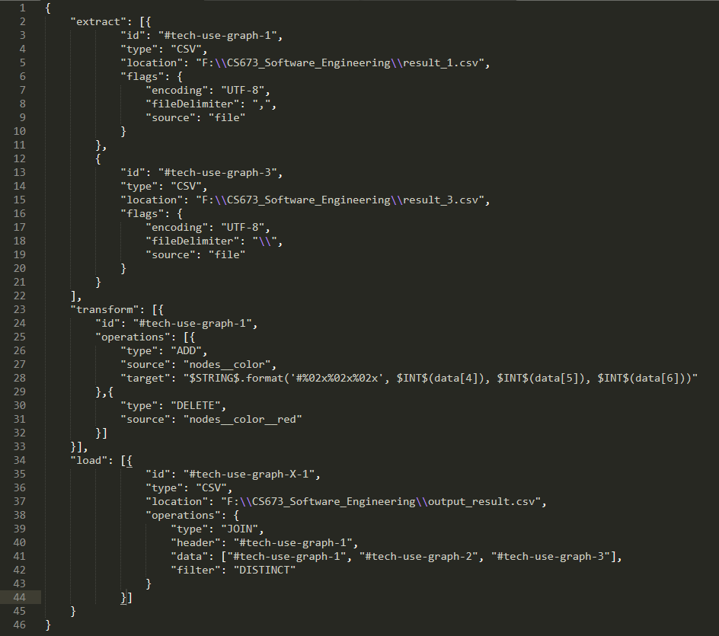
SECTION THREE
Key Algorithms
19
Notes:
The next big question is why do we need creative heatmaps.
Visualizing heatmaps can benefit us in following three ways.
We can do clicks analysis to determine the hot areas which are visually appealing to users.
We can priortize future experiments based on the information revealed by them.
We can also launch an advertiser facing version for the advertisers to visualize customers engagement.

Slide 20
Pipelines
Aggregation & Visualization
20

Slide 21
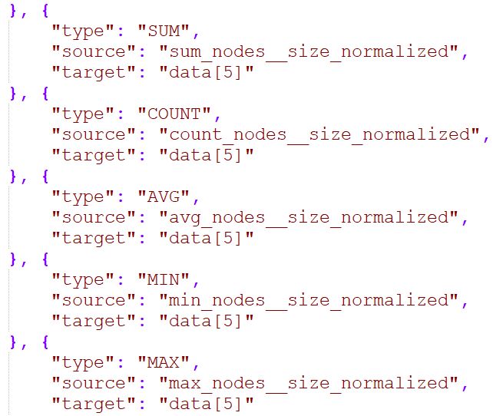
SECTION FOUR
Aggregation
21

Slide 22
SECTION FOUR
Aggregation
Reading TRANSFORM Operation(s) Schema
30%
UkubukaSchemaReader reads the injected schema file and calls the UkubukaTransformer to perform the transform operations by honoring the list order.
99%
Saving Dataset
The transformed tagged dataset is then saved to the Global DW for further processing.
70%
Load
Trigger
Column & Row Operations
90%
UkubukaTransformer leverages SpEL to perform the row and column level aggregation operations.
Data-Source Tagging
UkubukaTransformer attaches a UID (Unique Identification) Tag to each transformed file which later helps in uniquely identifying the source for transform and load operations.
22

Slide 23
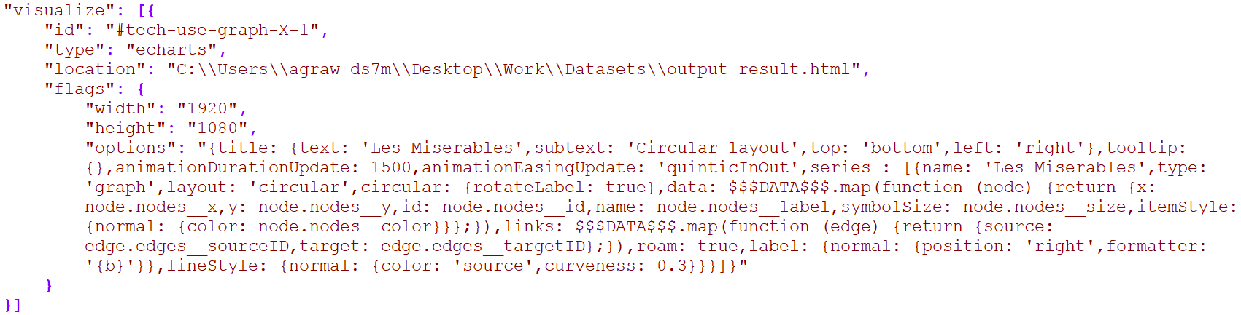
SECTION FOUR
Visualization
23

Slide 24
SECTION FOUR
Visualization
Reading VISUALIZATION Operation(s) Schema
Leveraging Spring Expression Language
UkubukaSchemaReader reads the injected schema file and calls the UkubukaVisualizer to perform the visualize operations by honoring the list order.
UkubukaScriptsVisualizer invokes the SpEL with the raw expression to evaluate the expression and plug in the data into the templated visualization.
15%
85%
Retrieving Dataset
20%
UkubukaVisualizer retrieves the dataset from the Global DW by matching the UID provided in the visualize tag.
99%
Vomiting Visualizations
60%
Created visualizations are vomited back to the specified locations after finishing the whole process.
Trigger
Reading Script(s)
UkubukaScriptsReader imports and leverages an externally supplied dependency called ukubuka-scripts to maintain the loose coupling.
30%
End
Performing Operations
* More scripts can be added to ukubuka-scrips easily.
UkubukaVisualizer loops in the list of operations to be performed and pipes to the scripts reader for performing these operations
45%
Creating Script(s)
UkubukaScriptsReader reads the scripts directory against the type attribute and create a static file with all the needed scripts in the HEAD.
24

Slide 25
Testing
Testing & Test Harness Framework
25

Slide 26
SECTION FIVE
System Testing
Initial Ideas
A collection of test cases to test Ukubuka engine under various conditions automatically.
Implementation
Implement comparators for csv, json, xml format files.
Compare expected and actual files.
Test Cases
Cover single or multiple operations including split files, merge files, add, delete or modify attributes.
Cover all three file formats.
26

Slide 27
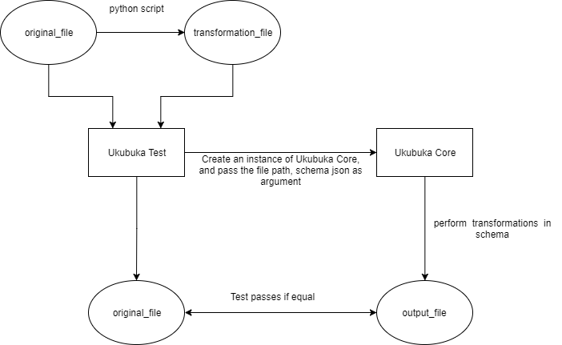
SECTION FIVE
Test Harness Design
27

Slide 28
SECTION FIVE
Unit Testing
Test Driven Development
Mockito Framework
Test related functionality can be added to a mock interface.
Used Mocks and Inject Mocks to handle dependency in Spring.
Allows to test the functionality of a class in isolation.
It neither uses a DB connection nor any other server
JUnit
The JUnit test is written to pass the assertion.
All the boundary conditions and behaviour are tested.
28

Slide 29
SECTION FIVE
Acceptance Testing
User Acceptance Test
Beta testing to ensure the Ukubuka working.
Acceptance criteria for this test are the usability, functional correctness and completeness.
Business Acceptance Test
The ETLV operation working as open source project.
Ability to overcome the shortcomings of Kibana.
29

Slide 30
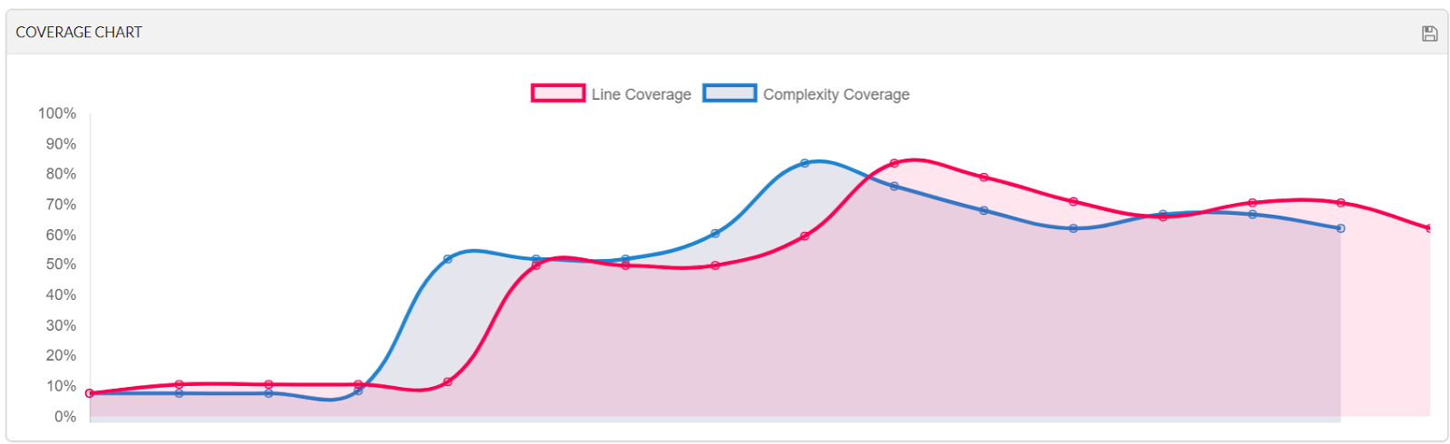
SECTION FIVE
Metrics
Code Coverage [89%]
30

Slide 31
Management
Project Management
31

Slide 32
SECTION SIX
Project Management
Knowledge Areas
Software Life cycle : Agile Methodologies
Work Breakdown Structure and Responsibility Matrix
Scope: To Visualize user inputs and provide manipulation feature.
Time: Regular monitoring of optimistic, pessimistic and likely time.
Follow up time: PERT = (Optimistic + Pessimistic + (4 *Likely time)) / 6
Communication:
1. Pair Programming
2. Plank meetings
3. Team Meetings
32
Notes:
The next big question is why do we need creative heatmaps.
Visualizing heatmaps can benefit us in following three ways.
We can do clicks analysis to determine the hot areas which are visually appealing to users.
We can priortize future experiments based on the information revealed by them.
We can also launch an advertiser facing version for the advertisers to visualize customers engagement.

Slide 33
SECTION SIX
Project Management
Knowledge Areas
Quality Management: Regular Monitoring and controlling through iteration.
Quality Metrics : Code coverage and review comments/ feedback.
Risk Management : Contingency Plan, Fall back Plan.
Project Milestones and Epic tracking in Pivotal tracker
Lessons learnt in challenges and future work.
33
Notes:
The next big question is why do we need creative heatmaps.
Visualizing heatmaps can benefit us in following three ways.
We can do clicks analysis to determine the hot areas which are visually appealing to users.
We can priortize future experiments based on the information revealed by them.
We can also launch an advertiser facing version for the advertisers to visualize customers engagement.

Slide 34
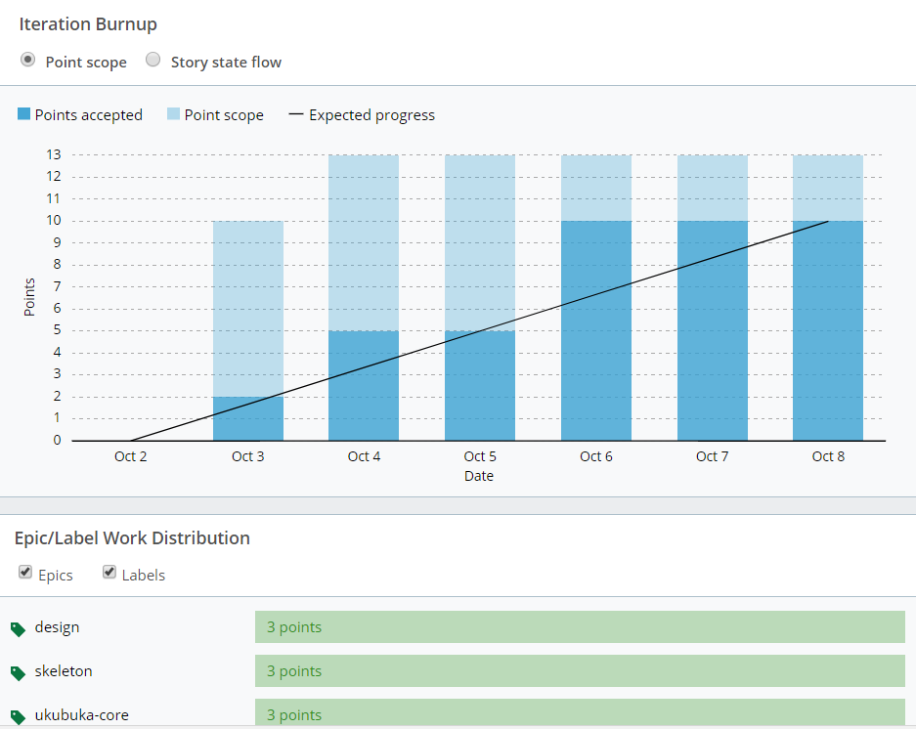
SECTION SIX
Iteration Evolution
34

Slide 35
Dataset
Dataset Description & Demo
35

Slide 36
SECTION SEVEN
Security
Data Privacy
Ukubuka runs locally and doesn't use internet.
Ukubuka doesn’t upload the dataset onto an internal databases.
Ukubuka doesn't upload the data onto any cloud or server.
The data is not retained after the visualization is complete.
36

Slide 37
SECTION SEVEN
Security
Data Integrity
Ukubuka does allow manipulation of data but it does not change the original data source.
Ukubuka maintains the dataset throughout the visualization process without any data drop.
Visualization is done for the dataset as a whole. There is no data fragmentation. Thus reducing vulnerability.
37

Slide 38

Dataset
Software Technologies Penetration
It’s a graph dataset which shows the penetration of software technologies for a number of different projects.
Here, the data is organized in terms of different nodes where each node determines a particular technology like Java or Javascript etc. and has following attributes associated with it:
Node Color
Node Size
Node Position [(x,y) Coordinates]
Node Edges Information
38

Slide 39
Dataset #1
Software Technologies Penetration
Delimiter: Comma (,)
Column Details:
nodes__label
nodes__y
nodes__x
nodes__id
nodes__color__red [RED Color Decimal Value]
nodes__color__green [GREEN Color Decimal Value]
nodes__color__blue [BLUE Color Decimal Value]
nodes__size
edges__sourceID
edges__targetID
edges__size
39

Slide 40
Dataset #2
Software Technologies Penetration
Delimiter: Bar (|)
Column Details:
nodes__color
nodes__coordinates [JSON with x & y coordinates]
nodes__label
nodes__id
nodes__size
edges__sourceID
edges__targetID
edges__size
40

Slide 41
Dataset #3
Software Technologies Penetration
Delimiter: Backslash (\)
Column Details:
nodes__color
nodes__label
nodes__y
nodes__x
nodes__size [Not Normalized : Need to divide these values by 100]
nodes__id
edges__sourceID
edges__targetID
edges__size
41

Slide 42
Operations Performed
Software Technologies Penetration
Dataset #1 : Add new column with RGB To HEX conversion
Dataset #1 : Delete RGB columns
Dataset #1 : Move newly added column to index 0
Dataset #2 : Add new column with parsed x & y coordinates
Dataset #2 : Delete nodes_coordinates columns
Dataset #2 : Move newly added column to their respective indices
Dataset #3 : Add new column with normalized data
Dataset #3 : Delete the column with un-normalized data
Dataset #3 : Move newly added column to its respective index
42

Slide 43

Demo Time
43

Slide 44

SECTION FIVE
Questions
44

