Slide 1

Project Ukubuka
Team 5
Rohit Agrawal, Anirvan Maiti, Yashvardhan Nanavati, Wenjun Shen, Aswin Vasudevan, Tianqi Xu

Slide 2
Overview
What & Why?

Slide 3
What is Ukubuka?
The name Ukubuka is inspired from a unique language spoken in South Africa and roughly translates to "View" or "Visualization" in Zulu which is one of the official languages of South Africa and is spoken by about 9 million people mainly in Zululand.
Ukubuka aims at producing high-quality interactive visualizations. It is powerful, lightweight and easy to use. It allows the users to analyze, manipulate and visualize their datasets in a novel and creative ways with no serious programming.

Slide 4
Why Develop Ukubuka?
Kibana is a visualization tool which allows its users to create visualizations from data indexes in ElasticSearch.
The main drawback of Kibana is that it very constrained in the type of data it can process and allows only a handful of simple graphical methods to choose from.

Slide 5
Kibana Issues
It can’t parse multi-level JSON data.
It requires the flattened data in order to create visualizations.
The visualizations are lack-lustered and doesn’t utilize the full potential of the data to engage the audience.

Slide 6
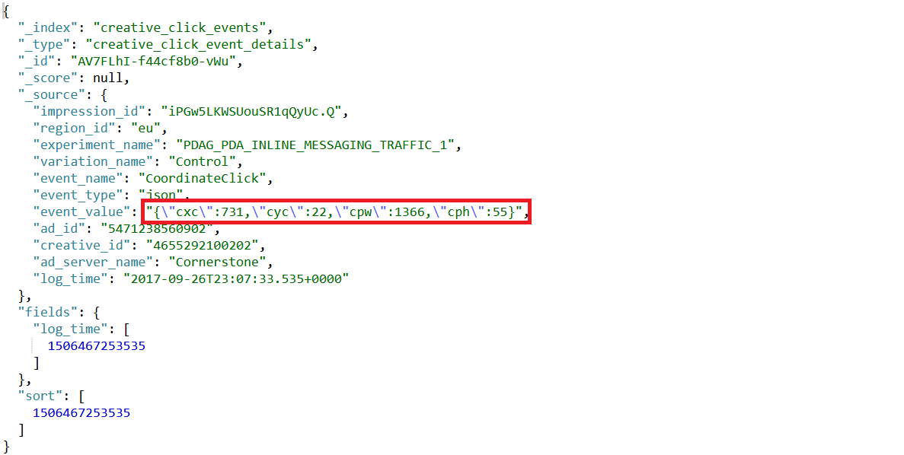

Slide 7
Kibana Issues
No way to compute and visualize new data.
No way to plot an X-Y graph with event_value.cxc * event_value.cpw on X-Axis & event_value.cyc * event_value.cph on Y-Axis.

Slide 8
Features of Ukubuka
Essential Features
Data Import [CSV, XML, ElasticSearch, DB]
Data Manipulation [SpEL Based Frameworks]
Data Visualization [TauCharts, Echarts, etc.]
Desirable Features
Data Export [Flat Files, DB]
Workflows
Optional Features
Data Analysis

Slide 9
Quality Assurance Plan
Unit Testing
TDD Framework
75% Code Coverage
Mocking Frameworks [JMock, EasyMock, Mockito]
Integration Testing
After every feature merge
Regression Testing
Regression Suite, After every major release
Stress, System, & Performance Testing [Before Alpha/Beta]

Slide 10
Technology Stack
Backend
Core Java + Spring Framework
SOA Architecture [Microservices]
Data Exchange Using JSON [Sorry, No XMLs]
Messaging Queues
Apache Camel
Frontend
React, JavaScript, Angular

Slide 11
Management Plan
3 Iterations – 3 Sprints Per Iteration [1 Week Each]
Every major task is divided into several small story with 1-2 points. [3 Points Per Sprint Per Individual]
Pair Programming [2 X 2 Hours Sessions Per Week]
2-Minute Plank Meetings every day for the status check.
Rotating Scrum Master & Time Keeper duties.
Planning, Retrospective & Backlog Refinement Meetings after every sprint.

Slide 12
Configuration Management Plan
Configuration items and tools
GitHub [Branching Strategy: feature, hotfix, develop]
TeamCity [Continuous Integration], SonarQube [Static Code Analysis]
Change management and branch management
All pull-requests(PRs) submitted by team members will be reviewed by the Configuration Leader (Yashvardhan Nanavati) and Project Leader (Rohit Agrawal)
The code will then be merged to the ukubuka/core master branch on Github and the PR will be closed. Master branch is like the golden source and is the only clean copy of the code and hence is locked at any time and no code can be pushed directly to master.
Only the team leader and the configuration leader will have commit rights to the main project repository.
Code commit guidelines

Slide 13
Future Plan
Iteration 1 – Data Data Data
Everything should be parsed and converted to JSON
SpEL for Data Manipulation
Iteration 2 – Visualizations
ECHarts, CD, TauCharts, etc.
Iteration 3 – Frontend
Web Interface

Slide 14
Questions?
?

