Slide 1

Rohit Agrawal, Yashvardhan Nanavati, Wenjun Shen, Tianqi Xu, Anirvan Maiti, Aswin Vasudewan
‹#›

Slide 2
FLOW OF TOPICS
Implementation of XML PARSER for Extract Operation
Test Harness
Research on Dex and E-charts
Implementation of Visualization for datasets.
Demo

Slide 3
XML Parser for Extract Operation
Extract operation to support XML input to Ukubuka Engine
Stack Implementation to parse the parent - child tags
Spring Framework - All changes are Bean invocation based.
Mockito Framework to test the XML parser
Code Coverage achieved : 78%

Slide 4
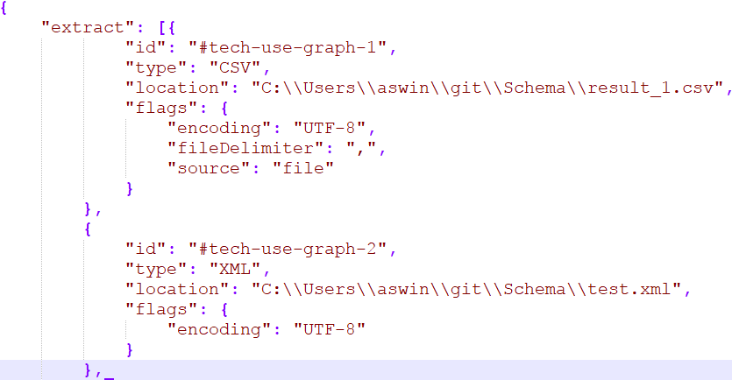
Schema for XML

Slide 5
XML Parsing Design
<?xml version="1.0" encoding="UTF-8"?>
<visualize>
<record>
<x>5</x>
<y>3</y>
<z>9</z>
</record>
<record>
<x>1</x>
<y>8</y>
<z>4</z>
</record>
<record>
<x>3</x>
<y>6</y>
<z>7</z>
</record>
</visualize>
x~`~y~`~z
5~`~3~`~9
1~`~8~`~4
3~`~6~`~7
LIST OF STRINGS
‹#›

Slide 6
XML Operation Flow Graph
Reading EXTRACT Operation(s) Schema
20%
Tag specific id : XML Location attribute Flag attribute for UTF encoding
10%
Saving Dataset
The extracted tagged dataset is then saved to the Global DW for further processing.
30%
Transform
Trigger
Ukubuka Reader Reading Input XML as stream of data using XML stream reader and input factory.
40%
Ukubuka XML Parser
Stack implementation. Adding delimiter for file between tags and next line for the fields .
*.
‹#›

Slide 7
Test Harness
•Test Launcher
•CSV Comparator
•Identical rows, Flexible order of rows
•XML Comparator
•Strict order of entries
•JSON Comparator
•Flexible order of entries

Slide 8
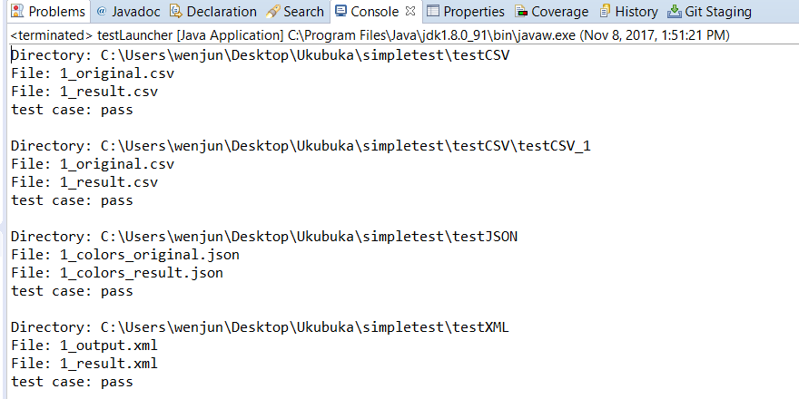
Test Harness
•Obtain the original file and the result file.
•Put both files under the same folder.
•Repeat the above steps for every steps.
•Put the test cases path as the input argument.
•Run the test launcher.

Slide 9
Research on charts library
Dex.js is a powerful visualization framework, it unifies a number of charts from other framework libraries.
Dex -> E chart
E chart is a pure javascript chart library that runs smoothly on PCs and mobile devices, is compatible with most current browsers. It contains many 2-D visualization libraries that can be developed by users.

Slide 10
METRICS
Visualization
Bar
Bar chart
Shows comparison among discrete categories easily.
Line
Line Chart
Used to visualize the trend in data, usually over interval of time
Pie
Pie Chart
Used to visualize the numerical proportion of data
Radar
Radar Chart
Display multivariate data in a 2 dimension chart
Bubble
Bubble Chart
Display 3 dimensions of data in a 2 dimension of chart
Sankey
Sankey Chart
show the flows between units with proportion of the quantity
‹#›

Slide 11
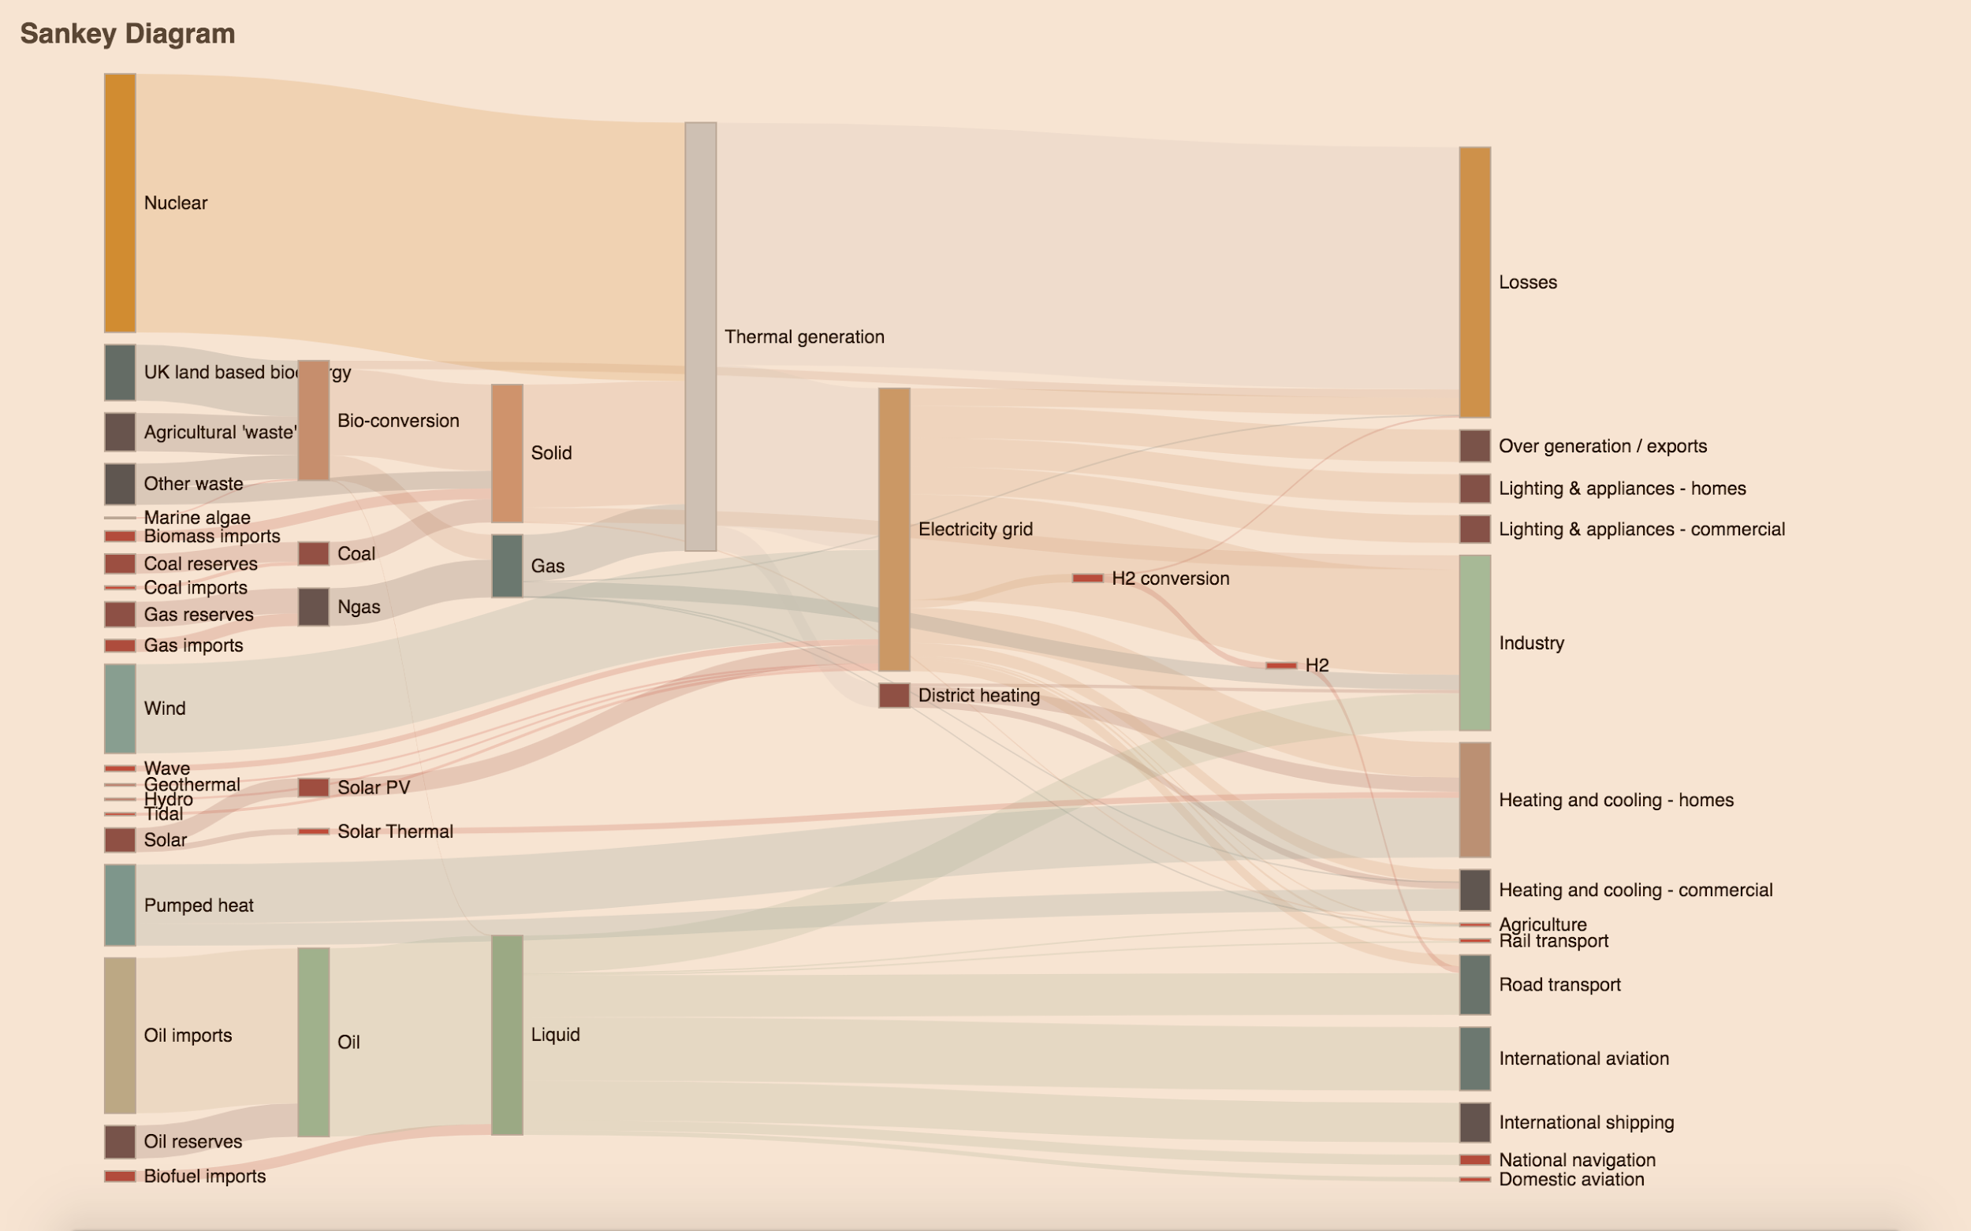
Visualization

Slide 12

Demo Time
‹#›

Slide 13
Plan for the next iteration
More type of charts
The connection between Ukubuka the visualization and the association between tags and visualization
code structure and library issue
tag and visualization connection
UI design, interactive or not

Slide 14

SECTION FIVE
Questions
‹#›

