Slide 1

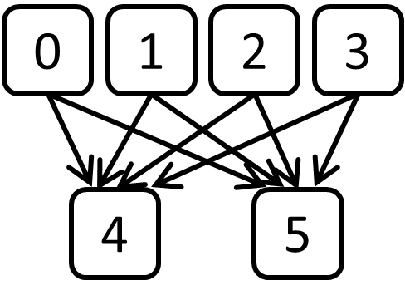
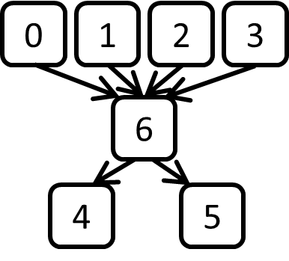
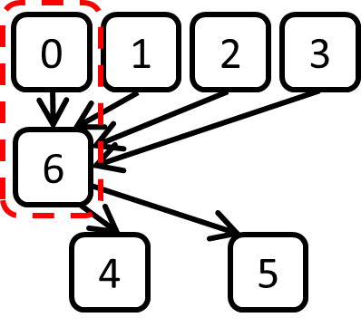
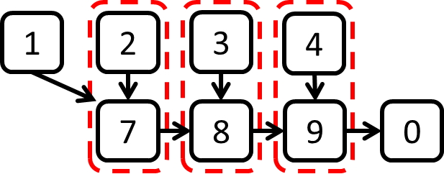
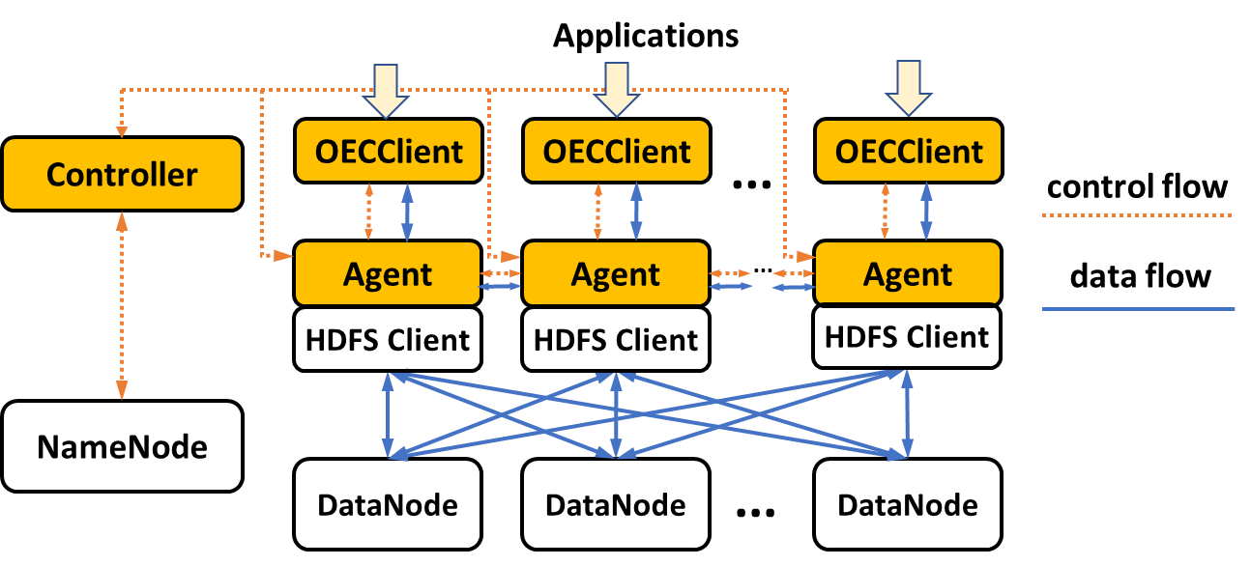
OpenEC: Toward Unified and Configurable Erasure Coding Management in Distributed Storage Systems
Xiaolu Li†, Runhui Li†, Patrick P. C. Lee†, and Yuchong Hu‡
The Chinese University of Hong Kong†, Huazhong University of Science and Technology‡ Source code: http://adslab.cse.cuhk.edu.hk/software/openec
Goals
Design OpenEC, a unified and configurable framework for erasure coding management
Defines an abstraction, ECDAG, for general erasure codes (e.g. RS Codes, Regenerating Codes, LRC, DRC) and repair-efficient algorithms (e.g., PPR, Repair pipelining)
Enables configurability of workflows and placement of coding operations
ECDAG
Encoding of (6,4) RS code:
ECDAG: a directed-acyclic-graph abstraction for erasure coding
Primitives
Join: defines the linear combination of a block
BindX and BindY: co-locate computations at same level and across levels, respectively
ECDAG* ecdag = new ECDAG();
ecdag->Join(4, {0,1,2,3}, {1,1,1,1});
ecdag->Join(5, {0,1,2,3}, {1,2,4,8});
int vidx = ecdag->BindX({4,5});
ecdag->BindY(vidx, 0);0
BindX
BindY
Decoding with repair pipelining:
ECDAG* ecdag = new ECDAG();
ecdag->Join(7, {1,2}, {1,1});
ecdag->BindY(7, 2);
ecdag->Join(8, {7,3}, {1,1});
ecdag->BindY(8, 3);
ecdag->Join(9, {8,4}, {1,1});
ecdag->BindY(9, 4);
ecdag->Join(0, {9}, {1});
OpenEC Design
Controller:
Manages erasure coding metadata
Parses ECDAGs and assigns tasks to Agents
Controls block placement
Coordinates repair operations
Agent:
Performs coding operations
OECClient:
Interfaces between applications and storage
OpenEC is now prototyped on Hadoop 3 HDFS, HDFS-RAID, and QFS with minimal code changes
Prototype Experiments
Online
Offline
Automated BindX&Y
Repair Optimization
OpenEC in Amazon EC2
Performance of basic operations
Automated Optimizations
Scalability in Amazon EC2
Online: preserves HDFS-3 performance
Offline: 137% faster than HDFS-RAID’s offline encoding
Automated BindX and BindY speeds up encoding by up to 44%
Automated pipelining of ECDAG speeds up repair by up to 128%
OpenEC scales well with number of instances (N)

