Slide 1

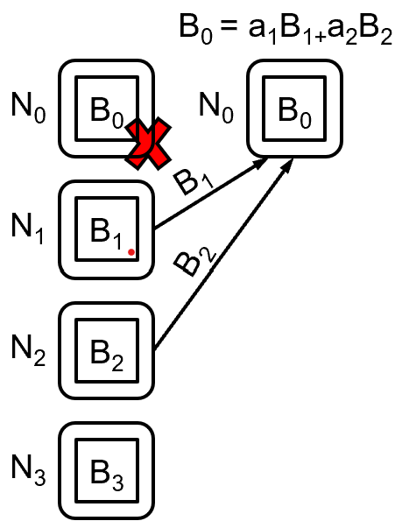
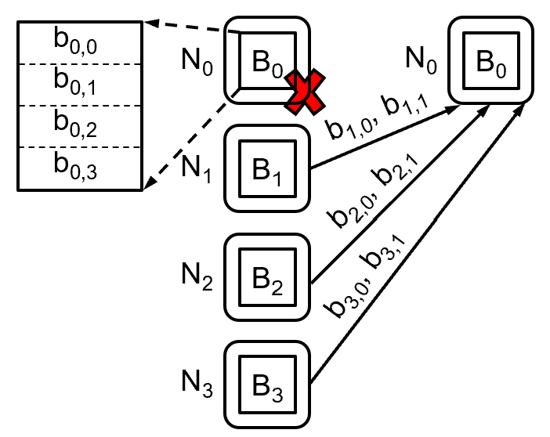
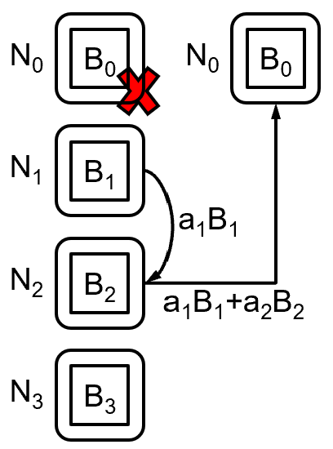
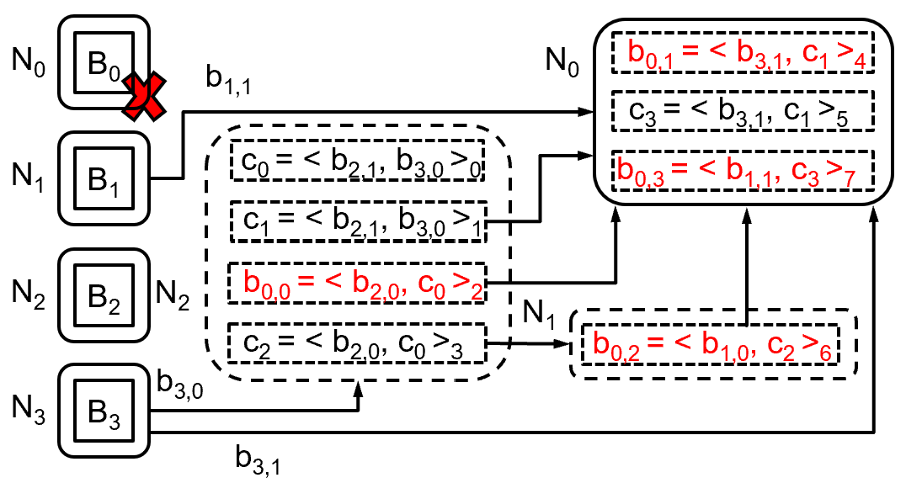
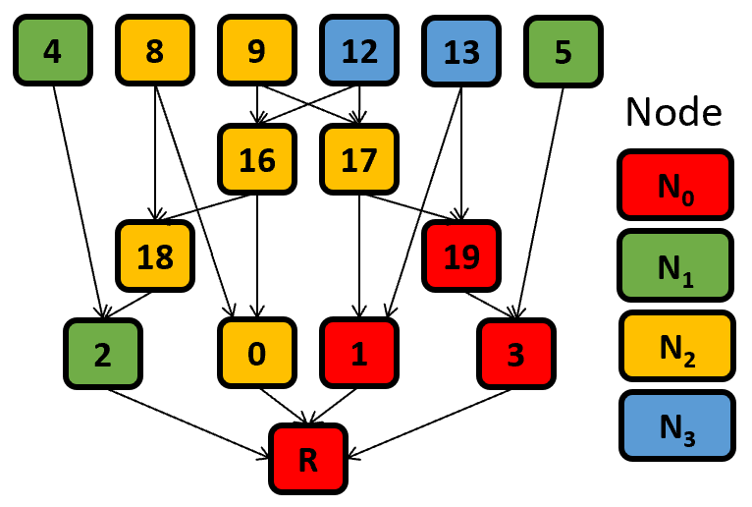
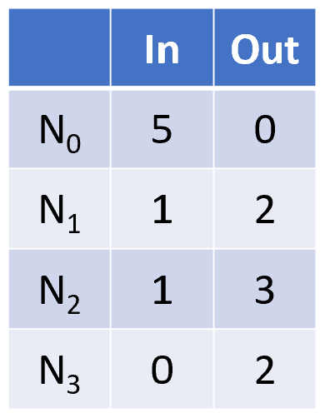
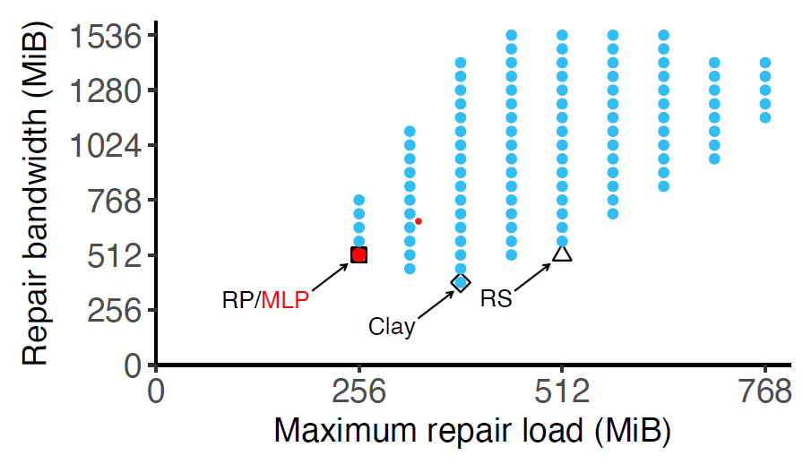
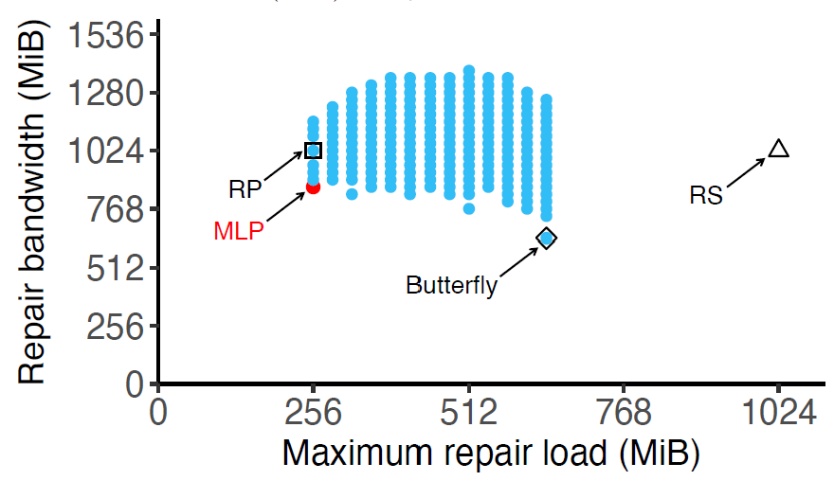

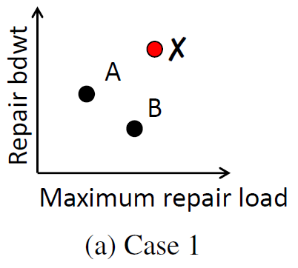
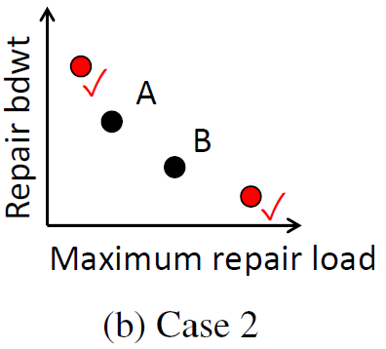
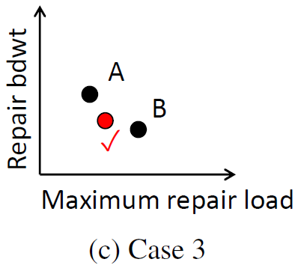
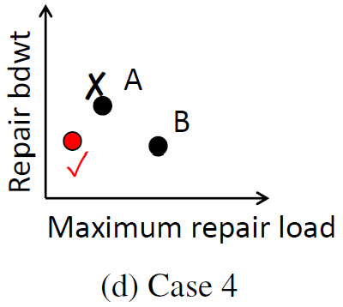
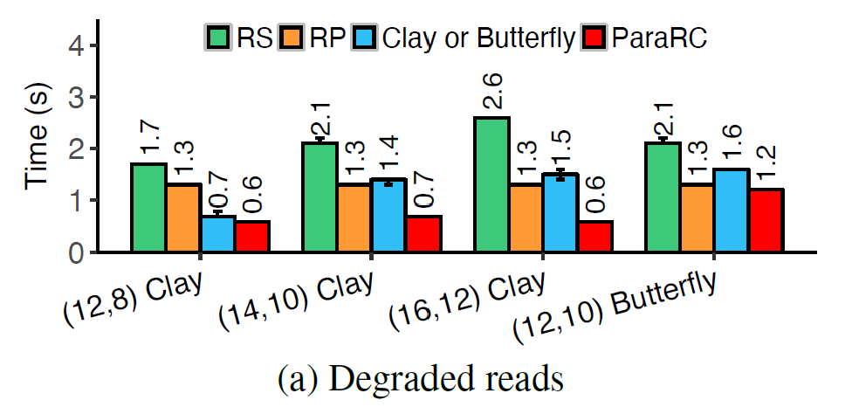
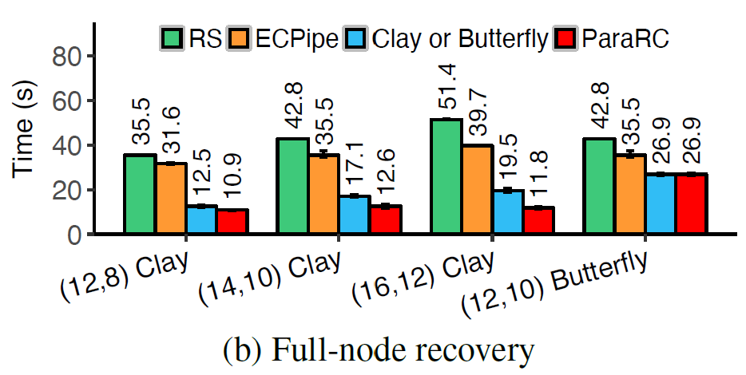
ParaRC: Embracing Sub-Packetization for
Repair Parallelization in MSR-Coded Storage
Xiaolu Li†, Keyun Cheng ‡, Kaicheng Tang ‡, Patrick P. C. Lee ‡ , YuchongHu†, Dan Feng†, Jie Li*, Ting-yi Wu*
Huazhong University of Science and Technology†, Chinese University of Hong Kong‡, Huawei Technologies* Source code: http://adslab.cse.cuhk.edu.hk/software/pararc/
Motivation
Goal: Design a parallel repair approach for MSR codes to balance repair bandwidth and maximum repair load
(4,2) RS; centralized
Repair bw: 512 MiB
Max repair load: 512 MiB
(4,2) Clay; centralized
Repair bw: 384 MiB
Max repair load: 384 MiB
(4,2) RS; repair pipelining
Repair bw: 512 MiB
Max repair load: 256 MiB
(4,2) Clay; parallel
Repair bw: 448 MiB
Max repair load: 320 MiB
Repair bandwidth: Amount of traffic transferred over the network
Maximum repair load: Maximum amount of traffic that a node sends or receives among all nodes
Model
pECDAG: A DAG that describes a parallel repair solution
Traffic table: Evaluating repair load (in sub-blocks) of each node for a pECDAG
Trade-off exists between repair bandwidth and maximum repair load
Goal: Find MLP (minimum maximum repair load point), with minimum repair bandwidth
(4,2) Clay
(6,4) Butterfly
pECDAG
Traffic table
Heuristic
Goal: Finding MLP by brute-force is expensive; instead, we find approximate MLP based on Pareto frontier
1. Initialize with a random pECDAG as a candidate
2. Examine the neighbors of each candidate pECDAG
3. Prune a neighbor pECDAG with worse solution (Case 1); otherwise, add the neighbor pECDAG as a candidate (Cases 2-4)
4. Repeat Steps 2 and 3
Evaluation
Prototype parallel repair on ParaRC on Hadoop 3 HDFS
Respective performance gains over RS (centralized repair), repair pipelining, Clay/Butterfly (centralized repair):
Degraded read: 76.4 %, 51.9%, 59.3%
Full-node recovery: 76.9%, 70.2%, 39.2%

