Slide 1
HyperGen: Optimizing Generative Inference With Long Prompts for Resource-Constrained Systems
LingWen Gong¹, Kaixin Liu¹, Xiaolu Li¹, Shujie Han²,
Patrick P. C. Lee³, Yuchong Hu¹, Dan Feng¹
¹Huazhong University of Science and Technology, ²Northwestern Polytechnical University, ³The Chinese University of Hong Kong
APSys 2024
Notes:
Hi eveybody, I am Xiaolu Li from Huazhong University of Science and Technology.
I’m honored to present our work here.
And this is a joint work with folks from Northwestern Polytechnical University and the Chinese University of Hong Kong.

Slide 2
Background and Motivation
Generative inference is popular
Text generation (ChatGPT)
Code generation (Github Copilot)
Increasing need to deploy generative inference at the edge
Enhanced data security
Personalized recommendation
What is generative inference？
Where is APSys’25 held?
Prefill
Decode
Decode
Decode
Decode
……
Input Prompt
Processing
X
It
is
in
Seoul
Notes:
Generative inference is popular in many applications, including text generation, code generation, and so on.
And there is an increasing need to deploy generative inference at the edge for enhanced data security and personalized recommendation
So what is the generative inference we are talking about here?
Currently, the most popular generative inference framework is based on the transformer model,
which comprises a prefill stage, that pre-processes the input prompts,
and several iterations of decode stages, where each decode stage generates an output word.
For example, we have an input prompt that asks “Where is APSys’25 held?”.
The input prompt is first tokenized and embedded into a vector X.
Then, the tokenized input prompts X go through the prefill stage for pre-processing.
Then, the pre-processed inputs go through the first decode stage, which output the first word It.
Next, several iterations of decode stage proceeds and generate outputs one by one.

Slide 3
Background and Motivation
Prefill stage processes the input prompts
Tokenized input X goes through multiple transformer blocks
The number of transformer blocks (n) depends on models
X₁
X₂
X_{n}
Transformer
Block
Transformer
Block
……
Transformer
Block
X
Input Prompt Processing
Where is APSys’25 held?
Notes:
Specifically, the prefill stage comprises multiple transformer blocks, where the number of transformer blocks depends on the used model for the inference.

Slide 4







Background and Motivation
Steps in a transformer block of the prefill stage
(i) QKV calculation
(ii) Attention score calculation
(iii) Softmax
(iv) Attention output generation
(v) Feed-forward network
Model weights
W_{Q}，W_{K}，…
Transient states
QKV matrices
Temporary results X’
(v) Feed-forward network
X’ = ReLU(X_{out} $∙$ W₁) $∙$ W₂ + X_{out}
Self-attention
(iv) Attention output generation
X_{out} = Softmax( $\frac{Q∙KT}{\sqrt{dK}}$ ) $∙$ V $∙$ W_{O} + X
(iii) Softmax
Softmax( $\frac{Q∙KT}{\sqrt{dK}}$ )
(ii) Attention score calculation
$$\frac{Q∙KT}{\sqrt{dK}}$$
(i) Q, K, V calculation
$$K=X∙WK$$
$$Q=X∙WQ$$
$$V=X∙WV$$
X
Notes:
Each transformer block comprises several steps:
Step 1 computes the QKV matrices based on the input X,
Step 2 Calculates the attention score based on the Q and K
Step 3 Calculates the softmax based on the output of step 2
Step 4 Generates the attention output based on temporary results from step 1, step 3, and the original input X
Step 5 Calculates a feed-forward network.
Among these steps, parameters marked in red are called model weights.
We also have some transient states here, such as the QKV matrices that we generate in the step 1

Slide 5

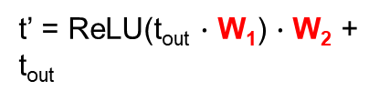



Background and Motivation
Decode Stage generates one token per iteration
Generation of a token also goes through multiple transformer blocks
The number of transformer blocks depends on the model
Transformer block
t’
t
t’
Feed-forward network
t’ = ReLU(t_{out} $∙$ W₁) $∙$ W₂ + t_{out}
Transformer
Block
Transformer
Block
……
Self-attention
t_{out} = Softmax( $\frac{Q∙KT}{\sqrt{dK}}$ ) $∙$ V $∙$ W_{O} + t
It
K = concat(K , $t∙WK$)
V = concat(V , $t∙WV$)
Q = $t∙WQ$
t
Notes:
Decode stage generates one token per iteration, where each iteration also goes through multiple transformer blocks.
Different with a transformer block used in the prefill stage, a transformer block in the decode stage only deals with a single token, while using the transient states
Generated in the prefill stage.

Slide 6
Background and Motivation
It is challenging to deploy generative inference at the edge
Resource is constrained at the edge
NVIDIA RTX 4090 has only 24 GiB of memory
Generative inference has high memory requirements
Model weights
GPT-3, 175 billion parameters, 350 GiB
OPT-30B, 30 billion parameters, 57 GiB
Notes:
However, it’s challenging to deploy generative inference efficiently at the edge, as the resource is contrained, while generative inference has high memory requirements.
For example, NVIDIA RTX 4090 has only 24 GiB of memory, but the model weights of GPT-3 requires 350 GiB.

Slide 7
Background and Motivation
FlexGen [Sheng et al., ICML’23]
Offloading
Load data with respect to a transformer block into GPU memory
Offload data to CPU memoy and disk after a transformer block finishes
PowerInfer [Song et al., OSDI’24]
Hot/Cold separation
Hot tensors are processed in GPU
Cold tensors are processed in CPU
Notes:
To address the problem of memory limitation, existing research works focuses on optimizing the decoding stage.
FlexGen proposes offloading, which solves a linear system for a proper offloading policy.
Each time, it only loads the required data with respect to a transformer block into GPU memory, while offloading other states in CPU memory or disk.
PowerInfer divides tensors based on their hotness, and only processes hot tensors in GPU, while offloading cold tensors to CPU.

Slide 8
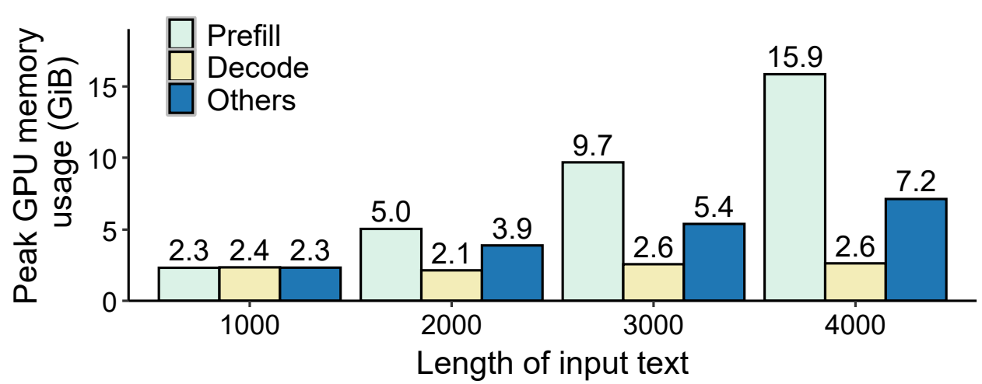
Background and Motivation
An evaluation on NVIDIA RTX 4090 with FlexGen
Fail to perform the inference when input prompt is larger than 4096
Prefill stage has high peak GPU memory usage!
Notes:
However，we find that the prefill stage can crash, before the first token comes out.
For example, FlexGen crashes when the input prompts is larger than 4096 on NVIDIA RTX 4090.
To enable the generative inference with long prompts in resource-constrained systems, we take a more detailed analysis in the memory usage.
Let me show you our observation.

Slide 9
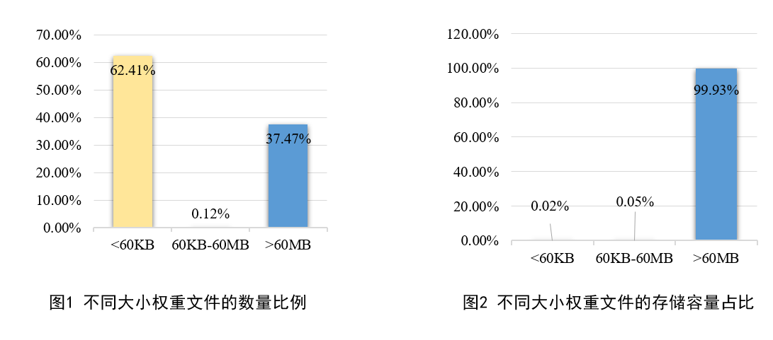
Background and Motivation
Observation 1:
Model parameters can be partitioned based on the usage
Partition sizes are various
Number of partitions
Total size
Notes:
First, we find that model parameters can be partitioned based on their usage.
For example, for OPT-30B, after the partitioning, around 62% of partitions are smaller than 60 KB.
The aggregated volume of these small partitions only counts on 0.02% out of the total capacity of the model.
This observation indicates that, there is a chance to cache small partitions in the GPU memory all the time to speed up the inference.

Slide 10
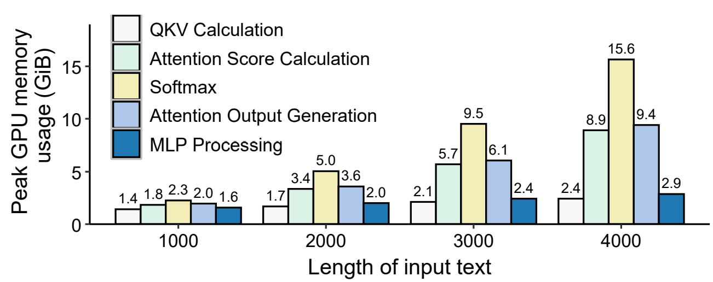







Background and Motivation
Observation 2:
Peak memory usage can be calculated before the actual computation
Computation inside a transformer block can further be partitioned
Matrix multiplication
Matrix addition
Softmax
$$Q=X∙WQ$$
$$K=X∙WK$$
$$\frac{Q∙KT}{\sqrt{dK}}$$
Softmax( $\frac{Q∙KT}{\sqrt{dK}}$ )
X_{out} = Softmax( $\frac{Q∙KT}{\sqrt{dK}}$ ) $∙$ V $∙$ W_{O} + X
X’ = ReLU(X_{out} $∙$ W₁) $∙$ W₂ + X_{out}
$$V=X∙WV$$
Notes:
Secondly, the inference can crash at different steps in the prefill. And the prefill is more likely to crash in step 2, 3, and 4, which
Performs operations such as matrix multiplication.
However, the peak memory usage can be calculated before the actual computation, such that we can predict whether
the peak memory usage will exceed the memory limitation.
This provides us the opportunity to partition the compution into sub-operations before the inference actually starts, such
That sub-operations will not exceed the memory limitation.

Slide 11
Our Contributions
HyperGen: Optimizing Generative Inference with Long Prompts for Resource-Constrained Systems
Size-aware parameter partitioning
Step-aware computation partitioning
Memory usage estimation
Computation scheduling based on memory pressure
Results:
Extends the maximum prompt length by up to 3.8x
Reduces the TTFT by up to 36.7%
Improves the throughput by up to 25.2%
Notes:
Based on these two observation, we propose HyperGen, which applies an idea of partitioning to efficiently utilize the memory resources.
We propose size-aware parameter partitioning as well as step-aware computation partition,
Which extends the maximum prompt length by up to 3.8 times, reduces the TTFT by up to 36.7%, and improves the throughput by up to 25.2%

Slide 12
HyperGen Design
Size-aware parameter partitioning
Divide parameters into groups based on different transformer blocks
Divide each group into fragments based on different weight matrices
Keep small fragments in GPU memory
Parameters in
Transformer Block 1
W_{Q}
W_{K}
W_{V}
Model
Parameters
Parameters in
Transformer Block 2
……
W_{O}
W₁
W₂
Parameters in
Transformer Block n
Notes:
Let me first introduce the size-aware parameter partitioning.
We divide parameters into groups based on different transformer blocks.
Then, in each group, we divide parameters into different fragments based on different weight matrices.
Thus, we keep small fragments in GPU memory, while loading larger fragments dynamically when needed.

Slide 13
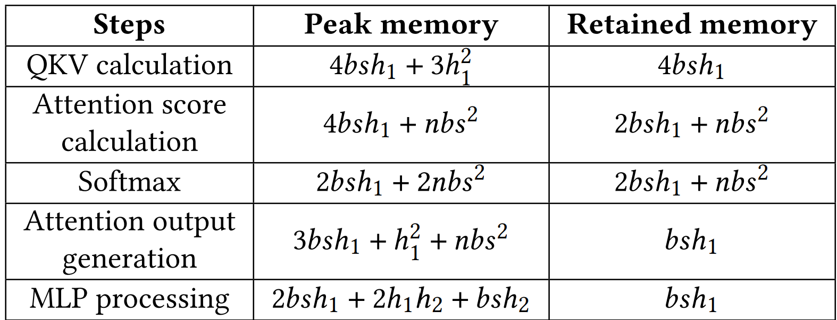
HyperGen Design
Size-aware computation partitioning
Memory usage estimation
input prompt length: s
batch size: b
hidden layer dimensions
h₁: for attention
h₂: for MLP processing
n: attention heads
Types of memory pressure
Moderate pressure
Severe pressure
severe
moderate
Notes:
Let me first introduce the size-aware parameter partitioning.
We divide parameters into groups based on different transformer blocks.
Then, in each group, we divide parameters into different fragments based on different weight matrices.
Thus, we keep small fragments in GPU memory, while loading larger fragments dynamically when needed.

Slide 14
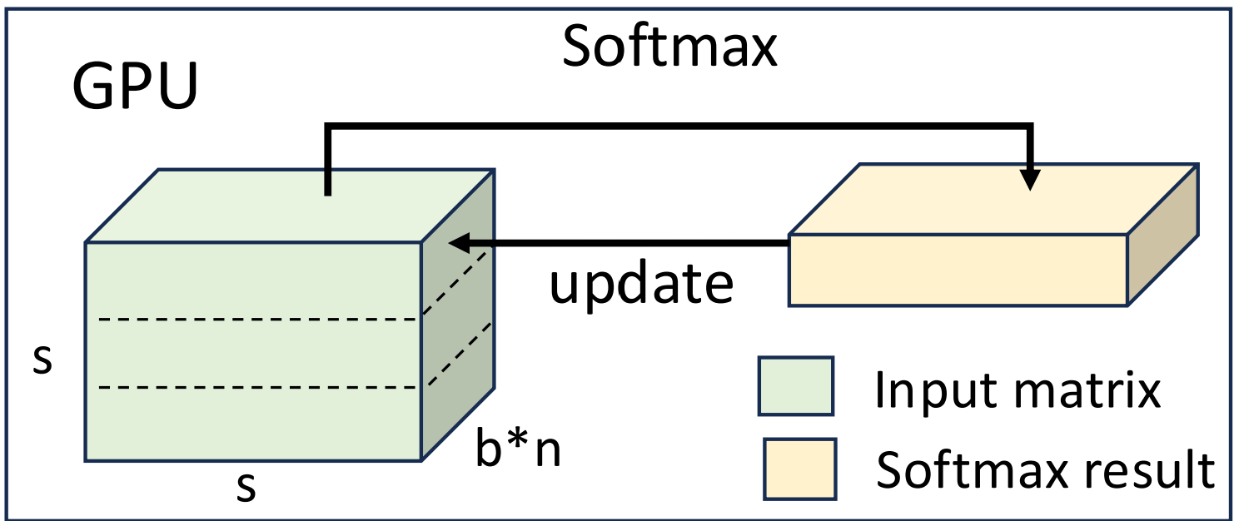

HyperGen Design
Size-aware computation partitioning
Partitioning for moderate pressure
Input of Softmax (A) reside in GPU memory
Partition the input into small splits based on available memory
Calculate Softmax of each splits in GPU
Update A with the Softmax result of each split
Softmax( $\frac{Q∙KT}{\sqrt{dK}}$ )
A
Notes:
For moderate pressure, we partition the input matrix of softmax into small splits based on the available memory.
Then, we perform softmax on splits one by one, such that they each split fits well into the available memory

Slide 15
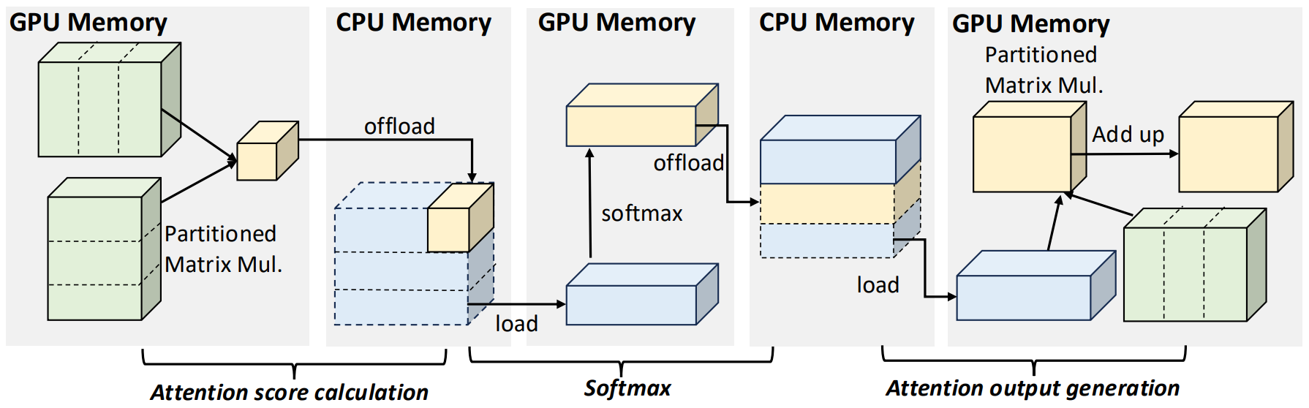
HyperGen Design
Size-aware computation partitioning
Partitioning for severe pressure
Attention score calculation: fine-grained matrix multiplication
Softmax: similar for moderate pressure
Attention output generation: fine-grained matrix multiplication
Notes:
For severe pressure, we carefully perform the partition for different operations.
For attention score calculation, which performs matrix multiplication, we partition the two input matrices of the matrix multiplication,
Such that we only calculate a small part of the final matrix.
For Softmax, we apply similar ideas from moderate pressure.
For Attention output generation, which also performs matrix multiplication, we also perform fine-grained partition for matrices.
As a result, HyperGen enables generative inference of long prompts.

Slide 16
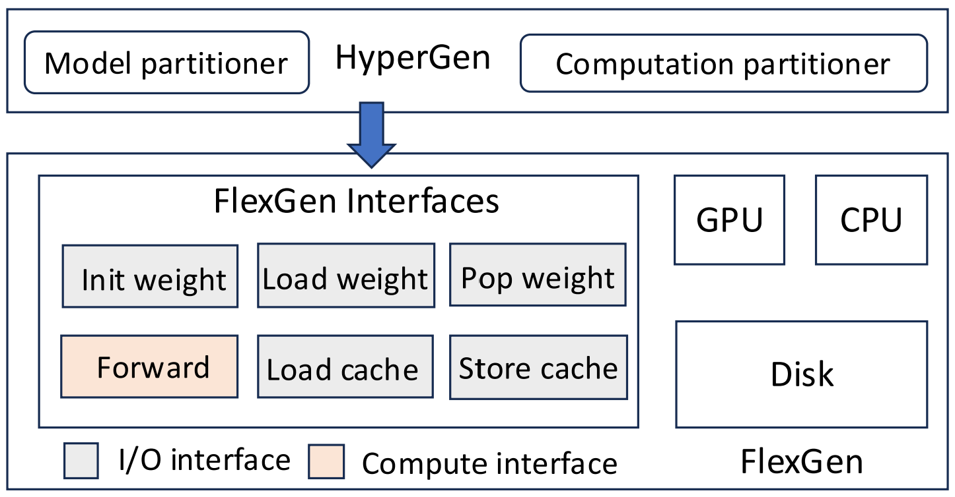
Implementation
HyperGen is implemented based on FlexGen with 325 LoC
Model Partitioner
Size-aware model partitioning
Computation Partitioner
Step-aware computation partitioning
Notes:
We implement HyperGen based on FlexGen with only 325 LoC.

Slide 17
Evaluation
Platform
An NVIDIA GeForce RTX 4090 GPU (24 GiB GDDR6X)
A 48-core Intel Xeon Silver 4310 CPU (2.1 GHz)
256 GiB DDR4 memory
Linux kernel version 5.15.0, CUDA 11.8, PyTorch 2.4.1
Parameters
Batchsize: 4, Output tokens: 32, Output tokens: 512
Available GPU memory: 4GiB
OPT-30B: h₁=7168, h₂=28672, n=56
OPT-66B: h₁=9216, h₂=36864, n=72
Notes:
and evaluate it in a machine with an NVIDIA RTX 4090 GPU

Slide 18
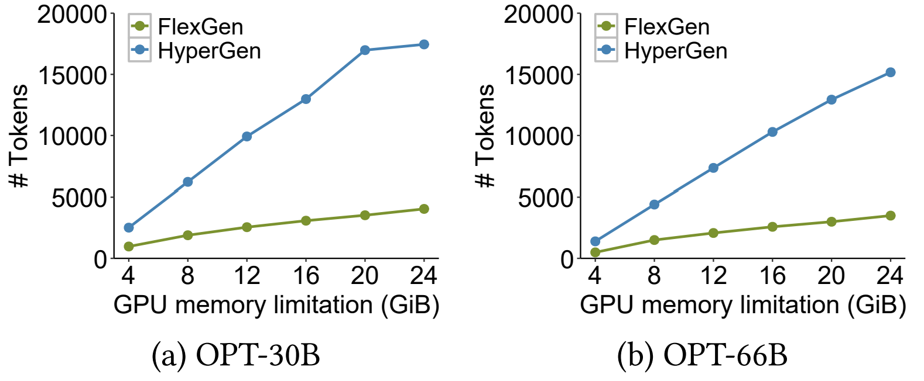
Evaluation
Maximum Prompt Length
OPT-30B: up to 3.8× improvements
OPT-66B: up to 3.3× improments
Notes:
Our evaluation shows that HyperGen improves the maximum prompt length by up to 3.8 and 3.3 times compared with FlexGen for OPT-30B and OPT-66B model.

Slide 19
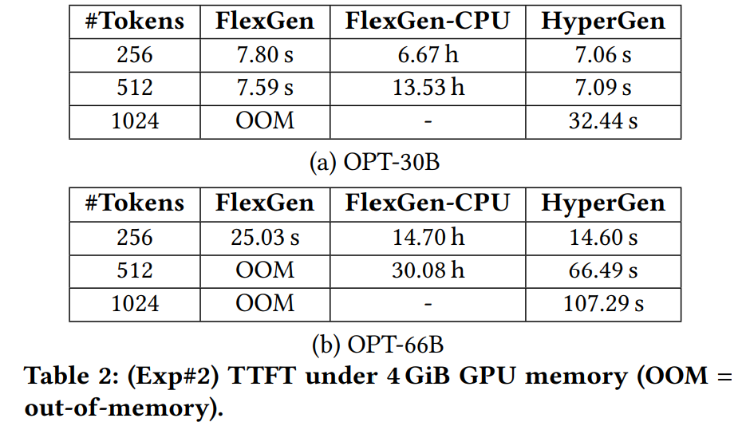
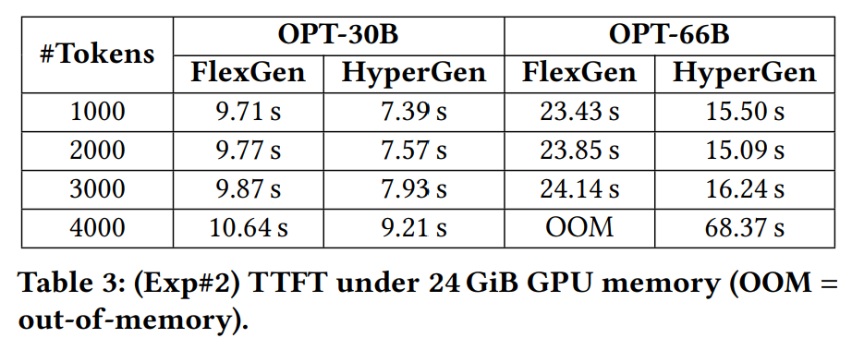
Evaluation
Latency analysis
Notes:
HyperGen reduces the TTFT by up to 36.7% for OPT-66B model, due to the size-aware partitioning for model parameters.

Slide 20
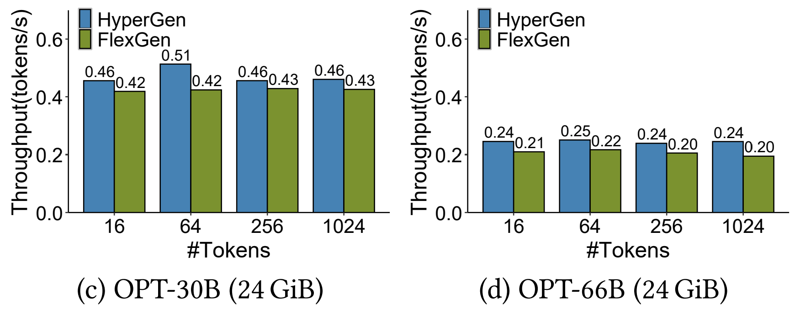
Evaluation
Throughput analysis
Notes:
HyperGen improves the throughput by up to 25.2% for OPT-66B model.

Slide 21
Conclusion and Future Work
Conclusion
Detailed peak memory usage analysis for resource-constrained systems
Size-aware model partitioning and pressure-aware computation partitioning
Enable generative inference with long prompts in resource-constrained systems
Future work
How does HyperGen work in multiple GPUs？
Can HyperGen support smaller models？
How does HyperGen works with other optimization techniques？
Notes:
For a conclusion, we perform a detailed peak memory usage analysis for generative inference in resource-constrained systems,
And propose HyperGen based on the idea of partitioning, which enables generative inference with long prompts in resource constrained systems.
We consider it as our future work to address the problems of enabling HyperGen with multiple GPUs, smaller models, and other optimization techniques.

Slide 22
Thank You! Q & A
Notes:
Thank you. I’d like to take your questions and comments.

