Slide 1

Group 7: JOIN OVER SKEWED DATASET Uday Shrinivas

Slide 2
Problem: Data Skewness
Data Skewness is a common problem in distributed processing(Imbalance in data). Whenever a key occurs several times in a column and the same column is used for join, this will lead to Data Skewness.
Example:- Table A = Million records(Large Dataset)
Table B = Million records(Large Dataset)
Join Condition => A.id = B.id

Slide 3
Disadvantage of Data Skewness
Performance of Spark job is impacted. Because Joins between big tables require shuffling data and the skew can lead to an extreme imbalance of work in the cluster
Job runs for longer time than usual
Resources allocated to spark job are not utilized, because most of the resources would be idle without performing any task.
Although Spark is known for its Distributed processing, we won’t be able get the advantage of that processing.

Slide 4

Pearson’s second coefficient of skewness :-
If the skewness is between -0.5 & 0.5, the data are nearly symmetrical.
If the skewness is between -1 & -0.5 (negative skewed) or between 0.5 & 1(positive skewed), the data are slightly skewed.
If the skewness is lower than -1 (negative skewed) or greater than 1 (positive skewed), the data are extremely skewed

Slide 5
Existing Solution:
Now let's assume that A was highly skewed in favor of id = 1. Reducers R2 and R3 will complete quickly but R1 will continue for a long time, thus becoming the bottleneck. If the user has information about the skew, the bottleneck can be avoided manually as follows:
Do two separate queries
select A.id from A join B on A.id = B.id where A.id <> 1;
select A.id from A join B on A.id = B.id where A.id = 1 and B.id = 1;
The first query will not have any skew, so all the Reducers will finish at roughly the same time. If we assume that B has only few rows with B.id = 1, then it will fit into memory. So, the join can be done efficiently by storing the B values in an in-memory hash table. This way, the join can be done by the Mapper itself and the data do not have to go to a Reducer. The partial results of the two queries can then be merged to get the final results.

Slide 6
Disadvantages:
The tables A and B must be read and processed twice.
Because of the partial results, the results also must be read and written twice.
The user needs to be aware of the skew in the data and manually do the above process.
They need to write two different queries all the time for different skewed keys.

Slide 7
Solution:
To avoid reading and writing twice, and to relax the assumption that the user is aware of the skewness and know exactly which keys are skewed.
We can improve this further by trying to reduce the processing of skewed keys. We tried to cast skewed customers data in memory and broadcast it to all the mappers.
We did broadcast join on the skewed keys and
For all other keys, send it to a reducer which does the join. This reducer will get rows of customers also from a mapper.

Slide 8
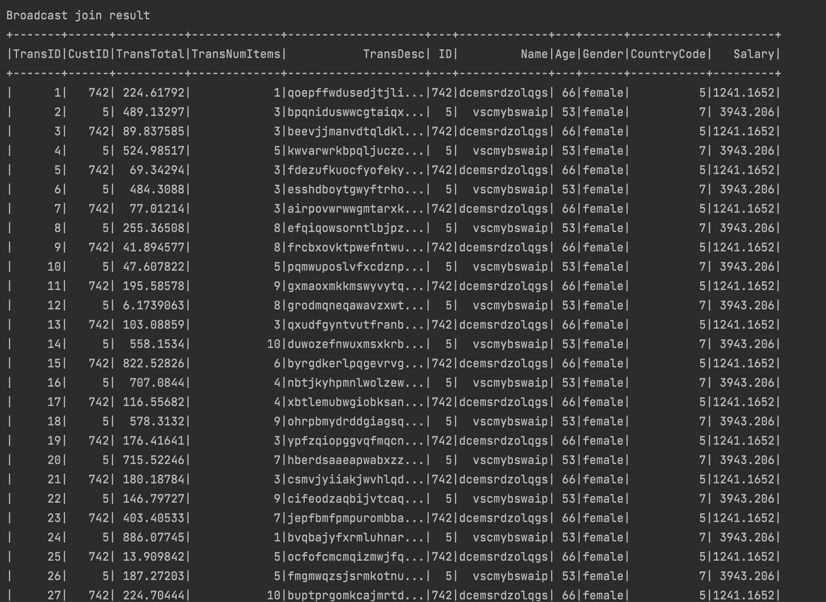
The output from the Broadcast:

Slide 9
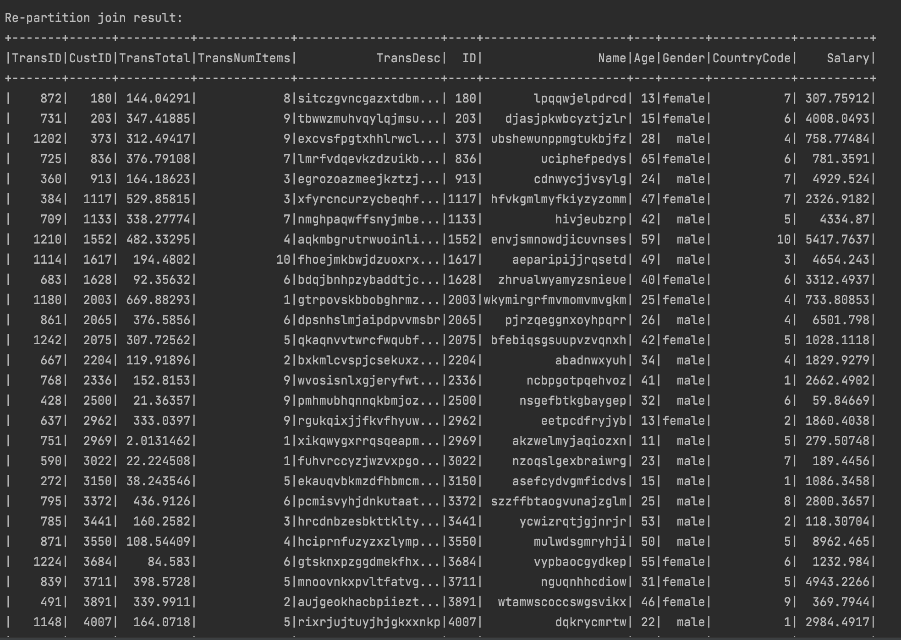
The output from the reduce side join :

Slide 10


Conclusion
To conclude, this optimization where we cast the skewed keys to the memory and perform broadcast join with repartition join on non skewed keys took about 4 nanoseconds.
Whereas single repartition join took about 10-11 nanoseconds.

