Slide 1
Simulation for
Wireless Sensor Networks

Slide 2
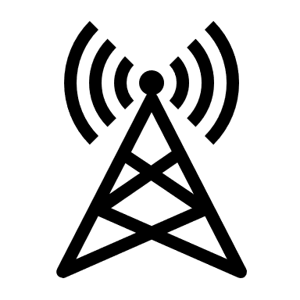


System Model
Antenna
QAM
S/P
ifft
CP
DM
fft
...01010001...
Scenario
Transmitter
Channel
Reveiver

Slide 3
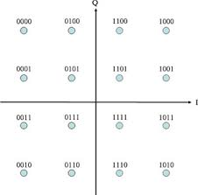
Transmitter
The transmitter is modeled under orthogonal frequency division multiplexing (OFDM) framework.
Sym₁
IFFT
Sym₁
Sym₁
Sym₁
Mapping to
Sym₂
Sym₂
...01010001...
S/P
CP
...
...
Sym_{N}
Sym_{N}

Slide 4
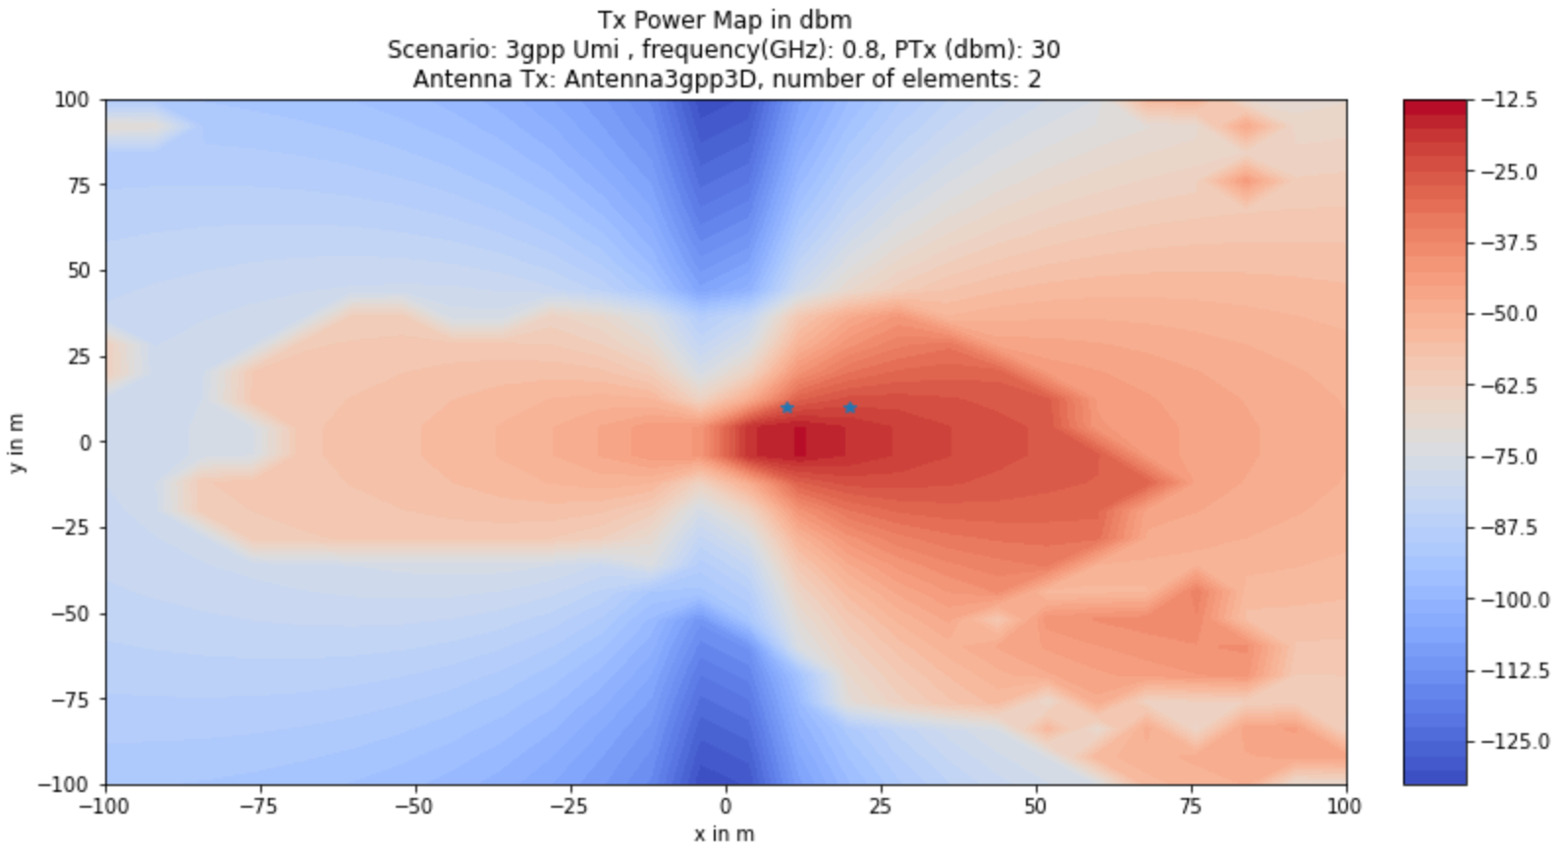
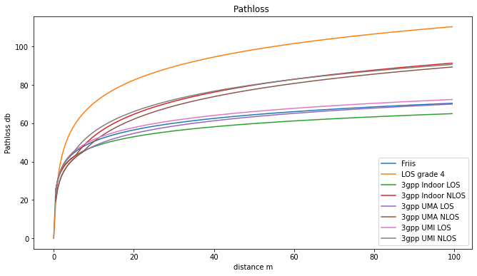
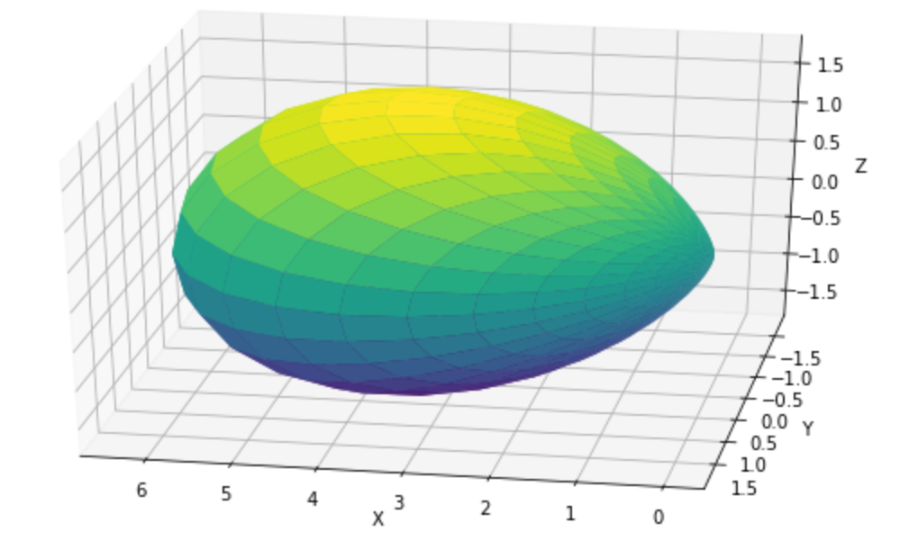
Channel Model^{[1]}
System Geometry: MIMO system
Antenna array
Radiation power pattern
Channel

Slide 5
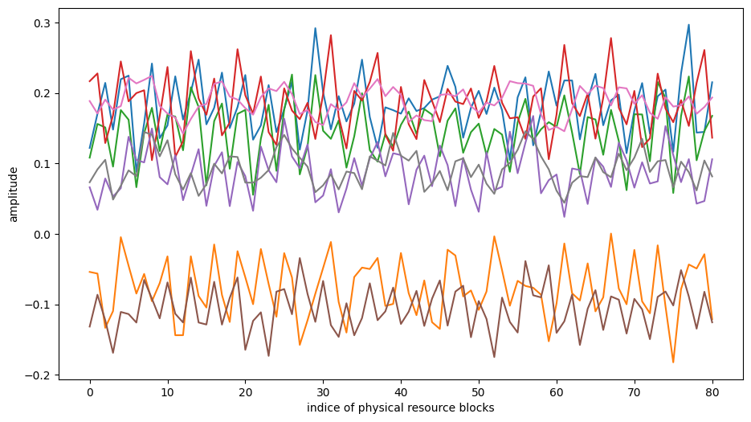
Channel response

Slide 6

Channel Model^{[2]}
Channel matrix
Path loss
Attenuation coefficient
Doppler drift
Synchornization offset
Antenna gain
Signal delay
Line of Sight: LOS
No line of sight: NLOS
Notes:
Depending on freq and dist

Slide 7
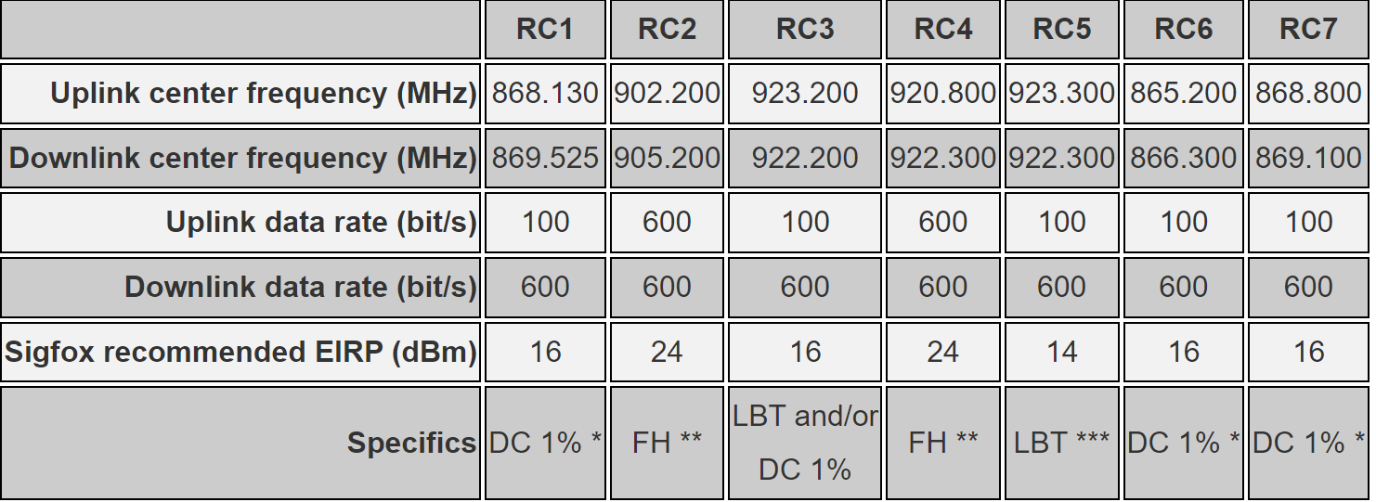
Device configuration with Sigfox
The Sigfox network globally works within the ranges from 862 to 928 MHz
Notes:
* DC: Duty cycle is 1% of the time per hour (36 seconds). For an 8 to 12 bytes payload, this means 6 messages per hour, 140 per day.
** FH: Frequency hopping: The device broadcasts each message 3 times on 3 different frequencies. Maximum On time 400 ms per channel. No new emission before 20 s.
*** LBT: Listen Before Talk: Devices must verify that the Sigfox-operated 200 kHz channel is free of any signal stronger than −80 dBm for RC3 and -65 dBm for RC5 before transmitting.

Slide 8
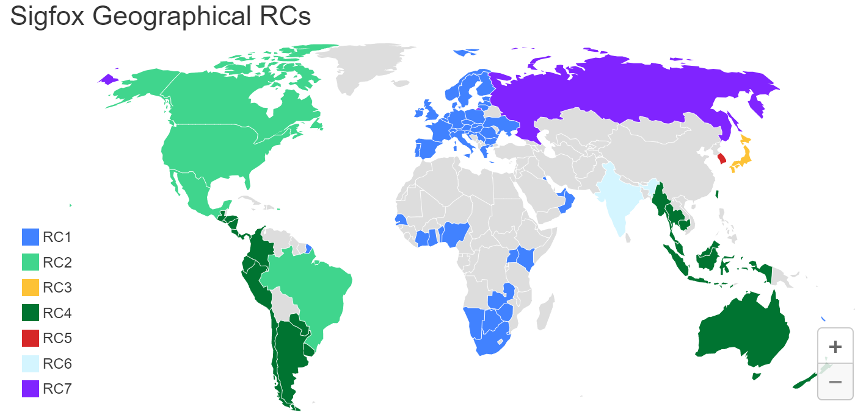
Sigfox Geographical RCs

Slide 9
Reference
[1] Hui Chen, Hadi Sarieddeen, Tarig Ballal, Henk Wymeersch, Mohamed-Slim Alouini, and Tareq Y Al-Naffouri. A tutorial on terahertz-band localization for 6g communication systems. arXiv preprint arXiv:2110.08581, 2021.
[2] A. Shahmansoori, G. E. Garcia, G. Destino, G. Seco-Granados,
and H. Wymeersch, “Position and orientation estimation through
millimeter-wave MIMO in 5G systems,” IEEE Trans. Wireless Commun., vol. 17, no. 3, pp. 1822–1835, Dec. 2017.

