Slide 1
Map configuration
1 km
#T transmitters
#S stations
…
…
eg: transmiters in shape20x20 - grid size: 50mx50m
1 km
…

Slide 2
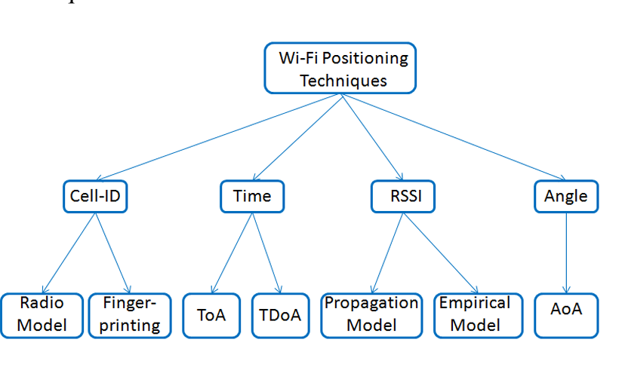
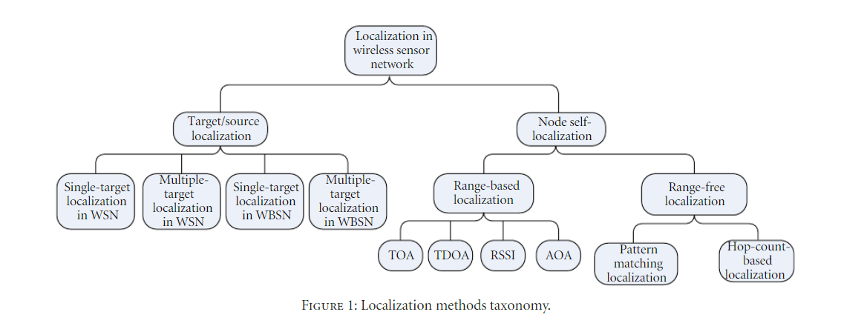
Methodolody
Fingerprinting localization: requires heavy data collection and database maintenance; deterministic
RF geometrics localization (RSSI, ToA, TDoA, AoA)
Notes:
https://zhuanlan.zhihu.com/p/45392067

Slide 3
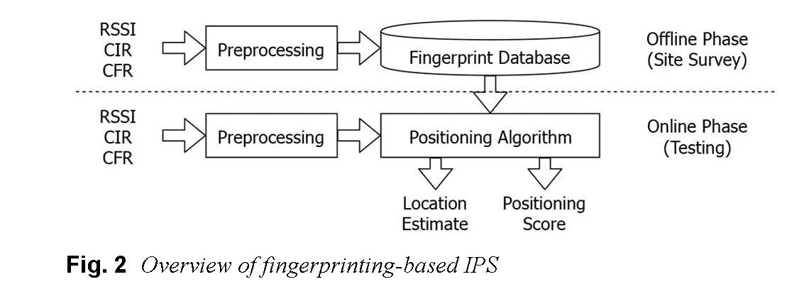
Localization method
Range-free
Range based

Slide 4
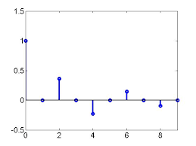
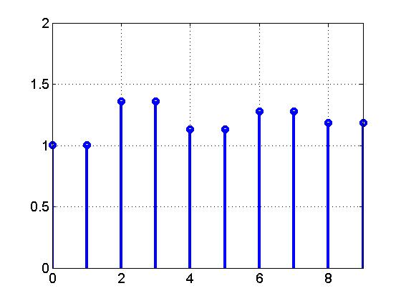
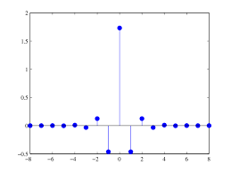
Max length
Τ₁₁ a₁₁
Τ₁₂ a₁₂
0
0
0
0
…
R
flatten
…
T1
T2
…
a1
a2
…
T
…
…
T1
T2
T3
…
a1
a2
a3
…
flatten
Dataset: T × (R*(M*2))
Τ₂₁ a₂₁
Τ₂₂ a₂₂
Τ₂₃ a₂₃
0
0
…
Max length M

Slide 5
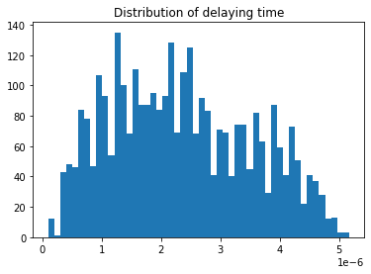
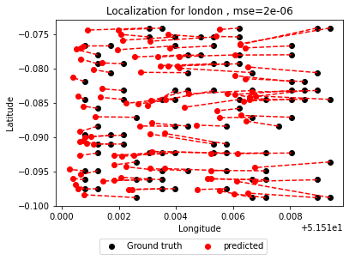
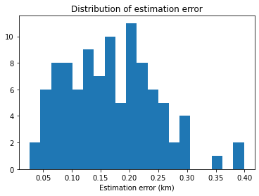
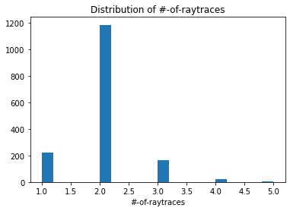
London
Grid size ~ 0.05 km by 0.09 km

Slide 6
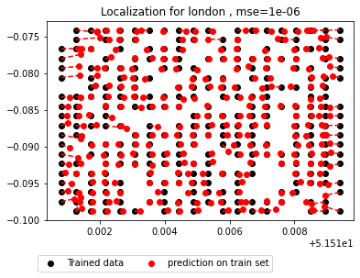
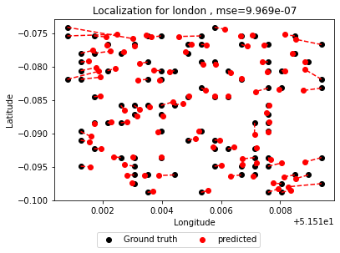
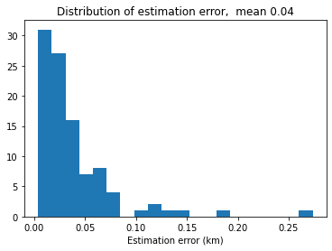
London - RF
Grid size ~ 0.05 km by 0.14 km

Slide 7
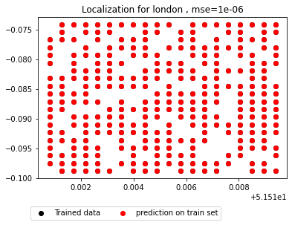
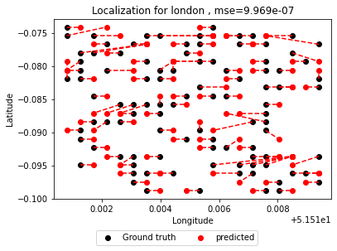
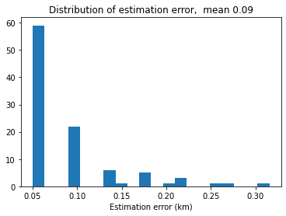
London - DT
Grid size ~ 0.05 km by 0.14 km

Slide 8
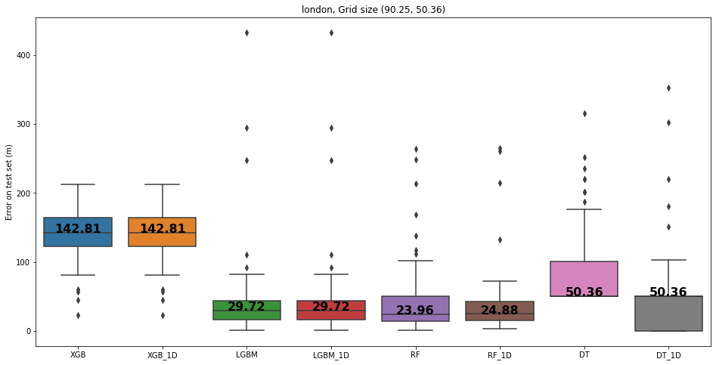

Slide 9
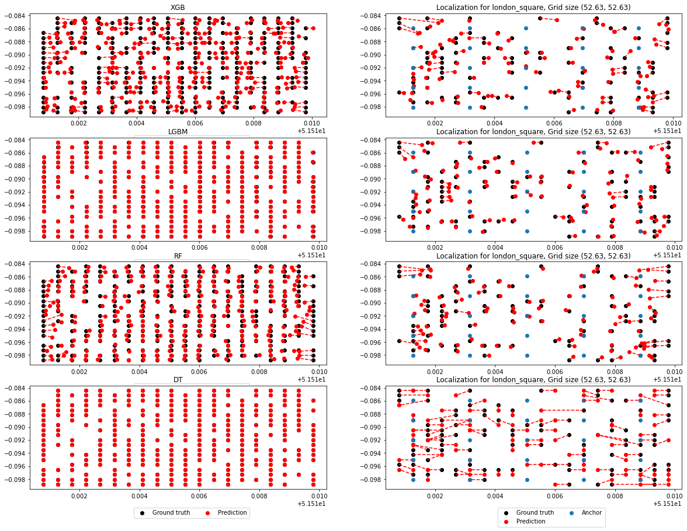

Slide 10
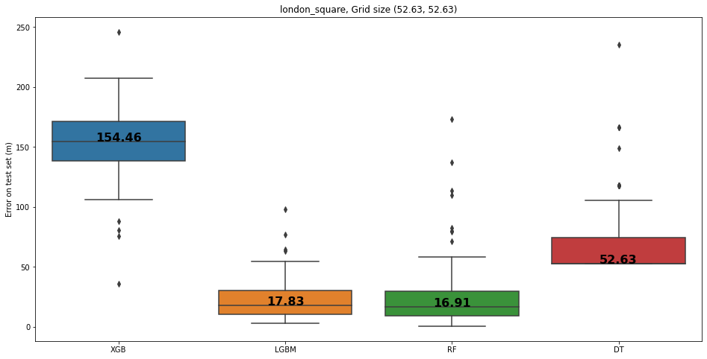
Square grids

Slide 11
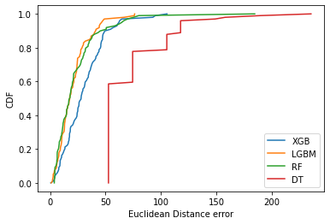
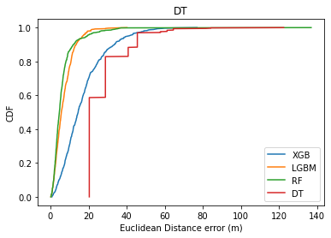

Slide 12
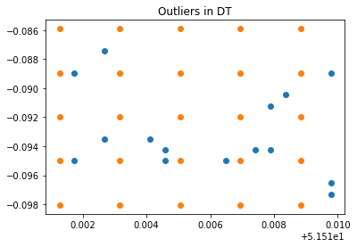
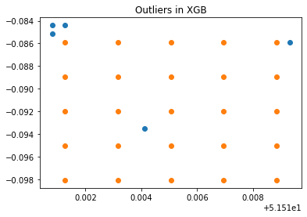
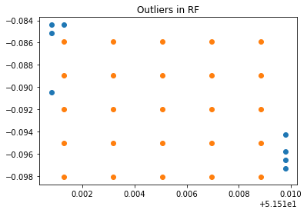
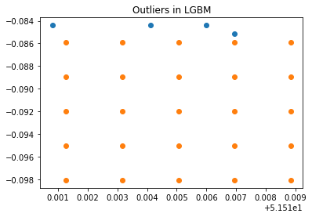
Outliers (London, square grids, 25 stations)

Slide 13
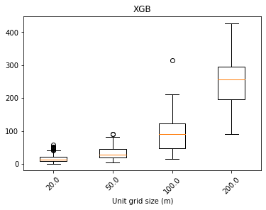
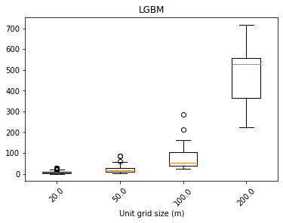
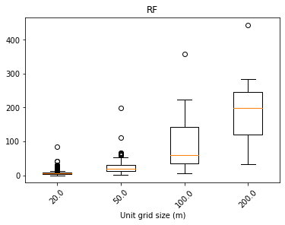
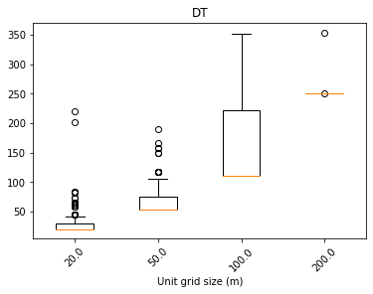

Slide 14
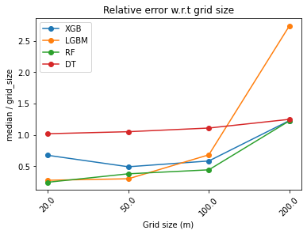

Slide 15
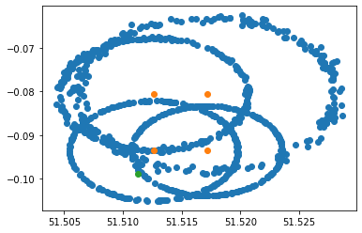

Slide 16
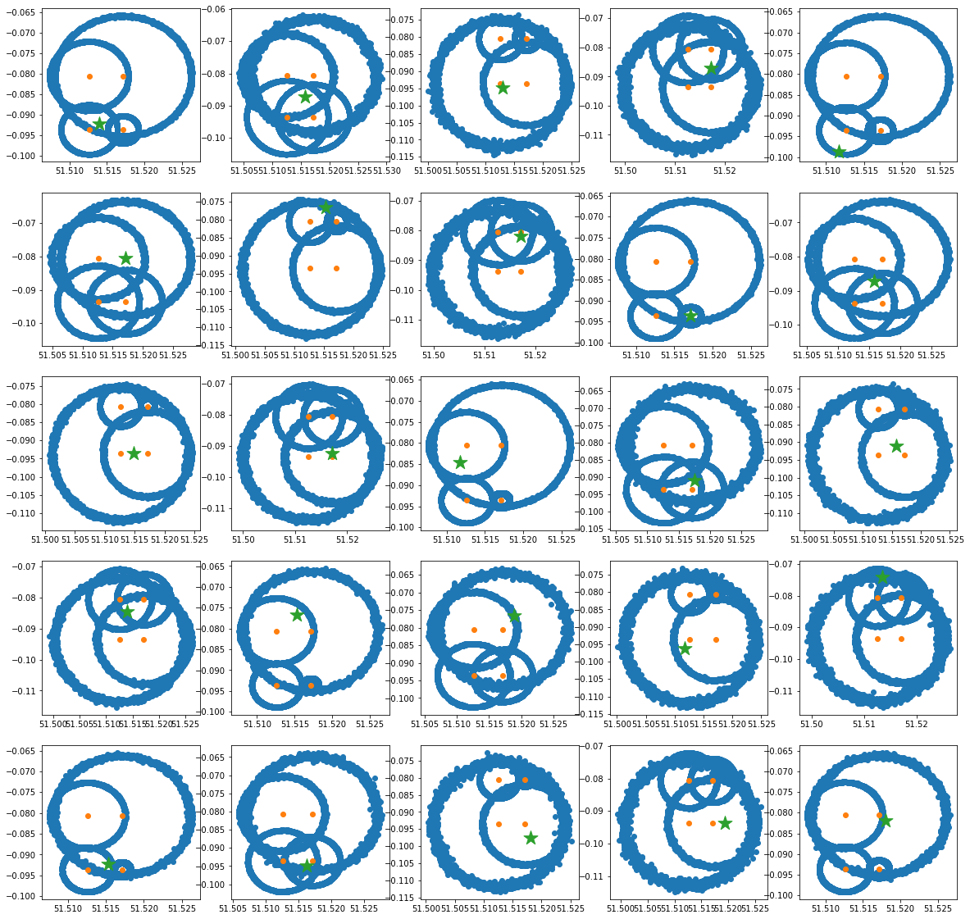
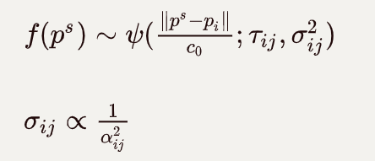
Result based on London map

Slide 17
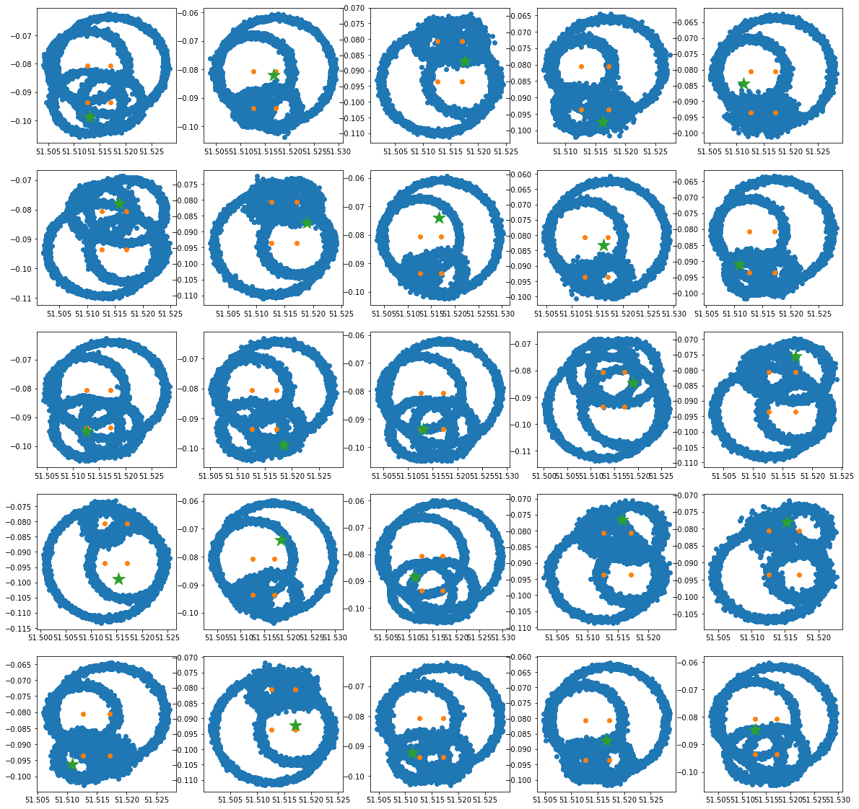
Sampling on larger std
1e-6

Slide 18
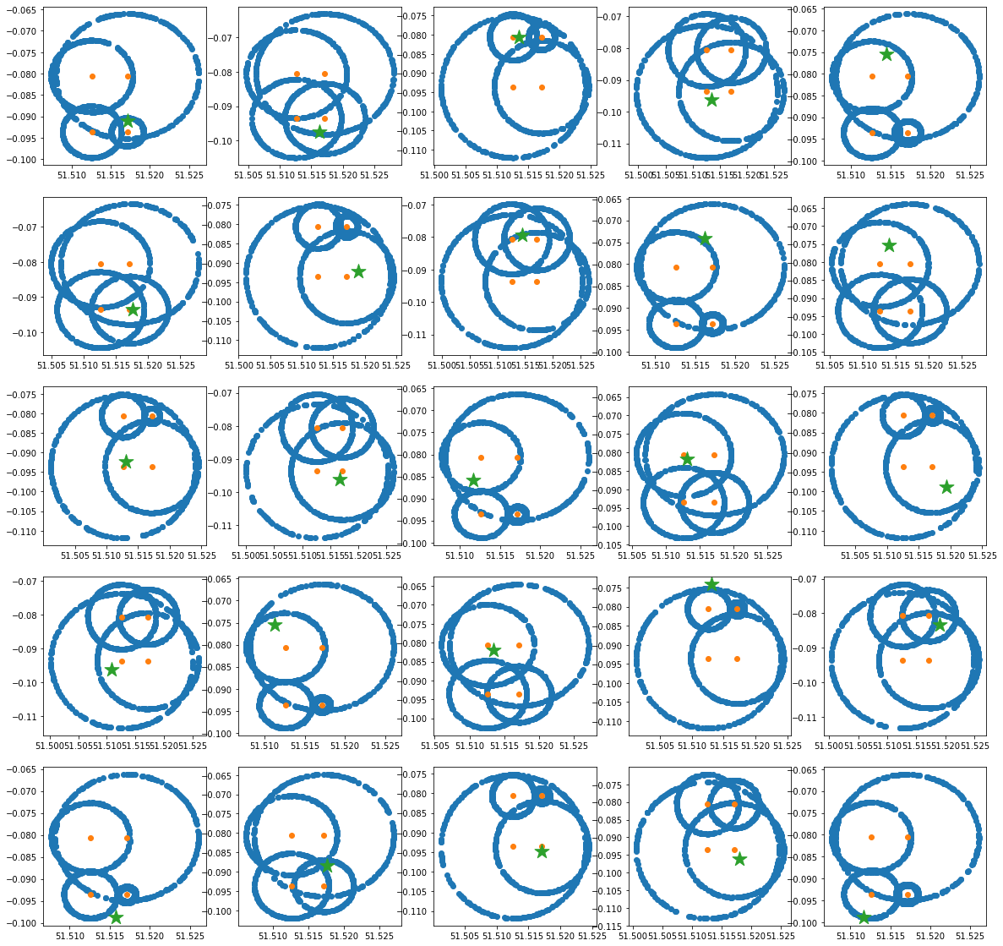
D=tau*c0

Slide 19
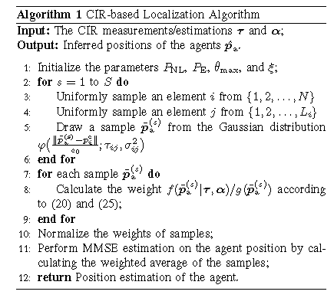
Statistical method^{[1]}

Slide 20
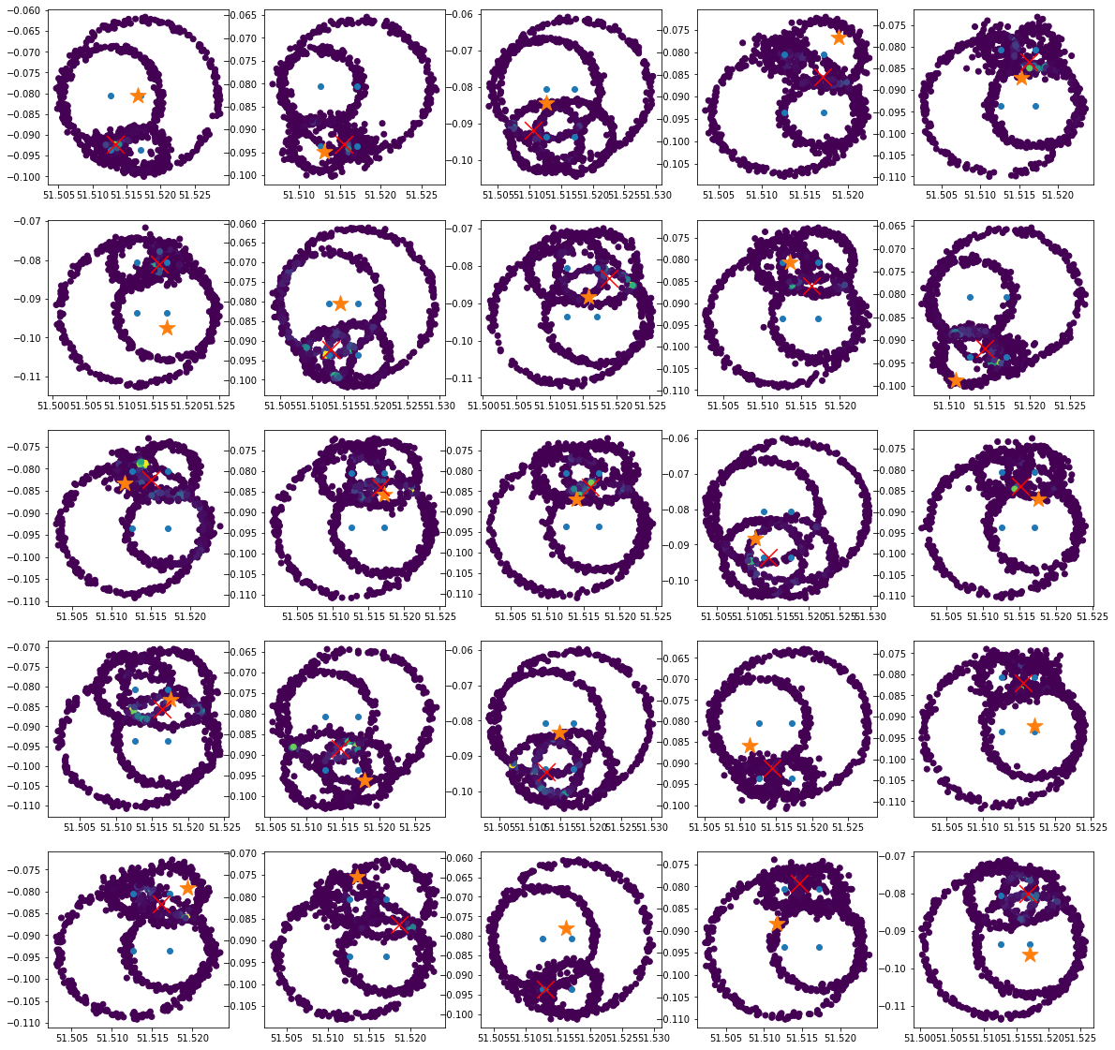
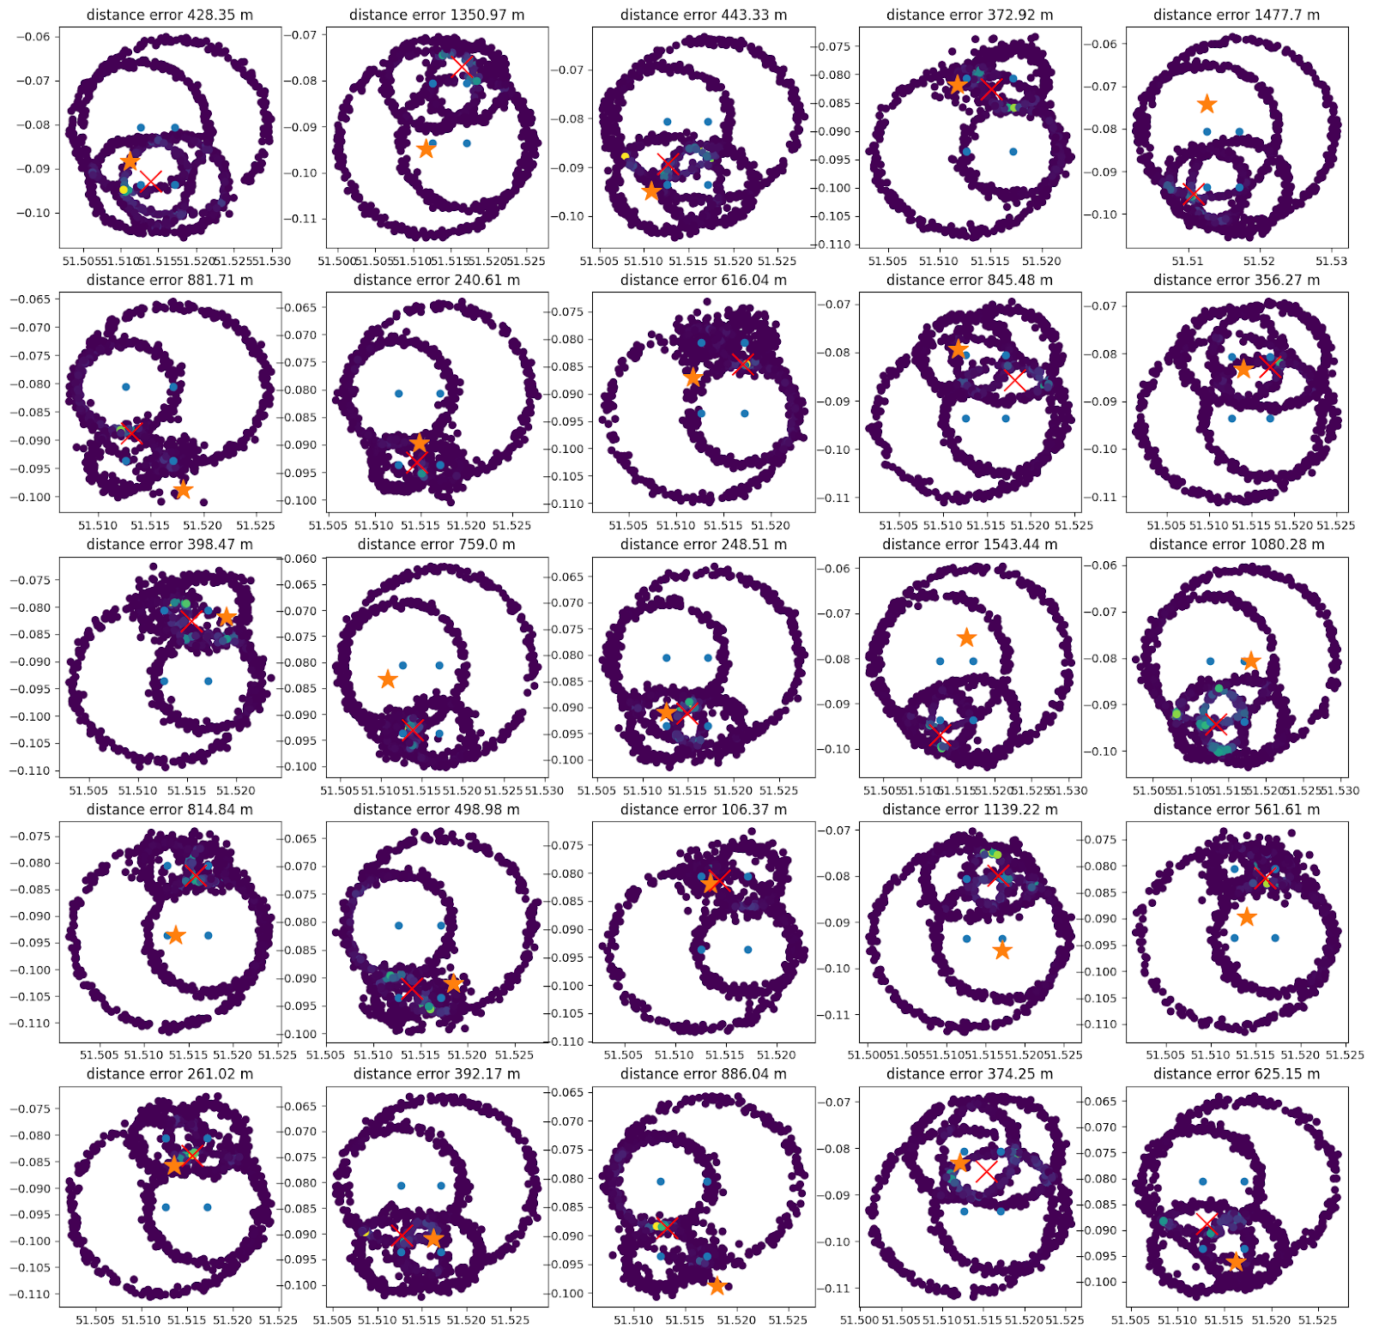

Slide 21
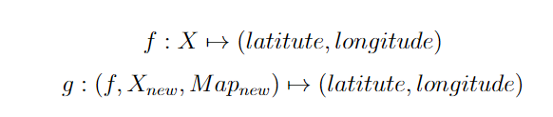
Transfer learning
Learning model on data from London, predict on data from Paris.
Difficulties:
Reconciling data: signals from London may be in different shape as the ones in Paris
Fusing signal data with map information (multimodal)

Slide 22
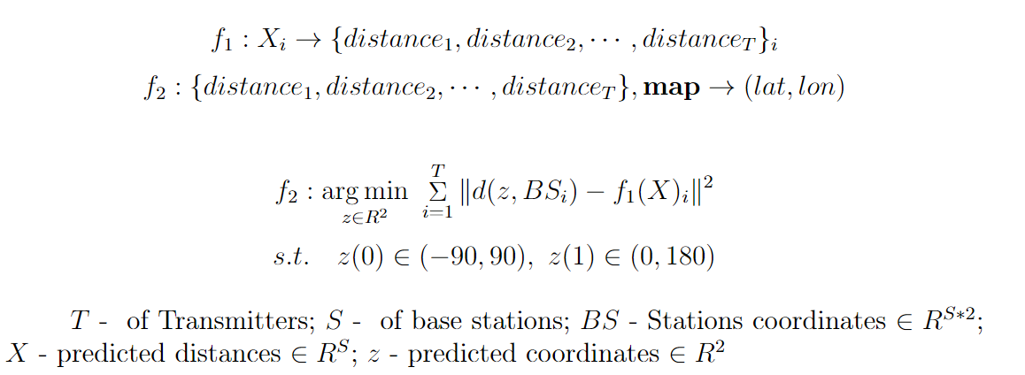
Map info
Regressor
Optimizer
CIR
dist
Lat
Lon
Learning & encoding Transfering
d*₁
d*₂
d*₄
d*₃

Slide 23
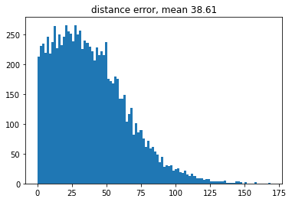
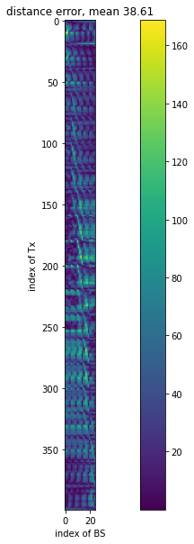
Map info
Regressor
Optimizer
CIR
dist
Lat
Lon
Learning & encoding Transfering
d₁
d₂
d*₁
d*₂
d₄
d₃
d*₄
d*₃

Slide 24
Source_{Train}
Training
Source_{Test}
Map info
Target
Regressor
Optimizer
dist
Lat
Lon
Learning & encoding Transfering

Slide 25
preprocessing
Fingerprint database
Measurements
Offline
Online
Measurements
preprocessing
Positioning algorithm
Location
position

Slide 26
Source
Regressor
Offline training
Online testing
Target
Regressor
Distance
Optimizer
Latitude
Longitude
Rx position

Slide 27
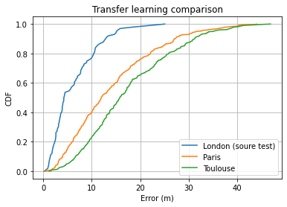
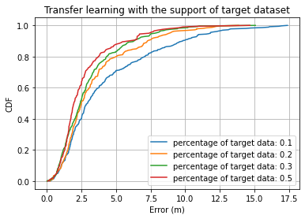
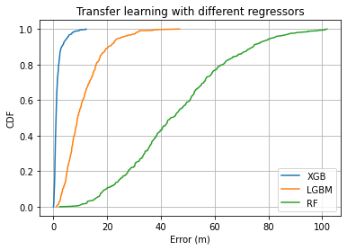
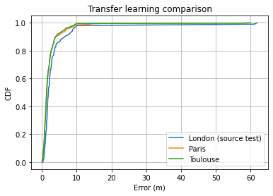
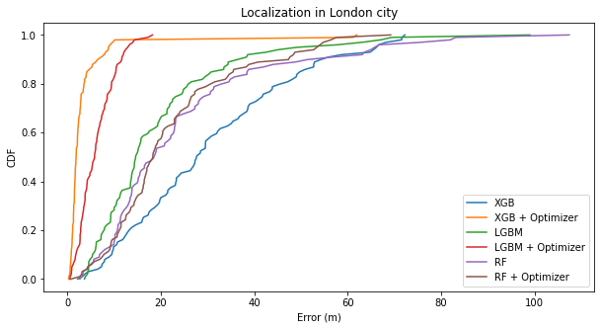
Grid size: 50m
Source: London
Target: Paris, Toulouse

Slide 28
Further improvement
More realistic scenario (noisy signal, indoor+outdoor transmission etc)
Adaptive transfer learning (known few target data)
More tests, bigger dataset
Self supervised learning
Algorithm improvement (Optimization part)

Slide 29
Reference
[1] Z. Yu, Z. Liu, F. Meyer, A. Conti and M. Z. Win, "Localization Based on Channel Impulse Response Estimates," 2020 IEEE/ION Position, Location and Navigation Symposium (PLANS), 2020, pp. 1014-1021, doi: 10.1109/PLANS46316.2020.9110161.

Slide 30
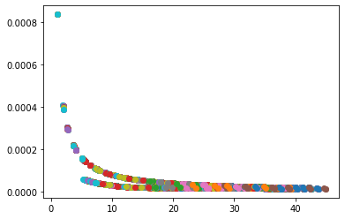

Slide 31
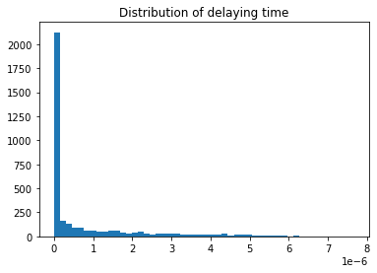
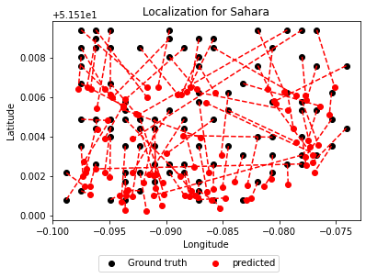


London (Minimize propagation delay)
Grid size ~ 0.05 km by 0.14 km

Slide 32




Sahara (Minimize propagation delay
Grid size ~1.1 km by 1.7 km

Slide 33



Sahara
Grid size ~ 1.1 km by 1.7 km

Slide 34





Sahara small
Grid size ~ 0.05 km by 0.13 km

Slide 35



Sahara small - RF

Slide 36



Sahara small – DT
Grid size ~ 0.05 km by 0.13 km

Slide 37


Slide 38




Outliers on sahara_small

Slide 39


