Slide 1
Map configuration
1 km
#T transmitters
#S stations
…
…
eg: transmiters in shape20x20 - grid size: 50mx50m
1 km
…

Slide 2
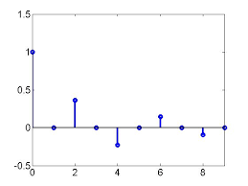
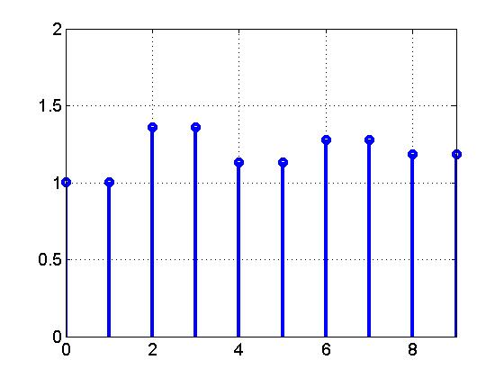
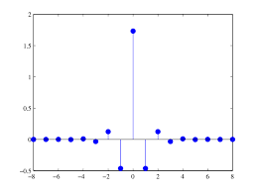
Max length
Τ₁₁ a₁₁
Τ₁₂ a₁₂
0
0
0
0
…
S
flatten
…
T1
T2
…
a1
a2
…
T
…
…
T1
T2
T3
…
a1
a2
a3
…
flatten
Dataset: T × (S*(max_len*2))
Τ₂₁ a₂₁
Τ₂₂ a₂₂
Τ₂₃ a₂₃
0
0
…
Max length

Slide 3
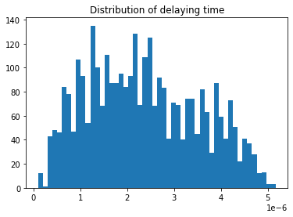
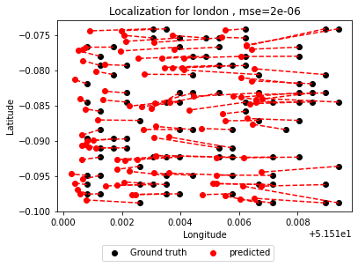
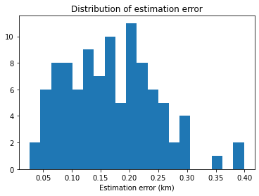
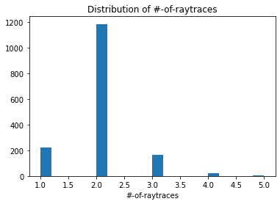
London
Grid size ~ 0.05 km by 0.09 km

Slide 4
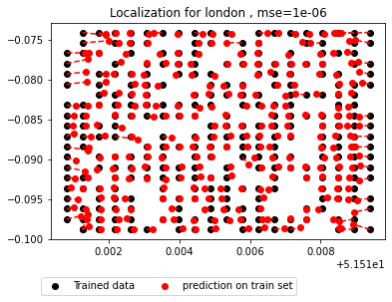
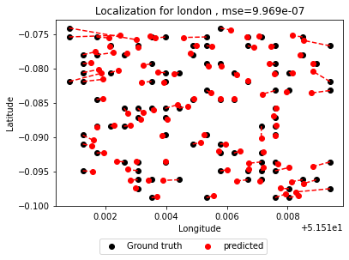
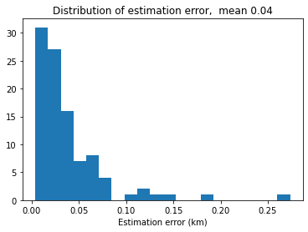
London - RF
Grid size ~ 0.05 km by 0.14 km

Slide 5
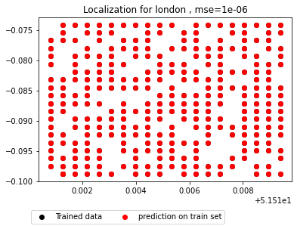
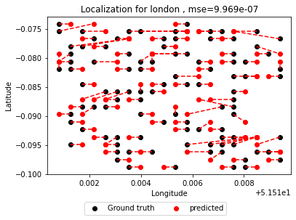
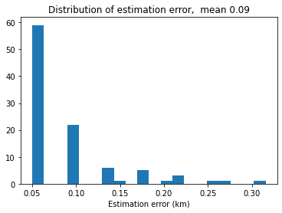
London - DT
Grid size ~ 0.05 km by 0.14 km

Slide 6
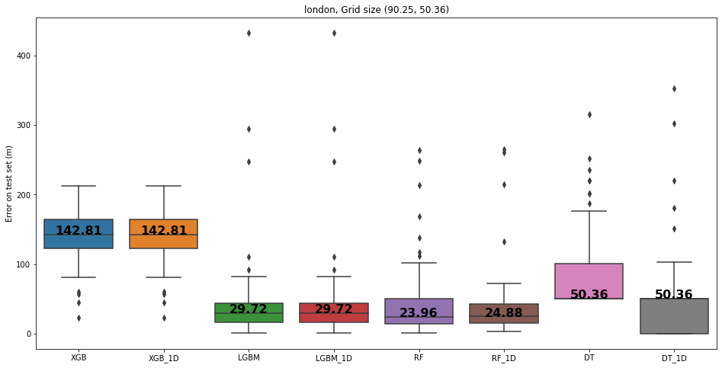

Slide 7
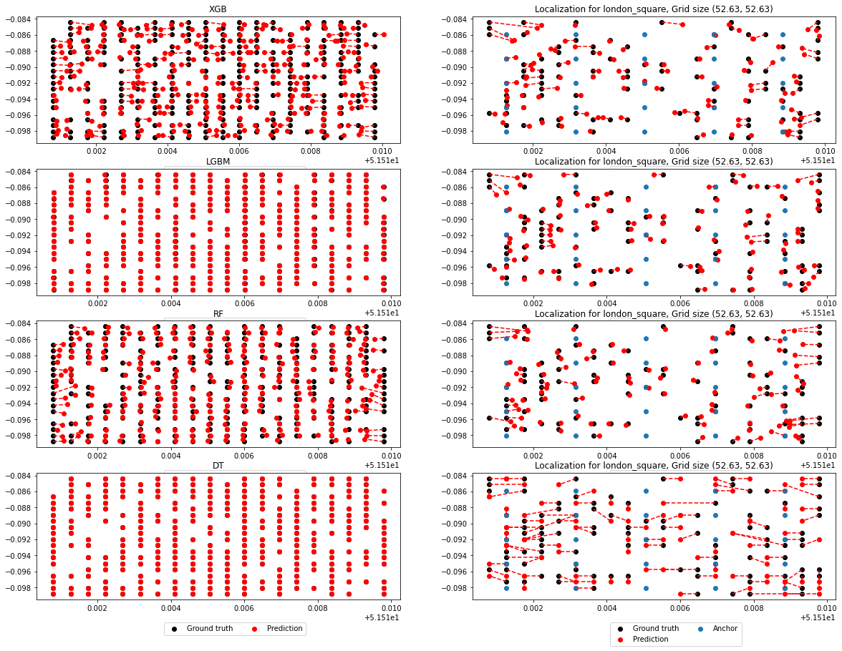

Slide 8
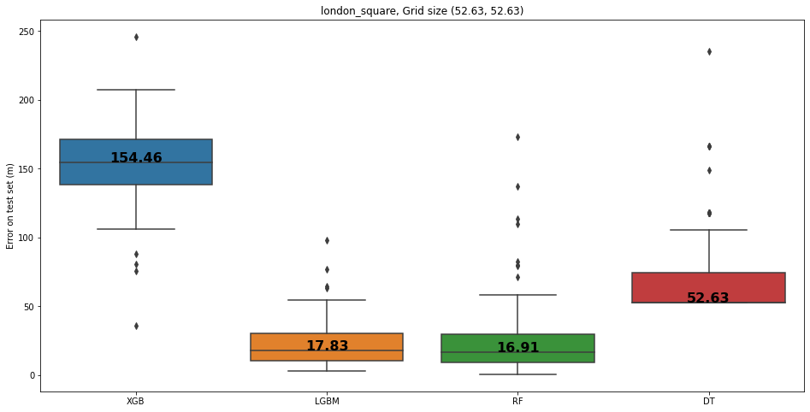
Square grids

Slide 9
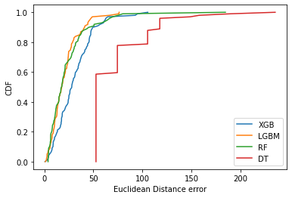

Slide 10
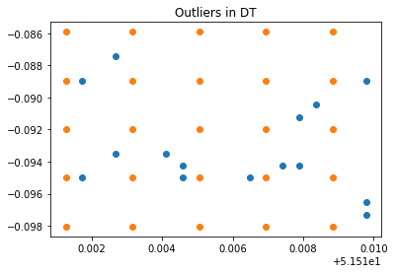
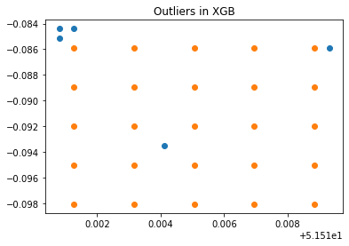
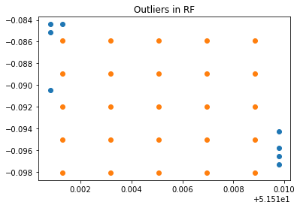
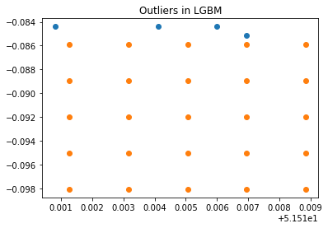
Outliers (London, square grids, 25 stations)

Slide 11
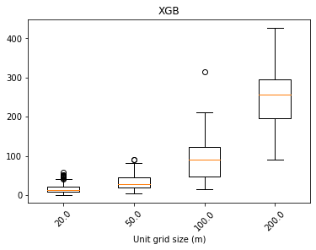
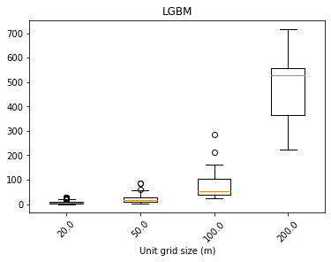
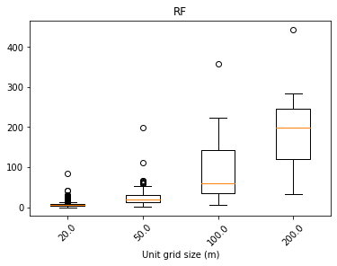
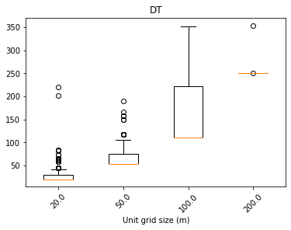

Slide 12
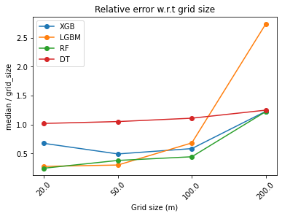

Slide 13
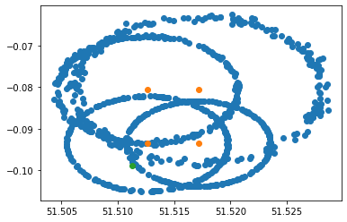

Slide 14
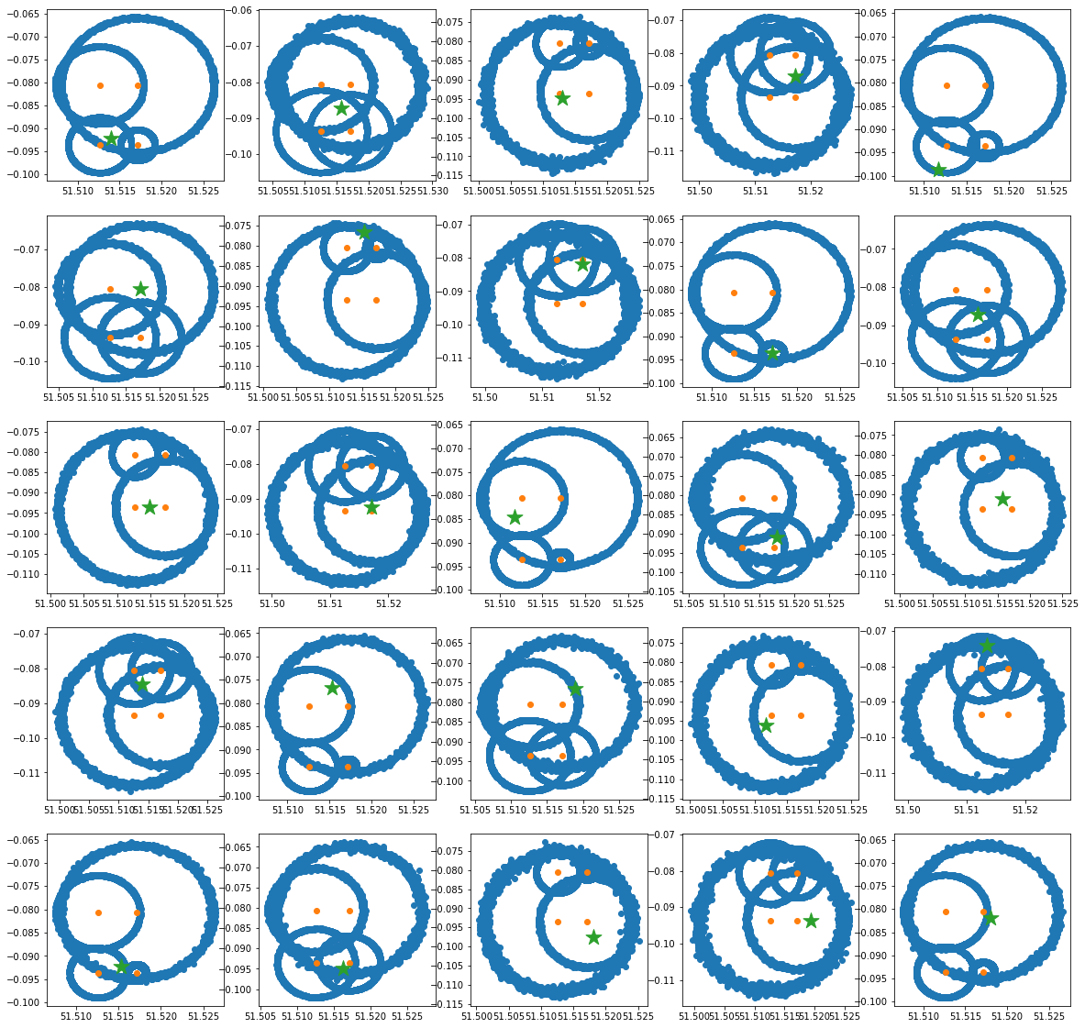
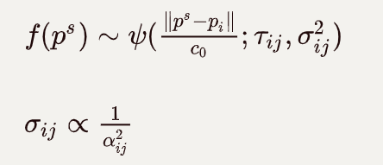
Result based on London map

Slide 15
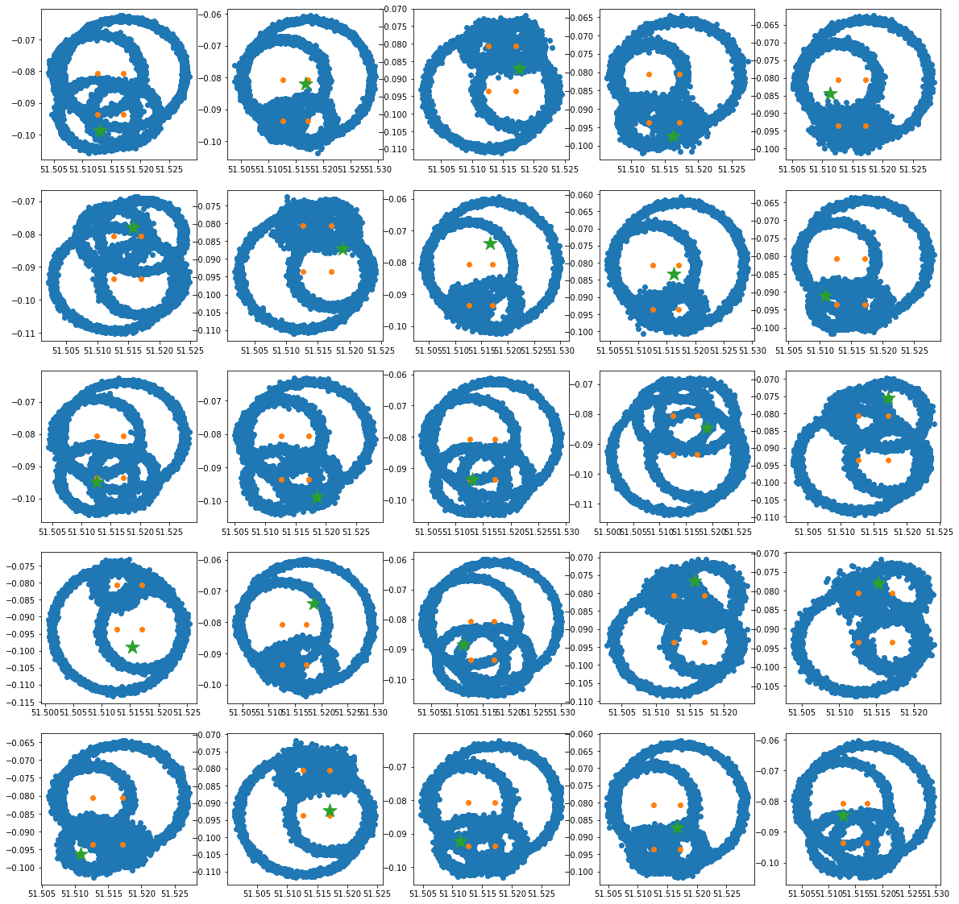
Sampling on larger std
1e-6

Slide 16
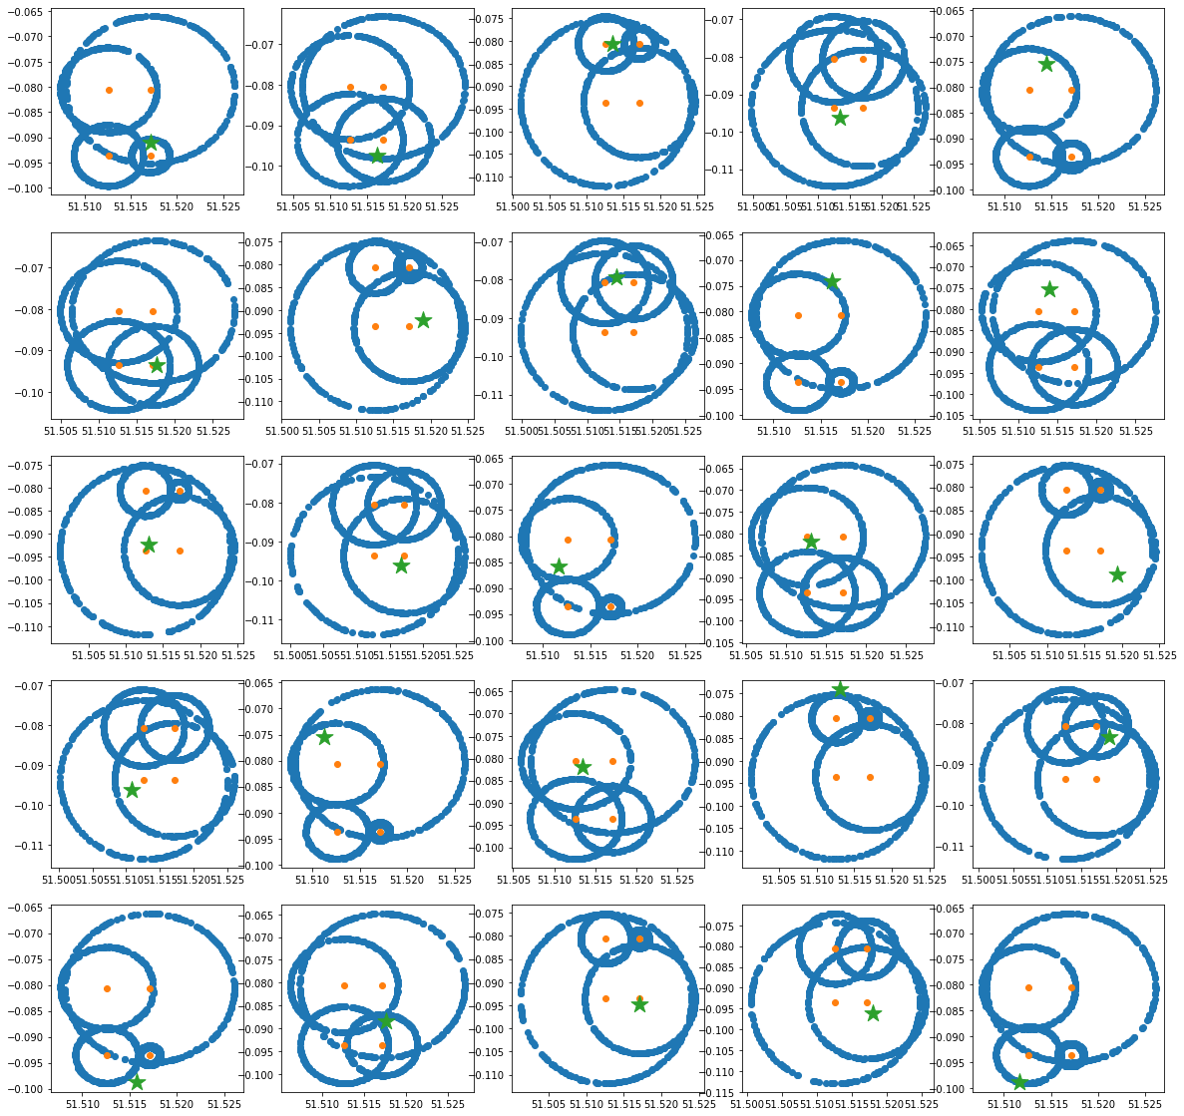
D=tau*c0

Slide 17
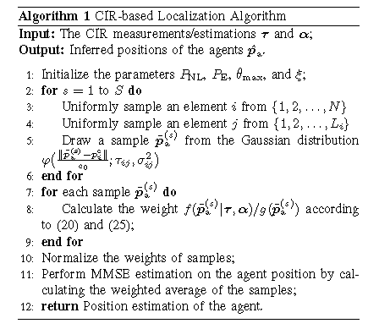
Statistical method^{[1]}

Slide 18
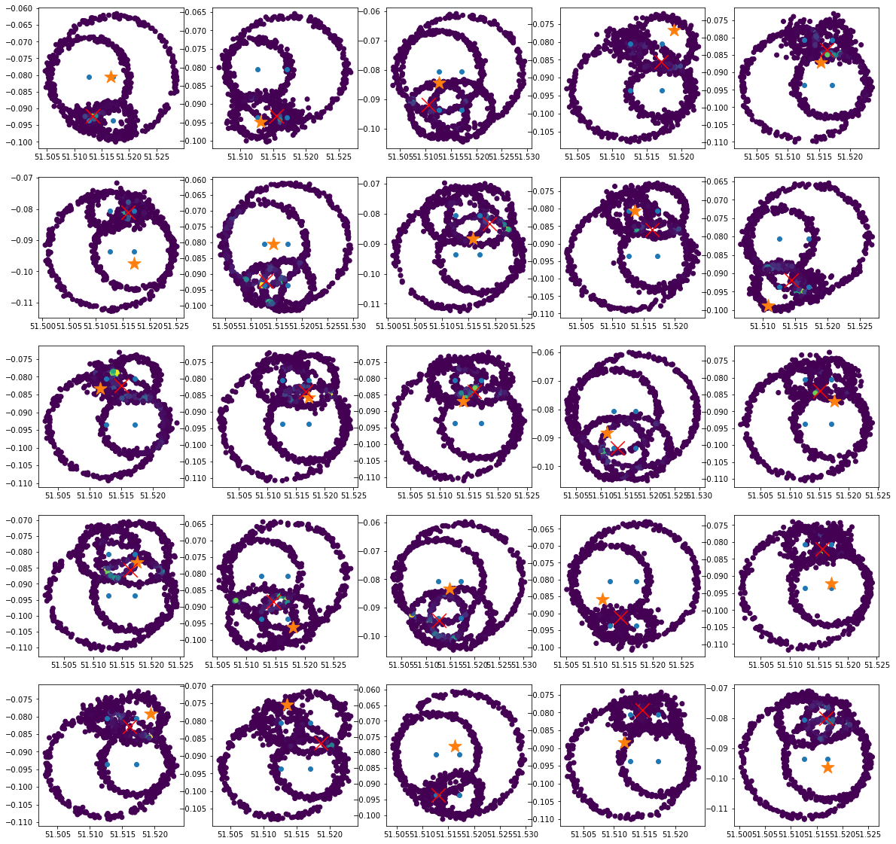
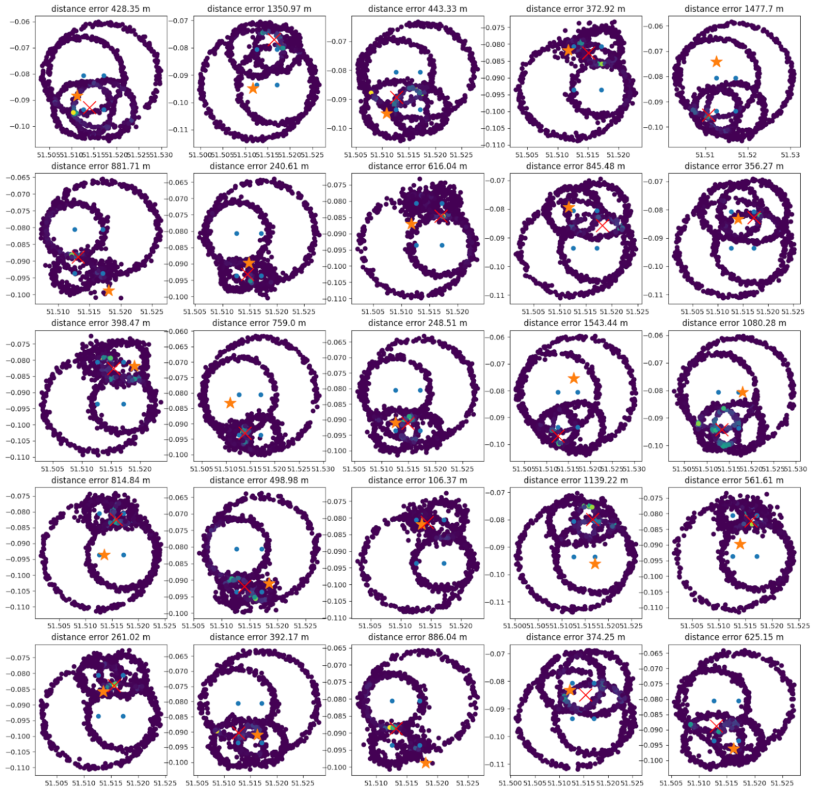

Slide 19
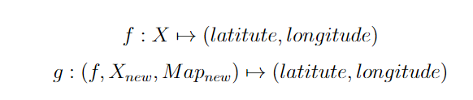
Transfer learning
Learning model on data from London, predict on data from Paris.
Difficulties:
Reconciling data: signals from London may be in different shape as the ones in Paris
Fusing signal data with map information (multimodal)

Slide 20
Reference
[1] Z. Yu, Z. Liu, F. Meyer, A. Conti and M. Z. Win, "Localization Based on Channel Impulse Response Estimates," 2020 IEEE/ION Position, Location and Navigation Symposium (PLANS), 2020, pp. 1014-1021, doi: 10.1109/PLANS46316.2020.9110161.

Slide 21
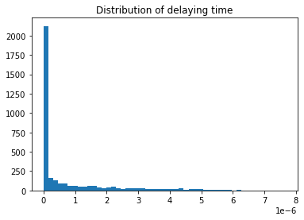
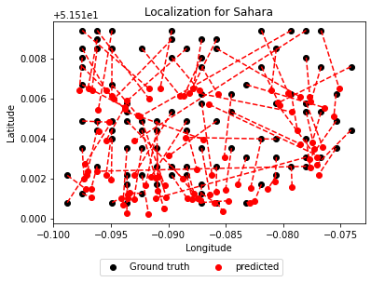
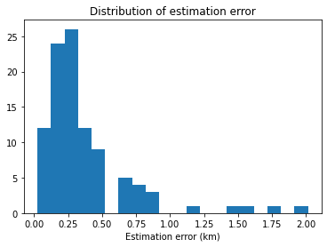
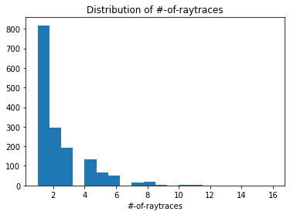
London (Minimize propagation delay)
Grid size ~ 0.05 km by 0.14 km

Slide 22
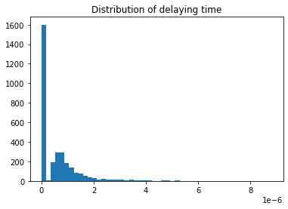
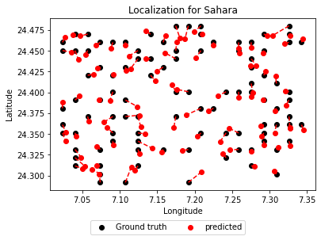
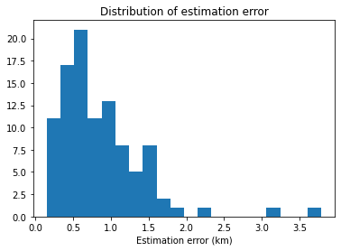
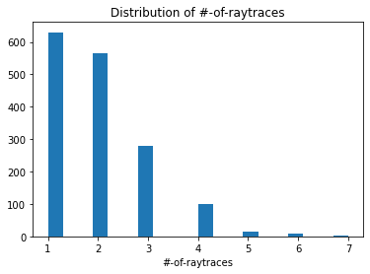
Sahara (Minimize propagation delay
Grid size ~1.1 km by 1.7 km

Slide 23
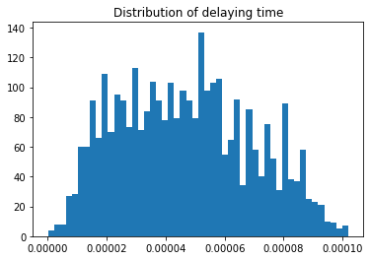
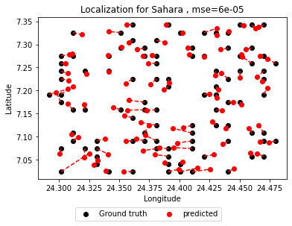
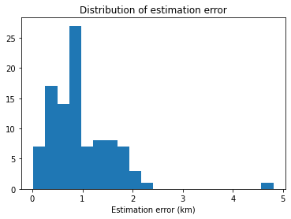
Sahara
Grid size ~ 1.1 km by 1.7 km

Slide 24
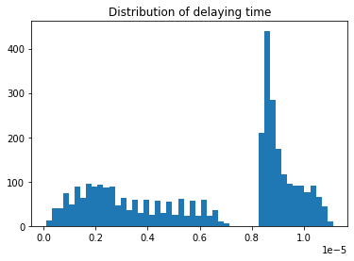
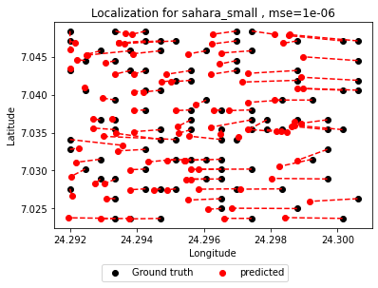
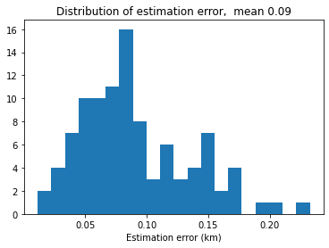
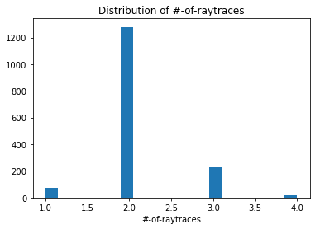

Sahara small
Grid size ~ 0.05 km by 0.13 km

Slide 25



Sahara small - RF

Slide 26



Sahara small – DT
Grid size ~ 0.05 km by 0.13 km

Slide 27


Slide 28




Outliers on sahara_small

Slide 29


