Slide 1
Map configuration
1 km
#T transmitters
#S stations
…
…
eg: transmiters in shape20x20 - grid size: 50mx50m
1 km
…

Slide 2
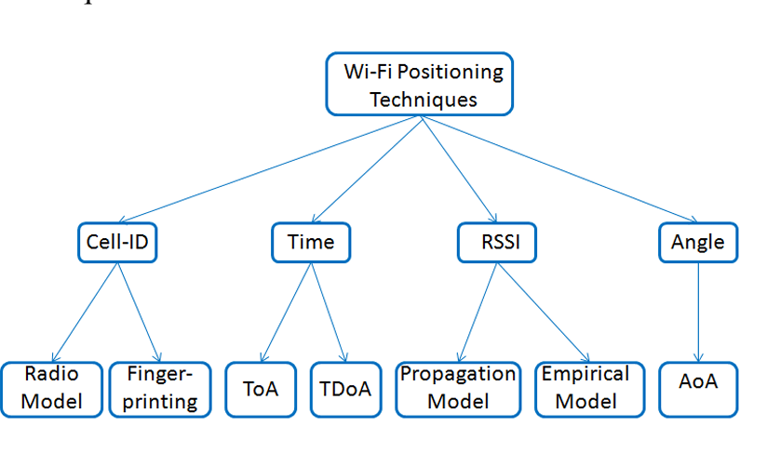
Methodolody
Fingerprinting localization: requires heavy data collection and database maintenance; deterministic
RF geometrics localization (RSSI, ToA, TDoA, AoA)
Notes:
https://zhuanlan.zhihu.com/p/45392067

Slide 3
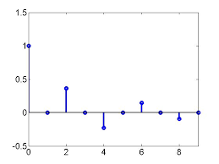
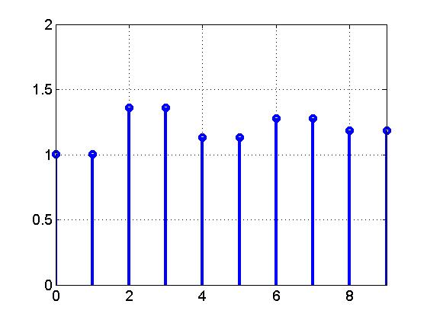
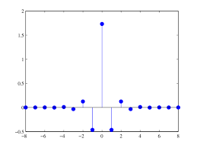
Max length
Τ₁₁ a₁₁
Τ₁₂ a₁₂
0
0
0
0
…
S
flatten
…
T1
T2
…
a1
a2
…
T
…
…
T1
T2
T3
…
a1
a2
a3
…
flatten
Dataset: T × (S*(max_len*2))
Τ₂₁ a₂₁
Τ₂₂ a₂₂
Τ₂₃ a₂₃
0
0
…
Max length

Slide 4
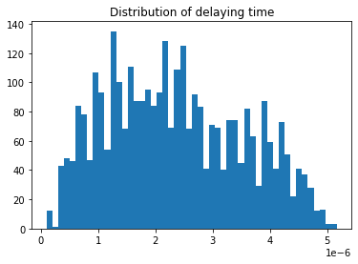
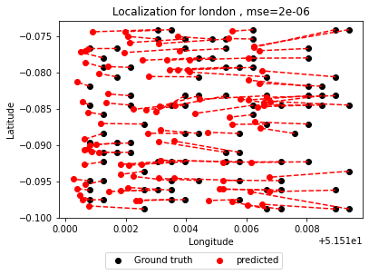
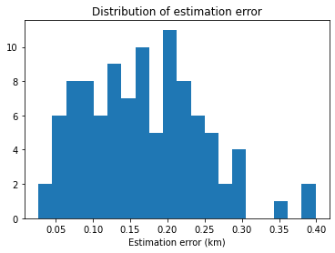
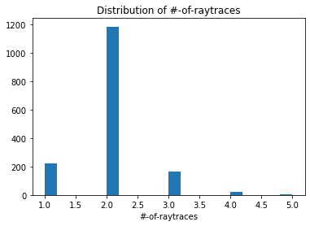
London
Grid size ~ 0.05 km by 0.09 km

Slide 5
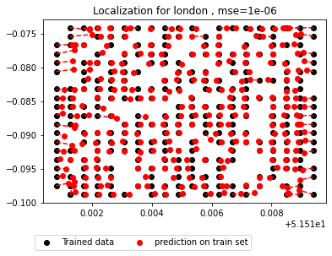
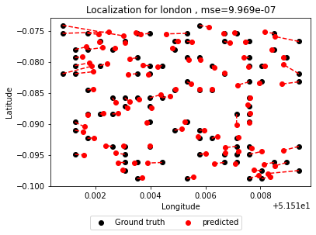
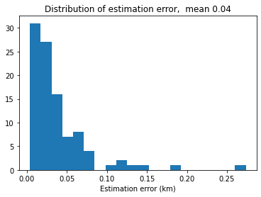
London - RF
Grid size ~ 0.05 km by 0.14 km

Slide 6
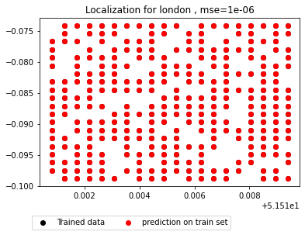
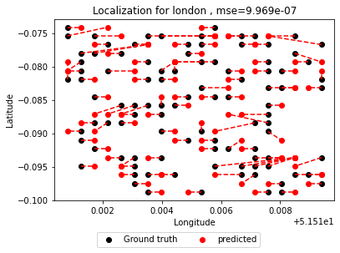
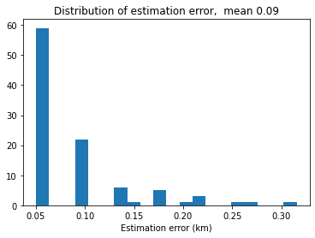
London - DT
Grid size ~ 0.05 km by 0.14 km

Slide 7
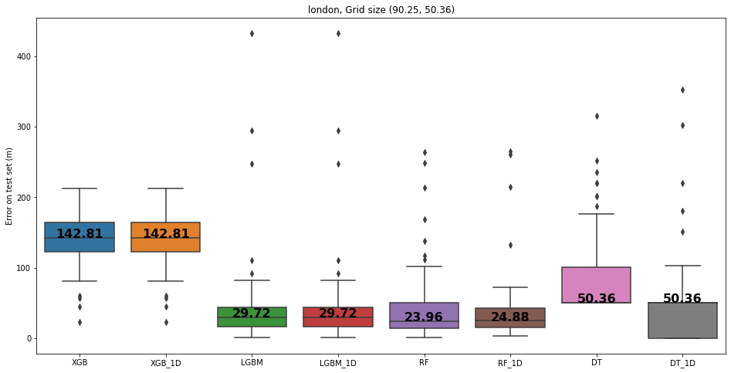

Slide 8
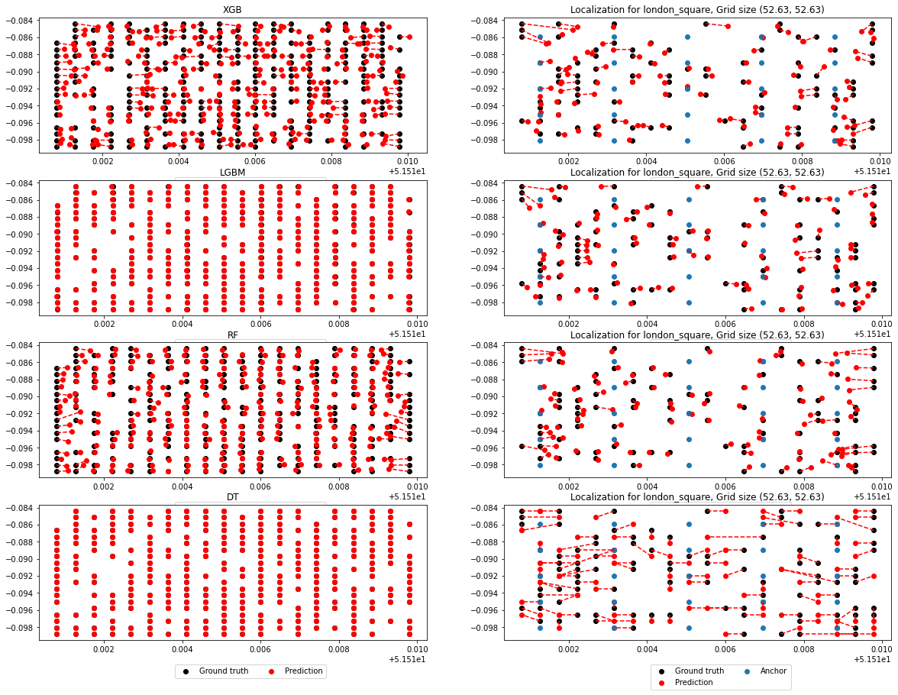

Slide 9
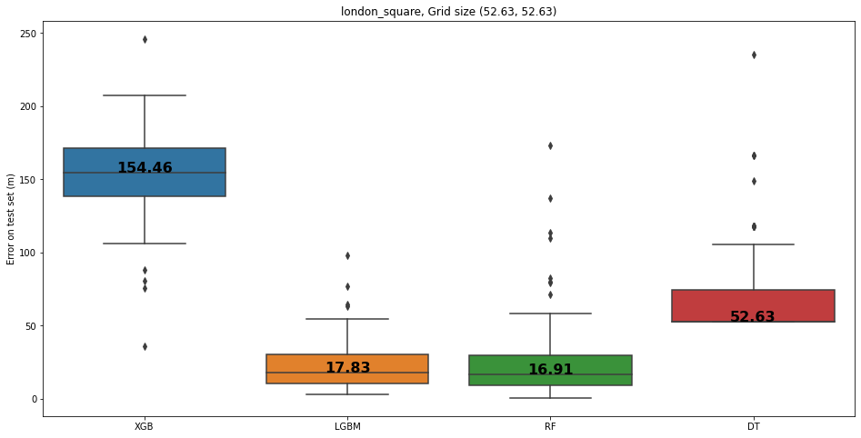
Square grids

Slide 10
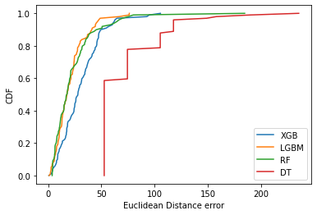
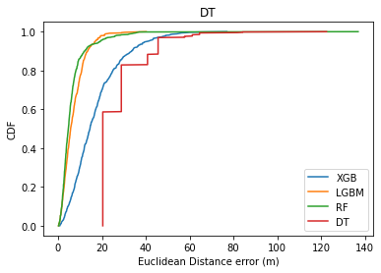

Slide 11
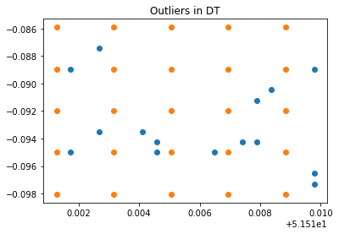
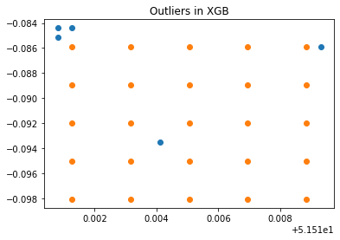
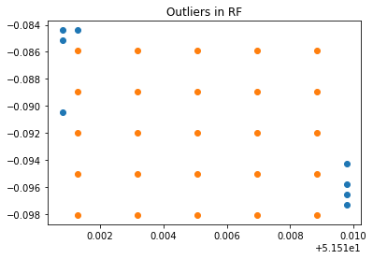
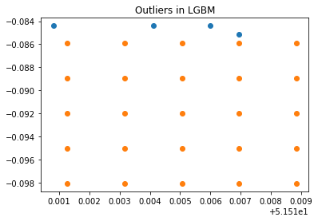
Outliers (London, square grids, 25 stations)

Slide 12
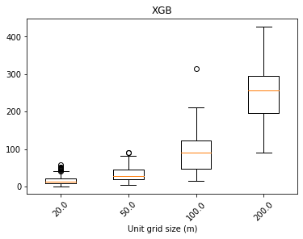
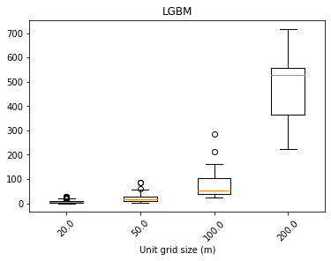
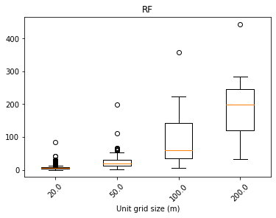
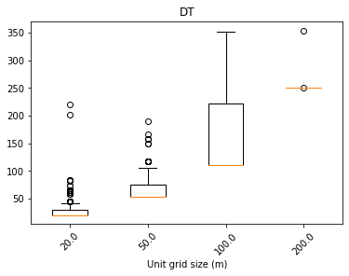

Slide 13
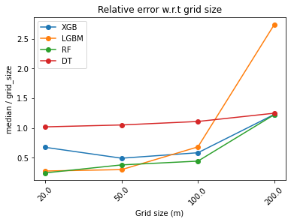

Slide 14
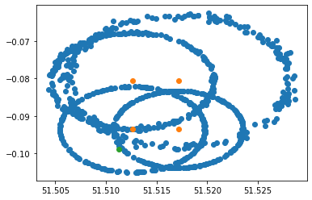

Slide 15
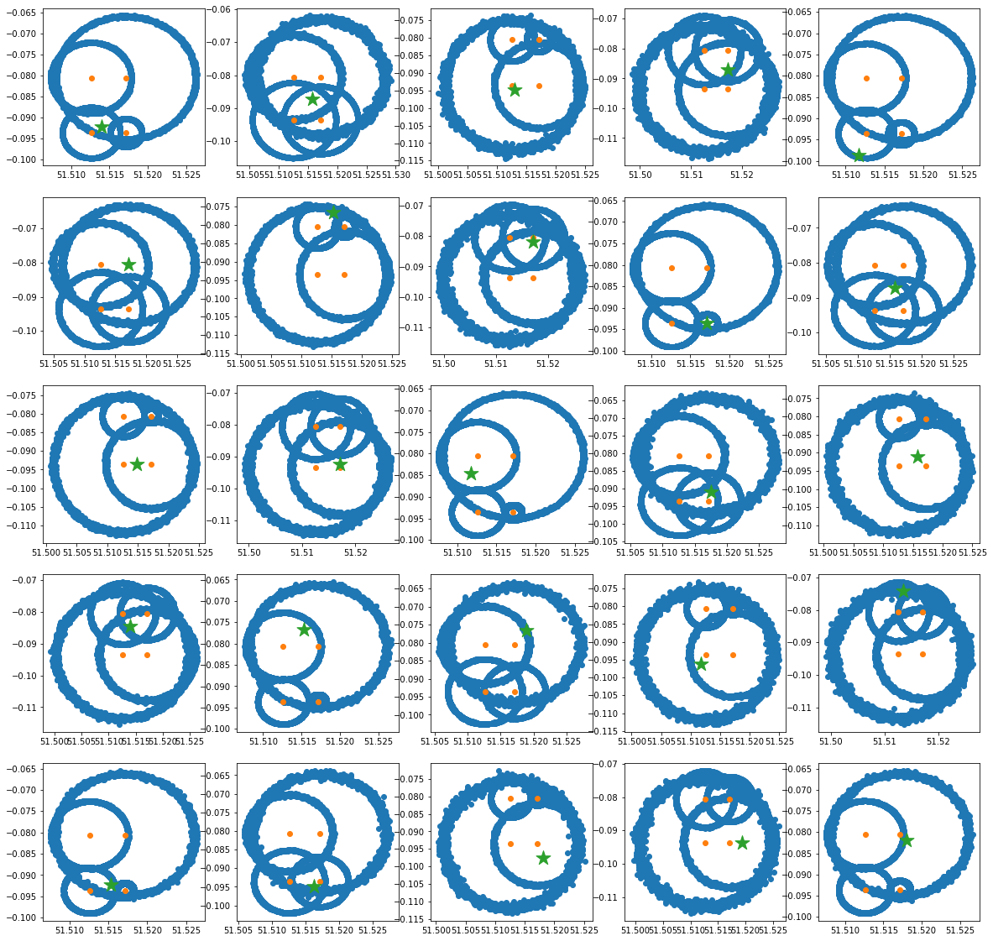
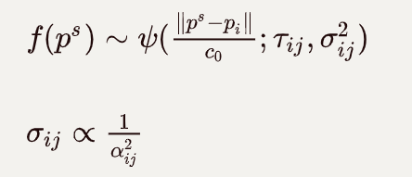
Result based on London map

Slide 16
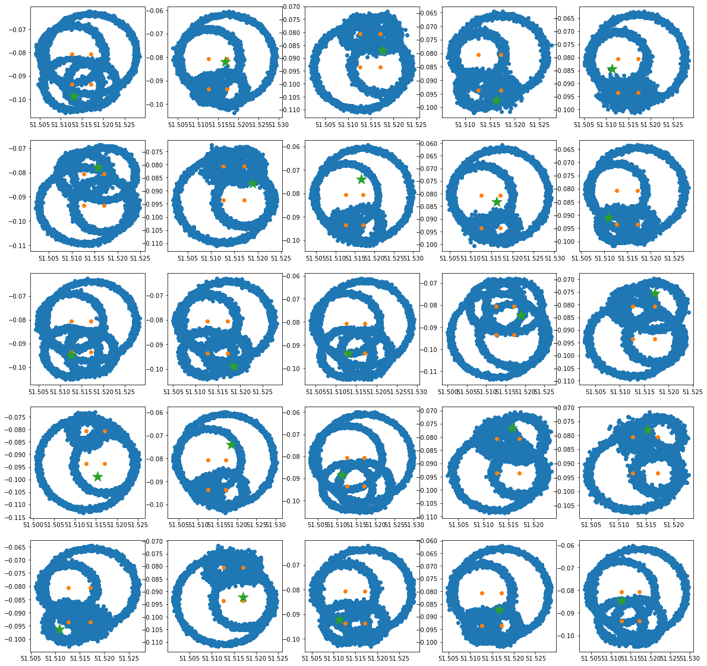
Sampling on larger std
1e-6

Slide 17
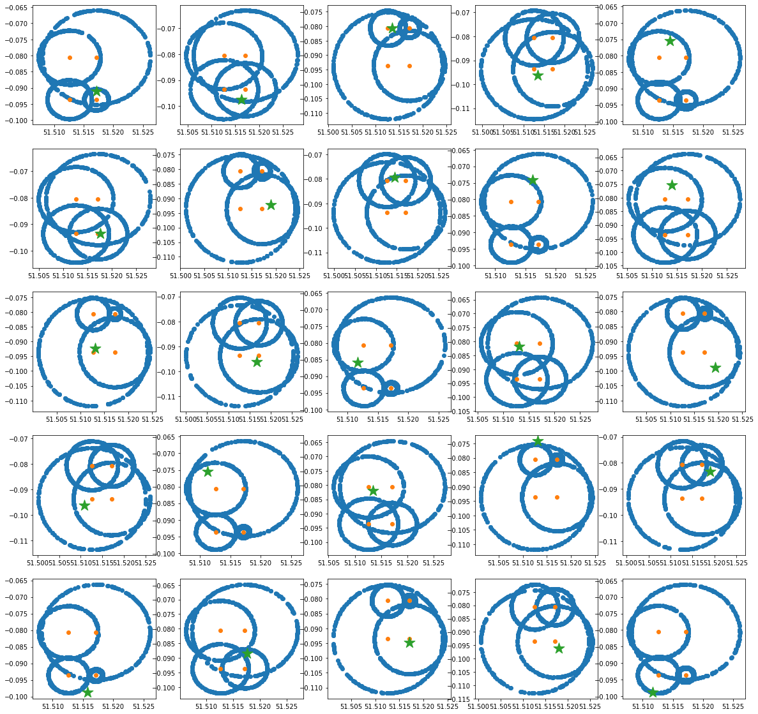
D=tau*c0

Slide 18
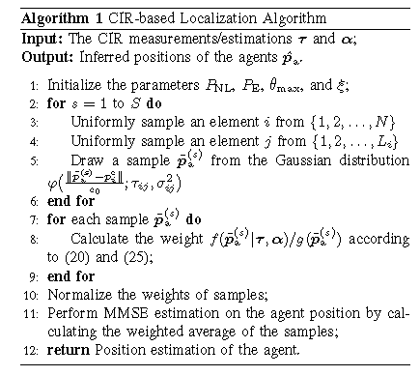
Statistical method^{[1]}

Slide 19
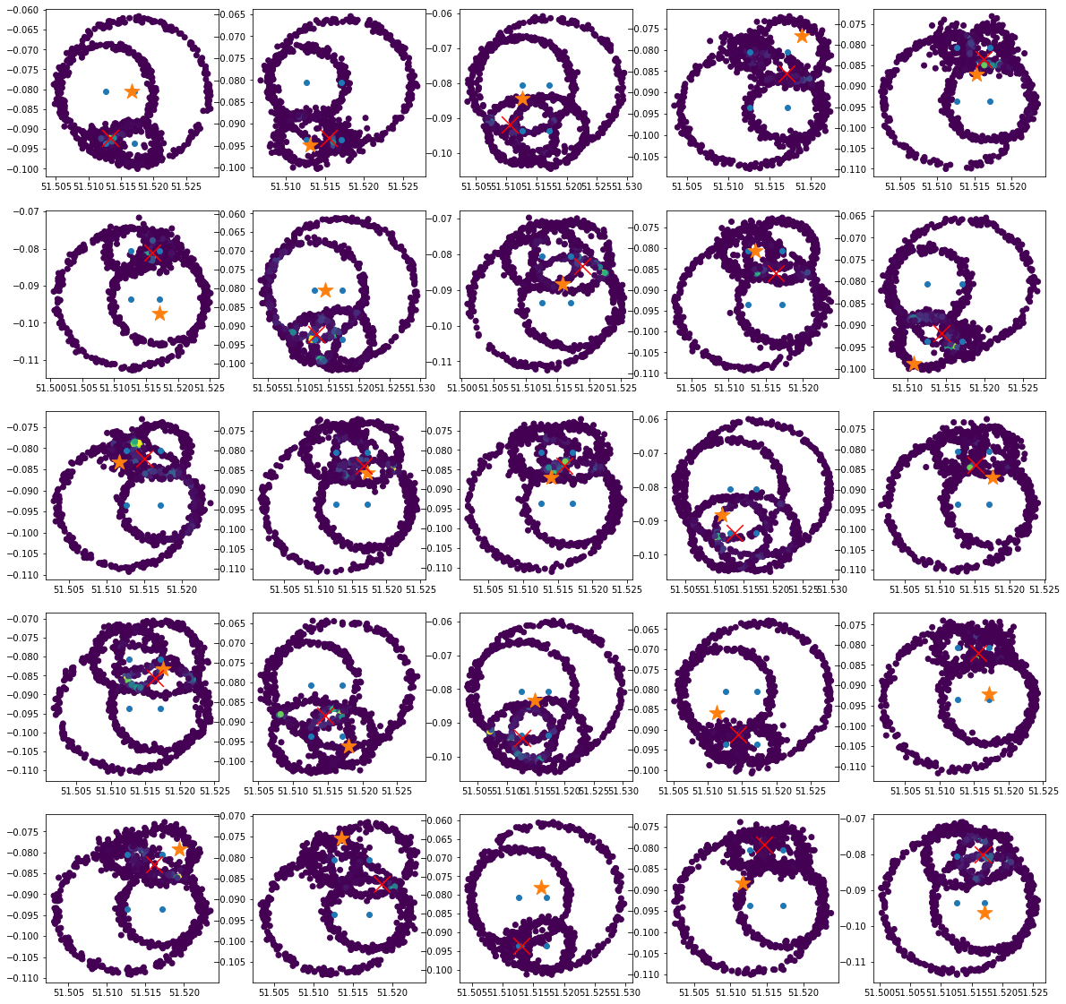
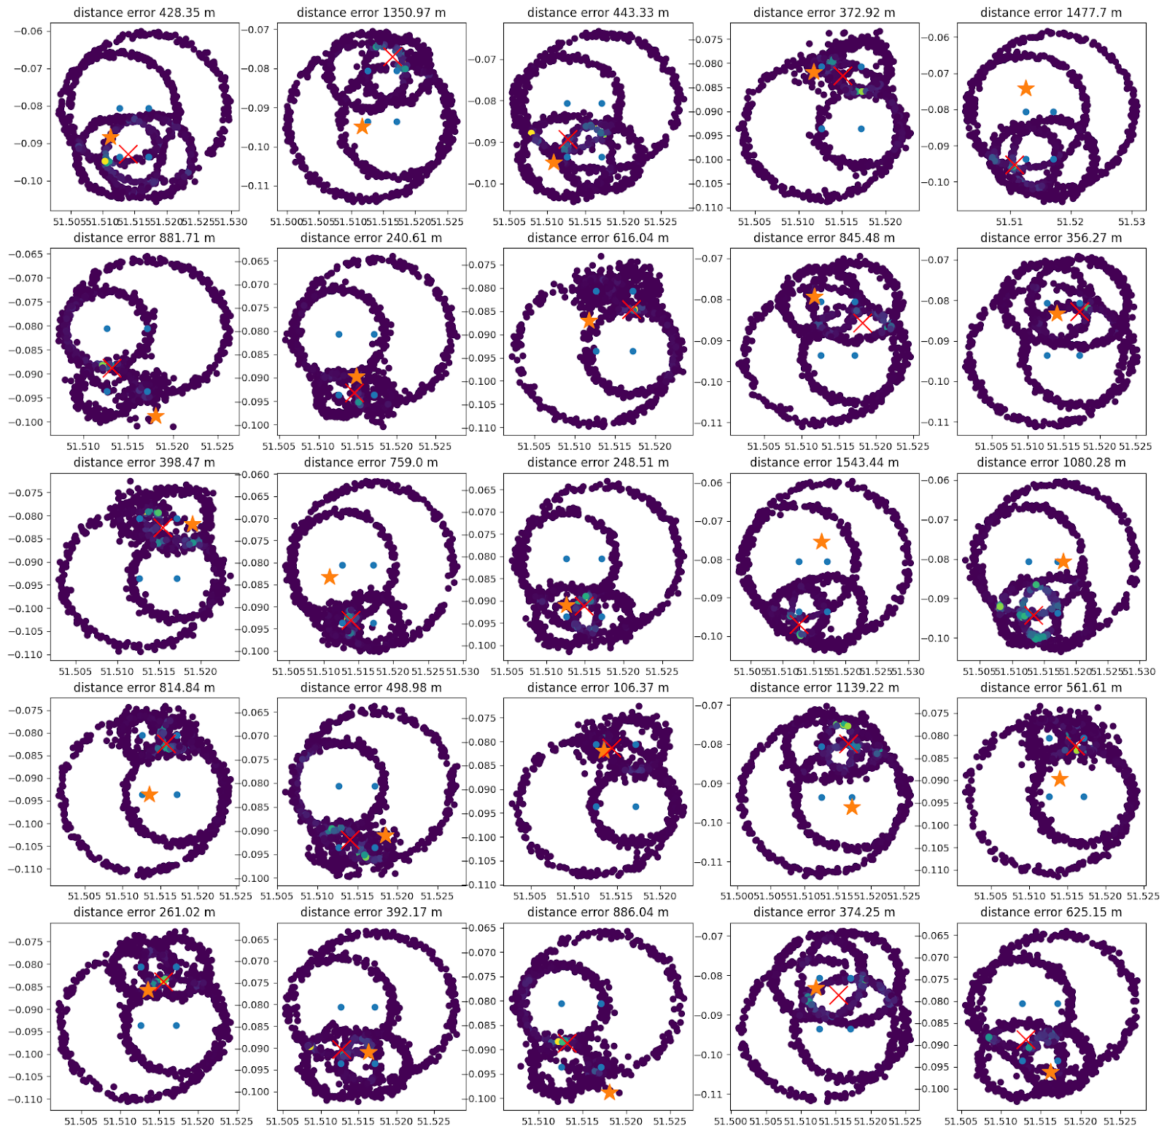

Slide 20
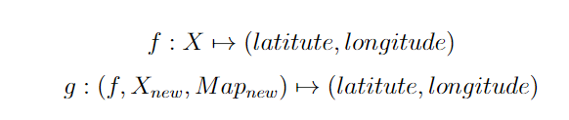
Transfer learning
Learning model on data from London, predict on data from Paris.
Difficulties:
Reconciling data: signals from London may be in different shape as the ones in Paris
Fusing signal data with map information (multimodal)

Slide 21
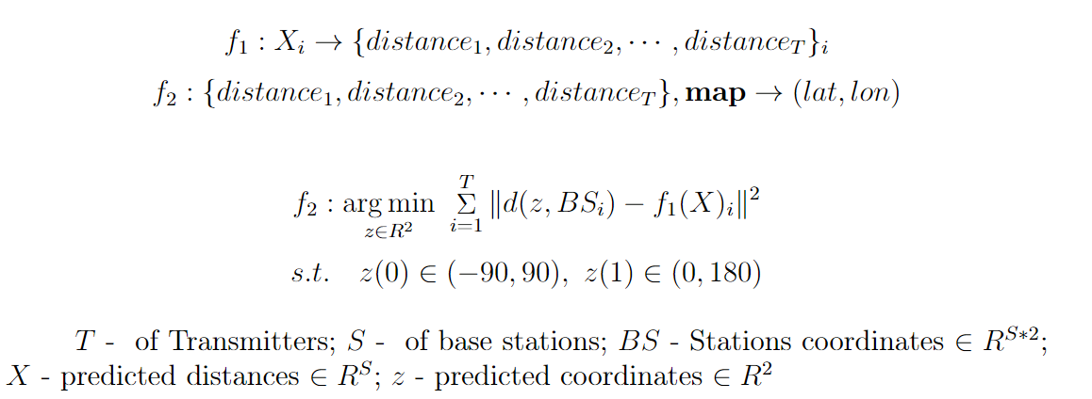
Map info
Regressor
Optimizer
CIR
dist
Lat
Lon
Learning & encoding Transfering
d*₁
d*₂
d*₄
d*₃

Slide 22
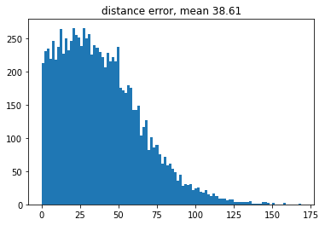
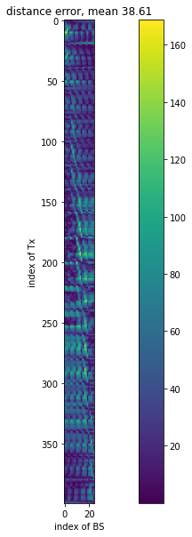
Map info
Regressor
Optimizer
CIR
dist
Lat
Lon
Learning & encoding Transfering
d₁
d₂
d*₁
d*₂
d₄
d₃
d*₄
d*₃

Slide 23
Source_{Train}
Training
Source_{Test}
Map info
Target
Regressor
Optimizer
dist
Lat
Lon
Learning & encoding Transfering

Slide 24
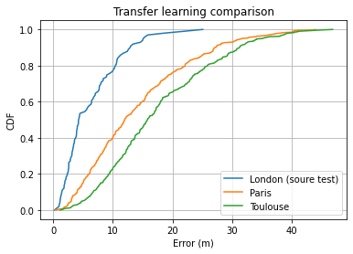
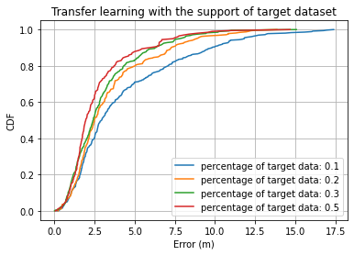
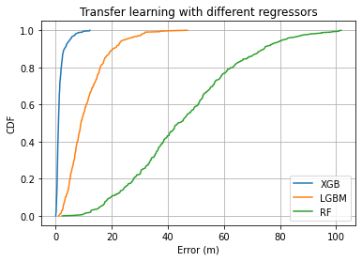
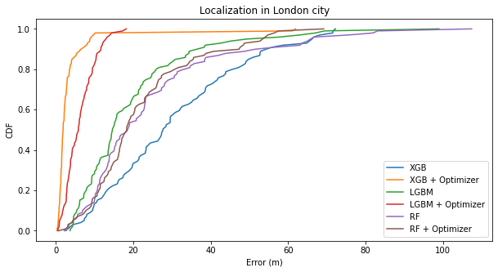
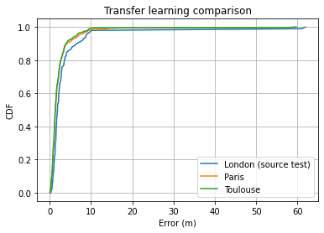
Grid size: 50m
Source: London
Target: Paris, Toulouse

Slide 25
Further improvement
More realistic scenario (noisy signal, indoor+outdoor transmission etc)
Adaptive transfer learning (known few target data)
More tests, bigger dataset
Self supervised learning
Algorithm improvement (Optimization part)

Slide 26
Reference
[1] Z. Yu, Z. Liu, F. Meyer, A. Conti and M. Z. Win, "Localization Based on Channel Impulse Response Estimates," 2020 IEEE/ION Position, Location and Navigation Symposium (PLANS), 2020, pp. 1014-1021, doi: 10.1109/PLANS46316.2020.9110161.

Slide 27
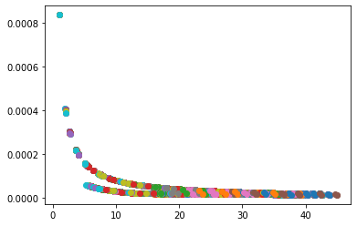

Slide 28
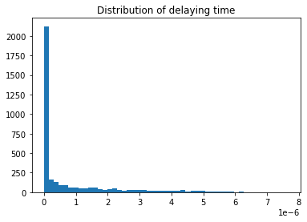
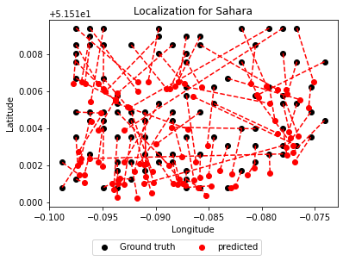
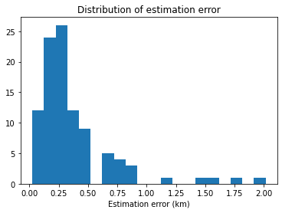
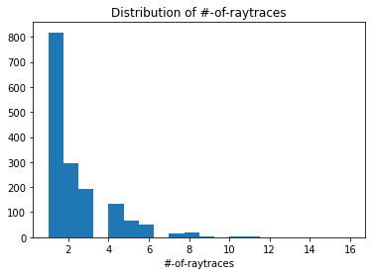
London (Minimize propagation delay)
Grid size ~ 0.05 km by 0.14 km

Slide 29




Sahara (Minimize propagation delay
Grid size ~1.1 km by 1.7 km

Slide 30



Sahara
Grid size ~ 1.1 km by 1.7 km

Slide 31





Sahara small
Grid size ~ 0.05 km by 0.13 km

Slide 32



Sahara small - RF

Slide 33



Sahara small – DT
Grid size ~ 0.05 km by 0.13 km

Slide 34


Slide 35




Outliers on sahara_small

Slide 36


