Slide 1
Map configuration
1 km
T transmitters, S stations
1 km

Slide 2
Simulation setup
Synchronized transmitters and receivers (time of travel is known)
Max reflections: 5
Transmit condition: urban...
Distance between sample points: c/f
Over-determined system
Fixed transmitters and receivers
Frequence: 10-9

Slide 3
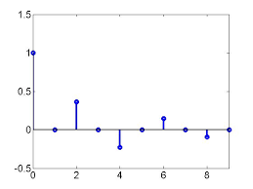
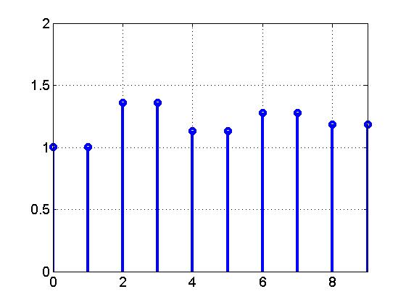
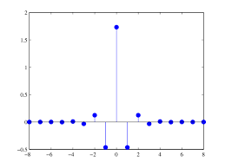
Max length
Τ₁₁ a₁₁
Τ₁₂ a₁₂
0
0
0
0
…
S
flatten
…
T1
T2
…
a1
a2
…
T
…
…
T1
T2
T3
…
a1
a2
a3
…
flatten
Dataset: T × (S*(max_len*2))
Τ₂₁ a₂₁
Τ₂₂ a₂₂
Τ₂₃ a₂₃
0
0
…
Max length
Notes:
CIR calibration and padding

Slide 4
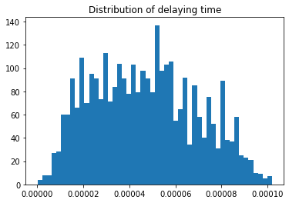
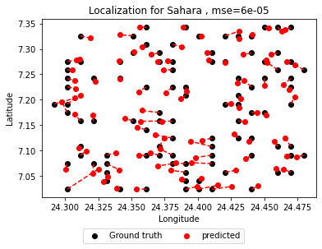
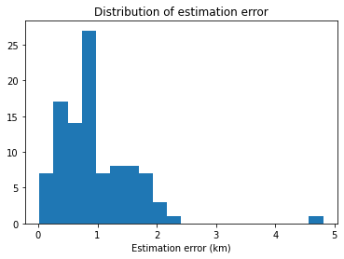
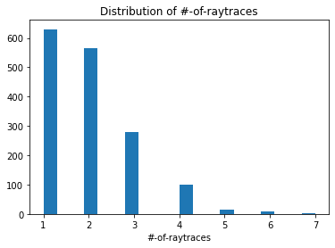
Sahara
Grid size ~ 1.1 km by 1.7 km

Slide 5
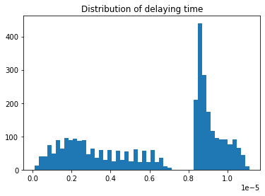
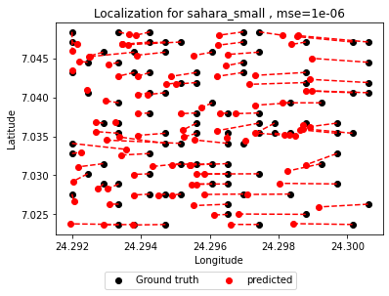
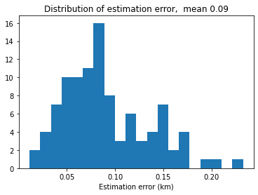
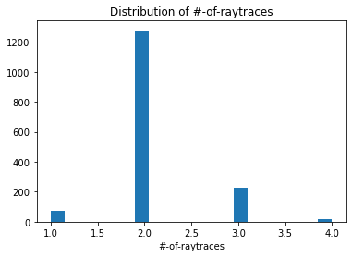
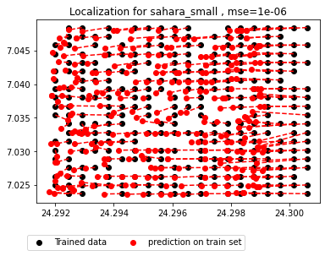
Sahara small
Grid size ~ 0.05 km by 0.13 km

Slide 6
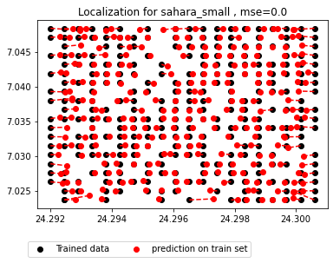
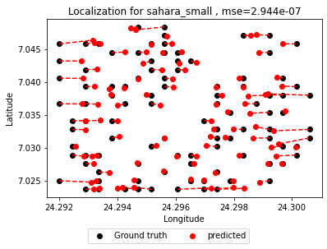
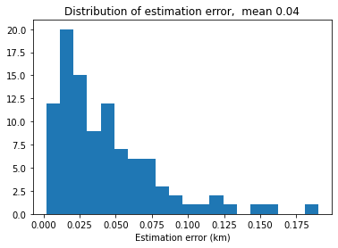
Sahara small - RF

Slide 7
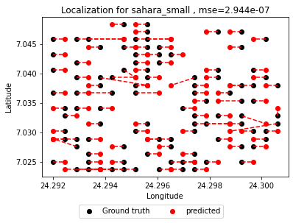
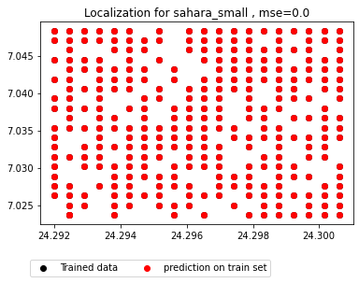
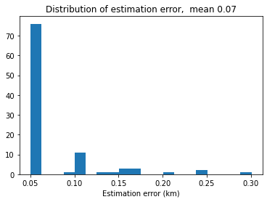
Sahara small – DT
Grid size ~ 0.05 km by 0.13 km

Slide 8
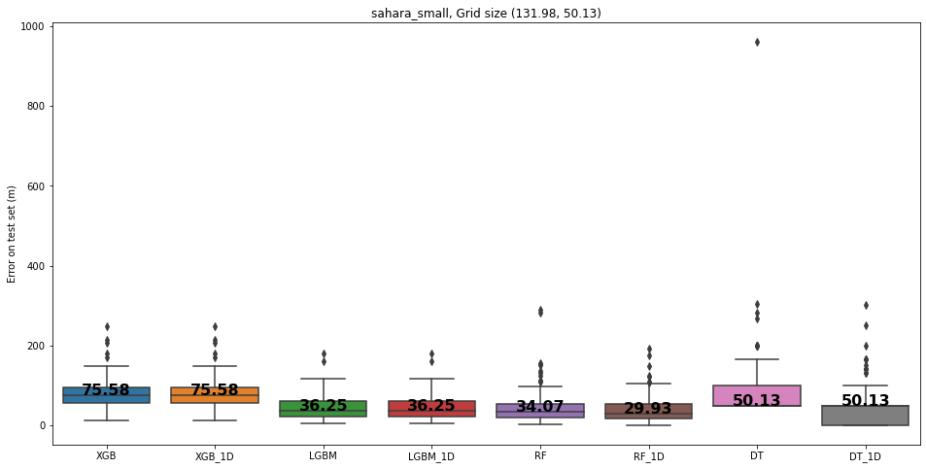

Slide 9
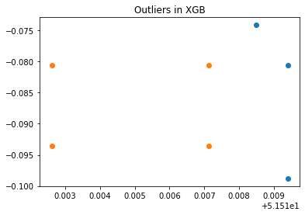
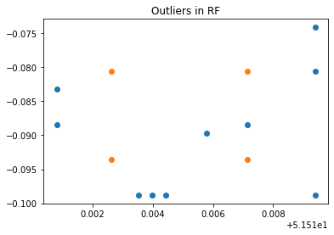
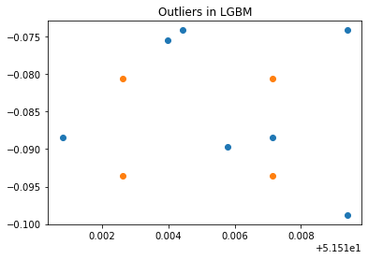
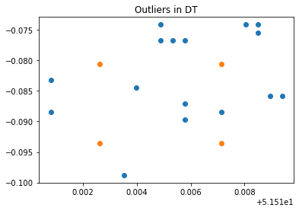
Outliers on sahara_small

Slide 10
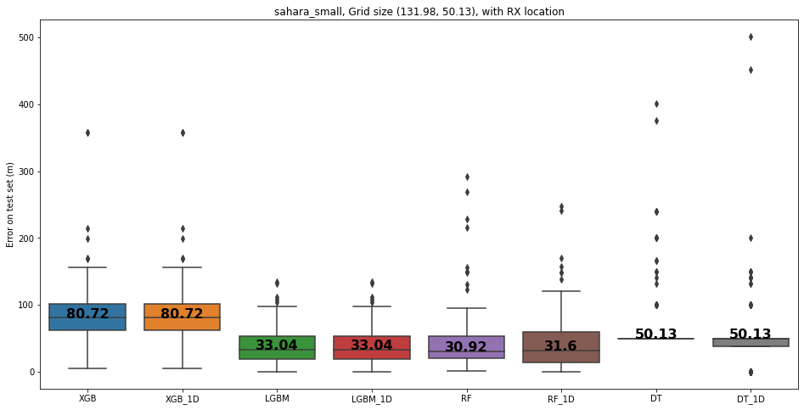

Slide 11
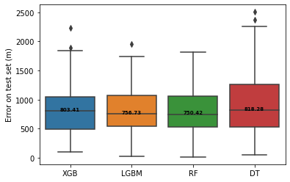
With truncated input

Slide 12
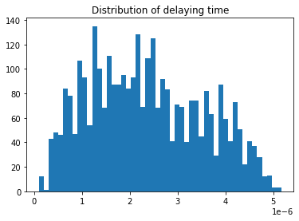
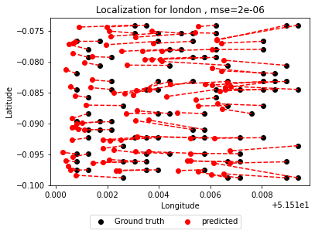
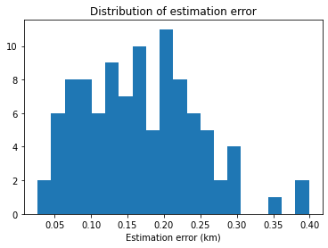
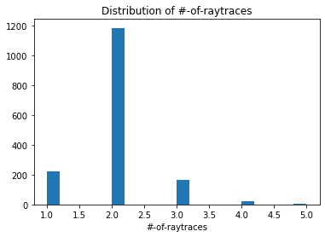
London
Grid size ~ 0.05 km by 0.09 km

Slide 13
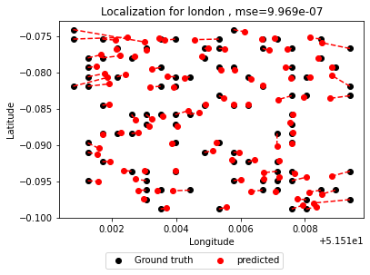
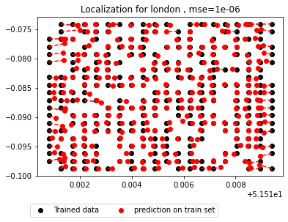
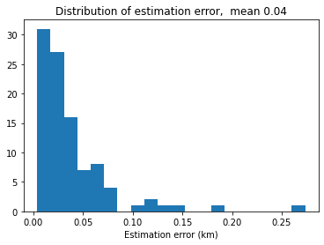
London - RF
Grid size ~ 0.05 km by 0.14 km

Slide 14
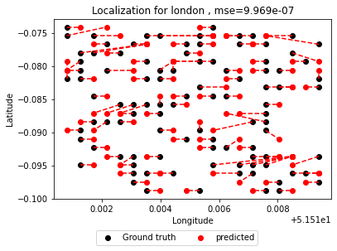
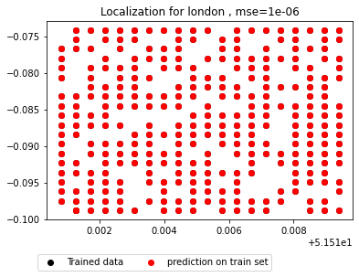
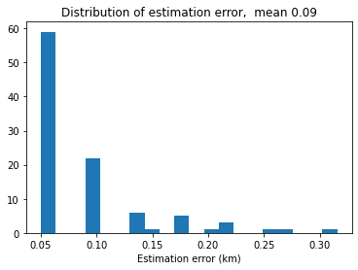
London - DT
Grid size ~ 0.05 km by 0.14 km

Slide 15
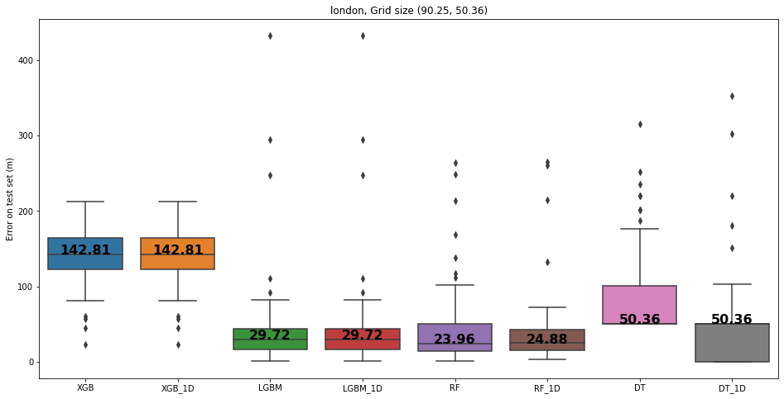

Slide 16
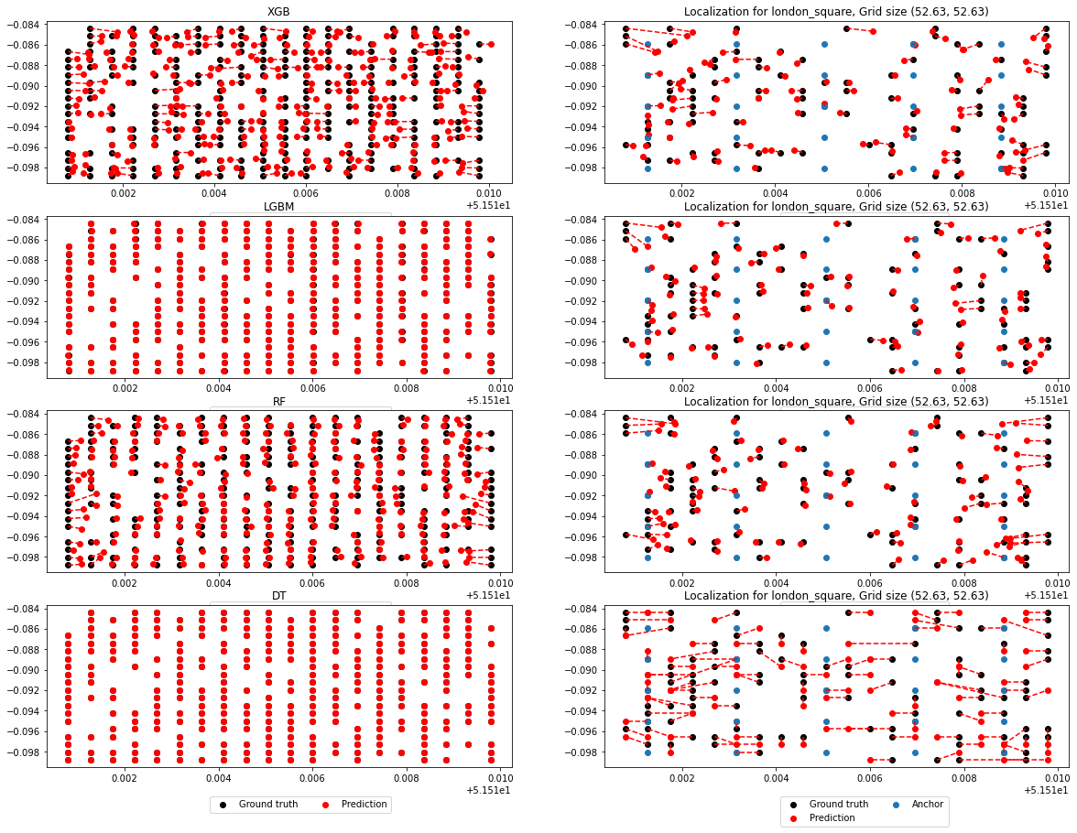

Slide 17
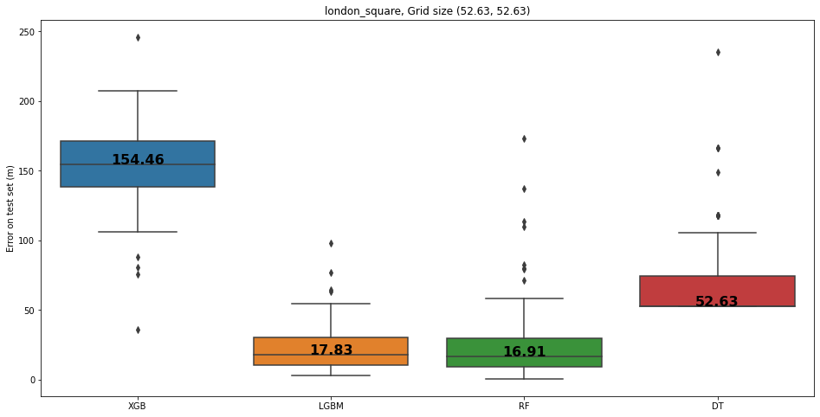
Square grids

Slide 18
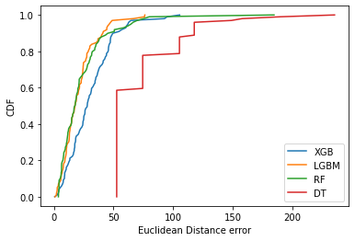

Slide 19
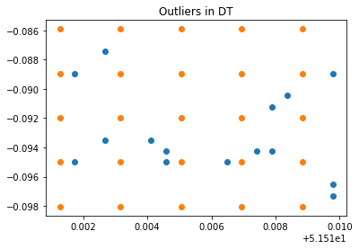
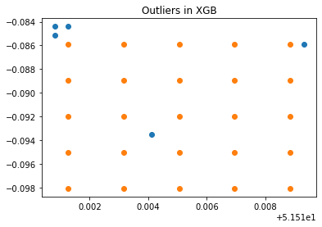
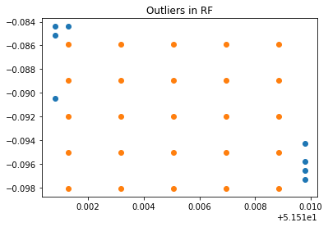
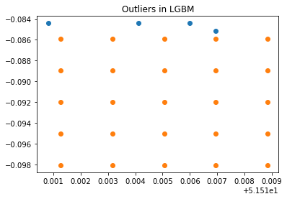
Outliers (London, square grids, 25 Bases)

Slide 20
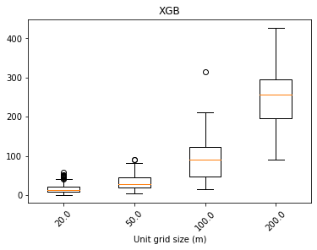
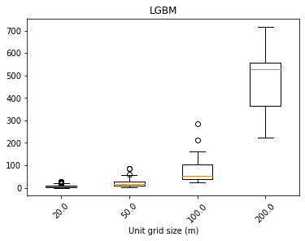
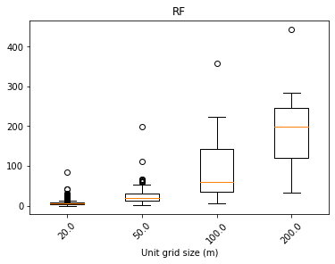
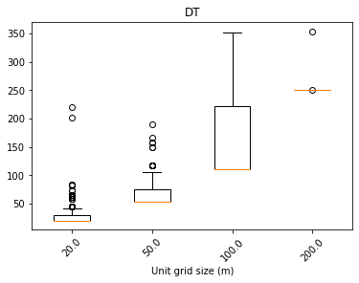

Slide 21
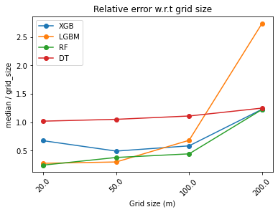

Slide 22
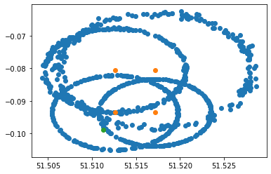

Slide 23
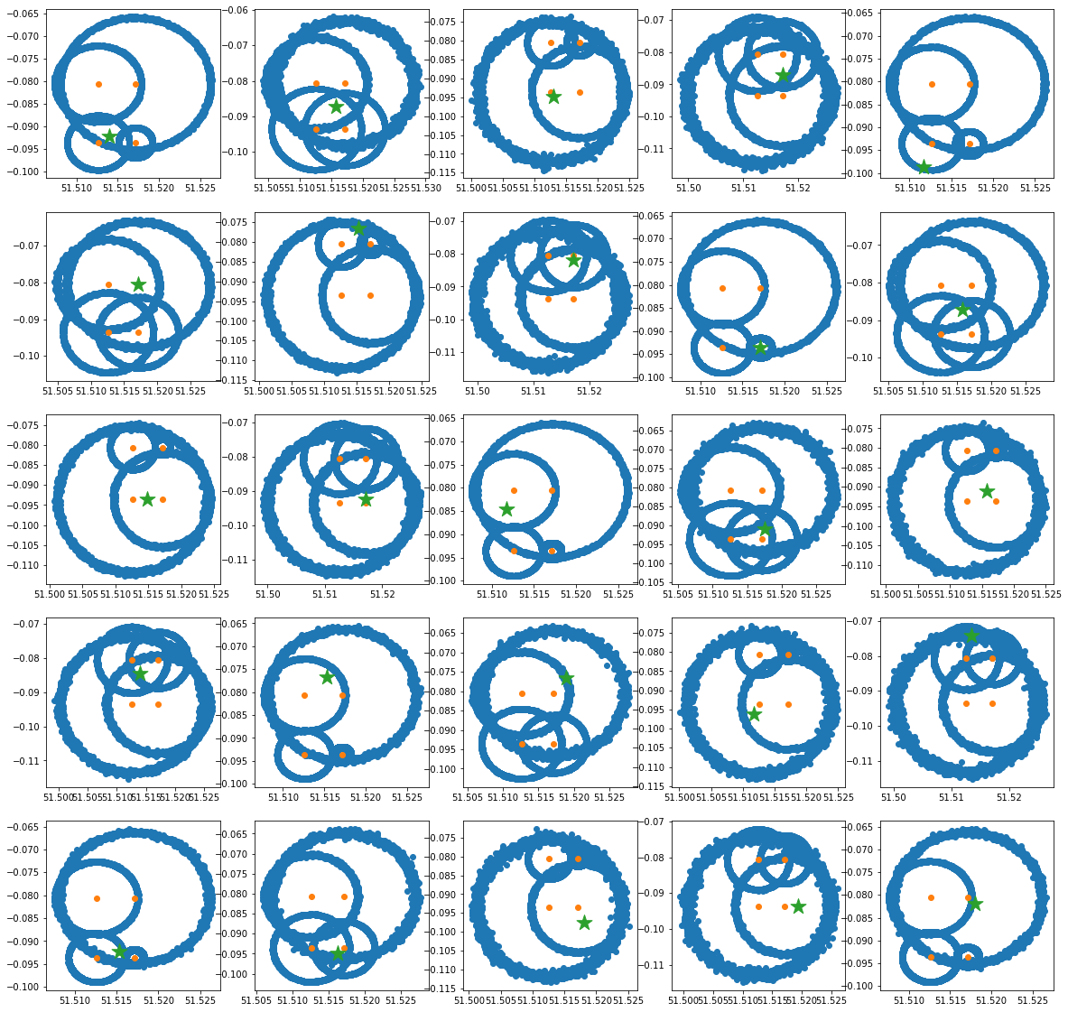

Result based on London map

Slide 24

Sampling on larger std
1e-6

Slide 25

D=tau*c0

Slide 26



Slide 27




London (Minimize propagation delay)
Grid size ~ 0.05 km by 0.14 km

Slide 28



Sahara (Minimize propagation delay
Grid size ~1.1 km by 1.7 km

