Slide 1

Tips for Review and Rebuttal
Jiaxuan You
Assistant Professor at UIUC CDS
CS598: Topics in LLM Agents, 2025 Spring
https://github.com/ulab-uiuc/CS598-Topics-in-LLM-Agents

Slide 2
Reminder: Project Due Tomorrow
Submission due by April 16 23:59 AOE
This is the draft submission
You can still improve your paper based on review & rebuttal later
At least 8-10 pages & 30 references (exclude references) in TMLR template
Minimum page: 3 student group: 9 pages, 2 student group: 8 pages, 4 student group: 10 pages. Having more pages is recommended.
After the submission DDL, everyone is expected to provide 1 review (for other’s paper) and 1 rebuttal (to defend your paper)

Slide 3
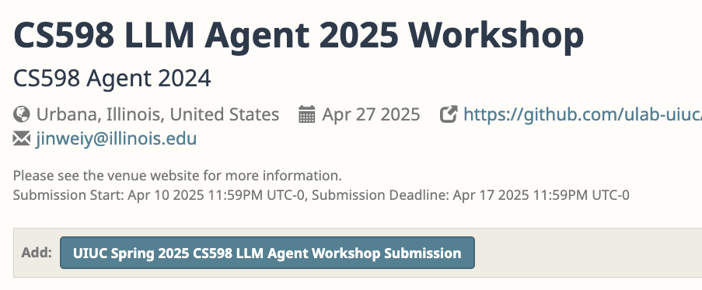
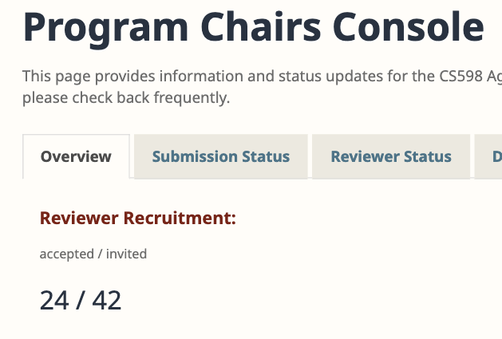
Reminder: Project Due Tomorrow
OpenReview submissions now open
https://openreview.net/group?id=illinois.edu/UIUC/Spring_2025/CS598_LLM_Agent_Workshop
Please accept the reviewer invitation sent to your UIUC email

Slide 4

Submission Made, What’s Next?
Next: Review and Rebuttal
Reviewers for conferences: invited or self nominated
Comprehensive review instructions are typically shared
https://icml.cc/Conferences/2025/ReviewerInstructions

Slide 5
High Quality Review
Overall suggestion: Avoid vague statements. Back your claims with evidence or examples.
Weak review: "The experiments are insufficient."
Stronger review: "The experiments focus only on synthetic data. Real-world datasets like ABC would provide stronger evidence for the method's generalizability.”
Next: We will do a walk through of a demo review

Slide 6
High Quality Review
1 Summary: Provide a brief, accurate summary of the paper, emphasizing its key contributions, methodology, and findings.
Example: "This paper proposes a novel method for optimizing transformer architectures using a learned attention pruning mechanism. The authors demonstrate improvements in both computational efficiency and downstream performance across three benchmark datasets."

Slide 7
High Quality Review
2 Strengths: Highlight the paper’s major contributions and strengths in detail.
Example: "The approach is innovative and addresses a significant problem in transformer scalability. The experimental results are compelling, with a 20% reduction in computational cost and consistent performance gains."

Slide 8
High Quality Review
3 Weaknesses: Clearly state limitations or potential issues, such as incomplete comparisons, insufficient analysis, or unclear writing.
Example: "The method lacks an ablation study to disentangle the effects of the pruning mechanism from other components of the model."

Slide 9
High Quality Review
4 Constructive Feedback: Provide actionable suggestions for improvement.
Example: "Adding a comparison with recent pruning methods like XYZ et al. (2023) would strengthen the claims. Also, explaining why Dataset A was chosen over other common benchmarks would improve clarity."

Slide 10
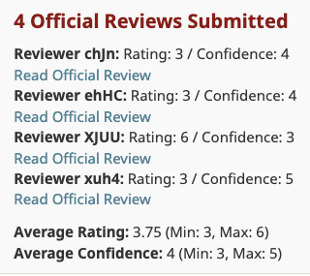
Next: Rebuttal
The most exciting (scary?) part of research project

Slide 11
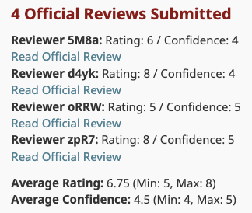
Next: Rebuttal
The most exciting (scary?) part of research project

Slide 12
A Good Rebuttal Strategy
Answer/satisfy whatever the reviewers expect you to do

Slide 13
A Good Rebuttal Strategy
Answer/satisfy whatever the reviewers expect you to do
A Common pitfall. Not the best strategy ☹
Why?
Reviewers could be hostile, not all requests are reasonable
You acknowledge that your work is somewhat not ready
You might waste a lot of time and get discouraged

Slide 14
A Better Rebuttal Strategy
Answer/satisfy whatever the reviewers expect you to do ☹
Defend yourself, explain why reviewers were wrong ☺
Why?
Showing that you are Professional, objective, yet hard to be bullied
You weren’t wrong – it’s the reviewers who didn’t understand
You can save some unnecessary efforts, and stay hopeful for your work
Next: The RAG Strategy for Rebuttal – “patent” from U Lab ☺
All my 10 1st author papers during my PhD were directly accepted (Could never be reproduced now)

Slide 15
“RAG” Strategy for Rebuttal – “Patent” from U Lab
Imagine yourself as an LLM agent – Retrieve, Argue, Generate (RAG)
Retrieve evidence
From your paper: Line xxx to xxx, Figure xxx, Table xxx
From other papers: Relevant works, famous works
Argue why you were right and the reviewer were wrong
They neglected something, Wrong statement, Request not reasonable, …
Generate action
Summarize your points. Promise to improve your writing.
Run experiment. Add new results.

Slide 16
Example Rebuttal
Review: Missing details
Thanks for the comments. The settings for the baselines primarily follow LLAGA (Chen et al., 2024a) and OFA (Liu et al., 2023a). As stated in Appendix A.3, we converted all nodes and labels in the Cora, PubMed, and HIV datasets into text. For all methods, we use BERT to obtain text embedding. We divide all datasets into training, validation, and test sets in an 8:1:1 ratio. We will add these details to the next version.
Retrieve evidence Argue your point Generate action

Slide 17
Example Rebuttal
Review. Can the author supplement the baseline that tuned on the task-specific dataset
Indeed, we have detailed the specific settings of the baselines for Table 6 in Appendix A.4 ([lines 779-796]). We primarily selected three classic agent baselines for comparison: CoT, ToT, and Few-shots. Although these baselines were not additionally fine-tuned on this dataset, the results of GWM shown in Figure 6, as described in [lines 382-384], were also not additionally fine-tuned. Therefore, from this perspective, the comparison between GWM and the baselines is fair. However, following the reviewer's suggestion, we added 2 new experiments to compare two baselines fine-tuned on AgentClinic: FT is a baseline finetuned on the task using the Llama-3-8B model.
Retrieve evidence Argue your point Generate action

