Slide 1
Adaptive-RAG: Learning to Adapt Retrieval-Augmented Large Language Models through Question Complexity
Presenter: Oliver Li
CS598: Topics in LLM Agents, 2025 Spring
3/4/25
CS598: Topics in LLM Agents, Jiaxuan You

Slide 2
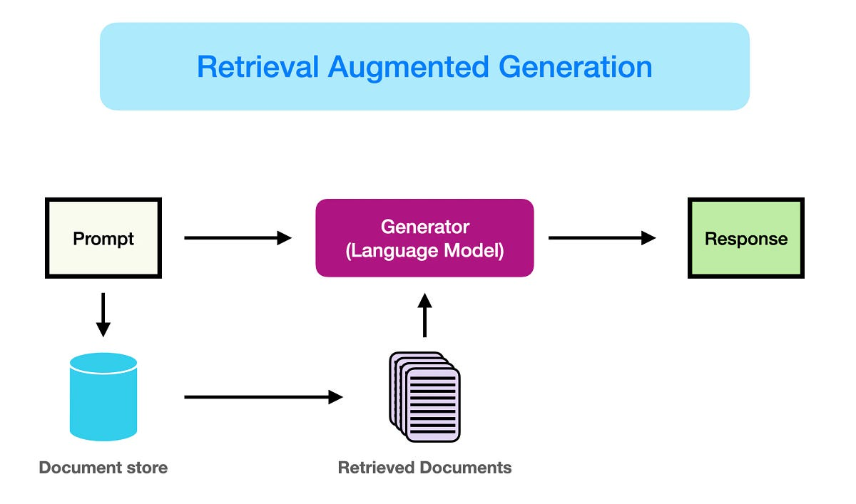
Background
■ Retrieval-Augmented (RAG) Large Language Models
■ Motivation: Incorporate external knowledge base to enhance response (e.g. factuality)
■ Retrieval – Generation
■ Application: QA
Source: https://medium.com/kinomoto-mag/enhancing-retrieval-augmented-generation-with-pre-trained-language-models-9903217a4124
3/4/25

Slide 3
Prior Settings
Question: Which ipsilateral deficits are most likely to occur in a patient with a lesion compressing the facial nerve at the stylomastoid foramen?
Non-Retrieval for QA
Response
LLM
3/4/25
CS598: Topics in LLM Agents, Jiaxuan You

Slide 4
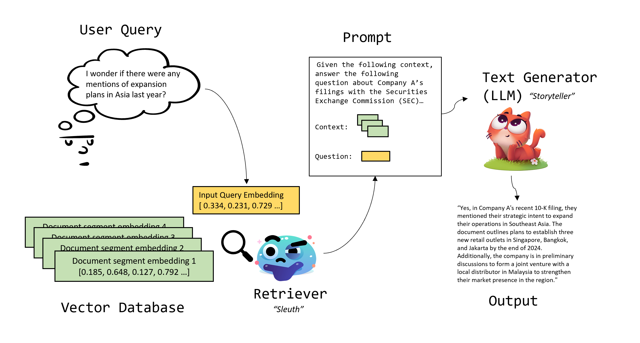
Prior Settings
Question: Which ipsilateral deficits are most likely to occur in a patient with a lesion compressing the facial nerve at the stylomastoid foramen?
LLM
Single-Step RAG for QA
Response
Using the context provided below, please answer the subsequent question related to medical examinations.
Context:
Question:
3/4/25
CS598: Topics in LLM Agents, Jiaxuan You

Slide 5
Prior Settings
Intermediate question example: Which terms, definitions, or criteria mentioned in the context are critical for understanding the medical exam question?
Incorporate Middle Steps
Intermediate Response
Question: Which ipsilateral deficits are most likely to occur in a patient with a lesion compressing the facial nerve at the stylomastoid foramen?
Intermediate question: ….
Final Answer
LLM
Multi-Step RAG for QA
Final Response
Repeat k times
Using the context provided below, please answer the subsequent question related to medical examinations.
Context:
Question (intermediate/final):
Intermediate Response: ….
3/4/25
CS598: Topics in LLM Agents, Jiaxuan You

Slide 6
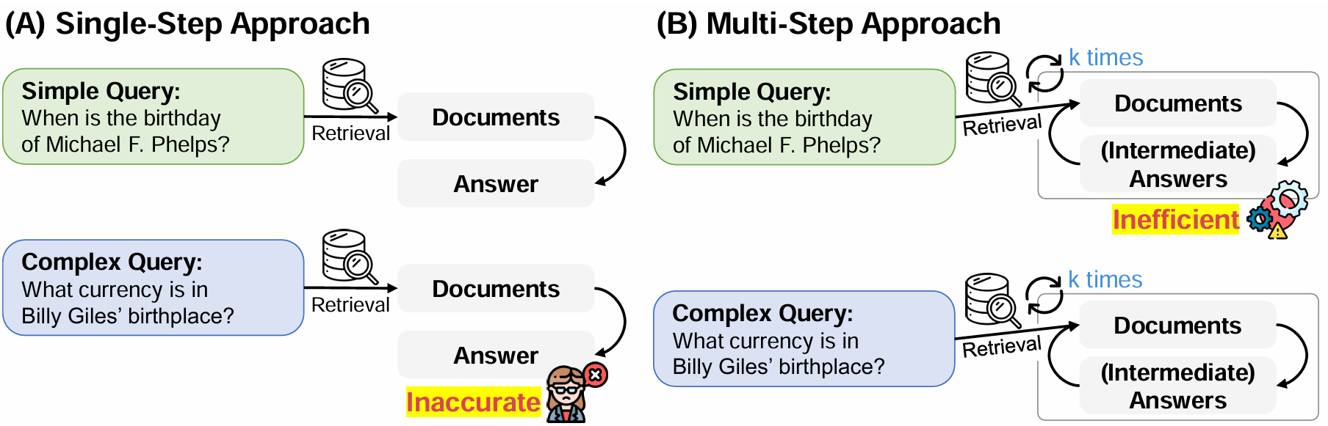
Motivations
Tradeoff between Efficiency v.s. Complexity
3/4/25
CS598: Topics in LLM Agents, Jiaxuan You

Slide 7
Problem Statement
How do we dynamically adapt to the varying difficulty of queries?
3/4/25
CS598: Topics in LLM Agents, Jiaxuan You

Slide 8
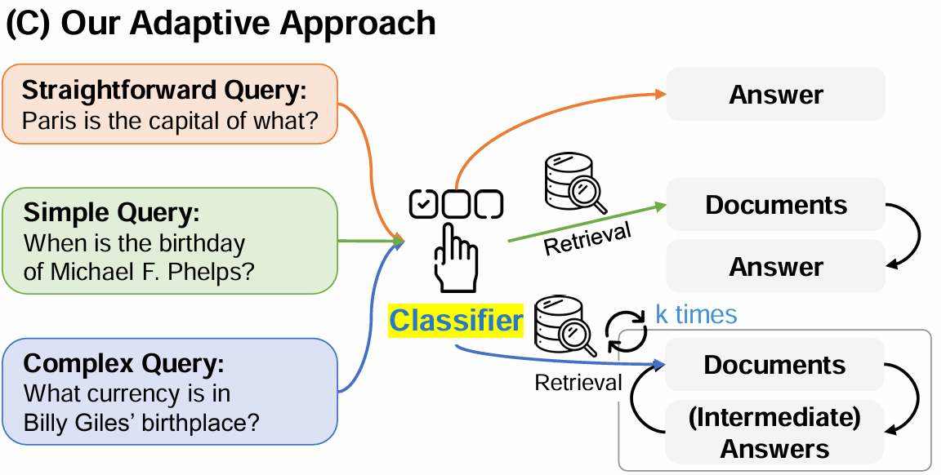
Method: Training a Small “Difficulty Classifier”
3/4/25
CS598: Topics in LLM Agents, Jiaxuan You

Slide 9
Method: Training a Small “Difficulty Classifier”
To construct the dataset for classifier:
LLM answer correctly with (a)
LLM answer correctly with (b), but not (a); or LLM answers wrong in single-hop dataset
LLM answer correctly with (c), but not (a, b), or LLM fails with all approaches in multi-hop datasets
non-retrieval based approach
Single-step RAG
Multi-step RAG
3/4/25
CS598: Topics in LLM Agents, Jiaxuan You

Slide 10
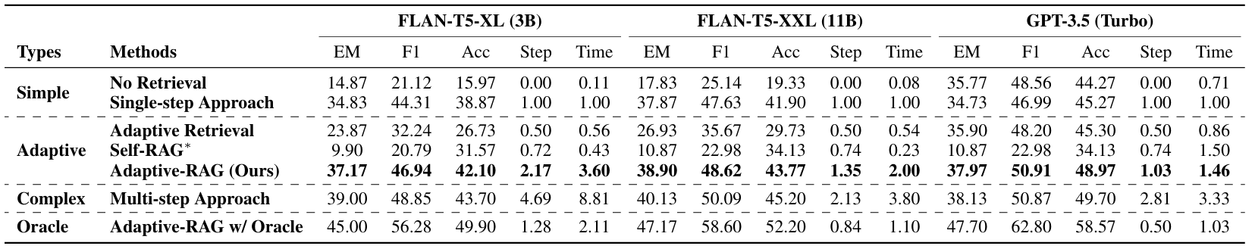
Experiment: Efficiency and Performance
Setting:
Fixed retriever: BM-25 (sparse retriever)
Corpus: Wikipedia
Classifier: T5-Large (training data size: 400 from 6 different datasets)
Table below: performance averaged over all benchmarks (single + multi)
3/4/25
CS598: Topics in LLM Agents, Jiaxuan You

Slide 11
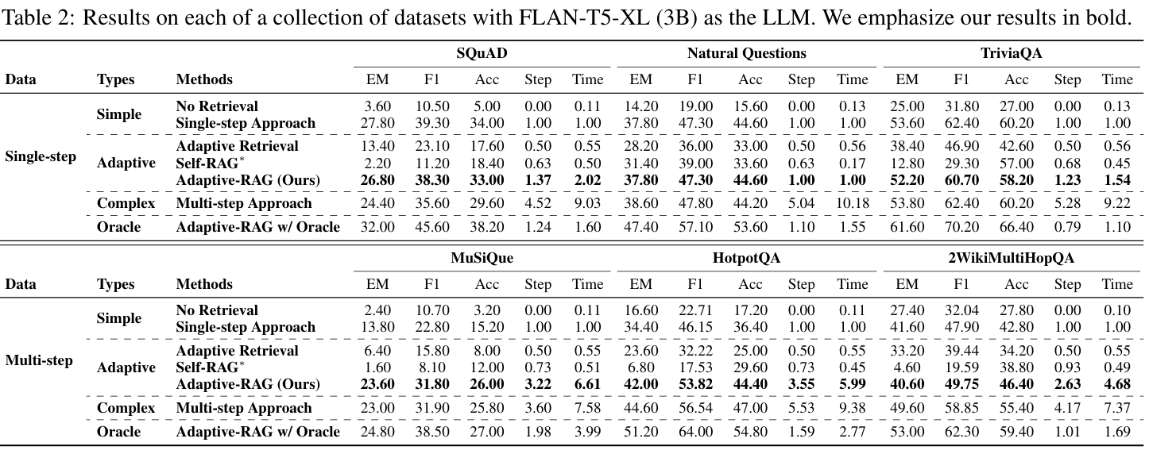
Experiment: Efficiency and Performance
3/4/25
CS598: Topics in LLM Agents, Jiaxuan You

Slide 12
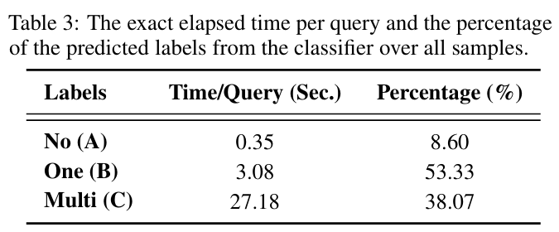
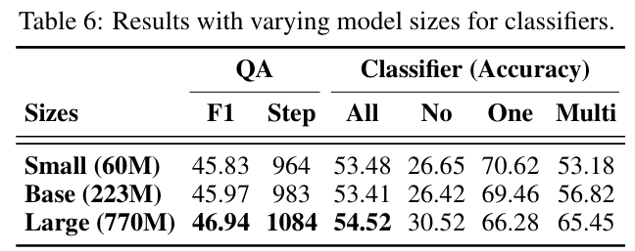
Additional Experiments
Much more efficient with adaptive method
The size of the classifier doesn’t matter too much
2/25/25
CS598: Topics in LLM Agents, Jiaxuan You

Slide 13
Summary and Future work
■ Summary
■ Developing difficulty-aware methods could significantly balance the tradeoff between efficiency and performance.
■ Future Work
■ Further refinement of the difficulty classifier
■ How to curate the “right” dataset for the classifier
2/25/25
CS598: Topics in LLM Agents, Jiaxuan You

Slide 14

Corrective Retrieval Augmented Generation
Presenter: Xuying Ning, Ting-Wei Li
CS598: Topics in LLM Agents, 2025 Spring
3/4/25
CS598: Topics in LLM Agents, Jiaxuan You

Slide 15
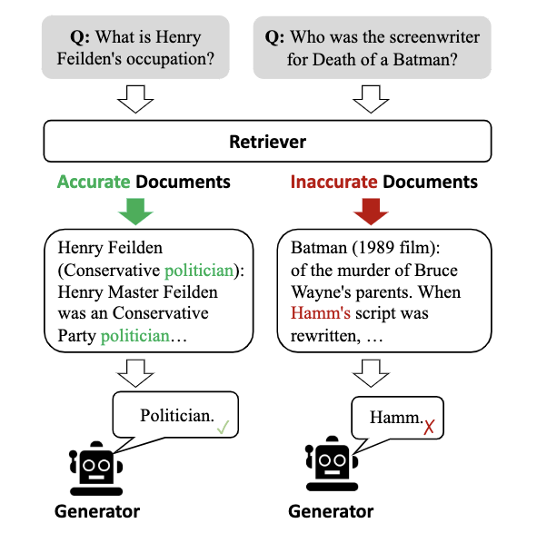
Background
■ Retrieval-Augmented Large Language Models
■ Motivation:
LLMs manifest hallucinations due to factual errors.
Retrieval-augmented generation (RAG) incorporates relevant knowledge.
However, RAG's effectiveness depends on the relevance and accuracy of retrieved documents.
3/4/25

Slide 16
CRAG Overview
■ Retrieval Evaluator
A lightweight retrieval evaluator estimates the relevance score of retrieved documents.
■ Large Scale Web Searches
Large-scale web searches are integrated for Incorrect and Ambiguous actions.
■ Decompose-then-Recompose Algo
A decompose-then-recompose algorithm eliminates redundant contexts.
3/4/25

Slide 17
CRAG - Evaluator
Ask: If retrieved documents are correct to the question?
Question: Which ipsilateral deficits are most likely to occur in a patient with a lesion compressing the facial nerve at the stylomastoid foramen?
T5-based Retrieval
Evaluator
(a) Correct
Using the context provided below, please answer the subsequent question related to medical examinations.
Context:
Question:
(b) Incorrect
(c) Ambiguous
3/4/25
CS598: Topics in LLM Agents, Jiaxuan You

Slide 18
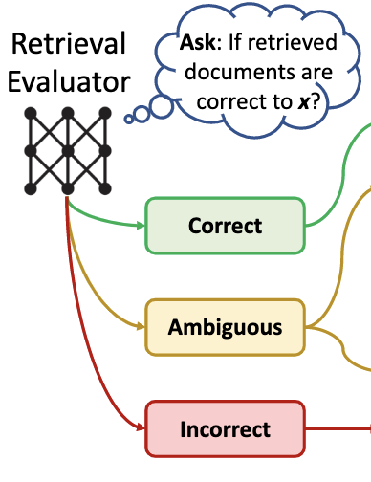
CRAG - Evaluator
■ Importance of Retrieval Evaluation
Ensures retrieved documents are accurate, filtering out irrelevant or misleading information to improve system performance.
■T5-Large as Evaluator
Fine-tuned on PopQA relevance signals and compared with Self-RAG for consistency.
■ Relevance Signals
Positive: High-quality Wikipedia-related passages.
Negative: Randomly sampled, query-similar but irrelevant results.
3/4/25
CS598: Topics in LLM Agents, Jiaxuan You

Slide 19
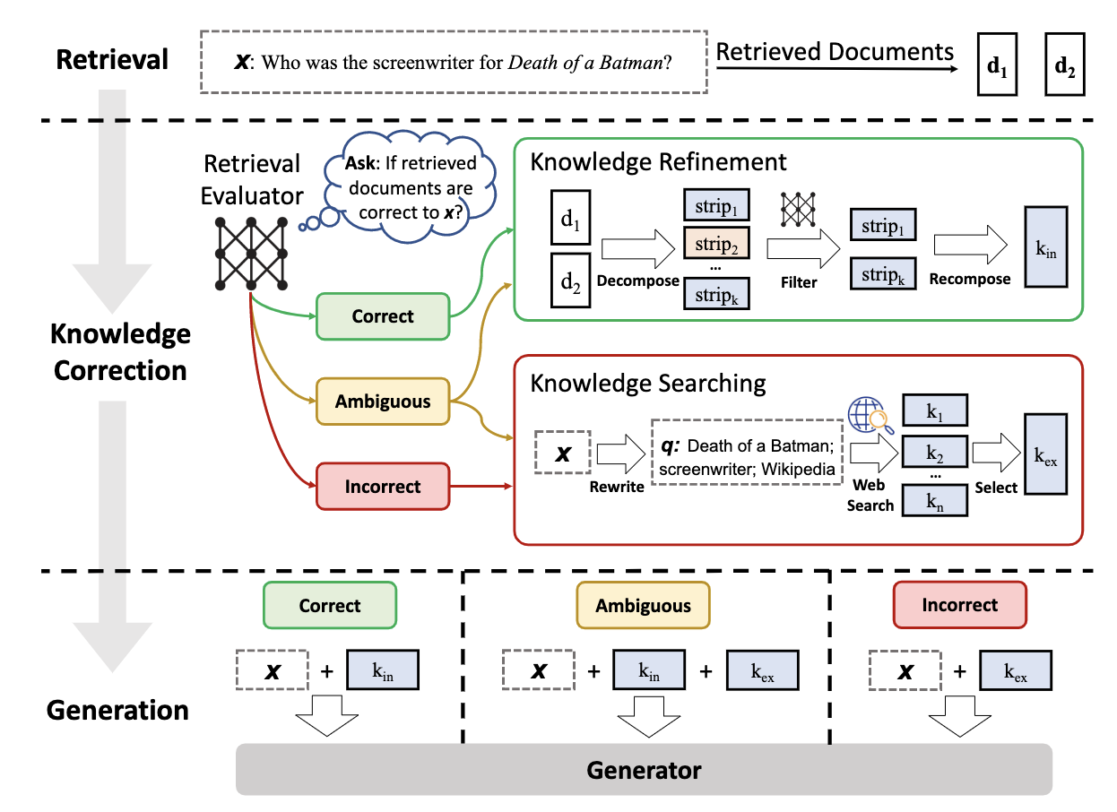
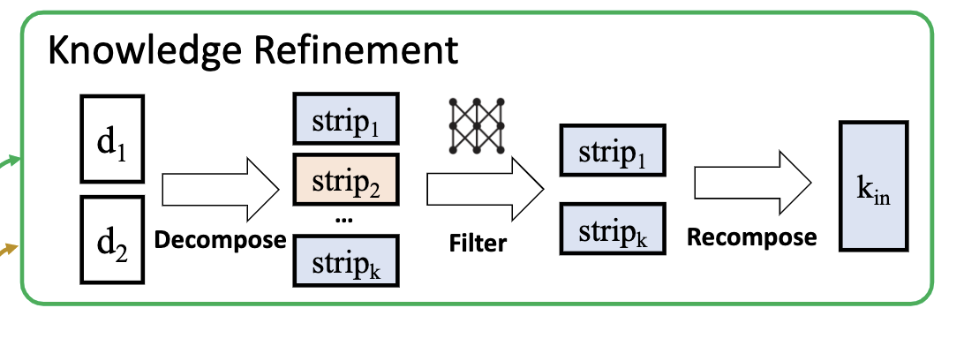
CRAG – Knowledge Refinement
■ (a) Correct - Knowledge Refinement
Retrieved results are segmented into internal strips.
The retrieval evaluator calculates the relevance score of each knowledge strip.
Irrelevant knowledge strips are filtered out, relevant ones are recomposed.
3/4/25
CS598: Topics in LLM Agents, Jiaxuan You

Slide 20
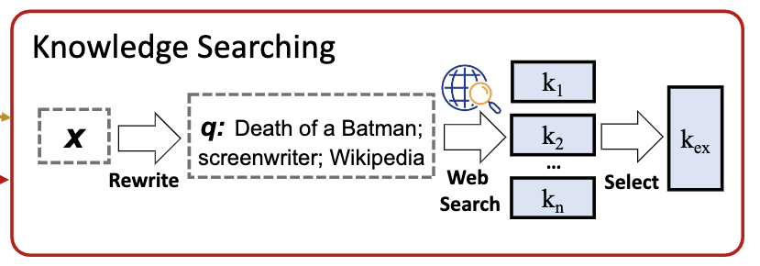
CRAG – Web Search
■ (b) Incorrect – Web Search
Inputs are rewritten into queries composed of keywords by ChatGPT.
A public and accessible commercial web search API generates URL links.
Authoritative and regulated web pages like Wikipedia are preferred.
3/4/25
CS598: Topics in LLM Agents, Jiaxuan You

Slide 21
Experiment
■ Setting:
Datasets: PopQA (short-form generation), Biography (long-form generation), PubHealth (true-or-false question), and Arc-Challenge (multiple-choice question)
Evaluation metrics: accuracy for PopQA, PubHealth, Arc-Challenge and Factscore for Biography
Baseline methods: standard RAG, SAIL, Self-RAG, Ret-ChatGPT and RetLLaMA-chat
3/4/25
CS598: Topics in LLM Agents, Jiaxuan You

Slide 22
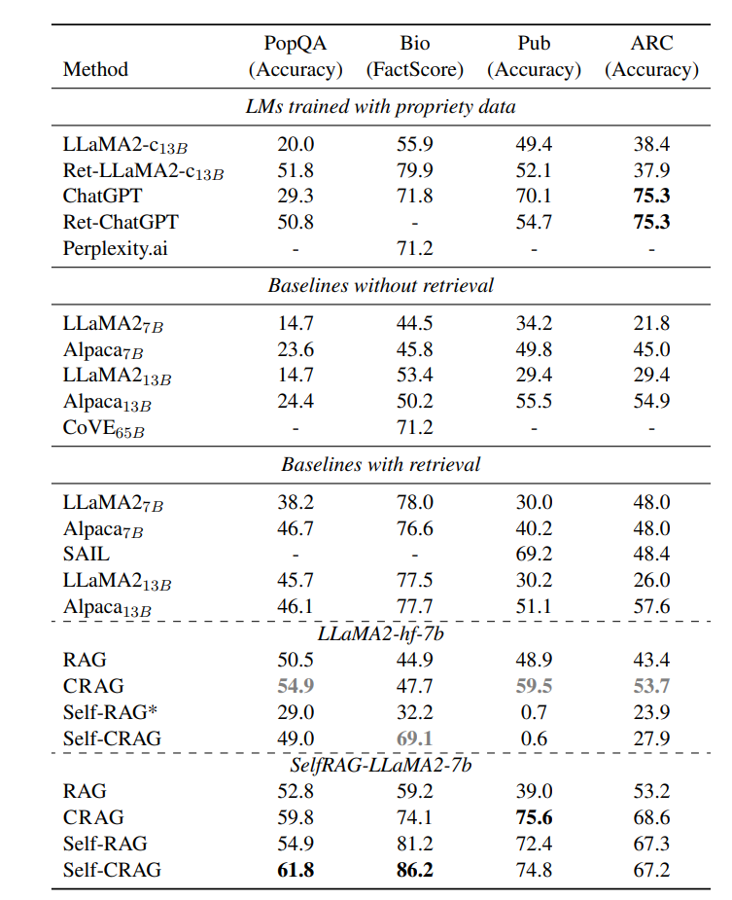
Experiments
CRAG significantly improves the performance of RAG and Self-RAG.
CRAG demonstrated great generalizability across a variety of generation tasks.
CRAG exhibited greater flexibility in replacing the underlying LLM.
2/25/25
CS598: Topics in LLM Agents, Jiaxuan You

Slide 23
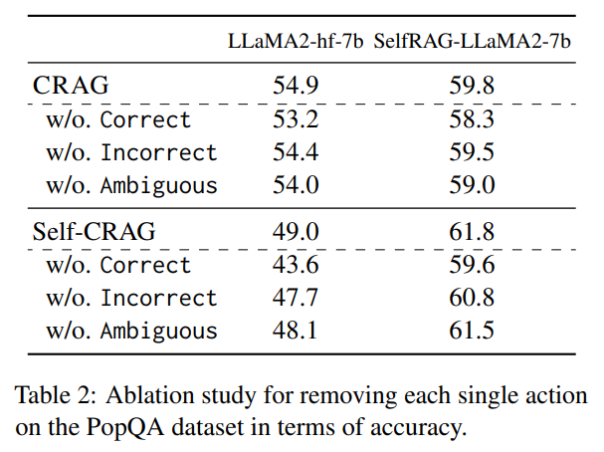
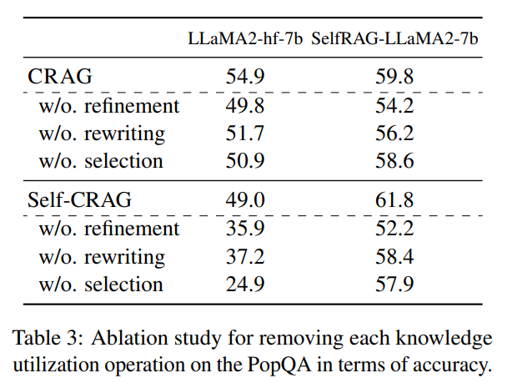
Ablation Study
Impact of each triggered action: removing any single action from the retrieval evaluator led to a performance drop, highlighting their collective importance in improving generation robustness.
Impact of each knowledge utilization operation: removing any key operation led to a performance drop.
2/25/25
CS598: Topics in LLM Agents, Jiaxuan You

Slide 24
Ablation Study
■Robustness to retrieval performance:
Self-CRAG demonstrated greater robustness, proving its superiority in handling lower-quality retrieval results.
■Consistent Supplementation of Web Search Knowledge:
Web search knowledge improved performance but the gains were limited. Integrating the self-correction mechanism led to significantly better results.
2/25/25
CS598: Topics in LLM Agents, Jiaxuan You

Slide 25
Summary and Future work
■ Summary
Improve the robustness of RAG systems by evaluating retrieved documents and incorporating large-scale web searches.
Employ a retrieval evaluator to assess knowledge relevance and a decompose-then-recompose strategy to refine information extraction
■ Future Work
eliminate the external evaluator
equip LLMs with better retrieval evaluation capabilities
3/4/25
CS598: Topics in LLM Agents, Jiaxuan You

Slide 26
Thanks!
Q & A
RAG-based Agent
CS598: Topics in LLM Agents, 2025 Spring
2/25/25
CS598: Topics in LLM Agents, Jiaxuan You

