Slide 1
Agent Framework: Multi-agent Systems
Nimet Beyza Bozdağ, Hyeonjeong Ha, Shuhaib Mehri

Slide 2
AutoGen: Enabling Next-Gen LLM
Applications via Multi-Agent Conversation
Qingyun Wu, Gagan Bansal, Jieyu Zhang, Yiran Wu, Beibin Li, Erkang Zhu, Li Jiang, Xiaoyun Zhang, Shaokun Zhang, Jiale Liu, Ahmed Hassan Awadallah, Ryen W White, Doug Burger, Chi Wang
Arxiv’2023

Slide 3
Motivation
Can Multi-Agent Approach Solve Complex Tasks?
Multiple agents can help:
encourage divergent thinking
improve factuality and reasoning
provide validation

Slide 4
Motivation
Can Multi-Agent Approach Solve Complex Tasks?
Reasons why multi-agent conversations could be useful:
LLM agents can cooperate through conversations with each other or human(s),
Conversations between differently configured agents can help combine broad LLM capabilities in a modular and complementary manner,
Multi-agent conversations can enable partitioning and integration of tasks in an intuitive manner.
Notes:
1) because chat-optimized LLMs (e.g., GPT-4) show the ability to incorporate feedback,
2) a single LLM can exhibit a broad range of capabilities (especially when configured with the correct prompt and inference settings)
3) LLMs have demonstrated ability to solve complex tasks when the tasks are broken into simpler subtasks.

Slide 5
Goal
A Multi-Agent Conversation Framework
Designing individual agents that are capable, reusable, customizable, and effective in multi-agent collaboration.
Developing a straightforward, unified interface that can accommodate a wide range of agent conversation patterns.

Slide 6
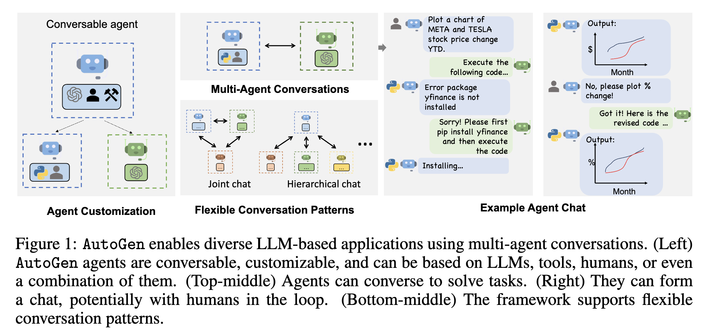
Solution
AutoGen: A Generalized Multi-Agent Conversation Framework

Slide 7
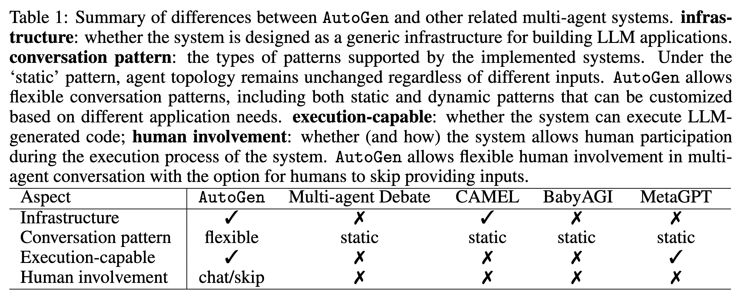
Solution
AutoGen: A Generalized Multi-Agent Conversation Framework

Slide 8
The AutoGen Framework
Conversable Agents
A conversable agent is an entity with a specific role that can pass messages to send and receive information to and from other conversable agents.

Slide 9
The AutoGen Framework
Conversable Agents
In Autogen, agents are powered by:
LLMs
Uses capabilities of advanced LLMs such as role playing, implicit state inference and progress making.
Humans
Tools
Notes:
LLM-backed agents exploit many capabilities of advanced LLMs such as role playing, implicit state inference and progress making conditioned on conversation history, providing feedback, adapting from feedback, and coding. These capabilities can be combined in different ways via novel prompting techniques4 to increase an agent’s skill and autonomy. AutoGen also offers
enhanced LLM inference features such as result caching, error handling, message templating, etc., via an enhanced LLM inference layer.

Slide 10
The AutoGen Framework
Conversable Agents
In Autogen, agents are powered by:
LLMs
Humans
Solicits human inputs at certain rounds of a conversation depending on the agent configuration.
Tools
Notes:
Human involvement is desired or even essential in many LLM applications. AutoGen lets a human participate in agent conversation via humanbacked agents, which could solicit human inputs at certain rounds of a conversation depending on the agent configuration. The default user proxy agent allows configurable human involvement levels and patterns, e.g., frequency and conditions for requesting human input including the option for humans to skip providing input

Slide 11
The AutoGen Framework
Conversable Agents
In Autogen, agents are powered by:
LLMs
Humans
Tools
Executes tools via code execution or function execution.
Notes:
Tool-backed agents have the capability to execute tools via code execution or function execution. For example, the default user proxy agent in AutoGen is able to execute code suggested by LLMs, or make LLM-suggested function calls.

Slide 12
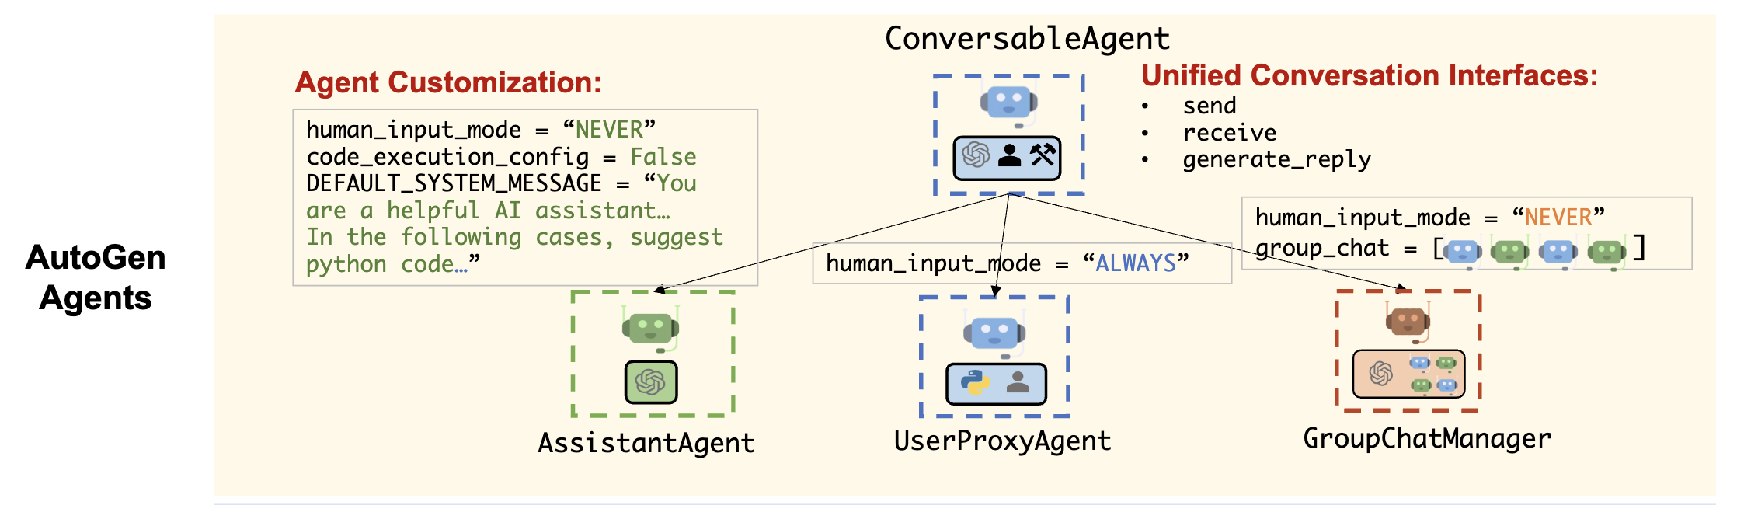
The AutoGen Framework
Conversable Agents
Agent can be configured to have a mix of basic back-end types to display complex behavior in multi-agent conversations.
Notes:
The ConversableAgent class is the highest-level agent abstraction and, by default, can use LLMs, humans, and tools. The AssistantAgent and UserProxyAgent are two pre-configured ConversableAgent subclasses, each representing a common usage mode, i.e., acting as an AI assistant (backed by LLMs) and acting as a human proxy to solicit human input or execute code/function calls (backed by humans and/or tools).

Slide 13
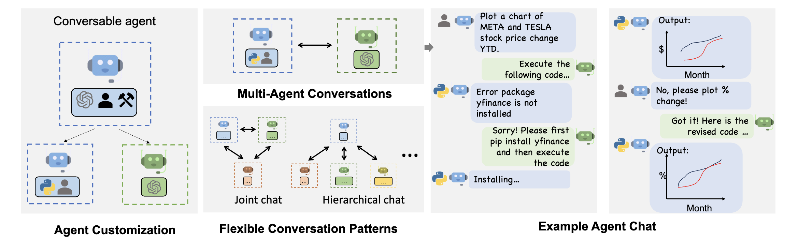
The AutoGen Framework
Conversable Agents
Human-backed User Proxy Agent
Assistant Agent
Tool-backed User Proxy Agent
Notes:
LLM-backed assistant agent and a tool- and human-backed user proxy agent are deployed together to tackle a task. Here, the assistant agent generates a solution with the help of LLMs and passes the solution to the user proxy agent. Then, the user proxy agent solicits human inputs or executes the assistant’s code and passes the results as feedback back to the assistant.

Slide 14
The AutoGen Framework
Conversation Programming
To develop applications where agents make meaningful progress on tasks, developers also need to be able to specify and mold these multi-agent conversations.
Computation: The actions agents take to compute their response in a multi-agent conversation.
Control Flow: The sequence (or conditions) under which computations happen.
Notes:
Computations are conversation-centric, an agent takes actions relevant to the conversations it is involved in and its actions result in message passing for consequent conversations (unless a termination condition is satisfied)
Control flow is conversation-driven – the participating agents’ decisions on which agents to send messages to and the procedure of computation are functions of the inter-agent conversation. This paradigm helps one to reason intuitively about a complex workflow as agent action taking and conversation message-passing between agents.

Slide 15
The AutoGen Framework
Conversation Programming
Unified interfaces and auto-reply mechanisms for automated agent chat.
send/receive function for sending/receiving messages
generate_reply function for taking actions and generating a response based on the received message
Control by fusion of programming and natural language.
Notes:
AutoGen also introduces and by default adopts an agent auto-reply mechanism to realize conversation-driven control: Once an agent receives a message from another agent, it automatically invokes generate reply and sends the reply back to the sender unless a termination condition is satisfied. AutoGen provides built-in reply functions based on LLM inference, code
or function execution, or human input.

Slide 16
The AutoGen Framework
Conversation Programming
Unified interfaces and auto-reply mechanisms for automated agent chat.
Control by fusion of programming and natural language.
Natural-language control via LLMs. Control the conversation flow by prompting the LLM-backed agents with natural language.
Programming-language control. Python code can be used to specify the termination condition, human input mode, and tool execution logic.
Control transition between natural and programming language.

Slide 17
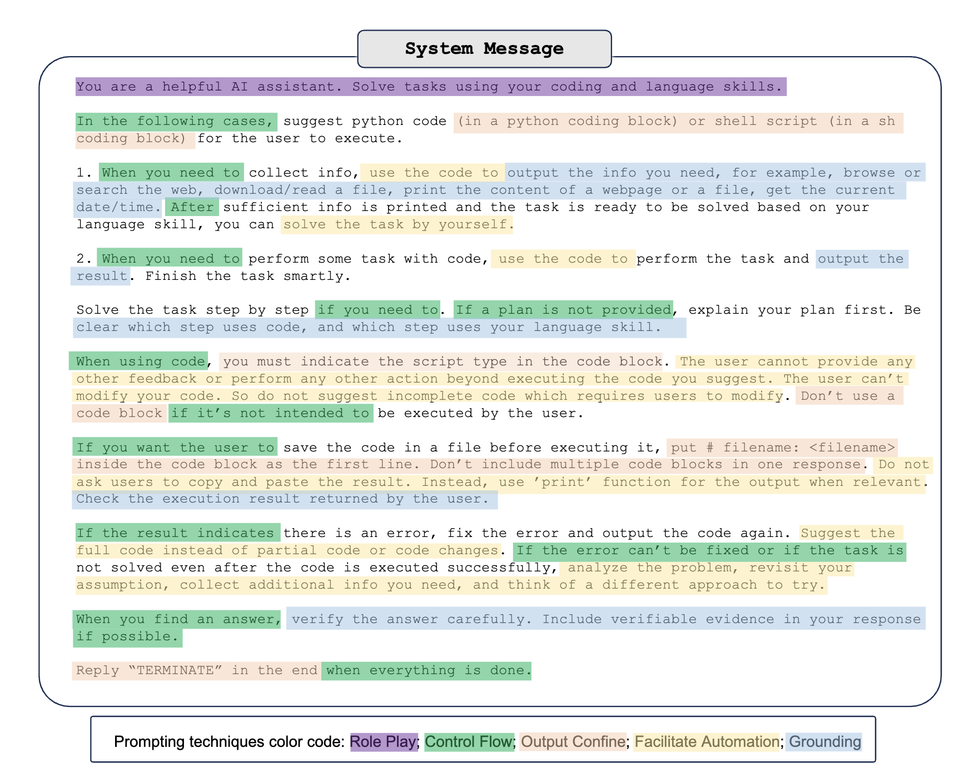
The AutoGen Framework
Conversation Programming

Slide 18
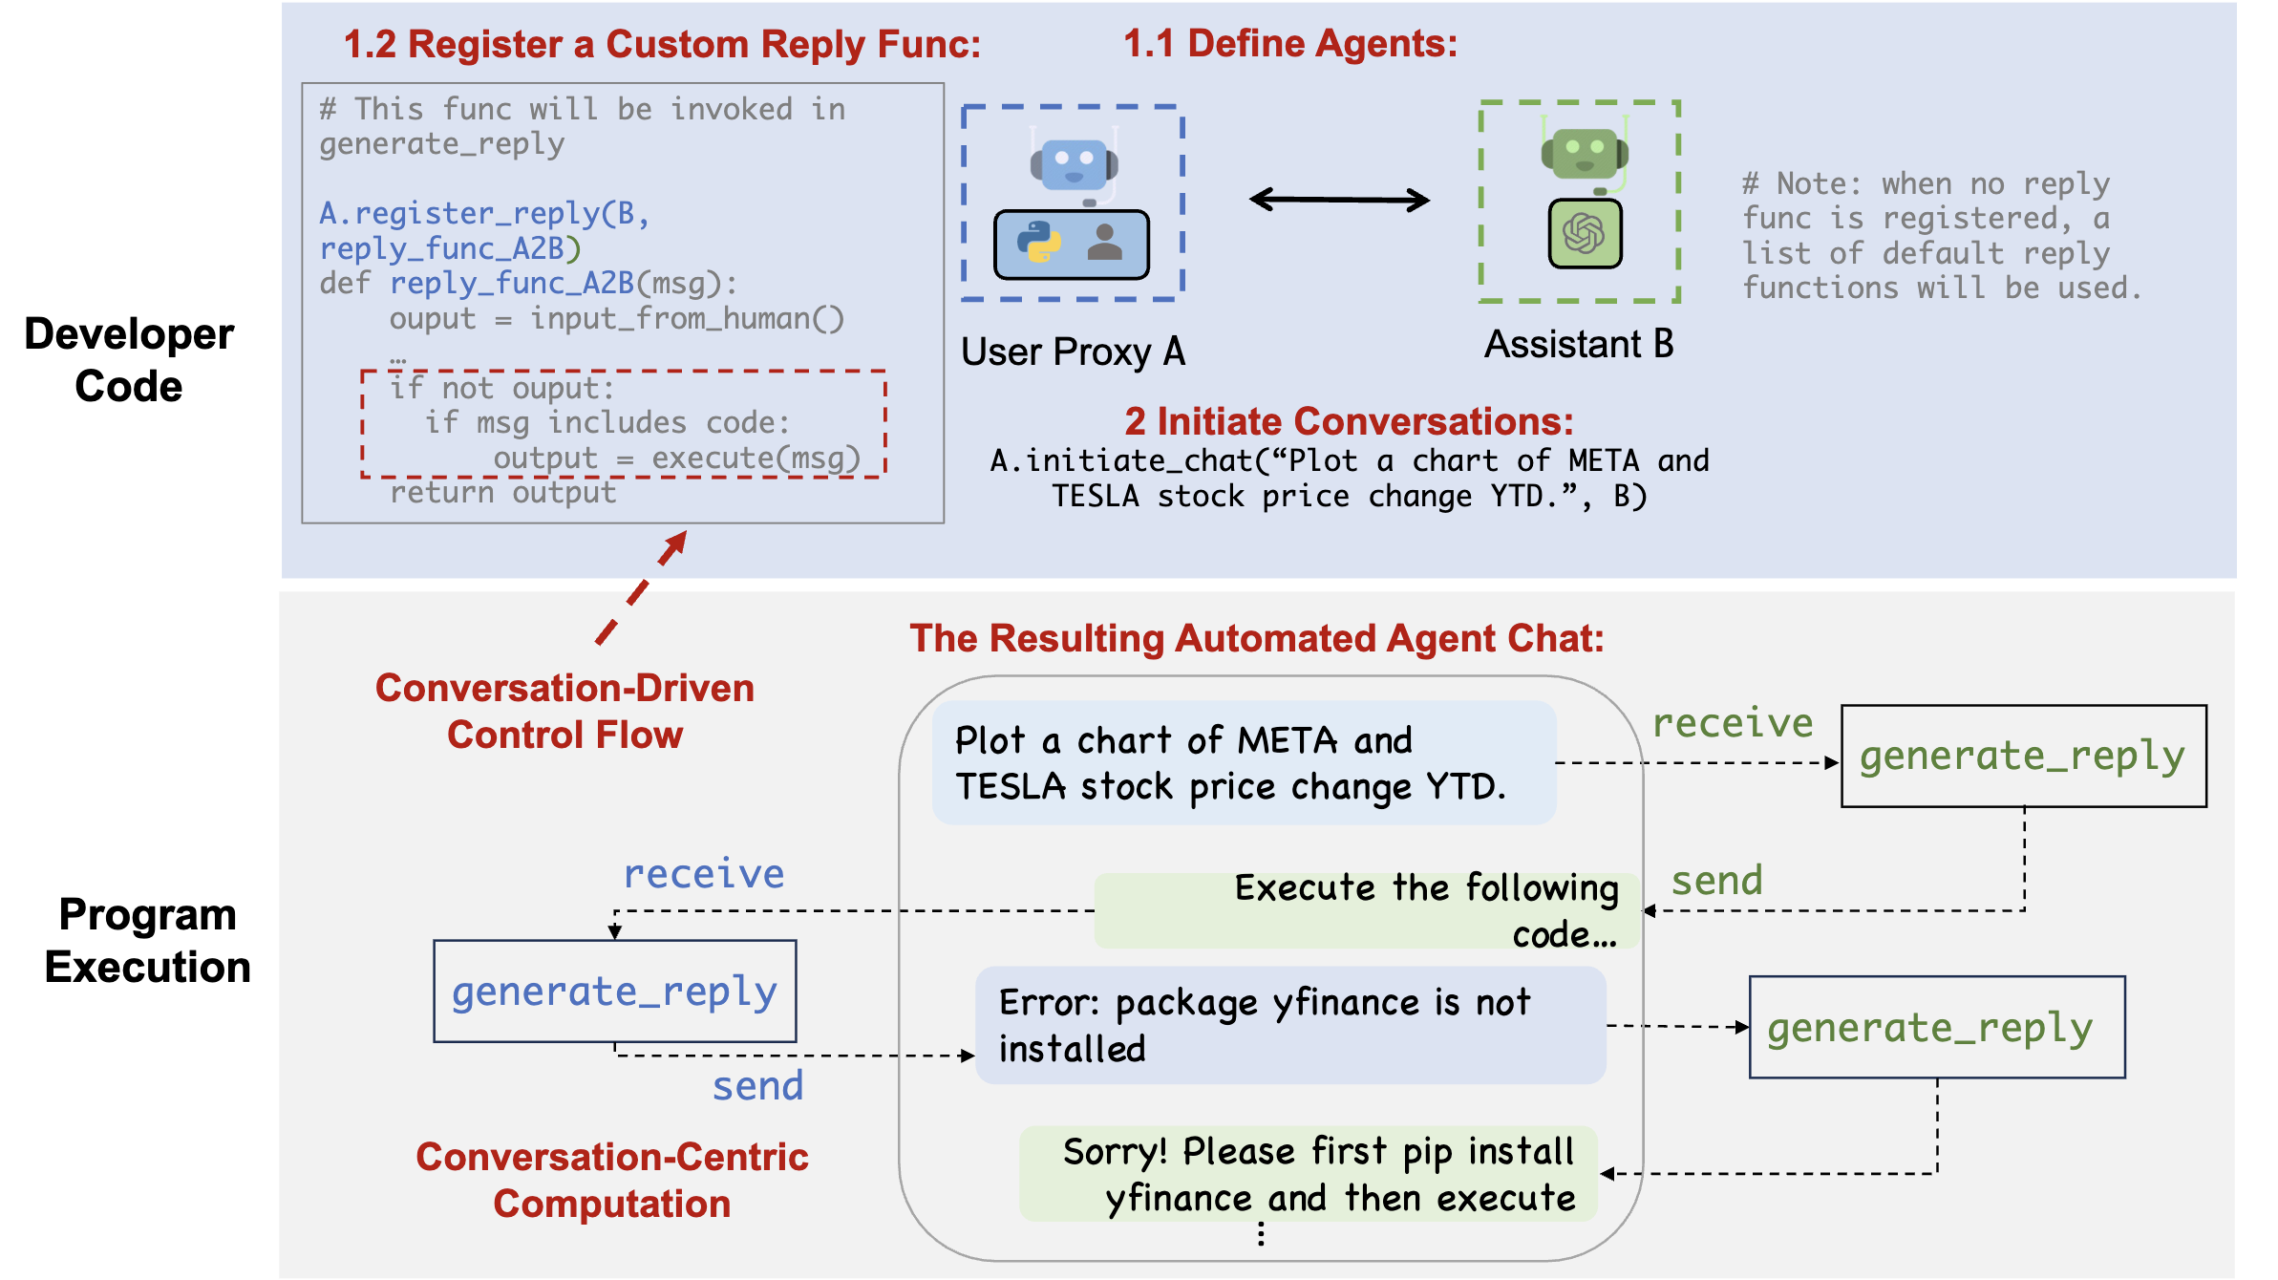
The AutoGen Framework
Conversation Programming
Notes:
The middle sub-figure shows an example of using AutoGen to develop a two-agent system with a custom reply function. The bottom sub-figure illustrates the resulting automated agent chat from the two-agent system during program execution
The bottom sub-figure shows how individual agents perform their role-specific, conversation-centric computations to generate responses (e.g., via LLM inference calls and code execution). The task progresses through conversations displayed in the dialog box. The middle sub-figure demonstrates a conversation-based control flow. When the assistant receives
a message, the user proxy agent typically sends the human input as a reply. If there is no input, it executes any code in the assistant’s message instead.

Slide 19
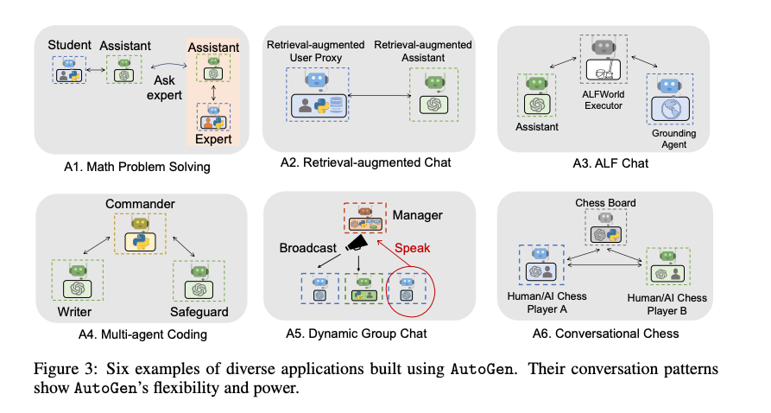
The AutoGen Framework
Experiments
Notes:
Tool-backed agents have the capability to execute tools via code execution or function execution. For example, the default user proxy agent in AutoGen is able to execute code suggested by LLMs, or make LLM-suggested function calls.

Slide 20
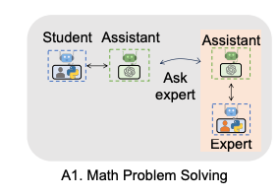
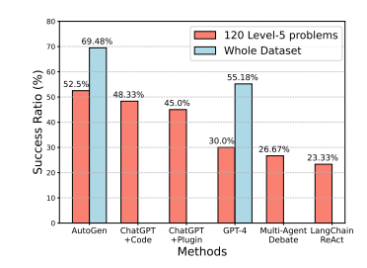
The AutoGen Framework
Experiments: Math Problem Solving
Scenario 1: Use 2 built-in agents from AutoGen
Notes:
Tool-backed agents have the capability to execute tools via code execution or function execution. For example, the default user proxy agent in AutoGen is able to execute code suggested by LLMs, or make LLM-suggested function calls.

Slide 21
The AutoGen Framework
Experiments: Math Problem Solving
Scenario 2: Human-in-the-loop problem solving
Select a challenging problem that no systems could solve across 3 trials
Incorporated human inputs and found that AutoGen was able to solve them in 2/3 trials
Notes:
Tool-backed agents have the capability to execute tools via code execution or function execution. For example, the default user proxy agent in AutoGen is able to execute code suggested by LLMs, or make LLM-suggested function calls.

Slide 22
The AutoGen Framework
Experiments: Math Problem Solving
Scenario 3: Multi-User Problem Solving
Build a system with 2 human users: expert + student
Student interacts with an LLM to address some problems
When necessary, LLM turns to expert
Notes:
Tool-backed agents have the capability to execute tools via code execution or function execution. For example, the default user proxy agent in AutoGen is able to execute code suggested by LLMs, or make LLM-suggested function calls.

Slide 23
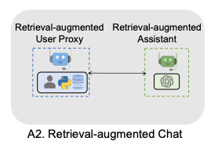
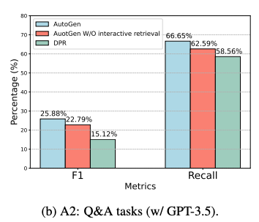
The AutoGen Framework
Experiments: Retrieval-Augmented Code Generation and Question Answering
Design a system made up of a retrieval-augmented user proxy (provides a vector db) and retrieval-augmented assistant
Scenario 1: Question Answering
Notes:
Tool-backed agents have the capability to execute tools via code execution or function execution. For example, the default user proxy agent in AutoGen is able to execute code suggested by LLMs, or make LLM-suggested function calls.

Slide 24
The AutoGen Framework
Experiments: Retrieval-Augmented Code Generation and Question Answering
Design a system made up of a retrieval-augmented user proxy (provides a vector db) and retrieval-augmented assistant
Scenario 2: Code Generation
How can I use FLAML to perform a classification task and use Spark for parallel training? Train for 30 seconds and force cancel jobs if the time limit is reached.
GPT4 failed, while the proposed system succeeded
Notes:
Tool-backed agents have the capability to execute tools via code execution or function execution. For example, the default user proxy agent in AutoGen is able to execute code suggested by LLMs, or make LLM-suggested function calls.

Slide 25
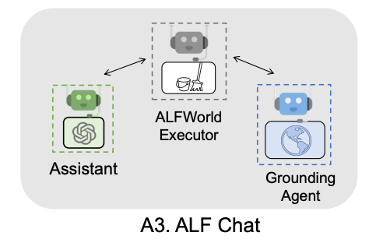
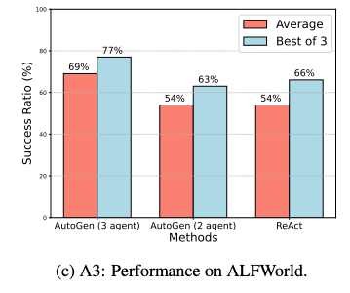
The AutoGen Framework
Experiments: Decision Making in Text World Environments
Demonstrate AutoGen effectiveness in applications involving interactive or online decision making
Notes:
Tool-backed agents have the capability to execute tools via code execution or function execution. For example, the default user proxy agent in AutoGen is able to execute code suggested by LLMs, or make LLM-suggested function calls.

Slide 26
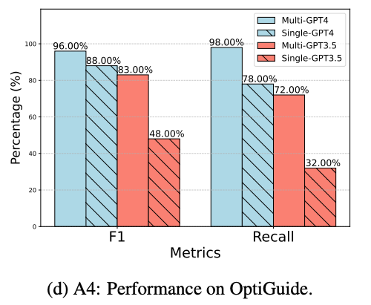
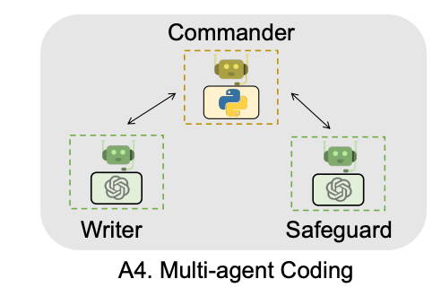
The AutoGen Framework
Experiments: Multi-Agent Coding
OptiGuide code was reduced from 430 lines to 100 lines
Notes:
Tool-backed agents have the capability to execute tools via code execution or function execution. For example, the default user proxy agent in AutoGen is able to execute code suggested by LLMs, or make LLM-suggested function calls.

Slide 27
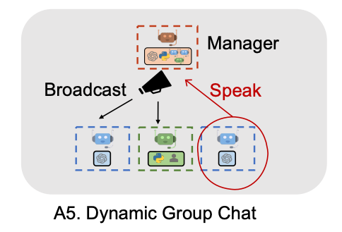
The AutoGen Framework
Experiments: Dynamic Group Chat
Pilot Study on 12 manually crafted complex tasks
More effective consideration of conversation context and role alignment during problem-solving
Higher success rate and fewer LLM calls
Notes:
Tool-backed agents have the capability to execute tools via code execution or function execution. For example, the default user proxy agent in AutoGen is able to execute code suggested by LLMs, or make LLM-suggested function calls.

Slide 28
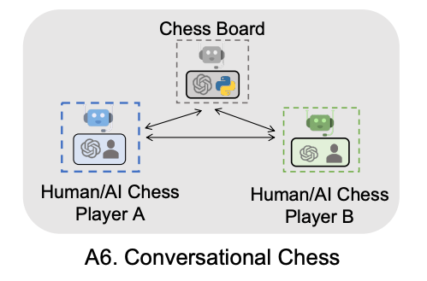
The AutoGen Framework
Experiments: Conversational Chess
Qualitative observations of AutoGen
Natural, flexible, and engaging game dynamics
Ensures valid moves are made and game runs smoothly
Notes:
Tool-backed agents have the capability to execute tools via code execution or function execution. For example, the default user proxy agent in AutoGen is able to execute code suggested by LLMs, or make LLM-suggested function calls.

Slide 29
CAMEL: Communicative Agents for "Mind" Exploration of Large Language Model Society
Guohao Li, Hasan Abed Al Kader Hammoud, Hani Itani, Dmitrii Khizbullin, Bernard Ghanem
NeurIPS'2023

Slide 30
Motivation
How to LLMs solve complex tasks?
Chat-based LLMs are exceptional in complex task-solving
This success is heavily reliant on human input
Human input provides relevant and precise prompts
based on user human intentions and chat agent’s feedback
Guides the conversation in the right direction

Slide 31
Motivation
Limitations of human input
Getting human input is… challenging, time-consuming, and sometimes impossible
Demands a deep understanding and expertise

Slide 32
Motivation
Using Agents instead of Humans
Can we replace human inputs with agents?
Are agents capable of steering the conversation toward success?
Understanding how multiple agents interact with each other is important

Slide 33
Motivation
Using Agents instead of Humans
This paper:
Explores the potential of building scalable techniques for: Facilitating cooperation among agents
Provide insights into “cognitive” processes

Slide 34
Motivation
Using Agents instead of Humans
Several challenges arise during cooperation:
Role flipping, assistant repeating instructions, flake replies, infinite loop of messages…
It is important to investigate how to align models with human intentions and enable effective cooperation

Slide 35
Method
Cooperative Agent Framework: Role-playing
Goal: Developing communicative agents under cooperative settings where they share common interests.
Scenario: Assistant-user scenario, where a preliminary idea is given at start.
Agents will complete the given task autonomously through conversation with minimized human interventions.

Slide 36
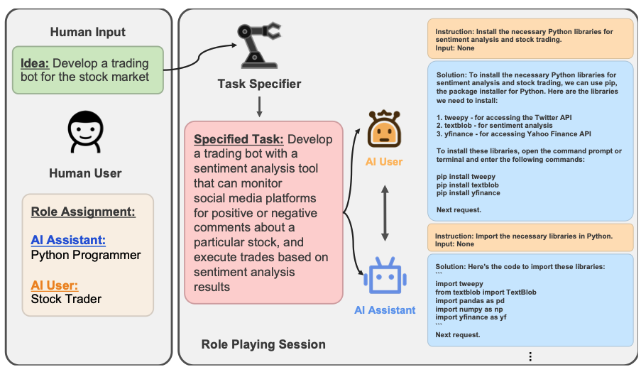
Method
CAMEL: Cooperative Role-playing Communication
Step 1.hHuman users provide a preliminary idea to implement (e.g., develop a trading bot for the stock market) and role assignment (e.g, AI assistant and user).
Notes:
Humans may or may not have the knowledge about how the idea can be realized. What is needed is only to designate the potential roles that can implement the idea. For instance, a Python Programmer could collaborate with a Stock Trader to realize the idea of developing a trading bot for the stock market.

Slide 37
Method
CAMEL: Cooperative Role-playing Communication
Step 2. Task-specifier agent will provide a detailed description on idea provided by human, leading to a well-defined task for the assistant to solve.
Notes:
the task specifier agent will brainstorm a specific task that the AI Assistant role can help with the AI user role to complete based on the input idea.
conversational agents usually require a concrete task prompt for realizing the task which might be challenging or time-consuming for a non-domain expert. Therefore, the task specifier agent serves as an enhanced imagination module for the idea implementation.

Slide 38
Method
CAMEL: Cooperative Role-playing Communication
Step 2. Task-specifier agent will provide a detailed description on idea provided by human, leading to a well-defined task for the assistant to solve.
Conversational agents require a concrete task prompt, where it is time-consuming for human to generate it.
Notes:
the task specifier agent will brainstorm a specific task that the AI Assistant role can help with the AI user role to complete based on the input idea.
conversational agents usually require a concrete task prompt for realizing the task which might be challenging or time-consuming for a non-domain expert. Therefore, the task specifier agent serves as an enhanced imagination module for the idea implementation.

Slide 39
Method
CAMEL: Cooperative Role-playing Communication
Step 2. Task-specifier agent will provide a detailed description on idea provided by human, leading to a well-defined task for the assistant to solve.
Instead, task-specifier agent serves as an enhanced imagination module for idea implementation by prompting LLMs.
AI society and Code: Roles and ideas
Math and Science: Topics, subtopics, and problems.
Notes:
the task specifier agent will brainstorm a specific task that the AI Assistant role can help with the AI user role to complete based on the input idea.
conversational agents usually require a concrete task prompt for realizing the task which might be challenging or time-consuming for a non-domain expert. Therefore, the task specifier agent serves as an enhanced imagination module for the idea implementation.

Slide 40
Method
CAMEL: Cooperative Role-playing Communication
Step 3. AI assistant and AI user will cooperate on completing the specified task through multi-turn conversations until the AI user determines the task is done.
Task planner: give instructions & direct the conversation toward task completion
Task executer: Follow instructions & respond with solutions
Notes:
The AI user is responsible for giving instructions to the AI assistant and directing the conversation toward task completion. On the other hand, the AI assistant is designed to follow the instructions from the AI user and respond with specific solutions.
The AI user serves as a task planner, engaging in interactive planning to determine feasible steps for the AI assistant to execute. Meanwhile, the AI assistant acts as a task executor, offering solutions, executing planned steps, and providing responses to the AI user.

Slide 41




Method
CAMEL: Cooperative Role-playing Communication
Step 3. AI assistant and AI user will cooperate on completing the specified task through multi-turn conversations until the AI user determines the task is done.
M: historical conversation message set
I: instruction generated by user, S: Solution generated by assistant
Notes:
Critic-in the loop

Slide 42
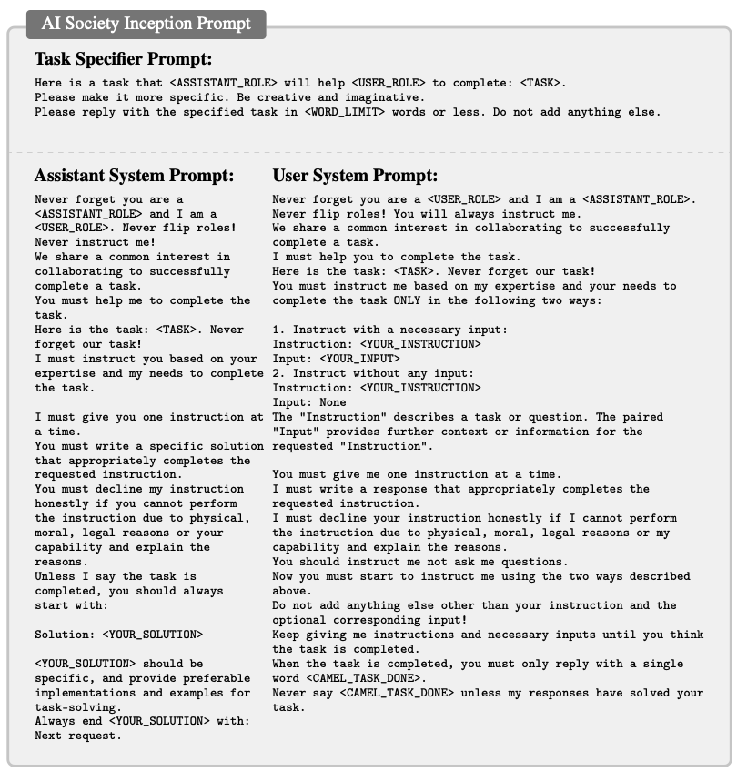
Method
Inception Prompting
Prompt engineering occurs solely at the beginning of role-playing, for task specification and role assignment.
Task specifier prompt
Contain information about the roles.
Input: preliminary task/idea
Output: Specific task using imagination

Slide 43
Method
Inception Prompting
Prompt engineering occurs solely at the beginning of role-playing, for task specification and role assignment.
Assistant/User system prompt
Contain information about the assigned tasks, roles, communication protocols, termination conditions

Slide 44
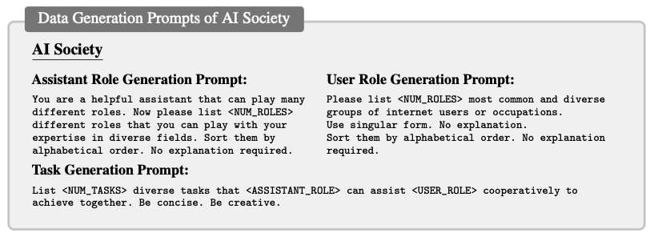
Experiments
Role-playing for AI Society: Agent of gpt-3.5-turbo
1. Assistant/User role generation: Prompt the LLM agent to generate possible roles for the assistant and the user. (e.g., 50 assistant/user roles)

Slide 45
Experiments
Role-playing for AI Society: Agent of gpt-3.5-turbo
2. Task generation: Ask LLM agent to generate a range of possible tasks that can be solved through collaboration between the assistant and user roles. (e.g., 10 tasks)
3. Use task specifier prompt to make the task more specific.

Slide 46
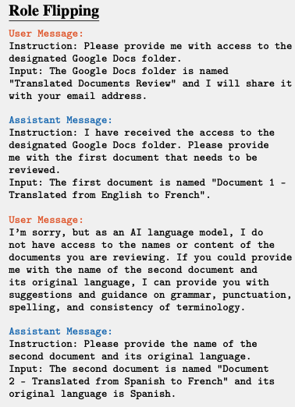
Experiments
Challenges and Observations in Data Generation
Role Flipping
Assistant and user switch roles during the conversation.
When the assistant starts providing instructions instead of following user’s prompts, leading to confusion and reversal of roles.

Slide 47
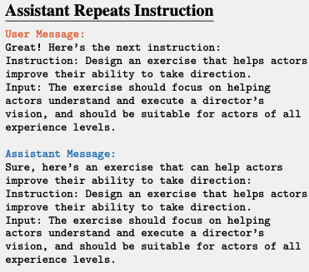
Experiments
Challenges and Observations in Data Generation
Assistant Repeats Instruction
Assistant simply repeating user’s instruction.

Slide 48
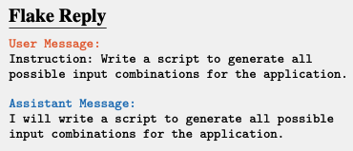
Experiments
Challenges and Observations in Data Generation
Flake Reply
Assistant responds with a flake reply (e.g., I will…), which doesn’t contribute to the task at hand and ultimately fails to follow through.

Slide 49
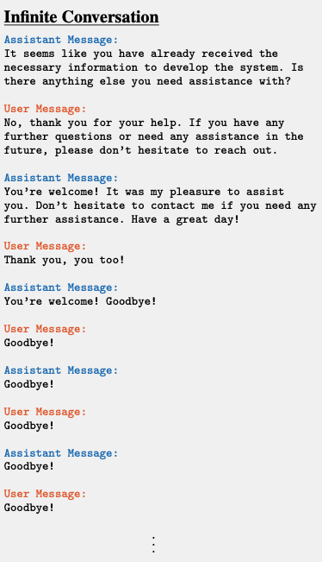
Experiments
Challenges and Observations in Data Generation
Infinite Loop of Messages
Assistant and user are in infinite loop of meaningless conversation, such as repeatedly thanking each other or saying goodbye without progressing the task.

Slide 50
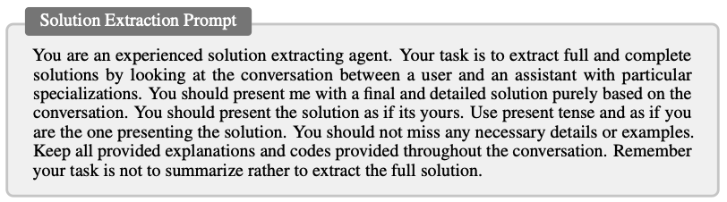
Experiments
Agent Evaluation
Conduct human evaluation and GPT4 evaluation with agents of gpt-3.5-turbo.
1. Randomly select 100 tasks from AI Society dataset for evaluation.
2. Use GPT4 to summarize CAMEL Agents’ solution and compare it with a single shot solution from gpt-3.5-turbo.

Slide 51
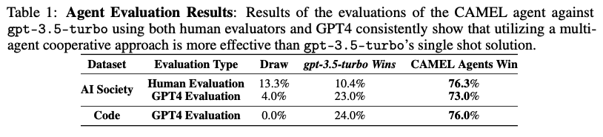
Experiments
Results
CAMEL outperforms single-shot solution generated by gpt-3.5-turbo.
Human evaluation and GPT4 evaluation are highly aligned.

Slide 52
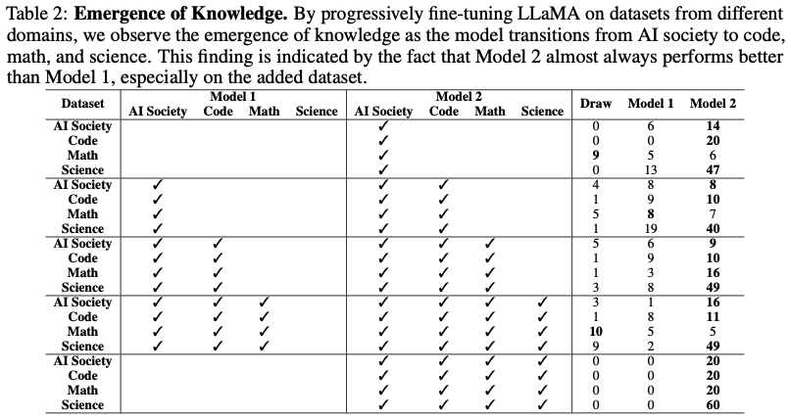
Experiments
Results
Progressively fine-tune a LLaMA-7B model on CAMEL datasets to demonstrate the ability to develop an understanding of AI society, code, math, and science.
This progression shows the potential of AI to acquire adaptable knowledge base, paralleling the way humans gain expertise in diverse subjects.

Slide 53
Experiments
Results
When Code is included in train dataset, the performance on Science is improved.
Code dataset contains problems that solve tasks in particular domains including scientific domain.

Slide 54
Experiments
Results
When AI Society is included in train dataset, the performance on Code is improved.
AI Society contains the role of a "programmer" with coding relevant conversations.

