Slide 1

LLM-Agent Memory
Yuyang Wang, Tianyi Huang, Boyang Sun
CS598 JY2

Slide 2
Recall From Last Lecture

Slide 3
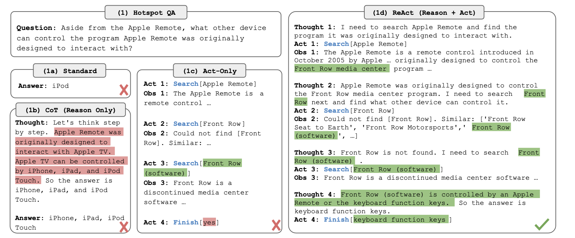
Action based Retrieval Process
REACT :
SYNERGIZING REASONING AND ACTING IN LANGUAGE MODELS

Slide 4
Retrieve From Internet
Working memory : The searching record only remains in current task by tracking thought process and observations during execution
Retrieve From Memory

Slide 5
Sub-sections For LLM-Memory
1 Background & Information
2 Coala :Cognitive Architectures for Language Agents
3 HippoRAG: Neurobiologically Inspired Long-Term Memory for Large Language Models
4 More Architectures Comparison (Coala & RAM)

Slide 6
Background & Information

Slide 7
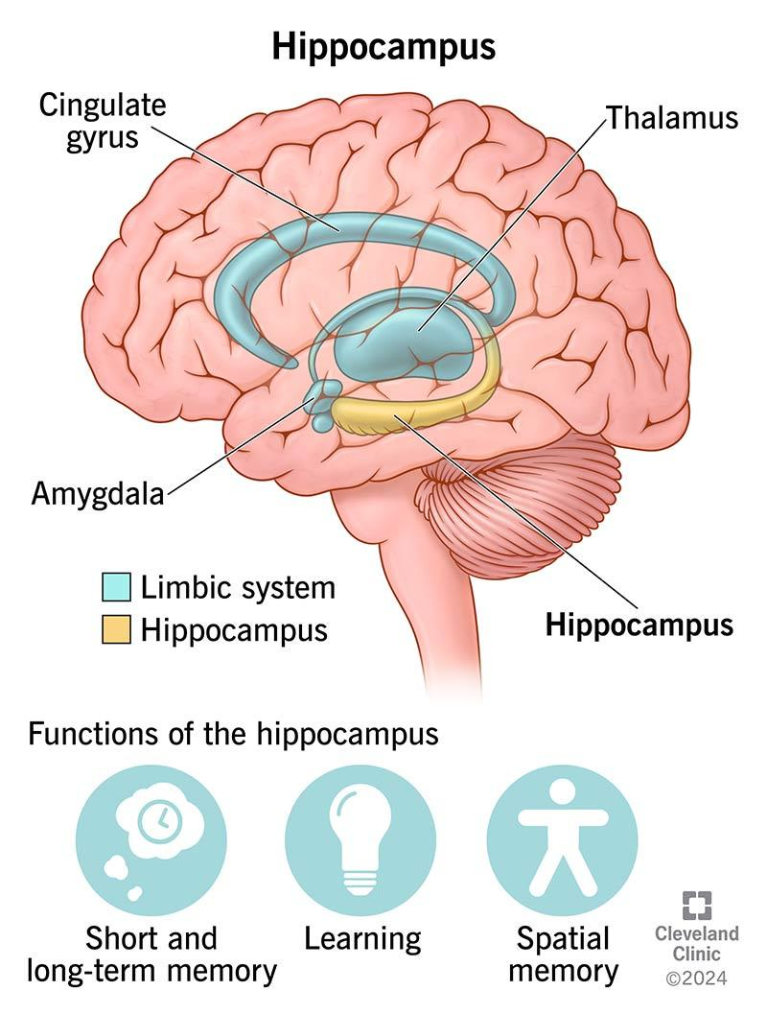
Information
Memory systems in AI agents have been heavily inspired by how biological memory works, particularly human memory. Just as humans have different types of memory systems (working memory, episodic memory, semantic memory, etc.), AI agents have evolved to incorporate similar structures, though often implemented quite differently.

Slide 8
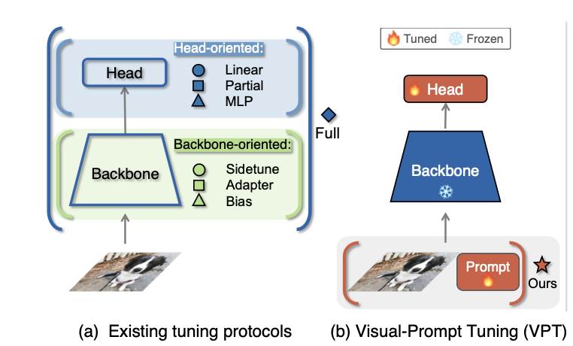
Related Work
Modern AI systems increasingly need to handle multiple types of information:
Vision Memory →
prompt tuning … →
classification problem
VPT (1) Visual Prompt Tuning. arXiv preprint arXiv:2203.12119.

Slide 9
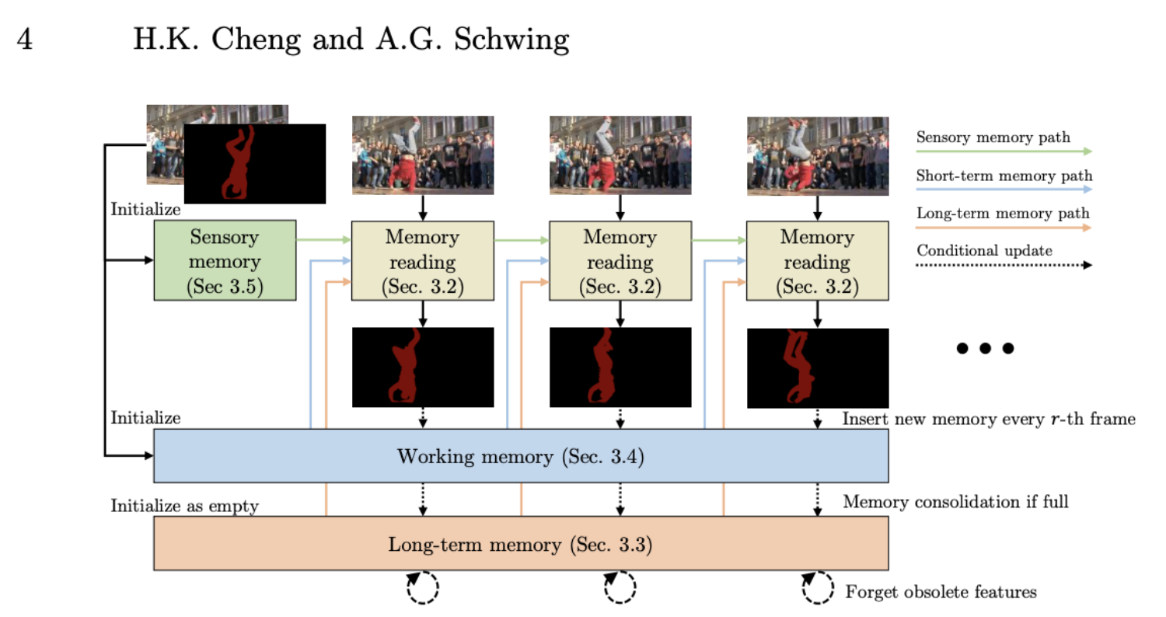
Related Work
Modern AI systems increasingly need to handle multiple types of information:
Video Understanding →
video mem … →
frame predictions
Xpem (2)
Long-Term Video Object Segmentation with an Atkinson-Shiffrin Memory Model.

Slide 10
Related Work
Modern AI systems increasingly need to handle multiple types of information:
Robotics Memory → robot state information… -> motion prediction and learning
And etc …

Slide 11
Key Innovations in AI Memory
Retrieval-Augmented Generation (RAG):
Allows LLMs to access external knowledge bases
Combines parametric and non-parametric memory
Long-Context Windows:
Newer models can handle much longer sequences
Enables better maintenance of conversation history
Hierarchical Memory:
Different levels of memory storage with varying access speeds
Inspired by human memory consolidation processes

Slide 12
Challenges and Future Directions
Memory Efficiency:
Managing the trade-off between storage size and access speed
Developing better compression techniques for memory storage
Cross-Modal Integration:
Better methods for connecting memories across different modalities
Unified representations for multi-modal information
Continuous Learning:
Developing methods for safely updating stored knowledge
Handling contradictory or outdated information without forgetting
Safety and Privacy: (rehearsal base and non-rehearsal base mem)
Ensuring private information is properly protected
Preventing manipulation or poisoning of memory systems

Slide 13
Cognitive Architectures for Language Agents
Why language agents need structure.
Core components of CoALA: memory, actions, decision-making.
Case studies like Voyager and Generative Agents.
Future directions inspired by cognitive science.
Notes:
Today, we’re diving into Cognitive Architectures for Language Agents. So, why do language agents even need structure? Well, as these agents become more sophisticated, they’re interacting with the world in increasingly complex ways—whether that’s controlling robots, navigating websites, or even holding conversations. Without a solid structure, their decision-making processes can become fragmented and inefficient.
This is where CoALA comes in. CoALA stands for Cognitive Architectures for Language Agents, and it introduces a framework built around three core components: memory, actions, and decision-making. Memory allows agents to retain past experiences and knowledge, actions define how agents interact with both their internal knowledge and the external environment, and decision-making is the process that ties everything together—helping agents plan, evaluate, and execute tasks effectively.
We’ll explore how this framework plays out in real-world case studies like Voyager, an agent that learns to navigate and perform tasks in Minecraft, and Generative Agents, which simulate human-like behavior in interactive environments.
Finally, we’ll look at future directions inspired by cognitive science, exploring how we can push the boundaries of what language agents can achieve. By grounding language agents in cognitive principles, we can make them more flexible, efficient, and capable of generalizing across a wide range of tasks

Slide 14
What is the Problem ?
Language agents use LLMs to interact with the world—like controlling robots or browsing the web. But today’s agents are fragmented:
Problem 1: No common framework. Terms like ‘tool use’ or ‘grounding’ vary across papers, making comparisons hard.
Problem 2: Ad-hoc design. Agents mix LLM calls, memory, and code without principled structure.
Problem 3: Limited generalization. Agents struggle to adapt beyond narrow tasks.
Example: ReAct (Yao et al., 2022) uses LLMs for reasoning and acting, while Voyager (Wang et al., 2023) adds skill libraries. But how do we systematically improve both?
The paper addresses the lack of a unified framework for organizing and understanding language agents.
Notes:
So, what exactly is the problem we’re trying to solve here?
Language agents today use large language models, or LLMs, to interact with the world. This can mean controlling robots, browsing the web, solving puzzles, you name it. But despite all the progress, there are some major issues holding these agents back.
First, there’s no common framework. Terms like ‘tool use’ or ‘grounding’ are thrown around in different papers, but they often mean different things. This makes it really hard to compare agents or build on each other’s work.
Second, the designs are often ad-hoc. Many agents just mix LLM calls, memory modules, and bits of code without any principled structure. It’s like building with LEGO bricks but without any instructions—you can get something that works, but it’s messy and hard to improve.
Third, these agents have limited generalization. They might do great on specific tasks they were designed for, but they struggle when you throw them into new, unfamiliar situations.
Let’s take some examples. ReAct—introduced by Yao and colleagues in 2022—uses LLMs for reasoning and acting in digital environments. It’s powerful but limited in flexibility. Then there’s Voyager—by Wang and team in 2023—which adds skill libraries to help agents learn over time. But here’s the question: How do we systematically improve both of these? How do we create agents that aren’t just good at specific tasks but can generalize and adapt?
That’s exactly what this paper addresses—the lack of a unified framework for organizing and understanding language agents. And that’s where CoALA steps in

Slide 15
History Inspiration: Cognitive Architecture
CoALA draws from symbolic AI and cognitive science:
Production systems (Newell & Simon, 1972): Rules like “IF temperature > 70°C, THEN turn off furnace.”
Soar architecture (Laird, 1987): Structured agents with working memory, procedural rules, and decision cycles.
Key analogy:
Traditional productions → Handwritten rules.
LLMs → Probabilistic productions that generate text-based actions.
Example: An LLM completing the prompt “The room is hot…” with “…open a window” mirrors a production rule, but with uncertainty.
Notes:
To tackle this problem, the authors drew inspiration from the history of cognitive science and artificial intelligence, especially from something called cognitive architectures.
So, what are cognitive architectures? Well, they come from early AI systems like production systems, introduced by Newell and Simon in 1972. These were simple, rule-based systems. For example, you might have a rule like, ‘IF the temperature is greater than 70°C, THEN turn off the furnace.’ It’s straightforward, but powerful—it lets machines make decisions based on predefined conditions.
Then we have the Soar architecture, developed by Laird in 1987. Soar introduced more structure by combining different types of memory—like working memory and procedural rules—with decision cycles to help agents decide what to do next. It made agents more flexible and capable of handling complex tasks.
Now, here’s the key analogy the authors make: In traditional systems, those production rules were handwritten. You had to manually program every ‘IF-THEN’ rule. But with LLMs, we’re talking about probabilistic productions. Instead of rigid rules, LLMs generate actions based on probabilities. They can complete text prompts in flexible, dynamic ways.
For example, if you prompt an LLM with ‘The room is hot…’, it might respond with ‘…open a window’. That’s similar to a production rule, but it’s not fixed—it’s probabilistic, meaning the LLM could generate different responses depending on the context. This flexibility makes LLMs powerful but also introduces uncertainty.
So, CoALA takes these ideas from traditional cognitive architectures and applies them to modern language agents, combining structured decision-making with the probabilistic power of LLMs.

Slide 16
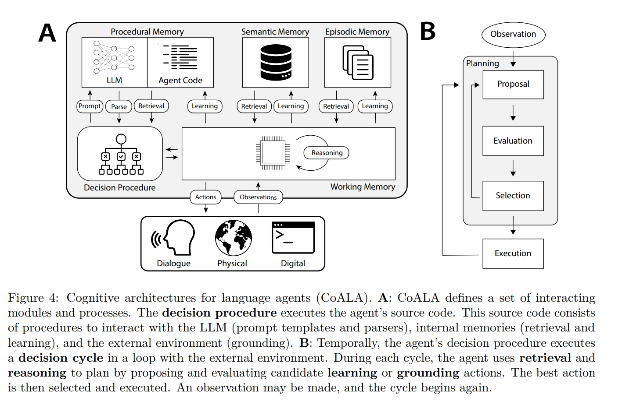
The CoALA Framework
CoALA has 3 pillars:
Memory
Decision process
Action space
Notes:
Now, let’s dive into the CoALA framework itself.
CoALA is built around three key pillars: Memory, Decision Process, and Action Space.
First, we have Memory. This isn’t just about storing information—it’s about organizing knowledge in a way that agents can actually use. CoALA divides memory into different types, like working memory for short-term tasks and long-term memory for storing experiences, facts, and procedures. We’ll dig into the specific memory modules a bit later.
Next, we have the Decision Process. This is how the agent decides what to do at any given moment. It’s a structured cycle where the agent plans possible actions, evaluates them, executes the best option, and then observes the outcome. This process helps the agent adapt and improve over time, much like how humans learn from experience.
Finally, there’s the Action Space. This is all about how agents interact with both their internal world—their memory and reasoning—and the external environment. Actions can be internal, like reasoning or retrieving information from memory, or external, like moving a robot or making an API call.
By combining these three components—memory, decision-making, and action—CoALA provides a unified framework for designing flexible, intelligent language agents. It’s a blueprint for building agents that can reason, learn, and adapt in complex environments.

Slide 17
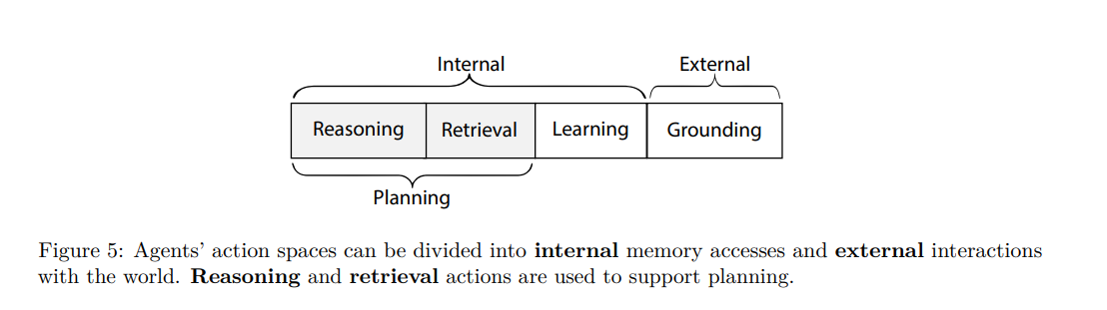
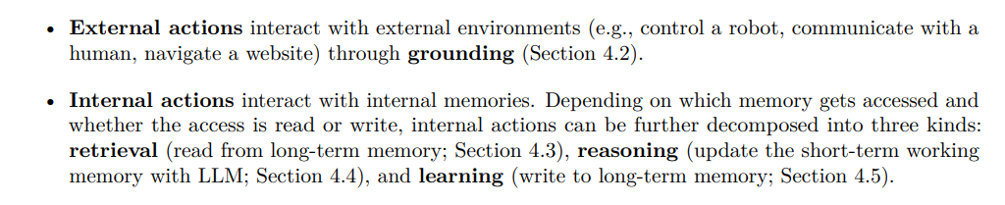
The CoALA Framework
Notes:
Let’s take a closer look at the Action Space in the CoALA framework.
In CoALA, actions are divided into two main types: external and internal.
First, we have external actions. These are actions that interact directly with the outside world. For example, a language agent might control a robot, navigate a website, or respond to a user in a conversation. These actions are about grounding the agent in its environment—making it capable of affecting and perceiving the real or digital world.
Then, we have internal actions. These happen within the agent itself and include things like reasoning, retrieving information from memory, and learning from past experiences.
Let’s break those down a bit more:
Reasoning is when the agent processes information to come up with new ideas or solutions. For example, an agent might analyze a problem step by step before deciding on the next move.
Retrieving is about pulling information from long-term memory. Maybe the agent remembers a previous conversation or retrieves facts from its knowledge base to inform its decision.
And learning is when the agent writes new information to memory, updating its knowledge or skills based on new experiences.
Finally, there’s grounding, which connects both internal and external actions. Grounding helps the agent interpret sensory input from the environment—like translating visual data into text for processing—or ensures that its actions are aligned with real-world constraints.
By structuring the action space this way, CoALA allows agents to seamlessly switch between thinking, learning, and acting, making them much more flexible and capable in dynamic environments.

Slide 18
Memory modules
Working memory
immediate thoughts about the current conversation
Memory modules
Episodic Memory
Long-term Memory
Semantic Memory
Procedural Memory
Notes:
CoALA organizes memory into 4 modules, mirroring human cognition:
Working Memory:
Short-term, active context.
Example: When solving a math problem, the LLM tracks intermediate steps like “Step 1: Calculate 5² = 25.”
Persists across LLM calls, unlike the model’s default context window.
Episodic Memory:
Stores past experiences as timestamped events.
Example: A cooking agent remembers “Failed to boil water at 2 PM because the stove was off.”
Used for reflection (e.g., “Why did I fail?”) and planning (e.g., “Check the stove first”).
Now, let’s talk about the Memory Modules in CoALA.
Memory is a critical part of any intelligent system, and CoALA organizes it into four key types: working memory, episodic memory, semantic memory, and procedural memory.
First, we have working memory. This is the agent’s short-term memory. It holds information that’s immediately relevant to the current task, like recent observations, active goals, or intermediate reasoning steps. Think of it like a scratchpad—the agent writes down what it needs to solve a problem in the moment, but this information doesn’t necessarily stick around for the long term.
Next is episodic memory. This stores the agent’s personal experiences over time. For example, if an agent helped a user book a flight last week, that interaction would be stored in episodic memory. Later, the agent can recall this specific event to provide more personalized assistance.
Then we have semantic memory. This is the agent’s general knowledge about the world. It includes facts, concepts, and relationships—things like ‘Paris is the capital of France’ or ‘Water boils at 100 degrees Celsius’. While episodic memory is about specific experiences, semantic memory is about general truths the agent can rely on.
Finally, there’s procedural memory. This is where the agent stores knowledge about how to perform tasks. It’s like having a set of instructions or skills. For example, the agent might know how to search for information online, filter results, or execute a specific command. Procedural memory includes both the agent’s code and any learned behaviors that guide its actions.
Together, these memory modules allow the agent to not just store information, but to use it in flexible, intelligent ways—whether it’s recalling a past event, applying general knowledge, or executing a learned skill. Semantic Memory:
General knowledge about the world.
Example: Retrieving “Water boils at 100°C” from Wikipedia or a manual.*
Unlike LLMs’ parametric knowledge, this is explicit and updatable.
Procedural Memory:
Skills and code.
Two forms:
Implicit: Knowledge embedded in LLM weights (e.g., “How to write a for-loop”).
Explicit: Code or rules written by the agent (e.g., Voyager’s “mine_ore()” function).

Slide 19
Memory modules
Long-term Memory comes in three types: (an example about shopping assistant)
• Episodic Memory: Past shopping interactions with users ("Last time this user bought size L")
• Semantic Memory: General knowledge about products ("Winter coats should be water-resistant")
• Procedural Memory: How to perform tasks (search procedures, filtering methods)
Notes:
Let’s dive deeper into Long-term Memory and how it works in CoALA, using a practical example—a shopping assistant.
Long-term memory in CoALA comes in three types: episodic memory, semantic memory, and procedural memory. Each plays a different role in helping the agent function intelligently.
First, there’s episodic memory. This is where the agent stores specific experiences from past interactions. For example, if a user previously bought a size L jacket, the agent would remember that. So, when the user comes back looking for winter clothes, the agent can suggest the right size based on that personal history. It’s like the agent saying, ‘Last time you bought size L—would you like the same size again?’.
Next, we have semantic memory. This is the agent’s general knowledge about the world. In the case of our shopping assistant, it might know things like ‘Winter coats should be water-resistant’ or ‘Running shoes typically have more cushioning than walking shoes’. This helps the agent provide useful, context-aware recommendations, even if it’s the first time a user is shopping for a particular item.
Finally, there’s procedural memory. This is all about how the agent performs tasks. For example, it knows how to search the product catalog, how to filter results based on user preferences, and how to recommend items effectively. This isn’t just general knowledge—it’s the step-by-step process the agent follows to complete tasks efficiently.
By combining these three types of memory, the shopping assistant can provide a much more personalized and intelligent experience. It remembers the user’s preferences, applies general knowledge about products, and knows exactly how to find and suggest the best options.

Slide 20
Decision-Making Loop
CoALA’s decision cycle mirrors human problem-solving:
Plan: Use LLMs to propose actions.
Example: Tree of Thoughts (Yao et al., 2023) generates multiple reasoning paths for math puzzles.
Evaluate: Score actions using LLM self-critique or simulations.
Example: Reflexion (Shinn et al., 2023) asks the LLM: “Will this code crash?”
Execute: Perform the best action (e.g., run code, move robot).
Observe: Update memory with results.
Notes:
Now let’s take a look at the Decision-Making Loop in CoALA, which mirrors how humans solve problems.
The process is structured into four key steps: Plan, Evaluate, Execute, and Observe. Let’s break these down with some examples.
First, we have the Plan stage. Here, the agent uses LLMs to propose possible actions. For instance, the Tree of Thoughts method, introduced by Yao and colleagues in 2023, allows agents to generate multiple reasoning paths when solving complex problems like math puzzles. Instead of jumping straight to an answer, the agent explores different possible solutions, just like how we might brainstorm ideas before making a decision.
Next comes Evaluate. In this stage, the agent scores or critiques the proposed actions. This can be done through self-critique or by running simulations. For example, the Reflexion framework by Shinn et al., 2023, allows the agent to assess its own outputs by asking questions like, ‘Will this code crash?’ or ‘Is this the most efficient solution?’ This step helps the agent filter out bad ideas and focus on the best options.
Once the best action is identified, the agent moves to Execute. This is where the agent carries out the chosen action, whether that’s running a piece of code, moving a robot, or making an API call. Execution is where all the planning and evaluation come to life.
Finally, there’s Observe. After the action is executed, the agent observes the outcome and updates its memory with the results. This feedback loop allows the agent to learn from its experiences and improve over time. It’s similar to how we adjust our strategies based on what works and what doesn’t.
By following this decision-making cycle—Plan, Evaluate, Execute, and Observe—CoALA agents can adapt, learn, and become more effective over time, making them capable of handling increasingly complex tasks.

Slide 21
Strengths & Limitations
Strengths:
Unifying: Compares agents like SayCan vs. Voyager.
Practical: Guides design (e.g., “Add episodic memory for reflection”).
Theoretical: Links LLMs to cognitive science.
Limitations:
Empirical Gaps: Needs benchmarks for components (e.g., memory vs. no memory).
Safety Risks: Learning actions (e.g., code modification) could introduce errors.
Scalability: LLM calls are slow; complex planning may be impractical.
Notes:
Let’s wrap things up by looking at the Strengths and Limitations of the CoALA framework.
Starting with the strengths:
First, CoALA is unifying. It provides a common framework that helps us compare different language agents. For example, it allows us to see how agents like SayCan and Voyager differ in their design and capabilities, but also how they fit into a larger, structured system. This makes it easier to identify what’s working, what’s not, and where we can improve.
Second, it’s practical. CoALA isn’t just a theoretical concept—it offers concrete guidance for designing better agents. For instance, if an agent is struggling to adapt to new tasks, CoALA suggests adding episodic memory to help the agent reflect on past experiences and improve its decision-making.
Third, CoALA has strong theoretical foundations. By linking LLM-based agents to cognitive science, it grounds modern AI in decades of research on how humans think, learn, and act. This connection helps us design agents that are not only more capable but also more aligned with human-like reasoning processes.
But, of course, there are limitations too:
One major limitation is the presence of empirical gaps. While CoALA provides a solid framework, we still need more benchmarks to test how different components—like memory or decision-making—actually impact performance. For example, how much better does an agent perform with episodic memory compared to without it? These are questions that need more data.
Another challenge is safety risks. As agents become more autonomous and start learning new actions—like modifying their own code—there’s a risk of unintended behavior. An agent might introduce errors into its system, or worse, take actions that weren’t intended by its designers.
Finally, there’s the issue of scalability. LLM calls can be slow and resource-intensive, which makes complex, multi-step planning impractical in some real-world applications. As agents become more sophisticated, finding ways to make them faster and more efficient will be crucial.
So, while CoALA offers a powerful framework for building more capable language agents, there’s still work to be done in addressing these limitations and pushing the field forward.

Slide 22
HippoRAG: Neurobiologically Inspired Long-Term Memory for Large Language Models
Notes:
In our previous discussion on the paper ‘Cognitive Architectures for Language Agents,’ we explored how modular designs can enable reasoning, planning, and memory in AI systems. A critical aspect that emerged from that conversation was the need for an efficient, long‐term memory mechanism—one that integrates new information without constantly retraining the entire model.
This naturally leads us to HippoRAG, a novel framework specifically designed to address the long‐term memory gap in LLMs. It does so by drawing on both biological inspiration from the human hippocampus and classical retrieval‐augmented generation (RAG) pipelines.

Slide 23
What is the Problem?
Problem Statement:
LLMs lack efficient mechanisms to integrate new knowledge without retraining.
Current RAG methods struggle with multi‐hop questions requiring knowledge from multiple passages.
Key Challenge:
Passages are encoded in isolation. Even multi‐step retrieval can be slow, expensive, or inaccurate for certain complex queries.
Notes:
“Now, why do we need something beyond standard RAG? Because Large Language Models—though powerful— don’t have a simple way to incorporate brand-new knowledge without retraining. And RAG alone often fails when a query spans multiple passages. We might have to chain retrieval steps, which can explode in cost and complexity.
The key challenge is that each passage is effectively encoded in isolation. A multi‐hop question, for instance, might need facts from Passage A, then from Passage B, then from Passage C. Doing that with multiple retrieval calls is not only slow and expensive, it can fail if the LLM misses a crucial intermediate hop. This is where HippoRAG comes in, offering a single‐step, more integrated retrieval solution.”

Slide 24
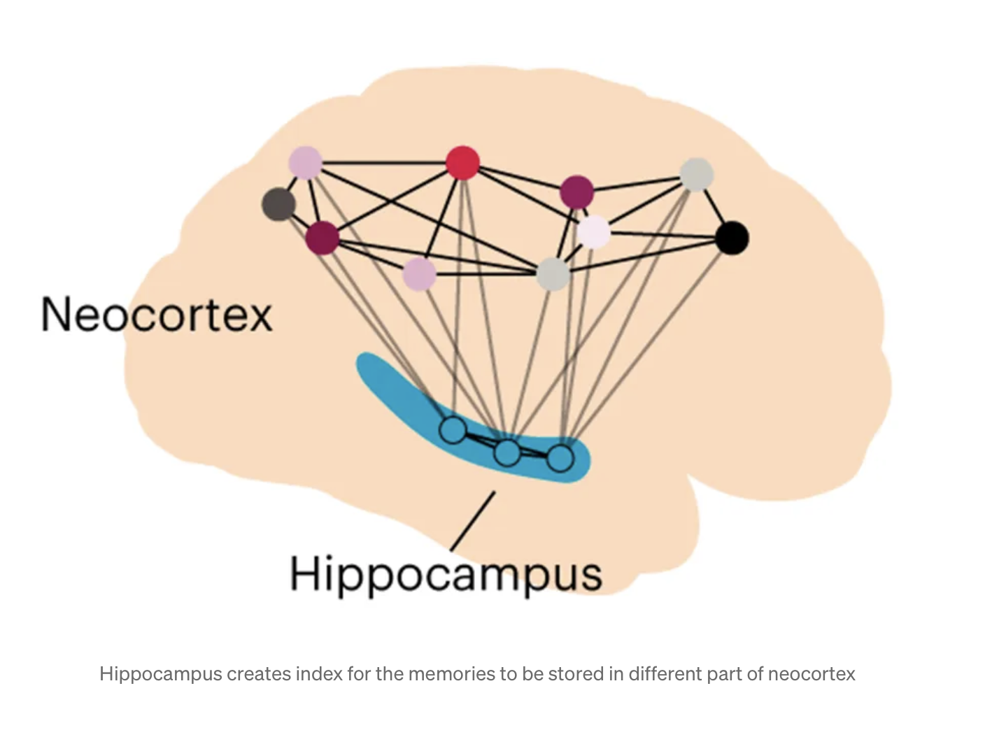
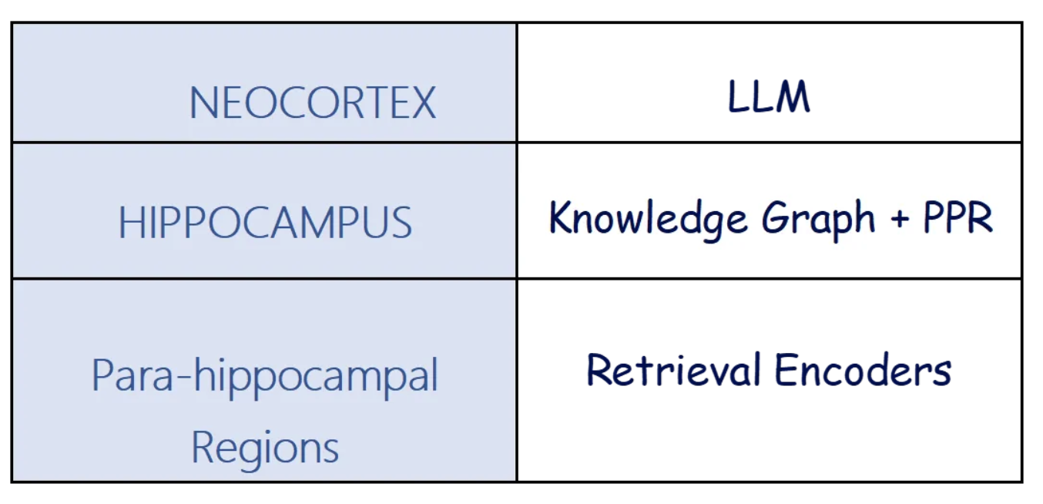
Neurobiological Theory
Hippocampal Indexing Theory → HippoRAG
Hippocampal Indexing Theory:
Neocortex = memory storage
Hippocampus = index
Parahippocampal regions = pipeline
Analogy for LLMs:
Notes:
**“HippoRAG’s design is inspired by hippocampal indexing theory in neuroscience. Let me elaborate:
The neocortex processes and stores our detailed memories—language, sensory details, etc.
The hippocampus acts as an ‘index’ or ‘pointer’ to those distributed memory traces, essentially linking different cortical areas.
The parahippocampal regions (PHR) help convey signals between cortex and hippocampus.
When we encode a new memory, it’s distributed in multiple brain regions, and the hippocampus keeps track of their connections. Later, from a partial cue, the hippocampus can ‘reactivate’ the rest of the memory—often described as:
Pattern Separation when encoding distinct experiences,
Pattern Completion when retrieving from partial stimuli.
In HippoRAG, we adapt this principle for multi‐document retrieval:
The LLM is the neocortex, processing textual information.
The knowledge graph is our hippocampus, storing associations between concepts as nodes and edges.
The retrieval encoders act like the PHR, detecting synonyms or similar phrases so they can be effectively ‘linked’ in the graph.
This allows us to add new knowledge as graph links, and then retrieve across them in a single step, mirroring how the hippocampus can rapidly connect partial cues to complete a memory.”**

Slide 25
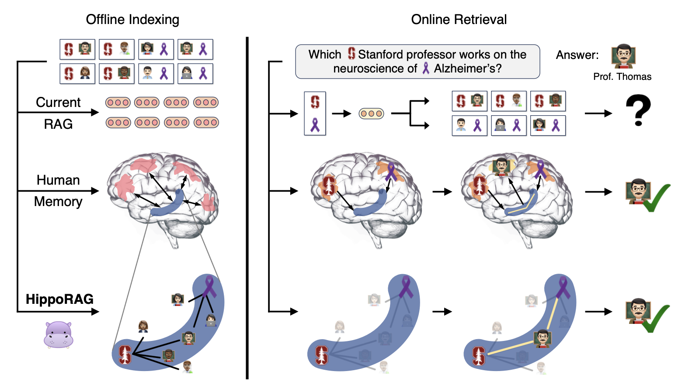
Notes:
Here we see a visual comparison of three approaches to knowledge integration.
On the top left, we have current RAG methods. Notice how each red circle represents an isolated passage. Because RAG treats documents as separate chunks with no explicit links, it fails whenever no single passage directly mentions all the key facts
In the center, we see human memory. The brain in the figure receives signals from different experiences and forms a single connected memory. The C‐shaped blue region depicts our hippocampus, which stores associations. This helps us rapidly combine disparate facts—like ‘Stanford affiliation’ and ‘Alzheimer’s research’—even if we originally learned them separately.
At the bottom, we have HippoRAG. It mimics that hippocampal approach by creating an integrated ‘hippocampal index’ that stitches together partial associations across passages. When the user asks a multi‐hop question—for example, ‘Which Stanford professor works on Alzheimer’s?’—HippoRAG can retrieve all relevant nodes in one shot, identifying that Professor Thomas meets both conditions.
Overall, this figure illustrates how HippoRAG bridges the gap between the isolated documents in standard RAG and the associative capabilities of human memory.

Slide 26
Multi‐Hop Questions
Definition: A question whose answer requires info from multiple sources or “hops.”
Examples:
“In which district was Alhandra born?”
“Which Stanford professor works on Alzheimer’s?”
Two Types
Path‐Following: More linear (“A → B → C → answer”).one known chain.
eg.like ‘Alhandra was born in which district?’ → you find District X → then discover the next fact from there
Path‐Finding: Multiple routes; more open‐ended; standard RAG can get lost.”
Notes:
Now that we’ve seen how HippoRAG can bring together isolated documents similarly to how the hippocampus binds distinct memories, let’s look at why this is so crucial in multi‐hop questions. By definition, these questions demand answers drawn from multiple pieces of information scattered across different segments of text—often from different documents. Unlike single‐hop questions, where one document might suffice, multi‐hop queries force us to integrate partial facts into a full chain of reasoning.
multi‐hop QA generally comes in two forms:
Path‐Following: A straightforward chain—like ‘Alhandra was born in which district?’ → you find District X → then discover the next fact from there. Iterative retrieval methods can handle it if they strictly follow that single chain.
Path‐Finding: Much more open‐ended. Suppose there are dozens of Stanford professors in various branches of brain research. A purely iterative method might not know which relationships to pursue and could get lost. By contrast, a more associative, graph‐driven approach supports a ‘web’ traversal, effectively uncovering the right chain in one shot.

Slide 27
HippoRAG Pipeline
Offline Indexing
Build knowledge graph (KG) via OpenIE
Nodes: noun phrases
Edges: relationships/synonyms
Online Retrieval
Seed KG with query entities (NER or embeddings)
Run Personalized PageRank once
Efficient multi‐hop retrieval
Notes:
“Here’s a quick overview of HippoRAG. We have two main phases: Offline Indexing and Online Retrieval.”
Offline Indexing
“We use OpenIE to build a knowledge graph, where each noun phrase is a node, and edges capture relationships or synonyms.”
Online Retrieval
“When we get a query, we find its entities—using NER or embeddings—and seed them in the graph. Then we run a single Personalized PageRank, which efficiently captures multi‐hop reasoning in one pass.”
“Next, we’ll dive into how each phase works in detail.”

Slide 28
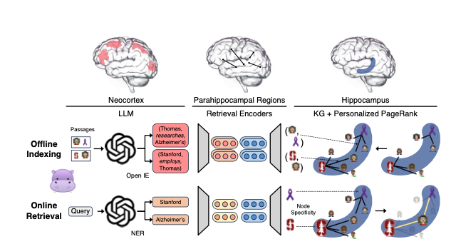
Offline Indexing
Neocortex (LLM) + OpenIE
Passages → instruction‐tuned LLM (e.g. GPT‐3.5)
Extracts noun phrases/relationships, forming triples: (“Thomas,” “researches,” “Alzheimer’s”)
Parahippocampal Regions (Retrieval Encoders)
Dense retriever (Contriever, ColBERTv2) detects synonymy E.g., “Prof. Thomas” ↔ “Thomas”
Hippocampus (KG Construction)
Integrate triples + synonym edges in a knowledge graph
Tie each node to the passages that mention it
HippoRAG(5)
Notes:
Now let’s examine the Offline Indexing phase, shown in the figure. We start by passing all our corpus passages into an instruction‐tuned LLM—like GPT‐3.5—to perform Open‐Information Extraction. This yields noun phrases and their relationships in the form of triples, for example (Thomas, researches, Alzheimer’s) or (Stanford, employs, Thomas).
In parallel, we use dense retrieval encoders—often called the ‘parahippocampal regions’ in our analogy—to detect synonymy. If two nodes, say ‘Prof. Thomas’ and ‘Thomas,’ appear highly similar in embedding space, we add a synonym edge.
Ultimately, these extracted triples and synonym edges form our artificial hippocampal index, or knowledge graph (KG). Each node, which is a noun phrase, is also tied back to the passage(s) where it appeared.
We call this entire step the pattern separation phase, because we’re essentially indexing all unique signals. We’re not doing any question answering here—just building the graph so it can be leveraged later.

Slide 29
Online Retrieval
Neocortex (LLM) for NER
Query: “Which Stanford professor works on Alzheimer’s?”
LLM extracts named entities: “Stanford,” “Alzheimer’s”
Parahippocampal Regions (Retrieval Encoders) for Query Nodes
Find KG nodes most similar to “Stanford,” “Alzheimer’s”
These become the “seed” nodes
Hippocampus (Personalized PageRank)
Run PPR from seed nodes
Probability flows through edges → highlight relevant subgraph
Rank passages based on final node scores
HippoRAG(5)
Notes:
After we’ve built that knowledge graph offline, we move on to Online Retrieval, shown in the bottom portion of the figure. Recall our earlier question about ‘Which Stanford professor works on Alzheimer’s?’—we prompt the same LLM to do named entity recognition, extracting key entities like ‘Stanford’ and ‘Alzheimer’s.’
Next, we match these entities against our KG nodes. That’s like finding which nodes in the graph are closest in embedding space, and we treat these matched nodes as seed nodes.
Then comes the core step: we run Personalized PageRank from those seeds. Just as the hippocampus would complete a partial memory, PPR spreads probability along the graph’s connections. Because we have both synonym edges and relational edges, the relevant subgraph lights up quickly.
The final PPR distribution tells us which nodes—and thus which passages—are most relevant. We return those top passages to the user or the LLM for a final answer. This approach effectively does multi‐hop retrieval in one pass, rather than running multiple iterative queries.

Slide 30
Node Specificity
Local Alternative to IDF: si=1/∣Pi∣​∣, where ∣Pi∣ = number of passages containing node i.
Common Nodes → Lower Weight: “person,” “city,” etc.
Avoid Flooding: Adjust probability injection in PPR to reduce noise.
Notes:
Finally, let’s talk about a unique twist in HippoRAG’s retrieval: node specificity. It tackles the problem of extremely common nodes, like ‘person’ or ‘city,’ which appear in a large fraction of passages. Standard IR uses something like inverse document frequency (IDF) to downweight frequent terms. We introduce a local variation called ‘node specificity.’
Formally, for each node i, we compute a specificity score si=1/∣Pi∣​, where ∣Pi∣ is the number of passages that mention that node. A higher ∣Pi∣ implies a lower specificity weight.
Why do we do this? Because if we inject too much probability into these overly general nodes when running Personalized PageRank, we end up ‘flooding’ the graph with unhelpful edges. Node specificity ensures the retrieval focuses on the unique nodes that best identify the right context, effectively simulating a localized version of IDF for the graph.

Slide 31
Evaluation & Result
Datasets: MuSiQue, 2WikiMultiHopQA, HotpotQA (with multi‐hop emphasis).
Metrics: Recall@k for retrieval, Exact Match & F1 for QA.
Findings:
Single‐Step Multi‐Hop: Up to +20% improvement over standard dense retrieval
Complements Multi‐Step: Stacks with iterative approaches (IRCoT)
Efficiency: 6–13× faster, 10–30× cheaper than iterative methods
Path‐Finding Advantage: Excels at open‐ended multi‐hop queries
Notes:
We evaluate HippoRAG on three multi‐hop QA benchmarks. MuSiQue and 2WikiMultiHopQA are specifically designed to test whether you can combine knowledge from different sources, whereas HotpotQA is also multi‐hop but often considered simpler because of shortcut cues.
For retrieval, we measure whether the system correctly brings back all relevant passages—often reported as Recall@2 or Recall@5. For QA, we typically use Exact Match or F1 scores.
The key results are very encouraging. First, HippoRAG outperforms strong dense retrieval baselines—like Contriever or ColBERTv2—by as much as 20% in recall@5 on some datasets. Second, when we combine HippoRAG with iterative retrieval methods such as IRCoT, we see additional gains, suggesting the graph‐based index can stack well with multi‐step retrieval.
And importantly, this is all done more efficiently: single‐step multi‐hop retrieval means we’re 6–13 times faster and 10–30 times cheaper than purely iterative approaches that must invoke the LLM multiple times. Finally, for truly open‐ended multi‐hop queries—so‐called path‐finding tasks—HippoRAG’s ability to explore the graph in one pass is especially powerful.

Slide 32
Strength & Weakness
Strengths
Single‐step retrieval for multi‐hop → fewer queries, robust synergy.
Easy to update knowledge (re‐extract new text without retraining the LLM).
Inspired by real memory processes—plausible approach to bridging neural & symbolic knowledge.
Weaknesses
Depends on the quality of OpenIE extraction (errors propagate).
Large KGs can be memory‐intensive for huge corpora.
Lacks integrated fine‐tuning (pipeline is still somewhat modular).
Notes:
Now, let’s take a candid look at HippoRAG’s Strengths and Weaknesses.
Strengths:
Single‐Step Multi‐Hop Retrieval: Instead of running multiple retrieval‐and‐LLM loops, we do it all in one pass with Personalized PageRank over the knowledge graph. This drastically reduces overhead and is highly effective for questions where you need two or more pieces of evidence from different passages.
Easy Addition of Knowledge: Because we build the knowledge graph offline, we can periodically update or expand it with new documents or facts—without retraining the entire LLM. All we do is re‐extract new nodes and edges from fresh text and plug them into the graph.
Neurobiological Plausibility: Our design draws directly from how the hippocampus and neocortex interact in the human brain. This cognitive neuroscience angle not only helps us conceptualize retrieval better, but also might inspire new cross‐domain research in memory indexing for AI.
Weaknesses:
Reliance on OpenIE Quality: Because we depend on the LLM to correctly extract triples, any mistakes—like missed relations or incorrectly identified synonyms—will carry over into the knowledge graph and potentially break the retrieval process.
Scalability: For very large corpora, the knowledge graph can grow to millions of nodes or edges. Storing and updating such a massive graph is non‐trivial—both in terms of compute costs and engineering effort.
No Fine‐Tuning: Finally, in this approach, we rely heavily on off‐the‐shelf LLMs and retrieval encoders. While that’s convenient, we might get even better performance by fine‐tuning the extraction or adjacency detection tasks. Of course, that adds more complexity and cost down the line.
Overall, HippoRAG is a promising direction, but there’s room for improvement—especially if we want a truly scalable, robust system.

Slide 33
More Architectures Comparison

Slide 34
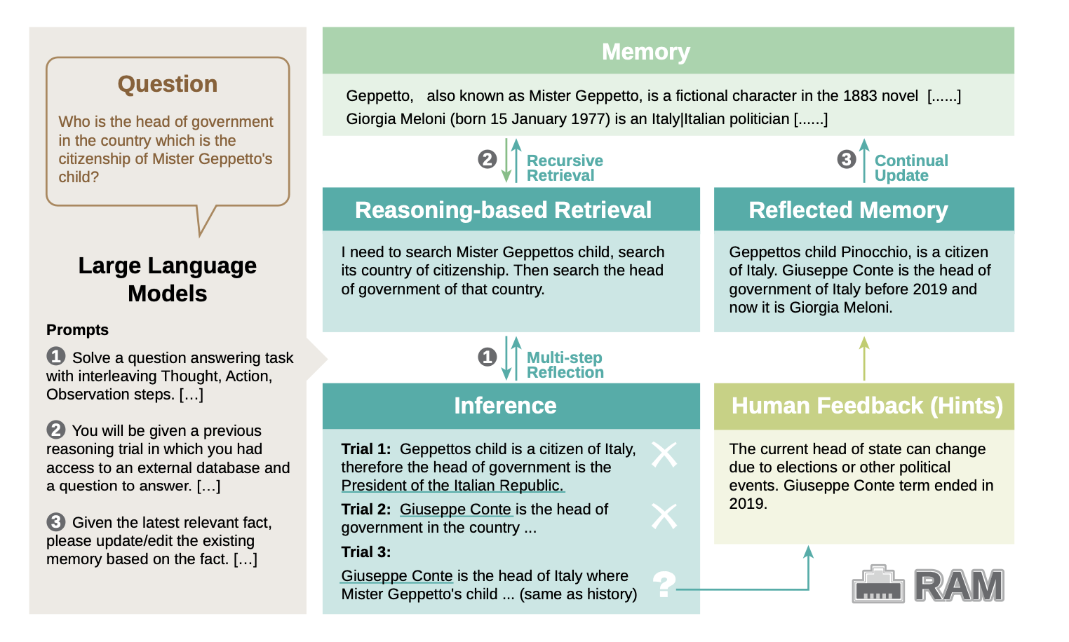
RAM
RAM(6) RAM: Towards an Ever-Improving Memory System by Learning from Communications

Slide 35
Recursive Retrieval Process
A. Retrieve Token:
Decides if external information is needed
Can output: "yes", "no", or "continue"
Example: For the question "What year was the Eiffel Tower built?", the system would generate a "yes" token since this requires factual verification
B. ISREL (Relevance) Token:
Evaluates if retrieved information is relevant
Outputs: "relevant" or "irrelevant"
Example: If retrieving a document about the Paris World's Fair when asking about the Eiffel Tower, it would mark as "relevant"
C. ISSUP (Support) Token:
Checks how well the evidence supports the generated response
Outputs: "fully supported", "partially supported", or "no support"
Example: If generating "The Eiffel Tower was built in 1889" with a document explicitly stating this fact, it would mark as "fully supported"
D. ISUSE (Utility) Token:
Rates the overall usefulness of the response on a 1-5 scale
Example: A complete, accurate answer about the Eiffel Tower's construction would receive a 5

Slide 36
Aspect | HippoRAG | RAM
Retrieval Method | Personalized PageRank algorithm for graph traversal | Using reflection tokens to decide if required external info
Updating Schema | uses a schemaless knowledge graph that can be continuously updated. Updates happen by adding new nodes and edges to the graph, (cosine similarity) | Updates are made by comparing (cosine similarity) and merging new information with existing memory entries.
Memory Structure | Hierarchical graph structure where: 1. Nodes represent concepts 2. Edges represent relationships | Flat document-based structure where each memory entry is a discrete unit
Calculation Efficiency | Single-step multi-hop retrieval | Requires multiple LLM calls for reflection tokens
Scalability | Designed for continuous learning | Can continuously learn and update memory

Slide 37
References
Yao, S., Zhao, J., Yu, D., Du, N., Shafran, I., Narasimhan, K., & Cao, Y. (2023). ReAct: Synergizing Reasoning and Acting in Language Models. In International Conference on Learning Representations (ICLR).
Jia, M., Tang, L., Chen, B., Cardie, C., Belongie, S., Hariharan, B., & Lim, S. N. (2022). Visual Prompt Tuning. arXiv preprint arXiv:2203.12119.
Cheng, H. K., & Schwing, A. G. (2022). XMem: Long-Term Video Object Segmentation with an Atkinson-Shiffrin Memory Model. In Computer Vision – ECCV 2022 (pp. 1–21). Springer.
Jiaxuan You, "Deep Learning with Graph" (PowerPoint presentation, CS598, University of Illinois Urbana-Champaign, 2024), slide X, https://ulab-uiuc.github.io/CS598/static/media/02_Graph_Learning_Basics.pdf.
Sumers, T. R., Yao, S., Narasimhan, K., & Griffiths, T. L. (2024). Cognitive Architectures for Language Agents. Transactions on Machine Learning Research, Published in 02/2024.
Jiménez Gutiérrez, B., Shu, Y., Gu, Y., Yasunaga, M., & Su, Y. (2024). HippoRAG: Neurobiologically Inspired Long-Term Memory for Large Language Models. In Proceedings of the 38th Conference on Neural Information Processing Systems (NeurIPS 2024).
Li, J., Wang, X., Ding, W., Wang, Z., Kang, Y., Jia, Z., & Zheng, Z. (2024). RAM: Towards an Ever-Improving Memory System by Learning from Communications. arXiv preprint arXiv:2404.12045.

Slide 38
Question & Answer

