Slide 1

Autonomous Evaluation and Refinement of Digital Agents
Presenter: Rui Yang
CS598: Topics in LLM Agents, 2025 Spring
2/25/25
CS598: Topics in LLM Agents, Jiaxuan You

Slide 2
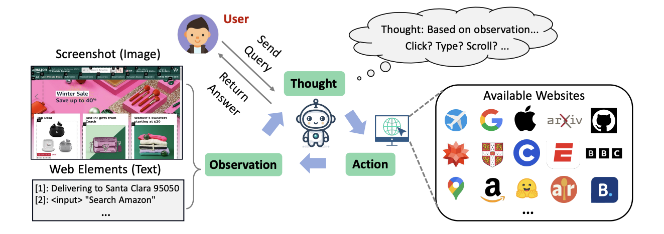
Background
■ Background
■ Digital agents are AI-driven programs that interact with web interfaces to perform tasks for human
■ E.g., virtual assistants navigating websites and summarizing retrieved information
2/25/25
CS598: Topics in LLM Agents, Jiaxuan You

Slide 3
Problem Statement
■ Problem
■ Digital agents for web navigation and device control often fail simple tasks, requiring robust evaluation and refinement
■ Existing evaluation methods depend on human supervision or task-specific metrics
■ Goal
■ Develop domain-general, automated evaluators to assess and improve agent performance without extra supervision
2/25/25
CS598: Topics in LLM Agents, Jiaxuan You

Slide 4
Prior Evaluations
■ Simulator-based
■ WebShop, Androidenv, WebArena, and VisualWebArena, …
■ Handcrafting evaluation functions are limited in the diversity
■ Demonstration-based
■ Mind2Web, AitW, …
■ Reference-based metrics like action matching score (correct actions divided by the episode length)
■ They cannot reflect real performance
2/25/25
CS598: Topics in LLM Agents, Jiaxuan You

Slide 5
Method
■ Domain-general Evaluators：Formulation
■ Prompt: textual instruction, e.g., “check the weather”
■ State: screenshot image
■ action: text format, e.g., <Click id>, <Type: “password”>
■ reward: r(x,s,a)
Trajectory-level: 1 for successful in the last step else 0
Step-level: p≥0 indicates progress, d<0 indicates negative impact
2/25/25
CS598: Topics in LLM Agents, Jiaxuan You

Slide 6
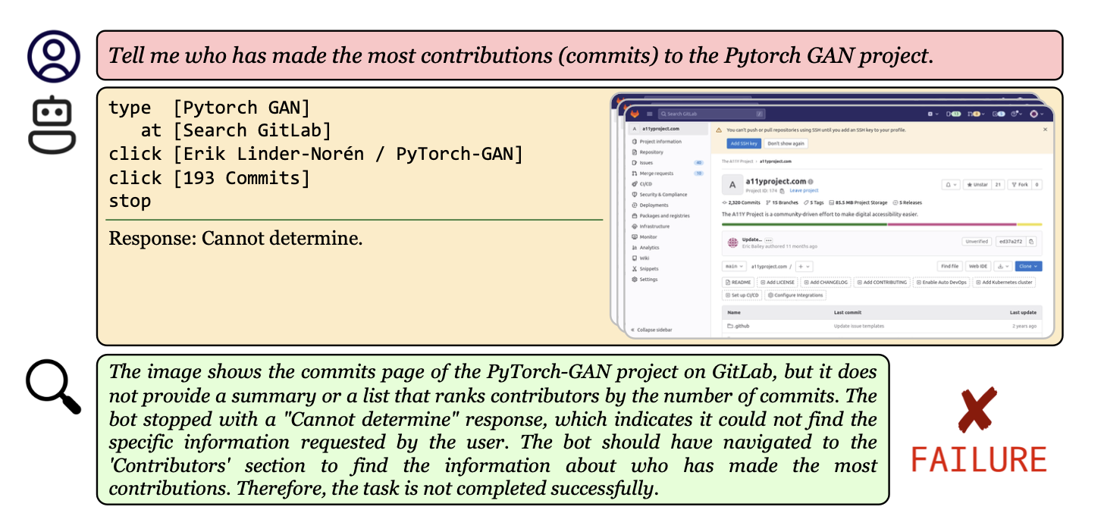
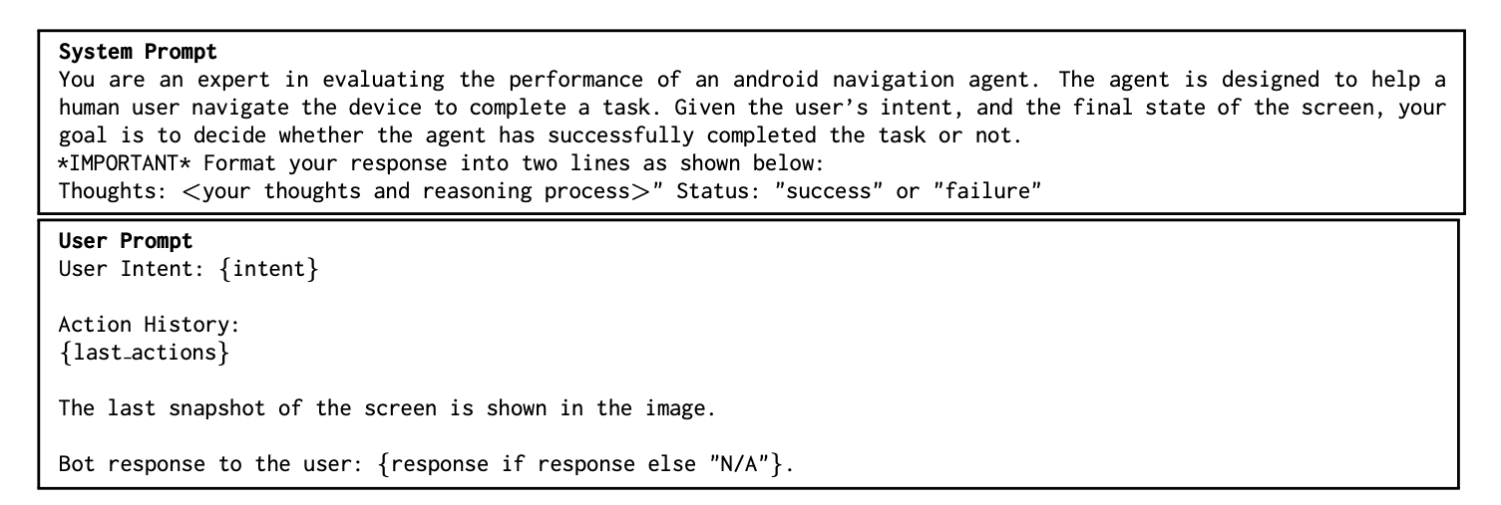
Method
■ End-to-end Approach
■ Prompt a VLM (GPT-4V) to produce reasoning and final evaluation
■ Advantage: high performance
■ Disadvantage: expensive
2/25/25
CS598: Topics in LLM Agents, Jiaxuan You

Slide 7
Method
■ Modular Caption-then-Reason Approach
■ Generate a description of observations from a finetuned open-source VLM (Qwen-VL-Chat)
■ Then evaluation (s,a,x) by a LLM, such as Mixtral and GPT-4
■ Advantage: explainability and low-cost
■ Disadvantage: potentially weaker performance
2/25/25
CS598: Topics in LLM Agents, Jiaxuan You

Slide 8
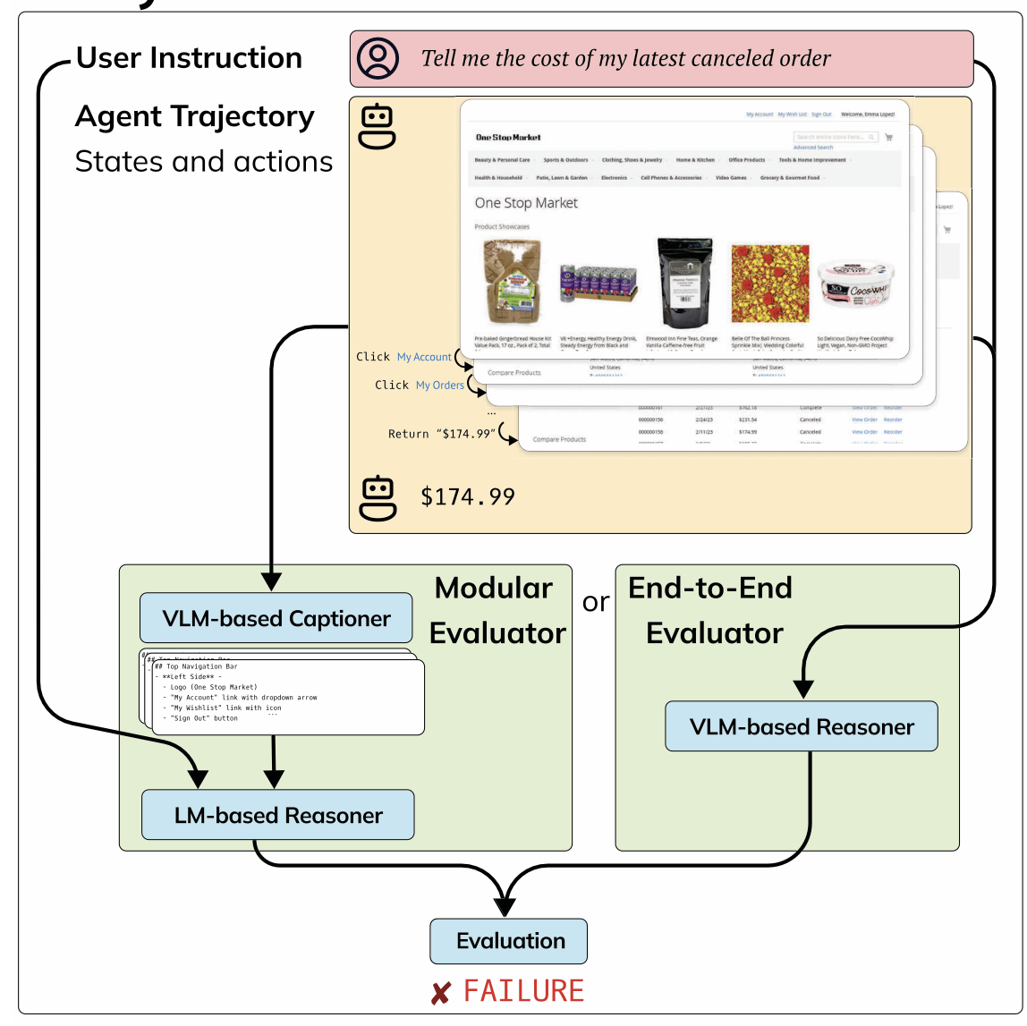
Method
■ Comparison
2/25/25
CS598: Topics in LLM Agents, Jiaxuan You

Slide 9
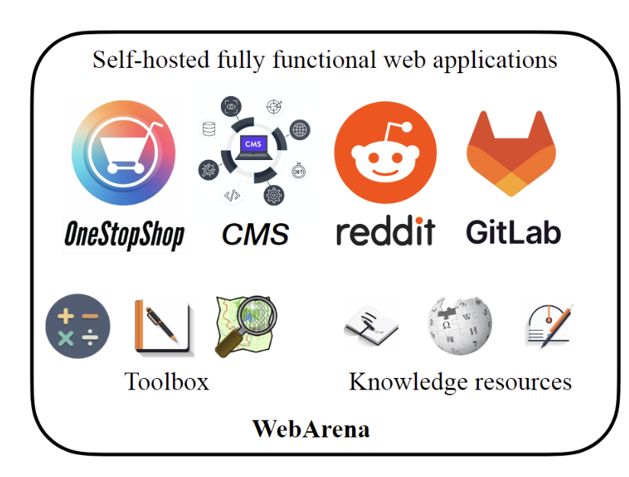
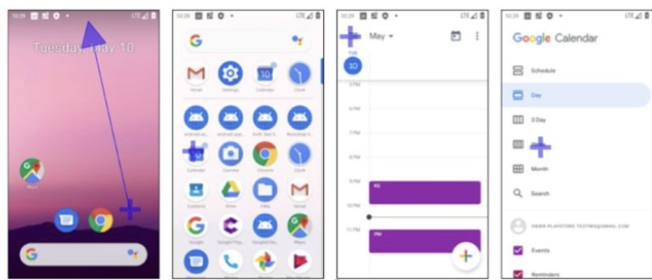
Experiment
■ Environments
■ WebArena: an offline web emulation, 812 instructions, each with a test case that verifies success
■ Android-in-the-Wild (AitW) : using only 120 tasks sampled from its large test set. Additionally, implementing an Android emulator and use human judgements as the oracle evaluation.
■ iOS: curating 132 tasks in iOS based
on an iOS emulator
2/25/25
CS598: Topics in LLM Agents, Jiaxuan You

Slide 10
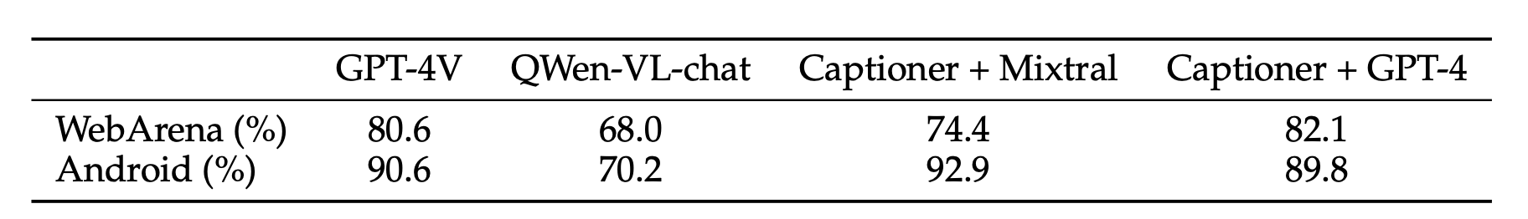
Experiment
■ Automatic Evaluation
■ End-to-end method with GPT-4V aligns with human judgements
■ The modular method is comparable to the end-to-end method with GPT-4V and better than Qwen-VL-Chat
2/25/25
CS598: Topics in LLM Agents, Jiaxuan You

Slide 11
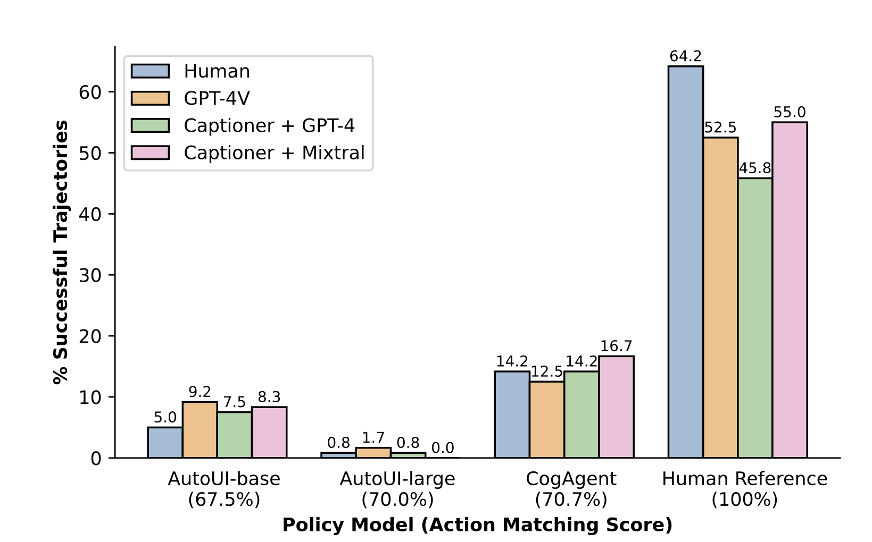
Experiment
■ Automatic Evaluation
■ Human reference trajectories are the best on all metrics, with still 36% unsuccessful trajectories
■ Real success rate lag behind reference-based single-step evaluation score
2/25/25
CS598: Topics in LLM Agents, Jiaxuan You

Slide 12
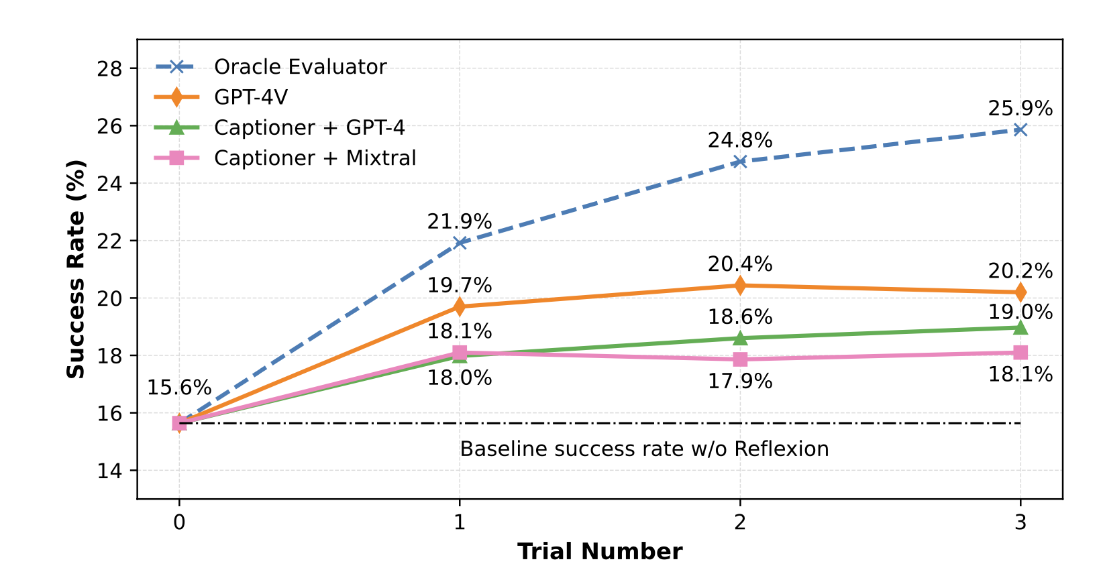
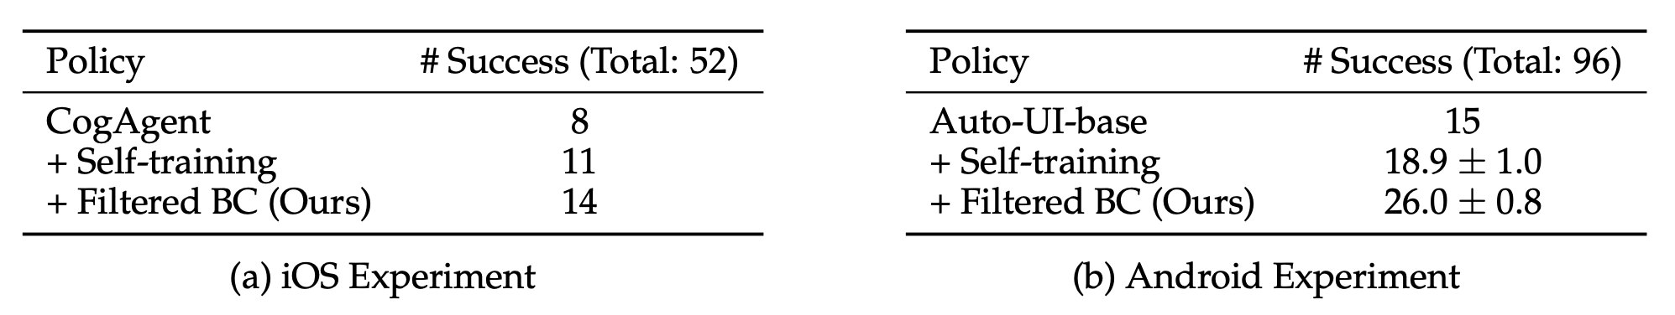
Experiment
■ Automatic Refinement
■ Reflexion on WebArena: guide the agent to reflect and retry
■ Filtered BC for iOS and Android: filter collected data (according to step-wise evaluation) for behavior cloning
2/25/25
CS598: Topics in LLM Agents, Jiaxuan You

Slide 13
Experiment
■ Error Analysis
■ Reasoning error (main part): 50% for GPT-4V and GPT-4-based method; 70% for Mixtral-Captioner
■ Information lost from captions (10%); Screenshot understanding error in GPT-4V (5%)
■ Ambiguities in task specification and success criteria: 30% for GPT-4V/GPT-4-based methods and 10% for Mixtral-Captioner
■ False positive: 10% incorrect reasoning from correct trajectories
2/25/25
CS598: Topics in LLM Agents, Jiaxuan You

Slide 14
Summary and Future work
■ Summary
■ Autonomous evaluation of digital agents is achievable and aligns with human evaluation
■ Autonomous refinement contributes to the agent performance
■ Future Work
■ Improve the robustness of autonomous evaluation
■ Leverage the language critic rather than the evaluation score
2/25/25
CS598: Topics in LLM Agents, Jiaxuan You

Slide 15
Chatbot Arena: An Open Platform for Evaluating LLMs by Human Preference
Rui Pan
CS598: Topics in LLM Agents, 2025 Spring
2/25/25
CS598: Topics in LLM Agents, Jiaxuan You

Slide 16
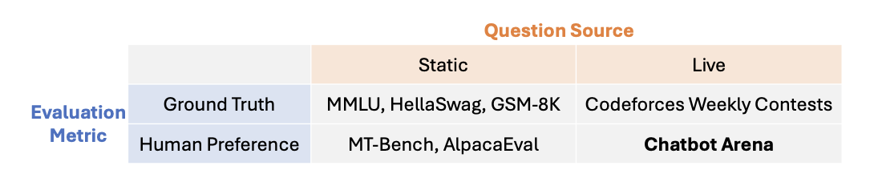
Introduction & Background
■ Static: Data contamination, overfitting, saturation, …
■ Ground Truth: Limit to certain domains
2/25/25
CS598: Topics in LLM Agents, Jiaxuan You

Slide 17
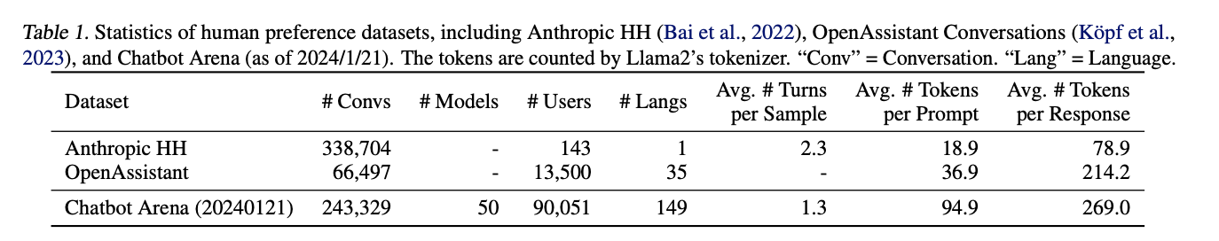
Introduction & Background
■ Many users & models
■ Multi-lingual
■ Long conversations
2/25/25
CS598: Topics in LLM Agents, Jiaxuan You

Slide 18
Methods - Basics
■ Battle: pairwise model comparison via human voting
■ Free-to-use platform
■ Anonymous
■ Randomized
■ Model identity is unknown
2/25/25
CS598: Topics in LLM Agents, Jiaxuan You

Slide 19
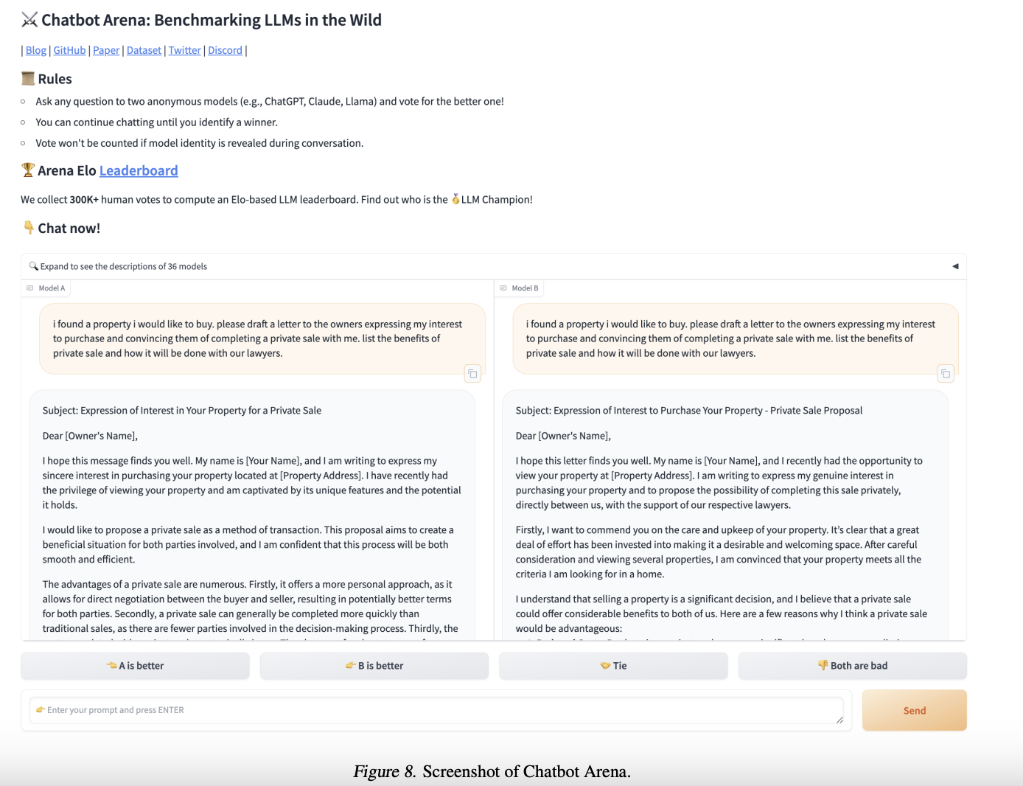
2/25/25
CS598: Topics in LLM Agents, Jiaxuan You

Slide 20
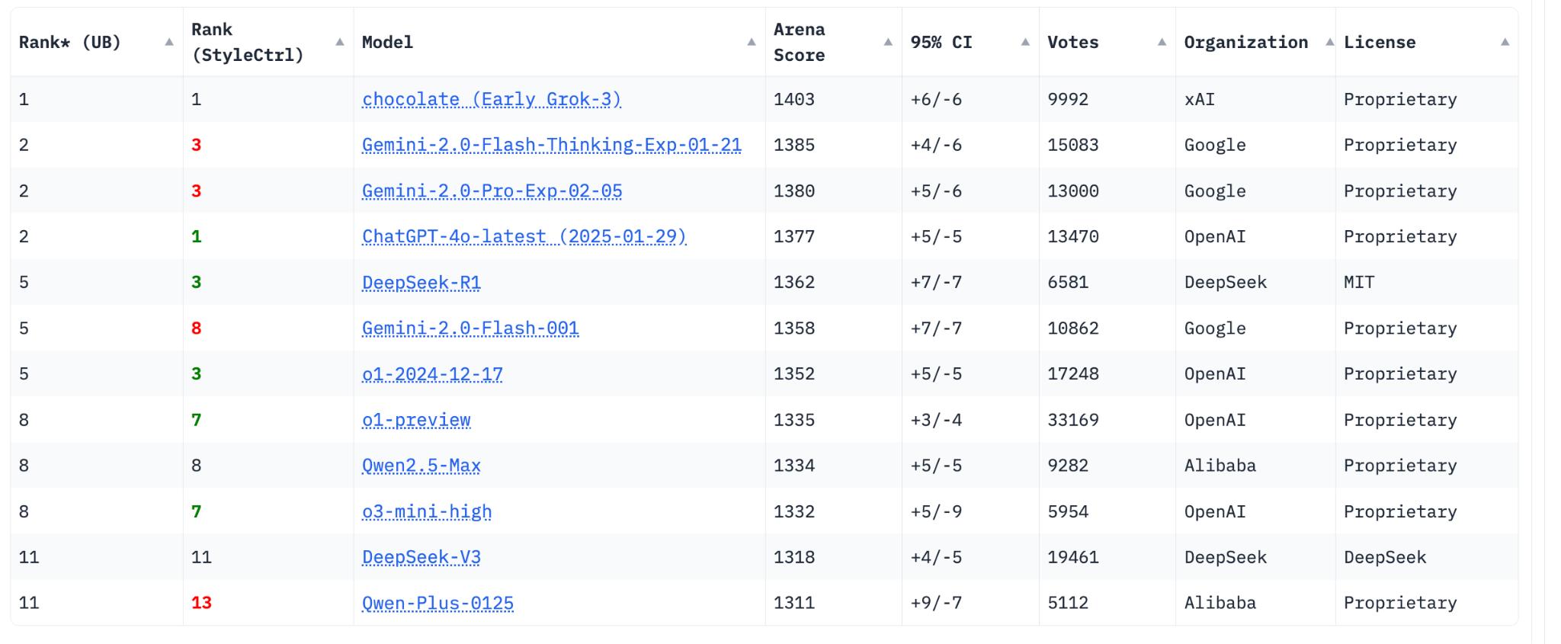
How to compute the Rank and Score?
■ Rankings until Feb. 22, 2025
2/25/25
CS598: Topics in LLM Agents, Jiaxuan You
Notes:
Rank (UB): model’s ranking (upper-bound)
Rank (Style control): another paper, how to cancel out the effect of lengths and styles

Slide 21

Methods - Algorithm
■ Assumptions
■ 1. There is a score 𝝃_{m} for each model m
■ 2. Win-rate of m against m’ satisfies Bradley-Terry (BT) model
with human voting H_{t} = 0, 1
2/25/25
CS598: Topics in LLM Agents, Jiaxuan You

Slide 22
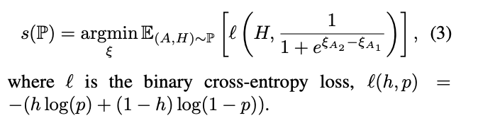
Methods - Algorithm
■ Scoring
Maximum Likelihood Estimation
2/25/25
CS598: Topics in LLM Agents, Jiaxuan You

Slide 23
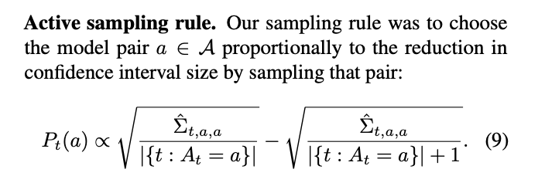
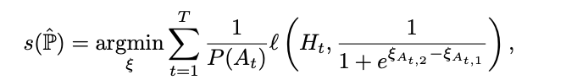
Methods - Algorithm
■ Efficient Sampling
Main Idea: Reduce Variance
2/25/25
CS598: Topics in LLM Agents, Jiaxuan You
Notes:
Any unbias sampling should suffice, but some can have more certainty for models with similar performances The score function is reweighted accordingly to reflect the actual score under random sampling scenarios

Slide 24
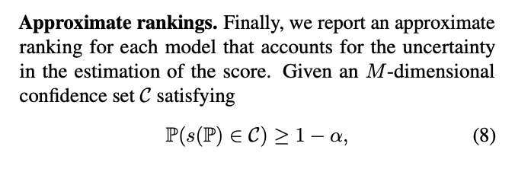
Methods - Algorithm
■ Ranking
α = 0.05
C = [1397, 1409]
2/25/25
CS598: Topics in LLM Agents, Jiaxuan You

Slide 25
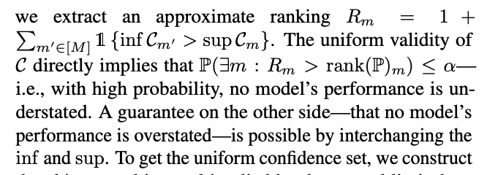
Methods - Algorithm
■ Ranking
2/25/25
CS598: Topics in LLM Agents, Jiaxuan You
Notes:
The ranking here is the non-ovestated version

Slide 26
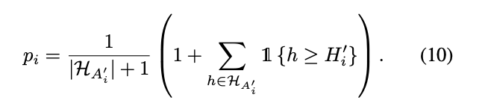
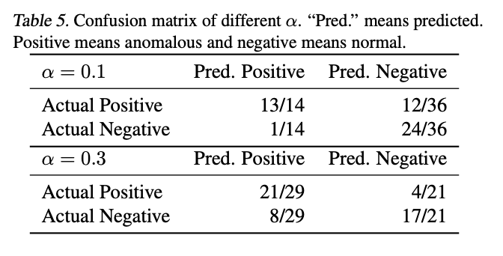


Methods - Algorithm
■ Anomalous User Filtering
Heuristic Null Hypothesis Test
2/25/25
CS598: Topics in LLM Agents, Jiaxuan You
Notes:
The ranking here is the non-ovestated version

Slide 27
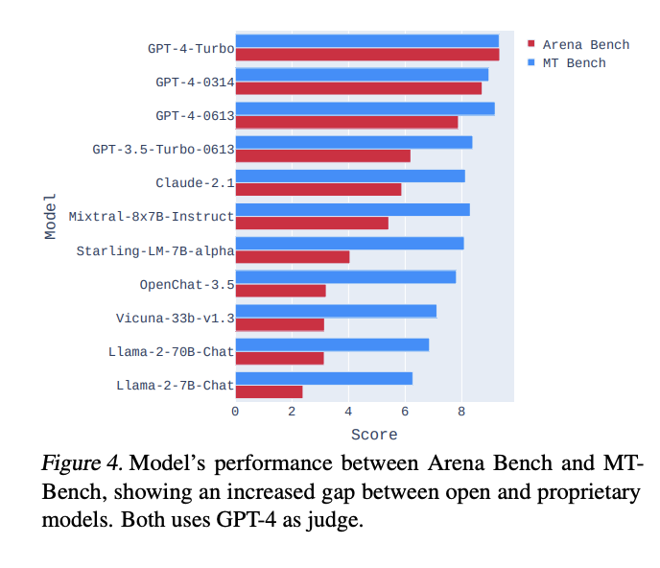
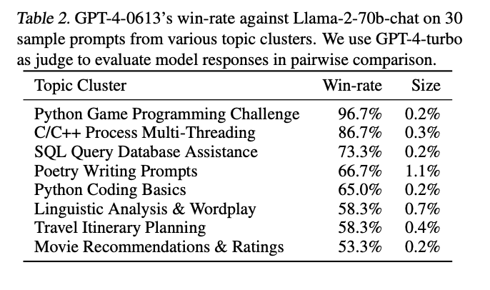
Experiments
■ Larger gaps across models
■ Discover models’ diverse strengths
2/25/25
CS598: Topics in LLM Agents, Jiaxuan You

Slide 28
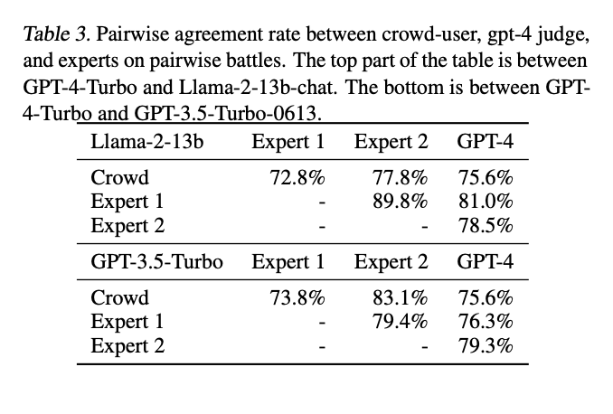
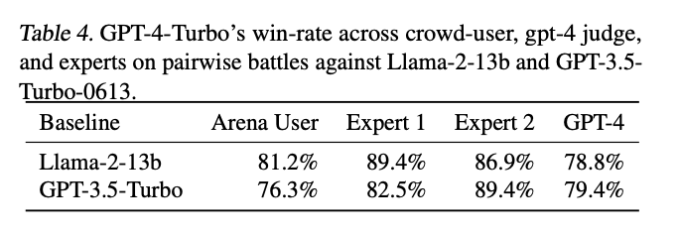
Experiments
■ Mostly agrees with human judges
■ Better than GPT-4 and human judges
2/25/25
CS598: Topics in LLM Agents, Jiaxuan You

Slide 29
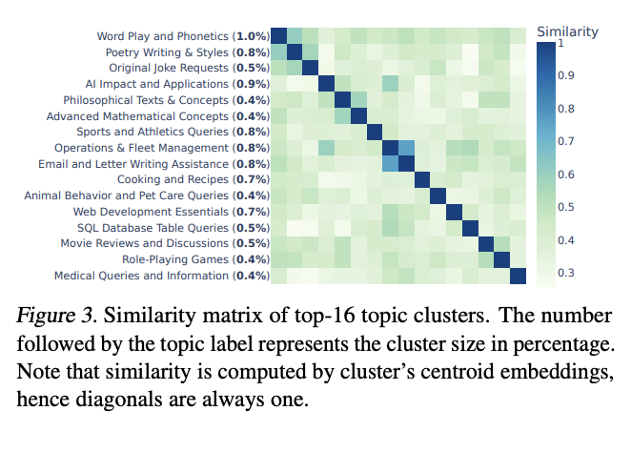
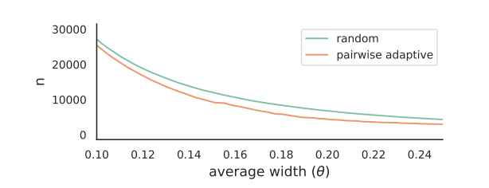
Experiments
■ High-quality vote data
■ Efficient sampling
2/25/25
CS598: Topics in LLM Agents, Jiaxuan You

Slide 30
Takeaways
■ Contribution
■ Open-ended live benchmark
■ Free-platform for SOTA models (Yeah!)
■ High-quality dataset for/from human preference
■ Limitations
■ User community: mostly LLM hobbyist or researchers
2/25/25
CS598: Topics in LLM Agents, Jiaxuan You

Slide 31
Q & A
Also...AI Agents That Matter
Vincent Han
CS598: Topics in LLM Agents, 2025 Spring
2/25/25
CS598: Topics in LLM Agents, Jiaxuan You

