Slide 1
JY2 Presentation
Tool Use in Agent Framework
Ke Yang, Kashob Kumar Roy, Aryan Bhardwaj

Slide 2
Guidelines for the Pilot Presenter
The course will follow a seminar format, with one group presenting during each class session. Each group will be responsible for presenting at least one lecture throughout the semester. Presentations should be no longer than 50 minutes, excluding interruptions. However, presenters should anticipate and be prepared to address questions and interruptions during their talk.
During your presentation, you are expected to:
Provide a concise background to introduce and motivate the problem (e.g., referencing prior talks for simplicity).
Explain the main idea, approach, and/or key insight from the required reading (use examples whenever appropriate).
Cover technical details to help the audience grasp the key points without needing to closely read the material (provide a quick overview of evaluations).
Highlight differences between the required reading and related works, including any additional readings.
Discuss strengths and weaknesses of the required reading and suggest potential directions for future research.
Submission of slides:
Deadlines: Slides for the presentation must be submitted to the instructor team via Canvas (in *.pptx format) at least 24 hours before the scheduled class.

Slide 3
10-15 min each
(Required) ToolLLM: Facilitating Large Language Models to Master 16000+ Real-world APIs (Aryan Bhardwaj)
(Required) Gorilla: Large Language Model Connected with Massive APIs (Ke Yang)
ToolkenGPT: Augmenting Frozen Language Models with Massive Tools via Tool Embeddings
What Are Tools Anyway? A Survey from the Language Model Perspective

Slide 4
Gorilla: Large Language Model Connected with Massive APIs
Shishir G. Patil*, Tianjun Zhang*, Xin Wang, Joseph E. Gonzalez
UC Berkeley, Microsoft Research
Presentor: Ke Yang

Slide 5
Introduction - The Problem
Large Language Models (LLMs) like GPT-4 have revolutionized various tasks, but their ability to effectively use tools via API calls remains underdeveloped.
Millions of APIs exist, and they are frequently updated.
LLMs lack awareness of available APIs and how to use them.
Key Question: How can we enable LLMs to generate accurate, context-aware API calls?

Slide 6
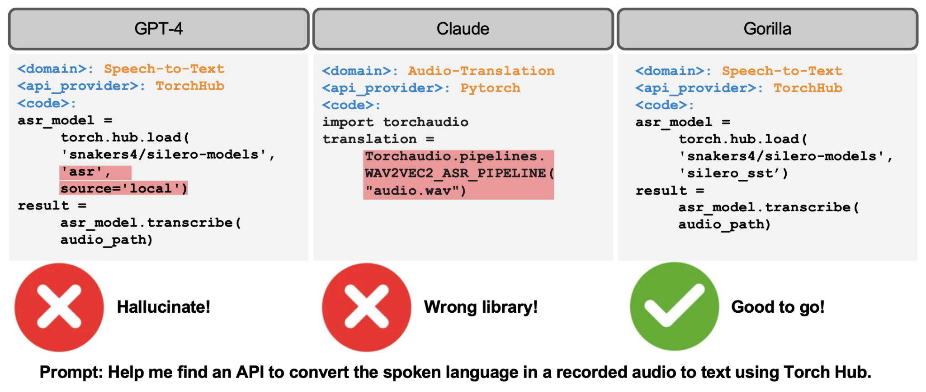
Introduction - Gorilla’s Solution
Gorilla: A retriever-aware fine-tuned LLaMA model designed to surpass GPT-4 in writing API calls.

Slide 7
Introduction - Gorilla’s Solution
Combines self-instruction and novel Retriever-Aware Training (RAT).
Enables LLMs to adapt to test-time changes in APIs and reduce hallucination errors.

Slide 8
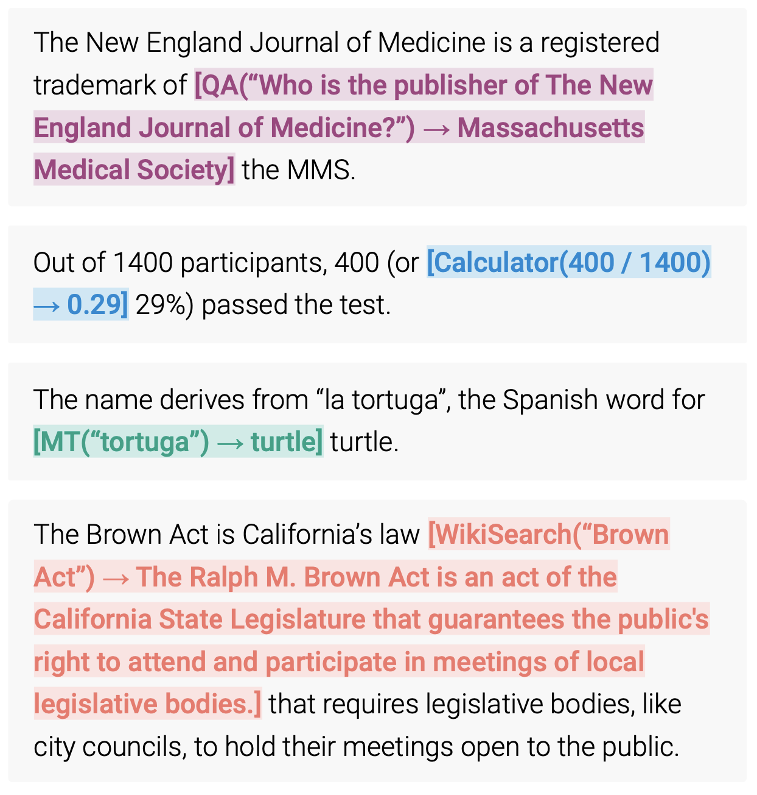
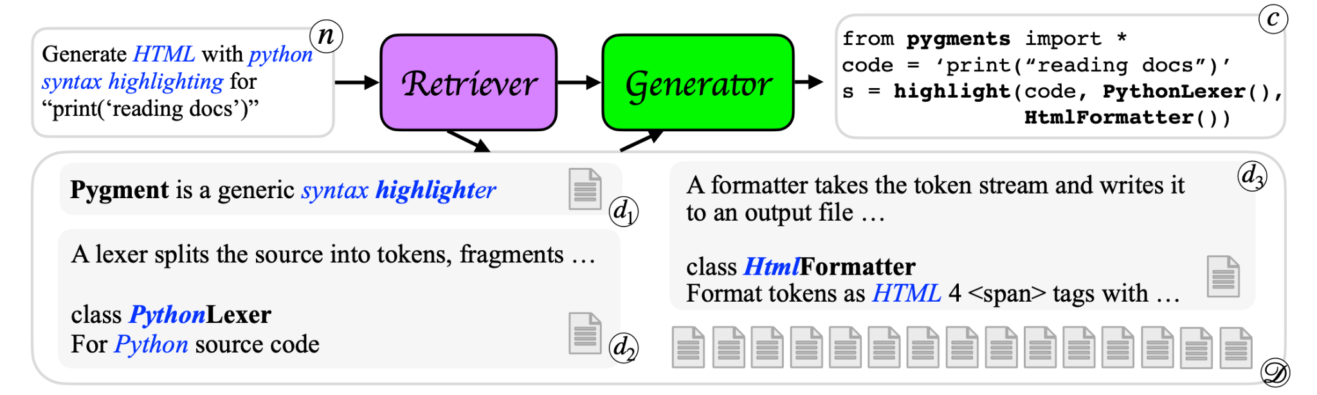
Related Work
Previous approaches focused on:
Prompting techniques for specific tools (e.g., web-browsing, calculators).
Fine-tuning LLMs for code generation or API calls.
Toolformer: Language Models Can Teach Themselves to Use Tools
DocPrompting: Generating Code by Retrieving the Docs

Slide 9
Related Work
Limitations of Previous Work:
Focused on narrow tool sets rather than a wide range of APIs.
Lacked systematic evaluation and training pipelines.
Gorilla’s Claimed Novelty:
Focuses on a vast array of tools (API calls) in an open-ended fashion.
Introduces systematic evaluation and fine-tuning methods.

Slide 10
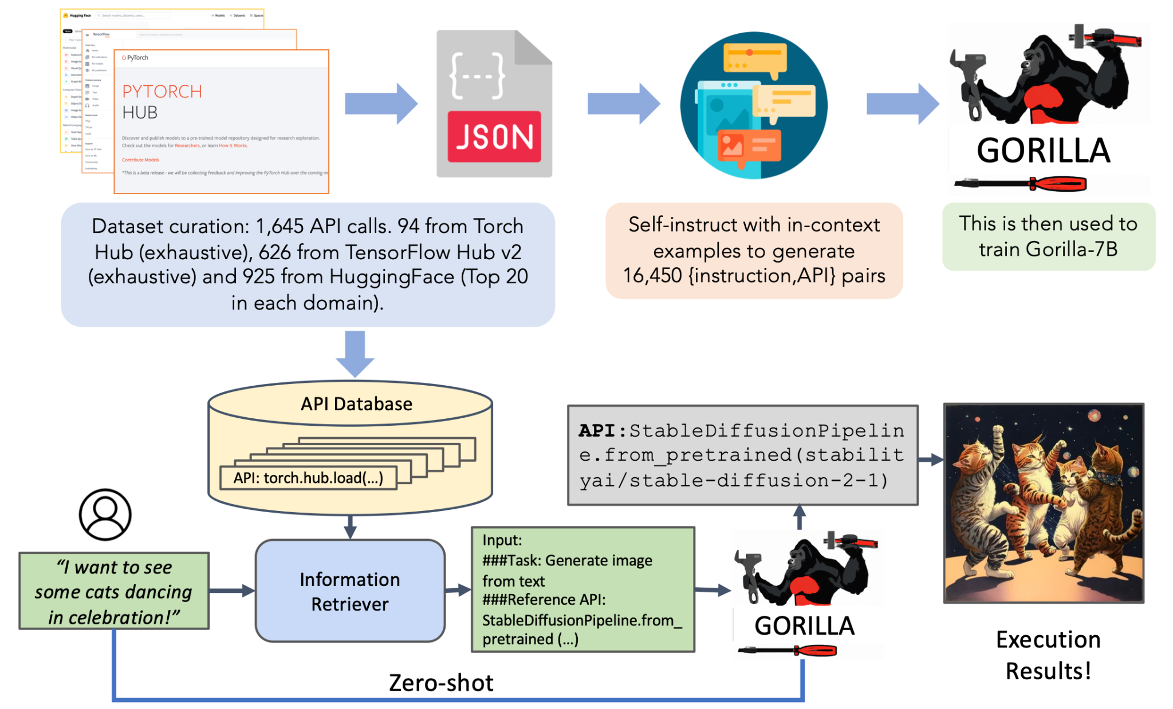
Overview
Benchmark: APIBench
Training: Retrieval-aware Training
Inference

Slide 11
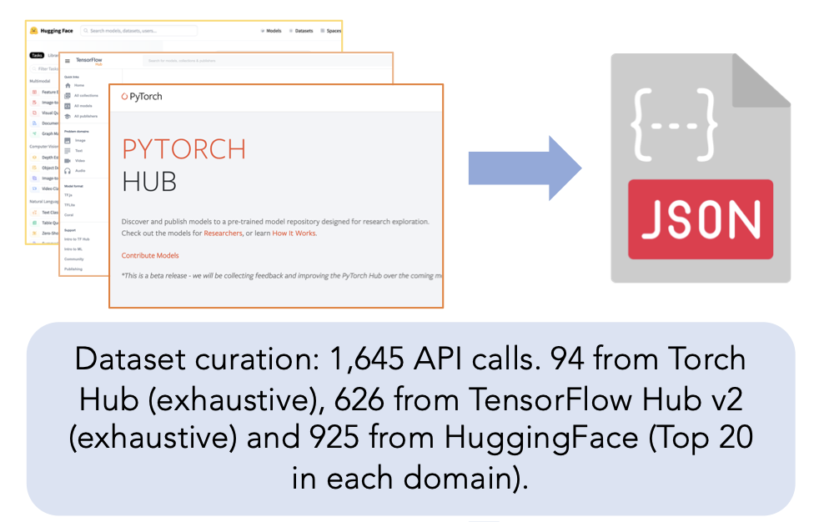
APIBench
APIBench: A machine learning model API benchmark built from:
TorchHub, TensorHub, and HuggingFace API Model Cards.
Contains diverse APIs for tasks like CV, NLP, and more.
Key Features:
Uses AST (Abstract Syntax Tree) tree-matching for evaluation.
Designed to evaluate the functional equivalence of API calls.

Slide 12
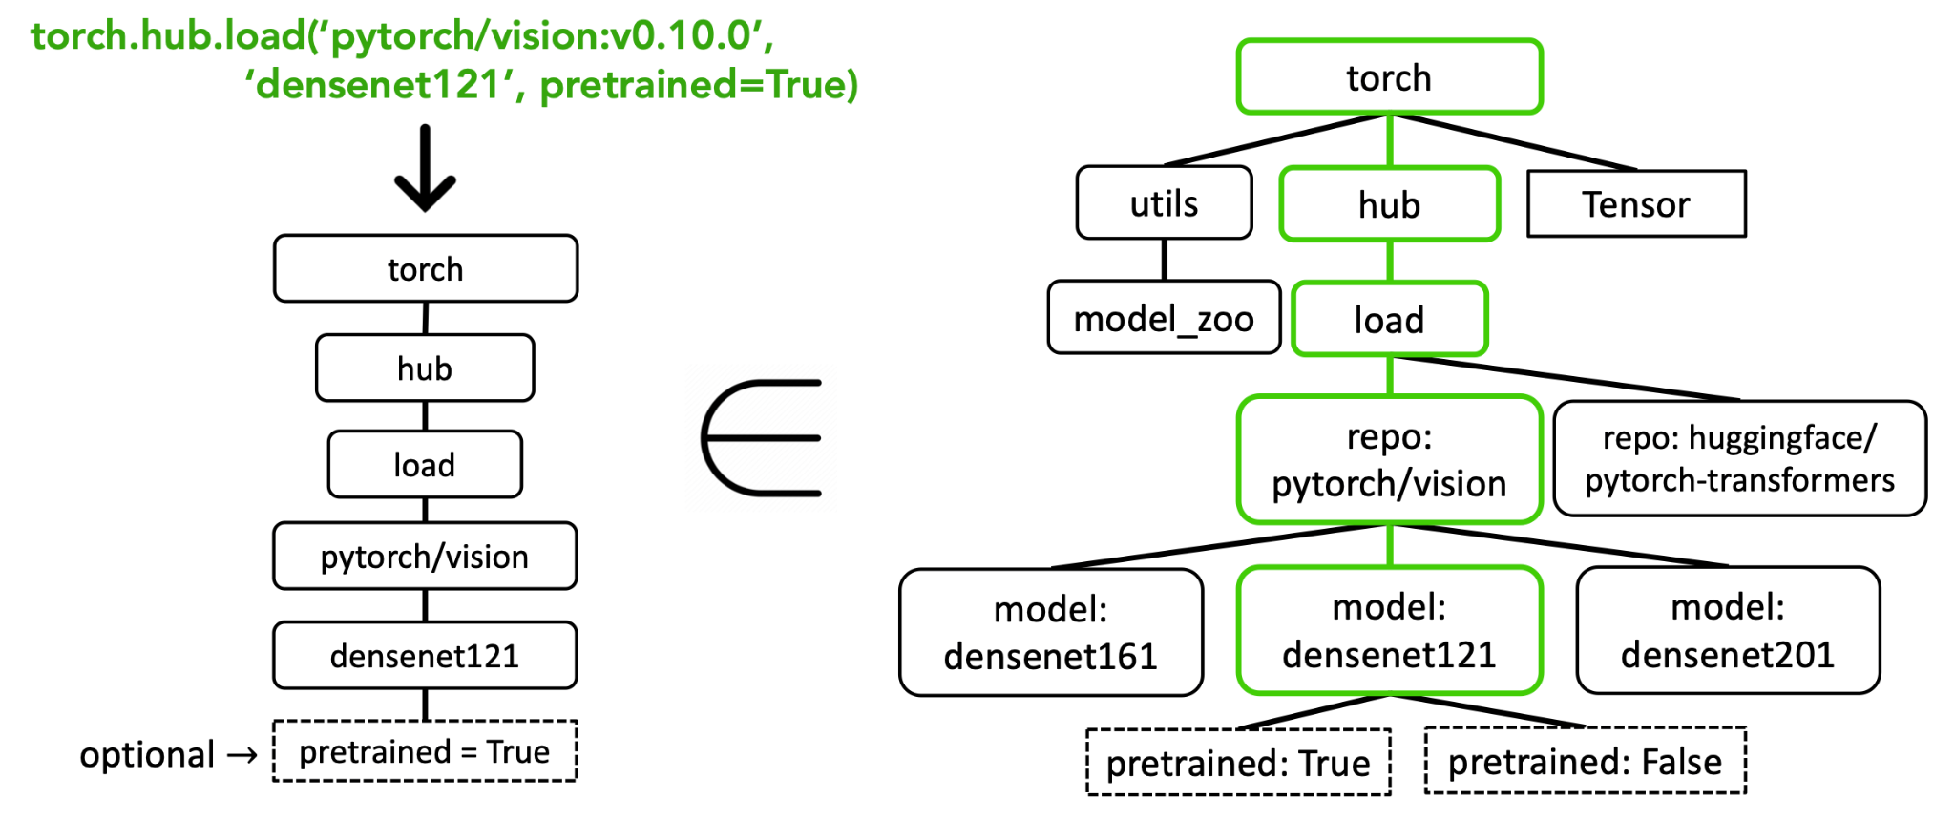
Abstract Syntax Tree (AST)
API subtree matching.

Slide 13
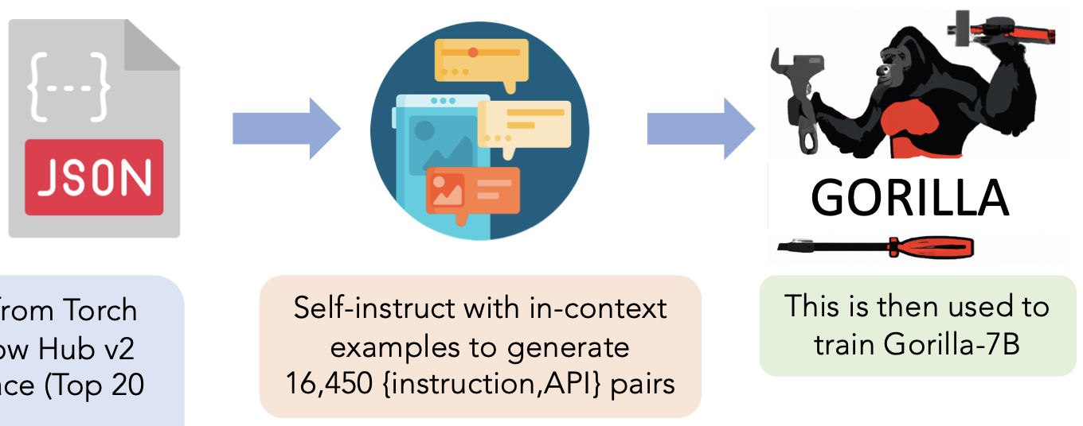
Retriever-Aware Training (RAT)
RAT Overview:
Combines instruction-tuned datasets with retrieved API documentation.
Augments prompts with potentially incorrect documentation during training.
Teaches the LLM to judge and adapt to retrieval errors at inference time

Slide 14
Retriever-Aware Training (RAT)
Benefits of RAT:
Reduces hallucination errors compared to direct prompting.
Enables adaptation to test-time changes in API documentation.

Slide 15
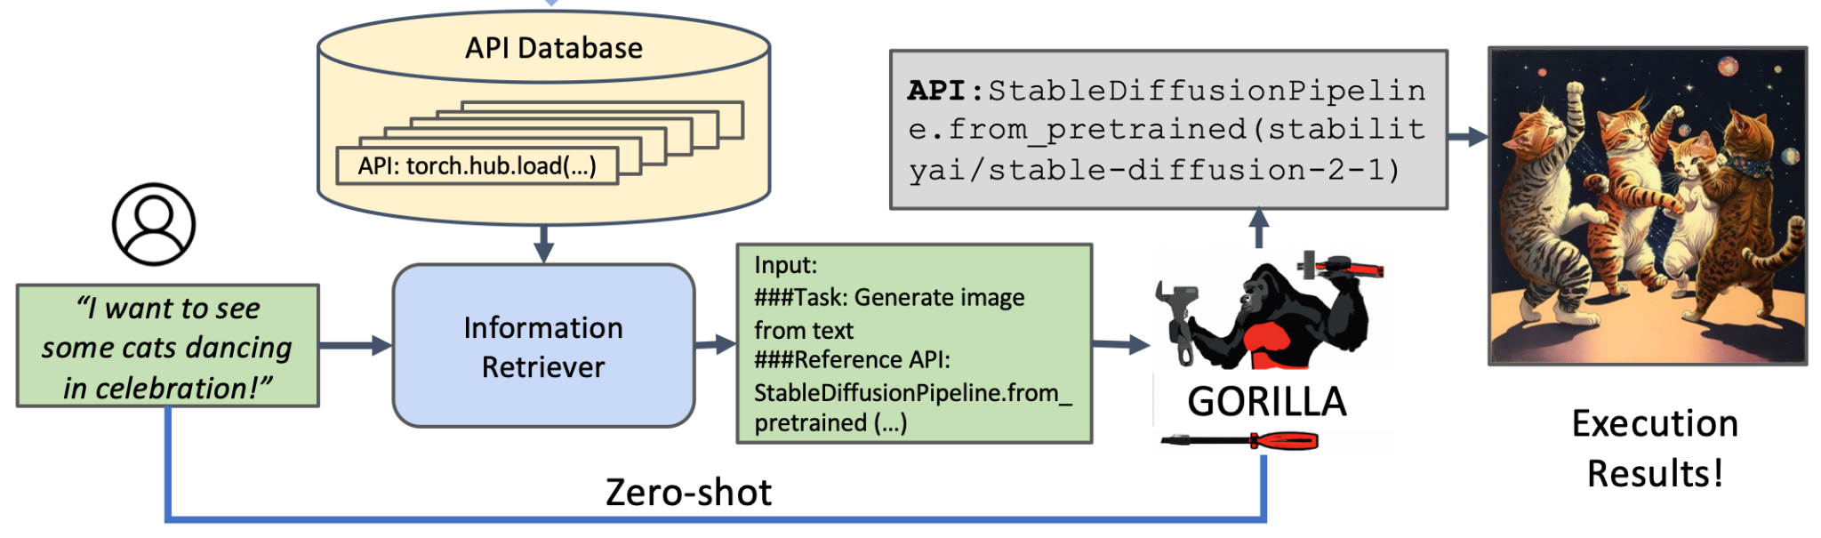
Gorilla Inference
Gorilla operates in two modes during inference:
Zero-shot Mode: Directly generates API calls from user prompts w/o context.
Retrieval Mode: Combines retrieved API documentation with the prompt before sending it to the LLM.

Slide 16
Gorilla Inference
Key Insight:
Retrieval mode improves accuracy but can sometimes hurt performance if the retrieved documentation is irrelevant.

Slide 17
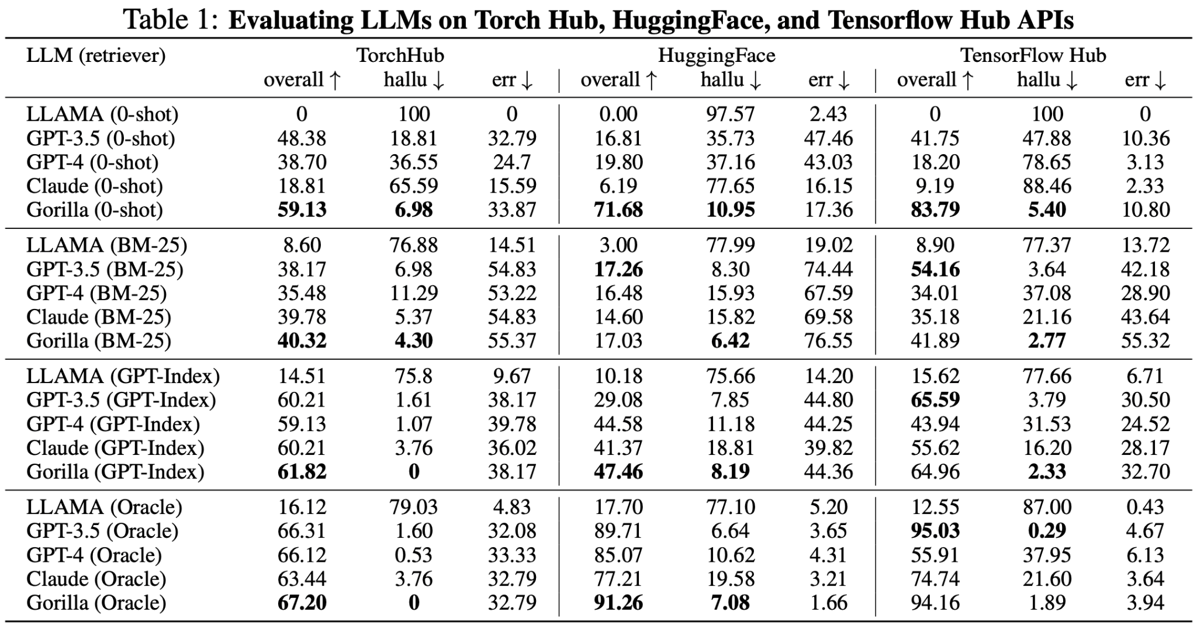
Main Evaluation Results
Gorilla significantly improves over GPT-4 in generating accurate API calls.
Functional equivalence evaluation using AST tree-matching shows high accuracy.

Slide 18
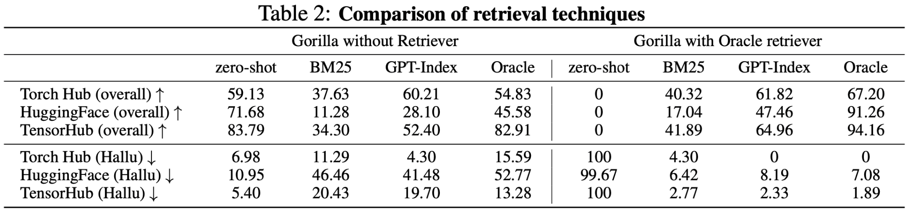
Main Evaluation Results
Gorilla significantly improves over GPT-4 in generating accurate API calls.
W/O retriever during inference, RAT reduces hallucination errors by up to 30% compared to direct prompting.

Slide 19
Limitations
Future Directions
Constrained APIs’ scope, and thus few system functionalities.
Challenge and method novelty mismatch: massive and consistently updated APIs -> accurate API documentation retrieval and evolving LLMs.
Syntax based evaluation metrics, overlooking executablily.
Expand APIs.
Adaptive system to updated documentation.
Process/outcome-based evaluation metrics.

Slide 20
Conclusion
Gorilla enables open-source LLMs to interact with ML model APIs.
Combines fine-tuning, retrieval, and novel RAT methods for accurate API generation.
Addresses critical challenges like hallucination and API evolution.

Slide 21
ToolLLM: Facilitating Large Language Models to Master 16000+ Real-world APIs
Yujia Qin*, Shihao Liang*, Yining Ye, Kunlun Zhu, Lan Yan, Yaxi Lu, Yankai Lin ,
Xin Cong1, Xiangru Tang, Bill Qian, Sihan Zhao, Lauren Hong, Runchu Tian,
Ruobing Xie, Jie Zhou, Mark Gerstein, Dahai Li, Zhiyuan Liu, Maosong Sun
Tsinghua University, ModelBest Inc. Renmin University of China
Yale University, WeChat AI, Tencent Inc. Zhihu Inc.
Presentor: Kashob Kumar Roy

Slide 22
Background and Motivation
LLMs need to interact with various tools (APIs) to accomplish complex tasks
Open vs. Closed-Source LLMs: open-source LLMs lacks robust tool-use capabilities with compared to closed ones.
Empowering open-source LLMs to master diverse APIs is essential for community driven research innovation.
High-quality instruction-tuning datasets with diverse set of APIs are required.
Prior works has also explored creating instruction-tuning datasets to enhance LLMs' tool-use capabilities.

Slide 23
Limitations of existing works
Limited APIs: Lack real-world APIs’ (e.g., RESTAPI) integration or cover a small, non-diverse set [1-3].
Constrained scenario: Focus only on single-tool instructions, while real-world tasks require multi-tool execution and automatic API selection.
Inferior planning and reasoning: Existing methods (CoT, ReACT) fail to fully utilize LLM capabilities, lack real API execution, and struggle with complex instructions.
[1] Shishir G Patil, Tianjun Zhang, Xin Wang, and Joseph E Gonzalez. Gorilla: Large language model connected with massive apis.
[2] Toolalpaca: Generalized tool learning for language models with 3000 simulated cases.
[3] Api-bank: A benchmark for tool-augmented llms.

Slide 24
Key Contributions
Introduction of ToolBench: a large-scale tool-use dataset (16,000+ real-world APIs).
Development of DFSDT (Depth-First Search Decision Tree) to enhance the planning and reasoning ability of LLMs.
Fine-tuning of API retriever and ToolLLaMA, a tool-augmented LLM with strong API generalization.
Introduction of ToolEval, an automatic evaluation metric for tool-use capabilities.

Slide 25
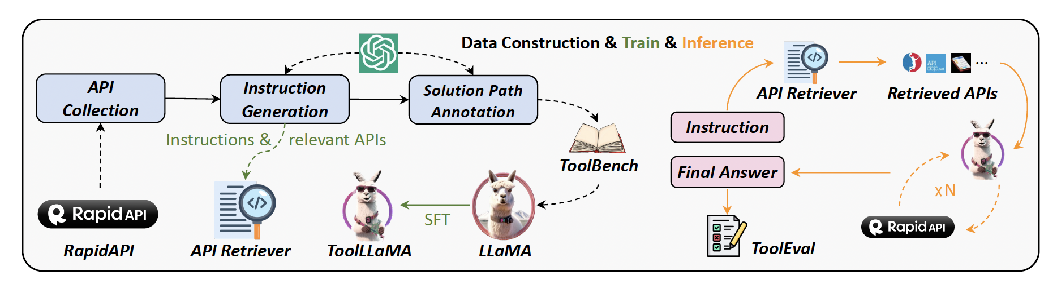
Overview of ToolLLM framework
An open-source tool-use framework that includes data constructions, model training, and evaluation.

Slide 26
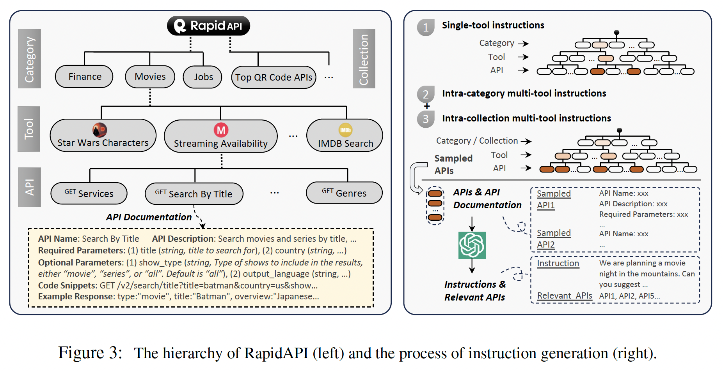
Construction of ToolBench (1/3)
Step 1: API collection
Collects APIs from RapidAPI hub
Filters out non-functional and low-quality APIs
Resulting in 16464 high-quality APIs

Slide 27
Construction of ToolBench (2/3)
Step 2: Instruction Generation
Prompts ChatGPT with i) general instruction, ii) list of APIs (S^{sub}_{N}) and their documentation, iii) three in-context seed examples.
Generate possible instructions and a set of relevant APIs (S^{rel}∗ ⊂ S^{sub}_{N})
For multi-tool instructions, randomly selects 2-5 tools from the same category / collection and sample at most 3 APIs from each tool.

Slide 28
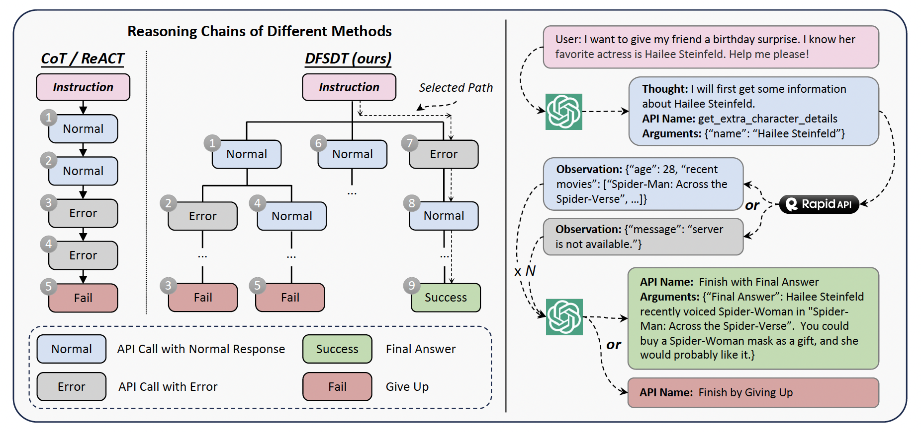
Construction of ToolBench (3/3)
Step 3: Solution Path Annotation: Leverages depth first search-based decision tree to expand the search space and increase the possibility of finding a valid path.

Slide 29
ToolEval: An automatic Evaluator
Develops a ChatGPT based evaluator to automatically evaluate solution paths by different models
Measures two metrics:
Pass Rate: to calculate the proportion of successfully completing instructions by a LLM.
Win Rate: to compare two solution paths and identify which one is better.
Demonstrates a high agreement of 87.1% in pass rate and 80.3% in win rate with human annotators.

Slide 30
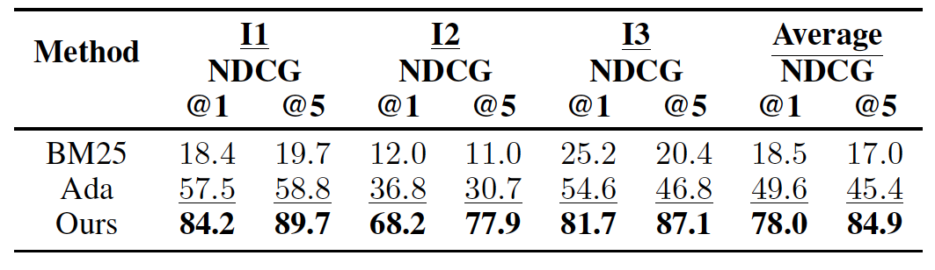
API Retriever: a dense Sentence-BERT Retriever
Aims to retrieve relevant APIs for an instruction.
Uses semantic similarity by encoding instruction and API document into embeddings
To finetune the retriever with contrastive loss, regards relevant APIs as positive and others as negative samples

Slide 31
ToolLLM Inference
ToolLLaMA : LLaMA-2 7B finetuned on ToolBench
Integrates the retriever to ToolLLaMA
Retriever finds more appropriate APIs for the current instruction
ToolLLaMA executes the instruction and finds the solution with DFSDT reasoning.

Slide 32
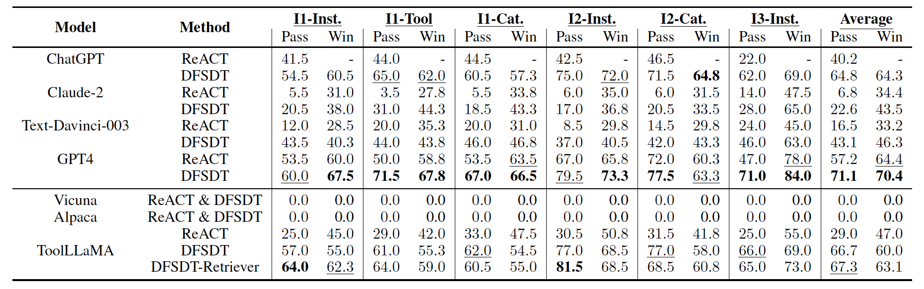
Main Results
DFSDT significantly outperforms ReACT for all LLMs
Finetuned LLaMA fine-tuned for general-purpose dialogue fail to pass any.
ToolLLaMA +DFSDT demonstrates competitive performance

Slide 33
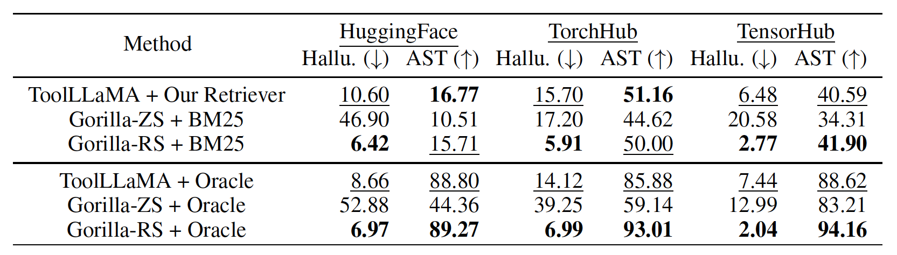
Out-of-Distribution (OOD) generalization TO APIBENCH (Patil et al., 2023)
ToolLLaMA achieves remarkable OOD generalization performance across all three domains

Slide 34
Limitations and Future directions
While effective, the retriever may struggle with unseen APIs requiring further domain adaptation.
Despite strong performance, ToolLLaMA still lags behind GPT-4 in handling complex, multi-step tool interactions.
A single retrieval step may not suffice for multi-tool reasoning; incorporating intermediate responses can dynamically refine API selection.
Handling an expanding API set efficiently remains a challenge, necessitating more robust retrieval and adaptation mechanisms.

Slide 35
Conclusion
ToolBench: Introduced a large-scale instruction-tuning dataset covering 16K+ real-world APIs with single and multi-tool tasks.
DFSDT Reasoning: Proposed a novel decision-making strategy to enhance the planning and reasoning capabilities of LLMs.
ToolEval: a LLM-based evaluator for efficient evaluation of tool learning
Automated tool-use pipeline: Integrated API retriever to ToolLLaMA to address complex multi-tool tasks.

Slide 36
Thank You!
Any Questions?

