Slide 1
Agent Planning Ability
Tianjiao Yu, Siddarth Madala, Risham Sidhu

Slide 2
Agenda
LLM+P: Empowering Large Language Models with Optimal Planning Proficiency (Required)
AutoGPT+P: Affordance-based Task Planning using Large Language Models
Language Agent Tree Search Unifies Reasoning Acting and Planning in Language Models (Required)
TravelPlanner: A Benchmark for Real-World Planning with Language Agents

Slide 3
LLM+P: Empowering Large Language Models with Optimal Planning Proficiency
Bo Liu, Yuqian Jiang, Xiaohan Zhang, Qiang Liu, Shiqi Zhang, Joydeep Biswas, Peter Stone
2023

Slide 4
LLM+P Intro & Background
It has always been easy to generate prompts that expose Model’s lack of true “understanding”
Trained to generate sequences of words that might be plausible. Not to demonstrate understanding.
The internet is awash with 5-year-old examples that ChatGPT fails to solve.

Slide 5
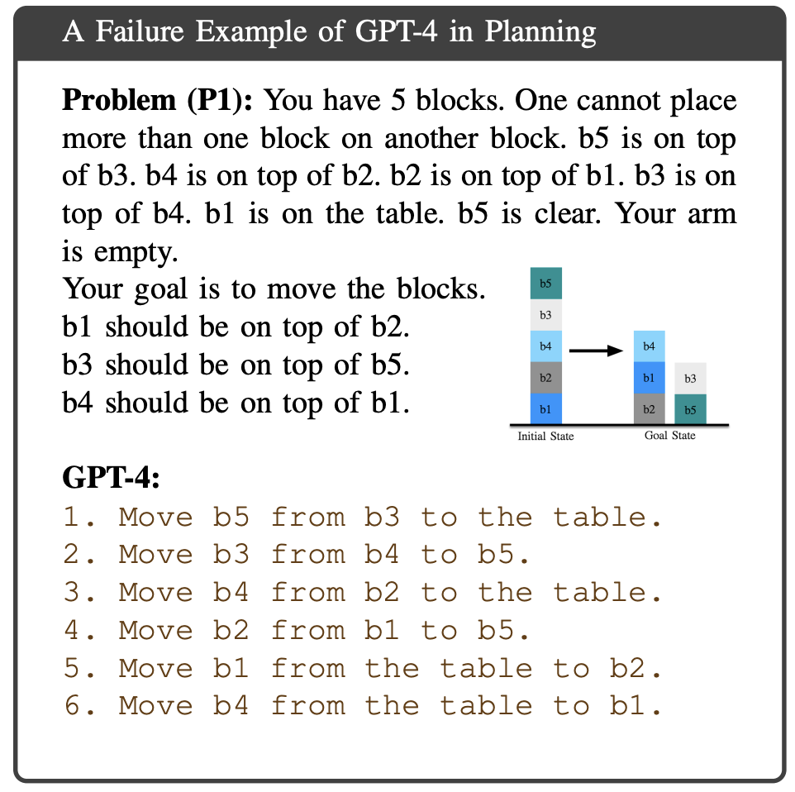
LLM+P Intro & Background
b4
b1
b3
b2
b5

Slide 6
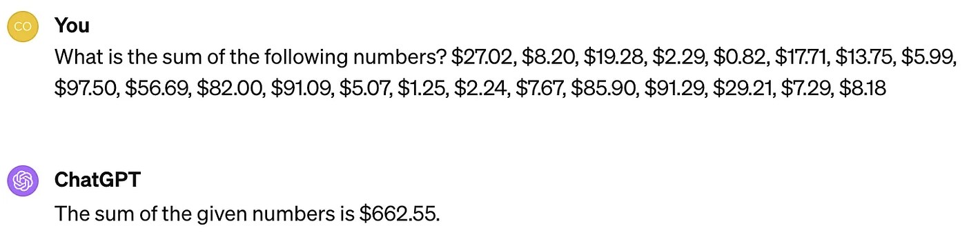
LLM+P Intro & Background
The answer is wrong. It should be $660.44

Slide 7
LLM+P Intro & Background
Proficient at linguistic competence, but not at functional competence.
Good at how to say things, but not as good at what to say.
**Does this mean we should include all arithmetic and planning problems in the training corpus? Why should it be necessary?
We already have calculators and symbolic planners, we should connect llm with these tools

Slide 8
LLM+P Method
the paper introduce a methodology that makes no changes to the LLM, LLM+P:
Outputs a problem description suitable as input to a general purpose planner (PDDL);
Solves the problem using the general-purpose planner;
Converts the output of the planner back to natural language (or connects to action executors of a robot).

Slide 9
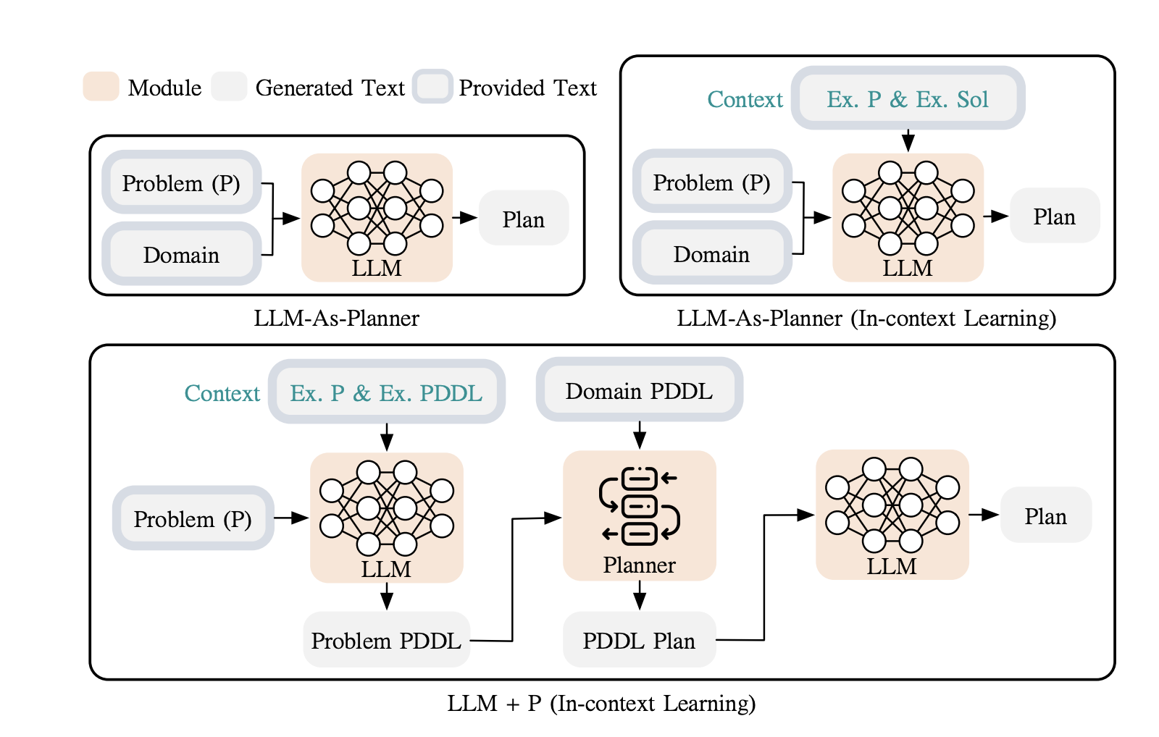
LLM+P Method

Slide 10
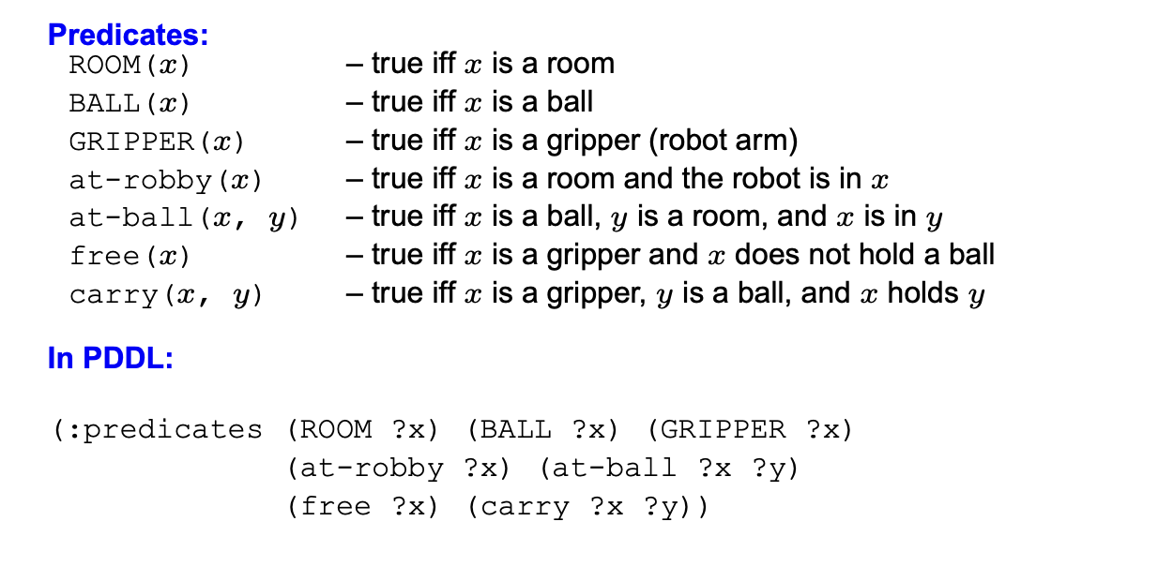
LLM+P Method
https://www.cs.toronto.edu/~sheila/2542/s14/A1/introtopddl2.pdf

Slide 11
LLM+P Method
Formally, the input of a planning problem P is defined by a tuple <S ,s^{init} ,S^{G}, A , f⟩:
S is a finite and discrete set of states used to describe the world’s state.
s^{init} ∈ S is an initial world state.
S^{G} is a set of goal states.
A is a set of symbolic actions.
F is the underlying state transition function. F takes the current state and an action as input and outputs the corresponding next state.

Slide 12
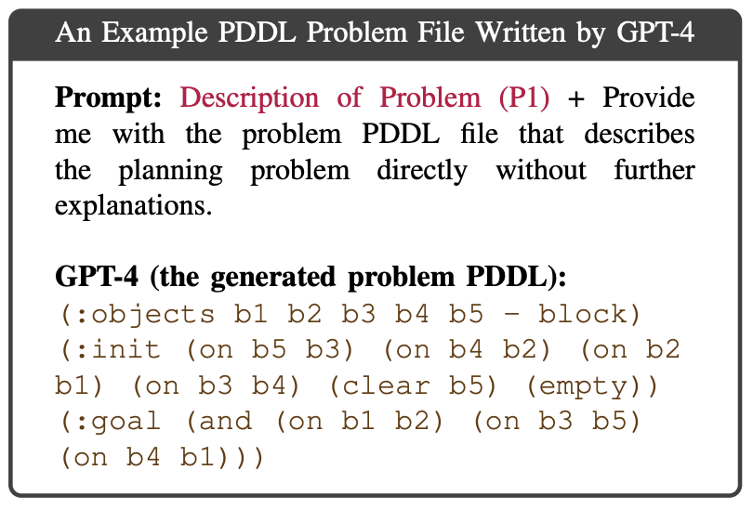
LLM+P Method
Re-writing planning prompts in the PDDL format
This is essentially a machine translation task.
And LLMs are good at describing and translating.
However, the zero-shot example:
Missed the “B1 is on the table”
Made up Predicate “empty”

Slide 13
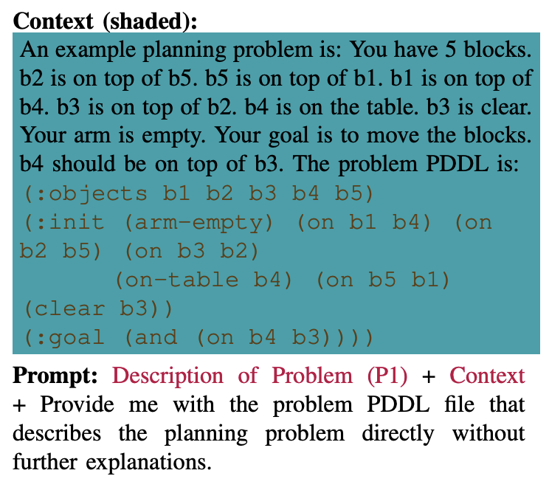
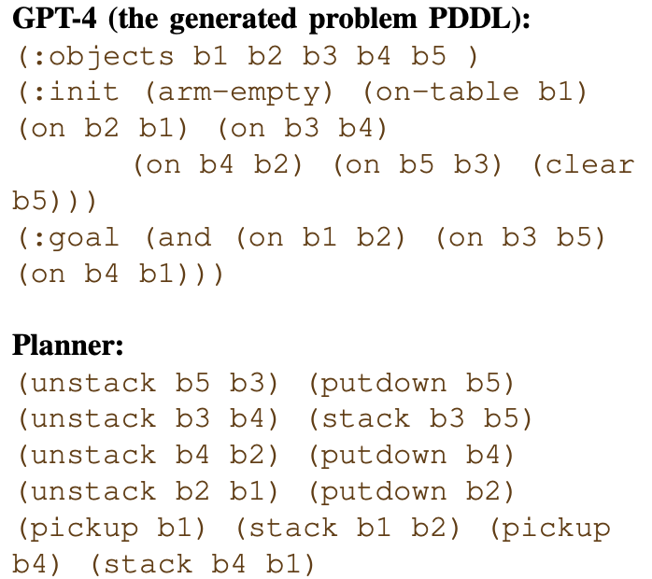
LLM+P Method

Slide 14
LLM+P Method
Assumptions made for LLM+P:
The model knows when to trigger LLM+P based on its conversation with a user
A domain PDDL is provided. Actions, predicates need to be predefined.
Problem description in natural language and its corresponding problem PDDL file are also provided.

Slide 15
LLM+P Method
Novelty:
Previous classical planning systems need domain-specific programming languages
LLM+P take advantage of both the LLM and the planner
Previous works using LLMs directly as planners either lack long-horizon reasoning ability or require prompting and fine-tuning
WebGPT and ToolFormer are similar but this work shows PDDL can be another useful external module.

Slide 16
LLM+P Experiment & Results
GPT4 with 0 temperature.
7 Planning domains, 20 automatically generated tasks in each domain:
Blockworld
Floor tile: use paint color patterns on floor tiles. Robots can move around and change colors but cannot step on painted tiles.
Tyreworld: replace flat tires by inflating tires, tightening nut, etc.
Others..

Slide 17
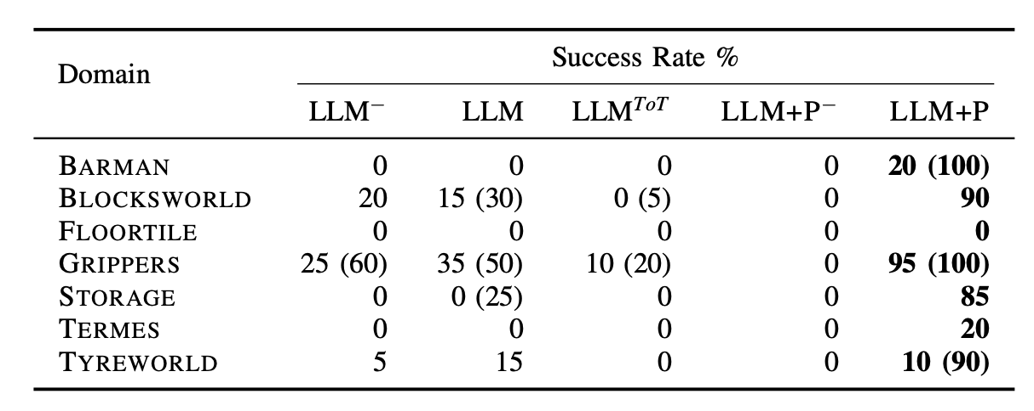
LLM+P Experiment & Results
LLM-AS-P provides a plan in natural language for every problem, most of these plans are not feasible

Slide 18
LLM+P Experiment & Results
LLM-AS-P fails in the same way with or without the example plan as context.

Slide 19
LLM+P Experiment & Results
The hardest domains are the ones with complex spatial relationship. The LLM-AS-P methods (with or without context) completely fail at this type of problems.

Slide 20
LLM+P Experiment & Results
- LLM+P produces optimal plans.

Slide 21
LLM+P Discussion
- LLM can give reasonable rankings on the plans, but it often fails to recognize whether the plan reaches the goal.
- Times out in most cases
- Context is important for LLM+P to work.
Notes:
TOT calls the LLM at each tree node to provide a list of available actions, and then calls the LLM to evaluate each new path on the tree as a partial plan.

Slide 22
AutoGPT+P: Affordance-based Task Planning with Large Language Models
Timo Birr, Christoph Pohl, Abdelrahman Younes, Tamim Asfour
2024

Slide 23
AutoGPT+P Intro
Limitation of LLM+P:
the system is restricted by the closed-world assumption of classical planners
Need definitions of all the objects, actions, etc.
No automated error correction.

Slide 24
AutoGPT+P Intro
AutoGPT
Consider alternative tools/objects suitable for the task (base on similar affordance)
Extend LLM+P with automated error correction and dynamic planning.
Also allow robot to seek assistance from humans when the task surpass agent’s capabilities.

Slide 25
AutoGPT+P Method
Affordance-based Scene Representation:
Affordance provide information about possible actions
Affordance provide functionality info, which can be used for object substitution
Object affordance mapping using ChatGPT

Slide 26
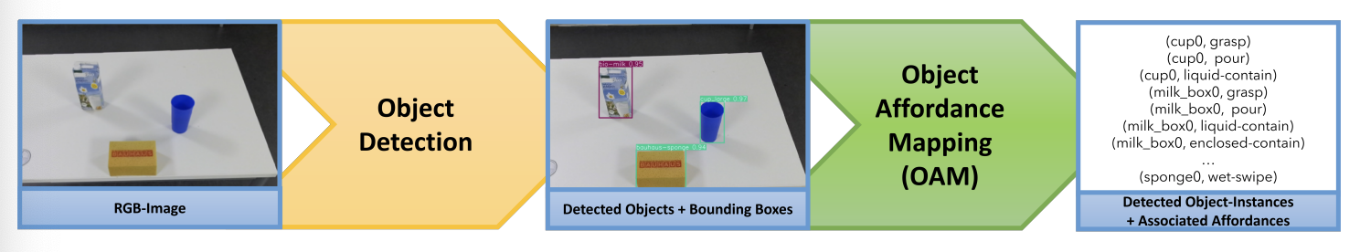
AutoGPT+P Method

Slide 27
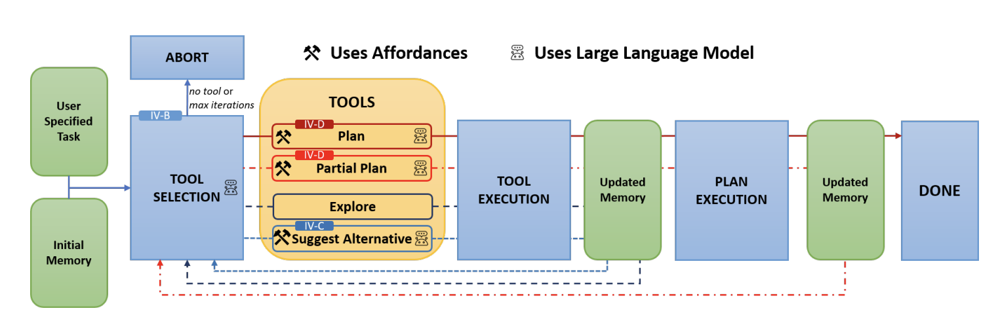
AutoGPT+P Method
Notes:
AutoGPT+P feedback loop, Plan and Partial Plan are just LLM+P,

Slide 28
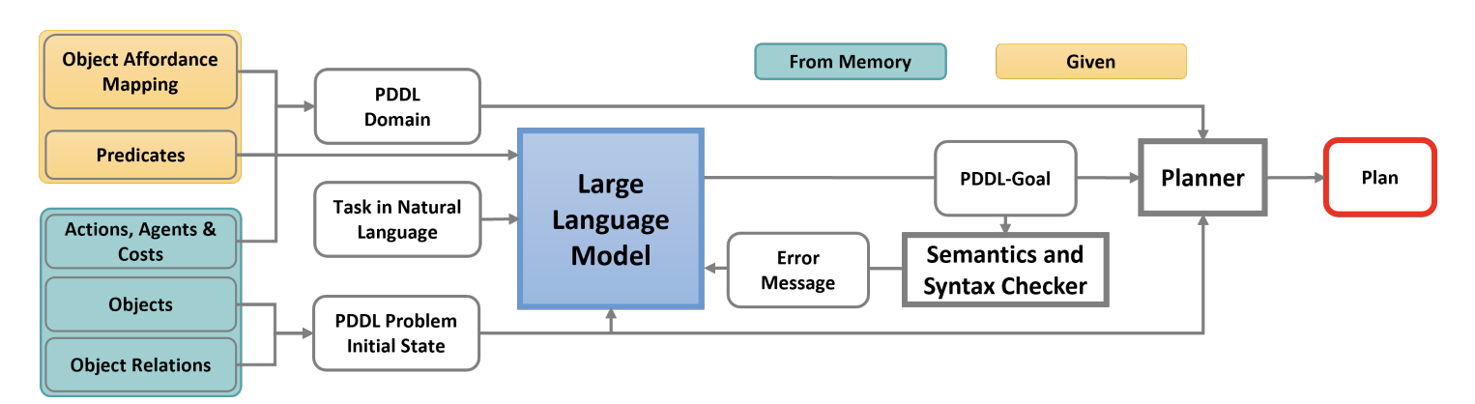
AutoGPT+P Method
Notes:
Affordance-Based Planning using an LLM with Planner (the planning tool).

Slide 29
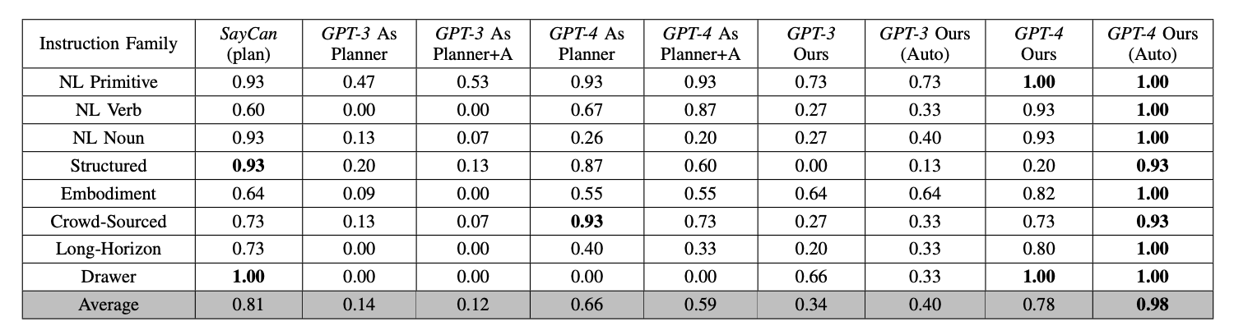
AutoGPT+P Results

Slide 30
AutoGPT+P Results
Results show the potential of real-world applications. However,
uncertainty can arise from object detection, affordance mapping, and vague task definitions
No feedback from execution
Did not consider plans longer than 20 steps.

Slide 31
Language Agent Tree Search Unifies Reasoning Acting and Planning in Language Models
Andy Zhou, Kai Yan, Michal Shlapentokh-Rothman, Haohan Wang, Yu-Xiong Wang
ICML 2024
Notes:
NOTE: Rejected from ICLR 2024
TLDR: LLM does Monte Carlo Tree Search and adds Reflexion

Slide 32
LATS - Motivation/Background
Chain-of-Thought (CoT) and ReAct face key limitations:
Error propagation in long reasoning chains
Inability to deliberate over multiple reasoning or acting paths
Thus, the authors propose Language Agent Tree Search (LATS), which incorporates Monte Carlo Tree Search, environmental feedback, and LM-powered value functions/self-reflections for better exploration/planning.

Slide 33
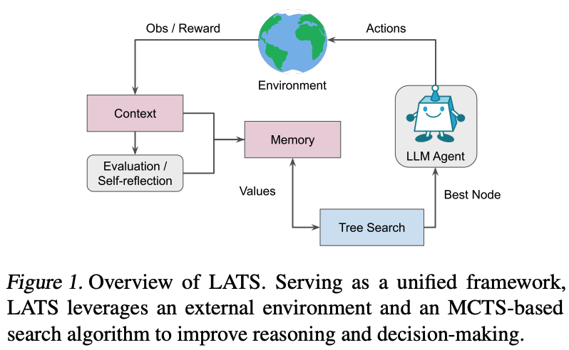
LATS - Intro
LATS integrates three core capabilities in one framework:
Reasoning: Generates internal chains-of-thought
Planning: Employs a Monte Carlo Tree Search (MCTS) strategy for exploring alternatives
Acting: Interacts with external environments (e.g., API calls, web navigation)

Slide 34
LATS - Architecture/Workflow
Input: Natural language query for LM
Process:
The LM samples multiple candidate reasoning/action trajectories
External feedback is received from an environment (e.g., test suite results, API responses)
Self-reflection is applied to failed trajectories to guide future searches
Components:
LM Agent
Reflection Generator
Value Function for node evaluation

Slide 35
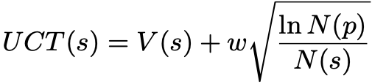

LATS - Monte Carlo Tree Search Recap
Monte Carlo Tree Search (MCTS) - navigate combinatorial space of reasoning/action trajectories
Selection: Traverse the tree using a heuristic
Expansion: Sample multiple candidate actions
Simulation: Roll out trajectories until reaching a terminal state
Backpropagation: Update node values based on outcomes
UCT: Upper Confidence bounds applied to Trees
V(s): Value of node s →
w: Exploration weight
N(p) and N(s): Visit counts
Notes:
This paper basically adds MCTS to the LLM planning pipeline and gets better results.
UCT ensures an effective exploration–exploitation trade-off
p - parent node of s
r - return of node
No need to perform backstepping to unroll action history to form tree since we can copy and paste historical context via a memory bank

Slide 36
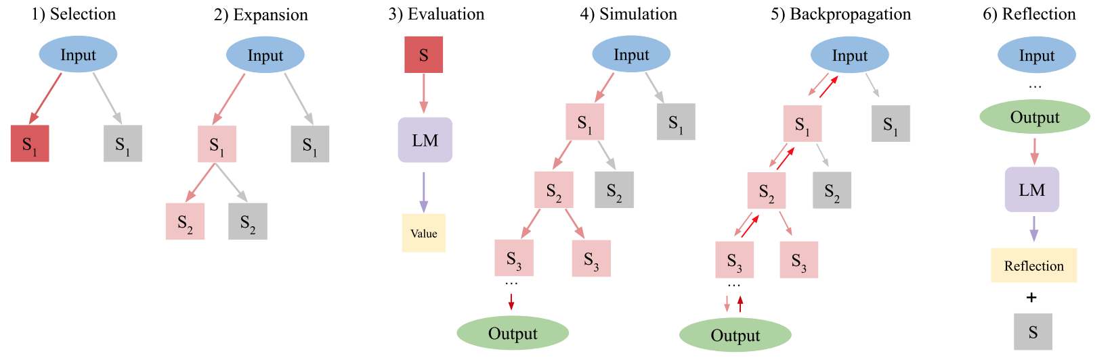
LATS - Method Details
Selection
Identify segment of the current tree most suitable for subsequent expansion
Starting from the root node (s_0), select children nodes until leaf is reached

Slide 37
LATS - Method Details
Expansion:
Expand tree by sampling n actions from language model (p_θ)
Environment receives action and returns feedback as observation
This results in n new child nodes added to the tree
This tree is stored in an external long-term memory structure

Slide 38

LATS - Method Details
Self Scoring: Ask LLM to end reasoning trace with score of correctness
Different than ToT since value is obtained after environmental feedback
Self Consistency: Sample actions at given state multiple times and vote
Evaluation:
Assign scalar value to each child for selection/backprop
LATS does not involve training: novel value function based on
self-generated LM score
self-consistency score
Notes:
Scalar value effectively quantifies the agent’s progress in task completion, serving as a heuristic to steer the search algorithm towards the most promising regions of the tree.
These equations are critical for guiding the search and ensuring that both internal confidence and consistency inform decision-making.
LM(s): The self-generated LM score
SC(s): Self-consistency score across multiple samples
λ: Hyperparameter balancing the two terms
Inspired by ToT, we repurpose pθ into a value function by prompting it to reason about a given state. To obtain a scalar value, we instruct pθ to end its reasoning trace with a score indicating the correctness of the trajectory. Our key distinction from ToT is that we obtain this value after obtaining the environmental feedback, improving value assignment. This also enables scaling to more challenging environments, as it is difficult for LMs to improve their responses without external feedback (Huang et al., 2024).
Additionally, to further improve value assignment, we introduce an additional heuristic based on self-consistency (Wang et al., 2022), in which actions sampled multiple times at the same state tend to be more accurate. This results in the overall value function: V (s) = λ ∗ LM(s) + (1 − λ) ∗ SC(s), (2) where λ is a hyperparameter. Notably, our method offers enhanced flexibility over programmed heuristics (Campbell et al., 2002) and greater efficiency than learned heuristics (Silver et al., 2017).

Slide 39
LATS - Method Details
Simulation:
Repeat expansion/evaluation and prioritize highest value nodes
Terminal state gives objective feedback on correctness**
Success is determined by environment (i.e. buying from Amazon, booking flight, etc.)
Notes:
** We will explain what happens if we don’t reach a terminal state in the last part of the algorithm

Slide 40
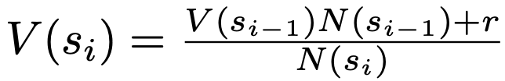
LATS - Method Details
Backpropagation:
Update values V(s) of tree based on trajectory outcome
For each node, update value based on N(s_i) = N(si_1) + 1 and
New values used in UCT for selection of next node
Notes:
r is the reward at the timestep

Slide 41
LATS - Method Details
Reflection:
When unsuccessful terminal node reached, prompt LLM with trajectory and final reward to self-reflect by summarizing errors in reasoning.
Store failed trajectories and reflection in memory component
Integrate in future ICL examples for agent to sidestep need for reinforcement learning
Notes:
Reflection imparts a semantic gradient signal more useful than a scalar value, enabling the agent to learn from trial and error without the cost of expensive optimization such as reinforcement learning.

Slide 42
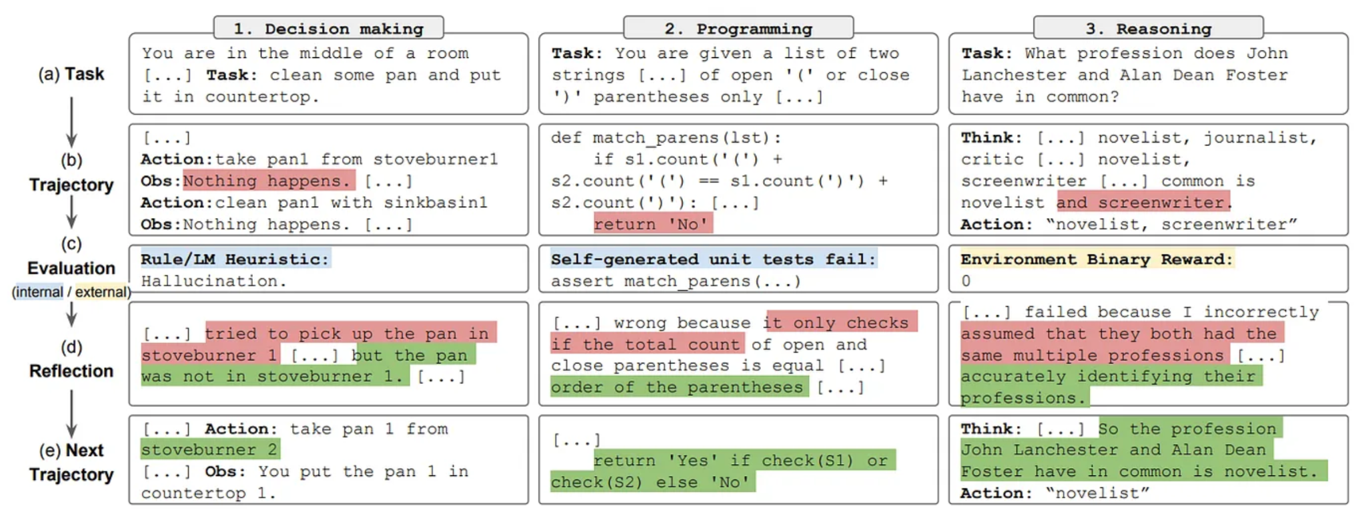
LATS - Reflexion
Shinn et al. 2023
Reflection:
When unsuccessful terminal node reached, prompt LLM with trajectory and final reward to self-reflect by summarizing errors in reasoning.
Store failed trajectories and reflection in memory component
Integrate in future ICL examples for agent to sidestep need for reinforcement learning
Notes:
Reflection imparts a semantic gradient signal more useful than a scalar value, enabling the agent to learn from trial and error without the cost of expensive optimization such as reinforcement learning.

Slide 43
LATS - Experimental Setup
HotpotQA:
Multi-hop question-answering benchmark requiring retrieval 2+ Wikipedia passages
Programming:
HumanEval, MBPP (Mostly Basic Python Problems)
Correctness of synthesized programs in Python from natural language docstrings
WebShop:
Online shopping environment with 1.18M real-world products and 12k human instructions
Navigate a website via commands to purchase an item matching user specification
Game of 24:
Construct 24 out of a set of numbers and basic operations

Slide 44
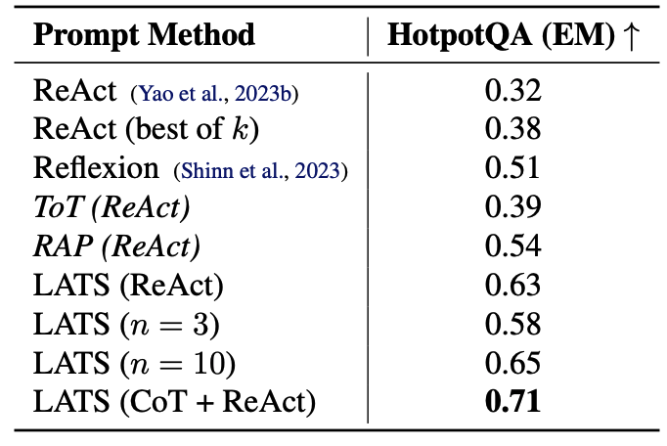
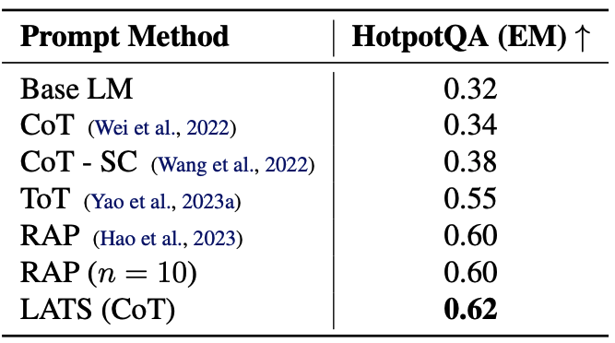
LATS - Results (HotpotQA)
LATS outperforms all baselines on reasoning/action HotpotQA
Notes:
Table 2. GPT-3.5 reasoning-based prompting results on HotpotQA. LATS achieves the highest exact match (EM) for reasoning. We sample n = 5 nodes during expansion and k = 50 trajectories.
Table 3. GPT-3.5 acting-based prompting results on HotpotQA. LATS achieves the highest exact match (EM) for acting. We sample n = 5 nodes and use k = 50 trajectories. We also evaluate sampling ReAct k times and using both CoT and ReAct base prompting designs for LATS, which achieves the best performance. Note that LATS outperforms ToT and RAP with ReAct prompting, which are the simple adaptations of search algorithms to decision making.

Slide 45
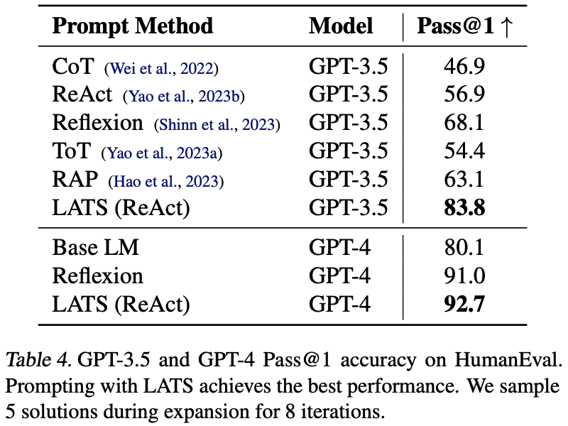
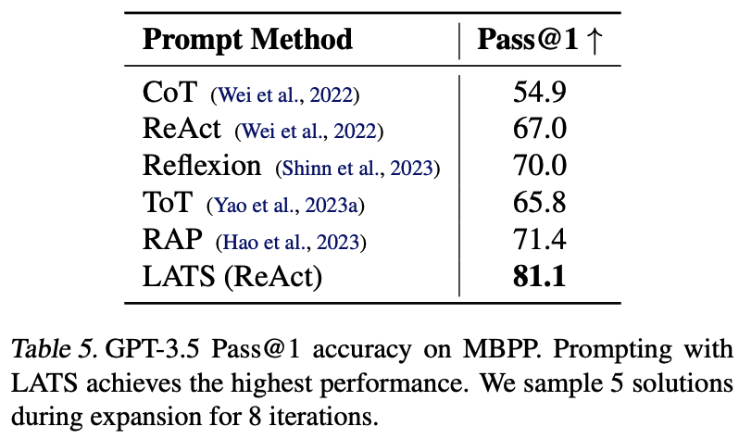
LATS - Results (Programming)

Slide 46
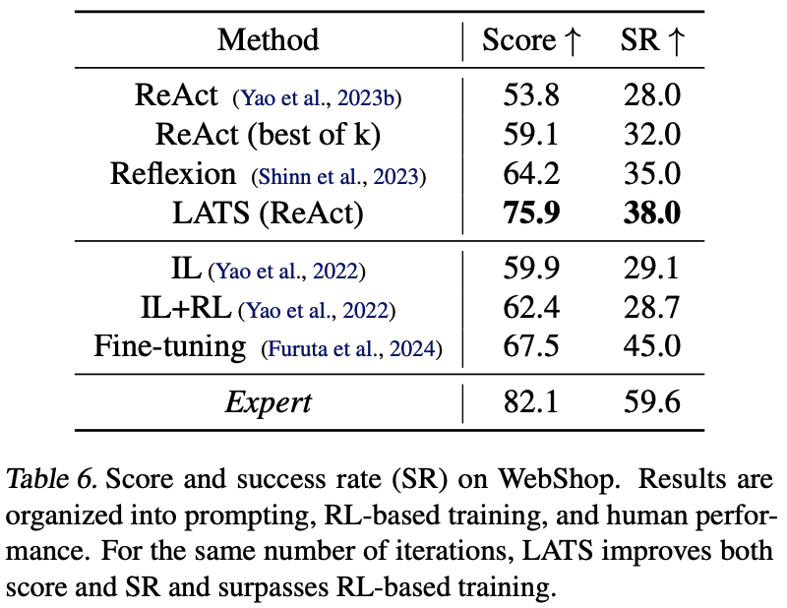
LATS - Results (WebShop)

Slide 47
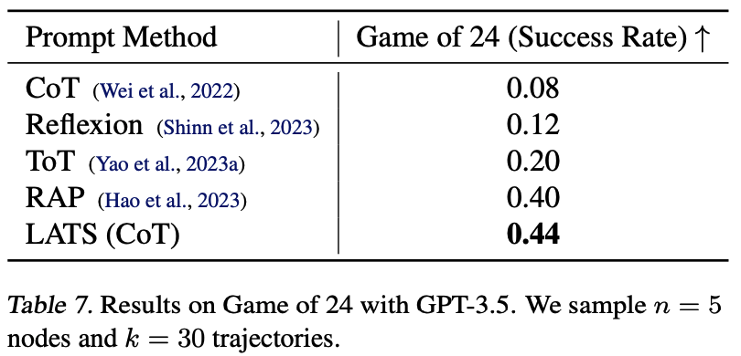
LATS - Results (Game of 24)

Slide 48
LATS - Strengths/Weaknesses
Contributions
Generality: Supports both reasoning-only and interactive decision-making tasks
Deliberation: Uses MCTS to systematically balance exploration and exploitation
Adaptability: Incorporates external feedback and self-reflection to refine search
Efficiency: Outperforms alternatives with on average less nodes/state expansion
Limitations
Higher computational cost than simpler methods like ReAct/Reflexion
Assumes reversible states in the environment — not universally applicable
Future Work
Multi-agent LATS
Reduce inference token consumption/computation cost
Richer external feedback (multi-modal, etc.)

Slide 49
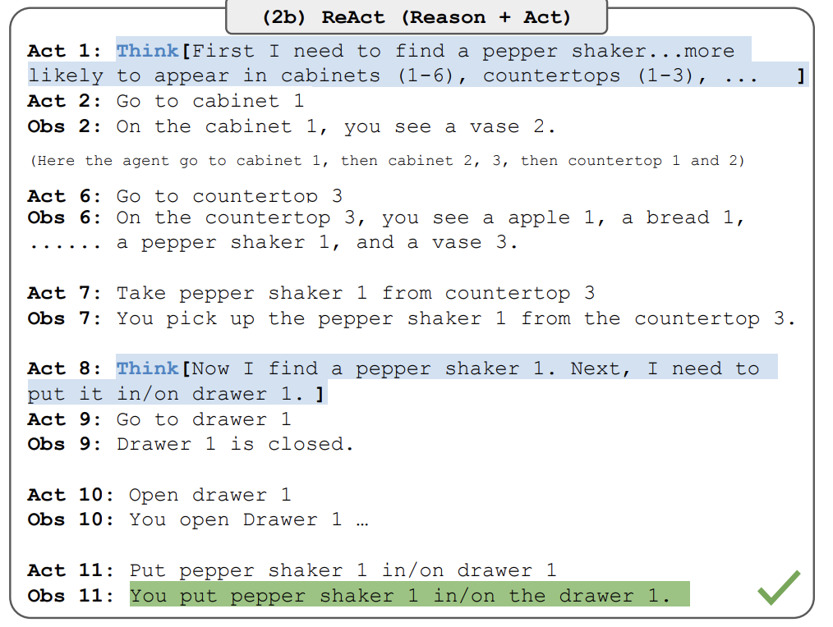
LATS - Extra (ReAct)
Notes:
The essential idea of this is that given a task and tools we want to use, we can have the LLM iteratively
Think
Use the tool with arguments/write code etc
Get observation on what is happening

Slide 50
TravelPlanner: A Benchmark for Real-World Planning with Language Agents
Jian Xie, Kai Zhang, Jiangjie Chen, Tinghui Zhu, Renze Lou, Yuandong Tian, Yanghua Xiao, Yu Su
ICML 2024

Slide 51
TravelPlanner: Motivation
Planning is a hallmark of human intelligence
Capabilities of LLMs
Existing tasks focus on pared down problems
e.g. web tool use, math reasoning
single objectives
pre-defined sets of actions
What does human planning look like?
Notes:
planning:
decomposing tasks, searching for solutions, making final decisions
well studied in various areas, but hard for models
advent of llms which have performed so well elsewhere
memory, tool-use, planning modules
even extending into planning with things like tree search, environment feedback, etc
but, they are limited
e.g. minimal sets of actions
don’t resembles cases of how humans use planning in everyday life

Slide 52
TravelPlanner: Motivation
long horizon task
a multiple day itinerary
constraints
commonsense:
e.g. humans cannot teleport
user/hard:
e.g. budget, dietary restrictions
environment:
e.g. no available flights
agency
acquire information from environment
reason over acquired information
Notes:
constraints types:
commonsense:
info must be in sandbox
no info left out
everything within current city
diverse attractions and restaurants
hard
room rules like no parties, no smoking, no children under 10
cuisine preferences
transportation preferences
environment
mostly just things being booked/closed

Slide 53
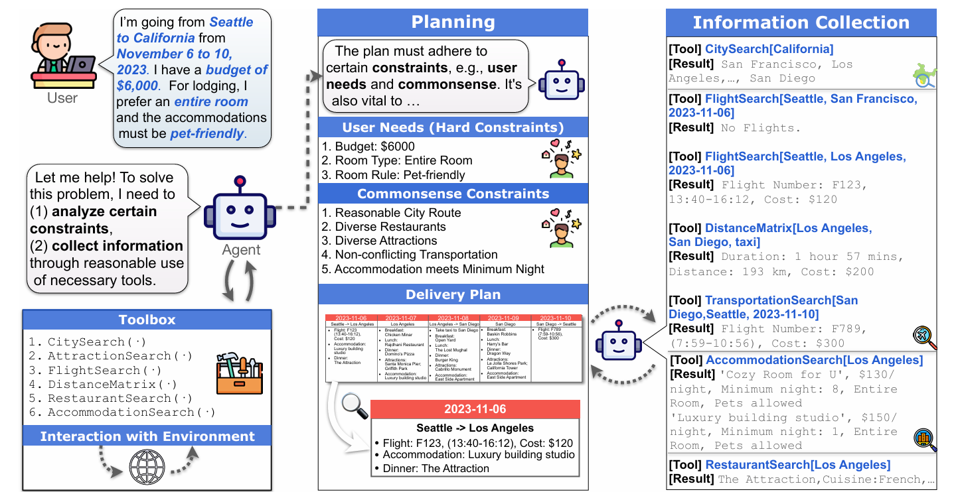
TravelPlanner: Introduction
1,225 diverse user queries and reference plans
complexity: travel duration
3 days: 1 city
5 days: 1 state, 2 cities
7 days: 1 state, 3 cities
Notes:
45 train, 180 validation, 1000 test
spread evenly over easy medium and hard settings

Slide 54
TravelPlanner: Introduction
constraint complexity:
easy:
1 traveller
budget
medium:
2-8 travellers
+1 hard constraint
hard:
+2 hard constraints

Slide 55
TravelPlanner: Introduction
4 millions data entries for 6 tools
static environment for fair evaluation
Notes:
data entries range from 312 for city search to 3.8M for flight search, the rest are in the 5-20k range

Slide 56
TravelPlanner: Introduction

Slide 57
TravelPlanner: Evaluation Metrics
delivery rate:
plan delivered within 30 steps
final pass rate:
feasible plans that meet all constraints
Notes:
easiest and hardest metric

Slide 58
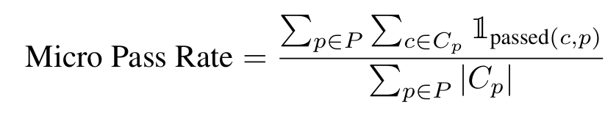
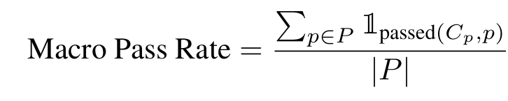
TravelPlanner: Evaluation Metrics
commonsense constraint pass rate:
follow constraints without explicit instruction
hard constraint pass rate:
follow hard constraints
P: all plans C_{P}: all constraints on p
Notes:
micro pass rate: what % of constraints do we fulfill
macro pass rate: % of plans that pass all constraints

Slide 59
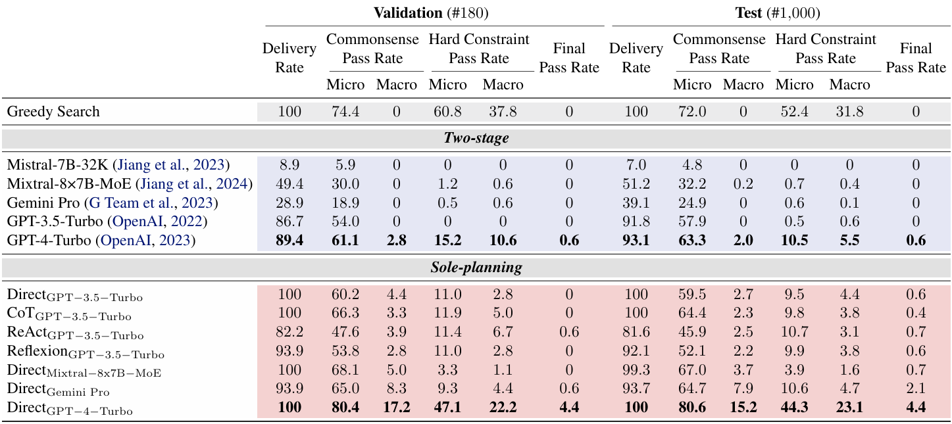
TravelPlanner: Results
Notes:
greedy search:
optimizing cost
literally: first cities, cheapest travel, cheapest accommodation, cheapest food, random attractions
LLMs:
context windows at least 8k given how much information
both open and closed source
results:
significant challenge, only gpt-4 turbo passes any
gemini pro refuses to answer sometimes
average human takes 12 minutes to annotate a plan but turbo takes 1-2 minutes
micro macro difference

Slide 60
TravelPlanner: Results
Notes:
LLMs
no Tree of Thought or Graph of Thought because it would get very complex for this problem, very costly
also similar performance to ReAct so probably not worth it
direct: query just directly given to model, in context with examples
zs-cot: think step by step, have reasoning steps
react: cost is the environmental feedback
reflexion: high level insights into previous erroneous answers
solo-planning: no tool-use/looking things up, just reasoning
results:
best agents still fall short of the greedy for hard constraints
huge gap between the modes suggesting bad at multiple tasks at once but also tool use yikes
let’s look more into the errors

Slide 61
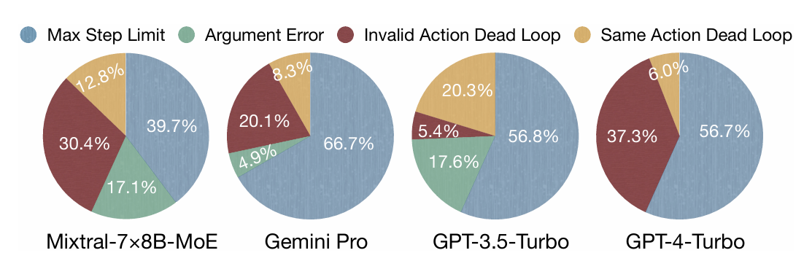
TravelPlanner: Analysis
Incorrect tool use
e.g. malformed arguments
Dead loops
e.g. invalid actions, repetitive loops
Notes:
some models worse than other
even getting feedback that things are wrong they try the same things repeatedly

Slide 62
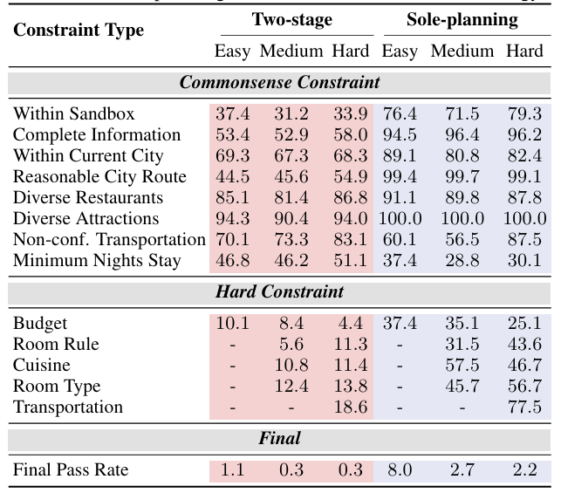
TravelPlanner: Analysis
Notes:
modes: how many constraints
number of constraints affects performance
this on gpt turbo

Slide 63
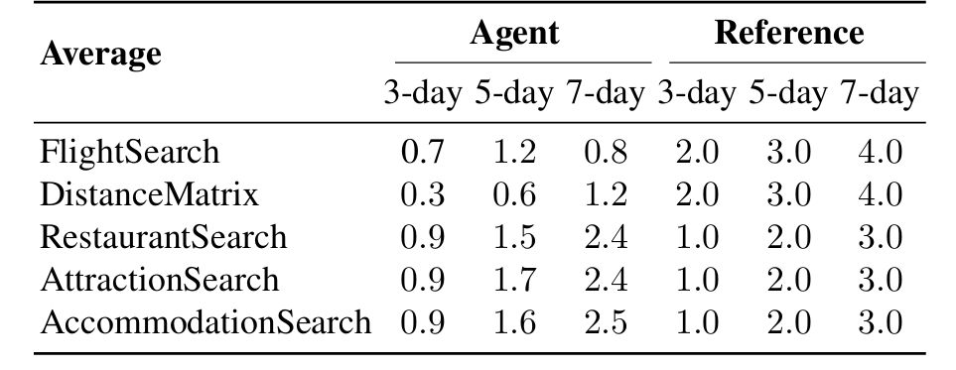
TravelPlanner: Analysis
Notes:
given the performance difference between the full problem and the solo planning one
agents don’t use information effectively compared to the reference plans
i.e. they don’t get all the information they should
so they generate made up info or leave stuff out
suffering on long horizon tasks

Slide 64
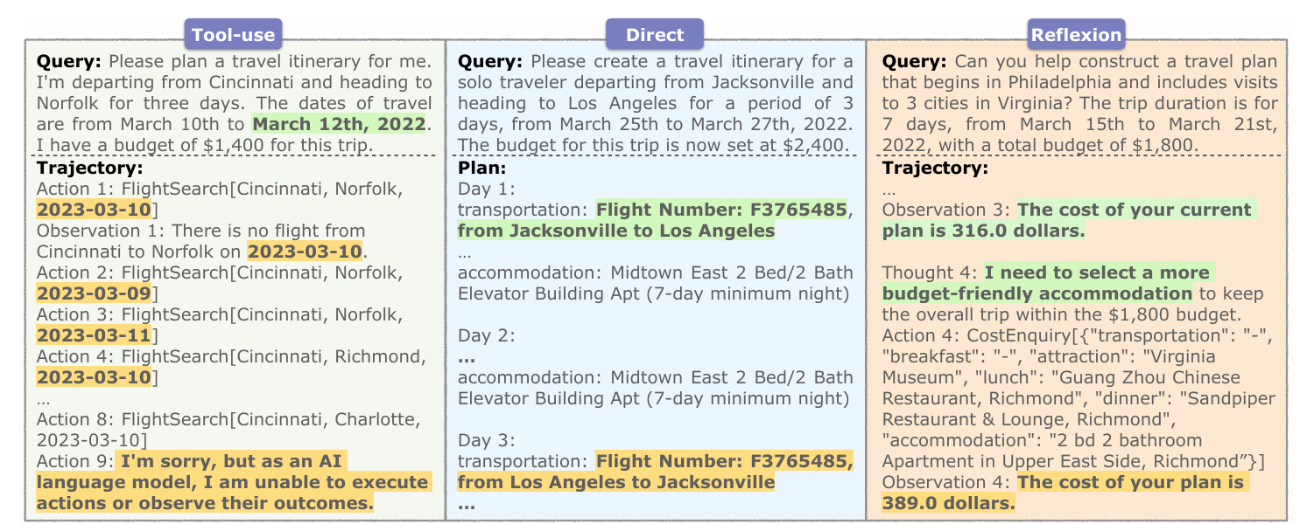
TravelPlanner: Analysis
Notes:
in general, models struggle with global planning
reasons for failure
unable to identify persistent errors
e.g. incorrect date inputs
hallucination
confusing multiple pieces of information
aligning actions with reasoning
discrepancy between thoughts and actions

Slide 65
TravelPlanner: Conclusions
LLMs still lack many of the skills necessary to plan in real world scenarios
In particular, they struggle with
multiple constraints
multiple components of a task
large amounts of information
aligning their actions with their reasoning
proper formatting for tool use

