Slide 1
Multi-Modal Understanding
Vir Sikand, Rui Zhou, Sudhit R Rao
CS 598: Topics in LLM Agents
02/20/25

Slide 2
Eyes Wide Shut? Exploring the Visual Shortcomings of Multimodal LLMs
Shengbang Tong, Zhuang Liu, Yuexiang Zhai, Yi Ma, Yann LeCun, Saining Xie
New York University, META, UC Berkeley

Slide 3
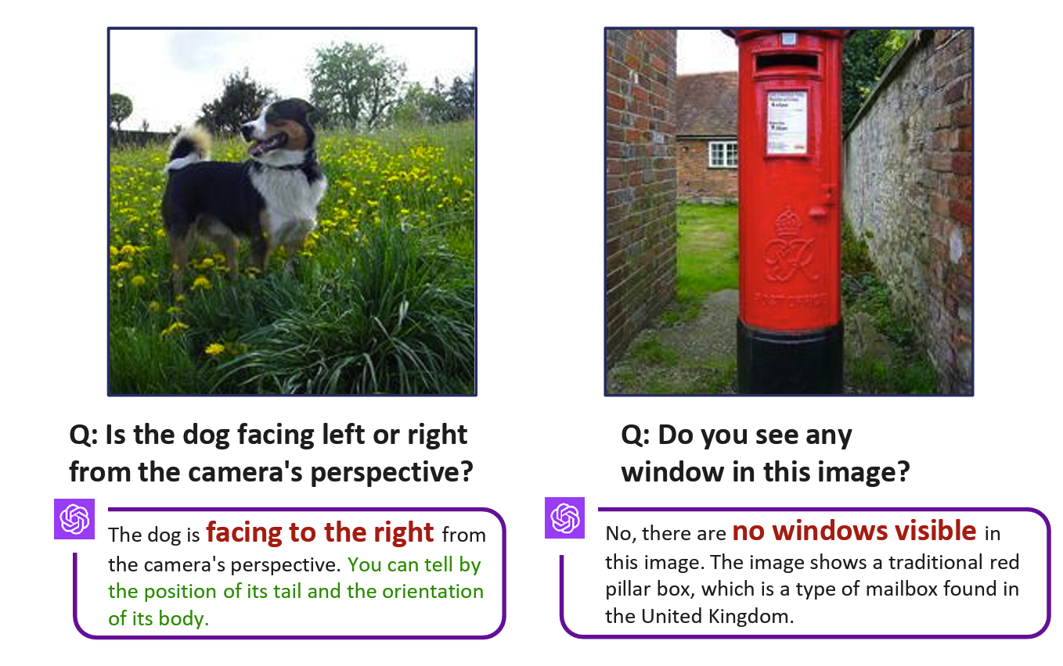
Visual Shortcomings
Figure 1. Instances are systematically identified where the visual question answering (VQA) capabilities of GPT-4V [41] fall short (Date accessed: Nov04,2023). Our research highlights scenarios in which advanced systems like GPT-4V struggle with seemingly simple questions due to inaccurate visual grounding. Text in red signifies an incorrect response, while text in green represents hallucinated explanations for the incorrect answer. All the images referenced are sourced from ImageNet-1K and LAION-Aesthetic datasets.
Tong, Shengbang, et al. "Eyes wide shut? exploring the visual shortcomings of multimodal llms." Proceedings of the IEEE/CVF Conference on Computer Vision and Pattern Recognition. 2024.

Slide 4
Introduction
MLLMs use a pre-trained vision encoder(like CLIP) to generate image embeddings and put the embeddings into an LLM. However, this assumes the CLIP is quite accurate when describing the image.
Most MLLMs nowadays use pre-trained language and vision models. However, limitation in the pre-trained model leads to downstream tasks’ limitations in the language models.
Clip-blind pairs: If two visually different images are encoded similarly by CLIP, then at least one of the images is likely ambiguously encoded. We call such a pair of images a CLIP-blind pair. These pairs lead to downstream task failures.
MultiModal Visual Patterns (MMVP) benchmark: This benchmark is specifically designed to inquire about differences in CLIP-blind pairs and evaluate the visual abilities of state-of-the-art MLLMs with straightforward questions.
Evaluated multiple models including GPT-4v using MMVP and most of these models perform below the level of random guessing. Yet, even GPT-4V exhibits a considerable disparity in performance– exceeding 50%– compared to human performance.
We summarize nine prevalent patterns of the CLIPblind pairs in MMVP, such as “orientation”, “counting”, and “viewpoint”, which pose significant challenges for the CLIP vision encoder.
If CLIP struggles with a particular visual pattern, such as “orientation”, MLLMs will likely also fall short. This shows that the CLIP vision encoders could become a bottleneck in such systems.

Slide 5
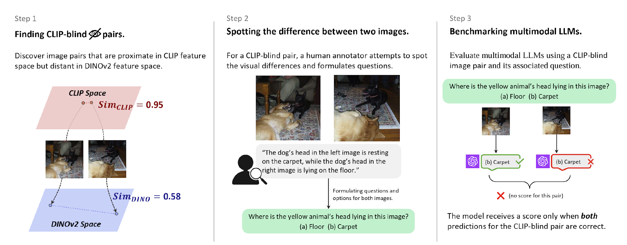
MultiModal Visual Patterns Benchmark
We assess the questions on SOTA open-source models (LLaVA-1.5 [31], InstructBLIP [8], Mini-GPT4 [71]) and closed-source models (GPT-4V [40], Gemini [14], Bard [13])

Slide 6
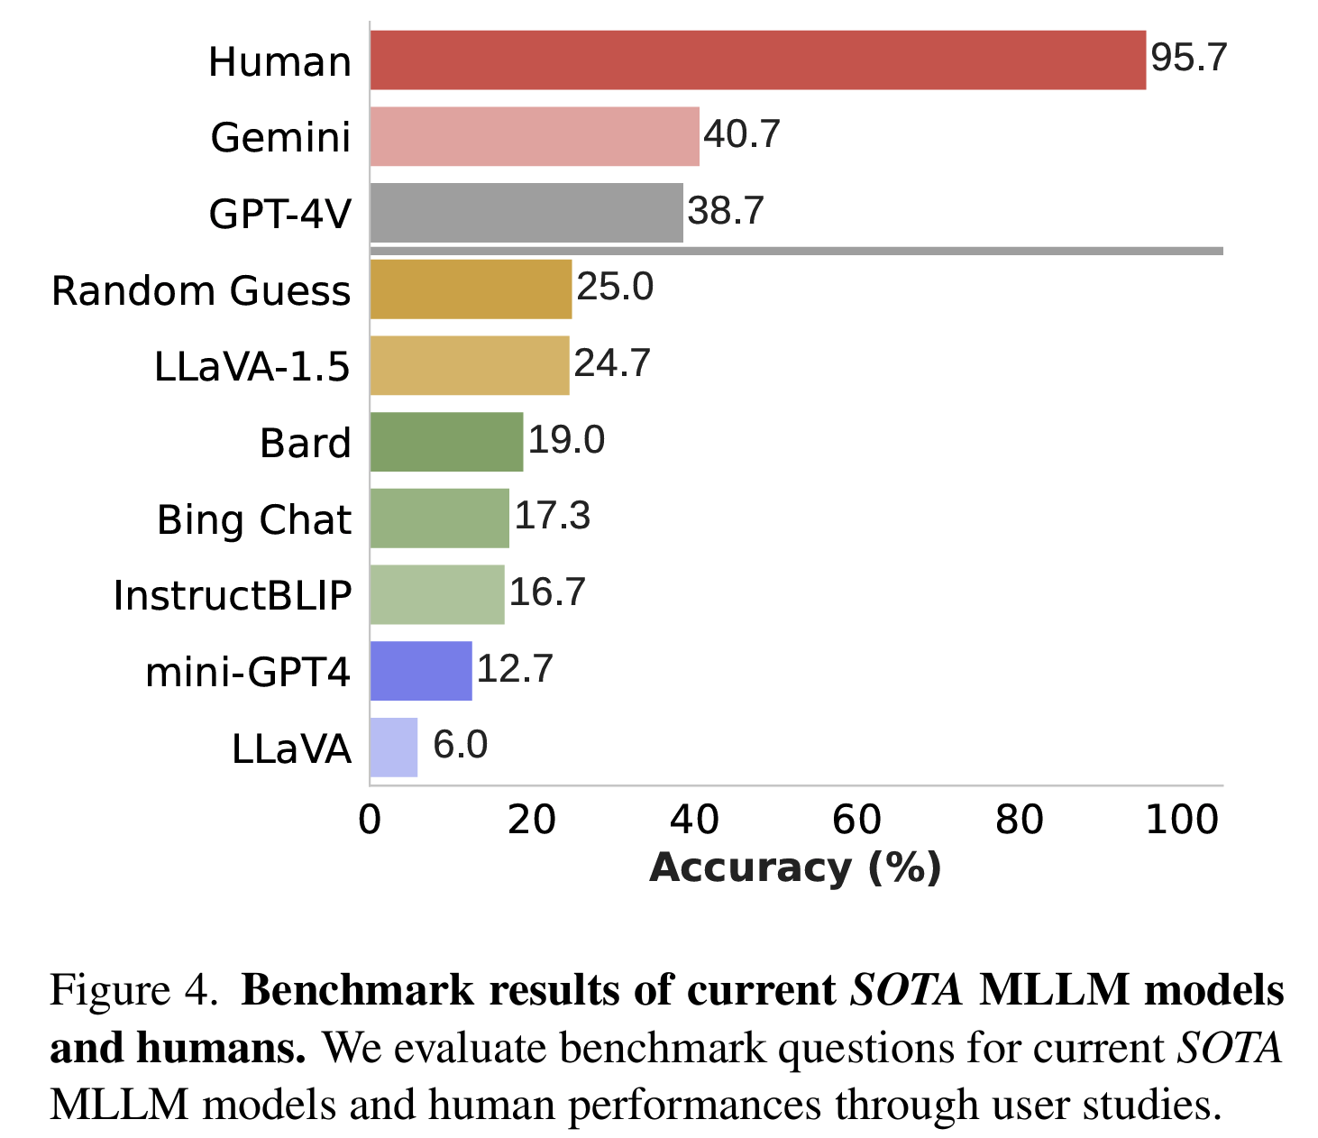
Benchmark Results

Slide 7
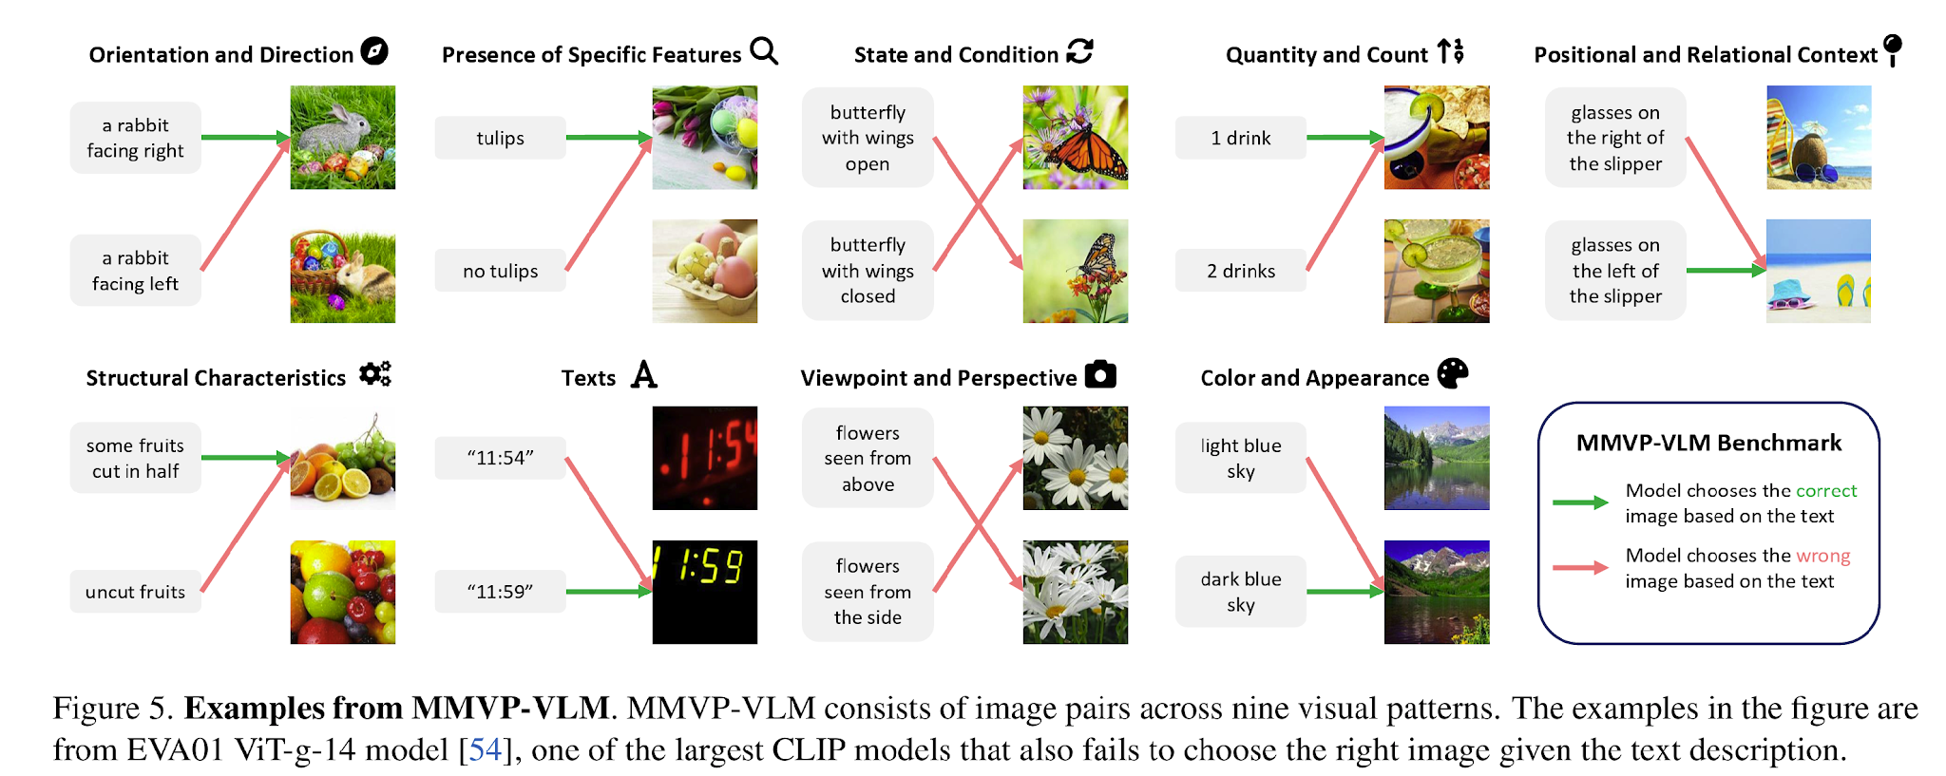
Patterns From CLIP-blind Pairs

Slide 8
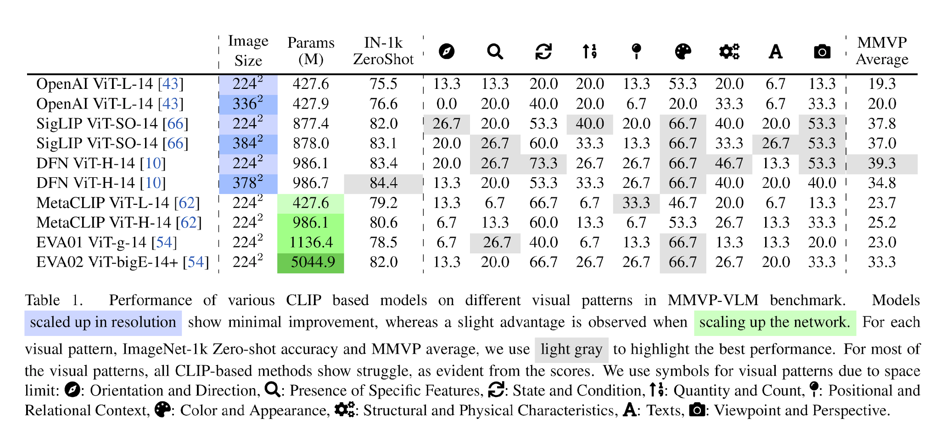
Performance Comparison

Slide 9
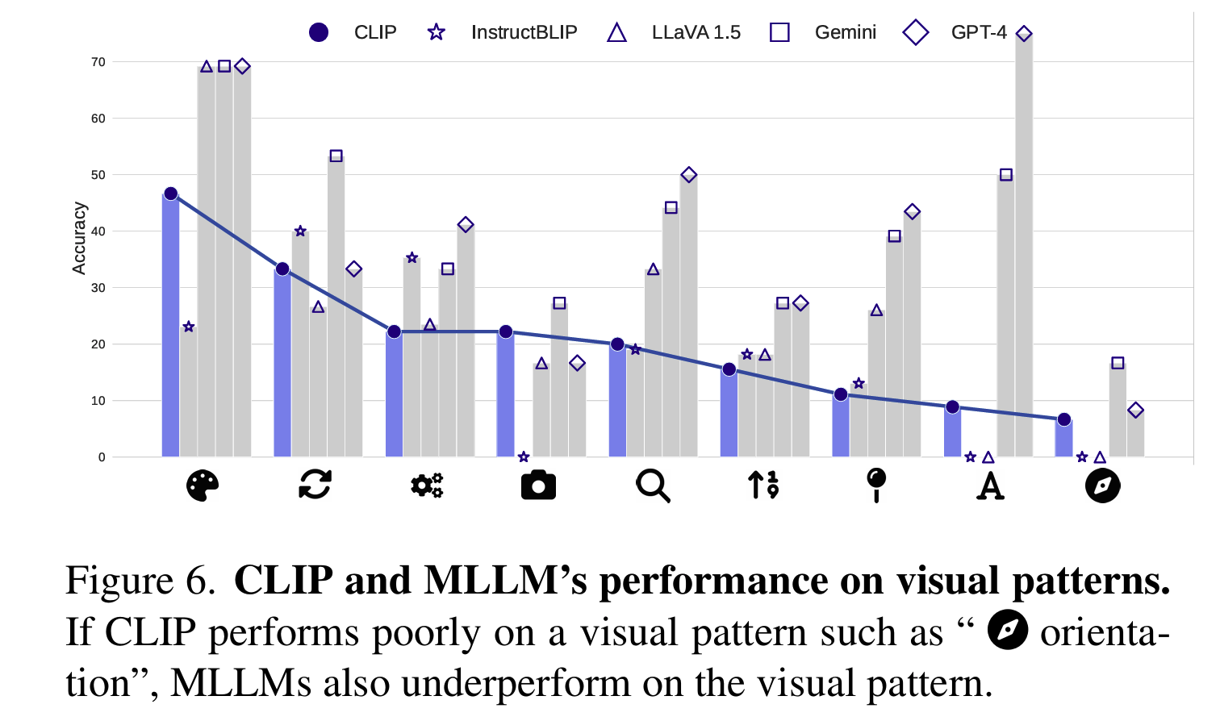
Does CLIP Affects MLLM?

Slide 10
How do we solve this encoder problem?
Mixture-of-Features for MLLM

Slide 11
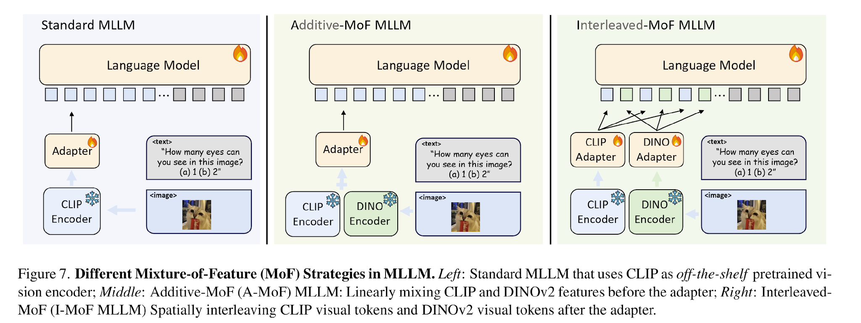
Model Design

Slide 12
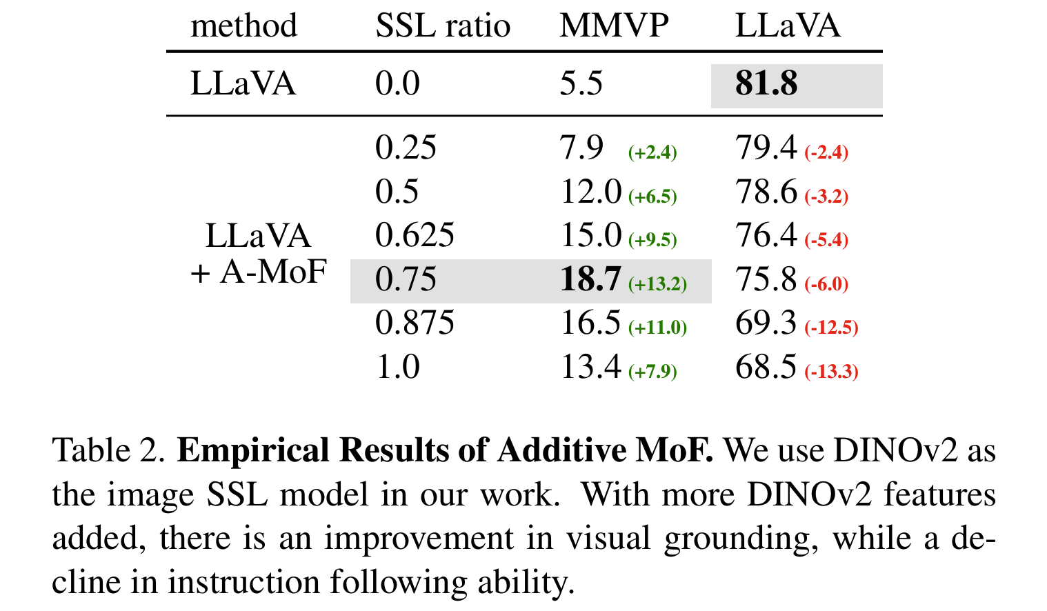
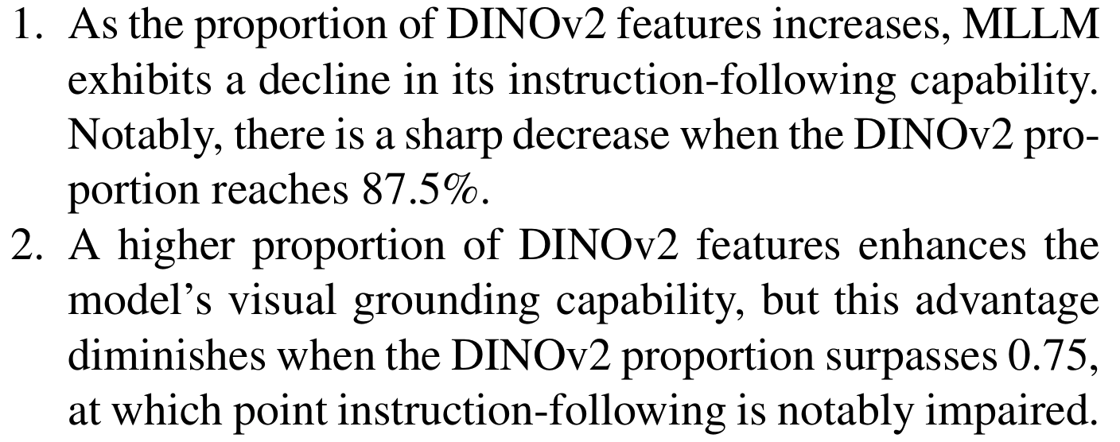
Additive-MoF

Slide 13
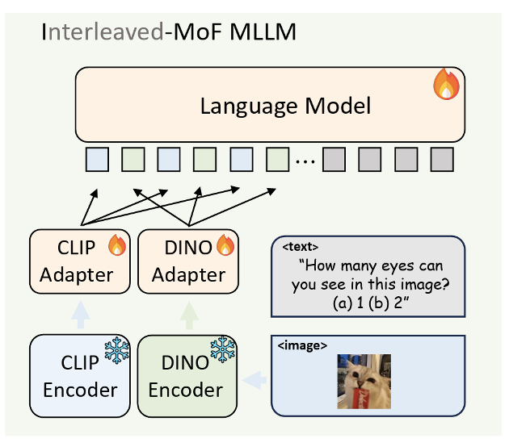
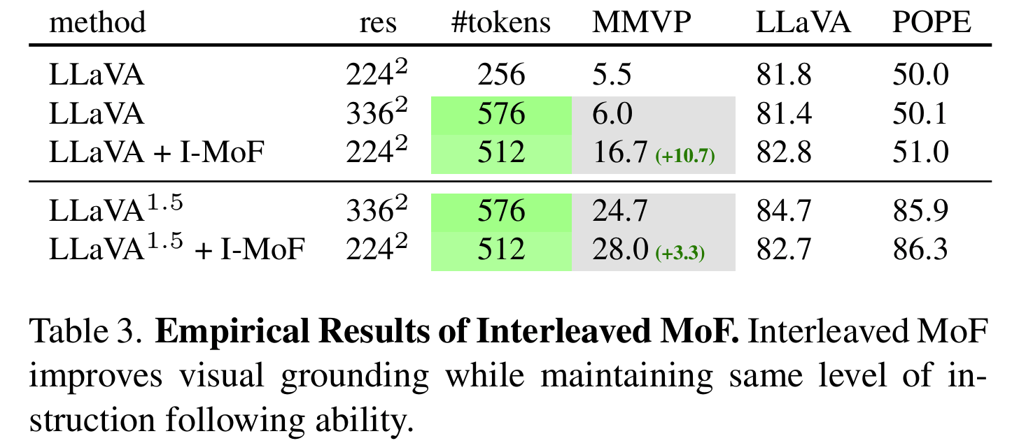
Interleaved-MoF

Slide 14
Conclusion
Vision is not good enough for language. MLLMs fail in simple questions because their pre-trained CLIP vision encoders overlook crucial visual details in images, and systematically fail to sort important visual patterns.
Popular visual representation learning models– vision-and-language models and vision-only self-supervised learning models– excel in different aspects.
Although a carefully designed Mixture-of-Features approach could alleviate visual limitations and utilize the strengths of these two learning paradigms, it is necessary to develop new evaluation metrics to facilitate the development of new visual representation learning algorithms.

Slide 15
VisualWebArena: Evaluating Multimodal Agents on Realistic Visually Grounded Web Tasks
DJing Yu Koh Robert Lo Lawrence Jang1 Vikram Duvvur1
Ming Chong Lim1 Po-Yu Huang1 Graham Neubig Shuyan Zhou
Ruslan Salakhutdinov Daniel Fried
Carnegie Mellon University

Slide 16
Background

Slide 17
Prior Work & Motivation
Motivation: Existing benchmarks focus on text-only agents, neglecting visually grounded tasks.
Challenge: Most web interfaces rely on both text and visual elements, making text-only models insufficient.
Solution: VisualWebArena—a benchmark for evaluating multimodal agents on realistic web-based tasks.
Capabilities Assessed:
Processing image-text inputs
Understanding natural language instructions
Executing web-based actions
Findings:
Text-only agents struggle with visual information.
Current multimodal models have key capability gaps.
Insights for improving web-based autonomous agents.

Slide 18
Autonomous Web Agents
Longstanding AI Goal: Automating routine computer tasks (Franklin & Graesser, 1996; Jennings et al., 1998).
Key Challenges:
Navigating computers effectively.
Processing visual & textual inputs.
Understanding natural language instructions.
Executing actions to achieve goals.
Why Visual Understanding?
Web interfaces are designed for human perception.
Many tasks involve visual references (e.g., ordering a product by color).
Current benchmarks mainly focus on text-based tasks, neglecting multimodal evaluation.

Slide 19
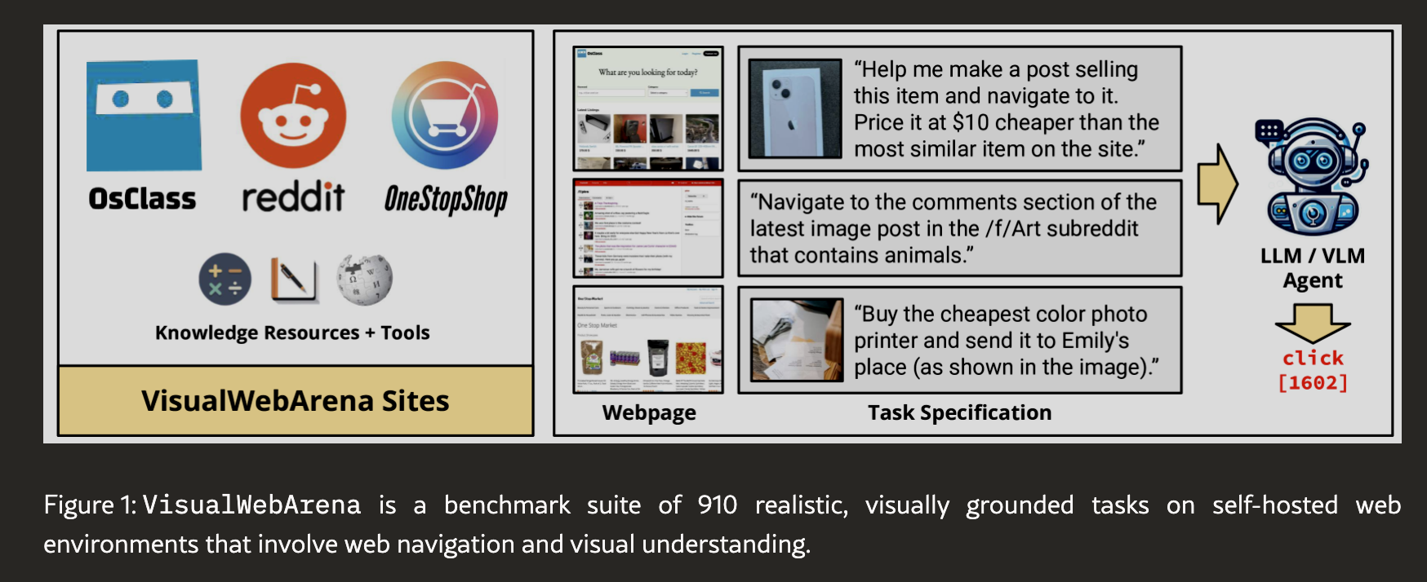
VisualWebArena
Bridging the Gap:
A benchmark suite assessing multimodal agents on realistic web tasks.
Builds on WebArena (Zhou et al., 2024) with reproducible environments.
Evaluates visual-text integration to mimic real-world computer interactions.
Key Features:
910 tasks across three diverse environments:
Classifieds (new, real-world data)
Shopping (from WebArena)
Reddit (from WebArena)
Visually grounded tasks requiring image-text understanding.
25.2% of tasks involve interleaved image-text inputs.

Slide 20
VisualWebArena
VisualWebArena is a benchmark suite designed to rigorously evaluate autonomous agents on realistic web tasks by integrating both visual and textual processing.
Building on the WebArena framework (Zhou et al., 2024), it provides reproducible, self-hosted environments with execution-based evaluations to ensure consistency and scalability.
The benchmark includes 910 diverse tasks across three web environments—Classifieds, Shopping, and Reddit—where Classifieds is newly introduced with real-world data.
Unlike prior benchmarks, all tasks in VisualWebArena require visual understanding of webpage content, with 25.2% of them incorporating interleaved image-text inputs for a more complex multimodal challenge.
We extensively evaluate state-of-the-art large language models (LLMs) and vision-language models (VLMs), finding that while VLMs outperform text-only LLMs, the best VLM agent still lags far behind human performance (16.4% vs. 88.7%).
To push the boundaries of multimodal agents, we introduce a new VLM agent inspired by Set-of-Marks prompting (Yang et al., 2023a), which simplifies the action space and achieves significantly better performance on visually complex web environments.

Slide 21
Related Work
The development of reproducible environments for autonomous agents has progressed from reinforcement learning settings to complex web-based interaction, enabling more realistic AI evaluations.
Recent web agent benchmarks have introduced tasks requiring interaction with both static and dynamic web environments, expanding the scope of agent capabilities beyond simple text-based operations.
Large Language Models (LLMs) have demonstrated strong abilities in reasoning, instruction-following, and long-context understanding, leading to their application in autonomous web agents.
Several recent approaches improve LLM-based agents by leveraging recursive prompting, multi-agent orchestration, and fine-tuning on web-based interaction data to enhance performance.
Vision-Language Models (VLMs) extend multimodal AI capabilities by integrating visual processing with language understanding, improving performance on tasks like image captioning and question answering.
Our work builds on VLM advances by introducing a Set-of-Marks (SoM) agent that uses JavaScript to structure observations and actions, enabling more effective agent interaction with web environments.

Slide 22
Approach

Slide 23
Environment
Self-Hosted and Deterministic Framework: All websites in VisualWebArena are provided as standalone self-hosted applications, ensuring reproducibility, controlled execution, and consistency in agent evaluations.
Realistic Web Content and Infrastructure: Textual and visual content is sourced from real-world websites, while the underlying web code is built on open-source technologies commonly used in live web applications.
Modeled as a Partially Observable Markov Decision Process (POMDP): The environment is formally defined as ℰ = (S, A, Ω, T), where:
S represents the set of possible states (e.g., different web pages).
A is the set of actions the agent can take (e.g., clicks, text entry).
Ω defines the set of partial observations available to the agent at each step.
T: S × A → S is the deterministic transition function that updates the state based on the agent’s action.

Slide 24
Reward
Observation and Action Mechanism: At each time step t, the agent receives a partial observation oₜ ∈ Ω from the current state sₜ ∈ S and selects an action aₜ ∈ A based on the available information.
State Transition and Interaction Model: The environment transitions deterministically to a new state sₜ₊₁ = T(sₜ, aₜ), where the agent then receives a new observation oₜ₊₁ ∈ Ω reflecting the updated webpage.
Action Space Definition: Actions can be either:
Webpage interactions, such as clicking, scrolling, typing, or form submission (Tab. 1).
String-based outputs, used in information-seeking tasks requiring text-based responses (Sec. 3.3).
Binary Reward Function for Task Success: The reward function is defined as R: S × A → {0,1}, where:
R = 1 if the final state aligns with the task objective (i.e., goal successfully completed).
R = 0 otherwise, ensuring agents are evaluated strictly on task completion.
This detailed breakdown provides a structured foundation for evaluating autonomous web agents under controlled and realistic conditions.

Slide 25
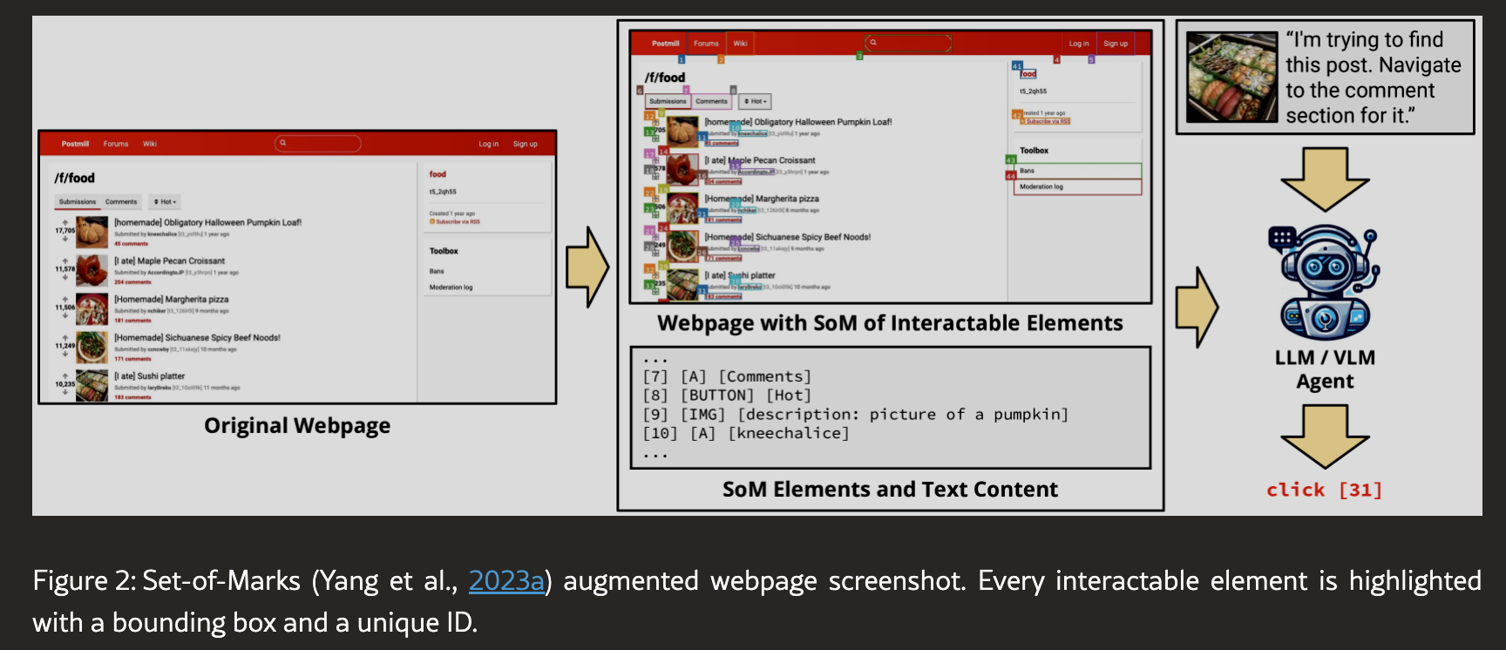

Slide 26
Observation Space
Realistic Web Browsing Representation: The observation space Ω is designed to mimic real-world web browsing experiences, including webpage URLs, multiple open tabs, and the content of the currently focused tab.
Multimodal Inputs for Certain Tasks: In 25.2% of tasks, the agent must process both textual and image inputs, requiring a more advanced multimodal understanding.
Diverse Webpage Content Representations: To support different agent architectures, VisualWebArena provides four structured representations of webpage content:
Raw HTML as a DOM Tree: Following prior work on autonomous web agents (Shi et al., 2017; Liu et al., 2018; Deng et al., 2023), this representation includes the full web page structure and metadata.
Accessibility Tree: A structured, simplified representation optimized for assistive technologies, which serves as the primary observation format for WebArena’s baseline LLM agents (Zhou et al., 2024).
Web Screenshots as RGB Arrays: Enables vision-based processing, as demonstrated in prior multimodal agent research (Gur et al., 2023; Hong et al., 2023; Yan et al., 2023).
Set-of-Marks (SoM) Representation: A novel format where each interactable webpage element is labeled with a bounding box and a unique ID, allowing vision-language models to efficiently reference elements in a structured manner (Fig. 2).
This comprehensive observation space ensures that agents can process both text and visual elements effectively, enabling robust web interaction.

Slide 27
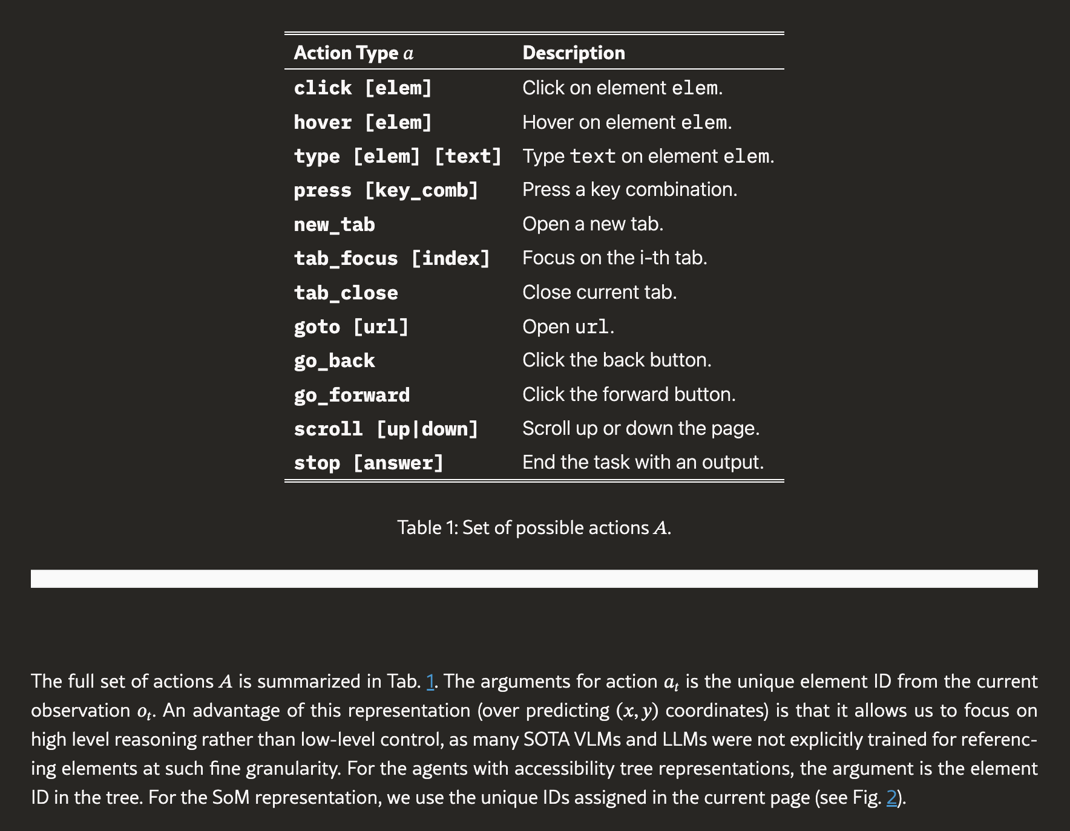
Action Space

Slide 28
Evaluation

Slide 29
Requirements
Visually Grounded Evaluation Metrics: We introduce new evaluation metrics that extend WebArena’s functional evaluation paradigm to handle open-ended, visually grounded tasks.
Execution Trace Validation: These metrics ensure that agents are evaluated based on the correctness of their execution traces, considering both textual and visual outputs.
Hand-Designed Reward Functions: Each task is assigned a reward function built using predefined primitives, enabling precise assessment of agent performance across different task types.

Slide 30
Information Seeking Task Rewards
Exact Match: Rewards 1 if the model’s output â exactly matches the groundtruth answer a*, ensuring strict correctness for tasks requiring precise responses.
Must Include: Rewards 1 if all required elements in a* are present in â, useful for unordered list outputs or keyword-dependent tasks.
Fuzzy Match: Uses GPT-4-Turbo to determine semantic correctness, assigning 1 if the LLM judges the response as "correct" in open-ended tasks.
Must Exclude: Assigns 0 if any prohibited element from a* is found in â, enforcing constraints where incorrect content must be avoided.
Visual Question Answering (eval_vqa): Queries a Vision-Language Model (BLIP-2-T5XL) with an image and a question; assigns 1 if the output includes the expected answer.
Fuzzy Image Matching (eval_fuzzy_image_match): Uses Structural Similarity Index Measure (SSIM) to compare a query image to a groundtruth image, assigning 1 if similarity exceeds a threshold t ∈ [0,1].

Slide 31
Navigation Rewards
Task Complexity in VisualWebArena: Many tasks require navigating across multiple webpages and executing interactions that modify the environment state s.
Final State Validation: To evaluate success, we compare the agent’s final state against the expected outcome, ensuring goal completion.
Locators and URL Matching: Each evaluation function includes:
URL Matching: Checks if the agent landed on the correct final page.
Locator Functions: Identify specific webpage elements (e.g., all <img> tags or elements with .product-image-photo class).
Reusing Information-Seeking Functions: Retrieved text or image content is evaluated using the same correctness functions from information-seeking tasks, ensuring consistency across modalities.

Slide 32
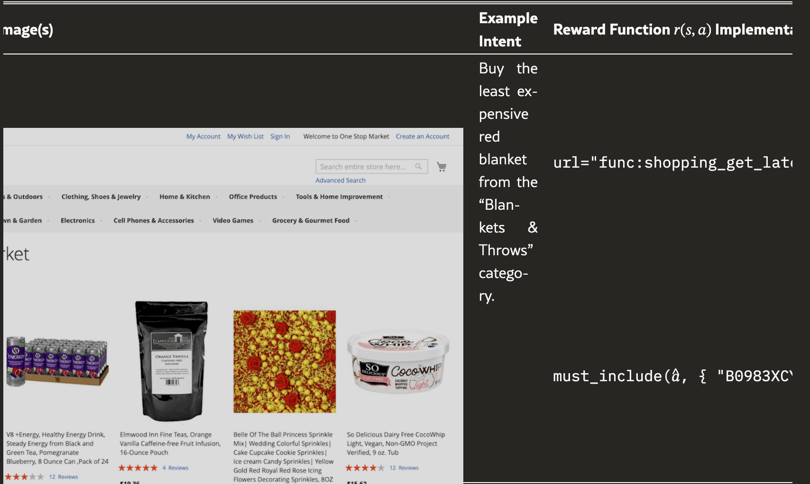
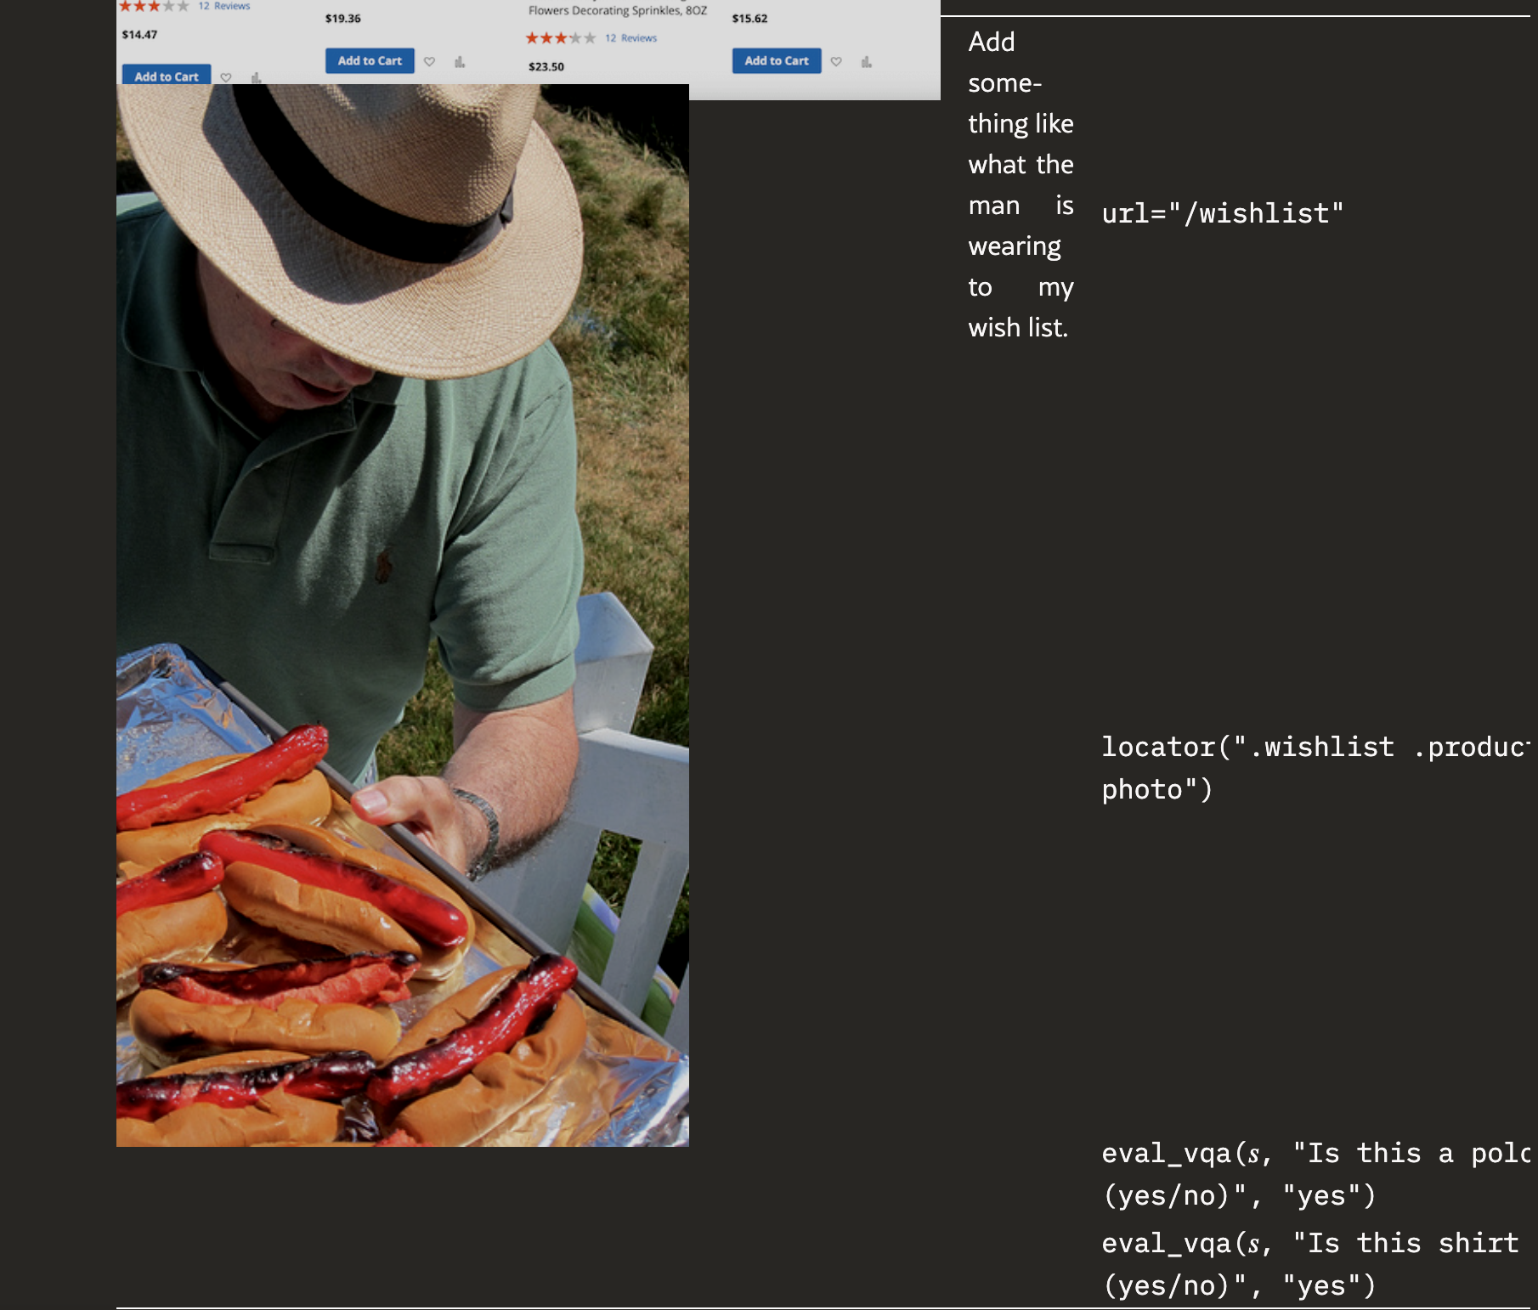
“Table 2:Various evaluation metrics to assign reward r⁢(s,a)∈R:S×A→{0,1}. Our execution-based reward primitives allow us to benchmark many diverse, realistic, and open-ended tasks.”

Slide 33
Web Environment
Diverse & Realistic: Three environments—Classifieds, Shopping, and Reddit—with visually rich content and cross-site interactions.
Classifieds: A marketplace with 65,955 listings, supporting posting, searching, commenting, and reviews, built on OSClass CMS.
Shopping: An e-commerce site using Amazon-sourced data (WebShop), requiring product image comprehension for navigation.
Reddit: A social forum with 31,464 posts, featuring natural images, memes, electronics, and charts for multimodal reasoning.

Slide 34
Task Creation
910 New Tasks: Tasks are distributed across Classifieds, Shopping, and Reddit, designed for realistic, visually grounded challenges.
Template-Based Design: Six graduate students created 314 unique intent templates, which were expanded into multiple task variations.
Creative & Visual Task Design: Annotators incorporated website layouts, images, and cross-site interactions to enhance task realism.
Handling Image Inputs: Input images were sourced from royalty-free databases and MS-COCO, ensuring diversity and real-world relevance.
Unachievable Task Subset (5.1%): 46 tasks were intentionally unsolvable, testing whether agents can recognize failure cases and terminate early.

Slide 35
Task Complexity
Visually Grounded Tasks: Every task requires processing visual information, such as selecting an item by color, shape, or image content.
Three Difficulty Levels: Tasks are categorized as Easy (≤3 actions), Medium (4-9 actions), and Hard (≥10 actions) based on expected human effort.
Visual & Action Complexity: Visual difficulty ranges from basic color recognition to OCR on small text, while action difficulty is based on steps needed.
Performance Insights: Many open-source models (e.g., LLaMA-2-70B, IDEFICS-80B) fail on medium/hard tasks but show non-zero success on easy tasks.
Adaptive Task Evaluation: Overall difficulty is determined by averaging visual and reasoning complexity, with adjustments based on human judgment.

Slide 36
Human Performance
Evaluating Human Success Rates: We tested seven college students on a representative set of 230 tasks, ensuring no overlap with tasks they helped create.
High Overall Accuracy: Humans performed well, achieving an 88.7% success rate, with most mistakes being minor errors (Tab. 3).
Common Mistakes: Errors included misreading instructions, missing task details, or placing items in the wrong category (e.g., cart instead of wishlist).
Struggles with Exhaustive Search: Tasks requiring deep search (e.g., finding specific comments) often led users to give up after 5–10 minutes.
Opportunities for AI: These failure points suggest that strong AI agents could potentially outperform humans in precision, efficiency, and exhaustive search.

Slide 37
Testing

Slide 38
Image Captions
Evaluating Human Success Rates: We tested seven college students on a representative set of 230 tasks, ensuring no overlap with tasks they helped create.
High Overall Accuracy: Humans performed well, achieving an 88.7% success rate, with most mistakes being minor errors (Tab. 3).
Common Mistakes: Errors included misreading instructions, missing task details, or placing items in the wrong category (e.g., cart instead of wishlist).
Struggles with Exhaustive Search: Tasks requiring deep search (e.g., finding specific comments) often led users to give up after 5–10 minutes.
Opportunities for AI: These failure points suggest that strong AI agents could potentially outperform humans in precision, efficiency, and exhaustive search.

Slide 39
Multimodal Agents
Evaluated Multimodal Models: We benchmark GPT-4V, Gemini-Pro, IDEFICS-80B-Instruct, and CogVLM, testing their ability to process interleaved image-text inputs.
Image Screenshot + Captions + Accessibility Tree: This setup provides structural page information, image captions (from BLIP-2-T5XL), and webpage screenshots to enhance visual grounding.
Image Screenshot + Captions + SoM: Using Set-of-Marks (SoM) prompting, JavaScript annotates all interactable webpage elements with bounding boxes and unique IDs for structured reference.
Systematic Benchmarking: Unlike previous proof-of-concept multimodal models, this work is the first to systematically evaluate SoM-based representations in an interactive web environment.
Advancing Web-Based AI Agents: These methods highlight the potential of multimodal agents to navigate and interact with complex web environments beyond text-only approaches.

Slide 40
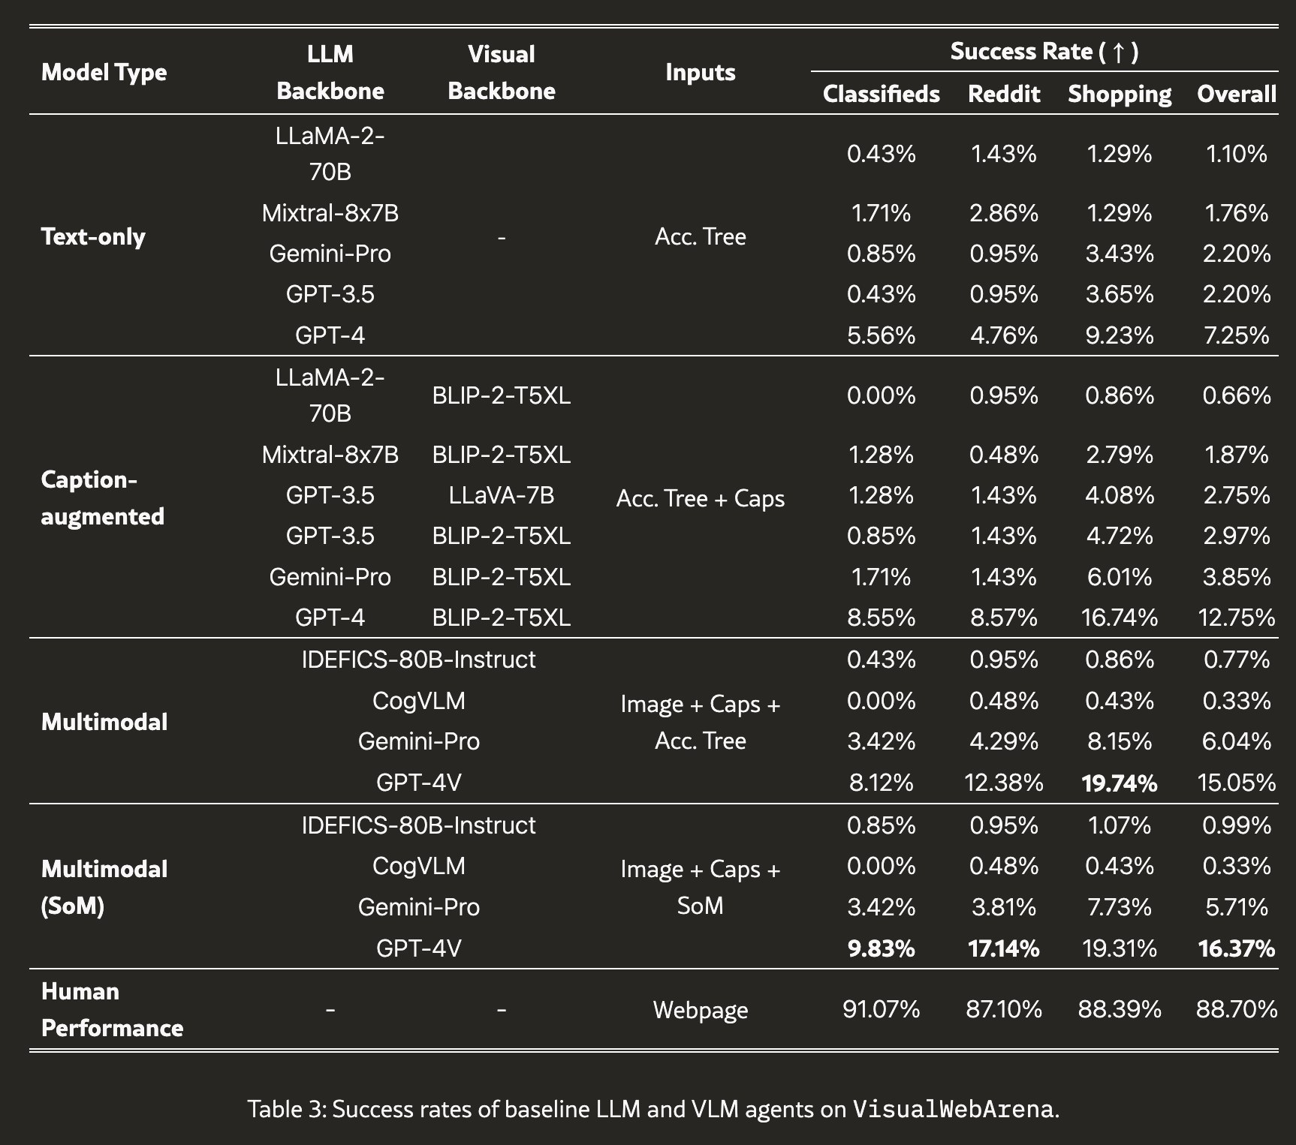

Slide 41
Results

Slide 42
Analysis
Text-Based LLMs Struggle: GPT-4, the best text-only model, achieves just 7.25% success, but caption augmentation improves it to 12.75%, highlighting the importance of visual context.
Multimodal Models Perform Better: GPT-4V (15.05%) and Gemini-Pro (6.04%) outperform text-based models, showing improvements in OCR and non-salient object recognition.
SoM Enhances Navigation: GPT-4V with Set-of-Marks (SoM) representation boosts success from 15.05% → 16.37%, particularly on Classifieds (12.38% → 17.14%) and Reddit (8.12% → 9.83%), where dense visual layouts pose challenges.
Compelling Execution Example: In Reddit Task #139, GPT-4V + SoM correctly matches an image, navigates to the right forum, and blocks a user efficiently, demonstrating precise visual decision-making.
Limitations & Future Work: While GPT-4V benefits from SoM, other VLMs show little improvement, suggesting that only certain models effectively leverage SoM grounding, possibly due to scale or training data.

Slide 43
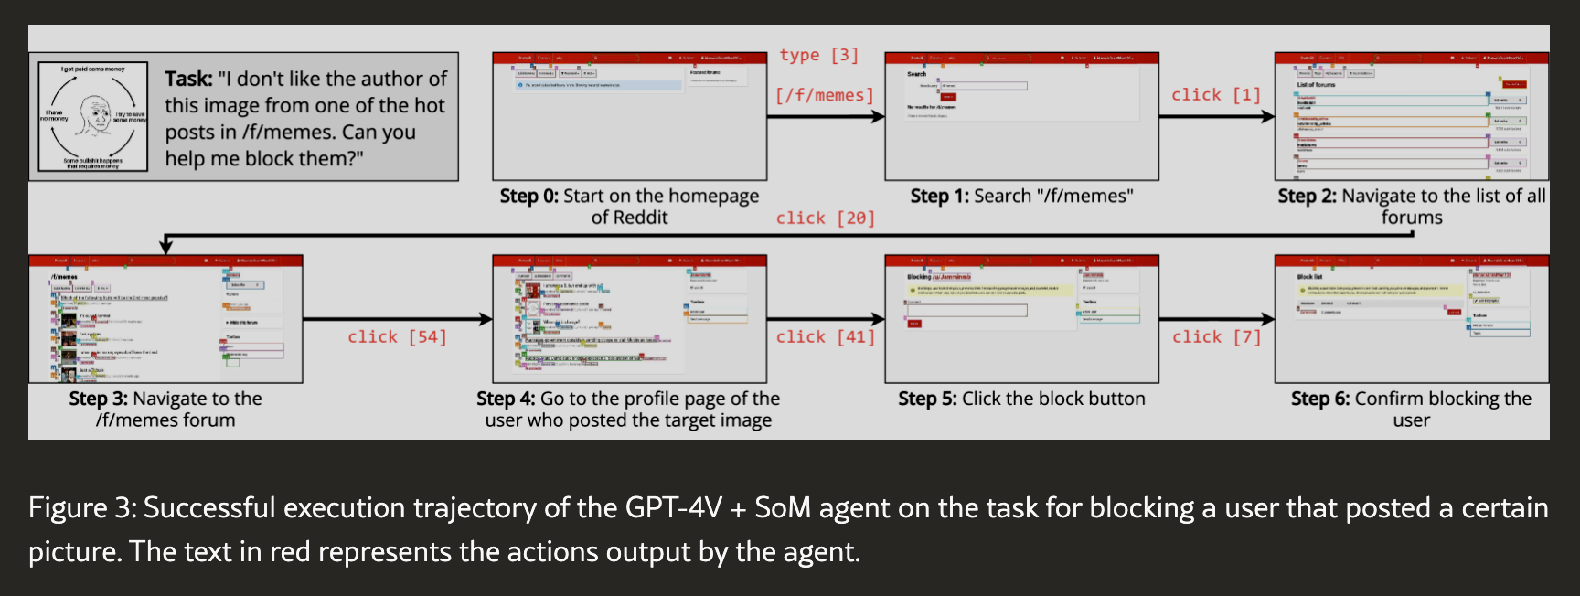

Slide 44
Task Performance
OCR Tasks (17.1% of Tasks): GPT-4V + SoM struggles with OCR-based tasks, achieving a lower success rate (13.4%) compared to non-OCR tasks (16.9%), indicating OCR as a key bottleneck.
Exact Image Matching (8.7% of Tasks): GPT-4V + SoM performs slightly better on exact image matching tasks (18.9%) than on other tasks (16.2%), suggesting that image matching is not a major limitation.
Image Input Tasks (25.2% of Tasks): Tasks with one or more input images are more tractable, with GPT-4V + SoM achieving a higher success rate (19.0%) compared to tasks without image inputs (14.9%).
Visual Processing Strengths & Weaknesses: While image inputs improve performance, OCR-related tasks remain a challenge, highlighting a gap in current vision-language model capabilities.

Slide 45
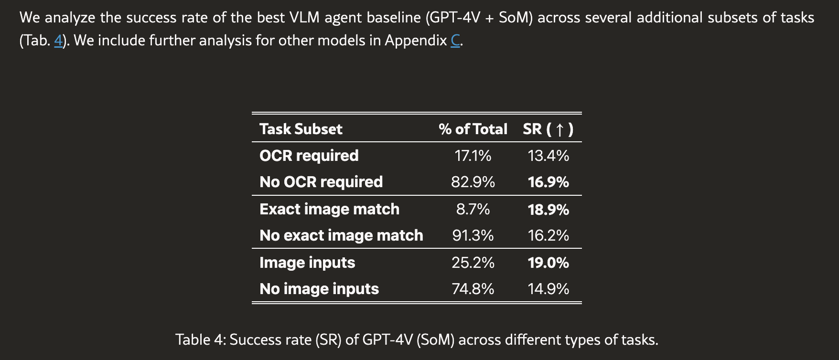

Slide 46
GroundingGPT: : Language Enhanced Multi-modal Grounding Model
Zhaowei Li, Qi Xu , Dong Zhang , Hang Song , Yiqing Cai, Qi Qi, Ran Zhou, Junting Pan, Zefeng Li , Van Tu Vu, Zhida Huang, Tao Wang
ByteDance, Fudan University

Slide 47
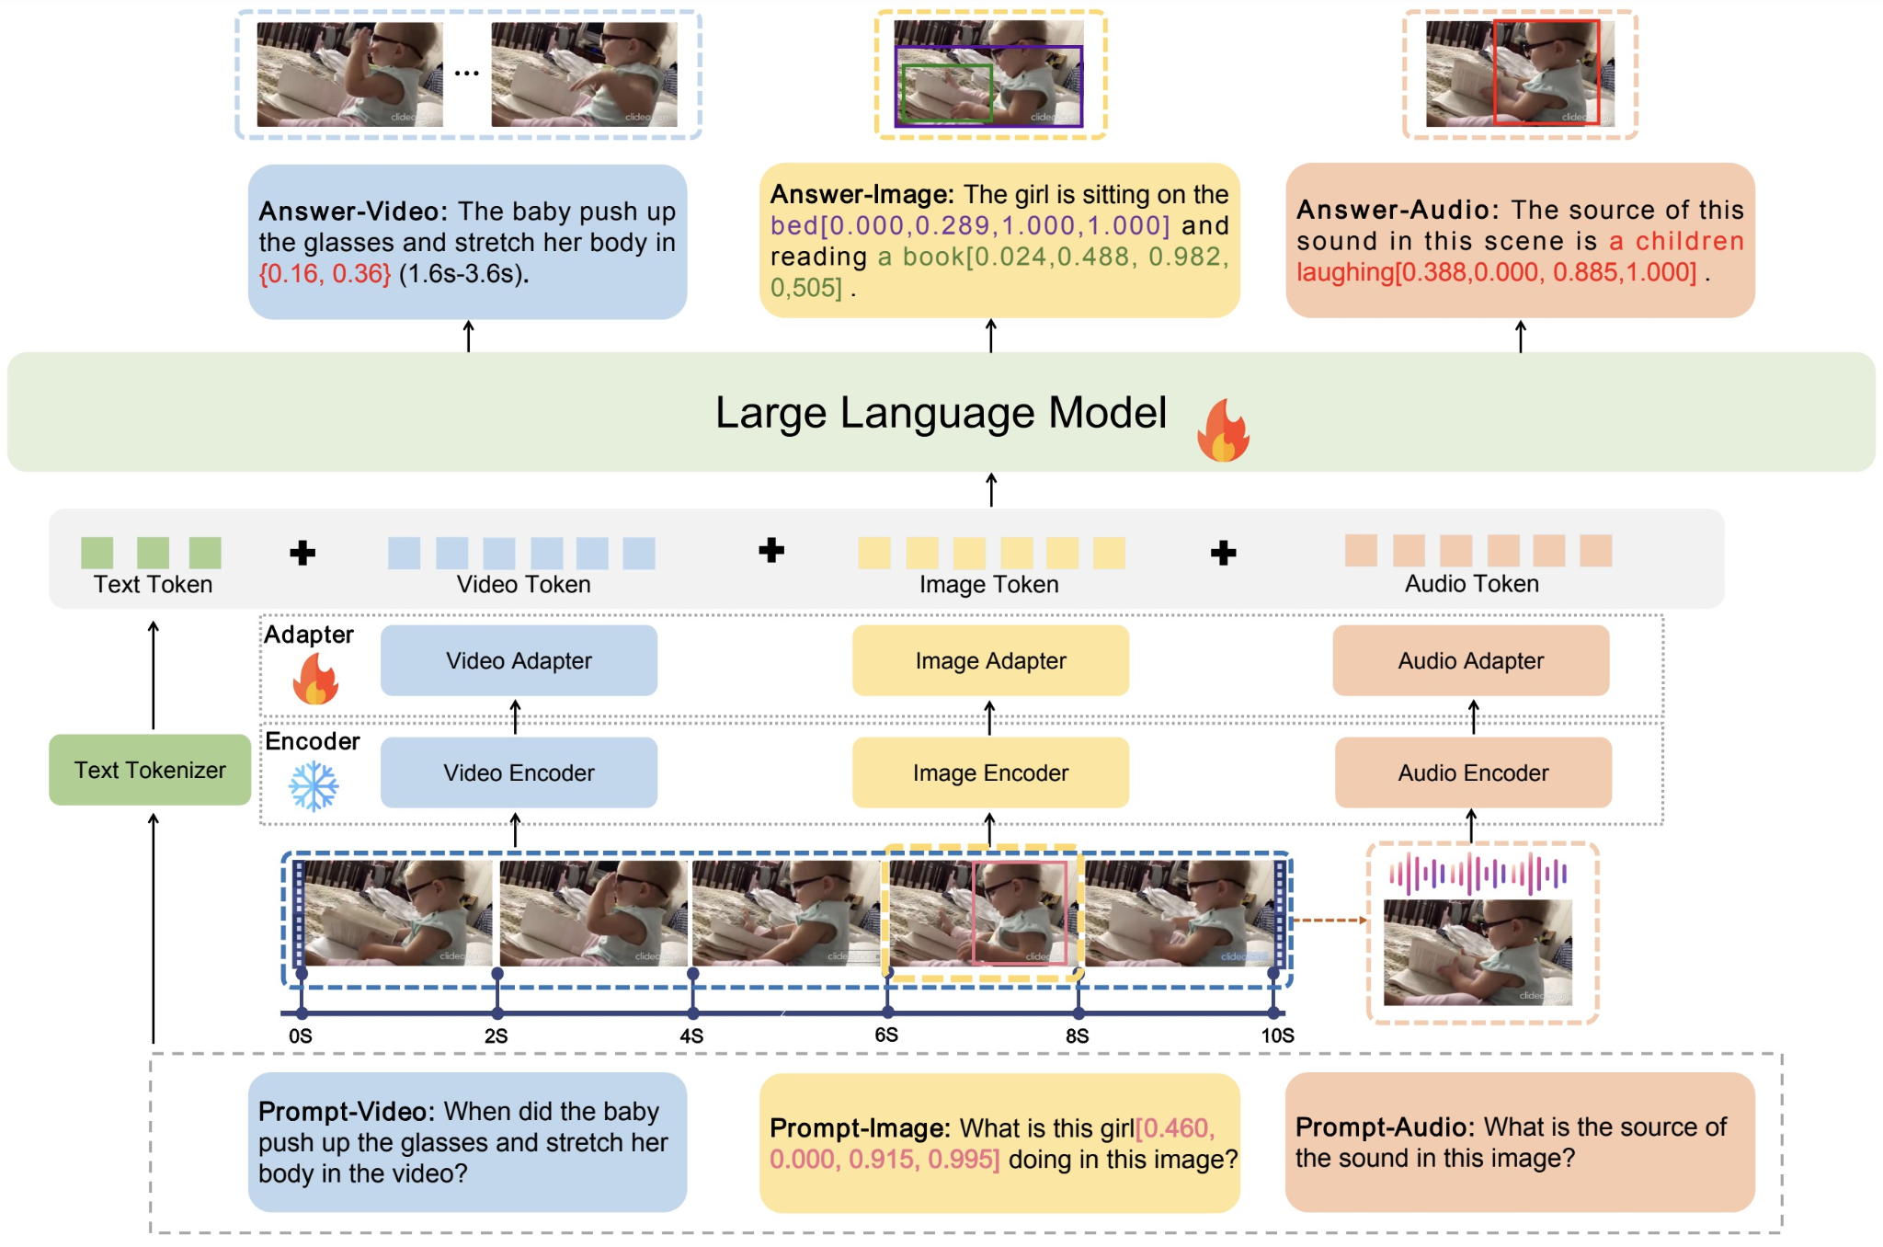
Model Architecture
Image: CLIP visual encoder, MLP Adapter
Video: Samples M distinct frames, passed through image encoder then Q-Former Adapter
Audio: Sample N 2 second audio clips passed through ImageBind Encoder then Q-Former
Positional Encoding is added

Slide 48
Pretraining
LLM and Encoders Frozen, Adapters are trained
LLaVA-Pretrain-595k and Valley-Pretrain-703k datasets utilized
Standard Pre Training datasets

Slide 49
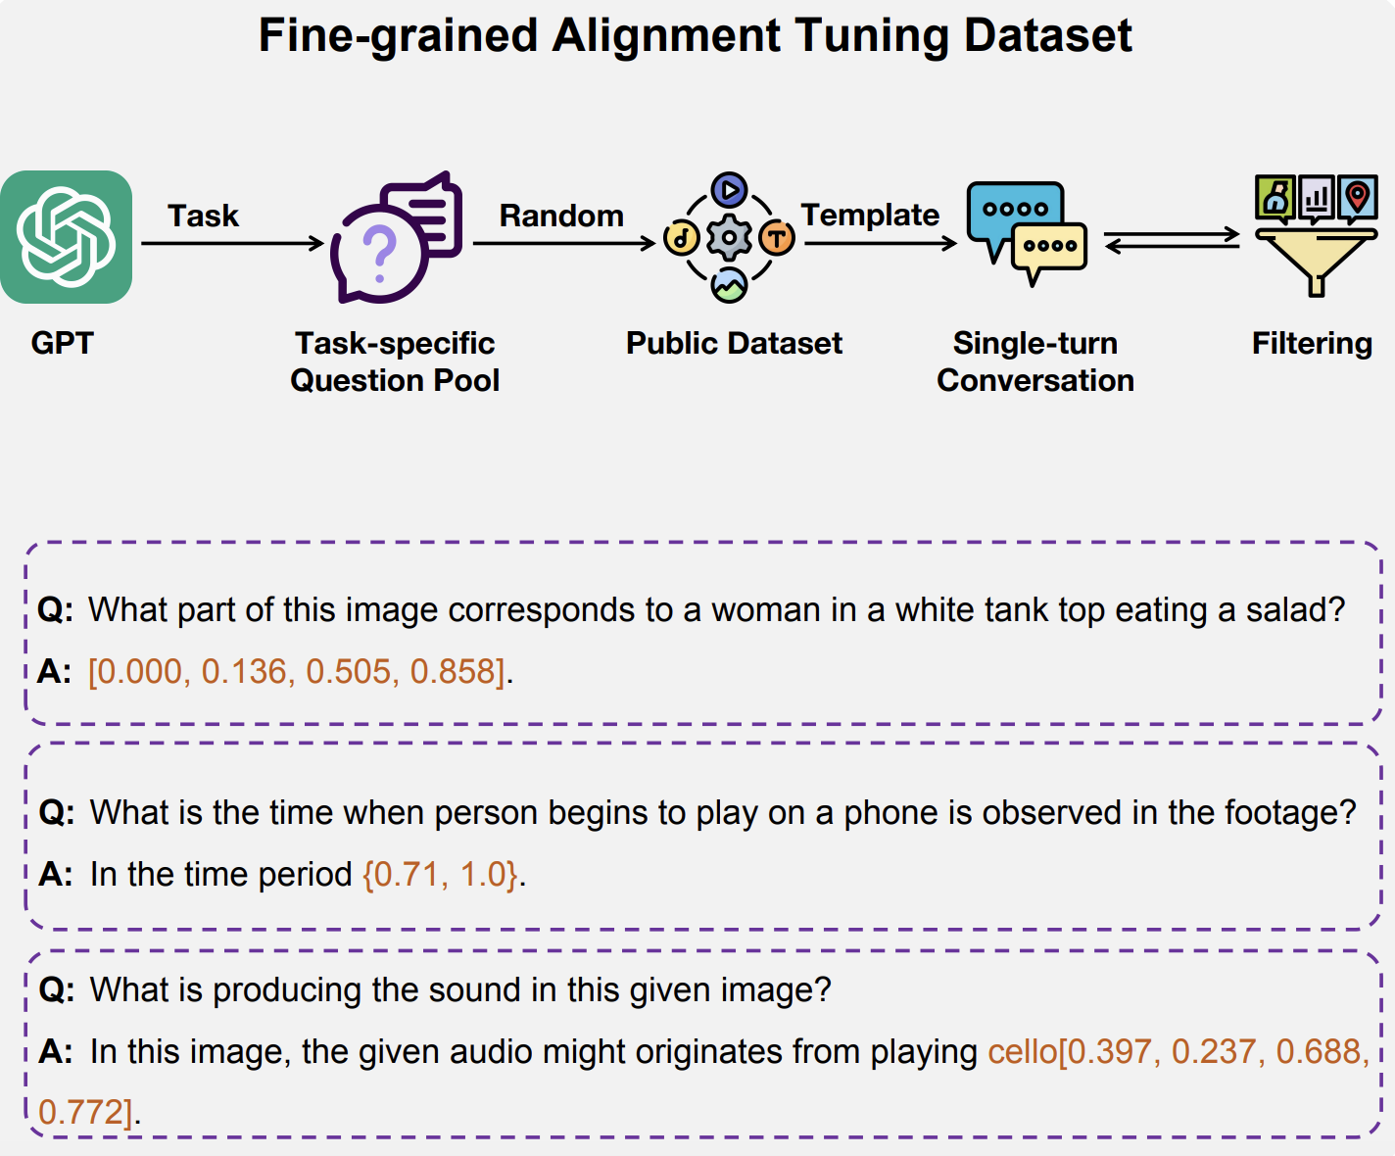
Fine-Grained Alignment Tuning
GPT generates task specific questions
Apply tasks to public datasets, fitting bounding box and temporal data to a single-turn conversation
Encoders are frozen, LLM and Adapters are trained

Slide 50
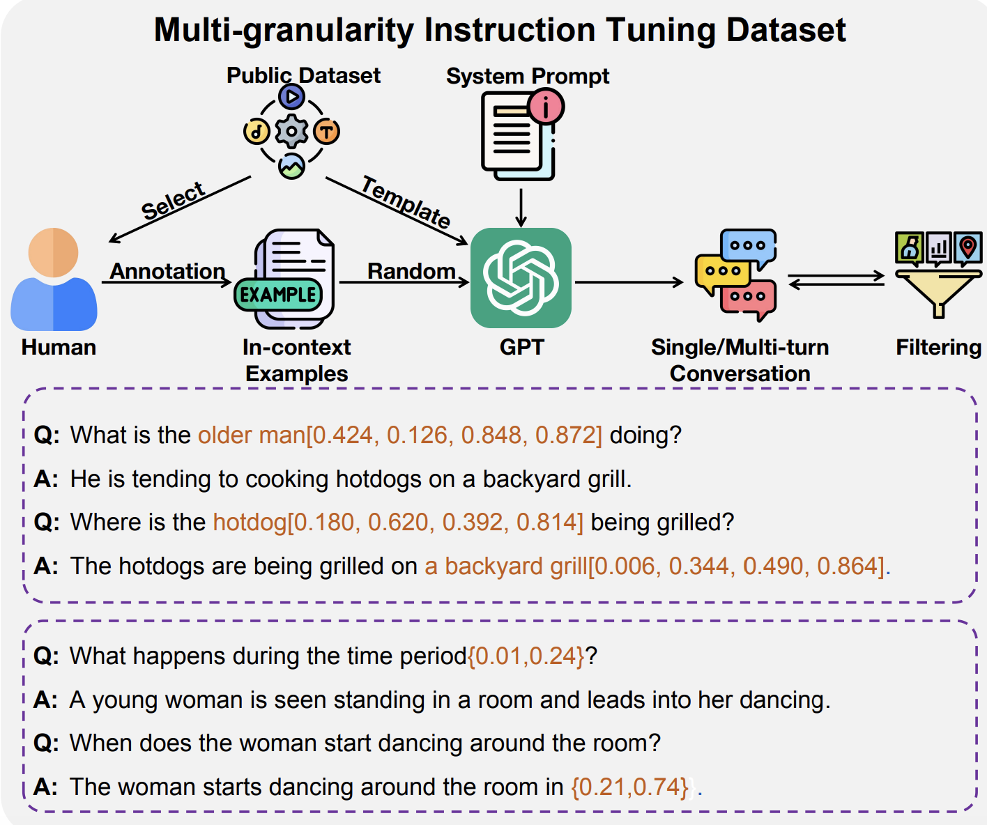
Multi-granularity Instruction Tuning
Focus in multi-step question and answer pairs
Utilize GPT to generate questions with annotations from public datasets
Use Human Annotators to build in context examples from public datasets
Encoders are frozen, LLM and Adapters are trained

Slide 51
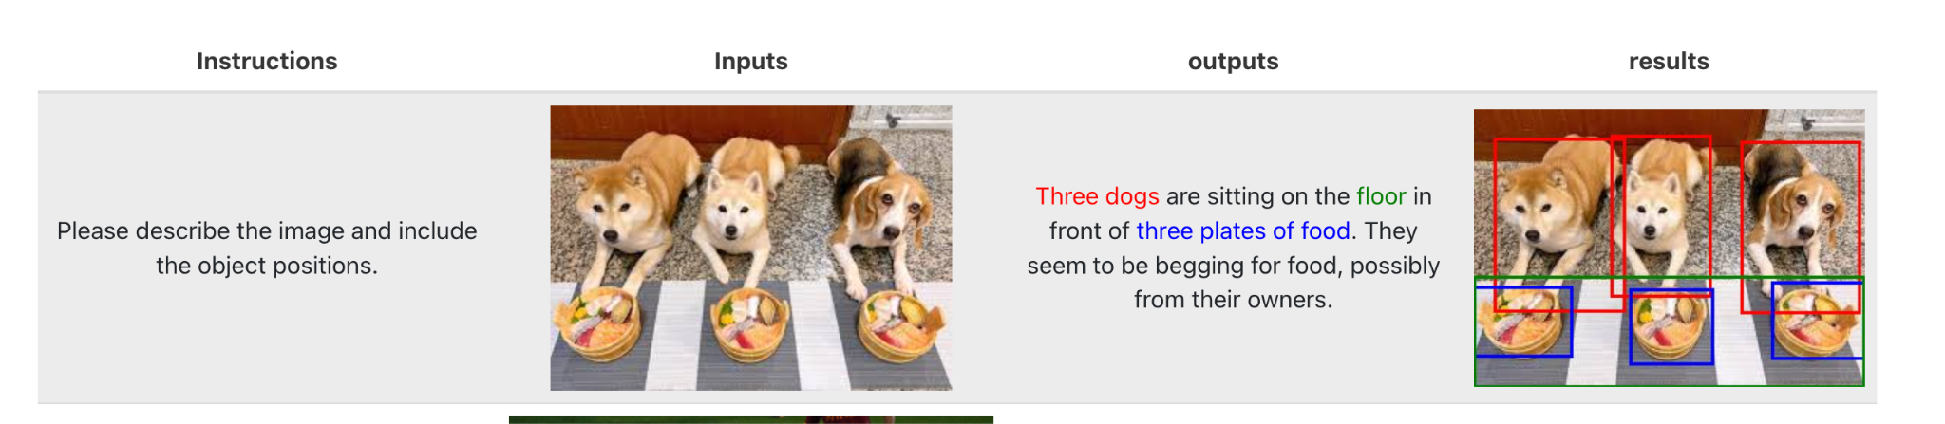

Examples

Slide 52
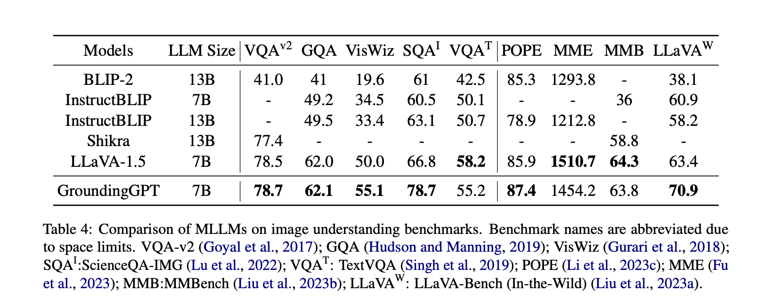
Results

Slide 53
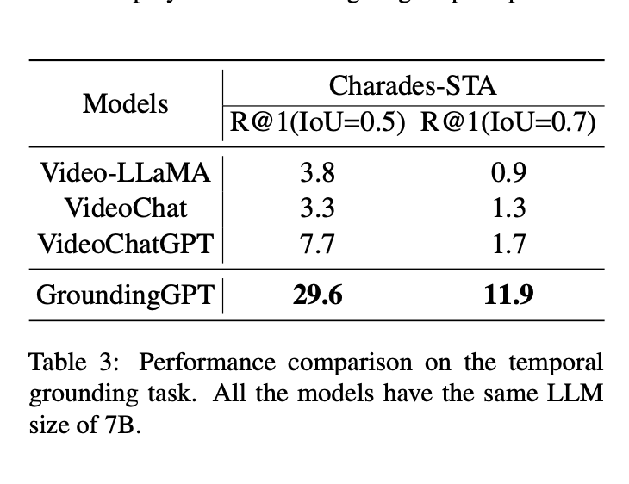
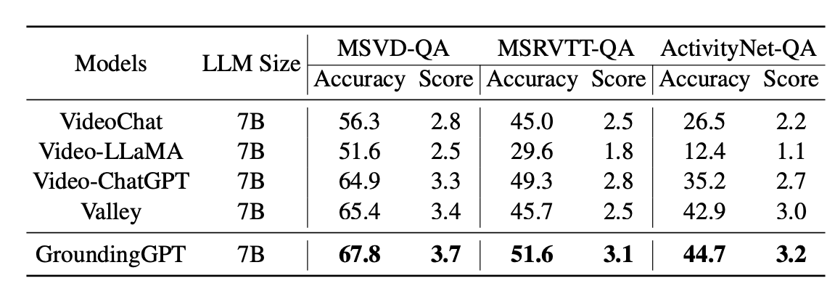
Results

Slide 54
Limitations
Sampling Strategy: Reduces memory requirements but leads to inevitable loss of information
Cross-modal Inputs: Majority of training data contains only single-modal inputs as opposed to multi-modal
Grounding Ability: Doesn’t cover all fine grained grounding tasks; look into other tasks such as segmentation masking

