Slide 1
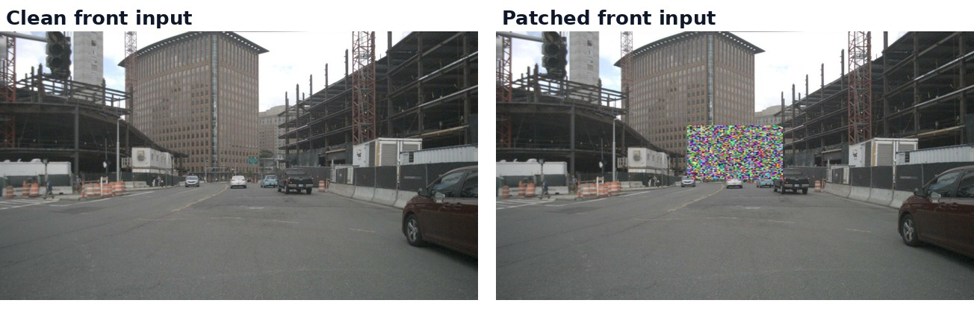
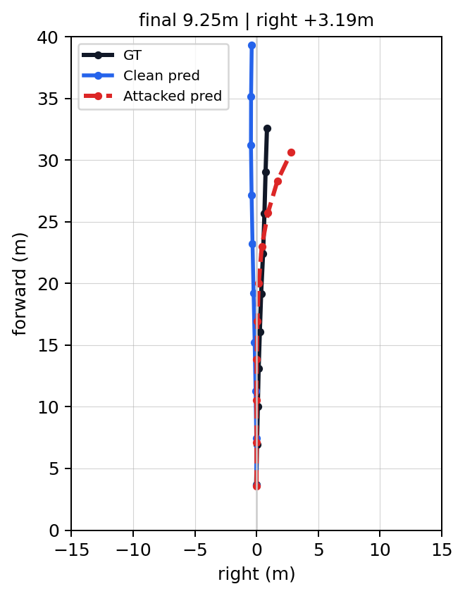
Case 1: strongest black-box patch effect
01bbf47b
p20 front-camera patch; final shift 9.25 m, right shift +3.19 m, mean shift 3.44 m.
Clean front input | Patched front input
GT / clean prediction / attacked prediction
Selected position = horizon_center; final shift 9.25 m, right shift +3.19 m.

Slide 2
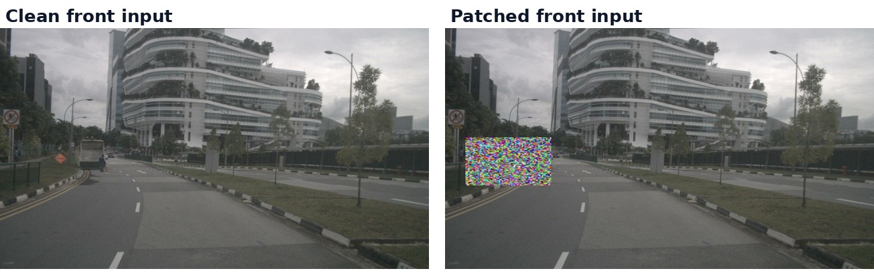
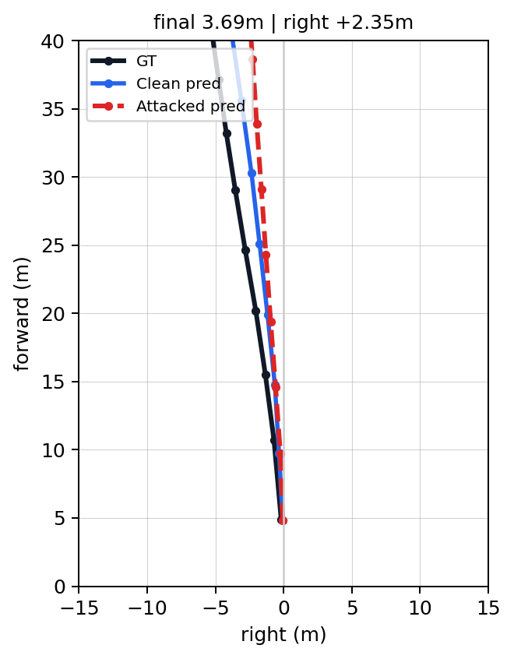
Case 2: scene-aware placement helps
01a7d01c
p20 front-camera patch; final shift 3.69 m, right shift +2.35 m, mean shift 1.47 m.
Clean front input | Patched front input
GT / clean prediction / attacked prediction
Selected position = scene_aware; final shift 3.69 m, right shift +2.35 m.

Slide 3
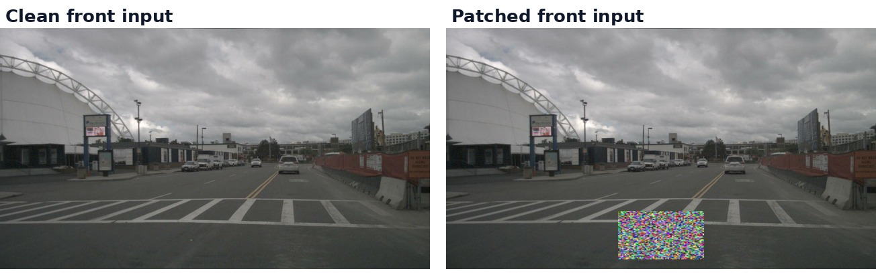
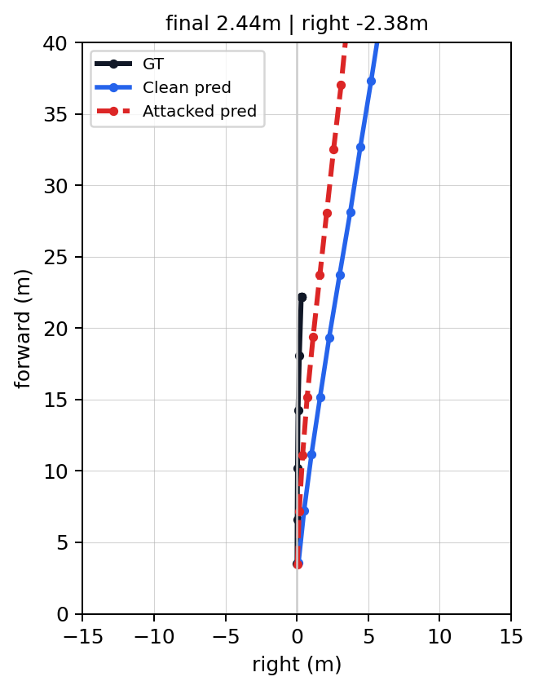
Case 3: AutoVLA black-box patch sample
0141260a
p20 front-camera patch; final shift 2.44 m, right shift -2.38 m, mean shift 1.26 m.
Clean front input | Patched front input
GT / clean prediction / attacked prediction
Selected position = bottom_center; final shift 2.44 m, left/opposite shift -2.38 m.

Slide 4
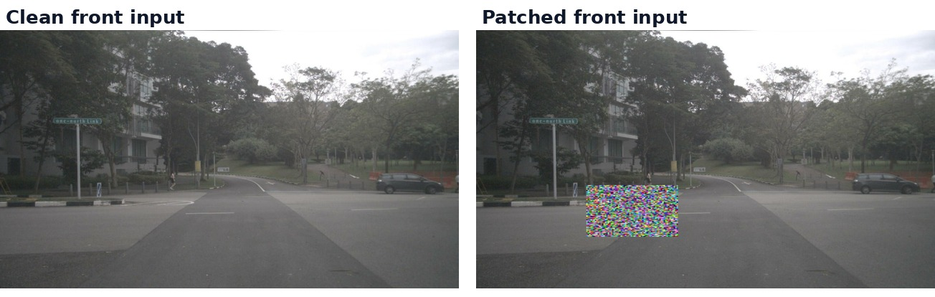
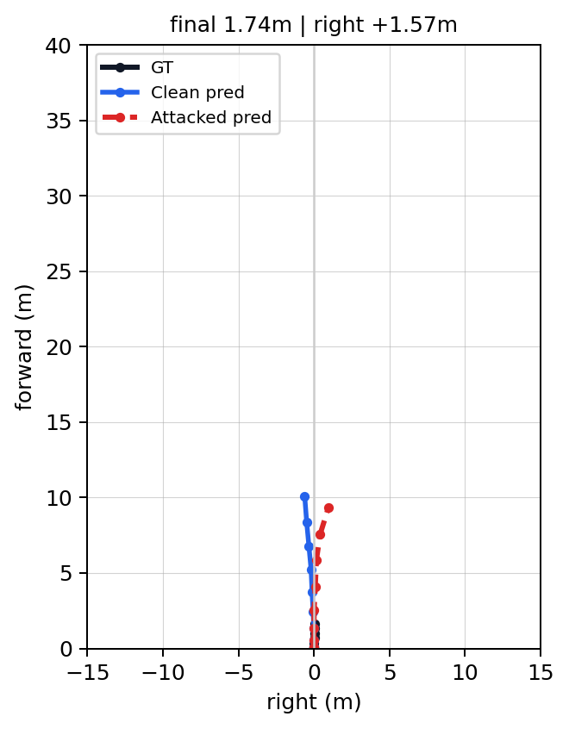
Case 4: AutoVLA black-box patch sample
000681a0
p20 front-camera patch; final shift 1.74 m, right shift +1.57 m, mean shift 0.88 m.
Clean front input | Patched front input
GT / clean prediction / attacked prediction
Selected position = road_left; final shift 1.74 m, right shift +1.57 m.

Slide 5
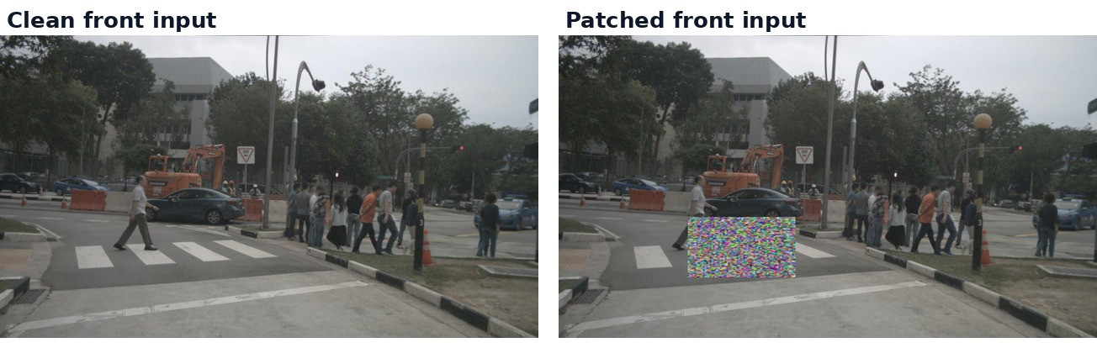
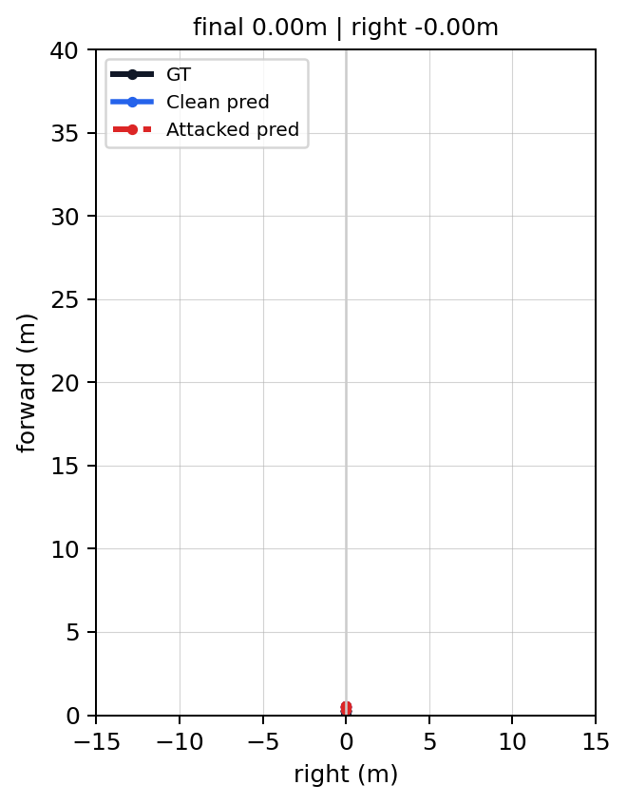
Case 5: AutoVLA black-box patch sample
012f334e
p20 front-camera patch; final shift 0.00 m, right shift -0.00 m, mean shift 0.00 m.
Clean front input | Patched front input
GT / clean prediction / attacked prediction
No decoded trajectory change in this sample; selected position = road_left.

