Slide 1


Module 2 – Conceptual modelling:
Basic structures

Slide 2

Describe and illustrate the ANSI/SPARC architecture, and relate the ER model to this
Understand the ER model as a conceptual modelling technique and develop ER models using the notation given in the set text
Describe the role of business rules in an organisation
Be aware of the flow, structure and state aspects of data

Slide 3

Define & describe the difference between:
  Entity types and entity instances
  Relationship types and relationship instances
  Attributes and values
Define and appropriately select:
  maximum & minimum cardinality
  Unique identifier
Note: concepts & definitions in these slides are derived from and complement the set text

Slide 4

Recall the problem discussed last week of file-based systems
Programs must know the location and structure of the data files in a FBS
Databases changed that – the DBMS “hid” the physical location/structure of the data
That’s because databases generally follow the ANSI/SPARC architecture

Slide 5
In 1978 the ANSI/SPARC committee published a document describing the three-schema architecture (or “three-level”)
Also known as the ANSI/SPARC architecture
Describes important separation of levels

Slide 6

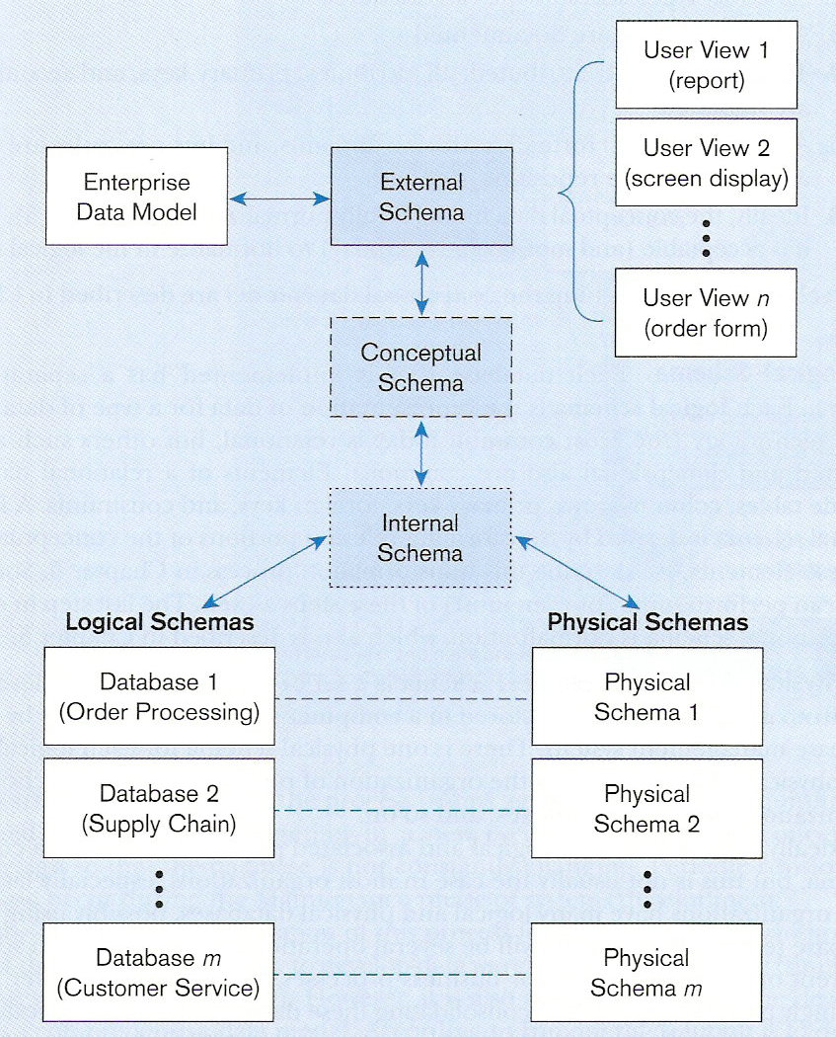
Different people have different views of the database…these are the external
The internal schema is the underlying design and implementation

Slide 7

Collection of detailed user views
Each user view is a logical description of some portion of data required by users to perform a task
Also called external level

Slide 8

Detailed logical specification of all data in the organisation/database
Each user view would be a subset of the conceptual schema
Represents the views of the data architect or data administrator
Also called conceptual level

Slide 9

Consists of Logical schema and Physical schema
Logical schema = representation of data for a specific DBMS (eg for a relational DB as opposed to an OODB)
Physical schema = how data is represented/stored in physical storage
Also called internal level

Slide 10

To design a database, we must first determine what data must be recorded for the business in question
Conceptual modelling is the process of conceiving, abstracting, naming & representing (usually as a diagram) the data that must be recorded
Notes:
Conceptual modelling is almost universally done in graphical form (i.e. as a diagram) but it’s actually quite possible to do conceptual modelling in different ways, such as using a mathematical language.

Slide 11







Examine existing processes
(what data needs to be
recorded?)
Develop
conceptual
model
Convert model
to logical
design
Implement
database
Do physical
design
Check DB design
for normalisation
Develop application
or web-based interface
(will involve SQL)
Test and
maintain...

Slide 12
There are many different forms of conceptual modelling:
  Entity-relationship modelling – very common, we will focus on this one
  UML – becoming more common, we will give you a brief overview so that you’re aware of it
  Other forms such as conceptual schema diagrams and semantic object modelling – rarely used, we won’t look at these.
Notes:
Each different form of conceptual modelling is like a different syntax. Entity-relationship modelling and UML are very similar, they basically have different symbols for much the same ideas. This is good – it means that once you are comfortable with ER modelling, you should be able to switch UML, semantic object modelling, or any of a number of other forms. Conceptual Schema Diagrams are quite different to ER models in that the underlying ideas are different, but this form is very uncommon and you need not worry about it.

Slide 13

The symbols used in an ER modelling are not yet standardised so -
  diagrams may appear somewhat different depending upon who created them
  The different ER syntaxes are similar, so you should be able to switch from one ER syntax to another once you’re familiar with
  We’ll follow the format shown in the set text

Slide 14

Entity-relationship modelling (ER modelling for short) is so-called because it models entities and relationships (and attributes).
For example, CQUni needs to record details of:
  Each student (an entity)
  Each course (another entity)
  Which students have enrolled in which courses (a relationship between students and courses)
  For each student, we would record such things as your ID, name, address, etc (these are attributes of students)

Slide 15


So if we were to draw an ER diagram for our students & courses entities and “enrols in” relationship at CQUni, it would look like this:
Notes:
Note that this example, like many others to come, is deliberately simplified. Some of the examples you will meet in this course will be deliberately simplified because a fully specified, flexible data model is simply WAAAY to complex for a lecture on introductory conceptual modelling. As your experience in conceptual modelling increases, you should be able to see some of the disadvantages inherent in some of these simplistic representations.
In the case of this particular model, you don’t actually enrol in a Course, you enrol in a Course offering – but we will ignore this distinction for the purposes of our current example.

Slide 16

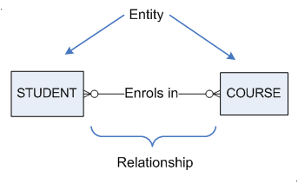

Slide 17

This ER model depicts the data that is recorded by CQU#, specifically:
  CQU keeps a list of all its students
  CQU keeps a list of all its courses
  CQU records which students enrol in which courses.
Notes:
# In reality, CQU records a very great deal more data than that which is shown in this ER model. But for the purposes of our introductory lecture, let’s assume that this is all that CQU is currently interested in.

Slide 18

Notice in the previous example that we have been only concerned with data that must be recorded. #
We do not model:
  Business processes or functions (“Monthly invoice statements are issued on the last day of the month”)
  Data flow (“Order details are sent to the dispatch office”)
  Forms or reports
  Individuals who might be responsible for certain tasks
Notes:
# As a consequence of this, conceptual modelling is often called data modelling. You need to be careful with this however, some people apply different meanings to each of these terms.
* Data modelling tends to be a challenging exercise for novices precisely because you have to model the data that is to be recorded, and yet users will almost invariably describe their business and systems in terms of business processes, data flow, data entry screens, forms, reports and individuals who are responsible for certain tasks. You must learn to listen to/read these descriptions and pick out what data is required to do that process, without getting too concerned about the process itself.

Slide 19
These things are useful because they tell us about the data that is needed, but we do not model them as part of database development.
For example:
  “Monthly invoice statements are issued on the last day of the month” – tells us that we almost certainly need to keep a list of invoices
  “Order details are sent to the dispatch office” – tells us that we need to keep a list of Orders and possibly also departments/offices
  Forms/ reports – tell us what data items the business records

Slide 20

ER diagrams model data structure – the static structure of data items and the relationships between them
Data flow diagrams (not covered in this course) model data flow – it shows what data moves from one process to another
State change diagrams (not covered in this course) model state changes – it shows possible events and the change in state that the events cause
There are other ways to slice & dice data but we model the data structure only!

Slide 21

So what exactly is an entity?
“An entity is a person, place, object, event or concept about which the organisation wishes to maintain data.” (McFadden, et al, 1999, p 89)

Slide 22

  Person: Employee, Student, Customer, Supplier
  Place: City, Province, State, Territory, Location
  Object: Vehicle, Building, Airplane, Part, Animal
  Event: Purchase, Sale, Registration, Game
  Concept: Account, Course, Work, Centre, Department

Slide 23

Note the difference between an Entity type and an Entity instance.
Student is an entity type; it describes students in general
A single student is an instance of student
Course is an entity type
COIS20026 is an instance of a course
COIS20024 is an instance of a course
Notes:
An entity type, such as Course, describes courses in general. That is, courses (in general) all have a unique course code, they all have a course name, and they all have a certain number of credit points. The actual code, name and credit points will vary according to each individual course instance.
Entity types have attributes (e.g. Course code, Course name, etc); Entity instances have values (e.g. COIS20024, Systems Management Overview)

Slide 24

CourseID: COIS20026
CourseName: Database Development & Mgt
Credit points: 8
CourseID: COIS20024
CourseName: Systems Development Overview
Credit points: 8

Slide 25

Note that entity types have attributes
Entity instances have values
For example, these are values
These are attributes
CourseID: COIS20026
CourseName: Database Development & Mgt
Credit points: 8

Slide 26
Note that we only model Entity Types; entity instances have no place in our models
When we say “entity”, we almost always mean “entity type”.

Slide 27

Entities are normally identified through user interviews, examining existing processes, looking at forms, etc.
Search for entities by:
  looking for nouns (but beware not all nouns become entities)
  finding objects/things that have many instances
  have descriptive/defining properties (attributes)
  Instances are uniquely identifiable

Slide 28
Another good technique for novices is to think: “What things would I need to keep a list of if I were running this business?”
For e.g., CQU needs to keep lists of:
  Students
  Courses
  Staff
  Etc
Each of these would become an entity.

Slide 29

For each entity, what needs to be recorded?
For example, for each student, we record StudentID, Name, Address, phone number, email etc.
These are attributes.
Attributes can be naming (e.g., names of people) or characterising (e.g., height and colour of hair).

Slide 30

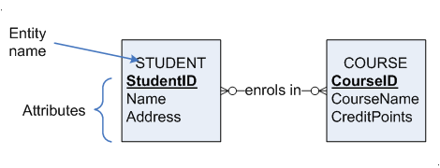
Our students & courses example would look like this:

Slide 31

Notice that StudentID was underlined?
An identifier attribute is used to uniquely identify every entity instance
STUDENT
StudentID

Slide 32


STUDENT
StudentID
Name
DateOfBirth
Address
ContactPhone
Email
This means that no two students may have the same StudentID. Every student must have a StudentID and it must be unique.

Slide 33
  person’s name or phone number would not be suitable
  can be simple key attribute; eg StudentID
  can be composite key attribute; eg FlightID, where this is composed of -FlightNumber + Date
Notes:
We’ll look more at composite attributes later.

Slide 34

  What does a relationship mean?
  A relationship is a meaningful association between one or more entity instances

Slide 35
  Example: The enrols in relationship means that it is neccesary for CQU to record which student enrols in which course
  Don’t create a relationship unless the business needs to know which courses a student has enrolled in (or whatever…)

Slide 36

Just as there are entity types and entity instances, there are relationship types and relationship instances
“Fred Smith enrolled in COIS20026” is a relationship instance
“Students enrol in courses” is a relationship type.
We only model relationship types

Slide 37


We have not explained this notation yet
These “crow’s feet” represent the cardinality of the relationship
They tell us more about the relationship

Slide 38


This one means that every student may enrol in many courses, but may enrol in none
The crow’s foot is the “many”
The circle is the “none”

Slide 39

This one means that every course may have many enrolled students, and may have none
The crow’s foot is the “many”
The circle is the “none”

Slide 40


This ER diagram represents (a portion of) the data that might be required to run a customer-order business, such as a website for ordering parts online

Slide 41

This one means that each recorded customer must have placed at least one order (represented by the dash) and possibly many orders (represented by the crow’s foot).

Slide 42

This one means that each order must have been placed by one and only one customer.

Slide 43

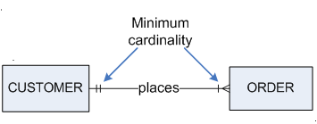
The inner marks indicate minimum cardinality and may be either 0 (a circle) or 1 (a dash).
Minimum cardinality defines whether every instance of an entity type must participate in a relationship (one) or the participation is optional (zero).
Notes:
The minimum cardinality of relationship is sometimes referred to as the participation of that relationship, and sometimes as the optionality of that relationship.
Note how the minimum cardinality specifies that every customer is required to have at least one order. That is, you can’t add details of a new customer if they don’t have an order. You can’t record a new customer unless they’re placing an order. Note that this sort of information will be different according to different businesses. Other businesses might wish to record details of a customer without a corresponding order (for e.g., they may want to record prospective customers). For such a business, the minimum cardinality would have to be “customer places zero or more orders”.

Slide 44

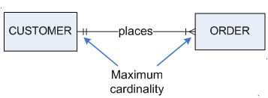
The outer marks indicate maximum cardinality and may be either 1 (a dash) or many (the crow’s foot).
Maximum cardinality defines if an instance participates in a relationship with more than one instances of the other entity type

Slide 45


Be careful how you read/determine cardinalities!
To determine the cardinality on the right, say:
“A single customer may have one or many orders.”
To determine the cardinality on the left, say:
“A single order may belong to one and only customer.”
“Customers place many orders and orders are placed by many customers” IS WRONG!
Notes:
Always, always, always, always, always, always, always, always, always, always, always, always, always, always, always, always, always, always, always, always, always, always, ALWAYS read cardinality in this way. You MUST consider a single customer and work out whether that individual customer may place 0, 1 or many orders. Then you must consider a single order and consider whether it can have zero, one or many customers.
Incorrect cardinality is one of the most common mistakes made by student modellers!

Slide 46

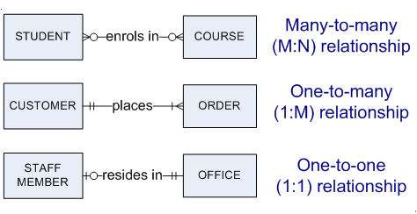
We usually describe the cardinality of a relationship by the maximum cardinality

Slide 47

Cardinality is important! Particularly the maximum cardinality
Make sure you practice reading and determining cardinality
Even a seemingly small oversight in cardinality can result in a serious error in the final database.
You must be very careful about cardinalities!

Slide 48

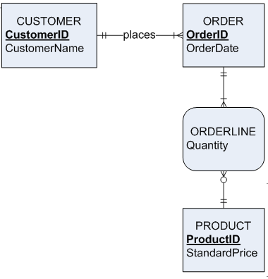
Data models can get quite big!
You can keep adding entities & relationships

Slide 49

Assume you have been asked to create a conceptual model for CQU.
CQU needs to keep lists of students, courses, faculties and staff.
CQU needs to know:
  Which students enrolled in which courses
  Which courses are owned by which faculties
  Which staff teach which courses
  Which staff belong to which faculties

Slide 50
You already know how to do the students and courses bit, so you just need to expand on that
Ask your lecturer what attributes should be recorded for each entity
Ask your lecturer to help you work out the cardinality of each new relationship.

Slide 51

Assume you’ve been asked to create a conceptual model for a doctor’s surgery
What things will they need to keep lists of?
What relationships are required?
  For eg, for each appointment they will need to know which patient made the booking
  Do they need to know which staff member took the booking over the phone?

Slide 52

This means that every student has an ID, name, DOB, Address, ContactPhone and Email.
You can only record (at most) one of each.
STUDENT
StudentID
Name
DateOfBirth
Address
ContactPhone
Email
Notes:
* It might be possible for a student to have no email (for example) – it depends on whether the attributes are required or optional. We haven’t looked at this yet. The point is, with the model above, you can only record one of each.

Slide 53

What about grade?
As a student, you get one grade for each course.
If we model it like this, then we’d only be able to record one grade for you.
Grade cannot go here!
STUDENT
StudentID
Name
DateOfBirth
Address
ContactPhone
Email
Grade
WRONG!

Slide 54

This won’t work either
This means you can record just one grade for every course, even if it has 500 students!
Grade cannot go here either!
It’s not one grade per student, it’s not one grade per course, it’s one grade per student and course combination!
COURSE
CourseID
CourseName
CreditPoints
Grade
WRONG!

Slide 55

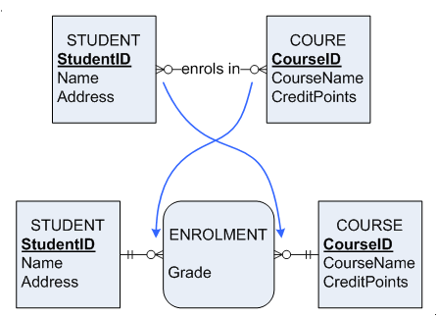
The answer is to create an associative entity in between Course and Student.
Notes:
The associative entity has rounded corners, regular entities have square corners.
Note the crossover of cardinalities. It’s not apparent in this example, but whatever cardinality was on the right of the relationship ends up on the left of the new associative entity, and vice versa.
Note that the relationship was called “enrols in” (a verb phrase) but this has been changed to “enrolment” (a noun) in the new entity.
Finally, note that Enrolment has no unique identifier. The unique identifier for an associative entity is always the combination of the unique identifiers from the outer entities. Thus the unique identifier for Enrolment would be the combination (StudentID, CourseID). This would mean that every (StudentID, CourseID) may have one grade – which is exactly what we’re after.
Associative entities are sometimes called Gerunds, after gerunds in language usage, meaning to turn a verb into a noun.

Slide 56
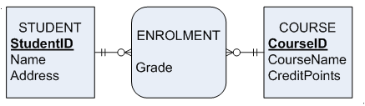
The unique identifier for each enrolment will be (StudentID, CourseID) – not shown
Associative entities can be used to replace M:N relationships only. You cannot replace 1:1 or 1:M with associatives.

Slide 57

Replace a M:N with an associative entity when:
  all relationships for participating entities are many
  resulting associative entity has independent meaning to end users
  has 1 or more attributes in addition to identifier
  participates in 1 or more relationships independent of entities related in associated relationship

Slide 58

Notice how ER models represent data without describing how/where that data is to be stored?
This means that ER modelling can be used to represent data at the conceptual or external schema levels of the ANSI/SPARC architecture.

Slide 59

A business rule is a statement that defines or constrains some aspect of the business.
When we do conceptual modelling, we are actually modelling business rules that govern data along with the actual data that needs to be recorded
Business rules will indicate:
  entities, relationships, attributes to be recorded
  appropriate names for entities, etc
  constraints on entities, relationships etc

Slide 60
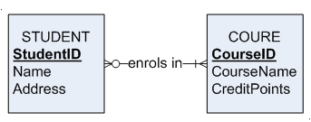
For example, if CQU had a business rule stating that students were required to enrol in at least one course, then our model would be:

Slide 61
Not all business rules affect the data model
“Every student must enrol in at least one course” – this affects the model
“Invoices can only be paid by in person at the finance department at your campus” – this does not affect the model.
(Note: neither of these is a rule at CQUni)
Notes:
# Actually, an ER model could be completely expressed as business rules. For example, you could our courses/students/enrols in ER model with the following business rules:
CQU records the following data about students: StudentID, StudentName, DOB, etc
CQU records the following data about courses: CourseID, CourseName, Credit Ponts
CQU records the enrolment of students in courses
A Student can enrol in many courses, but may enrol in none
etc

Slide 62

McFadden, et al (2016) define a business rule as:
  “a statement that defines or constrains some aspect of the business. It is intended to assert business structure or to control or influence the behaviour of the business” (Guide to Business Rules Project, 1997).

Slide 63

“A student may register for a course only if he or she has successfully completed the prerequisites for that course.”
“A preferred customer qualifies for a 10 percent discount, unless he or she has an overdue account balance.”

Slide 64

Today we have looked at the basic constructs of the Entity-Relationship (E-R) model,
These constructs should handle the majority of the modelling you will need to do.
You can’t develop modelling skills by reading or listening. The most important thing you can do is to practise, practise, practise and practise some more.

