Slide 1


Module 2 – Conceptual modelling:
Advanced structures

Slide 2


Entity-relationship models are used to describe the data that needs to be recorded for a business, eg:

Slide 3

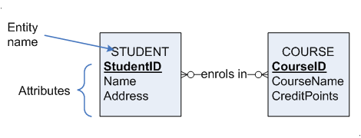
With attributes it looks like this:

Slide 4


STUDENT
StudentID
Name
DateOfBirth
Address
ContactPhone
Email
This means that no two students may have the same StudentID. Every student must have a StudentID and it must be unique.

Slide 5


Each student may enrol in 0 or many courses
Each course may have 0 or many enrolled courses
The inside ones are minimum cardinality
The outside ones are maximum cardinality

Slide 6

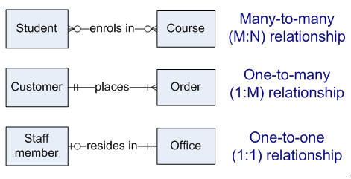

Slide 7

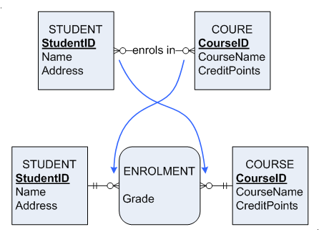
M:N relationships can be replaced with an associative entity:

Slide 8

Be able to define and describe:
  Strong vs weak entities
  Required vs optional attributes
  Simple vs composite attributes
  Single vs multi-valued attributes
  Stored vs derived attributes
  Degree of a relationship, esp. unary & binary
Notes:
* See study guide module for a complete description of the objectives

Slide 9
Be able to define and describe:
  Subtype hierarchies
  Disjoint vs overlapping subtypes
  Total vs partial specialisation
  Discriminators
Be able to develop ER models using all constructs in this lecture & the last lecture
Be able to recognise the equivalent UML symbols and read UML class diagrams

Slide 10

Rugular entity
  exists independently of other types of entities
  has its own unique identifier
    identifier underlined with single line
Weak entity
  dependent on a strong entity (identifying owner)…cannot exist on its own
  does not have a unique identifier (only a partial identifier)
  entity box and partial identifier have double lines
Identifying relationship
  links strong entities to weak entities

Slide 11
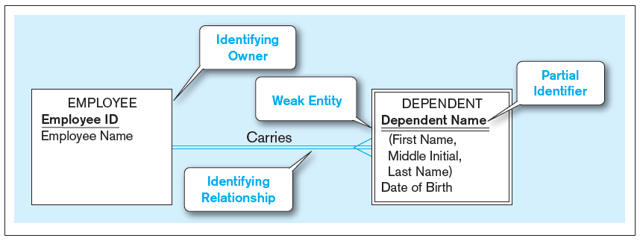
Figure 2-5 Example of a weak identity and its identifying relationship
Strong entity
Weak entity
Notes:
The organization doesn’t wish to record details of any dependent unless that person is a dependent of an Employee

Slide 12

Attribute–property or characteristic of an entity or relationship type
Classifications of attributes:
  Required versus Optional Attributes
  Simple versus Composite Attribute
  Single-Valued versus Multivalued Attribute
  Stored versus Derived Attributes
  Identifier Attributes (described in week2)

Slide 13

Sometimes it is necessary to specify an attribute as optional
For e.g., it may happen that not every student has an email address
Therefore Email would be considered an optional attribute
STUDENT
StudentID
Name
DateOfBirth
Address
ContactPhone
Email

Slide 14
Required attributes
  Each instance of an entity type must possess the attribute and value must be known.
  Value can change.
Optional attributes
  Some instances of an entity type may not possess the attribute or the value may not be known. It may become known later.

Slide 15
When creating a data model, you will have to decide which attibutes are to be required and which are optional.
For eg, would it be okay to record details of a student without recording their name? No! So Student name should be made a required attribute.
There is no syntax to show optional attributes, it would have to be noted in other documentation.
Notes:
There are a few things to keep in mind when deciding between optional and required attributes:
Does every instance of the entity have a value for this attribute? For example, every student has a date of birth but it’s possible that some students don’t have an email address. Therefore, email address would have to be a required attribute.
Will the attribute value be known at the time the record is created? For example, every student has a date of birth, but if the student chooses not to tell us their date of birth then we will not know their DOB at the record for that student is created. In this case, date of birth might have to be optional (unless the business decides that DOBs must be supplied).
Would it be okay to leave the attribute blank when a new record is created? For example, it is most definitely NOT okay to leave an invoice total blank when creating a new invoice. What would the customer do if they were given an invoice with a blank total? What are they supposed to pay? So invoice total in an invoice entity should be required so that it is never left blank at any time.

Slide 16

So far we have only looked at single-valued attributes. A single-valued attribute is an attribute that may take on at most one value for any given entity instance, for e.g.:
Every student has one Student ID
Every student has one recorded name

Slide 17
But assume we want to record multiple contact phone numbers for each student
A multi-valued attribute is an attribute that may take on more than one value for a given entity instance.
Therefore it would be better to represent ContactPhone as a multi-valued attribute

Slide 18
Curly brackets denote a multi-valued attribute
This means it’s possible to record many contact phone numbers for each student
The others are single-valued.
STUDENT
StudentID
Name
DateOfBirth
Address
{ContactPhone}
Email
Notes:
You might be wondering why ContactPhone is a multi-valued attribute whereas Grade (from last week’s lecture) ended up in an associative entity. The difference is as follows. It’s true that you, as a student, will have many grades, but to be more accurate you will have one grade per course. If Student and Course are separate entities, then grade must be recorded in an associative entity in between them. You as as student will have many contact phone numbers, but you don’t have many contact phone numbers per course or per anything. Therefore it’s just a repeating attribute within Student.
Each student has one grade per course -> Grade goes into an associative entity, provided that Student and Course are separate entities.
Each student has many phone numbers -> Phone numbers is a multi-valued attribute in Student.

Slide 19
Note that it depends upon what the business wants to be able to record.
For e.g., it may be true that students can have many email address, but if CQU only wants to record one email address, then Email would be single-valued. If CQU wants to record many, then it would be multi-valued.

Slide 20

Attributes can be made up of other attributes.
Address is a classic example. Address can be made up of Street, City, State & Postcode. #
Composite attributes are represented with round brackets.
Notes:
# Again it depends upon what the business wants to be able to record. The may want to break addresses down into AddressLine1, AddressLine2, AddressLine3 and AddressLine4. If they deal with international customers, then they may want Street, City, State, Postcode and Country. Or they may not want to break address down at all. Each representation gives different advantages and disadvantages. As a data modeller, it’s your job to choose the representation that gives the best advantages for what the business wants to be able to do. It’s a bit early yet for you to be able to see the different advantages, but as you get more experience it will hopefully become clear.

Slide 21

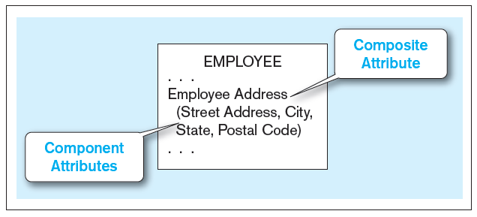
Composite attribute – An attribute that has meaningful component parts (attributes)
The address is broken into component parts
Figure 2-7 A composite attribute

Slide 22

Imagine CQU wanted to record your age.
If we record your age, however, it will only be accurate for one year.
If we record your date of birth, however, we can accurately work out (or derive) your age at any time.
These sort of attributes are called derived attributes.

Slide 23
STUDENT
StudentID
Name
DateOfBirth
Address (Street, City, State, Postcode)
{ContactPhone}
Email
[Age]
Derived attributes are shown using square brackets.
This shows that Age is derived from one or more other attributes.

Slide 24

It’s possible to combine these attribute types.
Imagine we want to record multiple contact phone numbers for each student, and for each contact phone we want to record:
  A description of the phone type (e.g. “mobile”)
  The phone number itself
While we’re at it, let’s make Email a multi-valued attribute.

Slide 25

Unique identifier
Simple attribute (can’t show that it’s required)
Composite attribute
Composite multi-valued
Multi-valued
Derived
STUDENT
StudentID
Name
DateOfBirth
Address (Street, City, State, Postcode)
{ContactPhone
(Type, Number)}
{Email}
[Age]
Notes:
Note that this means for each student you can record many contact phone numbers, where each phone number is made up of Type and Number. For e.g. you would be able to record the following for any given student:
Mobile 0411 000000
Home 4900 1111
Work 4900 2222

Slide 26

Relationship degree refers to the number of entity types participating in a relationship
For example, this relationship has 2 entity types, so has a degree of 2 and is therefore called a binary relationship:
The cardinality is not relevant when working out the degree.

Slide 27

A unary relationship is one that has a degree of 1 – that is, they involve only one entity type.
For example, imagine we want to model course pre-requisites at CQUni:
  Each course can have 0 or many pre-reqs
  Each course can be a pre-req for 0 or many other courses

Slide 28
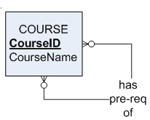
So we end up with this:
There is only one entity type in this relationship, so it’s unary.
The cardinalities can be read as in the case of binary.

Slide 29
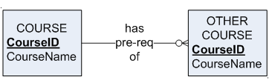
If you find the relationship difficult to read, then imagine if the relationship were “unfolded” like this:
Think of a specific “COURSE” on the left side. Any given course could have zero pre-reqs, or it could have many pre-reqs, just depending on which course it is.

Slide 30
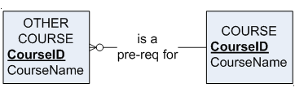
Now reading from right to left, think of a specific course (entity on the right):
Any given course could be a pre-req for zero other courses, or could be a pre-req for many other courses.

Slide 31
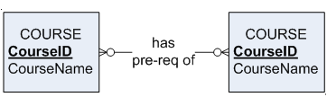
So combining both those cardinalities we get:
The cardinality that you get on the “unfolded” relationship is exactly what goes on the “folded” unary relationship:

Slide 32

You can also have relationships with degree three, called Ternary relationships
You can have higher degree relationships too (usually just called n-ary relationships)
However, you can always (and usually should) replace these higher degree relationships with associative entities, so we won’t cover them here.

Slide 33

It’s possible to have multiple relationships between the same entities
For e.g. imagine we are creating a model for an organisation and we need to keep lists of Staff and Departments (these are entities)
Imagine that we also need to know which staff belong to which departments (a relationship) and also which staff member is head of each department (another relationship)

Slide 34
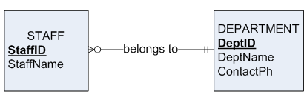
To record which staff belong to which department, let’s assume:
  Each staff member belongs to one and only one department
  Each department may have zero or many staff members:

Slide 35
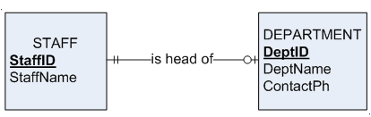
To record which staff member is head of which department, let’s assume:
  Each staff member may be head of at most one department, but may be head of none
  Each department has exactly one staff member as head:

Slide 36
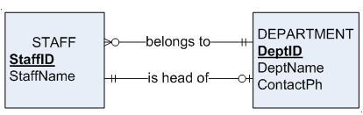
If we need to record both relationships, then we simply show both relationships:
Notes:
* Read each relationship on its own, pretending that the other one isn’t there. They are two separate, independent relationships

Slide 37

Cardinality Constraints—the number of instances of one entity that can or must be associated with each instance of another entity
Minimum Cardinality
  If zero, then optional
  If one or more, then mandatory
Maximum Cardinality
  The maximum number

Slide 38
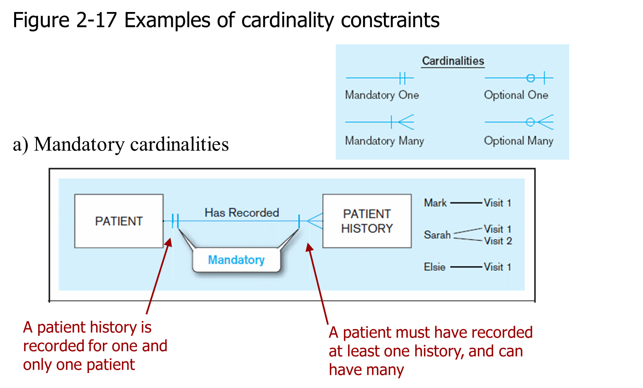

Slide 39
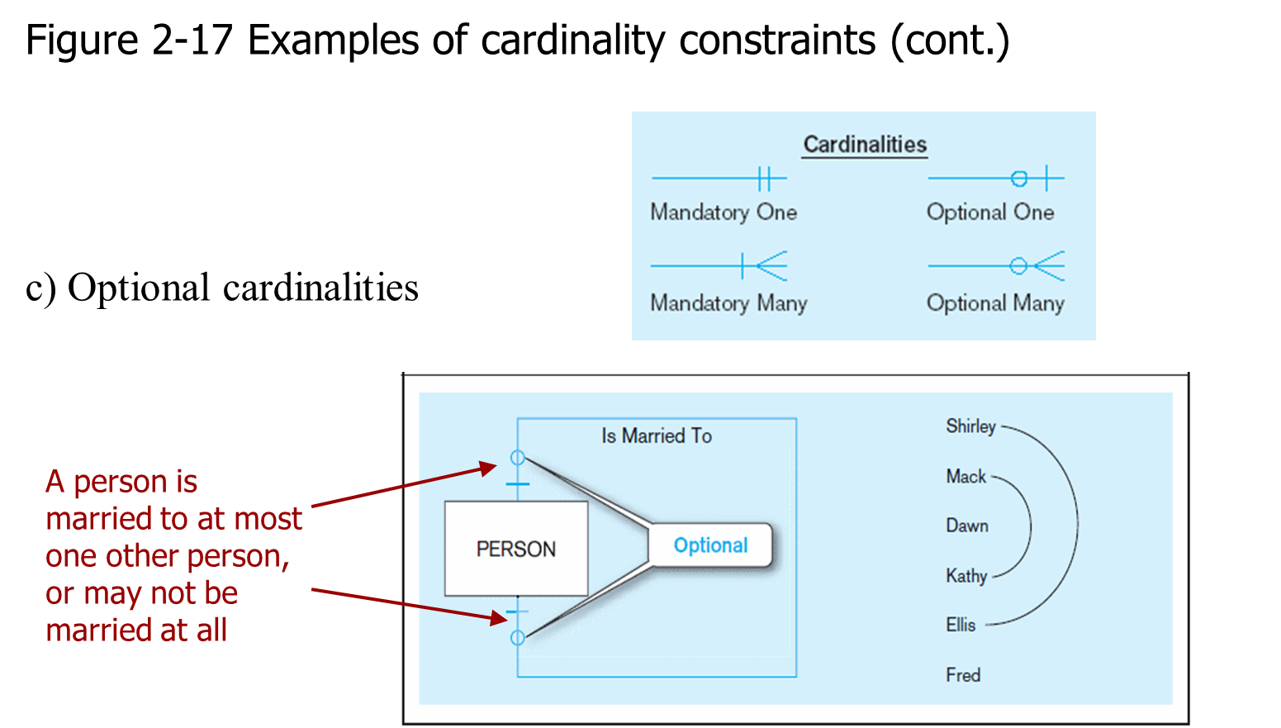

Slide 40

Enhanced ER model: extends original ER model with new modelling constructs.
A subtype is a subgrouping of the entities in an entity type that has attributes distinct from those in other sub-groupings
A supertype is a generic entity that has a relationship with one or more subtypes.
Attribute Inheritance:
  Subtype entities inherit values of all attributes of the supertype
  An instance of a subtype is also an instance of the supertype

Slide 41
At CQUni, we have on-campus students (who study at a particular campus) as well as flex students who don’t come to campus at all.
Assume CQUni wants to be able to record:
  For Flex students, whether or not they want to be part of a study group (CQUni does in fact do this)
  For on-campus students, whether or not they want to be a member of the on-campus gym (we don’t do this, but let’s pretend we do).
You can represent it in an ER model as follows:

Slide 42
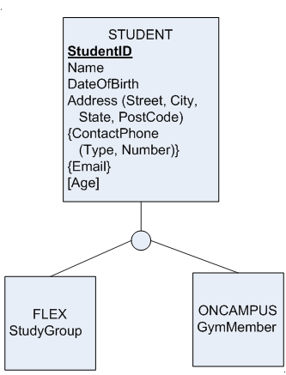
These attributes are recorded for every student.
StudyGroup is only recorded for students who are flex
GymMember is only recorded for on-campus students
Notes:
It is intended that the StudyGroup and GymMember would be Yes/No fields.

Slide 43
STUDENT is the supertype
FLEX and ONCAMPUS are subtypes
Notice that there’s no unique identifer in either of the subtypes?
That’s because the subtypes inherit all the attributes from the supertype, including the identifier.
This is called attribute inheritance.

Slide 44
So every FLEX student will have an ID, name, DOB, Address (made up of Street, etc) multiple phone numbers, multiple emails, a derivable age, and Study group.

Slide 45

Generalisation is the process of defining a more general entity type from a set of more specialised entity types.
Specialisation is the process of defining one or more subtypes from a given supertype.

Slide 46

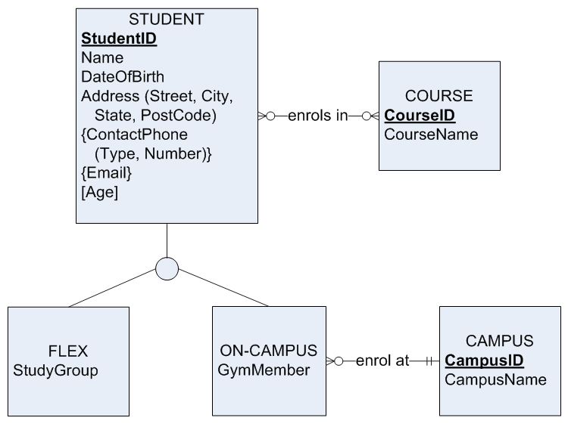
All students can enrol in courses
But only on-campus students can enrol at a campus.
Notes:
Once again, we are deliberately simplifying a real example. The model in this slide is not quite an accurate representation of how CQU handles flex vs on-campus students, but it will suffice for our example.

Slide 47

Flex and on-campus are the only two modes of study. There is no third type.
So we have shown all the subtypes for mode of study.
We can show this in the model by using a double line…

Slide 48


The double line indicates that the complete set of subtypes is shown, there is no third subtype.
This is total specialisation.
Every instance of supertype must also be a instance of at least one subtype

Slide 49

If some but not all of the subtypes are shown, then this is known as partial specialisation.
Partial specialisation is shown as a single line.
At CQU, students can have three levels of study: postgrad, undergrad and non-award.
Imagine we want to model this, but only show undergrad and non-award.

Slide 50
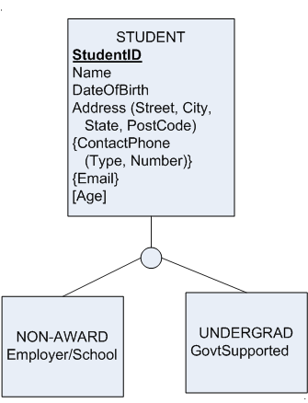
The single line tells us that not all the sub-types are shown
A student instance can be a non-award or a undergrad but does not have to be either.
For non-award students, we record which employer or school they come from
For UG students we record if they are Govt supported or not.

Slide 51

Is it possible for a student to be both on-campus as well as flex?
Let’s pretend it is – you could be enrolled as flex for one course and as on-campus for another. This would make you a student who is both Flex and On-campus.
If it’s possible for a student to be a member of more than one subtype, then we have an overlapping subtype.

Slide 52

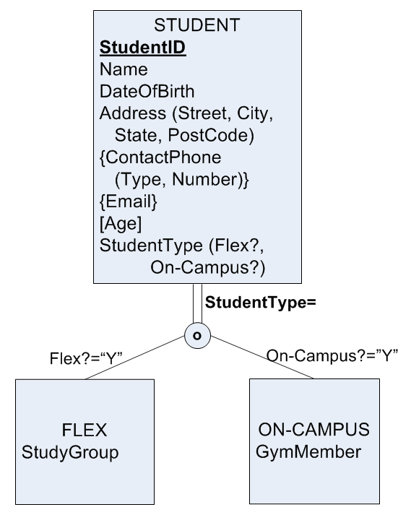
The O tells us that it is an overlapping subtype
That is, a student can be both flex and on-campus.
Note that this a total, overlapping subtype.

Slide 53

A Discriminator is an attribute in the supertype whose values determine the target subtype(s).
For a given student, if Flex is true, then the student will also be a member of the Flex subtype
If On-campus is true, then the student will also be a member of the On-campus subtype.

Slide 54

Pretend however that it is not possible to be both a postgraduate and undergraduate at the same time
You can be any one of undergrad, postgrad or non-award, but not more than one of these.
This is a disjoint subtype.

Slide 55
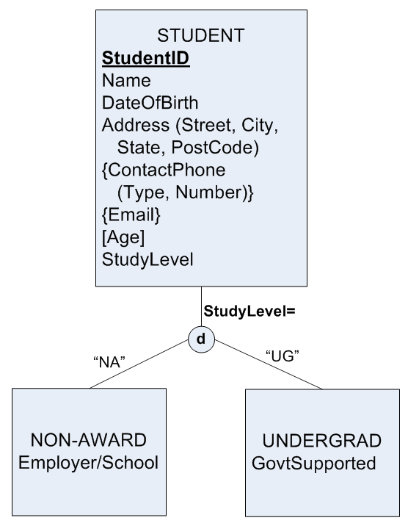
The d tells us that it is a distinct subtype
Any given student can be at most one of the subtypes shown.
Note that this is a partial, distinct subtype.

Slide 56

StudyLevel is the discriminator in this supertype
If StudyLevel = “NA”, then the student instance will also be a member of the Non-Award subtype
If StudyLevel = “UG”, then the student instance will also be in UnderGrad

Slide 57

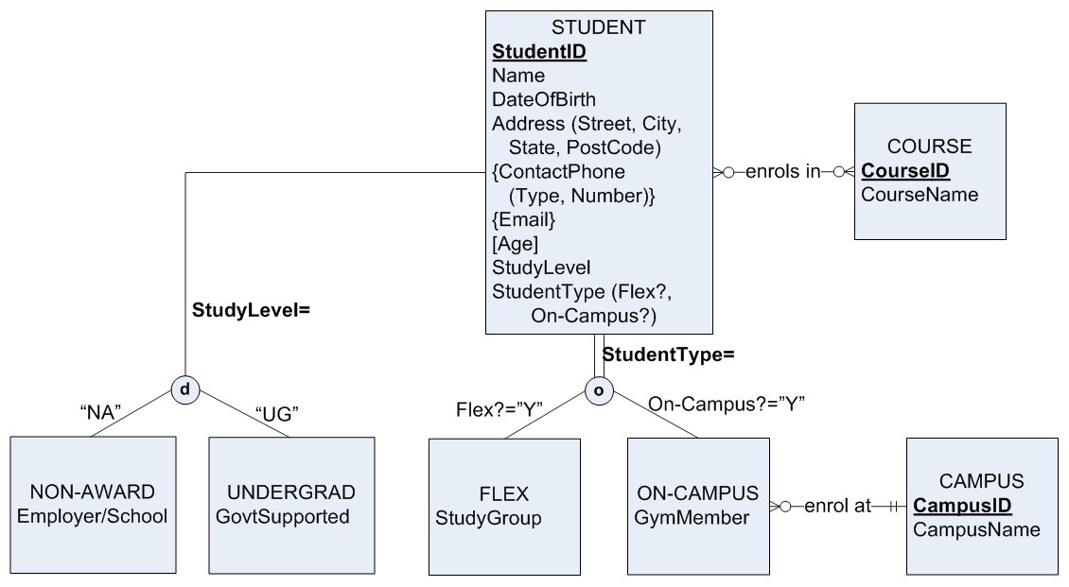

Slide 58

UML diagrams are becoming more common in industry particularly for developing object-oriented conceptual models
In UML, entities are called classes and entity instances are called objects

Slide 59
Classes are basically the same as entities, except that classes can additionally show operations
Relationships are called associations
Cardinality is called multiplicity

Slide 60

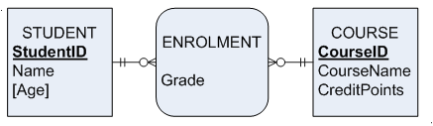
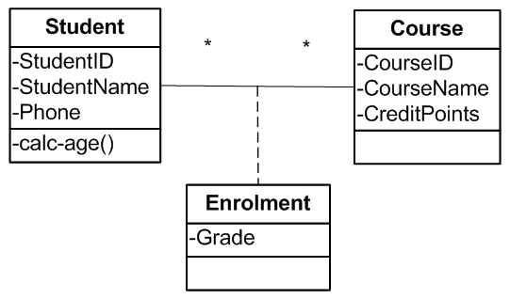
These ER and UML diagrams are similar
Notice that Student has an operation – calc-age()

Slide 61

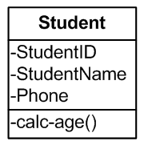
Class name
Attributes
Operation
An operation is like a function or procedure that can be performed for any instance in the class.

Slide 62

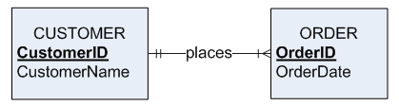
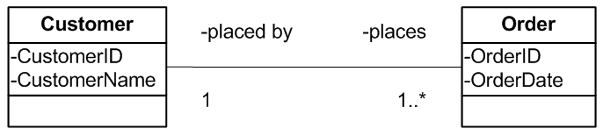

Slide 63

Today we looked at:
  Strong vs weak entities
  Different attribute types (required vs optional, simple vs composite, etc)
  Relationship degree, including binary and unary relationships
  Multiple relationships between entities
  Super types and subtypes
  UML syntax

