Slide 1


Module 3 – Logical design:
ER transformation

Slide 2

Transform an ERD to a logically equivalent set of relations, including:
  Strong & weak entity types
  Relationships of different cardinality & degree
  Associative entity types
  Supertype/subtypes
  Other ER modelling constructs
Note : Unless otherwise mentioned all the references of this lecture material are from the prescribed course text book or images from publishers.

Slide 3

Remember we had three ways of representing foreign keys.
For this lecture, we’ll be using this one:
    Customer (CustID, CustName)
    Order (OrderID, Date, Total, CustID)
But you are free to use any of the 3.

Slide 4

Logical design involves transforming entity-relationship models/diagrams developed during conceptual modelling into relational database schemas
process has a set of well-defined rules (steps) to complete the conversion

Slide 5







Examine existing processes
(what data needs to be
recorded?)
Develop
conceptual
model
Convert model
to logical
design
Implement
database
Do physical
design
Check DB design
for normalisation
Develop application
or web-based interface
(will involve SQL)
Test and
maintain...

Slide 6

Recall that regular entities have independent existence
Each regular entity is transformed into a relation
  name given to the relation is usually that of the entity type
  each simple attribute becomes an attribute in the relation
  entity type identifier becomes primary key of the relation

Slide 7
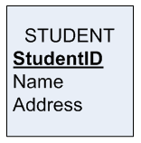

STUDENT (StudentID, Name, Address)
COURSE (CourseID, CourseName, CreditPoints)

Slide 8

  for composite attributes, only the simple attributes are included in the relation
  for multi-valued attributes, 2 new relations are created -
    the first relation containing all of the simple attributes
    a second relation containing the primary key attribute of the first relation as an attribute & an attribute for the multi-valued attribute
      in the second relation these 2 attributes will become a composite primary key

Slide 9
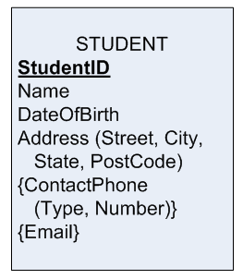
These multi-valued attributes must go into separate relations, so ContactPhone & Email are each separate relations
For composite attributes, only transfer across the simple attributes within; in this case, transfer Street, City, State, Postcode

Slide 10
STUDENT (StudentID, Name, DateOfBirth, Street, City, State, PostCode)
CONTACTPHONE (StudentID, Number, Type)
EMAIL (StudentID, Email)

Slide 11

Recall that a weak entity cannot exist independently -
  has an identifying owner
  does not have its own complete identifier
  does have a partial identifier to distinguish among instances

Slide 12

For each weak entity:
  create a new relation containing -
    all the simple attributes of the weak entity
    only the simple attributes of any composite attributes
    include the primary key of the owner relation as a foreign key attribute
  make the primary key from the owner relation & the partial identifier of the weak entity the concatenated primary key for the new relation

Slide 13
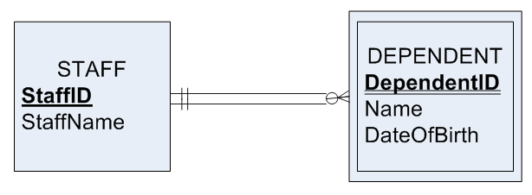
STAFF (StaffID, StaffName)
DEPENDENT (StaffID, DependentID, Name, DateOfBirth)

Slide 14

Procedure for this dependent on relationship degree & cardinalities
Map Binary One-to-Many Relationships
For each 1:M relationship:
  first create the two participating entity relations
  include the primary key attribute of the 1 relation as an attribute (foreign key) in the M relation (many side)

Slide 15

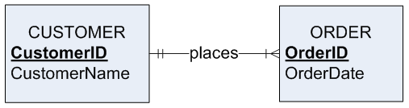

The primary key from the “one” side will go into the “many” side… (see next slide).
Don’t do it the other way around!

Slide 16
CUSTOMER (CustomerID, CustomerName)
ORDER (OrderID, OrderDate, CustomerID)

Slide 17

DO NOT DO THIS:
CUSTOMER (CustomerID, CustomerName, OrderID)
ORDER (OrderID, OrderDate)

Slide 18

For each M:N (many-to-many) relationship -
  create the relations for the entities
  create a new relation -
    add the primary keys of the participating entity types as foreign keys
      become the composite primary key of the new relation
    add any non-key attributes associated with the M:N relationship

Slide 19
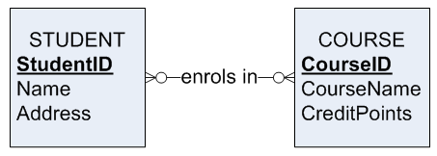
STUDENT (StudentID, Name, Address)
COURSE (CourseID, CourseName, CreditPoints)
ENROLMENT (CourseID, StudentID)

Slide 20

Special case of 1:M relationships
Create 1 relation for each of the participating entities
add the primary key of the entity type that has mandatory participation to the relation for the entity type that has optional participation in the relationship
add any relationship attributes to the relation with the foreign key

Slide 21
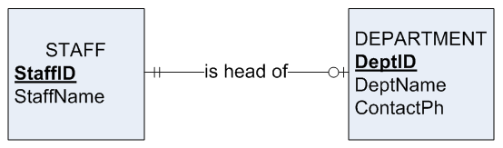
STAFF (StaffID, StaffName)
DEPARTMENT (DeptID, StaffID, DeptName, ContactPh)

Slide 22

First create a relation for each participating entity type and the associative entity
include the primary keys of the two regular entity relations as attributes of the associative relation
  these keys become the composite primary key if the associative relation has no identifier
  these keys become foreign keys if the associative relation has an identifier

Slide 23

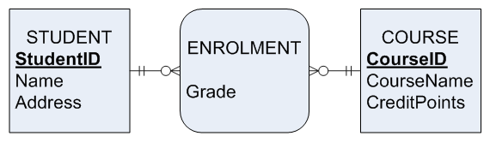
STUDENT (StudentID, Name, Address)
COURSE (CourseID, CourseName, CreditPoints)
ENROLMENT(CourseID, StudentID, Grade)

Slide 24

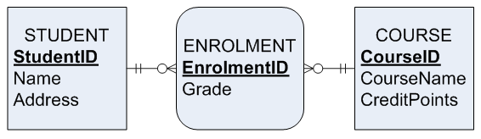
STUDENT (StudentID, Name, Address)
COURSE (CourseID, CourseName, CreditPoints)
ENROLMENT (EnrolmentID, StudentID, CourseID, Grade)

Slide 25

Recall that a unary relationship is a relationship between instances of a single entity type
Unary 1:M Relationships:
  create a relation for the entity type
  within the relation you just created add the primary key attribute as a foreign key attribute (needs to have a different name)

Slide 26

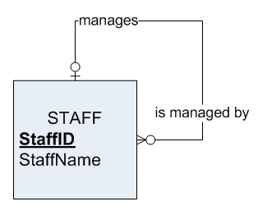

STAFF (StaffID, StaffName, ManagerID)
* Note how the name of the foreign key in this case must be different to the primary key to which it refers!

Slide 27

First create 2 relations -
  one to represent the entity type in the relationship
  one to represent the M:N relationship
Associative relation has primary key consisting of 2 attributes (with different names) that both take their values from primary key of the relation created for the entity type
add any nonkey attributes of the relationship to the associative relation

Slide 28
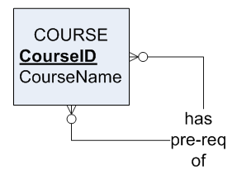
COURSE (CourseID, CourseName)
PREREQ (CourseID, PreReqCourseID)

Slide 29

Ternary relationship is a relationship among 3 entity types
The relationship is usually transformed in the ERD to an associative relationship
create the relations for the entity types
create an associative relation for the associative relationship
  include the primary keys of the other 3 relations (generally become the concatenated primary key for this relation)
  add attributes belonging to associative entity type

Slide 30
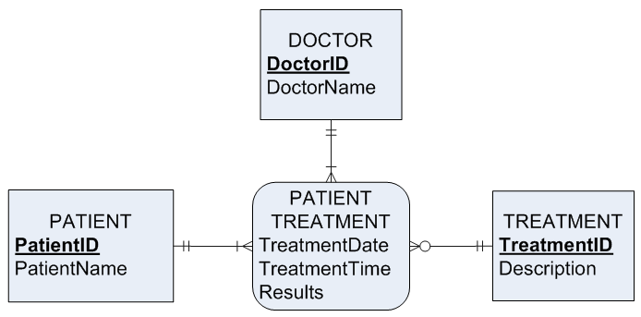
Next slide…

Slide 31
PATIENT (PatientID, PatientName)
DOCTOR (DoctorID, DoctorName)
PATIENT_TREATMENT (DoctorID, PatientID, TreatmentID, TreatmentDate, TreatmentTime, Results)*
TREATMENT (TreatmentID, Description)
Notes:
Note the primary key. The associative entity PATIENT_TREATMENT is an associative entity without its own primary key, and therefore takes PatientID, DoctorID and TreatmentID from the related strong entities to make a primary key of (DoctorID, PatientID, TreatmentID). However, a primary key of (DoctorID, PatientID and TreatmentID) is not sufficient for such a situation. This primary key (DoctorID, PatientID and TreatmentID) would mean that a given doctor could prescribe a given patient a given treatment on at most one occasion. The primary key would prevent the same (DoctorID, PatientID and TreatmentID) combination from occurring twice. Therefore, TreatmentDate and TreatmentTime would have to be added to the primary key.
This leads to the rather undesirable situation of having a primary key with 5 attributes in it. Most database professionals avoid composite primary keys or have a composite key of at most two attributes. It would be far, FAR better to simply give PATIENT_TREATMENT a primary key of PatientTreatmentID (thus making PATIENT_TREATMENT independently identified).
The model on the previous slide (taken from the text) is arguably wrong because the fact that the associative entity is not uniquely identified. However, it just goes to show that you can’t always be literal. You do need to be careful and to check things.

Slide 32

These relationship types are not directly supported by relational data model
Most common strategy employed is:
  create a separate relation for the supertype and each subtype
  assign the attributes common to all subtypes to the supertype
  for each subtype add the primary key of the supertype & attributes unique to itself
  assign one (maybe more) attributes of the supertype to function as subtype discriminator

Slide 33

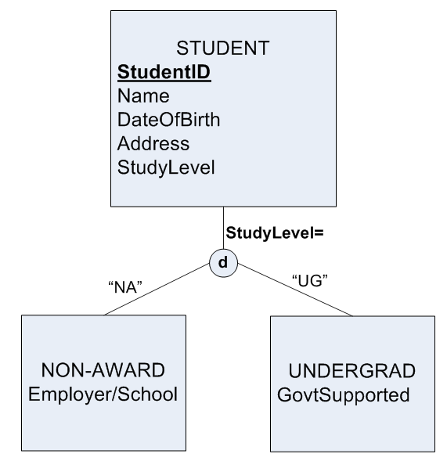
STUDENT (StudentID, Name, DateOfBirth, Address, StudyLevel)
NON-AWARD (StudentID, Employer-School)
UNGERGRAD (StudentID, GovtSupported)
Notes:
Actually this isn’t the only way (and it is arguably not the best way) to implement subtypes in a relational database. Most industrial modellers would convert the above ER model into:
STUDENT ( StudentID, Name, DateOfBirth, Address, StudyLevel, Employer-School, GovtSupported)
where Employer/School would only be filled in for those students who are non-award, and GovtSupported would only be filled in for those students who are Undergrad. For the purposes of this course, you should stick to the transformation shown on the slide.

Slide 34

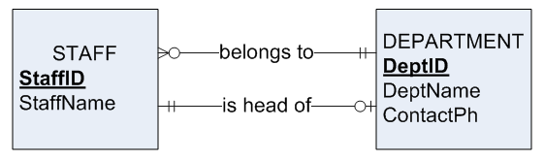
STAFF (StaffID, StaffName, DeptID)
DEPARTMENT (DeptID, DeptName, ContactPh, StaffID)

Slide 35

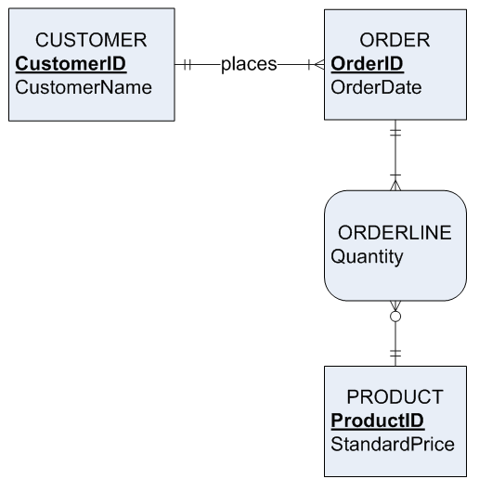

Slide 36

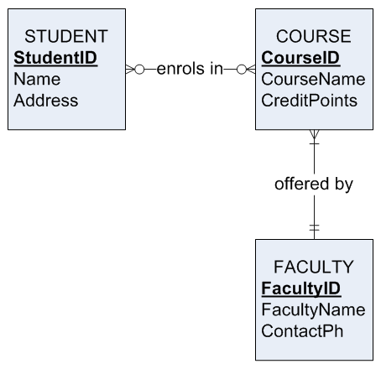

Slide 37

Each entity type & relationship in the entity-relationship diagram is mapped into corresponding relations
  This mapping process has a well-defined sequence of steps that identify how to map each entity & relationship type into well-structured relations

Slide 38

Supertype/subtype relationships are not directly supported by the relational data model but,
  can be represented by creating a relation for the supertype & each subtype and including a subtype discriminator attribute in the supertype

