Slide 1


Module 5 – SQL:
Overview

Slide 2

So far we have done:
  Conceptual modelling
  Logical design:
    Transform ER model to relations
    Check relations for normalisation
  Physical design (not including implementation)
Next would be:
  Physical implementation
  Application development

Slide 3

We won’t be doing a full system/application implementation (that’s another course in its own right… this is a database course)
We’ll be looking at SQL to physically create/implement the database tables
We’ll also be looking SQL as it would be used in application development & regular database use.

Slide 4







Examine existing processes
(what data needs to be
recorded?)
Develop
conceptual
model
Convert model
to logical
design
Implement
database
Do physical
design
Check DB design
for normalisation
Develop application
or web-based interface
(will involve SQL)
Test and
maintain...

Slide 5

Structured Query Language (SQL) is a language for writing statements
It’s a bit like a programming language, but higher level.
It is the most common and standard language for interacting with a relational DB.
SQL is probably the singly most important skill you can take away from this course, no matter what IT job you might do.

Slide 6

You can use SQL to write statements to:
  Create new tables in a database, including foreign key references
  Alter (e.g. add/remove columns) those tables
  Drop (delete) tables
  Insert, update and delete rows/data in tables
  Retrieve data from tables in all kinds of combinations & configurations
Data retrieval is the most common use for SQL

Slide 7

As a user, you don’t have to use SQL to manipulate a database – you can do most of what you want by using point-and-click
BUT if you want to manipulate a database programmatically (i.e. from code) then you’ll almost certainly have to use SQL
Retrieving data is done almost entirely by SQL. Even functional analysts with no database training usually rely on SQL to do their job

Slide 8

For the purposes of these SQL lectures, we’ll be changing away from our usual student & course entities/tables
We’ll be using a variation on the customer-order database (seen in previous lectures)
The ER model describing our customer-order DB is shown on the following slide..

Slide 9

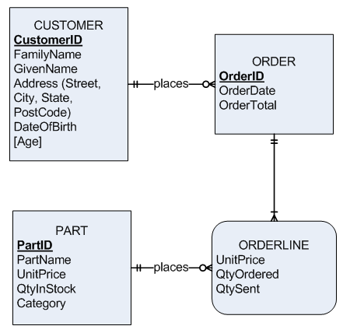

Slide 10

This ER model describes customers who place orders for parts from a Homewares shop.
The OrderLine entity describes what parts were ordered on each order
Note that prospective customers are possible, i.e. a customer can be recorded without having placed an order, therefore customer to order has a min cardinality of 0.

Slide 11

Parts are grouped into categories (such as “kitchen”, “bathroom” etc – the Category attribute describes which category each part belongs to.
QtySent describes how many parts have been sent – a customer might order 10 of a particular part, but only 5 have been sent so far.

Slide 12

Converting the ER model to relations, we get…
Customer (CustomerID, FamilyName, GivenName Street, City, State, Postcode, DateOfBirth)
Order (OrderID, OrderDate, OrderTotal, CustomerID )
OrderLine (OrderID, PartID, UnitPrice, QtyOrdered, QtySent)
Part (PartID, PartName, UnitPrice, QtyInStock, Category)
Note that Age has been omitted from the physical design – it can be easily calculated in SQL!

Slide 13

Customer ID | Family Name | Given Name | Street | City | State | Post Code | DateOf Birth
1 | Smith | Fred | 12 West Street | Rockhampton | Qld | 4701 | 15-Aug-78
2 | Li | Bruce | 45 East Street | Melbourne | Vic | 3040
3 | Noble | Donna | 25 North Street | Sydney | NSW | 2015 | 22-Jul-69
4 | Singh | Rakesh | 55 South Avenue | Rockhampton | Qld | 4700 | 30-Nov-81

Slide 14

PartID | PartName | UnitPrice | QtyInStock | Category
1 | Kitchen table | $220.00 | 0 | Kitchen
2 | Mixing bowl | $14.95 | 8 | Kitchen
3 | Cutting board | $19.00 | 25 | Kitchen
4 | Pillow | $15.50 | 18 | Bedroom
5 | Fleece blanket | $21.00 | 5 | Bedroom
6 | Shower curtain | $12.00 | 0 | Bathroom
7 | Bathmat | $18.95 | 12 | Bathroom
8 | Dinner plates (Set of 6) | $85.00 | 15 | Dining
9 | Set of cutlery | $55.00 | 0 | Dining

Slide 15

OrderID | OrderDate | OrderTotal | CustomerID
1 | 16/03/2009 | $88.50 | 1
2 | 17/03/2009 | $220.00 | 2
3 | 17/03/2009 | $116.90 | 3
4 | 26/03/2009 | $220.00 | 3
5 | 01/04/2009 | $32.00 | 1

Slide 16

OrderID | PartID | UnitPrice | QtyOrdered | QtySent
1 | 4 | $15.50 | 3 | 3
1 | 5 | $21.00 | 2 | 2
2 | 1 | $220.00 | 1 | 0
3 | 2 | $14.95 | 2 | 1
3 | 4 | $16.00 | 2 | 2
3 | 9 | $55.00 | 1 | 1
4 | 1 | $220.00 | 1 | 0
5 | 4 | $16.00 | 2 | 2

Slide 17

This database will be used throughout all our SQL lecture slides
Keep the ER model, relational design & sample data handy throughout the lectures.
An Access implementation of the DB can be downloaded with the lecture slides.

Slide 18

Learning SQL is like learning to drive – you have to practise it for yourself! You can’t just read about it.
If using MS Access for your SQL do not use the query design view – you will never learn SQL properly this way.
Switch to SQL view and type your queries in manually.

Slide 19

Also note that SQL is a standard, different vendors (such as Microsoft or Oracle) implement SQL more or less to that standard
Most SQL is the same, but different SQL implementations will have some minor differences
Data types and dates are particularly different between different implementations.

