Slide 1
CAPSTONE PROJECT TEAM 16
Mrunal Dipjay Vichare 7223247
Ashwin Balaji Arun Kumar 7224514
Adithya Ambazhappilly Radhakrishnan 7224277
Ulaş Arslan 7223322

Slide 2
Project Topic: Automated Pharmacy
Storage System

Slide 3
DESCRIPTION OF DOMAIN
This project models the core domain of a small warehouse management system that manages the storage, transportation, and distribution of medication to tasks and orders.
The subsystems are follows:
  Storage management
  Task management
  Charging stations
  Order Management

Slide 4
ROLE DISTRIBUTION
Mrunal Dipjay Vichare: Order Management, Charging Station, Exceptions, Unit tests
Ashwin Balaji Arun Kumar: HMI, Exceptions, Unit tests
Adithya Ambazhappilly Radhakrishnan: Storage Management, Exceptions, Unit tests
Ulaş Arslan: Task Management, Logging, Database, Exceptions, Unit tests

Slide 5
REQUIREMENTS OF PROJECT
Each station has capacity, availability, location, and status
Charging Stations support equipment or robots requiring periodic charging
Tasks represent work units in the system (e.g., moving stock, processing orders)
Each Task has: ID, type, assigned resource and status
Storage Locations have capacity and current load, validated on each operation
StorageException, TaskAssignmentException, IllegalArgumentException etc. handled in this project.
All key operations and errors must be logged
System should have a unit testes.

Slide 6
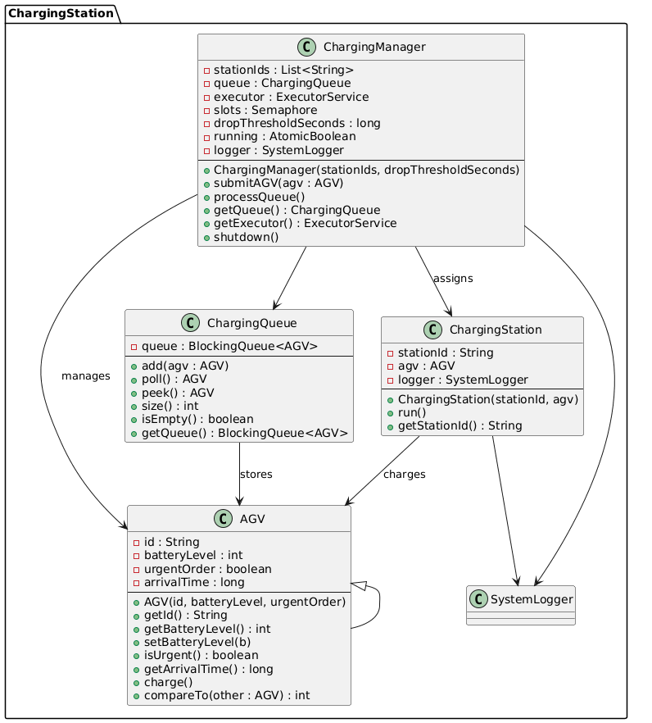
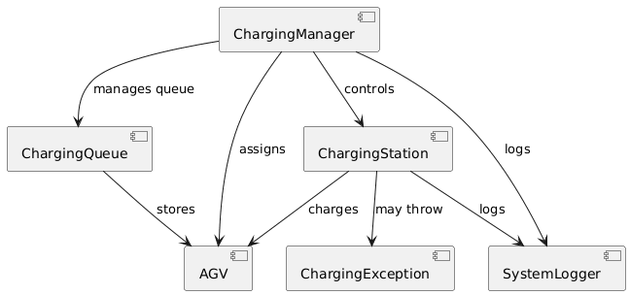
UML AND COMPONENTS DIAGRAMS : Charging Station

Slide 7
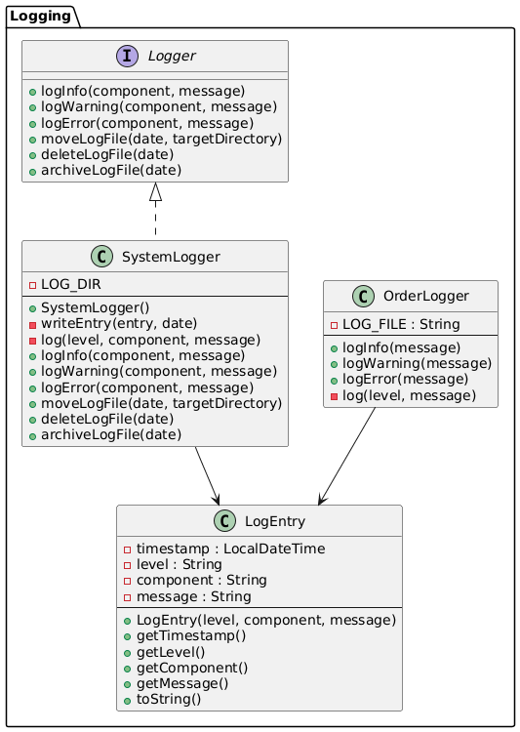
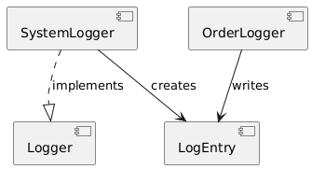
UML AND COMPONENTS DIAGRAMS: Logging

Slide 8
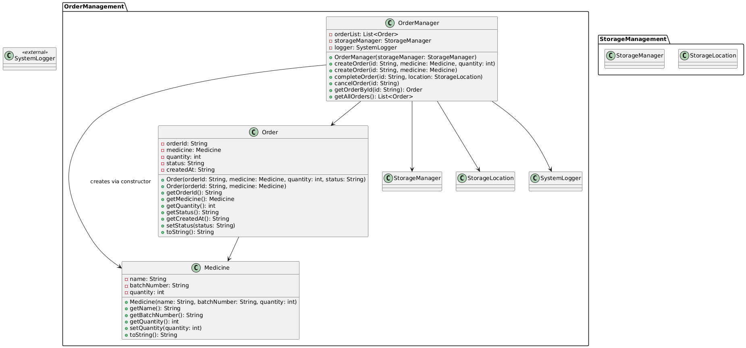
UML AND COMPONENTS DIAGRAMS : Order Management

Slide 9
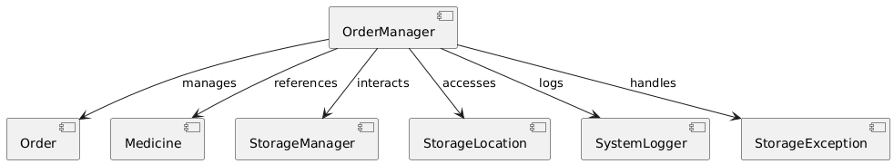
UML AND COMPONENTS DIAGRAMS : Order Management

Slide 10
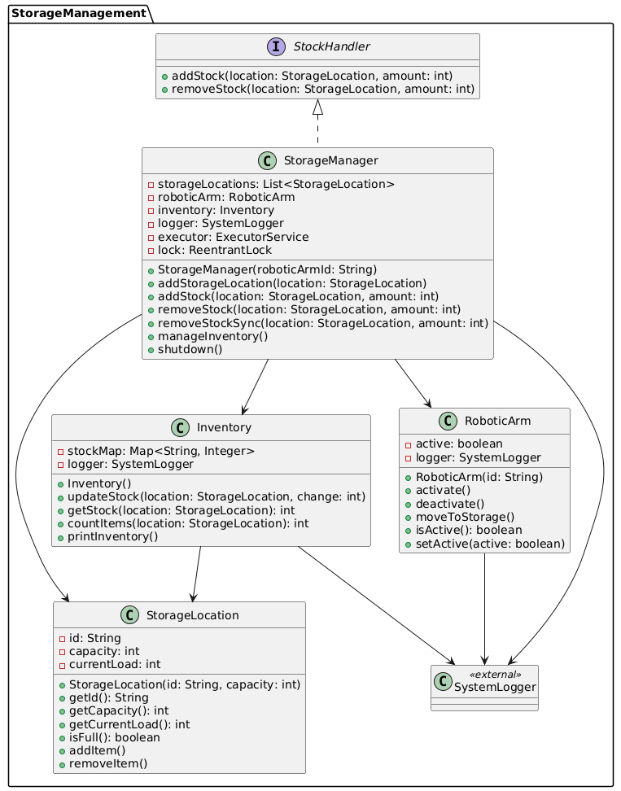
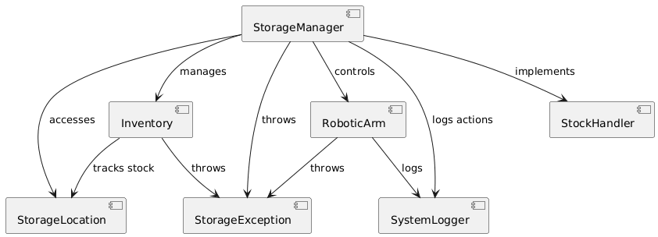
UML AND COMPONENTS DIAGRAMS : Storage Management

Slide 11
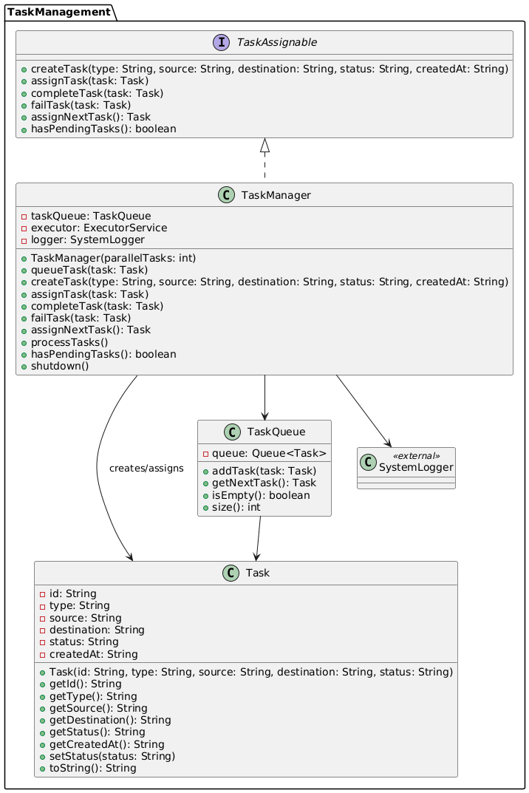
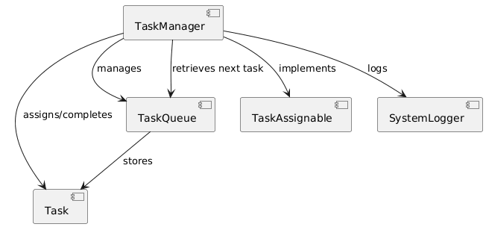
UML AND COMPONENTS DIAGRAMS : Task Management

Slide 12
MANAGEMENT I/O IN THE SYSTEM
Logging:
  Each subsystem writes logs to daily files.
  Logs save
    AGV movements
    Charging station events
    Storage operations
    Task processing steps
    Error & exception chain and similar event
  Purpose: Debugging, tracing, historical event analysis
  Tools: FileWriter, BufferedWriter (Byte and Charachter streams)

Slide 13
MANAGEMENT I/O IN THE SYSTEM
Databases:
  Database generator creates csv files for these instaances:
    AGV
    Charging Station
    Medicine
    Order
    Robotic Arm
    Storage Location
    Task
  Purpose: Providing data to system
  Tools: FileWriter

Slide 14
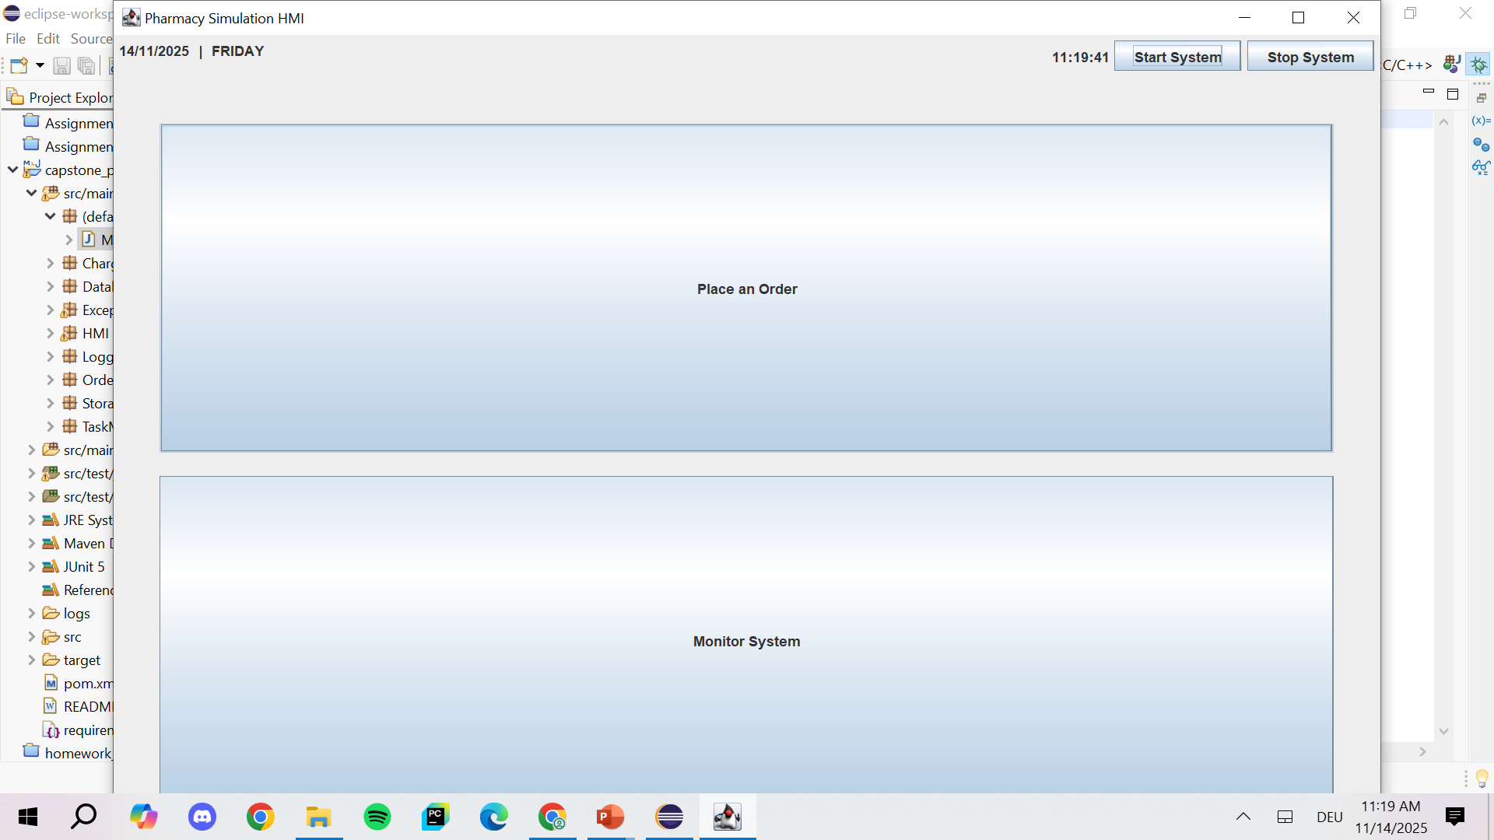
USER INTERFACES
Main Page

Slide 15
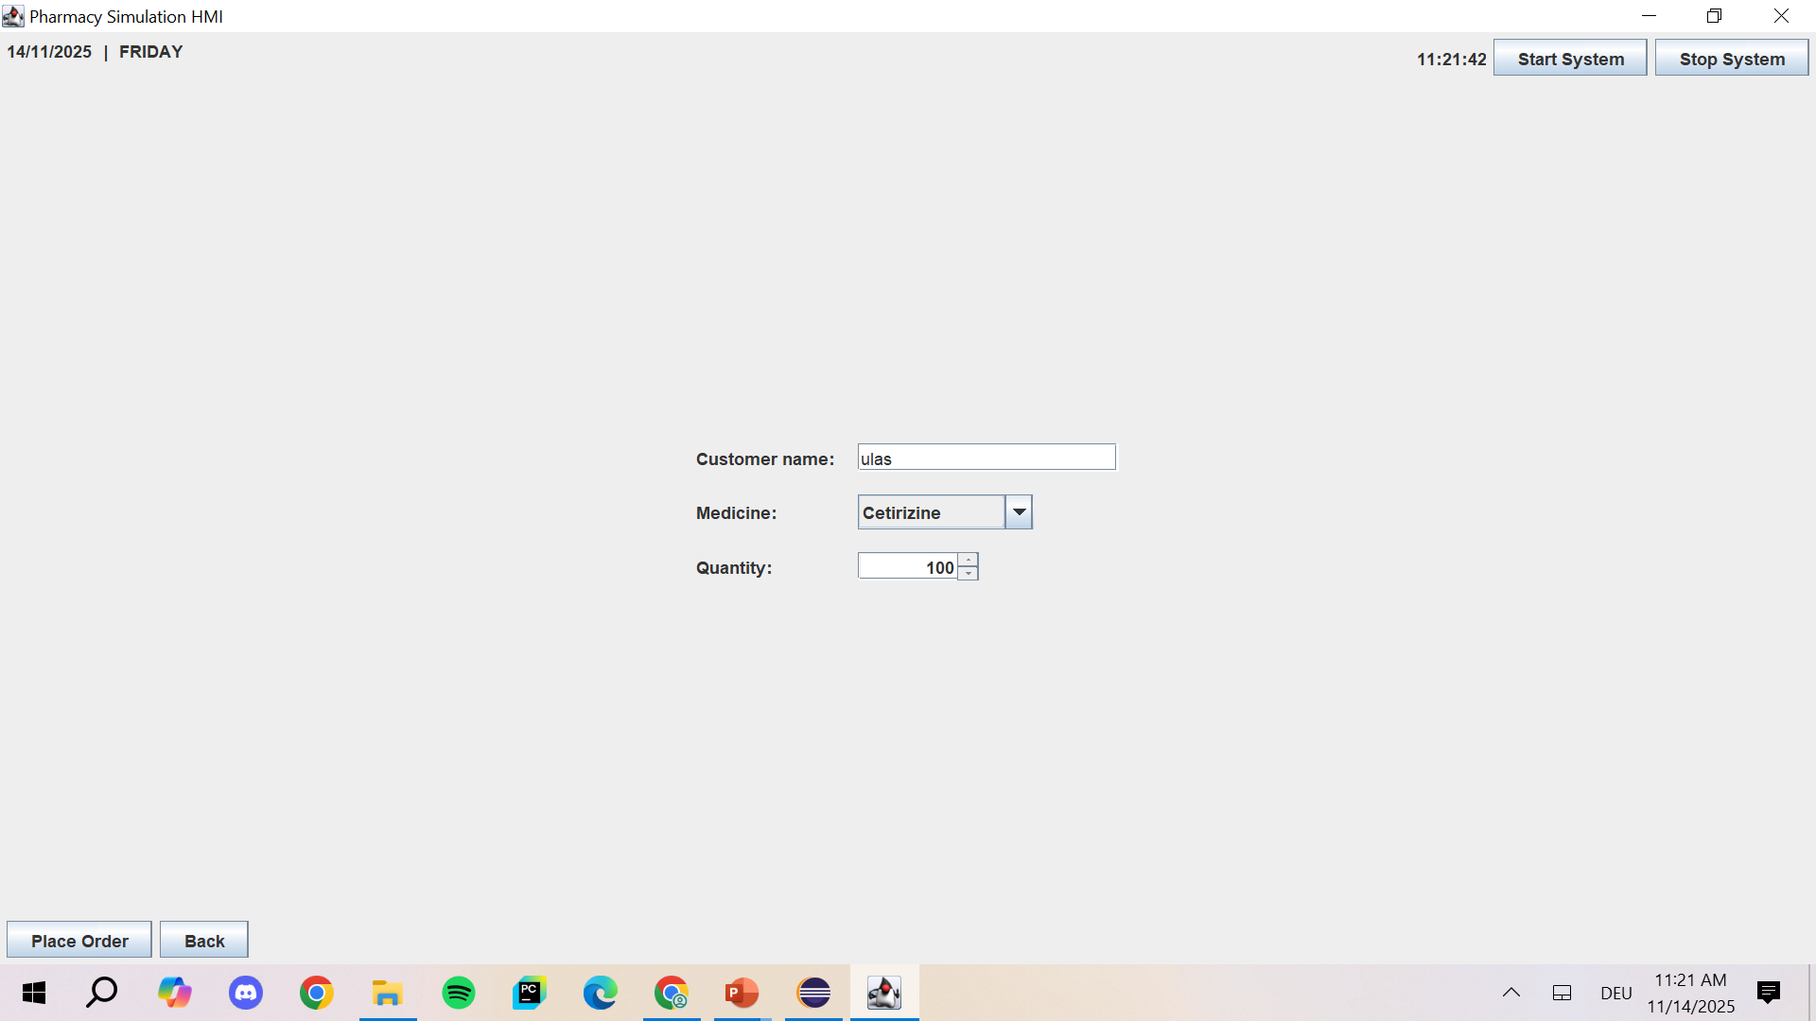
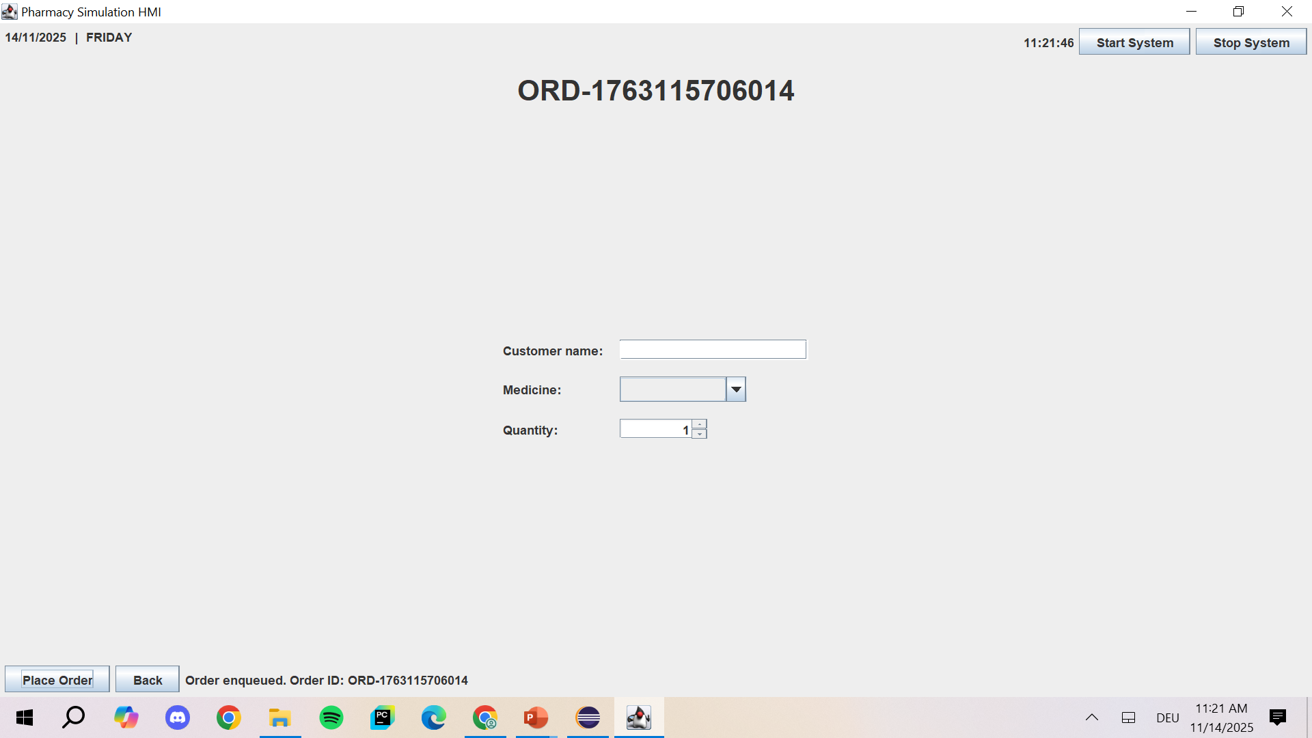
USER INTERFACES
Place an Order

Slide 16
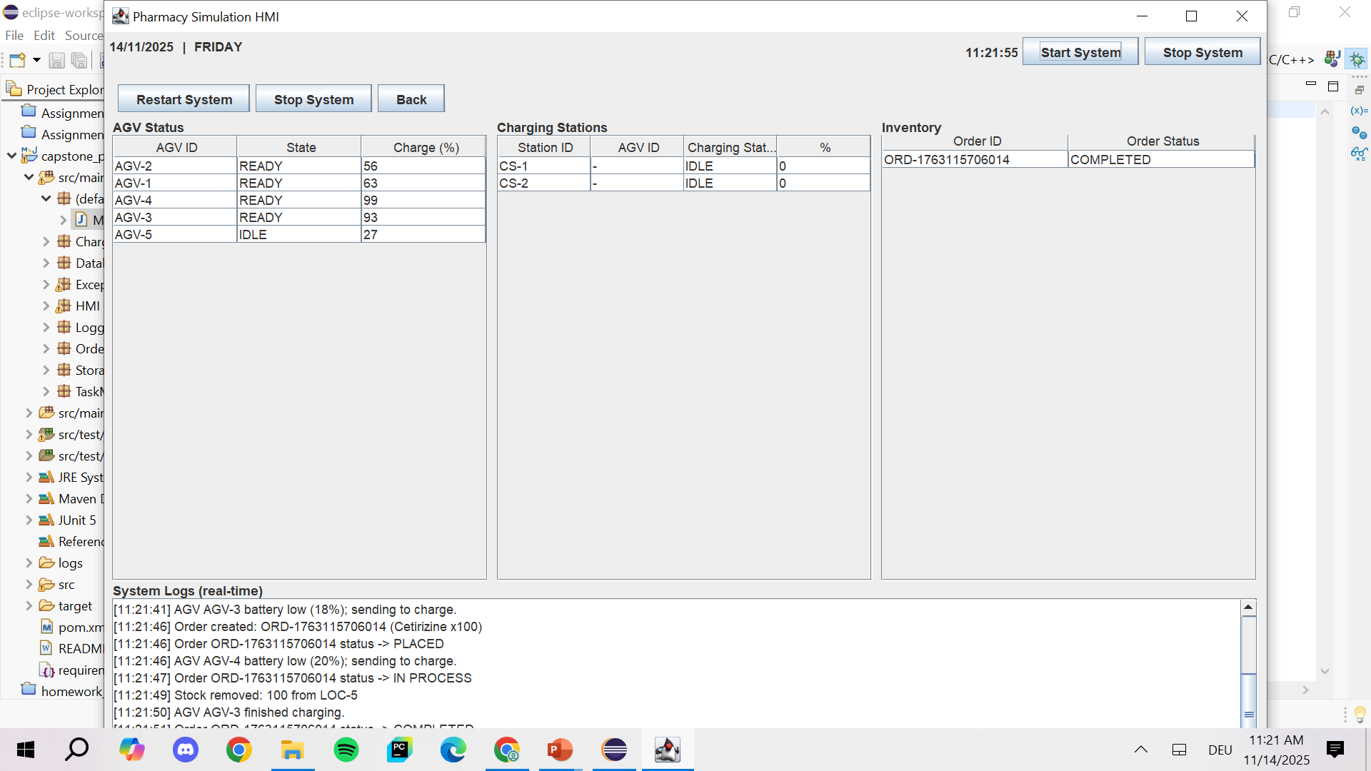
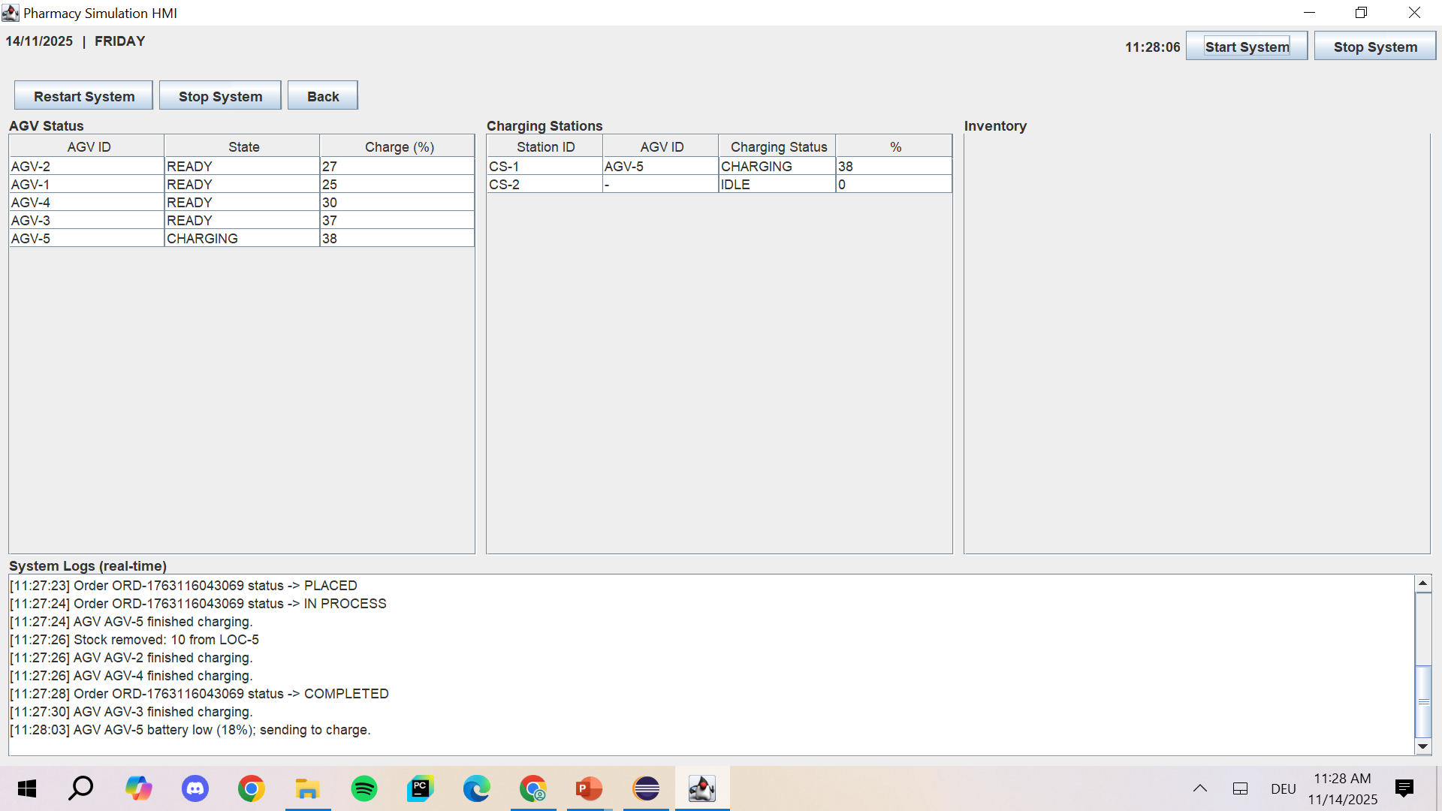
USER INTERFACE
Monitor System

Slide 17
DESCRIPTION OF CONCURRENCY
Subsystem | Conncurrency Model | Purpose
Charging Station | Thread, Runnable, Executor Service | Parallel charging management of AGVs
Storage Management | Executor Service | Simultaneous storage/retrieval operations
Task Management | Executor Service | Parallel processing of tasks

Slide 18
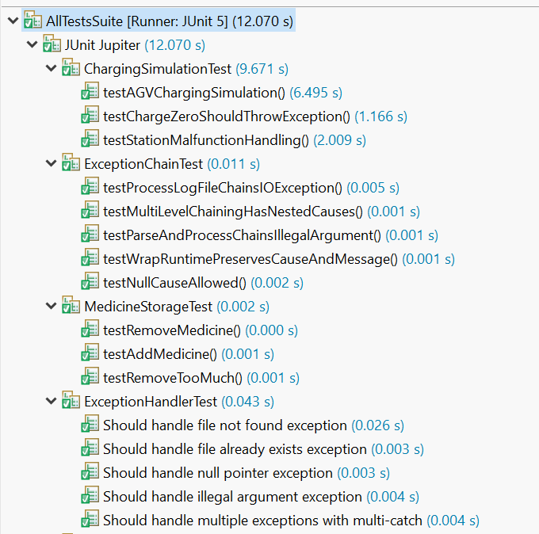
UNIT TEST RESULTS

Slide 19
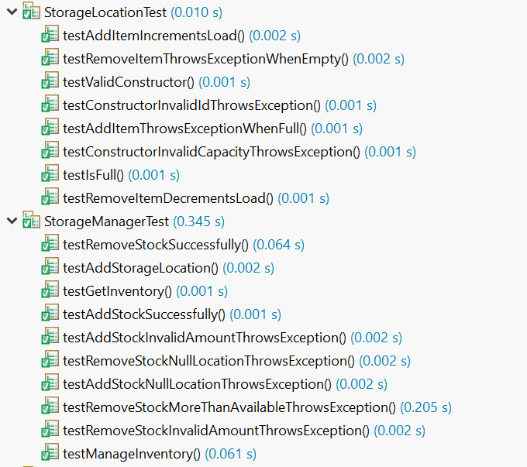
UNIT TEST RESULTS

Slide 20
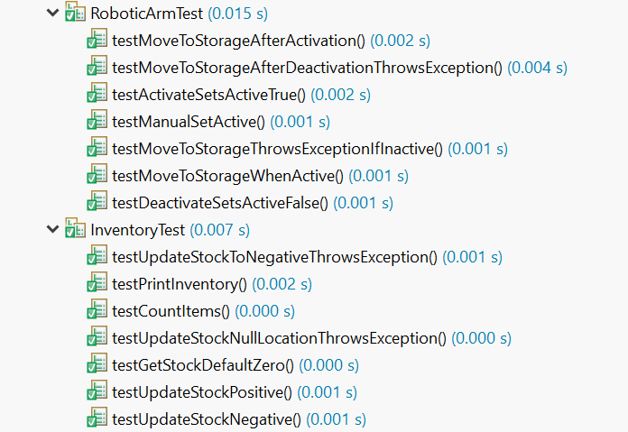
UNIT TEST RESULTS

Slide 21
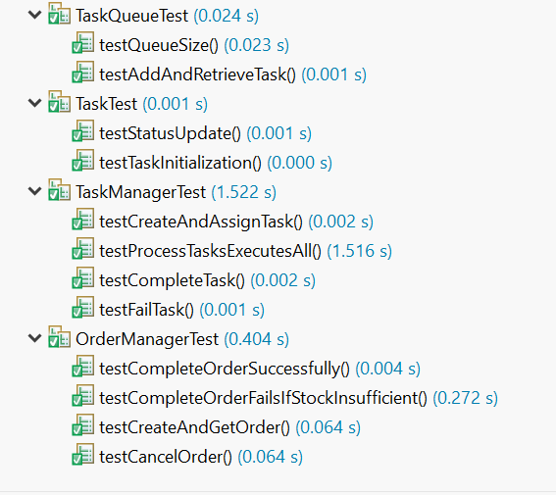
UNIT TEST RESULTS

