Slide 1
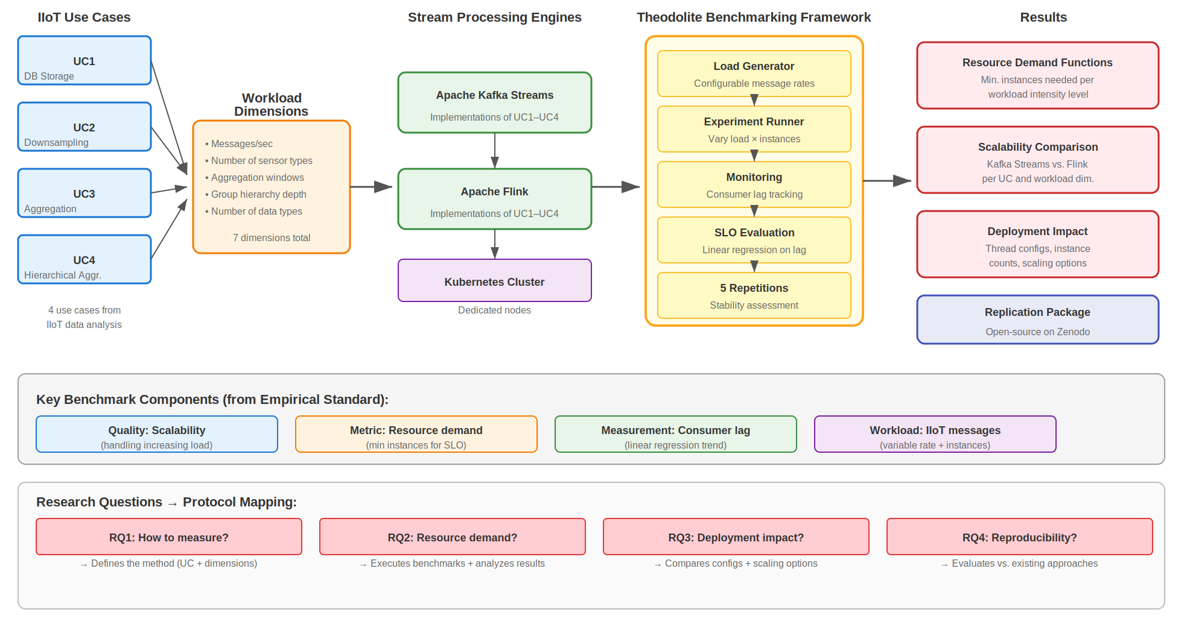
Benchmarking (of Software Systems)
Brice Delcroix, Timothé Piscaglia, Pierre-Louis Lefèvre
Vint Cerf, INFOB302 - IDS (2025 - 2026)
Sören Henning and Wilhelm Hasselbring. 2021. Theodolite: Scalability Benchmarking of Distributed Stream Processing Engines in Microservice Architectures. Big Data Research 25, 100209. DOI: https://doi.org/10.1016/j.bdr.2021.100209
Context: Distributed stream processing engines like Apache Kafka Streams and Apache Flink process large volumes of data, especially in microservice environments. Scalability is one of their core design strengths. Still, there isn’t a widely accepted way to actually measure how scalable they are. Existing performance evaluations often rely on ad hoc measurement setups, which makes it hard to compare results across studies or reproduce them.
Objective: Presenting the Theodolite method for benchmarking the scalability of distributed stream processing engines. This method defines use cases, identifies relevant workload dimensions, and proposes one benchmark per use case and dimension.
Application: This standard applies to empirical research that: investigates software systems within a defined context with an automated, repeatable procedure; studies the software system's quality of service under a specific workload or usage profile
RQ₁ How can the scalability of distributed stream processing engines be measured in a systematic and reproducible way?
RQ₂ What is the resource demand of Kafka Streams and Apache Flink for different stream processing use cases under increasing workloads ?
RQ₃ How do different deployment options, like the number of instances and thread configurations affect the scalability of stream processing engines ?
RQ₄ How does this new benchmarking approach compare to existing methods in terms of reliability and fairness in evaluating scalability?
Characteristics:
Philosophy: positivism
Approach: deductive
Choice: mono-method (quantitative benchmarking evaluation)
Time horizon: cross-sectional
Techniques and procedures: automated benchmark execution on Kubernetes clusters, measurement of resource demand functions, comparison of scalability across engines and deployment options.
Protocol:
Threats to validity:
The selected use cases (UC1-UC4) may not fully represent all possible stream processing scenarios. These use cases come from actual IIoT needs, which reduces this threat.
The SLO-based measurement, which looks at consumer lag via linear regression, may not cover all aspects of scalability. Still, consumer lag is a commonly accepted metric for measuring stream processing performance.
Cloud infrastructure changes can affect benchmark results, experiments are repeated 5 times and executed on dedicated nodes to mitigate this.
Only two stream processing engines are tested —Kafka Streams and Flink. Still the framework is designed to be extensible to other engines
Default configurations are used, which may not be optimal. However, defaults reflect typical usage.
There could be implementation bugs in the benchmarking framework. The tool is open-source and a replication package is provided.

