Slide 1

CDH Ai/ML Architecture walkthrough
comprehensive analytics capabilities on existing databricks infrastructure

Slide 2
cdh databricks analytics and AI/ML
Current State
Notebook based, with sequential Cell execution
Single Compute with cluster level libraries
%PIP to install and configure additional libraries ad hoc
Next Level: Advanced Workflow Based Analytics with Experiments
Cells → Tasks
Custom Compute or Libraries by task
Paramerization at task or workflow level
Intertask communication with dbutils taskValue or mlflow via Experiment Runs
Workflow Job Runs
Can view logs during run, similar to interactive notebook
Runs are logged for debugging and history
Experiment Run tntegration (MLFlow)
Exhibits and Artifacts can be logged to Experiment Run and Tie back to Workflow Run

Slide 3
Appendix

Slide 4
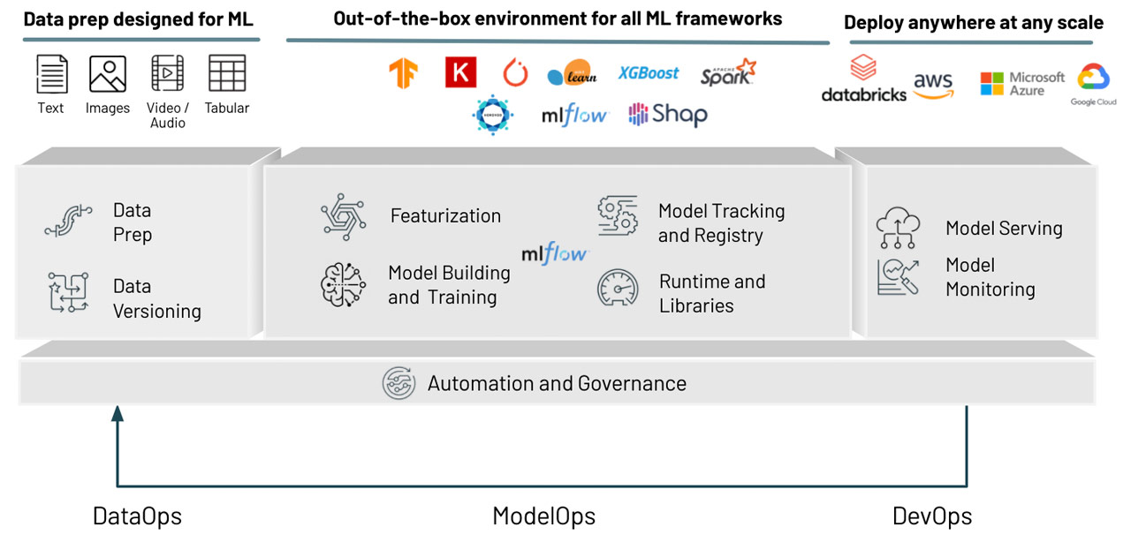
OVERVIEW OF MLOPS technical configuration
Work solely within the production environment
Task based Workflow Jobs for Analysis Runs rather than “Notebook Cells”
dbutils widgets and taskValues parameterizatio
Jobs compute for Workflow, customized to task
Workflow sources are CDCENT github by branch
Development and Production (master) branches with PR
Clone Workflow to “Production” and update branches
Databricks Experiments tracking
Model Serving and Monitoring available as needed

