Slide 1
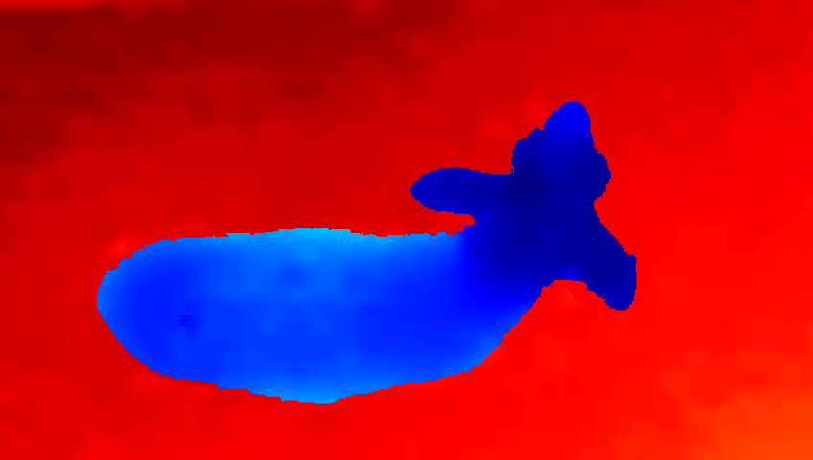

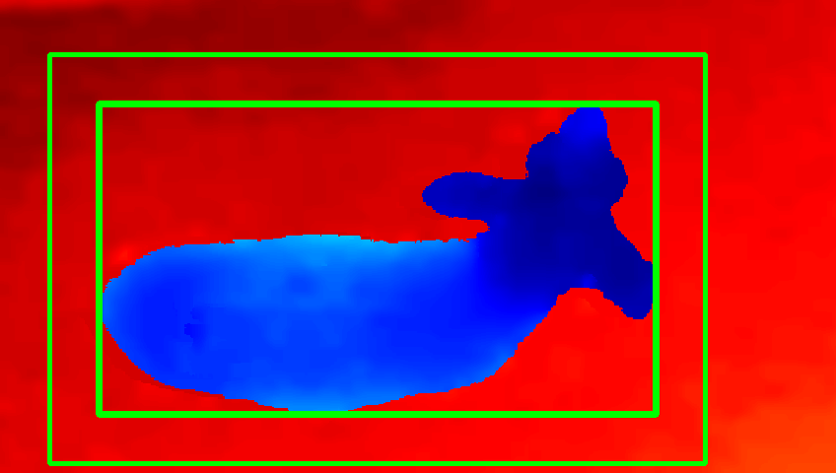

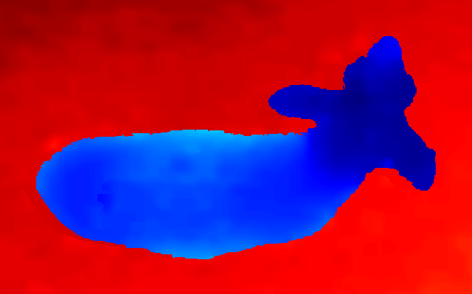
Threshold Binarization
Bounding Box and Border
Crop around the border
Deproject pixel to point
Height in meters

Slide 2
Height in meters
Threshold Binarization
Bounding Box and Border
Deproject pixel to point
Depth image
Crop around the border

