Slide 1
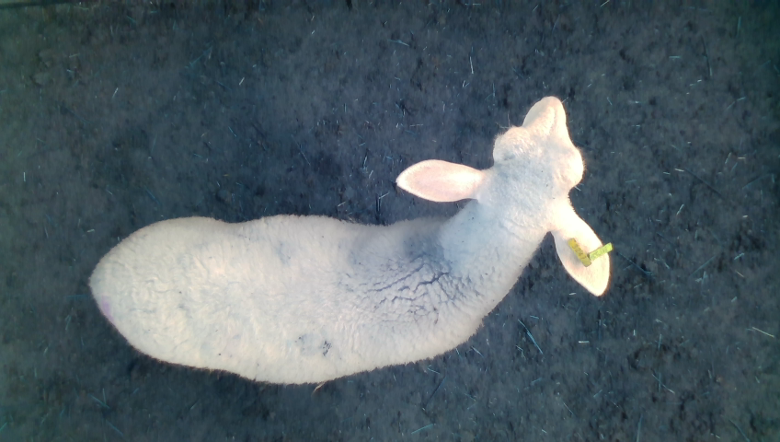
240x424x3
RGB Image
Pretrained Network
Sex
128 u.
Relu
1 u.
Sigmoid
Height
Convolution
Max-Pooling
Global Average Pooling
Dense

