Slide 1
Laser
Laser
Laser
192.168.1.31 xtool-d1.laser.local # 1c:eb:d6:ac:ef:c1
192.168.1.32 xtool-d1.air.local # 4c:eb:d6:ae:22:fd
192.168.1.33 xtool-d1.smoke.local # 4c:eb:d6:ae:22:96
192.168.1.34 xtool-d1.enclosure.local # 4c:eb:d6:ae:23:3d
Laser
Air
Air
Air
Smoke
Smoke
Air
Smoke
Enclosure
Enclosure
Smoke
Enclosure
Laser
Laser
Laser: 1cebd6acefc1
Enclosure
Air
Air
Air: 4cebd6ae22fd
Smoke
Smoke
Smoke: 4cebd6ae2296
Enclosure
Enclosure
Enclosure: 4cebd6ae233d

Slide 2
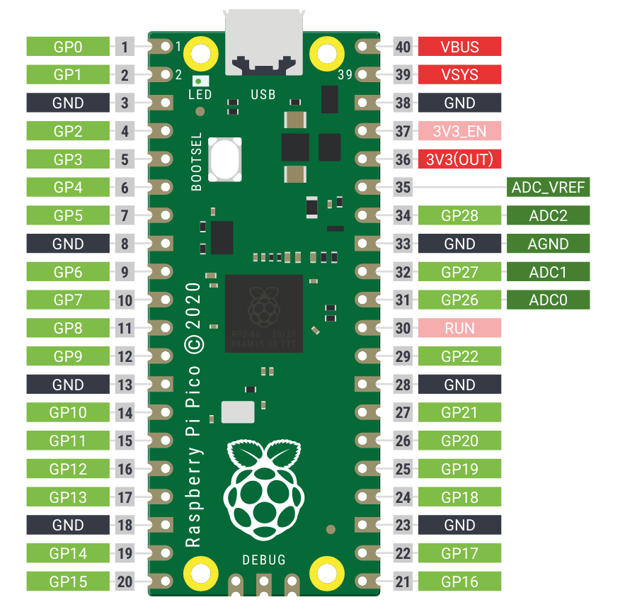

Buttons
Led
Led
Led
Led

