Slide 1


Build a Personalized Online Course Recommender System with Machine Learning
Isaac Ramirez
05-24-2024

Slide 2

Outline
Introduction and Background
Exploratory Data Analysis
Content-based Recommender System using Unsupervised Learning
Collaborative-filtering based Recommender System using Supervised learning
Conclusion
Appendix

Slide 3
Introduction
Create a recommendation system for a course platform

Slide 4
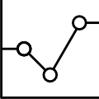
Exploratory Data Analysis

Slide 5
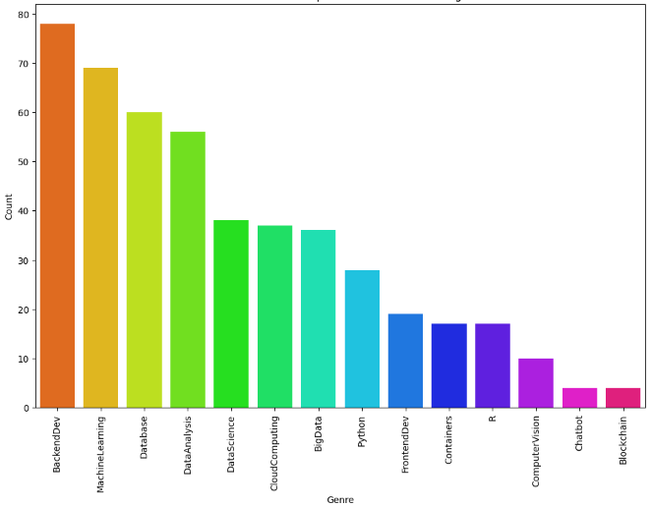
Course counts per genre

Slide 6
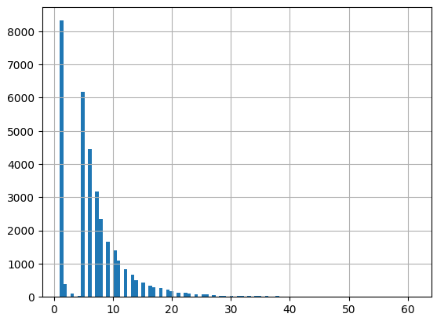
Course enrollment distribution

Slide 7
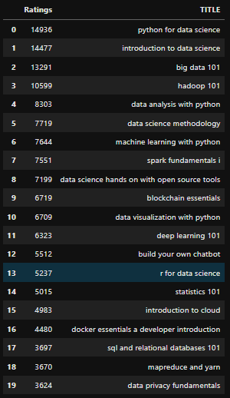
20 most popular courses

Slide 8
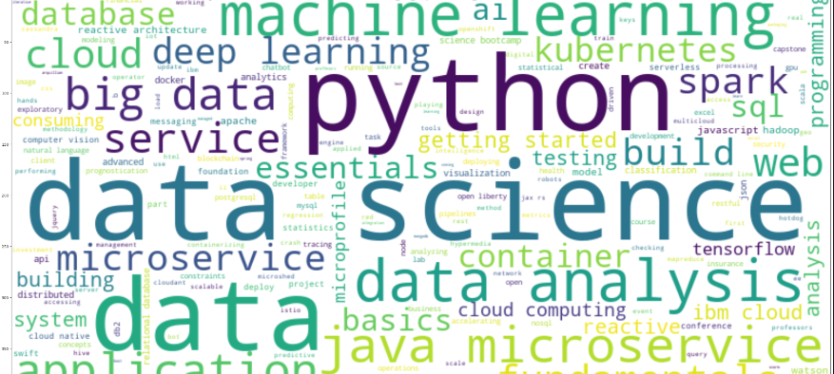
Word cloud of course titles
I can see this platform prioritizing data science and everything related.

Slide 9
Content-based Recommender System using Unsupervised Learning
Cluster2
Cluster1

Slide 10
Flowchart of content-based recommender system using user profile and course genres
Validate and compare performance
Raw data
DBA
Train models
Recommendations

Slide 11
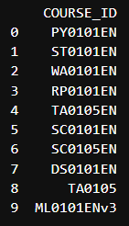
Evaluation results of course similarity based recommender system
On average, how many new/unseen courses have been recommended per user
Top 10 course most recommend
1 Courses per User

Slide 12
Flowchart of content-based recommender system using course similarity
Validate and compare performance
Raw data
DBA
Train models
Recommendations

Slide 13
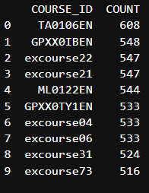
Evaluation results of user profile-based recommender system
On average, how many new/unseen courses have been recommended per user
Top 10 course most recommend
61.81 courses per User

Slide 14
Flowchart of clustering-based recommender system
Validate and compare performance
Raw data
DBA
Train models
Recommendations

Slide 15
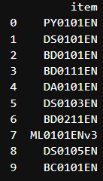
Evaluation results of clustering-based recommender system
On average, how many new/unseen courses have been recommended per user
Top 10 course most recommend
9.40 courses per User

Slide 16
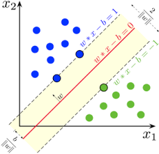
Collaborative-filtering Recommender System using Supervised Learning

Slide 17
Flowchart of NMF based recommender system
Load data
Load surprise library
Load «data»
Split data
Predicts
Train NMF model
calculate hyperparameters

Slide 18
Flowchart of KNN based recommender system
Load data
Load surprise library
Load «data»
Split data
Fit model(50 epoch)
Generate train datasets
Train KNN model

Slide 19
Flowchart of Neural Network Embedding based recommender system
Load data
Load surprise library
Load «data»
Create Model NN
Predicts
Decoder labels

Slide 20
Compare the performance of collaborative-filtering models

Slide 21
Conclusions
The model that has the best performance is neural networks. Point 2
The algorithm based on user profiles recommends more courses Point 4

Slide 22
Appendix
https://github.com/ulisac04/final-project-ML

