Slide 1
Evidence of the bandwagon effect
Otherwise known as fair weather fans

Slide 2
Basic facts of study
Data taken from www.reddit.com/r/nba , an internet discussion board for NBA basketball
4591 separate data points
Each data point consists of a unique user with a ‘flair’. This flair indicates which team the user is a supporter of
Data taken from separate forum posts where users discuss basketball

Slide 3
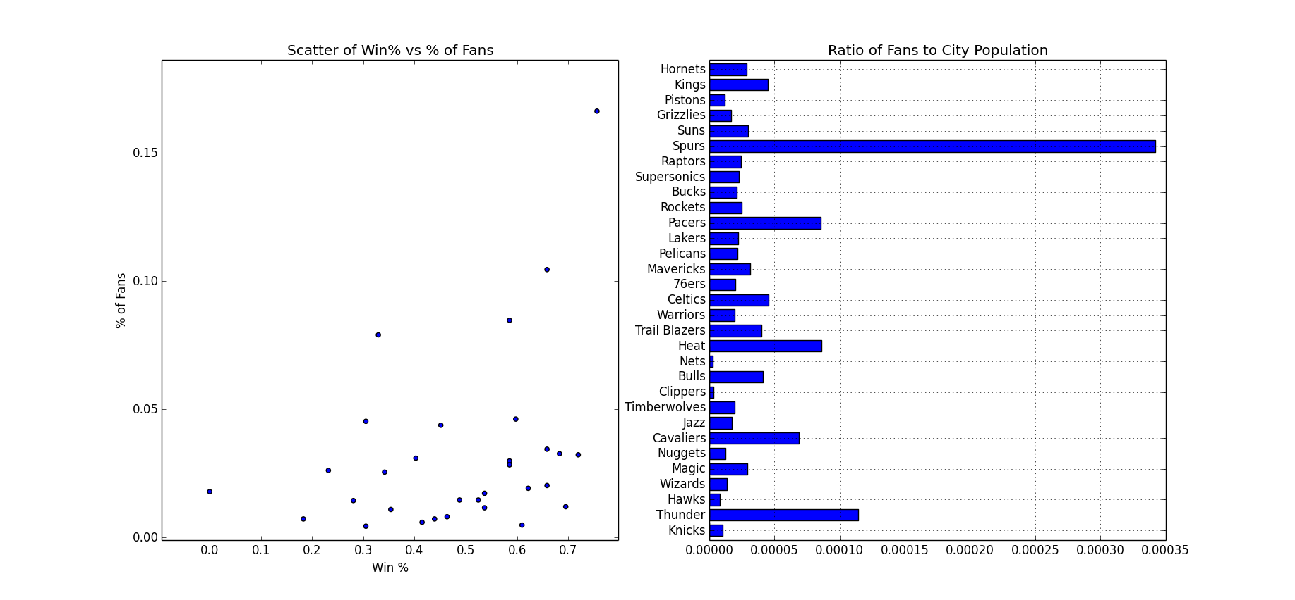
Scatter plot and evidence of bandwagon fans
Loose relationship between a team’s win percentage and a team’s percentage of fan population
Top 4 teams have an especially large ratio of fans to city population
The championship team (Spurs) is experiencing a surge in support

Slide 4
Scatter plot and evidence of bandwagon fans
Interesting note, the Seattle Supersonics (2 rows below the Spurs) are a defunct team and now exist as the Oklahoma City Thunder
Continued support for the Supersonics suggests that returning a team to the area would be profitable

Slide 5
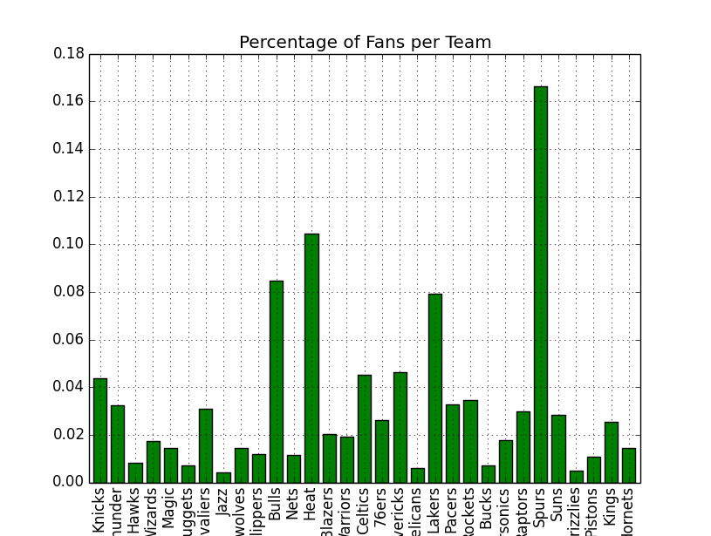
Their percentage of fans is higher than many teams that currently exist and make a profit

Slide 6
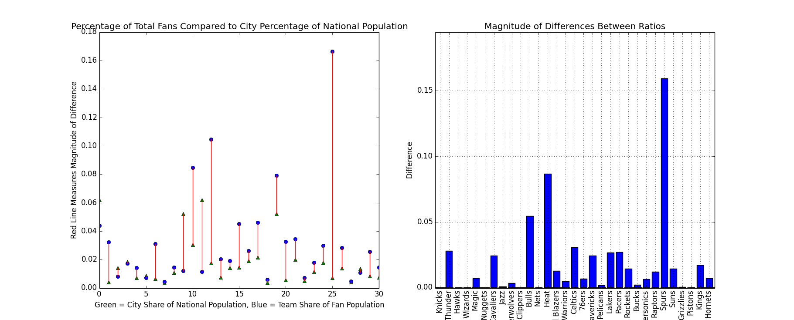
The top teams in the league have more fans than their city populations suggest they should
The championship team in particular has more fans than it should
San Antonio has more fans in absolute terms than New York, the bandwagon effect can be quite powerful

Slide 7
Conclusions
The percentage of fans that San Antonio has now is more than 4 times what most teams have. This suggests some truth to the fair weather fan theory
Seattle should have an NBA team, support there is still strong despite not having a team for 7 years
The study needs more data taken over a longer period of time where team win percentages change in order to be more conclusive
More data points taken from www.reddit.com/r/nba need to be taken over a period of time in order to compare

