Slide 1
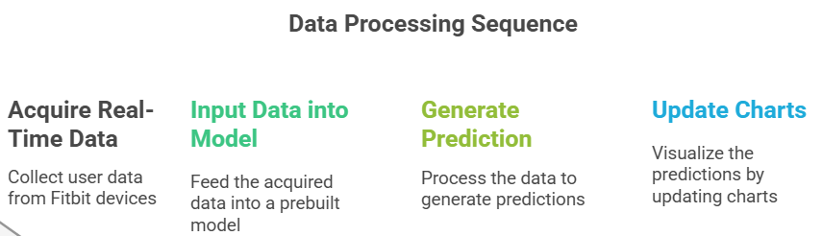

Slide 2
How Stress is Detected
I will add parameters over here
If, for example:
Heart Rate is high and HRV is low: It could suggest the person is under stress.
Sleep patterns are disrupted: It may indicate stress levels affecting recovery.
Activity levels are low while Heart Rate is elevated: This could indicate anxiety or heightened stress.

Slide 3
Input data into model & Generate Pridiction
We will make different ML & DL model
Select Best models with Highest Accuracy
Make .pkl file and import it in FLASK application

Slide 4
END GOAL
Make a Web Application to process data of FITBIT and give prediction and Notify on alarming situations.

Slide 5
Paper Referred:

Slide 6
Past Experience
Already Made a web application for Depression Detection with text analysis.
SIH Finalists with ISRO Problem statement.

